Slide 1
Illinois’ Joint Research Adventure
NRRA Influence

Slide 2
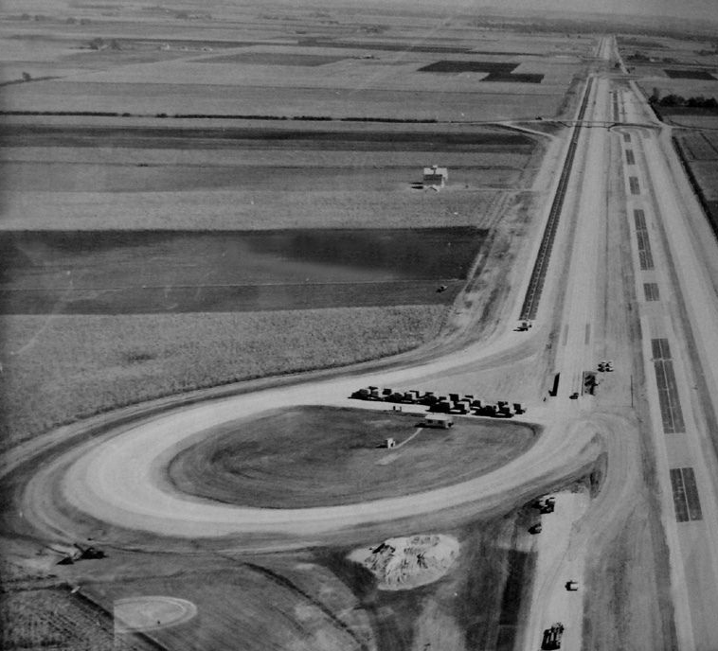

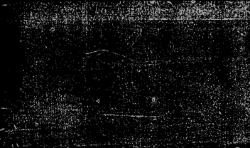
ILLINOIS’ ORIGINAL TEST FACILITY
AASHO Road Test
Built in 1956
7 miles of 2 lane pavement
6 loops and a tangent section
836 test sections
Half Concrete and half asphalt
Courtesy of FHWA Website

Slide 3
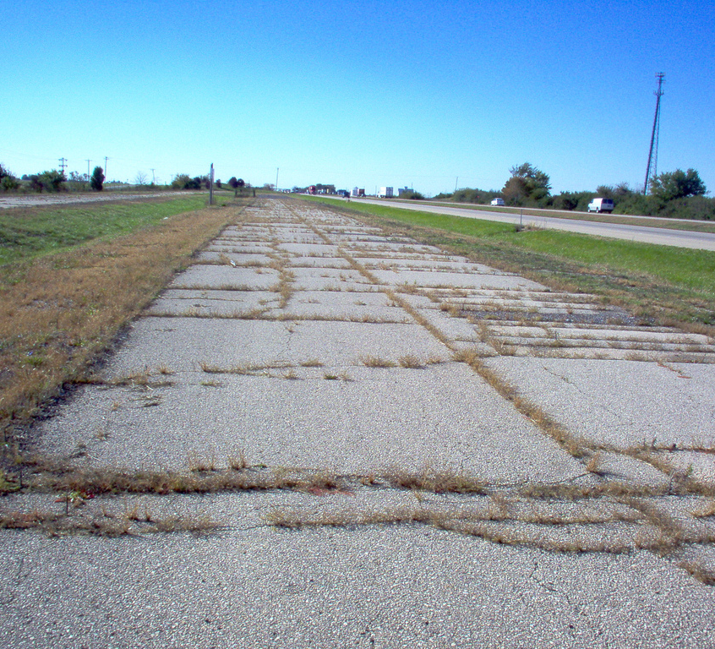
AASHO ROAD TEST TODAY
Tangent section is now part of I-80
Environmental section still exists
No available revenue to revive test sections
Courtesy of FHWA Website

Slide 4
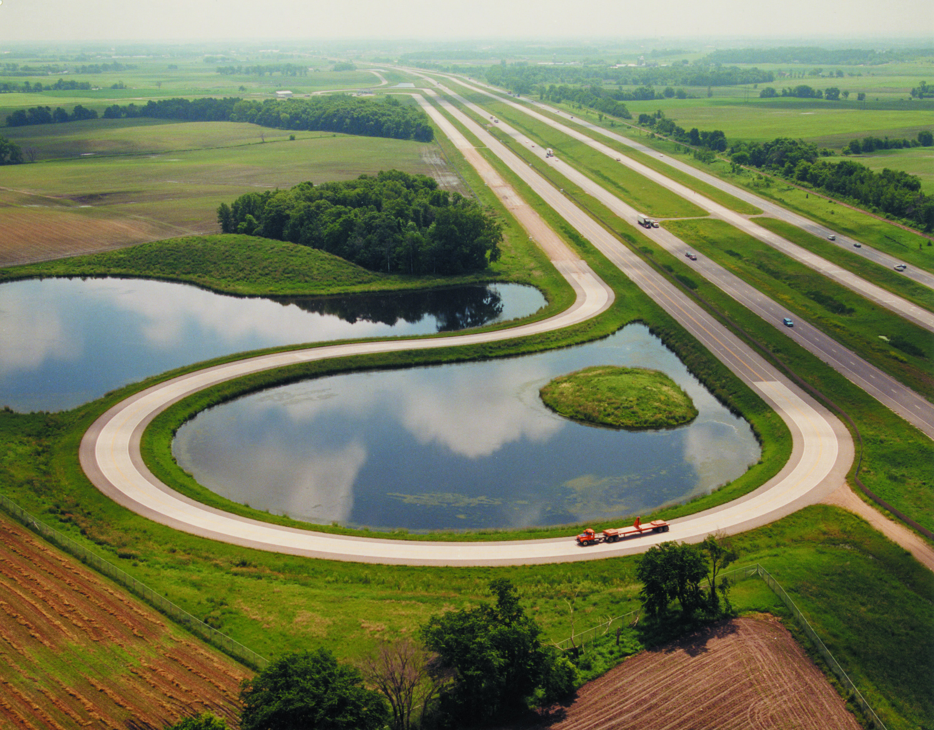
ACCESS TO MnROAD
Invaluable research facility
Central location for state agencies to converge and network
Always willing to assist and share knowledge
Involved in smoothness, pavement design, friction testing, FWD calibration, pavement preservation
Similar environment to evaluate designs and treatments
Courtesy of MnRoad Website

Slide 5
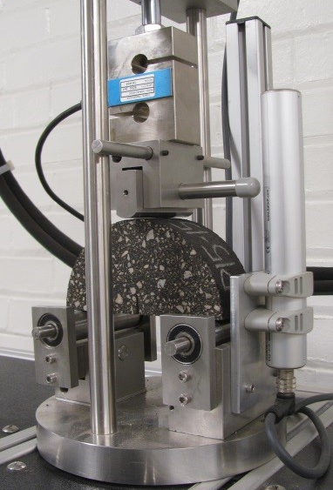
FLEXIBLE
Illinois’ current network is 85% composite
  Reflective cracking is a predominant distress that we are always trying to mitigate
  Overlay research on by-pass will be valuable to IDOT’s network and decision tree development
Cold Central Plant and Cold In-Place Recycling
  Help with specification development
  Maintain lower volume roads in the most cost effective manner

Slide 6
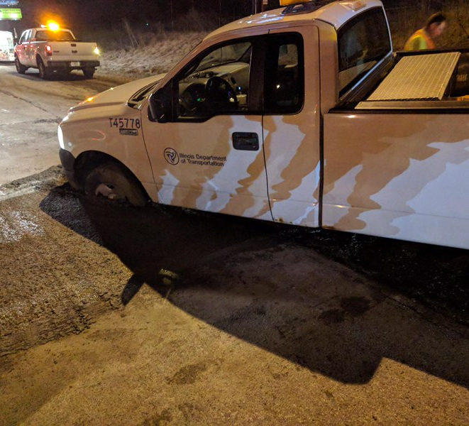
RIGID
Illinois’ version of early age opening
Illinois is looking at building more unbonded concrete overlays as alternative to structural HMA overlay
  Recent projects with fibers are showing promising results but more data is needed
Recent research project on RCC was just completed
  Additional research will help validate design processes

Slide 7
GEOTECHNICAL
Comparison of subgrade thicknesses showed a failure in the 9” section
  Consistent with our predicted behavior in our Department’s Subgrade Stability Manual
  Validation of current Policies
Partnered with another research project conducting intelligent compaction of the aggregate subgrades
  Information presented was found to be interesting by IDOT staff
  Continue involvement and may possibly lead to future policy

Slide 8
ILLINOIS’ PROGRESS
FY 2005 – 2015: Districts funds
  $300,000 - $800,000 annually
  Limited list of treatments
FY 2016 – 2018: Set aside from annual program
  Districts split $7.5 million
  Encouraged to construct additional projects
FY 2019 – Future: Required percentage of program
  $50 million in preservation projects
  Expanded list of treatments

Slide 9
ILLINOIS’ TOOLBOX
Crack Fill / Seal
Chip Seal
Micro-surfacing
Cape Seal
Slurry Seal
CIR
HIR
S.M.A.R.T. Overlay
Half-S.M.A.R.T.
Fog Seal
UTBWC
Limited Patching

Slide 10
NRRA INFLUENCE
Helps Create a Vast Network to Build Connections
Large Variety of In-Place Treatments
Informative conferences and pooled fund meetings
Technology Transfer has been made a priority

Slide 11
NRRA EXPERIENCE
Very Informative Conferences and Pooled Fund Meetings
Open to new ideas and looking for innovative solutions to the Agencies’ problems

Slide 12
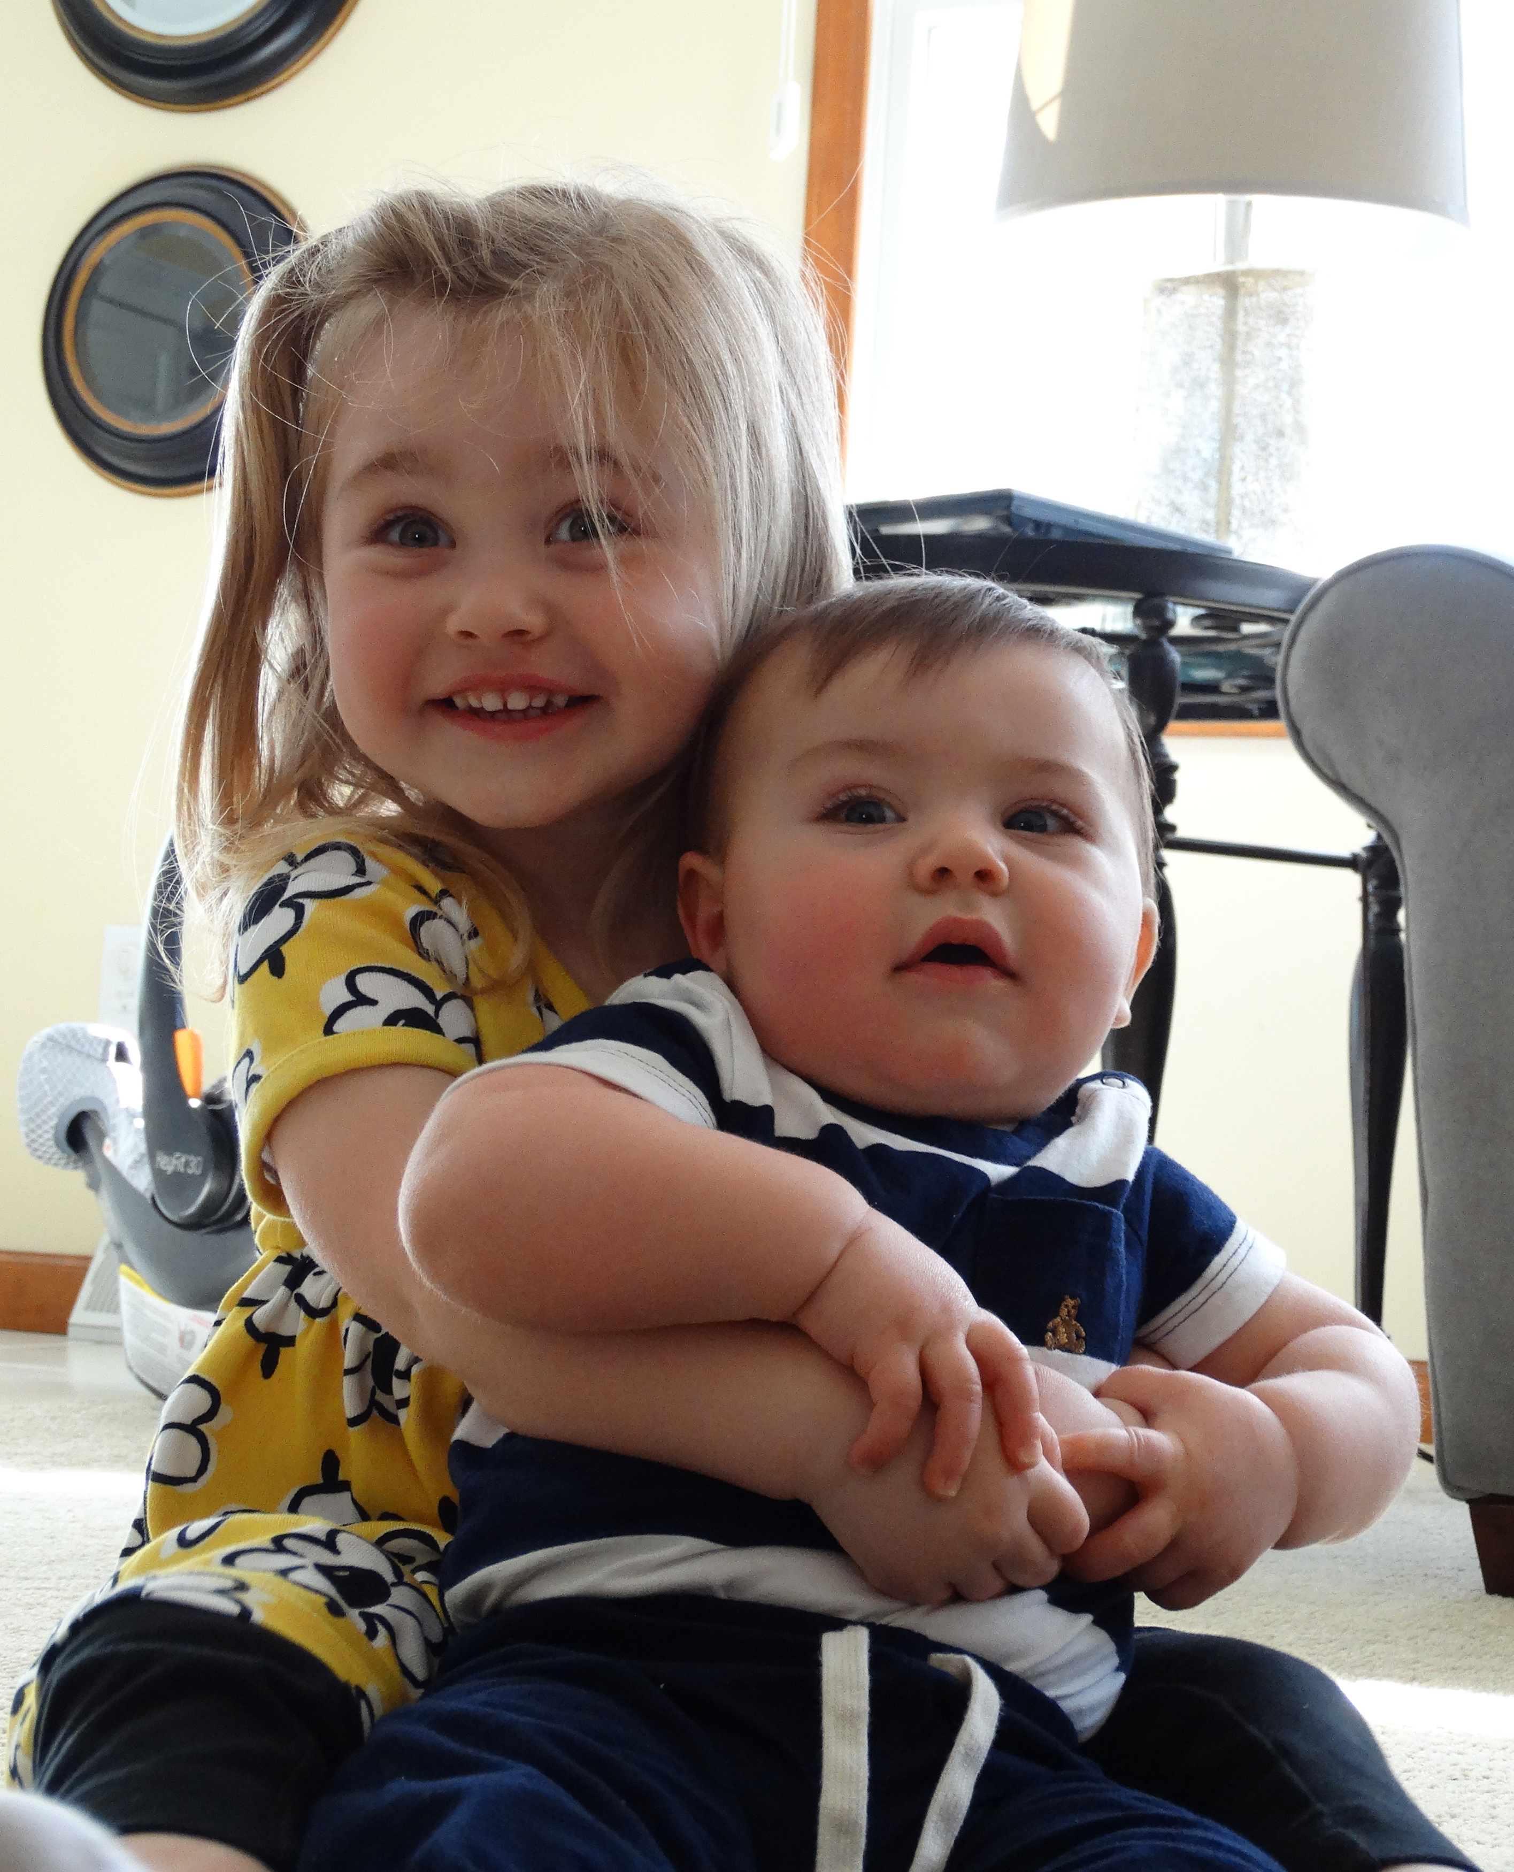
QUESTIONS
John Senger
Engineer of Pavement Technology
Bureau of Research
Illinois Department of Transportation
John.Senger@Illinois.gov
217-782-8582

