Slide 1


2018 Pavement Workshop
May 23-24, 2018
CONCRETE PAVEMENT JOINT DISTRESS
(Cause and Mitigation)
Gordon L. Smith, PE
Associate Director
National Concrete Pavement Technology Center
+ 46 Associate Members

Slide 2
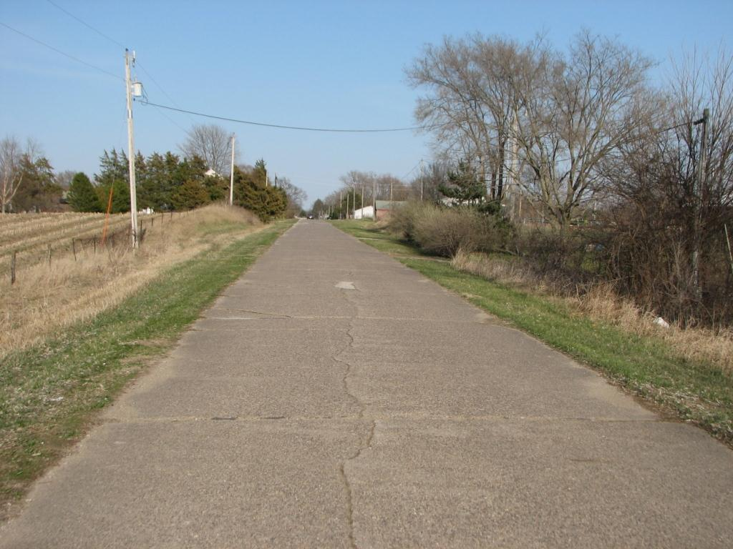
A Touch of History
Pavement jointing methods and designs have evolved over the past century plus.
In 1952, air entrainment was required to mitigate freeze-thaw damage.
D-cracking was researched extensively and poor aggregate sources identified in the 1970s+
Early 1990’s saw incidents of “early joint deterioration” leading to more research into vibration, air content, saturation levels, and expansion of paste via calcium oxychloride.
Built in 1914, 18’ wide, no longitudinal joint, 25’ formed transverse joints
Moscow Road 2014

Slide 3
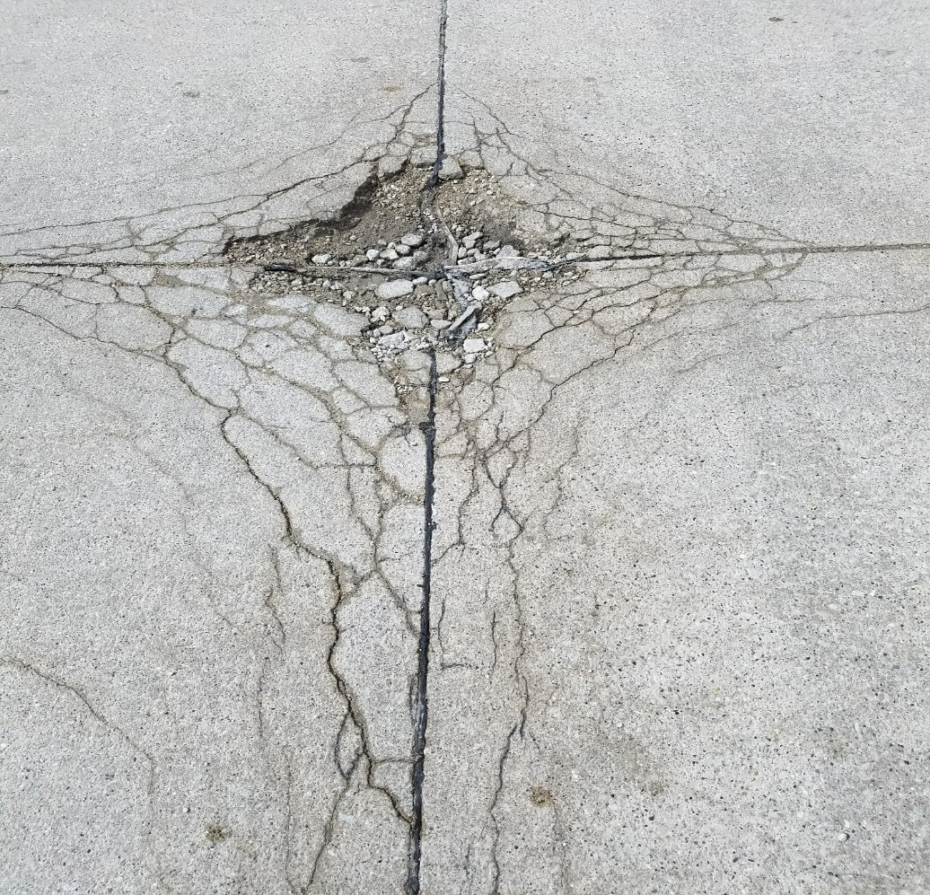
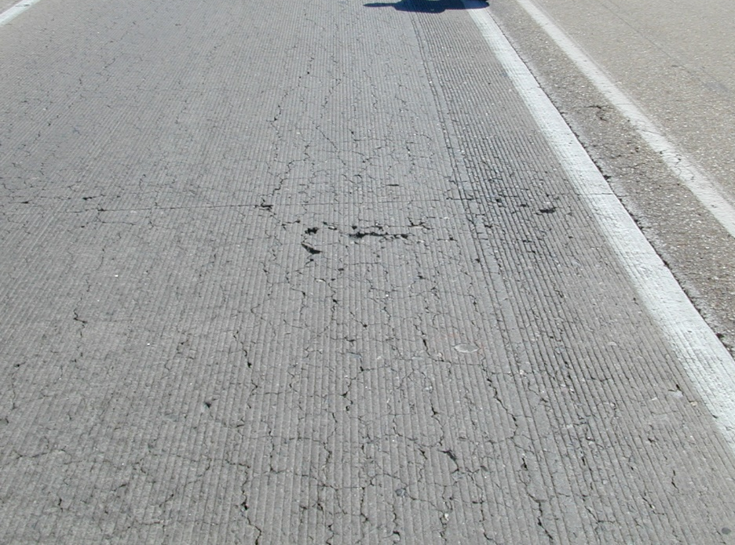
Materials Related Distress
(Reactive & Expansive)

Slide 4
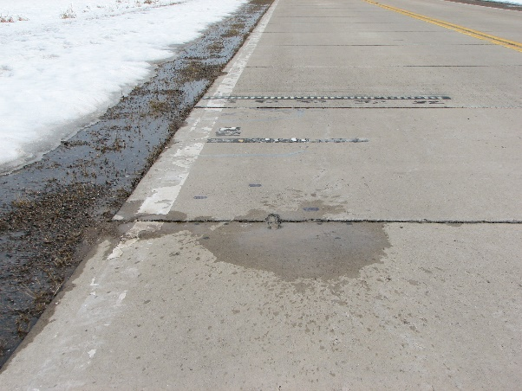
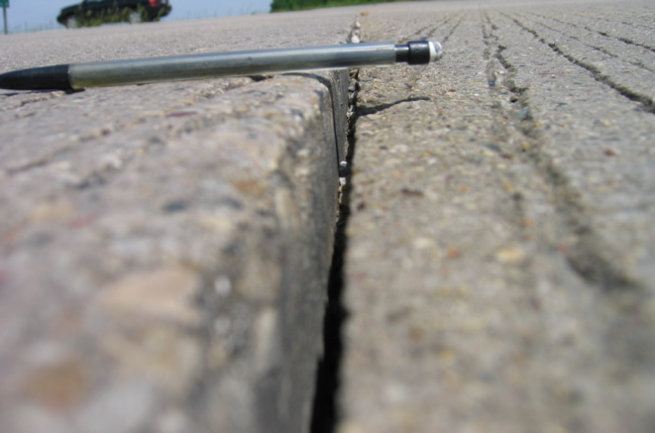
Loss of Support/Load Transfer

Slide 5
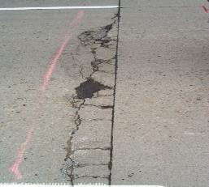
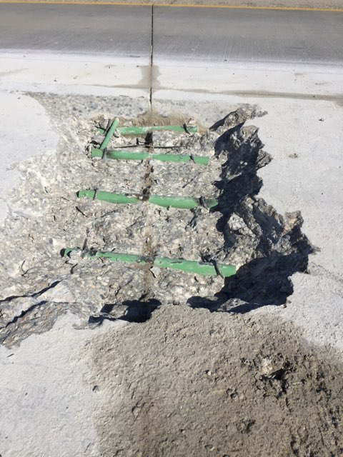
Load Transfer Failures

Slide 6
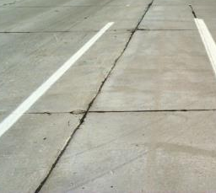
Curling and Warping

Slide 7
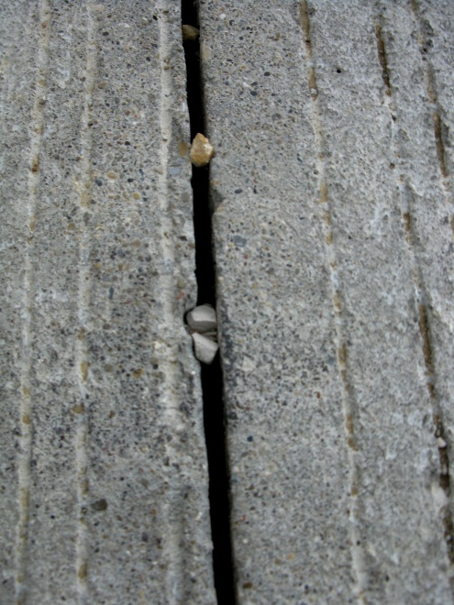
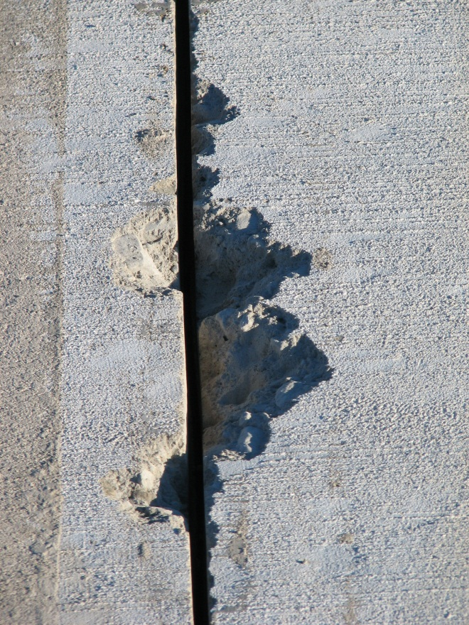
Compression Failures/Spalling

Slide 8
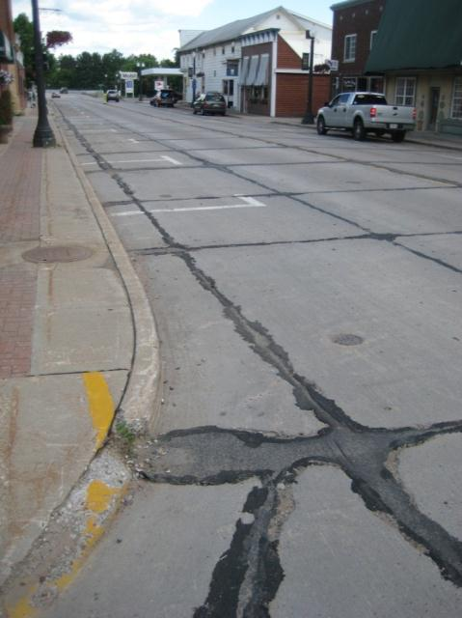
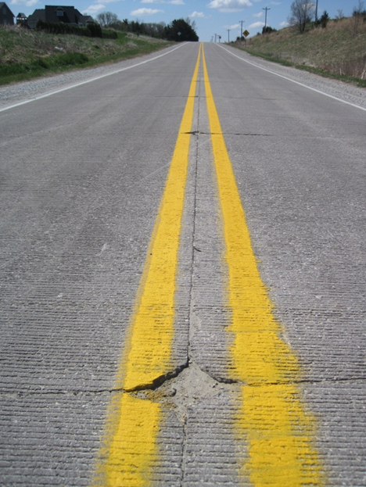
The New Challenges -
Notes:
Every joint or just transverse

Slide 9
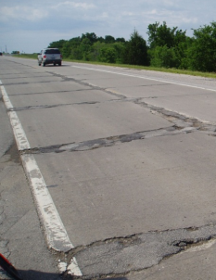
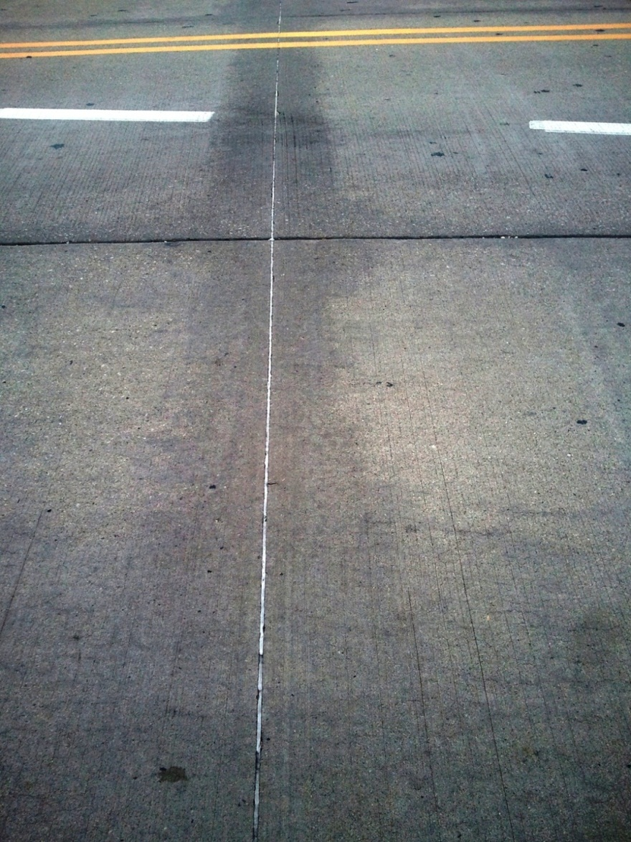
Striving for more durable concrete for today’s pavement environments
Notes:
Shadowing leading to severe distress

Slide 10
The Clues . . . .
Predominately in cold, wet places
Notes:
Zone 1

Slide 11
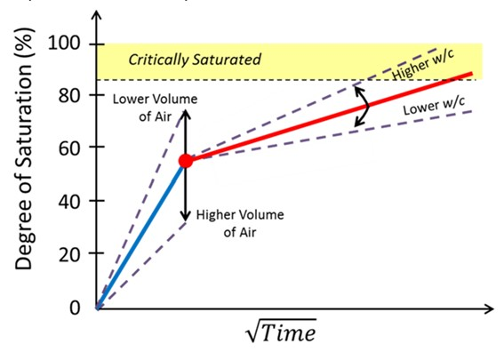
Types and Mechanisms of Joint Deterioration
Saturated Freeze-thaw Damage
Volume of pores
  Measure mass change from oven dry to vacuum saturated
Degree of saturation
  Compare mass of sample with oven dry and saturated masses
Sorption / Saturation
  ASTM C 1585 (modified)
Jason Weiss

Slide 12
Types and Mechanisms of Joint Deterioration
Calcium Oxychloride Formation, Expansion, and Damage
Chemical Reaction
  Calcium chloride and calcium hydroxide forms calcium oxychloride – cracking due to volume change
Mitigate
  Use SCMs
  Reduces calcium hydroxide
  Use low w/c ratios to reduce fluid transport
  Proper entrained air-void system

Slide 13
The Causes
Saturation/freeze thaw
Oxychloride formation
Sawing practice
Notes:
Summary of the problem

Slide 14
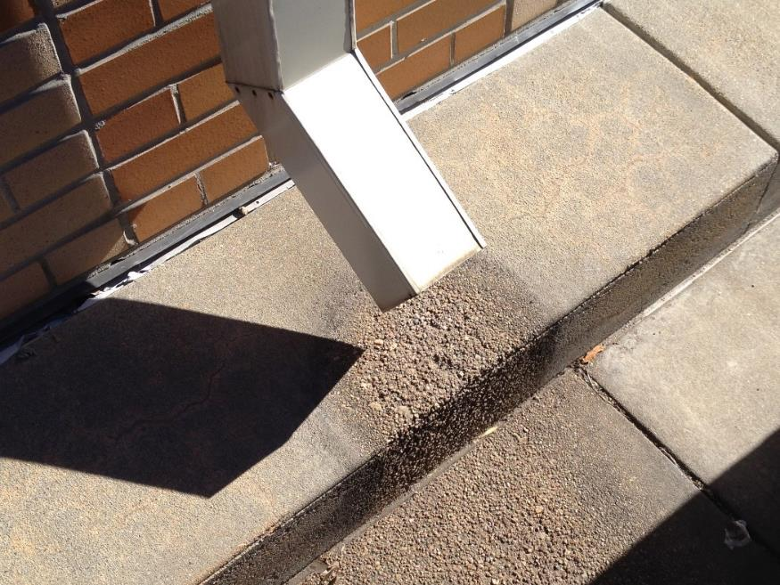
Saturation
Damage occurs where the concrete does not dry out
Water needs space to expand into

Slide 15
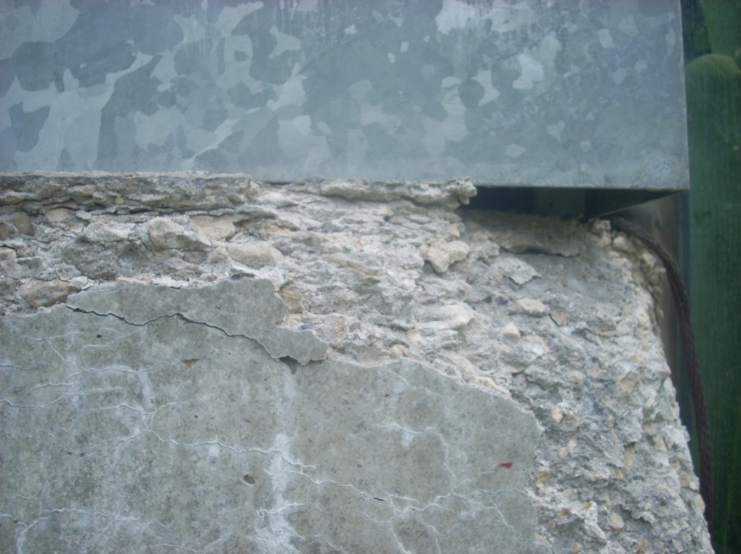
Saturation/freeze thaw distress
Marginal w/cm
Marginal air
Poor local drainage
Leads to:
Rapid saturation
Shadowing
Thin flakes
Notes:
Summary of the problem

Slide 16
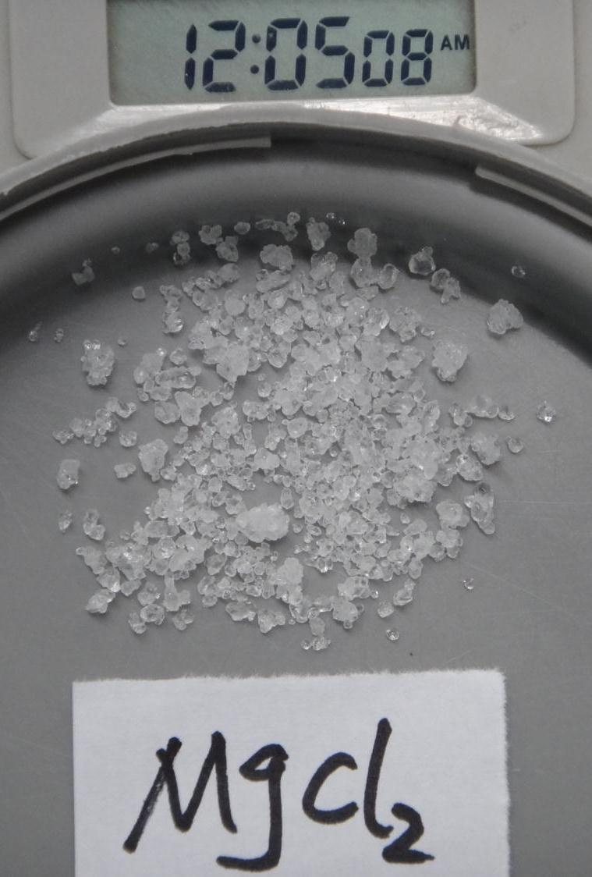
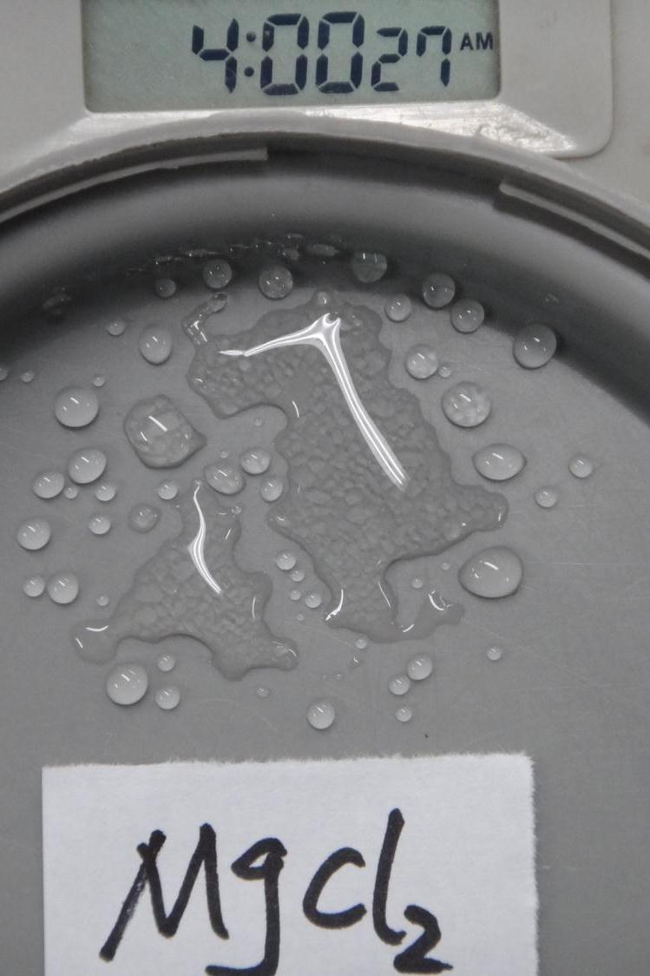
Saturation/Enhanced!
Notes:
Mag chloride will suck water out of the air and go from a crystal to a puddle that never dries out.

Slide 17
The Causes
Saturation/freeze thaw
Oxychloride formation
Sawing practice
Notes:
Summary of the problem

Slide 18
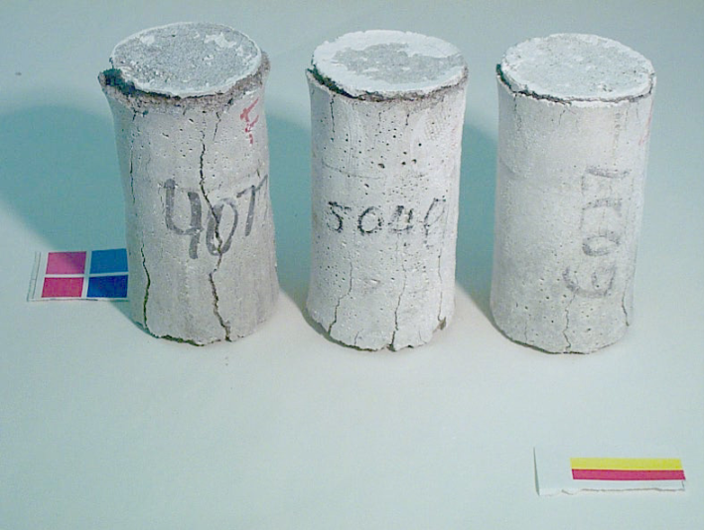
Oxychloride formation
(Salts can cause chemical attack)
Calcium oxychloride
  Calcium hydroxide
  Chlorides from salts (MgCl₂ and CaCl₂)
  Expands >30%
  At ~40°F
  Use SCMs to
  reduce CaOH
CaCl₂ @ 40°F
Sutter
Notes:
There are signs of chemical attack in some cases. The oxychloride later decomposes and disappears. This from Larry Sutter’s work for SD. Have to have the right temperature.

Slide 19
The Causes
Saturation/freeze thaw
Oxychloride formation
Sawing practice
Notes:
Summary of the problem

Slide 20
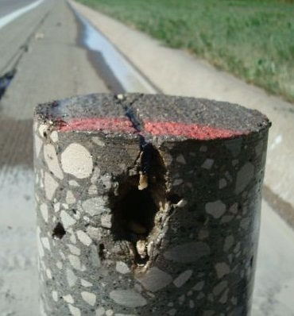
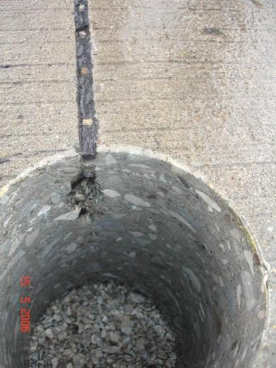
What is the common denominator?

Slide 21
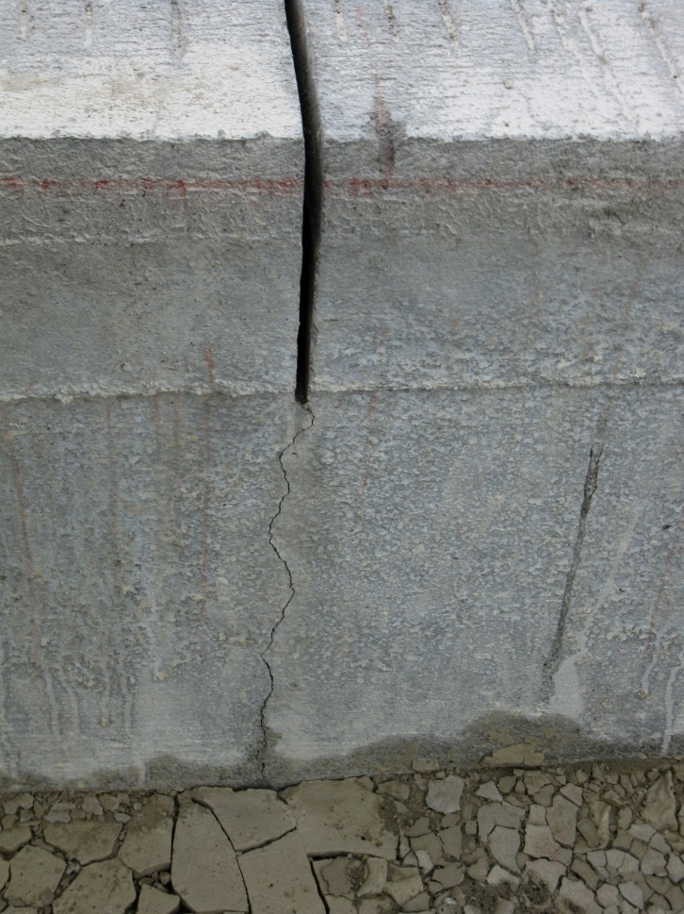
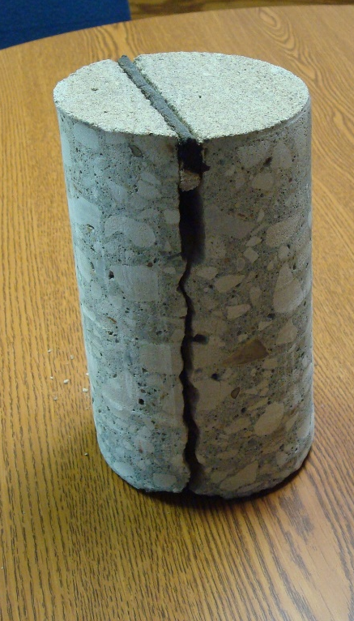
The Objective
Notes:
Work continues on these tasks
Input is welcome -

Slide 22
Preventing Joint Deterioration in New Pavements
Soil, Subgrade, and Base systems
  Stabilized subgrade
  Granular subbase
  Drainage of pavement system
Concrete Mixture Recommendations
  Low water-cement ratio
  Supplementary cementitious materials
  Well-graded aggregates
  Air-void system

Slide 23
Preventing Joint Deterioration in New Pavements
Construction Practices
  Curing
    Ensure adequate coverage and application rate
  Sawing joints
    Sawing window and proper depth
  Sealing joints
    If seal, have to maintain the seal
    Consider drainable base
  Surface Sealers
    If use, consider high solids content
    Research is ongoing

Slide 24
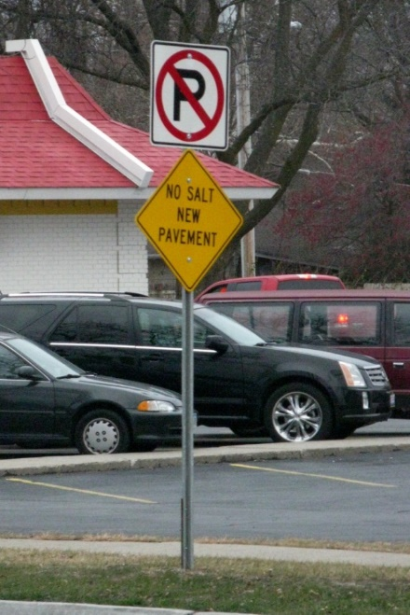
Maintenance Activities to Reduce Joint Deterioration Risk
Routine Maintenance
  Joint cleaning and sealing
  Surface sealers
  Drainage
Winter Maintenance
  Deicing/anti-icing chemicals
    #1 state was IA, averaging the application of 20,209,040 gal of NaCl brine in the last three years applied to 19,279 ln mi
    #1 state was NY, averaging 920,866 tons NaCL in the last three years over 43,603 ln mi
    Calcium chloride and magnesium chloride are more detrimental to cement paste than sodium chloride
  Do not expose concrete to salt for at least 30 days after placement

Slide 25

So…
  The game has changed . . . . .
    Water has to be prevented from saturating the concrete
    Permeability of the concrete should be as low as practical
    The air void system
    in the in-place
    concrete must be
    adequate
Notes:
Fence is only as good as the weakest point – note the lock on the gate

Slide 26
The Lessons
Significant change seems to be deicing salt selections
Concrete ingredient changes may contribute
Acknowledging that safety is paramount, we need to make better concrete to resist these salts
  Air void system
  w/cm
  SCM dose
Notes:
Summary of the problem

Slide 27
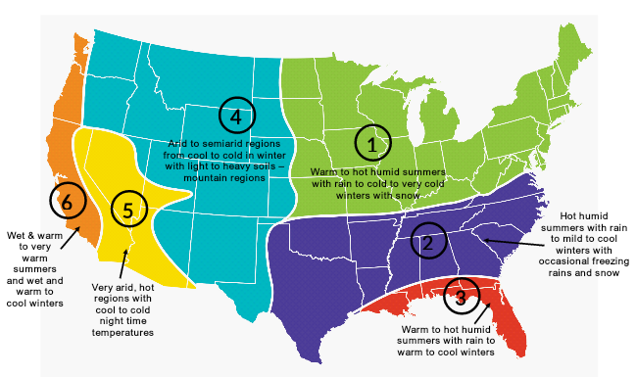
A Better Specification through the Performance Engineered Mixture Initiative
Require the things that matter
  Transport properties (everywhere)
  Aggregate stability (everywhere)
  Strength (everywhere)
  Cold weather resistance (cold locations)
  Shrinkage (dry locations)
  Workability (everywhere)

Slide 28
In Short
Low w/cm ratio – consider 0.4 target
Adequate entrained air – 5% to 8% w/5% min in place
SCMs
  20-25% class F fly ash
  30-35% class C fly ash
  Combination 20% slag and 20% C fly ash
Well graded aggregates
Use chemicals appropriately
  Salts
  Penetrating sealers

Slide 29
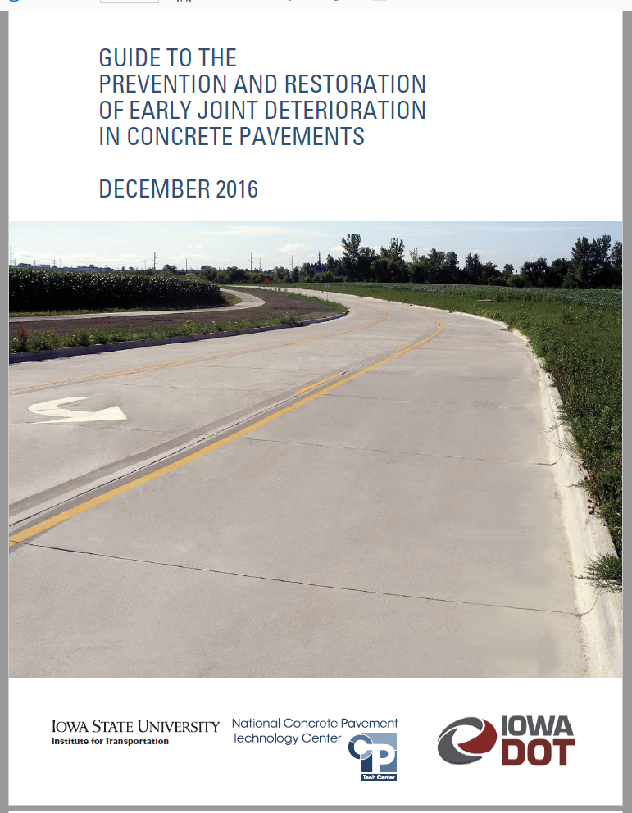
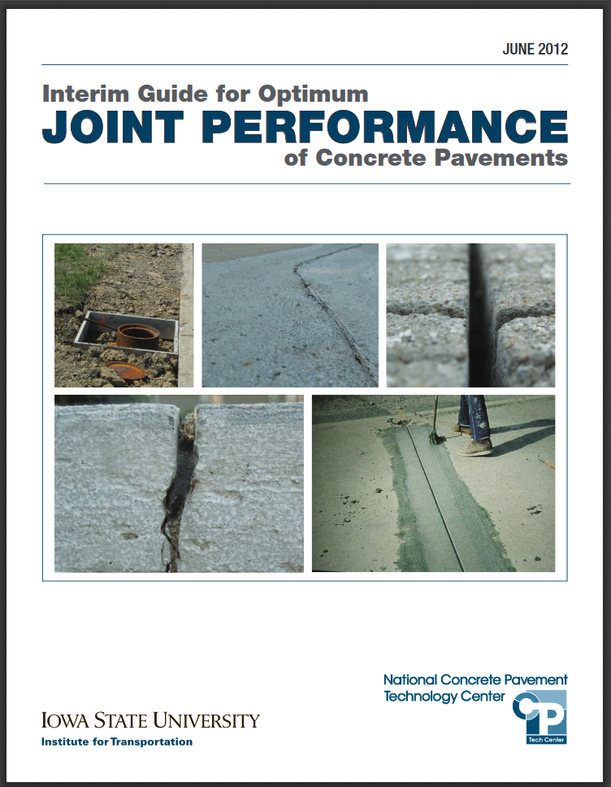
http://www.intrans.iastate.edu/research/documents/research-reports/2016_joint_deterioration_in_pvmts_guide.pdf http://www.cptechcenter.org/technical-library/documents/Joint-Performance-Guide.pdf

Slide 30
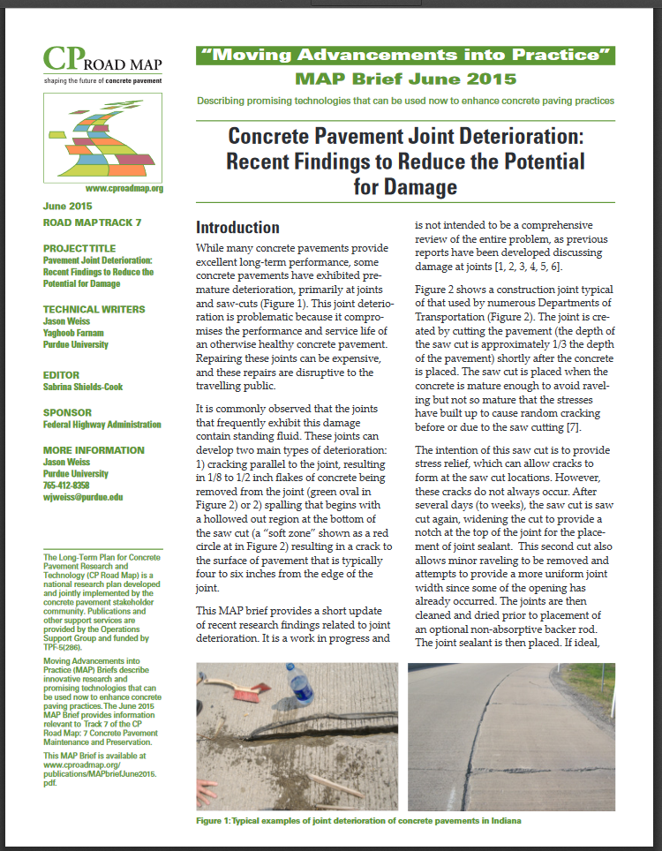
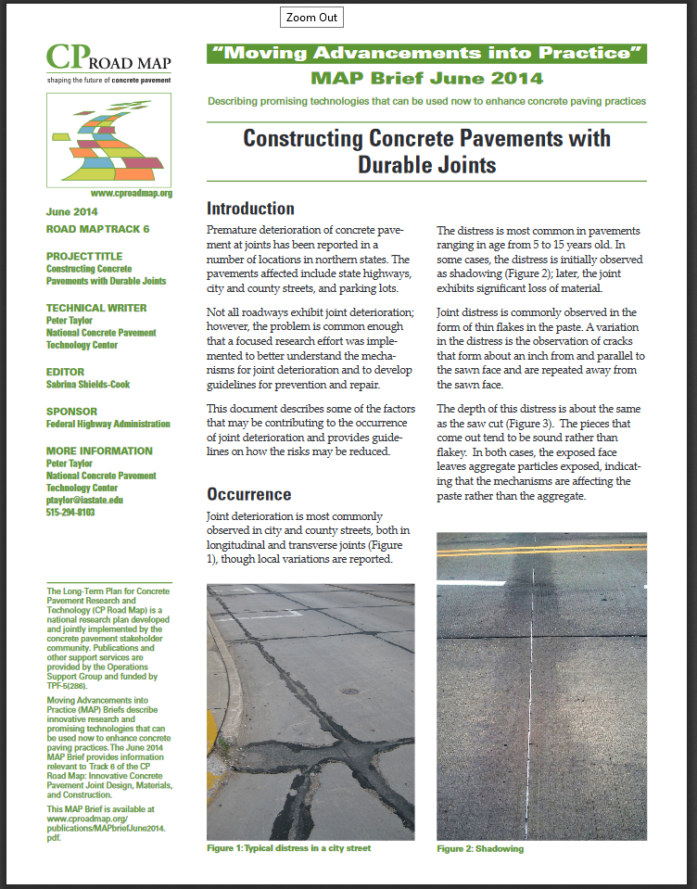
http://www.cproadmap.org/publications/MAPbriefJune2015.pdf http://www.cproadmap.org/publications/MapbriefJune2014.pdf

Slide 31


















































Thank You

Slide 32
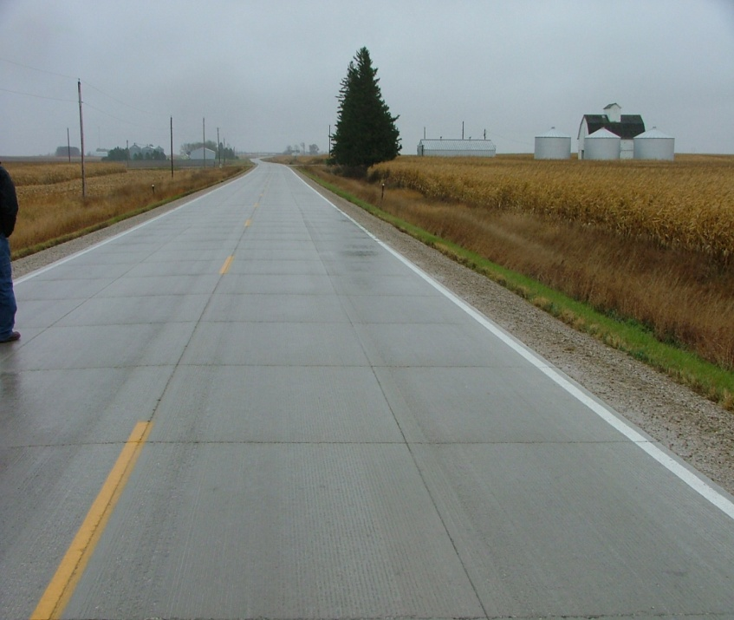
Concrete Pavement Joint Distress
Cause and Mitigation

