Slide 1


2018 Pavement Workshop
May 23-24, 2018
Rigid Team Overview
Brett Trautman, PE
Physical Laboratory Director
Construction and Materials Div.
Missouri DOT
+ 46 Associate Members

Slide 2
Determining Research Topics
MnROAD had topics remaining
Team Members proposed topics
Research defined (i.e. purpose)
Members ranked their top five topics
Scoring system utilized
Top 4 selected
Scoring System
Rank 1 2 3 4 5
Score 5 4 3 2 1

Slide 3
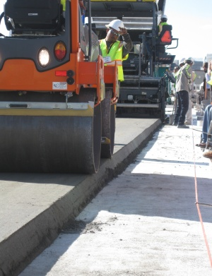
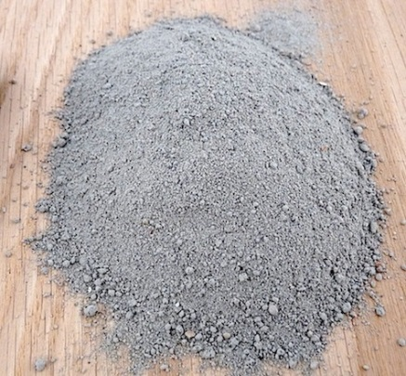
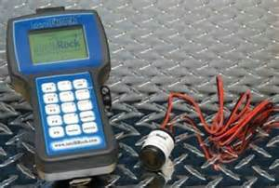
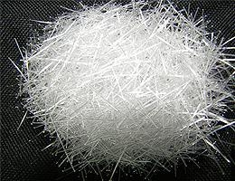
Selected Research
Fiber-Reinforced Concrete (FRC) Pavement
Evaluation of Long-Term Impacts of Early Opening of Concrete Pavements
Reduced Cementitious Materials in Optimized Concrete Mixtures
Compacted Concrete Pavement

Slide 4
Fiber-Reinforced Concrete
Objectives
  Determine contribution of fibers in reducing panel fatigue cracking
  Determine contribution of fibers in mitigating joint faulting
  Determine optimal panel size for thin unbonded concrete overlays
  Determine minimum thickness of FRC for low-volume streets

Slide 5
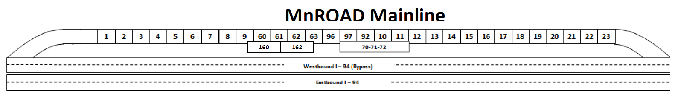
Fiber-Reinforced Concrete
Mainline Cell #6 (506, 606, 706, & 806)
Evaluating the impact fiber dosage has on fatigue cracking & joint faulting
Cell No. | 506 | 606 | 706 | 806
Length | 144 ft. | 138 ft. | 138 ft. | 138 ft.

Slide 6
Fiber-Reinforced Concrete
Pavement Details
  Full depth pavement on grade
  All cells: 6’ x 6’ panels
  Fiber content:
  Cell 506: No fibers (control)
  Cell 606: 20% RSR
  Cell 706: 30% RSR
  Cell 806: 0.75% fibers by volume

Slide 7
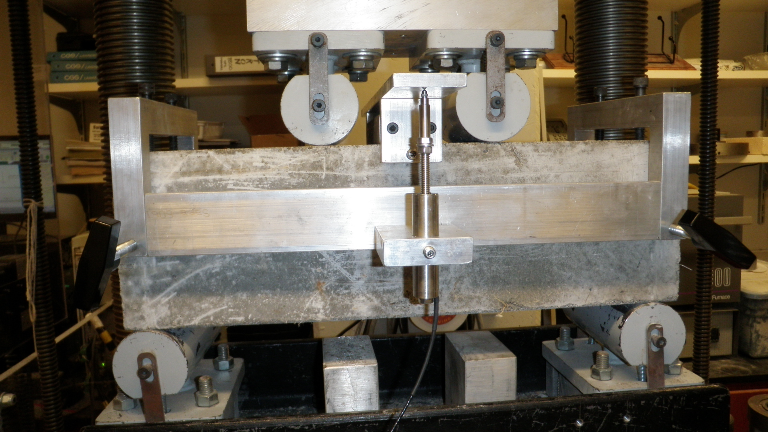
Performance Testing
Residual Strength Ratio (ASTM C 1609)

Slide 8
Load-Deflection Curve
Specimen Cracks
Residual Load @ Deflection = L/150
Specimen Carries Additional Load

Slide 9
Residual Strength Test Results
Table courtesy of American Engineering Testing/Testing, Engineering & Consulting Services, Inc.

Slide 10
FRC Mix Designs
Fiber type: FORTA-FERRO
Table courtesy of American Engineering Testing

Slide 11
Fiber-Reinforced Concrete
Mainline Cell #5 (705 & 805)
Evaluating the impact fibers have on fatigue cracking, joint faulting, & panel size
Cell No. | 705 | 805
Length | 144 ft. | 124 ft.

Slide 12
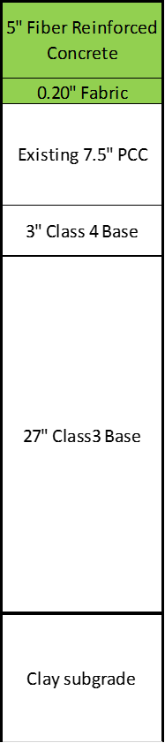
Fiber-Reinforced Concrete
Pavement Details
  Unbonded Overlay
  - Non-woven geotextile fabric interlayer
  Cell 705
  - 14’W x 12’L & 12’x12’ panels
  Cell 805
  - 6’ Wx12’L & 8’Wx12’L panels
  Fiber content: 20% RSR

Slide 13
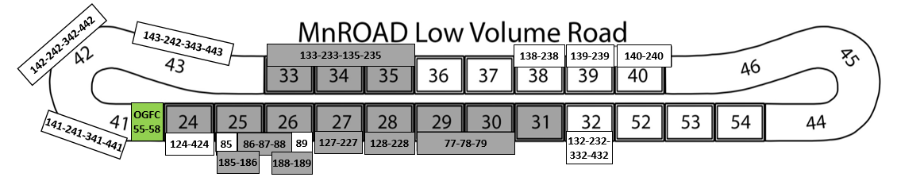
Fiber-Reinforced Concrete
Low Volume Road Cell #39 (139 & 239)
Evaluate using fiber-reinforced concrete pavement for city streets
Cell No. | 139 | 239
Length | 270 ft. | 273 ft.

Slide 14
Ultra-thin Fiber-Reinforced Concrete
Pavement Details
All cells: 6’ x 6’ panels
Full depth concrete on grade
Fiber content: 30% RSR

Slide 15
Early Opening to Traffic
Objectives
  Evaluate visible and non-visible immediate damage caused by early age loading
  Quantify the effect of early loading damage on long-term performance
  Determine minimum strength at opening or other measurable variables associated with this parameter
  Recommend strategies for minimizing or avoiding early loading damage

Slide 16
Early Opening to Traffic
Low Volume Road Cell #24 (124, 224, 324, 424, 524 & 624)
Early sequential traffic loadings
Cell No. | 124 | 224 | 324 | 424 | 524 | 624
Length | 120 ft. | 120 ft. | 120 ft. | 115 ft. | 60 ft. | 20 ft.

Slide 17
Early Opening to Traffic
Pavement Details
  Standard panel size 12’W x 15’L
  Full depth concrete on grade
  Standard concrete mix
  Doweled joints

Slide 18
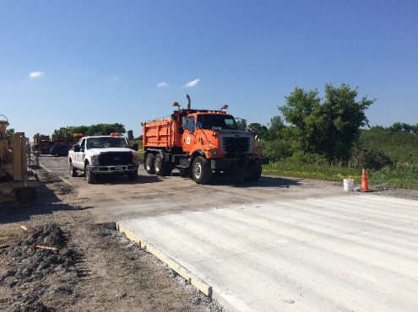
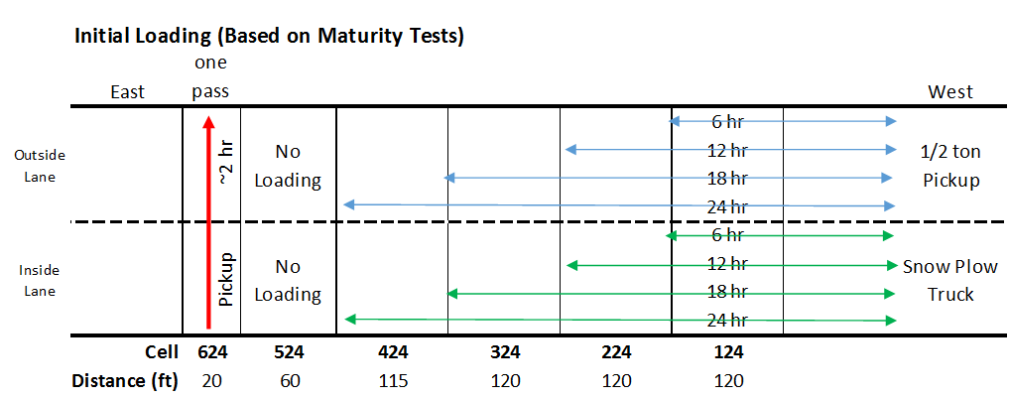
Early Opening of PCCP
Initial Loading
Half ton pickup truck
Snow plow truck

Slide 19
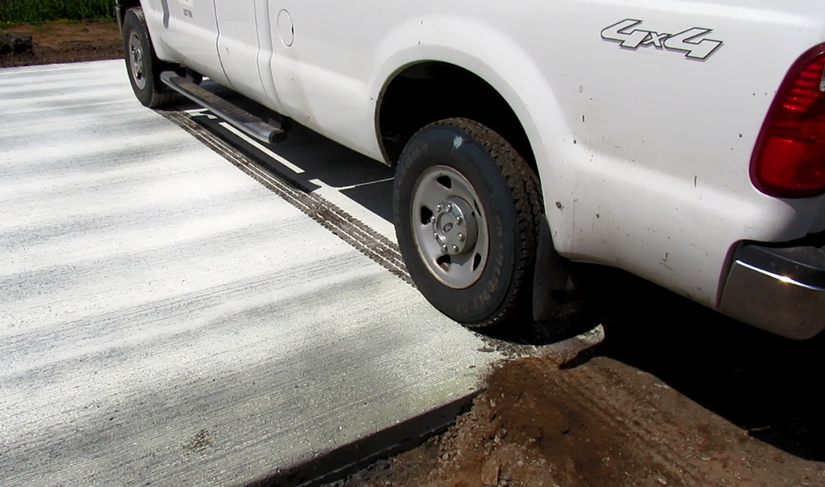
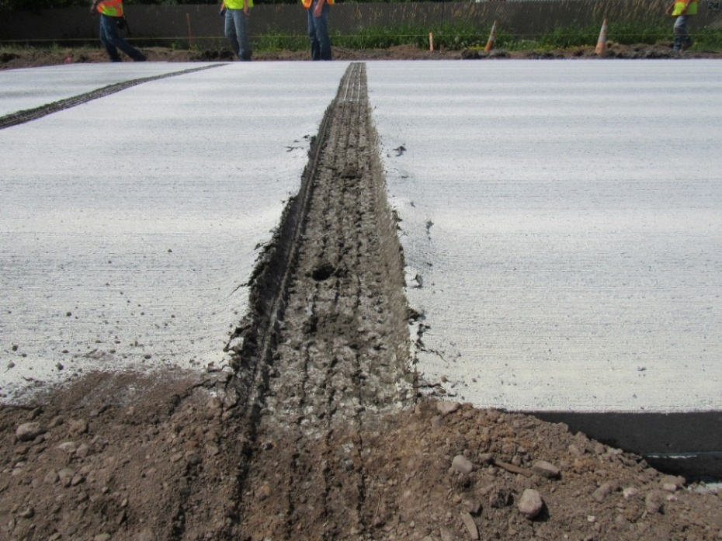
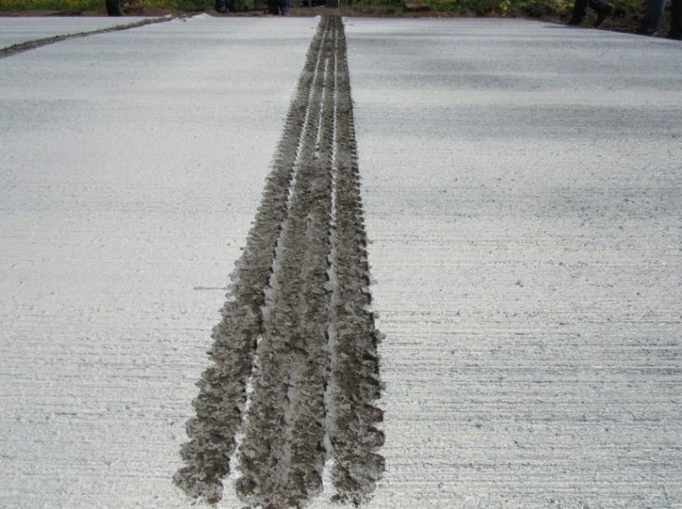
Initial Loading
Cell 624
2-hrs (hot day)
Inside Lane
Outside Lane

Slide 20
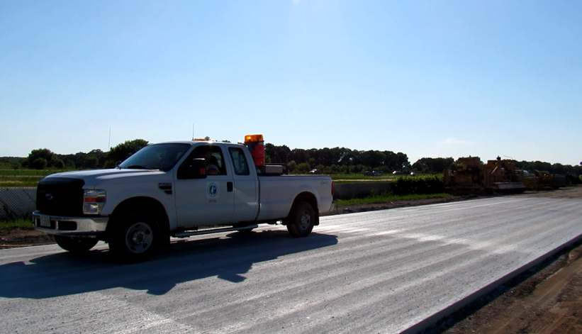
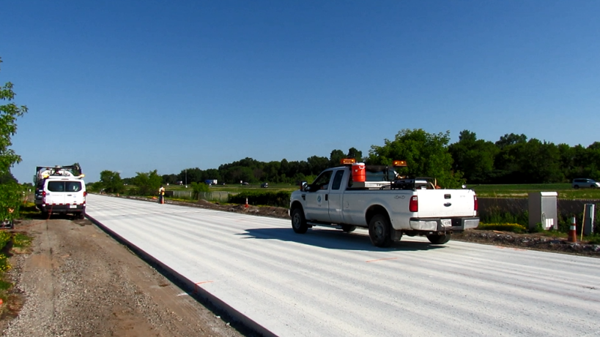
Initial Loading
Cells 124 – 424
Half ton pickup truck
Outside Lane

Slide 21
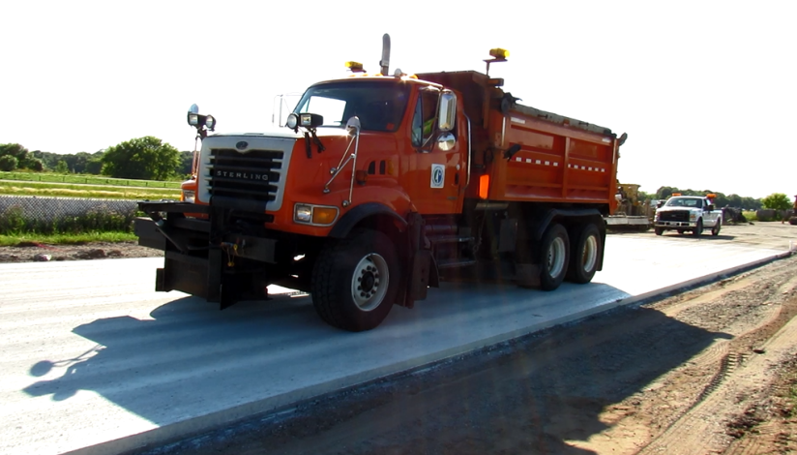
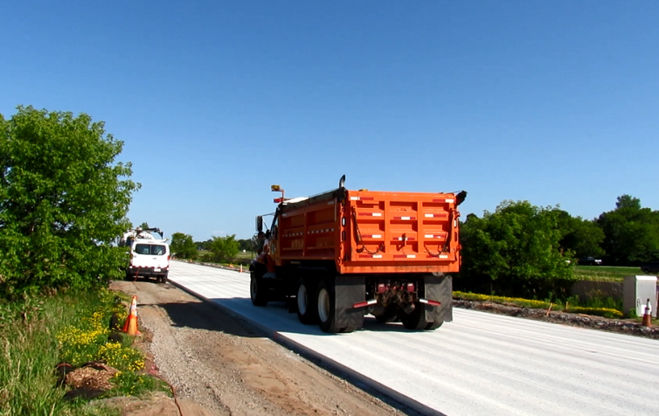
Initial Loading
Cells 124 – 424
Snow plow truck
Inside Lane

Slide 22
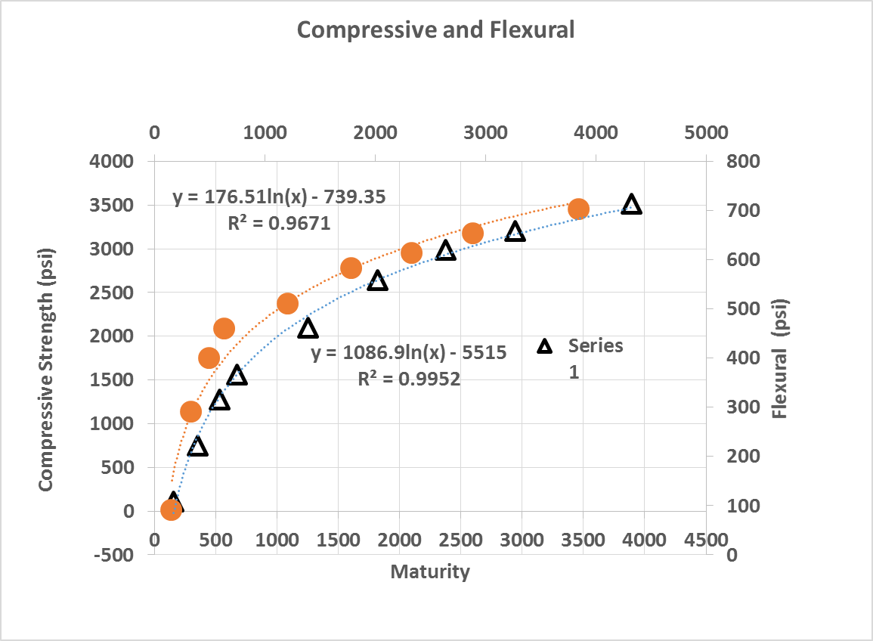
Initial Loading
Cells 124 – 424
Cell 524 not loaded early
Control

Slide 23
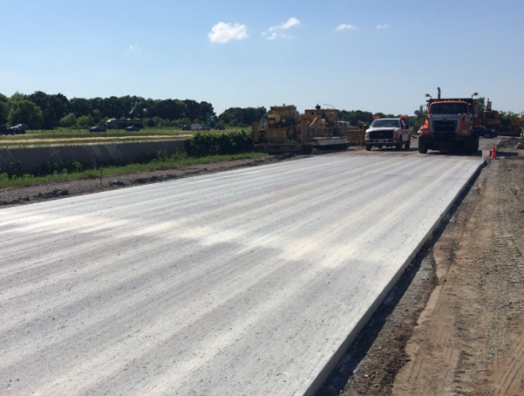
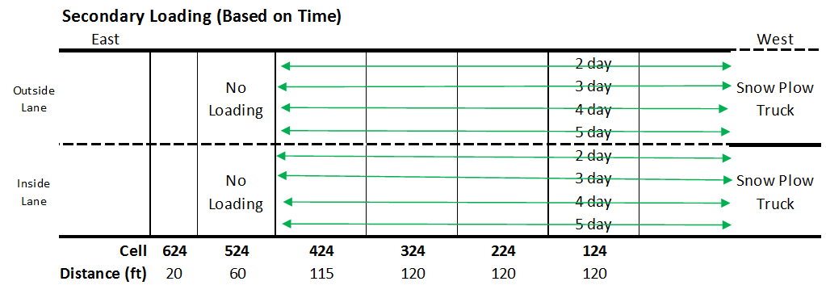
Early Opening of PCCP
Secondary Loading
Snow plow truck

Slide 24
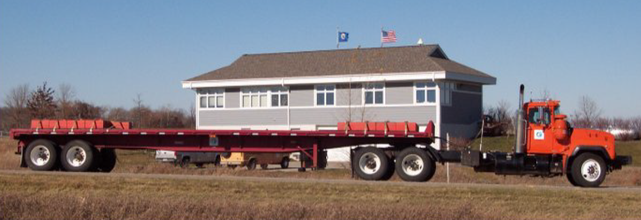
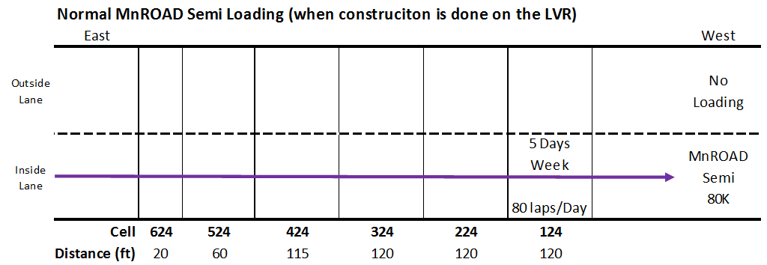
Early Opening PCCP
Normal Loading
Semi truck (80K)

Slide 25
Reduced Cementitious Content
Objectives
  Investigate the early-age characteristics of concrete paving mixes containing low cementitious content
  Assess the potential for durability issues with very low cementitious content
  Identify effect of reduced cementitious content on long term serviceability and economics
  Develop recommended specifications, mixing and placement practices for the use of low cementitious content concrete mixes

Slide 26
Reduced Cementitious Content
Low Volume Road Cell #38 (138 & 238)
Cells will be exposed to deicing agents
Cell No. | 138 | 238
Length | 258 ft. | 260 ft.

Slide 27
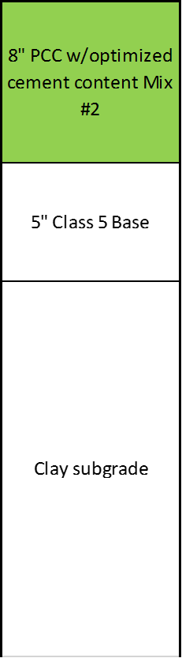
Reduced Cementitious Content
Pavement Details
Standard panel size 12’W x 15’L
Full depth concrete on grade
Doweled Joints
Cell 138
- Cementitious content = 500 lb./cy
Cell 238
Cementitious content = 470 lb./cy
138 & 238

Slide 28
Reduced Cementitious Content
Performance Engineered Mixture (PEM) testing performed
Box Test after 30 minutes
Photos courtesy of American Engineering Testing

Slide 29
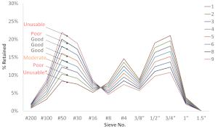
Reduced Cementitious Content
Mix designs for Cells 138 & 238
Table courtesy of American Engineering Testing

Slide 30

Construction Activities

Slide 31
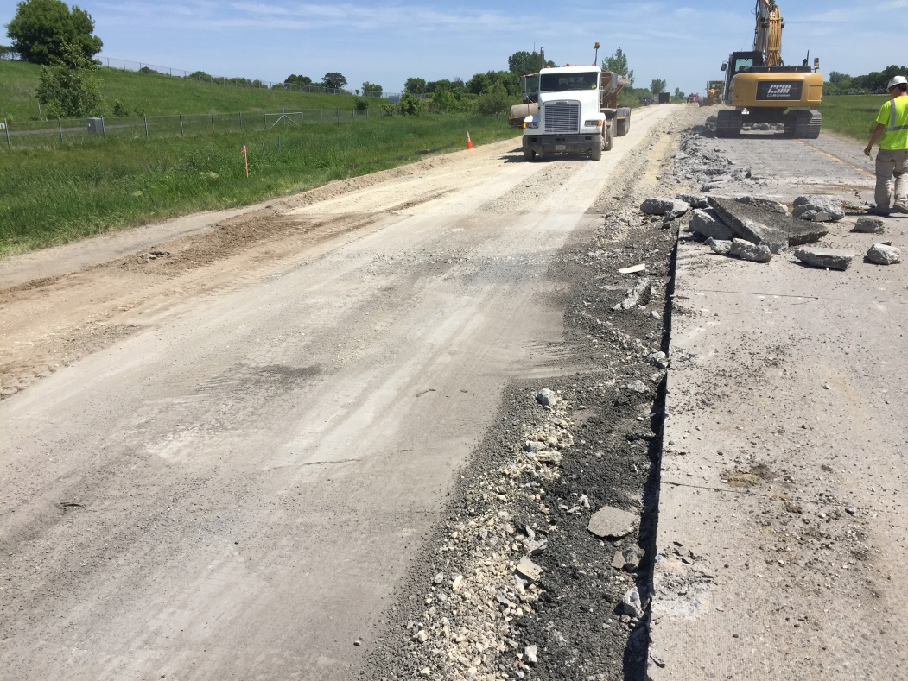
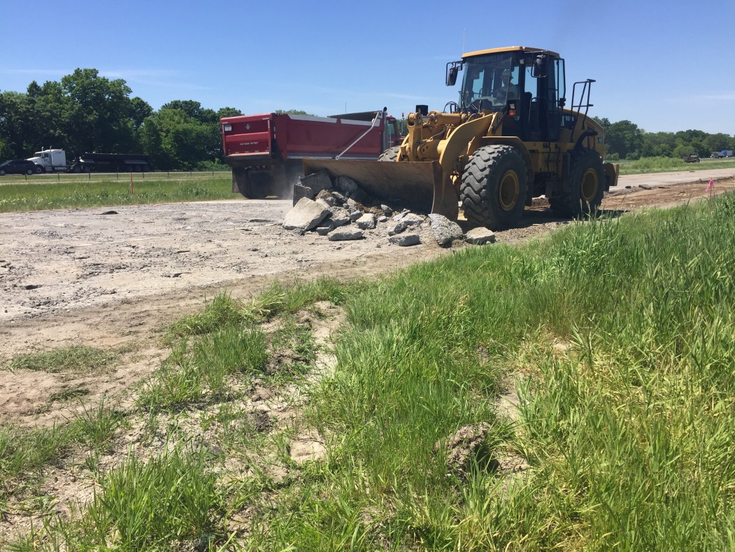
Preparation
Removing existing pavement and preparing the base

Slide 32
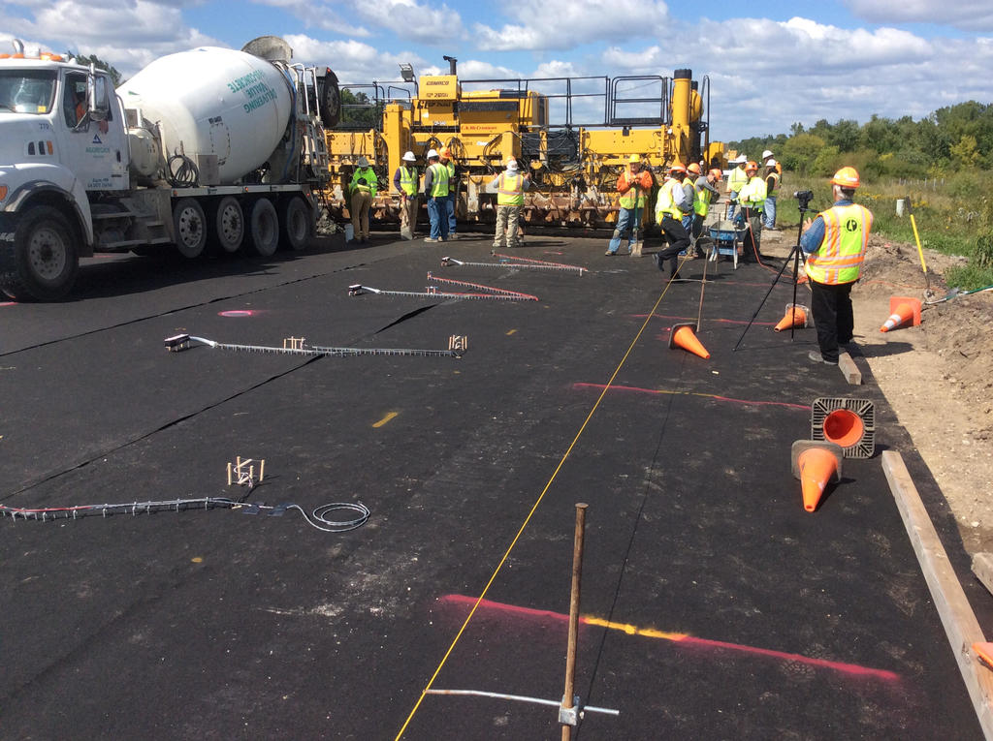
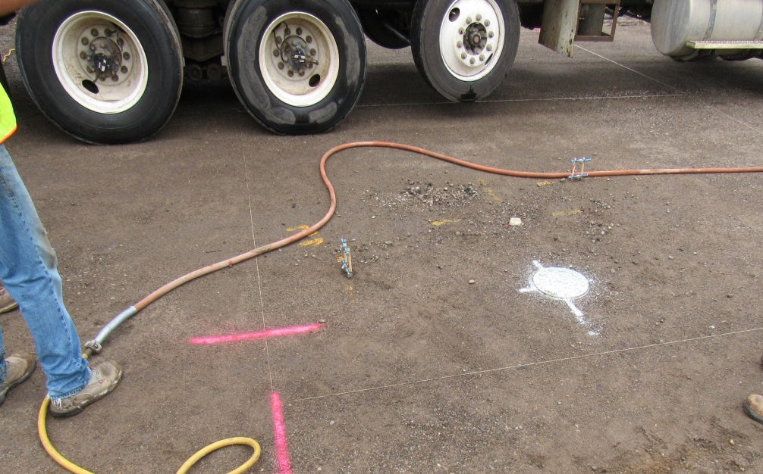
Instrumentation
Sensors embedded in concrete to monitor pavement response
Utilized in all of the concrete test sections
Fiber-reinforced concrete
Early opening to traffic
Reduced cementitious content

Slide 33
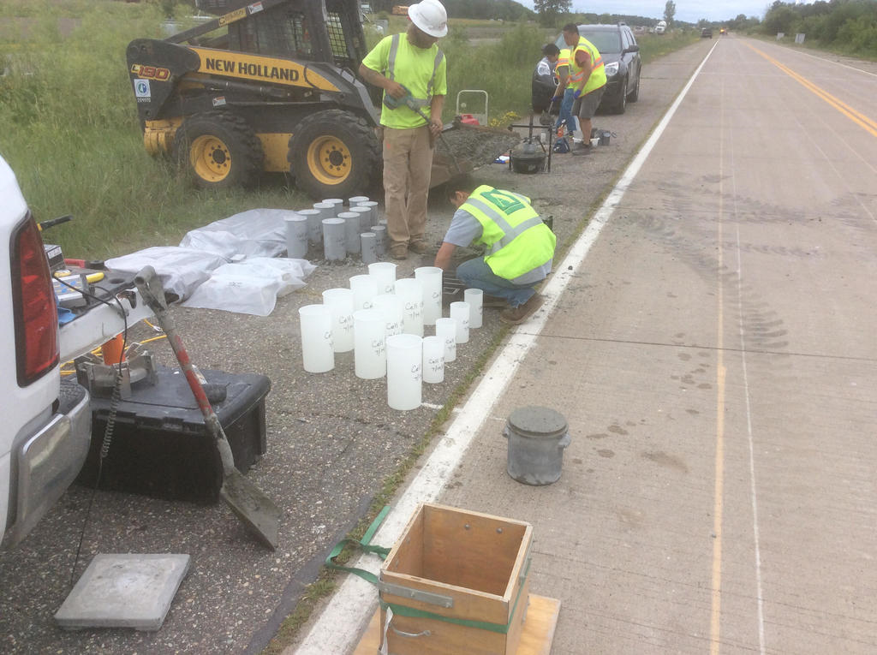
Sampling
Numerous samples made
V-Kelly Test
S.A.M.
Box Test

Slide 34
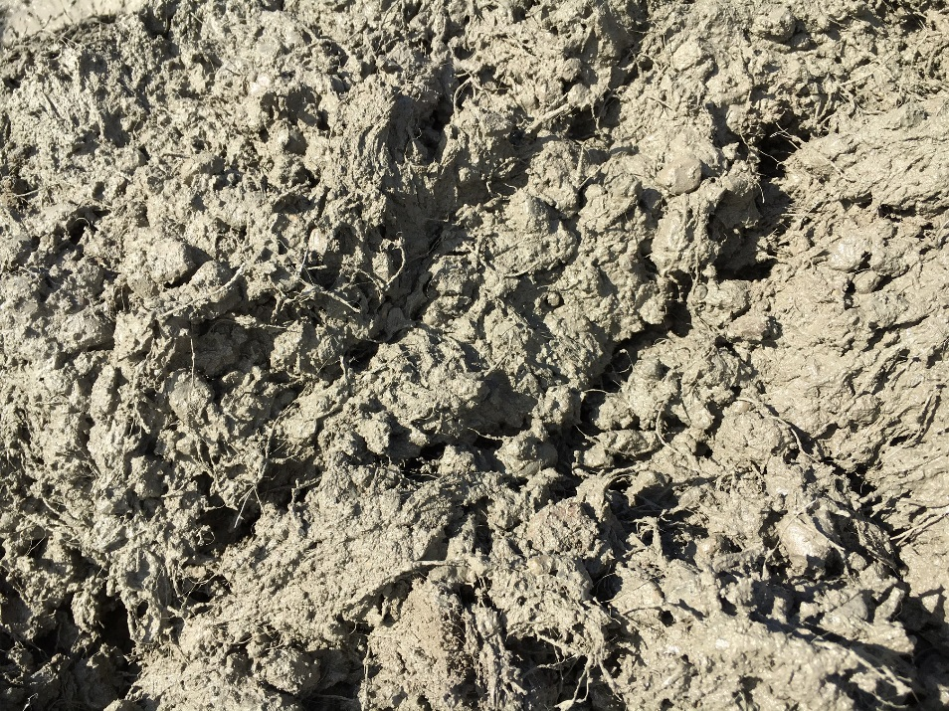
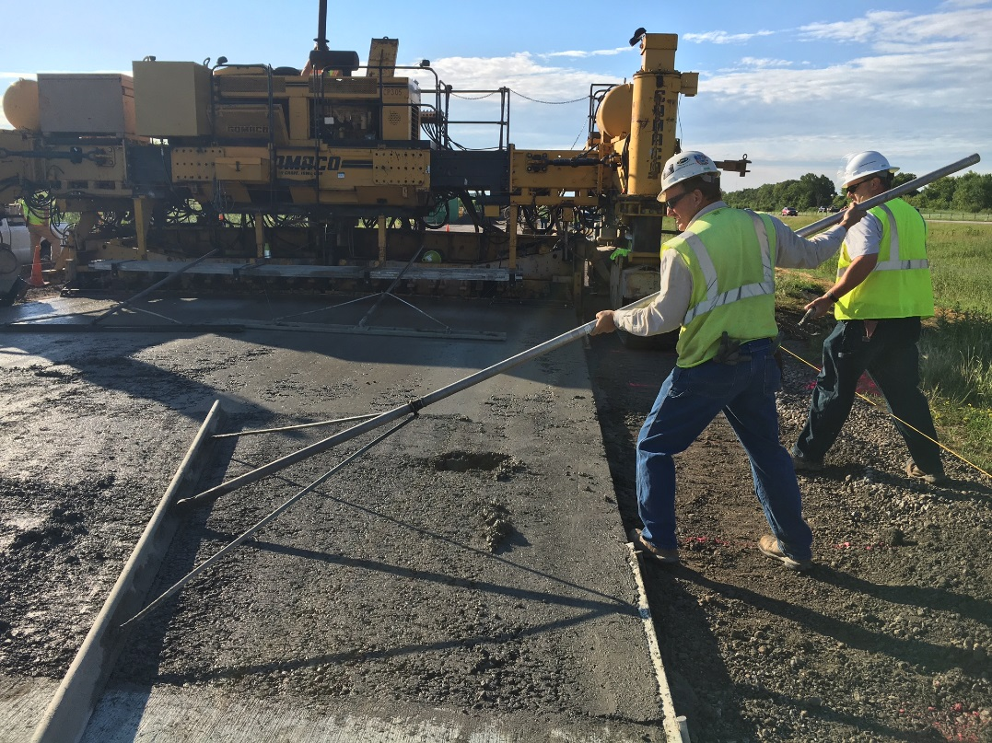
Fiber-Reinforced Concrete
Paving Cell 806, 5-inch thick
0.75% fibers by volume

Slide 35
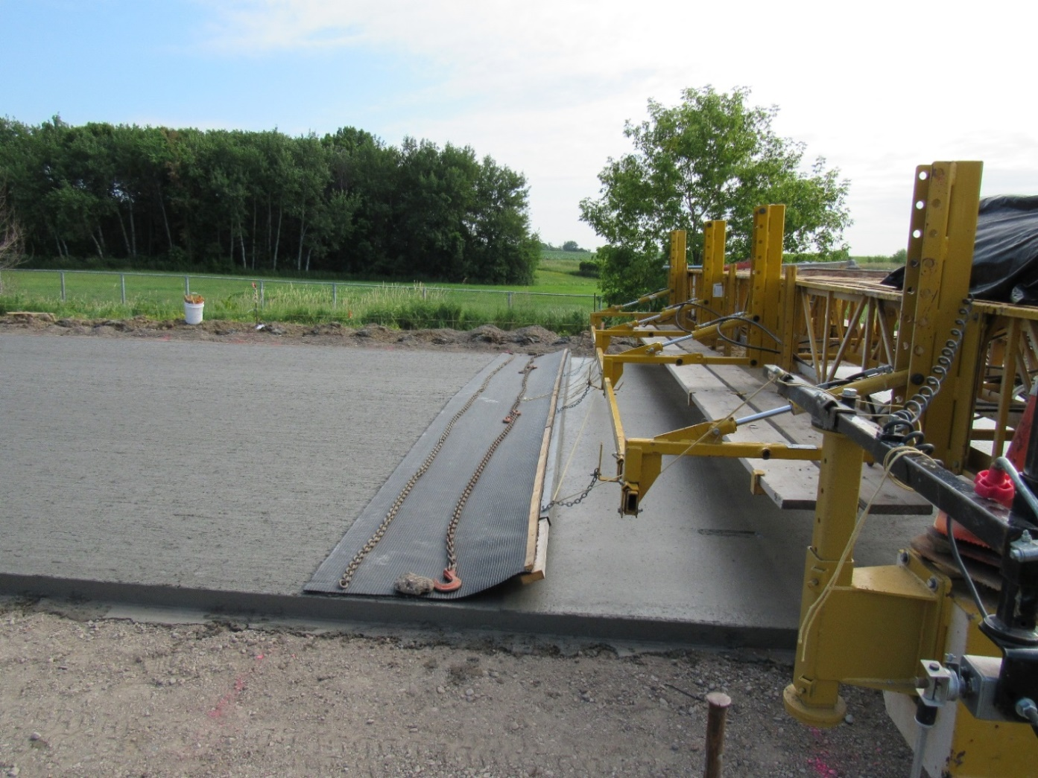
Fiber-reinforced Concrete
Paving Cell 139, 3-inches thick

Slide 36
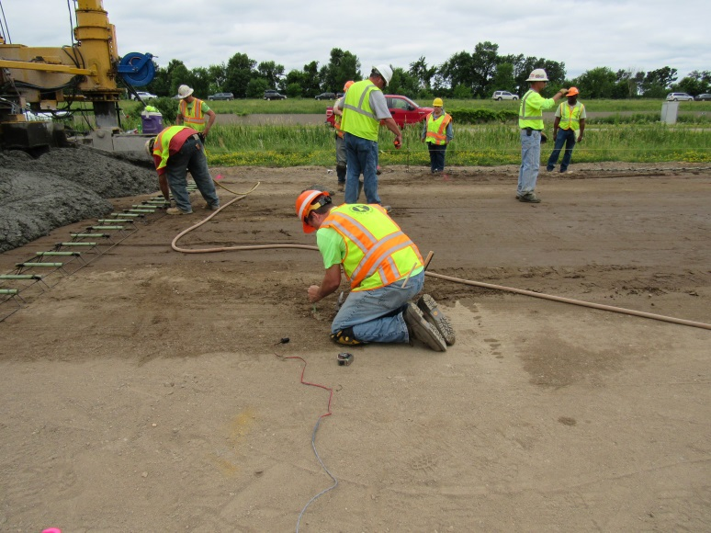
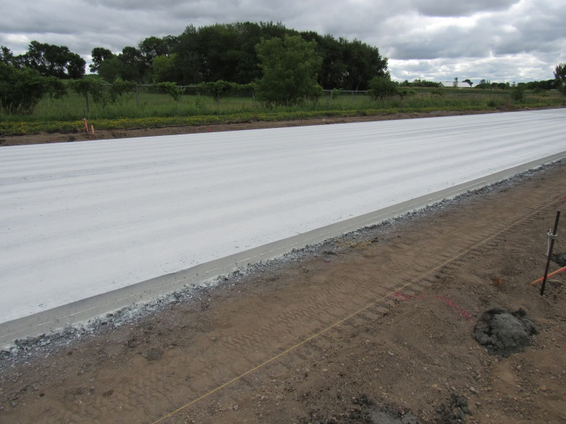
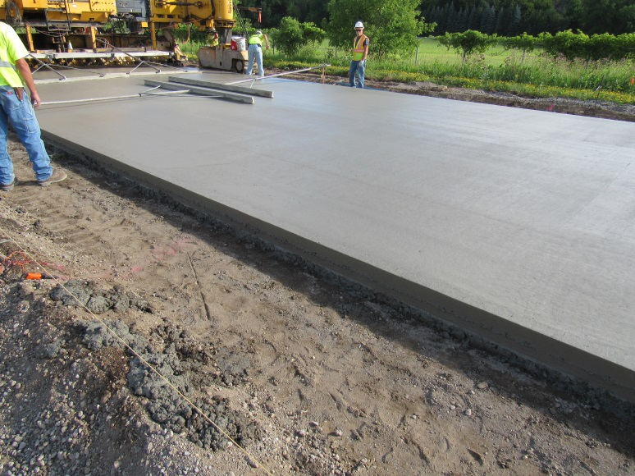
Reduce Cementitious Content
Paving Cell No. 138
500 lbs./CY cementitious material

Slide 37

Huge Thank You!!
Minnesota DOT for providing information and photographs
Ben Worel
Tom Burnham

Slide 38


















































Thank You

