Slide 1


2018 Pavement Workshop
Flexible Session
May 23-24, 2018
Tensile Strength Ratio (AASHTO T 283)
Testing
Brett Trautman, PE
Physical Laboratory Director
Construction and Materials Division
Missouri DOT
+ 46 Associate Members

Slide 2

History in Missouri
Been performing on field samples for over 15 years
Allows contractors options (hydrated lime, anti-strips, etc…)
Samples taken at the asphalt plant
Material retain for dispute resolution purposes
Sampling Frequency
QC: 1 sample per 10,000 tons
QA: 1 sample per 50,000 tons

Slide 3
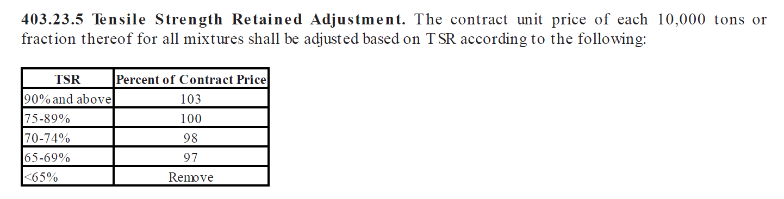
History in Missouri
Incentive/Disincentive pay factors
Price adjustment based on QC data
Need favorable comparison between QA and QC test results
The following pay adjustment table used:

Slide 4
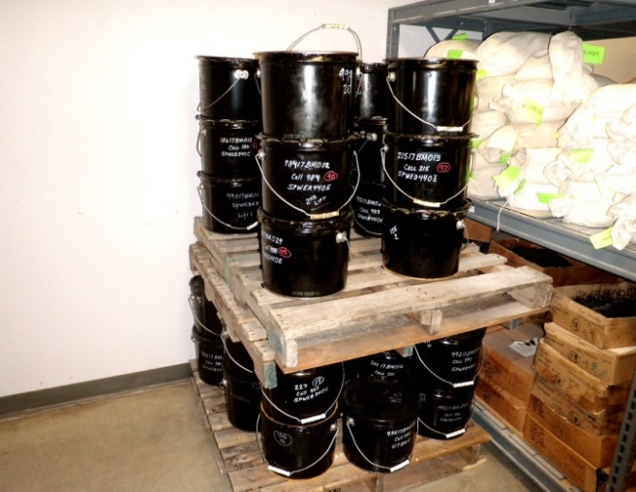
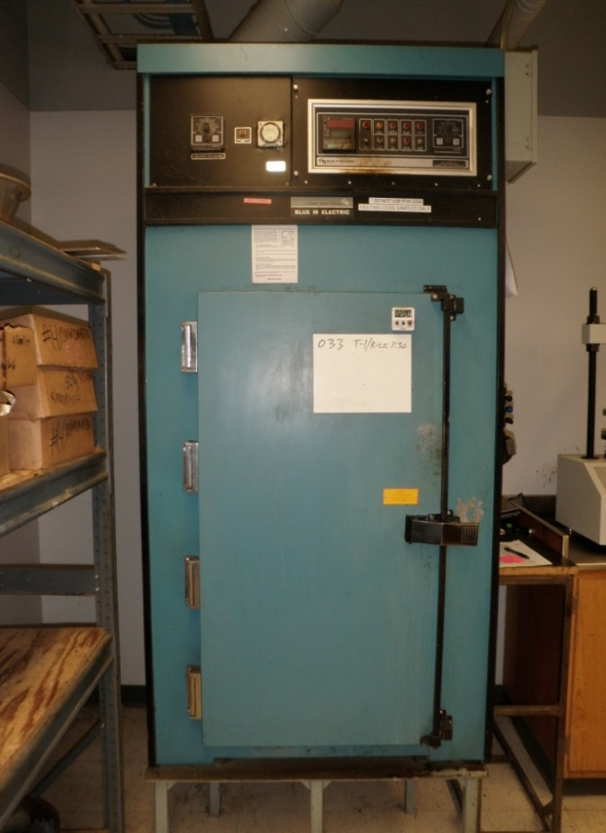
Molding Process
Samples received at the Central Laboratory
Bucket place into oven set at 5 deg. C below the molding temperature
Achieve a workable mix
Max. time limit of 2 hours
Weigh out material for molding specimens
Use quartering method

Slide 5
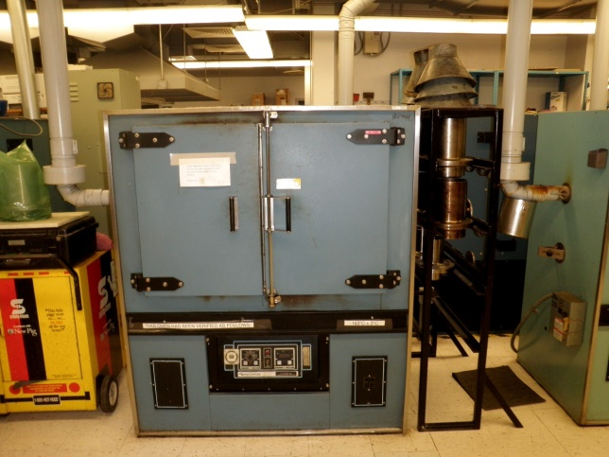
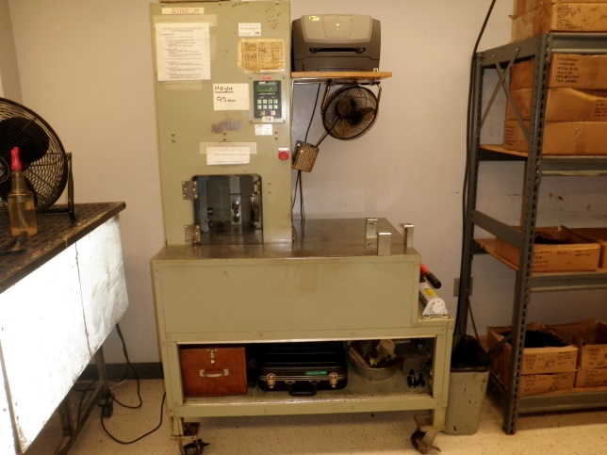
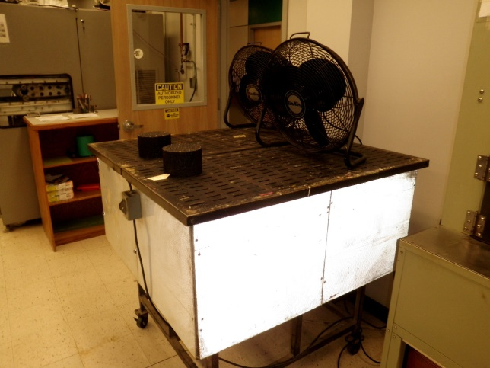
Molding Process
Samples then placed into an oven set at the molding temperature
Max. time limit of 2 hours
Samples compacted to 95 mm
Achieve 7.0 +/- 0.5% air voids
Trial specimen molded to verify the mix weight is correct
Prevent wasting material

Slide 6
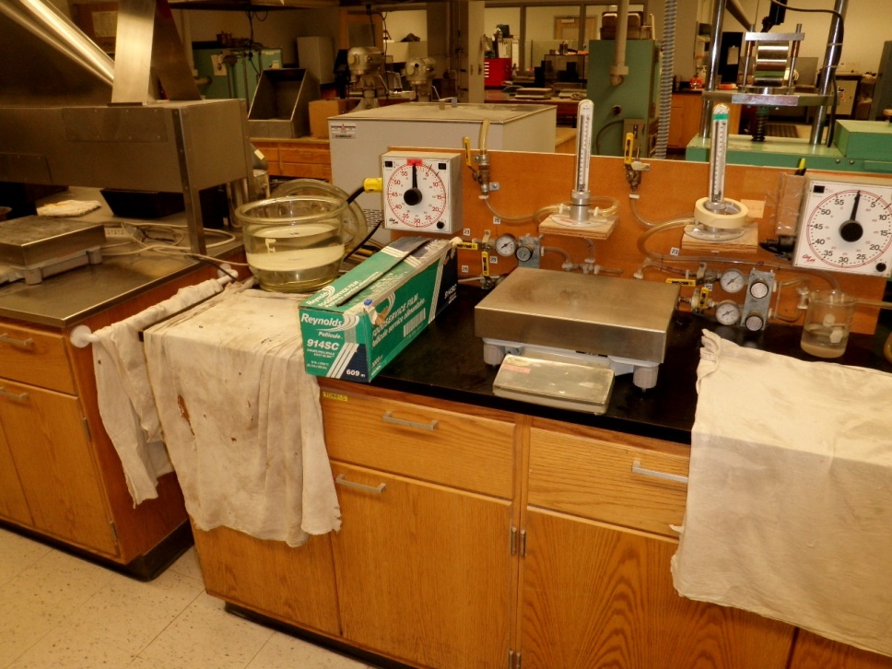
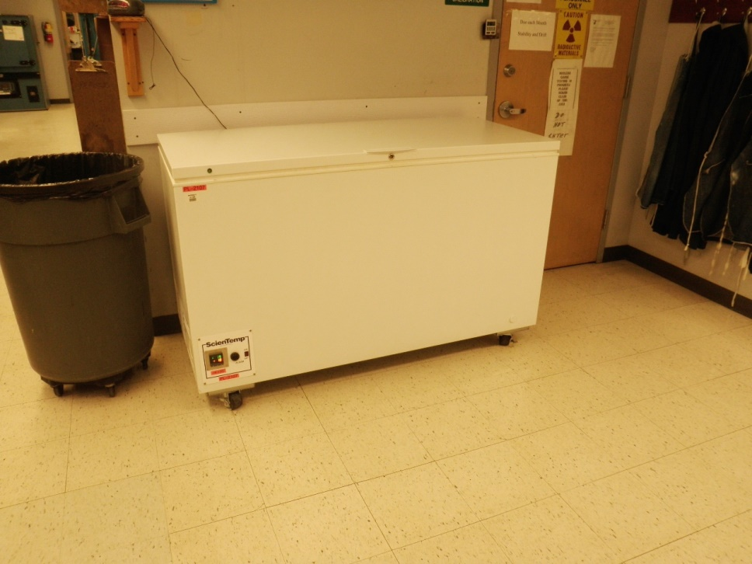
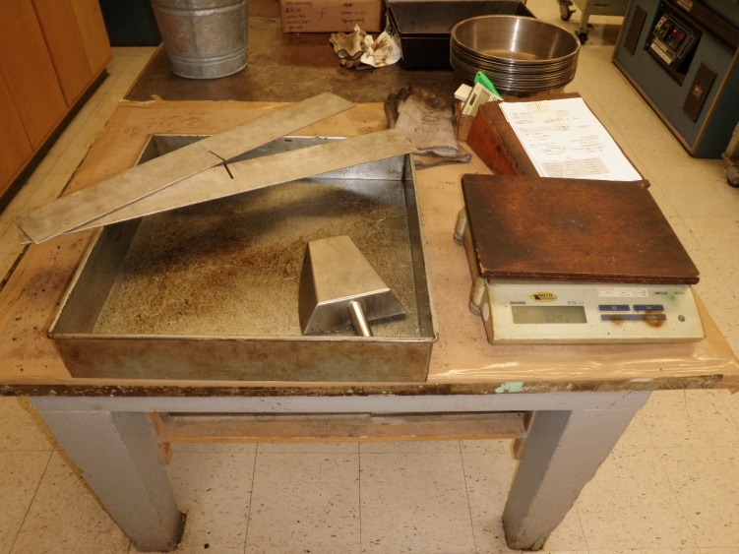
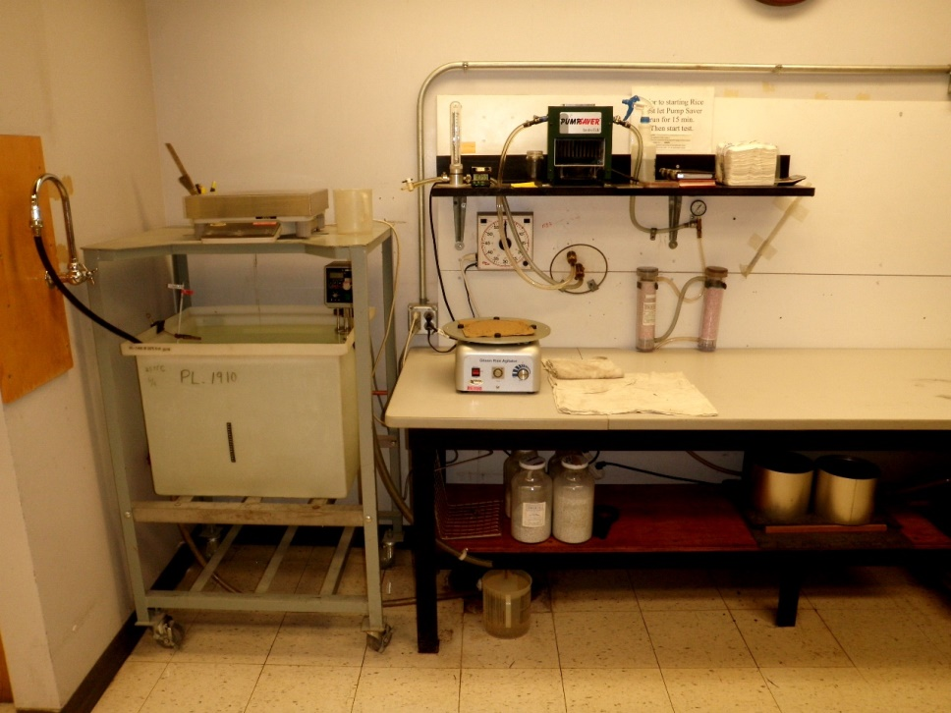
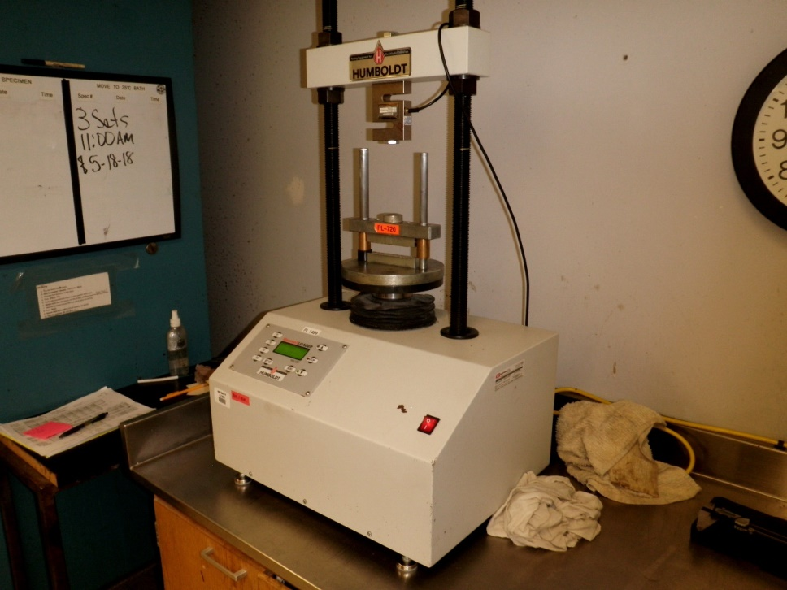

Slide 7
Mix Designs
TYPE | AGG SIZE | BINDER | DES VOIDS | MODIFIED N_{DES}
SPWEB340C | 12.5 | 58H-34 | 4.0 | 0
SPWED440E | 4.8 | 58H-28 | 4.0 | 0
SPWEA440E | 9.5 | 58H-28 | 4.0 | 0
SPWEB450E | 12.5 | 58H-28 | 5.0 | 50
SPWEB440E | 12.5 | 58H-28 | 4.0 | 0
SPWEC440E | 19.0 | 58H-28 | 4.0 | 0
SPWEB430E | 12.5 | 58H-28 | 3.0 | 0
SPWED430I | 4.8 | 58E-34 | 2.0-3.0 | 50
UTBWC | - | - | - | 0

Slide 13

Questions

