Slide 1


2018 Pavement Workshop
May 23-24, 2018
NRRA Workshop Summary
Benefits of the NCAT / MnROAD Partnership
Benjamin Worel, P.E.
(MnROAD Operations Engineer)
Dr. R. Buzz Powell, P.E.
(NCAT Assistant Director)
NRRA – May 24, 2018
+ 46 Associate Members

Slide 2


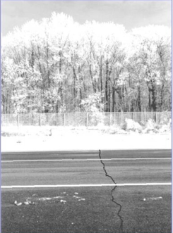
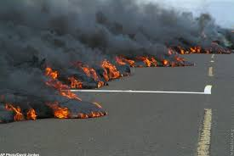
Presentation Outline
NRRA Workshop Summary
MnROAD – NCAT partnership
  Northern Experiment
  Southern Experiment

Slide 3
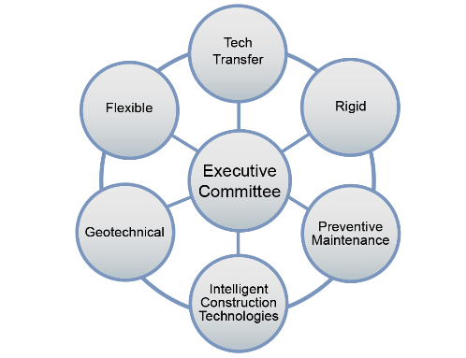
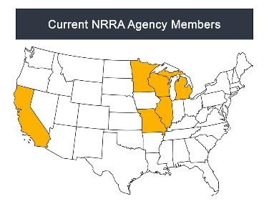

NRRA Workshop Summary
Glenn’s Overview of NRRA
Phase 1 - Started (Feb 2016)
Phase 1 – Ending (Feb 2021)
Membership
Technical Teams
Contracts
42 Associates

Slide 4
NRRA Workshop Summary
  Flexible
    Asphalt Pavement Performance Testing
  Rigid
    Summary of CP Tech Center Study on Mechanisms of Joint Distress
    Concrete Pavement Repair Product Evaluations at MnROAD
    Findings From Study on Dowel Bar Anchorage in Full-depth Concrete Repairs
  Geotechnical
    Pavement Design Criteria for Recycled Aggregate Base and Large Stone Subbase
    Case Study TDA Recycled Tires
  Pavement Maintenance
    Spray Applied Rejuvenators
    DOT Decision Management Decision Trees

Slide 5


Benefits of the NCAT / MnROAD Partnership
- National Research Initiatives -
National Pavement Preservation Study
Development of a National Cracking Test

Slide 6
MnROAD / NCAT Partnership History
Summer/Fall 2012
Lee Road 159 (Alabama)
Summer 2015
US – 280
(Alabama)
Summer 2016
US – 169
CSAH – 8
(Minnesota)
2015
NCAT – MnROAD Partnership
2015
2018
2012
2013
2014
2016
2017

Slide 7


























First of All
Thank you!

Slide 8

Common Activates
Common Performance Monitoring
  Dedicated Pathways Van
    Cracking/Rutting/Ride
  Deflection (FWD), …..
Traffic Monitoring
Sensor Monitoring
Database
  Utilize the MnROAD common database with NCAT
  Development of a LTPP InfoPave system
Communication / Implementation
  Face to Face Meetings
    2X yr sponsors (North and South)
    Host agencies
  Website / Reporting
Notes:
Note schedules

Slide 9
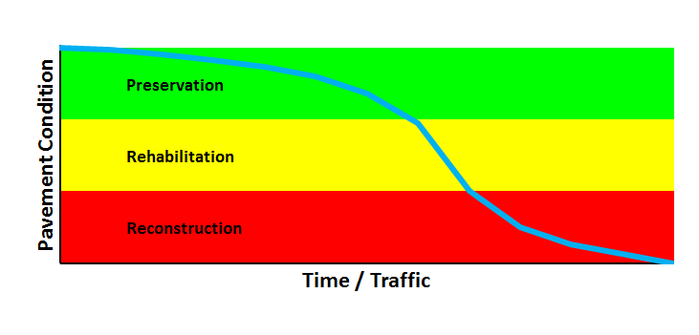
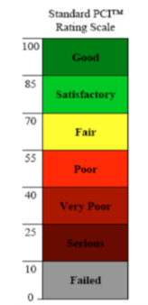


National Pavement Preservation Study
Crack/fog seal
Chip/slurry/micro
Thin overlay
Thick overlay
Shallow mill/inlay or hot recycle + overlay
Deep mill/inlay or cold recycle + overlay(s)
Reclamation + overlay(s)
Select for
Lowest Life
Cycle Cost

Slide 10
Preservation Group (PG) Experiment
Need to quantify the benefits of preservation
Good materials, designs, placement quality
Designs verified with actual onsite materials
All rates calibrated before and verified as placed
MAP-21 (cracking, rutting, roughness) focus
Many other non MAP-21 performance measures
Benefits as function of pretreatment condition
Agency decision process implementation.

Slide 11
Preservation Options Studied
Emulsion surface treatments
  Fog seals with, without rejuvenators
  Chip seals with, without rejuvenators (scrubs), fibers
  Micro surface with, without HiMA, fibers and double
  Micro surface as Cape seals on chips, scrubs.
Plant produced thinlays
  4.75 DGA (virgin, 50% RAP, 5% RAS, 11% RAP + 3% RAS)
  DGA Thinlays over 100% RAP cold recycle (CCPR, CIR)
  DGA Thinlays as “HMA Capes” on chips and scrubs
  Open graded friction course (OGFC) surfaces (tack study)

Slide 12
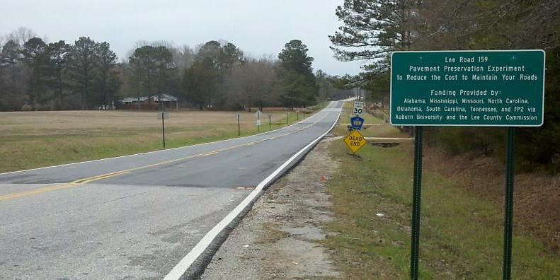
Lee Road 159 Low Traffic Preservation
70k ESALs
880k ESALs
Notes:
As of April 2016

Slide 13
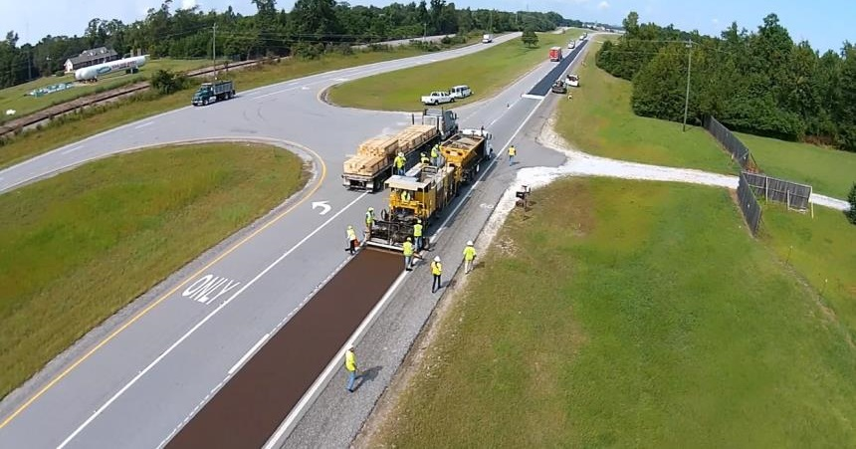
US-280 High Traffic Preservation
5.6M Vehicles, 1.6M ESALs
Notes:
As of April 2016

Slide 14
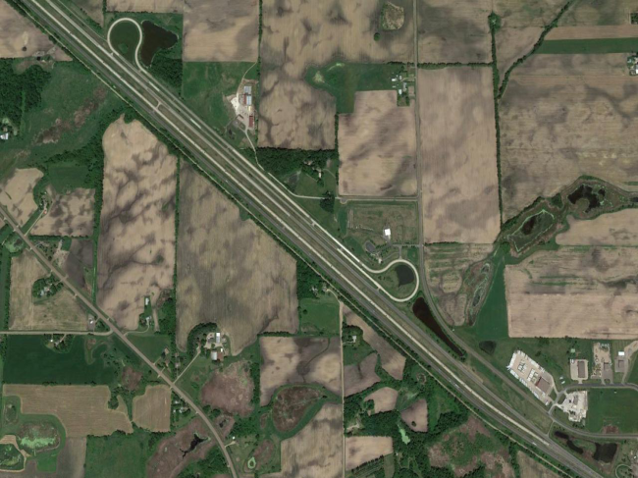
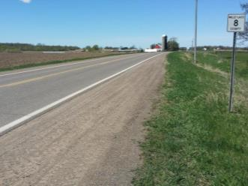
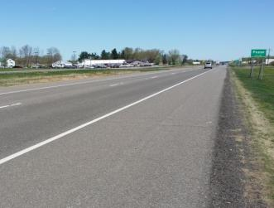
Cold Climate Sections

Slide 15
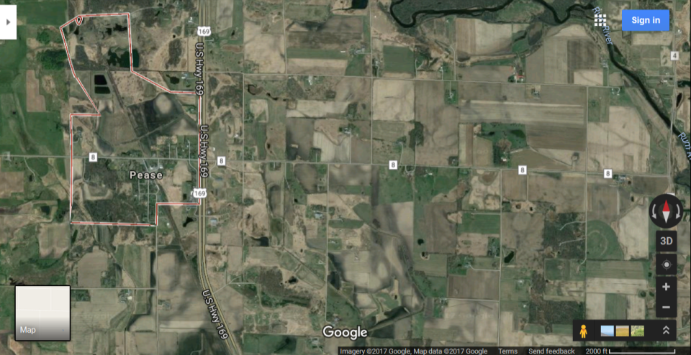
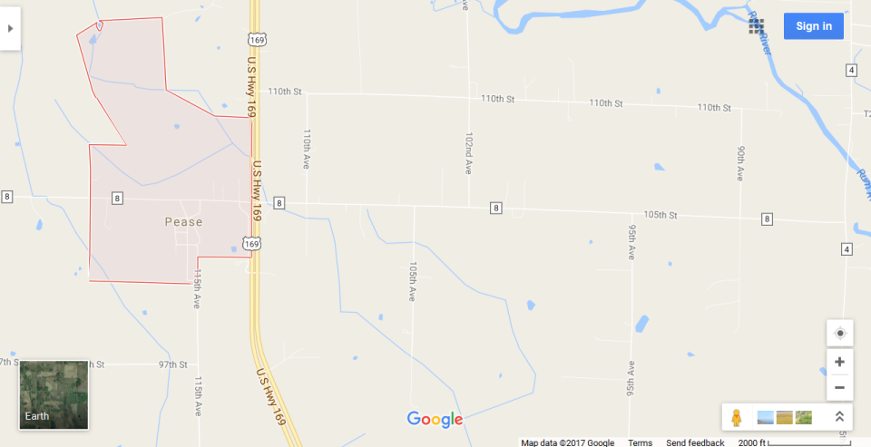
Cold Climate Sections
710 ADT with 8% Heavy Commercial
16,500 ADT with 3% Heavy Commercial

Slide 16
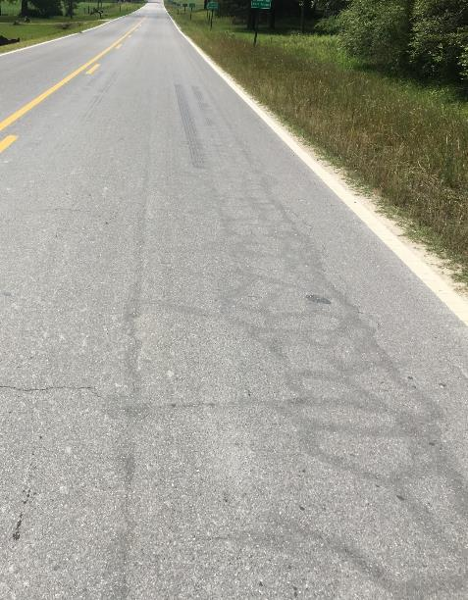
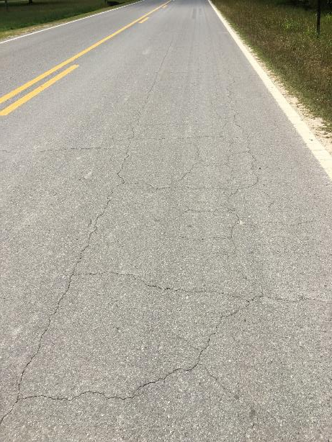
Similar Findings
SINGLE MICRO SURFACE
SINGLE MICRO SURFACE + CRACK SEALING

Slide 17
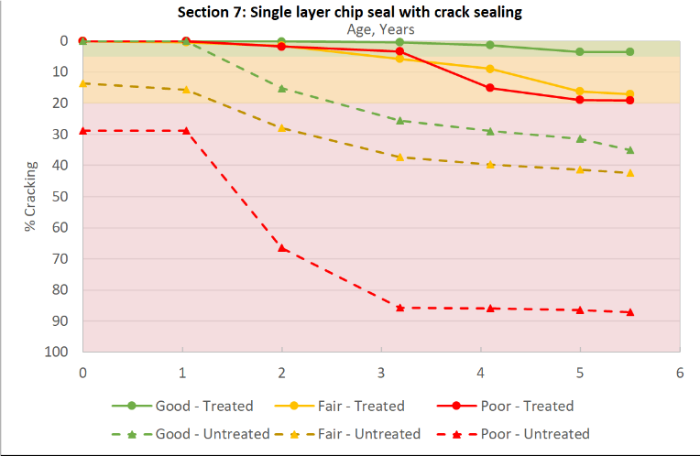
Benefits = f(Pretreatment Condition)
“Fair” Life Extending Benefit
“Fair”
Condition
Improving
Benefit at
End of
Year 5
MAP-21 Cracking
Green = “Good” (< 5%)
Yellow = “Fair” (5% ≤ 20%)
Red = “Poor” (> 20%)
Notes:
As of April 2016

Slide 18
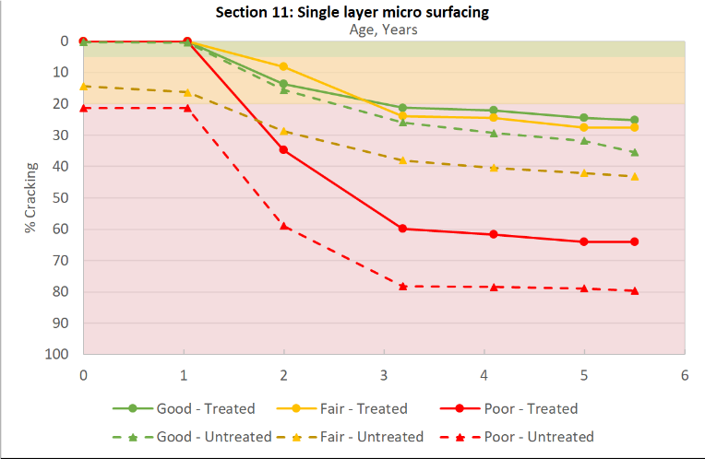
Benefits = f(Pretreatment Condition)
MAP-21 Cracking
Green = “Good” (< 5%)
Yellow = “Fair” (5% ≤ 20%)
Red = “Poor” (> 20%)
Notes:
As of April 2016

Slide 19
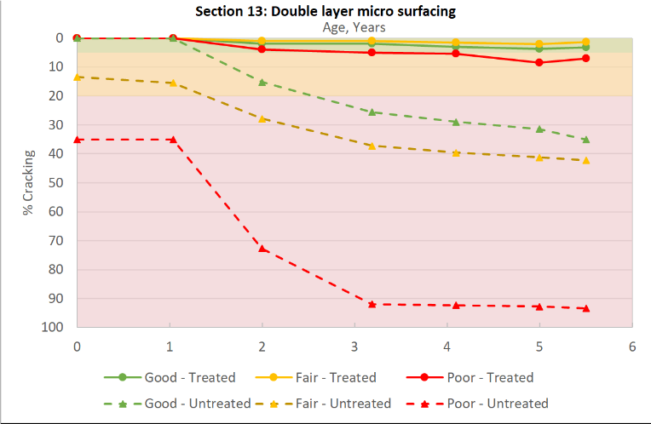
Benefits = f(Pretreatment Condition)
MAP-21 Cracking
Green = “Good” (< 5%)
Yellow = “Fair” (5% ≤ 20%)
Red = “Poor” (> 20%)
Notes:
As of April 2016

Slide 20
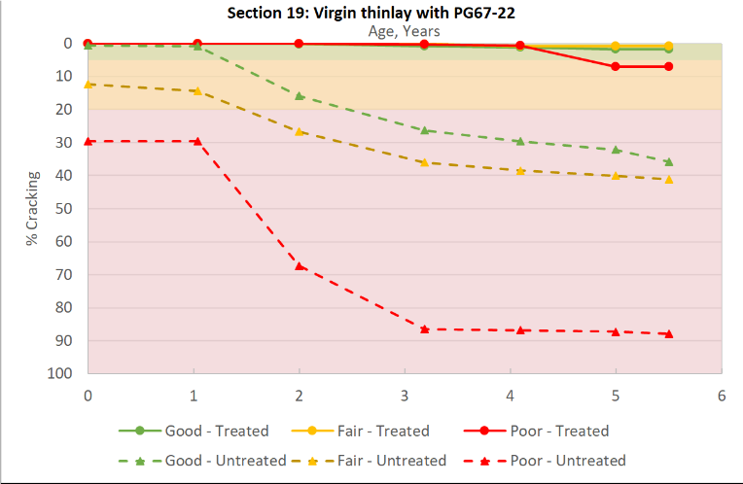
Benefits = f(Pretreatment Condition)
MAP-21 Cracking
Green = “Good” (< 5%)
Yellow = “Fair” (5% ≤ 20%)
Red = “Poor” (> 20%)
Notes:
As of April 2016

Slide 21
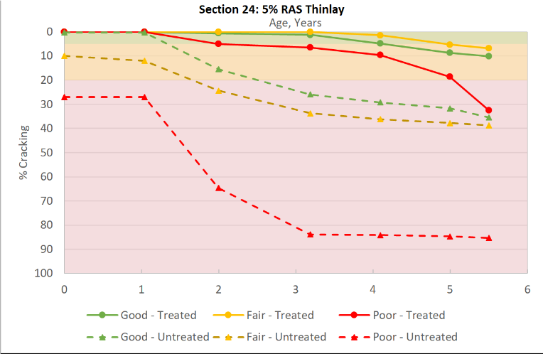
Benefits = f(Pretreatment Condition)
MAP-21 Cracking
Green = “Good” (< 5%)
Yellow = “Fair” (5% ≤ 20%)
Red = “Poor” (> 20%)
Notes:
As of April 2016

Slide 22
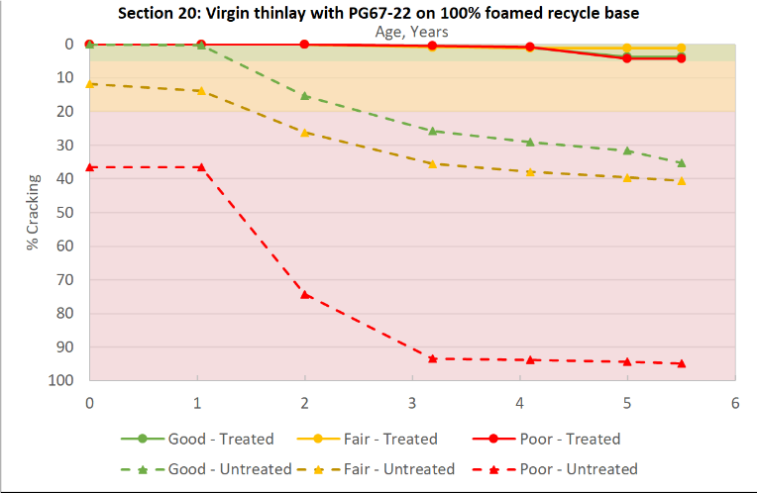
Benefits = f(Pretreatment Condition)
MAP-21 Cracking
Green = “Good” (< 5%)
Yellow = “Fair” (5% ≤ 20%)
Red = “Poor” (> 20%)
Notes:
As of April 2016

Slide 23
Summary
Value of good materials, designs, construction, inspection
Life extending_{x} & condition improving_{y} preservation benefits
Measured reduction in subgrade moisture contents
Similar trends in south vs north, low vs high traffic sections
Planning underway for 2019 northern CR, FDR sections
Anticipate long term data collection for many years to come
Support for state agency decision process implementation
20 US state DOTs now supporting pooled fund, more likely.

Slide 24
2018 Pavement Research Partnership
$100k/year for Cracking Group (CG)
  Alabama DOT Lead
  Traffic continuation at MnROAD₈ and NCAT₈
  Design, QC, unaged, aged array of test results
  Support for implementation of suitable test(s)
$50k/year for Preservation Group (PG)
  Minnesota DOT Lead
  Data collection, management, analysis
  Life extending & condition improving benefits
  Specifications, best practices, testing protocols

Slide 25
Test Track Sponsor Meeting
September 25-27, 2018
Minneapolis Minnesota
Review of MnROAD and NCAT Findings
Tour of MnROAD / PG Sections near Milaca
Focus on Implementation Products
  Best way to customize for agencies use
  Specifications, best practices, testing protocols, ….

Slide 26














































Thank You

