Slide 1

MTU MIST Results
Zhanping You
Michigan Technological University
May 24, 2018

Slide 2
Test Procedures
Compaction Process
  Pre-heat samples at a temperature of 5 °C lower than the compaction temperature for 2 hours
  Quarter the samples
  Place the samples in the oven for 1 hour to reach the compaction temperature
  Molds are in the other oven at a temperature of 5 °C higher than the compaction temperature
  Compact sample to design height, 63.5mm

Slide 3
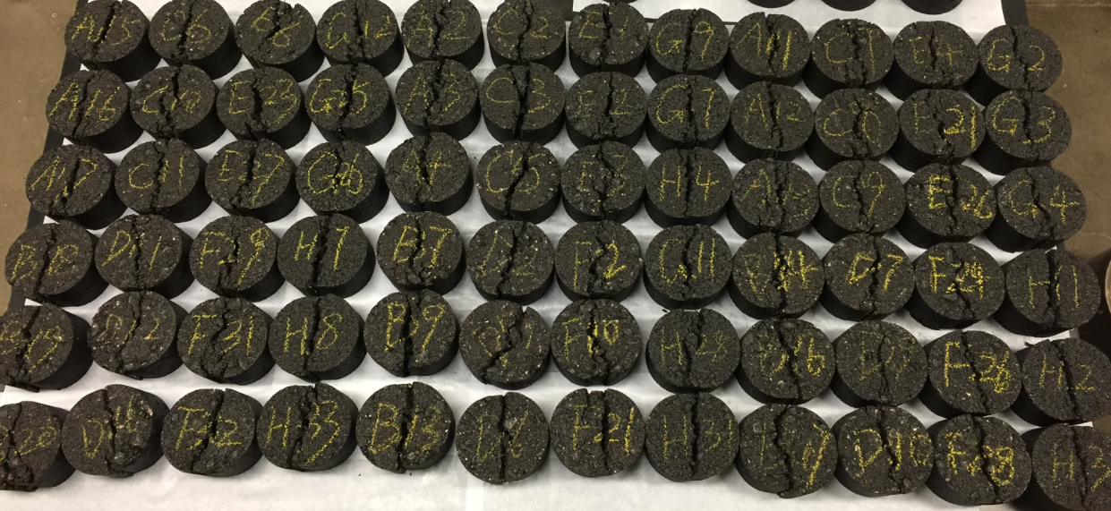
Test Procedures
Gmb tests (AASHTO T166)
MIST tests (ASTM D7870, at 55 °C, 40 psi)
  3 samples under 500 cycles
  3 samples under 3500 cycles
IDT tests (AASHTO T283)

Slide 4
TSR Results

Slide 5
TSR Results
TSR values of most of the mixes over 0.80
Mix SPWEB340C has a low TSR value of 0.55
Mix SPWEB440E may be moisture susceptible
Mix SPWED430I and mix SPWED440E have high TSR values of greater than 1

Slide 6
Discussion
Mixs SPWED430I and SPWED440E
  Difficult to obtain required air voids percent
  Anti-stripping agent
MIST difference between 500 cycles and 3500 cycles

