Slide 1


North Dakota Testimonial
Amy Beise, P.E.
NDDOT Materials & Research
May 23, 2019
Notes:
Good Morning. My name is Amy Beise. I lead the research and pavement design efforts for the North Dakota Department of Transportation. North Dakota is on of the recent state to join the NRRA and I would like to share a little bit about why we joined and the benefits that we see.

Slide 2
Why did North Dakota Join?
Notes:
The short answer is because we want to.

Slide 3
LEARN
IMPLEMENT
EVOLVE
Notes:
More specifically we want to learn, we want to evolve, and we want to implement better solutions.
This was the theme from the North Dakota asphalt conference this year.

Slide 4
LEARN

Slide 5

LEARN
State of the Practice
Notes:
What is the common means of doing business. What are other NRRA state agency and associate members doing? How does it compare to North Dakota.
Short term research: Longitudinal joints and tack coats.

Slide 6
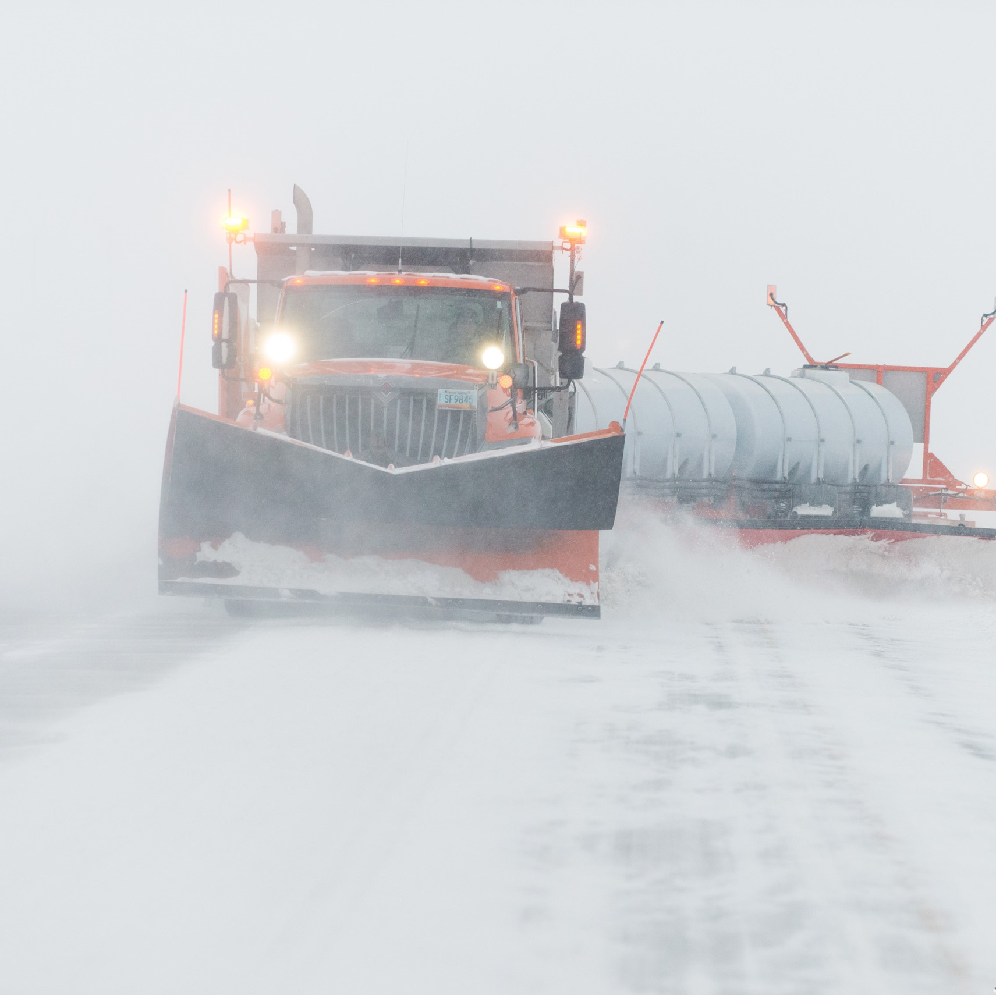
LEARN
Shared Challenges
Notes:
What challenges are other NRRA state agency members facing and how are they addressing challenges.
North Dakota Challenges: ND is a fairly large state by size but small by population. Extreme seasonal climactic changes. Winters are very long and construction seasons are relatively short.
Materials limitations: Build our roads to fit the environment.

Slide 7
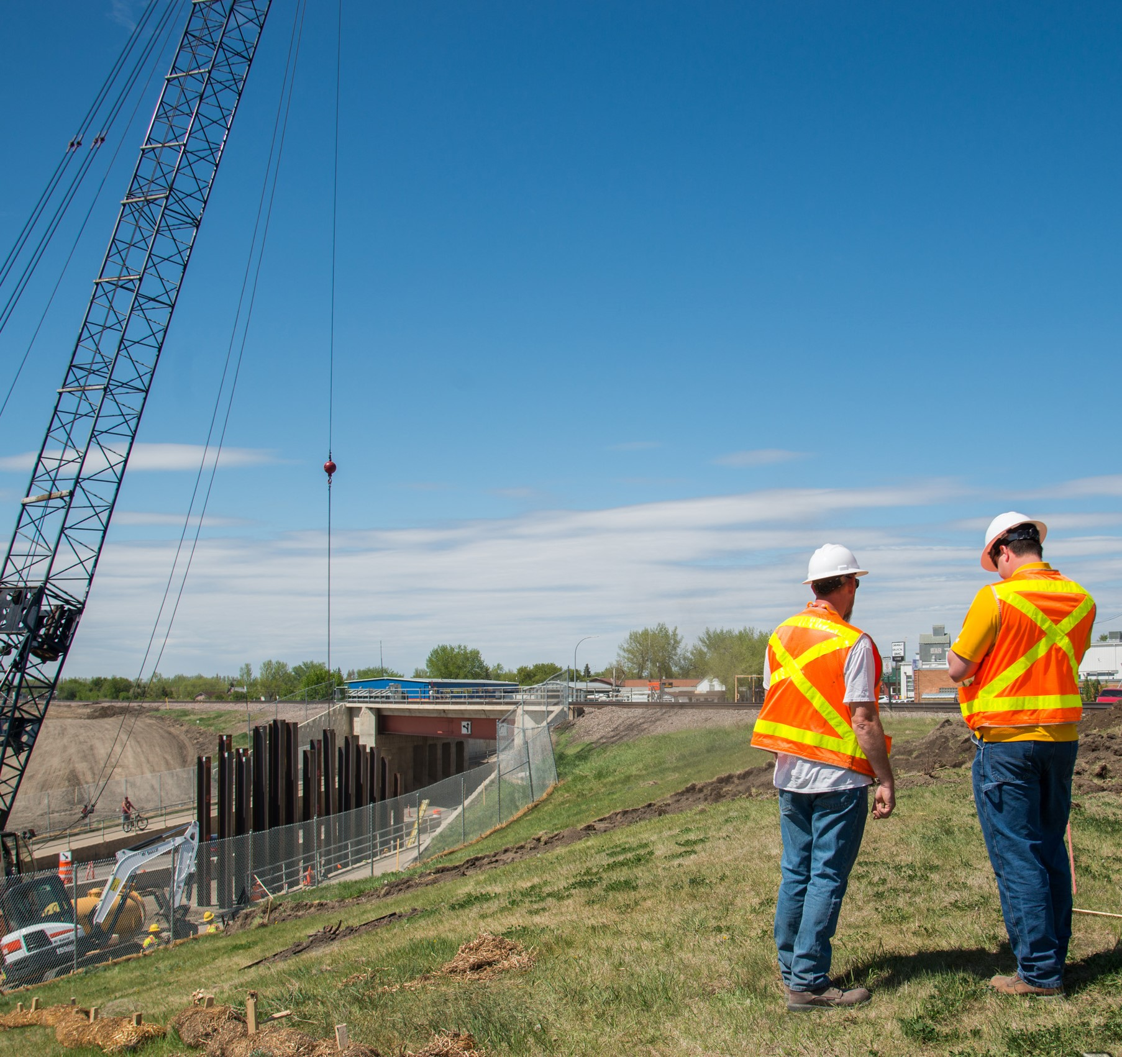
LEARN
Create Connections
Notes:
More than a pooled fund study. A network of people and resources. Contacts are different than connections.
Opportunity to get several people involved.

Slide 8
LEARN
Receiving
Information
Contributing
Notes:
Both learning and contributing is important. Good ideas don’t happen in a vacuum. Good ideas build off one another. Which leads me to my next point.

Slide 9
EVOLVE

Slide 10
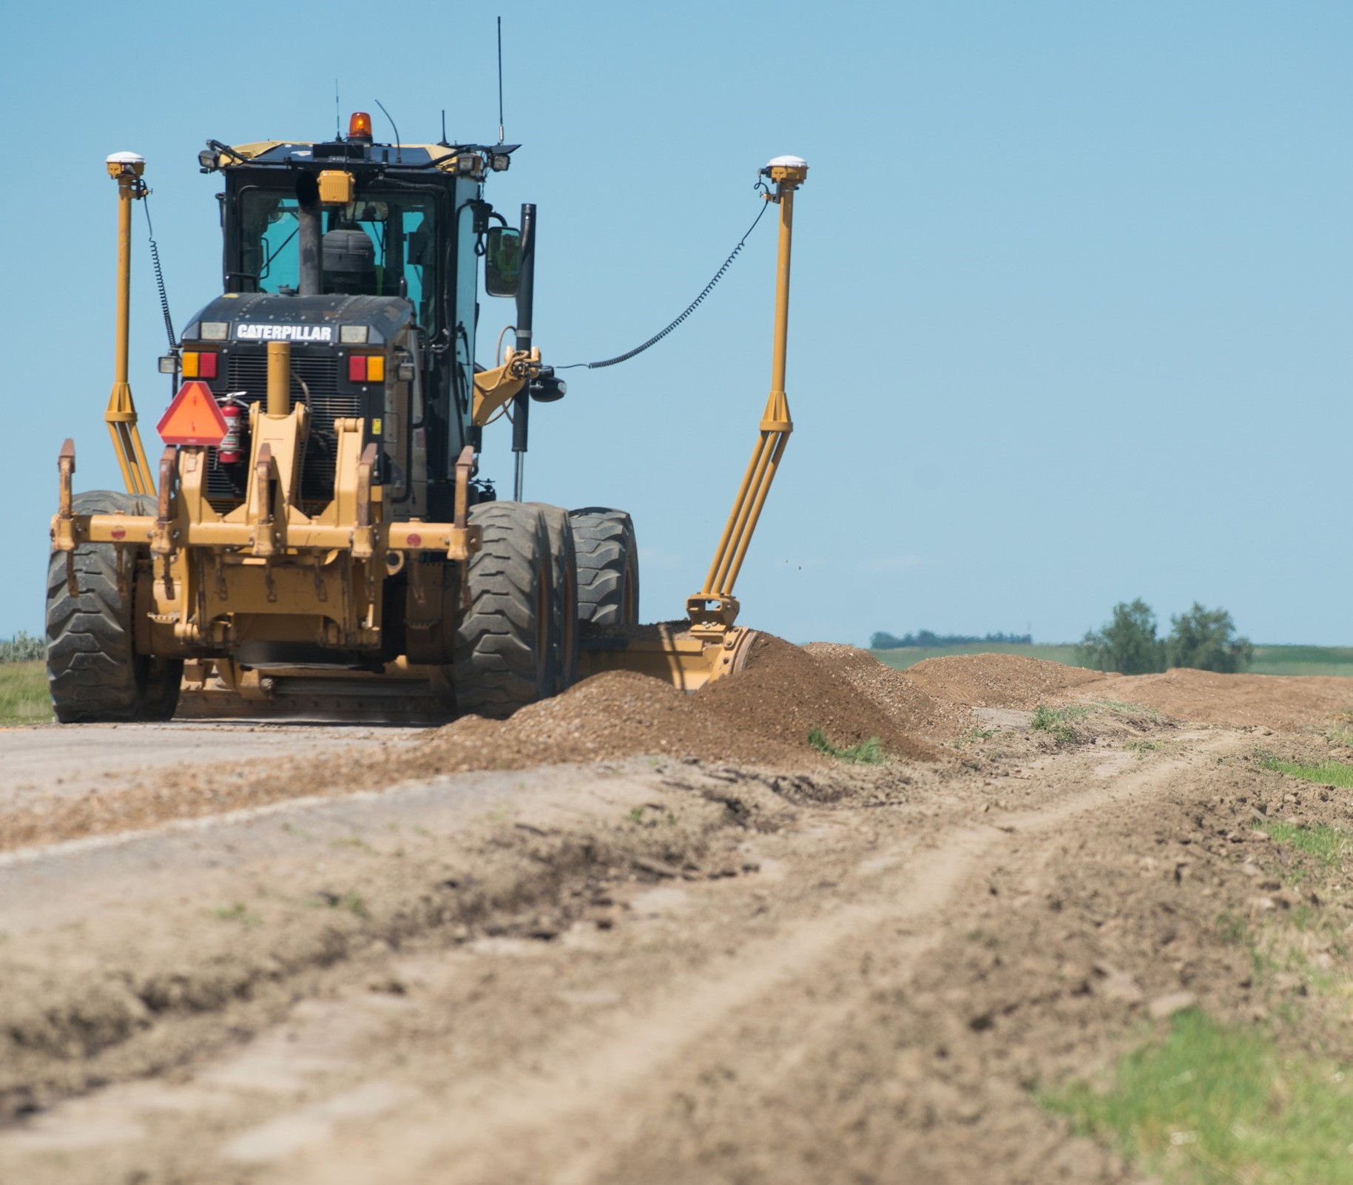
EVOLVE
Users
&
Needs
Notes:
Transportation as a whole is ever evolving and we need to adapt. Evolution can make the ways we previously have done things inefficient or even obsolete.

Slide 11
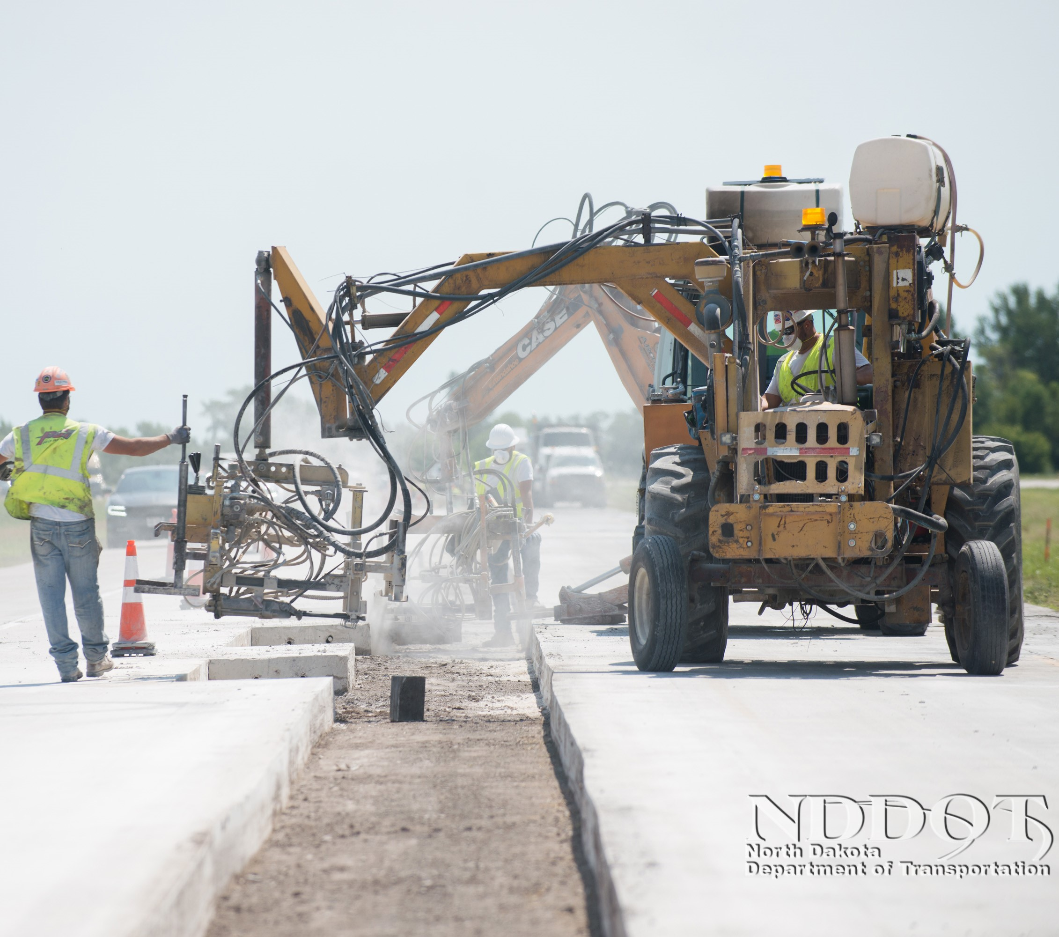
EVOLVE
New Solutions
vs
Prescriptive Fixes
Notes:
Current practices and specifications can be blinding
Prescriptive Fixes

Slide 12
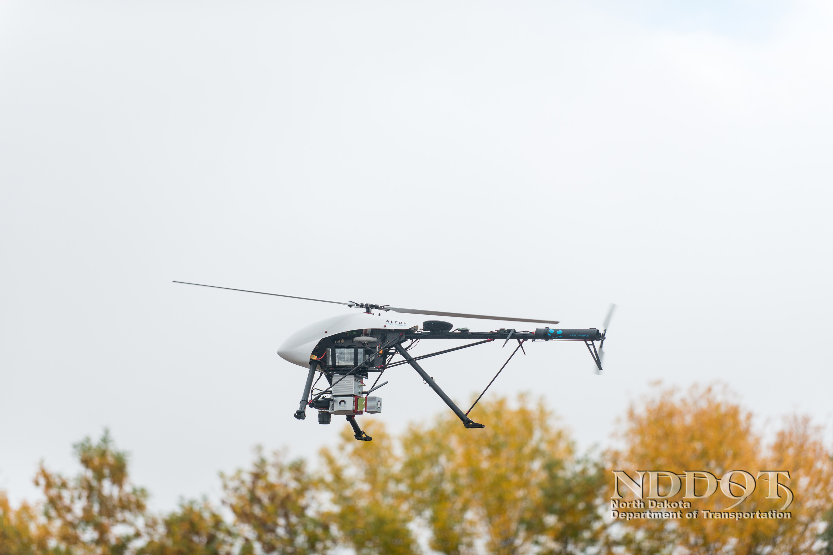
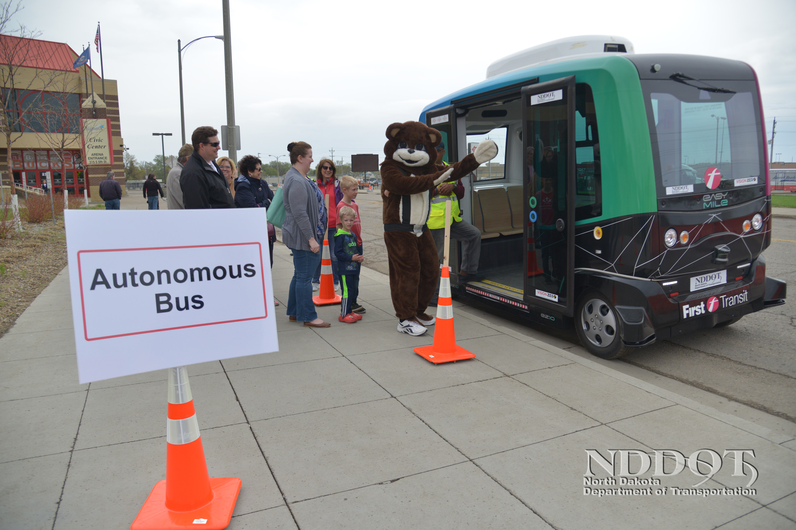
EVOLVE
Emerging Technology
Notes:
We want to learn to embrace emerging technology and leverage it in our favor.

Slide 13
IMPLEMENT
Notes:
Implementation is an outcome of learning and evolving.

Slide 14
IMPLEMENT
Implementation takes Initiative
Notes:
This is one of North Dakota’s initiatives to work towards implementable cost saving solutions.

Slide 15
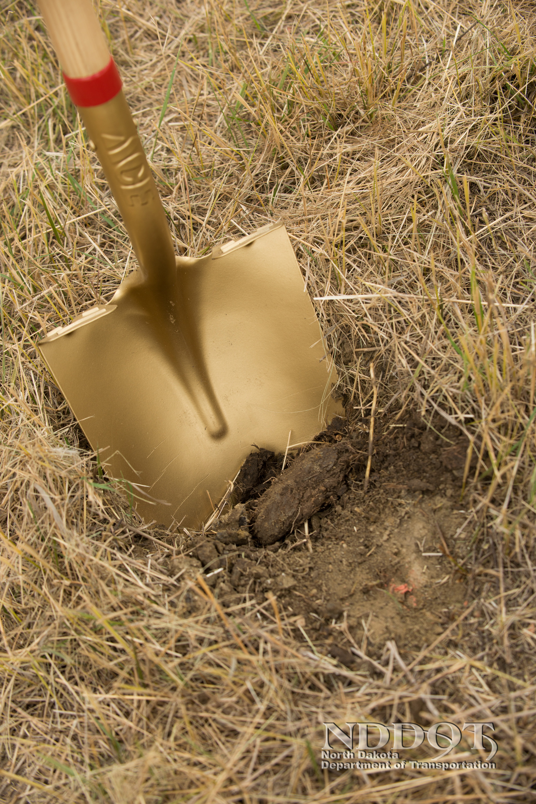
IMPLEMENT
Implementation Strategies
Notes:
Where do you start.

Slide 16
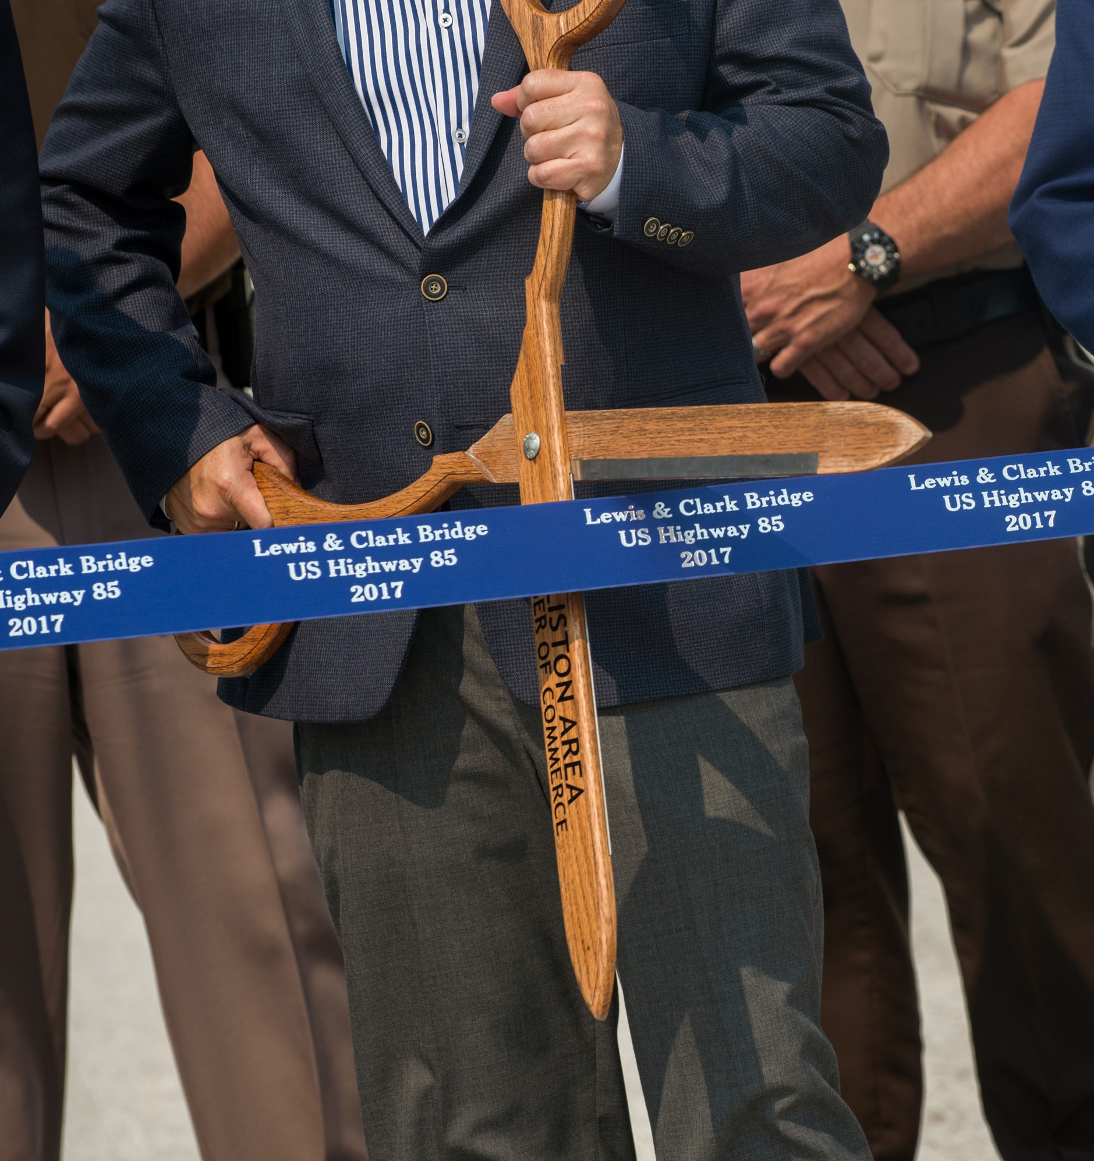
IMPLEMENT
Implementation Success Stories
Notes:
Successful pilot projects drive innovation.
Very helpful in risk adverse environments.

Slide 17
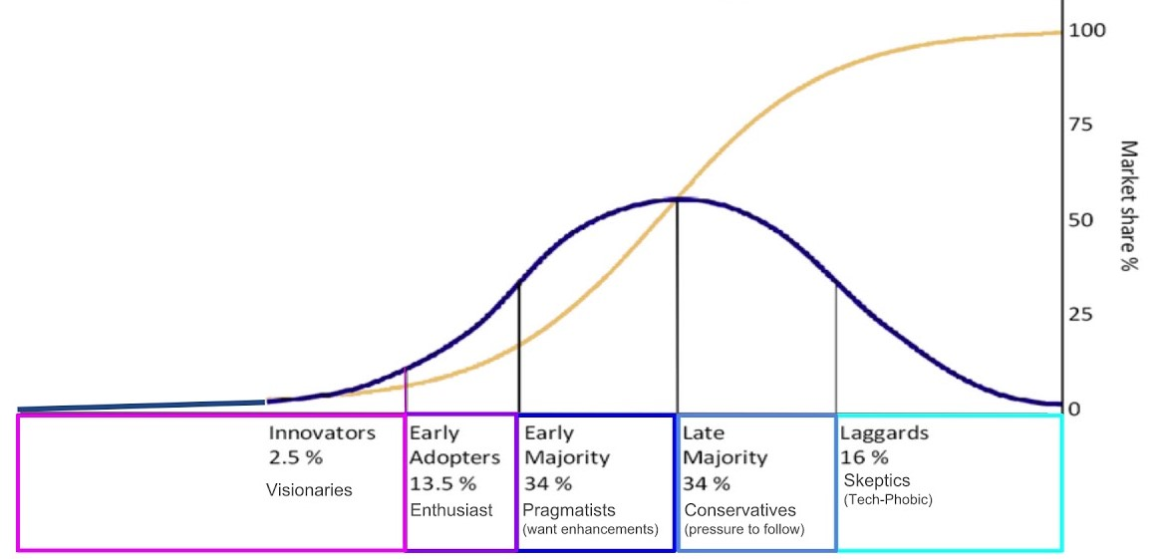
IMPLEMENT
Early
Majority
34%
Late
Majority
16%
Early
Adapters
13.5%
Innovators
2.5%
Laggards
16%
Notes:
Timing of implementation is everything.
We want to implement because we want to and not because we are forced to.
We want to take the initiative to learn and evolve so that we can get the max benefit of what we are implementing.

Slide 18
LEARN
IMPLEMENT
New Solutions
Emerging Technologies
User Needs
State of Practice
Shared Challenges
Create Connections
Strategies
Successes Stories
Timing
EVOLVE

Slide 19
BENEFITS

Slide 20
BENEFITS
Quality & Economical Research

Slide 21
BENEFITS
Network of People and Resources

Slide 22

Thank You
Amy Beise, P.E.
NDDOT Materials & Research
abeise@nd.gov
701-328-6921

