Slide 1
2019 NRRA Preventive
Pavement Workshop
Evaluation of Rejuvenators and Surface Sealing Products in Missouri

Slide 2
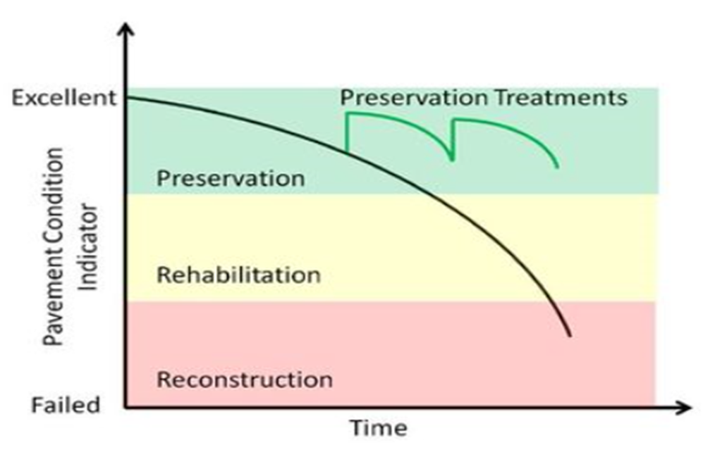
MoDOT Direction
2006 MoDOT Funding In
Preservation Mode
  Asset Management Plan
  Keeping Treatments on a Routine Cycle
Limited Rehabilitation & Reconstruction

Slide 3
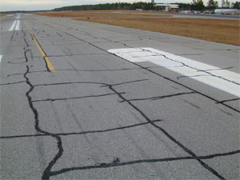
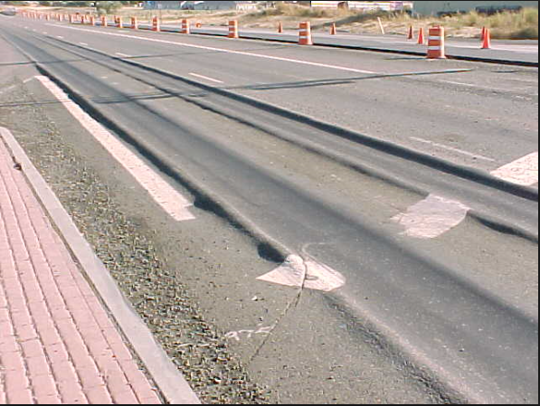
Primary Failure Modes for Asphalt
RAP & RAS
Cracking
Rutting

Slide 4
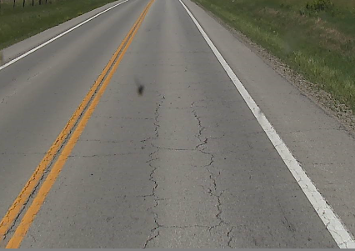
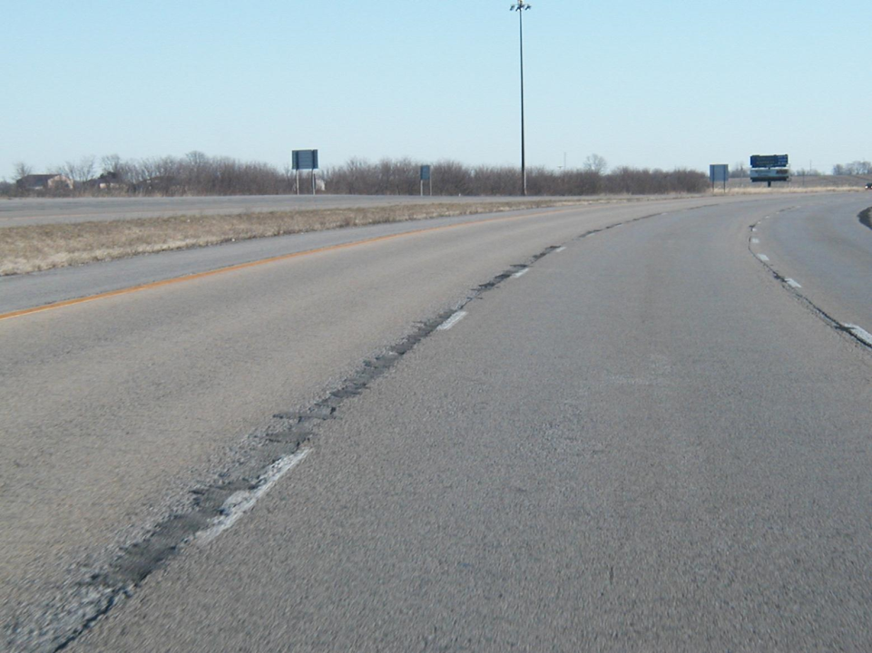
Why Rejuvenators and Sealers?
Many miles of pavement that is relatively new, smooth, and rut resistant…just cracked or joint deterioration!

Slide 5
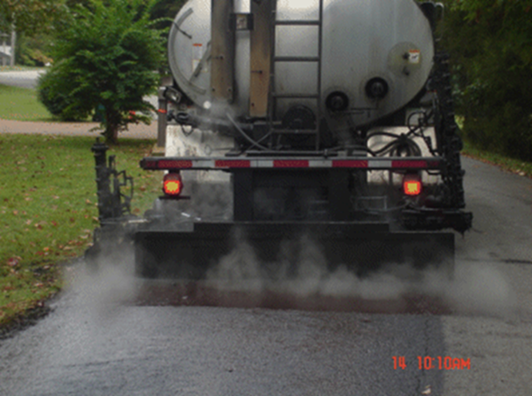
Need for Inexpensive Treatments
Spray on Applications that are:
  Inexpensive – Less than $1.50 yd²
  Maintains Friction
  Open to competition with different suppliers and applicators
  Effective – Actually work – reduces the amount and severity of block cracking and joint deterioration

Slide 6
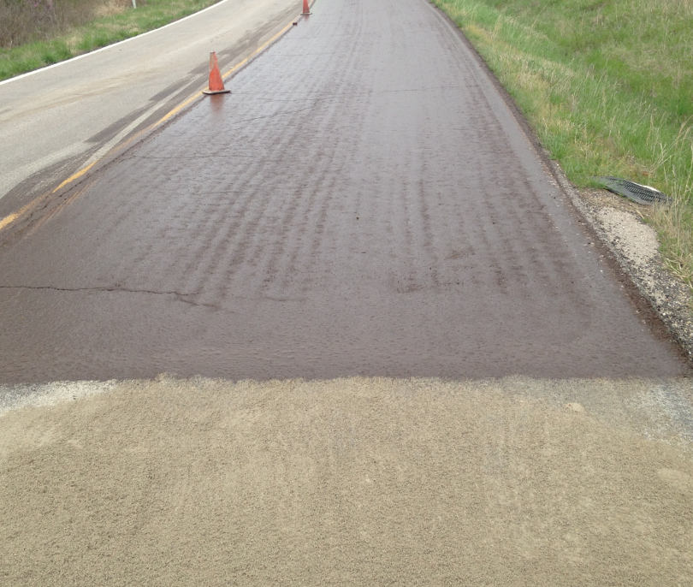
MoDOT Experiences Since 2014
Onyx® – Mastic Sealer
CRF® – Maltene-based Rejuvenator

Slide 7

Pains of Proprietary Products™
Everyone has a product that works better than the rest!
State Agency restrictions from using proprietary products.
Very difficult to prove or disprove effectiveness.
A need for a performance specification that only allows the effective products.

Slide 8


RoadLock® I, II, & III
J-Band®
ANOVA 1815®
GSB Friction Seal®
RPE®
Biorestor®
Onyx®
Rhyno-Tite®
CRF®
Replay®
MSS-P®
Fiberlock®
Reclamite®
Jointbond®
RavelCheck®
LCJ-100®

Slide 9

MoDOT Research – TR201720
Evaluation of Rejuvenators and Surface Sealing Products to Extend Asphalt Pavement Life
Contract To:
Applied Research Associates, Inc.

Slide 10
Spray-On
Product Types
Rejuvenators
Penetrating Petroleum Based
Soy-Based/Polymer
Sealers
Non-Penetrating Petroleum Based

Slide 11
Research Goals
Evaluate the performance of all the different products to extend the life of an asphalt pavement in two categories.
  Mainline Treatments
  Longitudinal Joints
Identify appropriate testing procedures.
Provide a performance based specification.

Slide 12
Product Treatment Objectives
Extending the pavement’s life (Mainline & Joints)
  Improving rheological properties of the mix or binder
  Decreasing the permeability of the pavement
  Reduce the amount and severity of cracking or joint deterioration
Maintain Pavement Integrity (Mainline Only)
  Maintain Friction and Durability

Slide 13
Mainline Testing Plan
Evaluation of existing roadway conditions
  Product layout and set-up monitoring areas
  Pavement coring and field sampling
  Field permeability testing
  Electronic distress survey, pavement rating, and video/photos
  Friction testing
Testing repeated @ 4 time intervals post application: 30 days, 6 mo., 1 year, and 2 years.

Slide 14
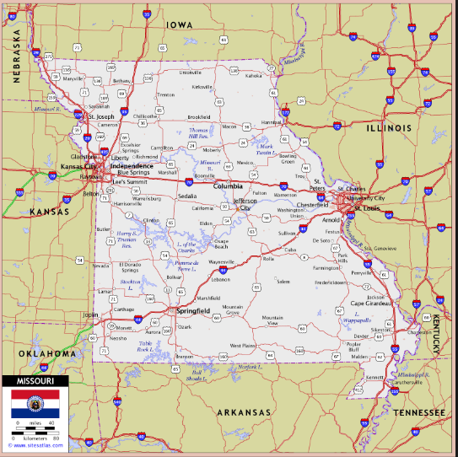
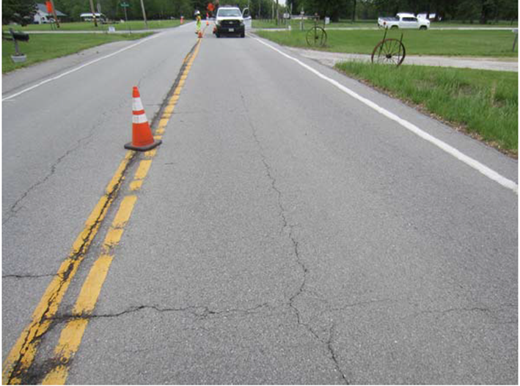
Missouri Site Location for Mainline
Route N_St. Charles County
  2-Lane Roadway; ADT = 4,500
  Surface Type - 1 ¾” BP-1 (2014)
  Avg. Thickness = 9.25”

Slide 15
Route N – Layout of Test Sections
13 Test Sections – 11 Products & 2 Control Sections
  8 Successful Products Applied
  2 Products had Equipment Issues
  1 Product Cancellation
Test Section Layout
  Randomly Selected
  700 feet in Length w/ 150 feet between sections

Slide 16
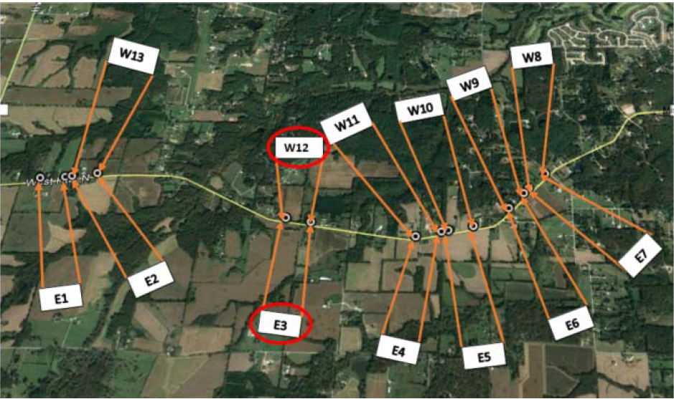

Slide 17
Test Section | Product Name | Material Supplier
E1 | Biorestor Asphalt Rejuvenator | Asphalt Systems Ohio
E2 | RavelCheck | Unique Paving Materials
E3 | Control Section
E4 | Reclamite Maltene Rejuvenator | Corrective Asphalt Materials
E5 | Untreated: Equipment Issues
E6 | CRF Maltene Seal | Corrective Asphalt Materials
E7 | Untreated: Equipment Issues
W8 | Onyx | Hutchens Construction
W9 | RoadLock I | BlackRoads Materials
W10 | GSB – Friction Seal | Asphalt Systems, Inc.
W11 | MSS-P | BlackRoads Materials
W12 | Control Section
W13 | Untreated: Cancellation

Slide 18
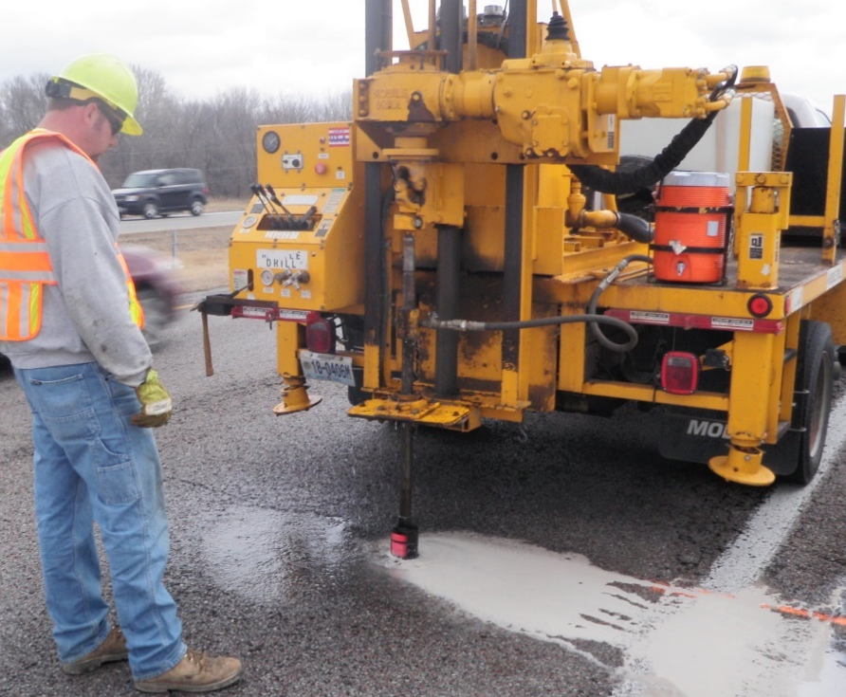
Route N – Mainline Pavement Coring
Six 6-in diameter cores taken per section (~80 cores)
  Binder properties before and 1-yr after application.
Testing | Test Method
PG Grade | AASHTO M320
Asphalt Content | AASTHO T164
DSR | AASHTO T 315
Multiple Stress Creep Recovery | AASHTO T 350
Note: Penetration and Viscosity (Kinematic and Saybolt Furol) test methods were not pursued.

Slide 19
RTE N – AC Extraction Binder Properties – ¾” from top surface
ID | Asphalt Characteristics Before Product Application
 | % AC Content | RTFO Grade º C (G*Sinƍ >2.2 kPa) | BBR Grade º C | Jnr (3.2 kPa) | MSCR Grade
E1 | 4.4 % | 82.9 | -21.44 | 0.2 | 64 – 22 E
E2 | 4.6 % | 85.6 | -18.60 | 0.1
E3 | 5.4 % | 85.7 | -18.07 | 0.1
E4 | 4.5 % | 85.8 | -17.57 | 0.1
E5 | 5.0 % | 85.0 | -14.50 | 0.2
E6 | 4.4 % | 87.5 | -16.83 | 0.1
E7 | 4.4 % | 86.2 | -18.11 | 0.1
E8 | 4.6 % | 81.8 | -19.95 | 0.2
W9 | 7.6 % | 83.4 | -19.30 | 0.2
W10 | 5.6 % | 82.3 | -17.80 | 0.3
W11 | 4.2 % | 84.2 | -19.50 | 0.2
W12 | 4.9 % | 85.4 | -17.61 | 0.2
W13 | 5.5 % | 87.2 | -17.90 | 0.1

Slide 20
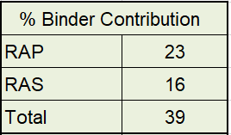
Rte N – Mix Design w/ Typical RAP/RAS Incorporation
2014 BP-1 Mix Composition
Min. Aggregate | 95.1 %
Virgin Asphalt | 3.2 %
Total AC w/ RAP & Shingles | 4.9 %

Slide 21
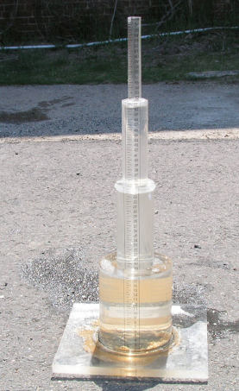
Route N Field Permeability Tests
Keeping Hot Mix Asphalt Impermeable
  Minimize moisture infiltration
  Increase in-situ density
Internal Spec - MoDOT TM 83
Conducted @ time zero (prior to treatment), 30-days, 6 months, 1 year, and 2 year intervals

Slide 22
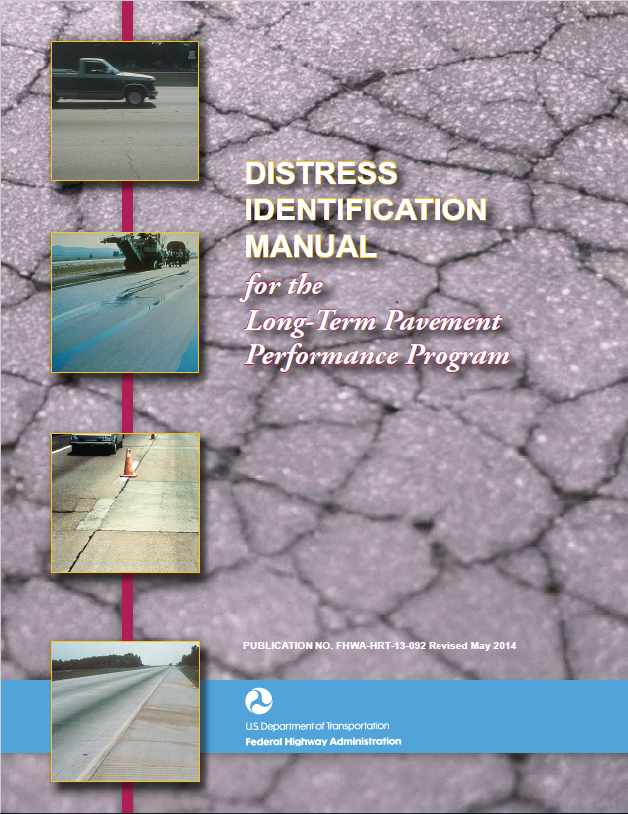
Route N Mainline Visual Surveys
Electronic Distress Surveys
Photos and Video Footage
Condition Index (~PASER)
Conducted @ time zero (prior to treatment), 30-days, 6 months, 1 year, and 2 year intervals

Slide 23
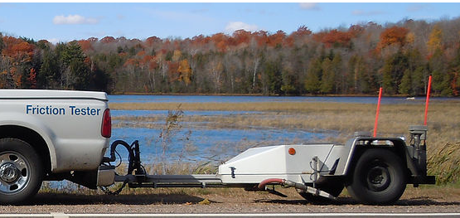
Route N Mainline Friction Testing
Maintaining frictional properties paramount!
  ASTM E274 – FN 40R
  One friction test per 200 feet (~ 3 tests per section)
  Testing results are provided as a comparison only.
Conducted @ time zero (prior to treatment), 30-days, 6 months, 1 year, and 2 year intervals

Slide 24

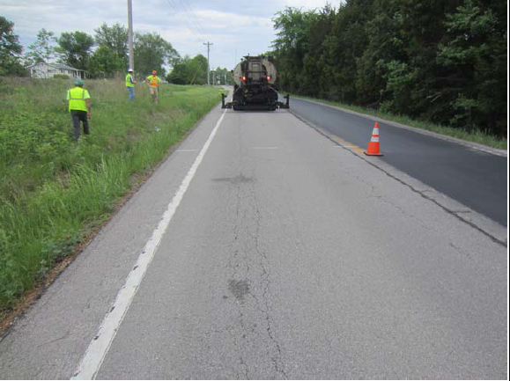
Rte N – Existing Conditions
Existing surface was 4 years old
  Minor block cracking and longitudinal cracking present
  Initial distress surveys are completed; but not compiled

Slide 25
Rte N – Construction of Test Sections
Application Rate – For product comparisons
Sampling of 1 gallon container for lab testing
Documenting construction processes
  One pass vs two pass operations
  Blotter material used
  Traffic issues or anomalies

Slide 26
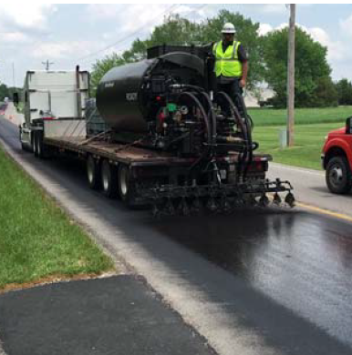
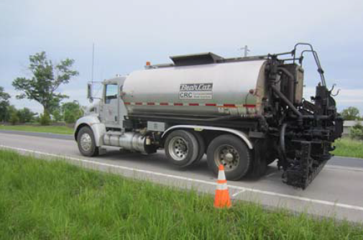
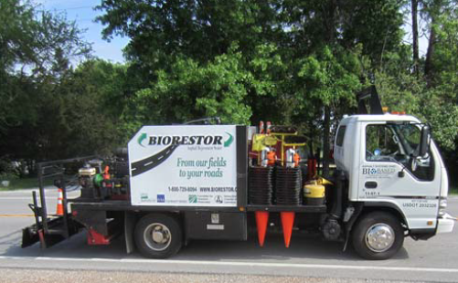
Rte N – Equipment Types

Slide 27
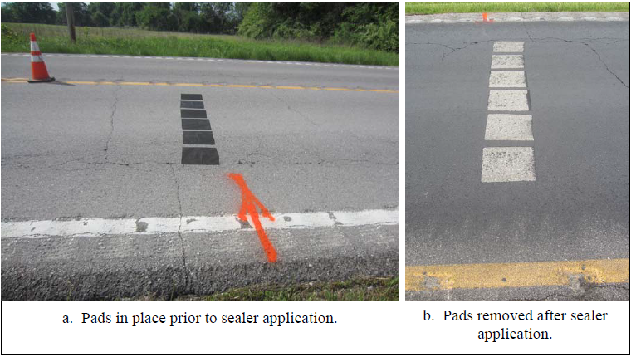
Rte N – Residual Application Rates

Slide 28
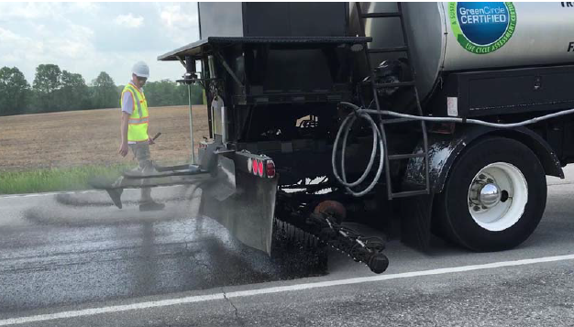
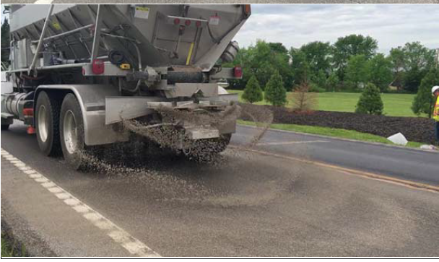
Rte N – Blotter Material
Sieve Size | % Passing
3/8” | 100
No. 4 | 99
No. 8 | 61-69
#16 | 28-36
#30 | 11-19
#50 | 5-11
#100 | 5-9
#200 | 4-8

Slide 29
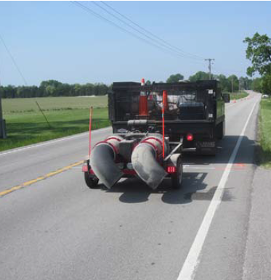
Rte N – Surface Prep
Surface was swept by MoDOT maintenance prior to product applications.
One contractor chose to further clean the pavement.

Slide 30
Rte N – Construction of Test Sections
ID | Product Name | Residual Application Rate (gal/yd2) | No. of Passes | Blotter Material | Visually Filled Cracks?
E1 | Biorestor Asphalt Rejuvenator | 0.01 | 1 | None | No
E2 | RavelCheck | 0.04 | 1 | None | Yes
E4 | Reclamite Maltene Rejuvenator | 0.02 | 1 | Yes | Yes
E6 | CRF Maltene Seal | 0.08 | 1 | Yes | Yes
W8 | Onyx | 0.12 | 1 | None | Yes
W9 | RoadLock I | 0.07 | 2 | None | Yes
W10 | GSB – Friction Seal | 0.16 | 1 | Yes | Partial
W11 | MSS-P | 0.08 | 2 | None | Yes

Slide 31
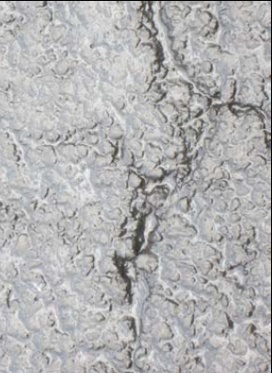
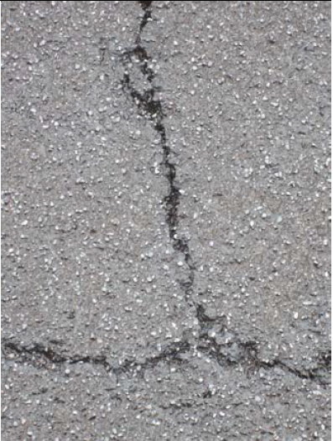
Rte N – Construction of Test Sections
Visually filled cracks
Visually unfilled cracks

Slide 32

Rte N – Permeability Results
Existing Pavement was already impermeable
  Permeability results on existing pavement were already less than 0.5 ft/day; which makes the test method inadequate for comparison.
  1-month permeability was inconclusive.
  1-year and 2-year permeability may be
  conducted.

Slide 33
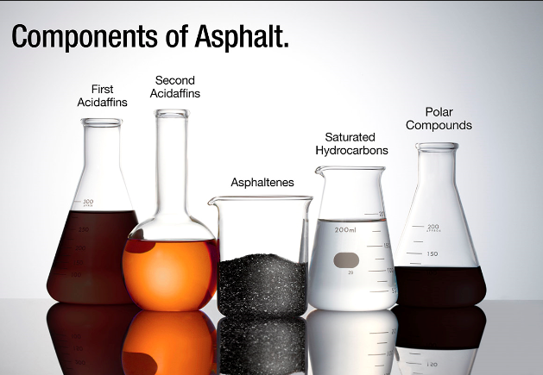
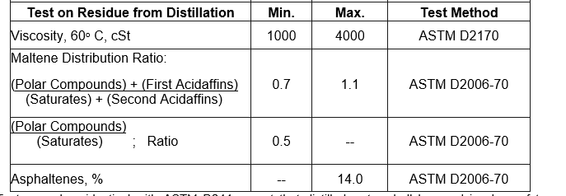
Route N – Chemical Components
  Asphaltenes – Insoluble in n-pentane. Bodying agent. “The heavy stuff”
  Maltenes - Soluble and highly reactive materials. “The good stuff”

Slide 34
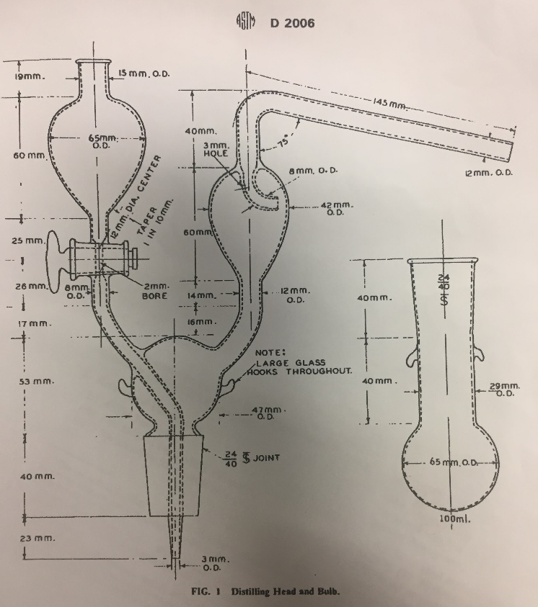
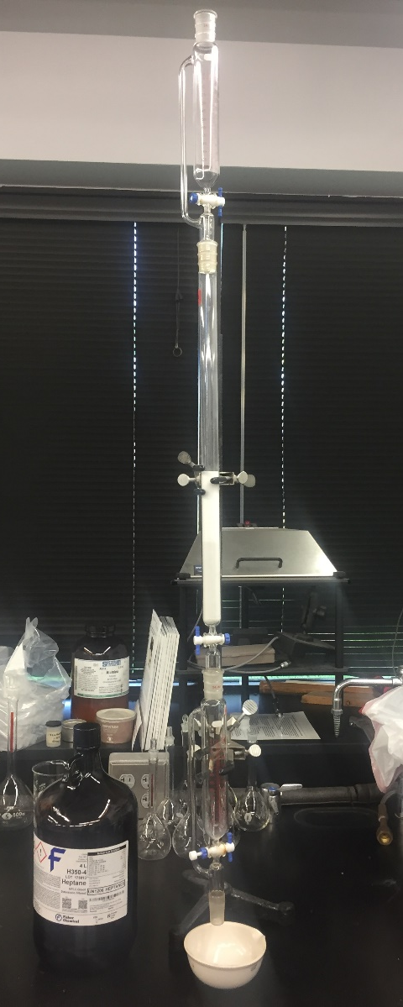
Modified ASTM D2006 – Determination of Chemical Components in Asphalt and non-Asphalt Rejuvenators
  Allows us to check individual asphalt components
  Relationship between components and performance- TBD

Slide 35

ID | Product | Asphalt-enes % | Polar Comp. | First Acidaffins | Second Acidaffins | Saturates | MDR Ratio | PC/S Ratio
E1 | Biorestor | < 0.1 | 89.8 | 10.2 (Combined) |  | N/A | N/A | N/A
E2 | RavelCheck | 23.0 | 42.0 | 2.1 | 20.3 | 12.2 | 1.4 | 3.4
E4 | Reclamite Maltene Rejuvenator | 1.8 | 27.2 | 4.1 | 31.4 | 19.9 | 1.4 | 5.2
E6 | CRF Maltene Seal | 0.24 | 36.0 | 11.4 | 32.6 | 19.9 | 0.9 | 1.8
W8 | Onyx | 34.9 | 33.9 | 5.0 | 17.7 | 8.5 | 1.5 | 4.0
W9 | RoadLock I | 33.6 | 36.0 | 10.4 | 18.2 | 7.4 | 1.8 | 4.9
W10 | GSB – Friction Seal | 16.7 | 49.0 | 2.5 | 22.3 | 9.6 | 1.6 | 5.1
W11 | MSS-P | 36.1 | 35.7 | 2.6 | 18.0 | 7.7 | 1.5 | 4.7

Slide 36
Route N – Friction Results
ID | Product | 7- Day % Decrease | 2-month % Decrease
E1 | Biorestor Asphalt Rejuvenator | -17.2 | -2.9
E2 | RavelCheck | -47.5 | -27.5
E4 | Reclamite Maltene Rejuvenator | -13.2 | -2.0
E6 | CRF Maltene Seal | -16.1 | -23.6
W8 | Onyx | -30.6 | -27.5
W9 | RoadLock I | -60.5 | -48.5
W10 | GSB – Friction Seal | -7.9 | +2.7
W11 | MSS-P | -56.2 | -43.1
E3, W12 | Control Sections | -0.9 and -3.6 | +5.4 and +1.1
E5, E7, & W13 | Products Not Placed | -3.6, -2.0, +1.4 | -3.0, -4.2, +5.8

Slide 37
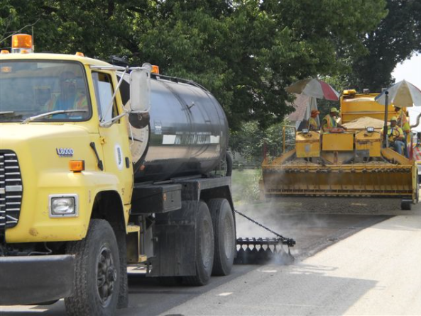
RoadLock I and MSS-P – Unacceptable Friction Loss
All products in the Westbound lane were chip sealed by an overzealous maintenance crew.
W8 – Onyx and W10 – GSB Friction Seal test sections were also covered during the chip sealing process.

Slide 38




Expressions of losing the entire westbound test sections

Slide 39
Route N – 1 year Findings
Friction loss varies between products
  Low, Moderate, and High friction loss were encountered
Permeability testing was inadequate to determine product’s ability to densify/seal the surface.
Distress survey results – To be determined
Extracted asphalt properties vs Performance
– To be determined

Slide 40
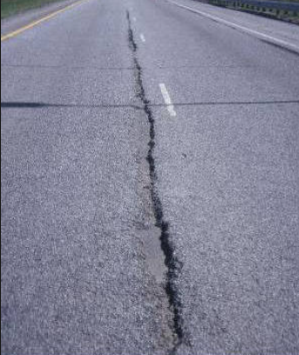
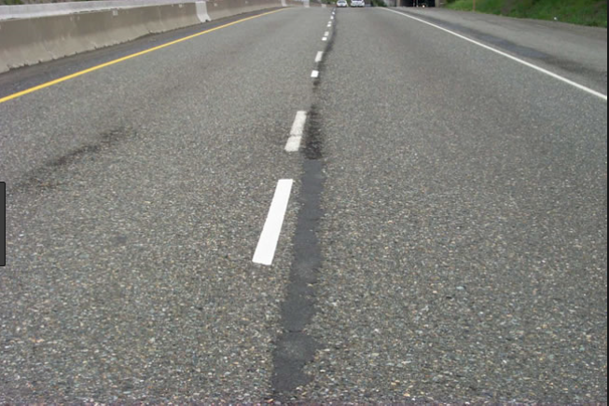
Longitudinal Joints Issues
Low density issues at construction joints
Find a cost effective treatment to fix joint ravelling

Slide 41
Route 30 and Route 52
Longitudinal Joint Test Sections
Long. Joint – Route 30_Jefferson
  4-Lane Roadway; ADT = 12,000
  Surface Type - 1 ¼” SP095 (2012)
Long. Joint – Route 52_Morgan
  2-Lane Roadway; ADT = 4,300
  Surface Type - 1 ¾” SP125 (2017)

Slide 42
Centerline Joint Testing Plan
Evaluation of existing roadway conditions
  Product layout and set-up monitoring areas
  Field permeability testing
  Modified electronic distress survey and video/photos
  Field sampling for laboratory testing
  Paint stripe retro-reflectivity
All testing repeated @ 4 time intervals post application for comparisons.

Slide 43
Rte 30 & 52 – Layout of Test Sections
11 Total Test Sections – 7 Different Products & 2 Control Sections
  5 products applied on Route 52
  4 products applied on Route 30
Test Section Layout
  Randomly Selected
  700 feet in Length w/ 150 feet between sections

Slide 44
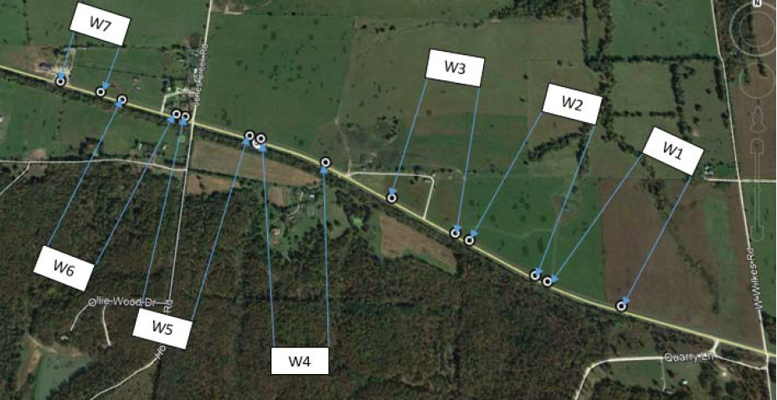
Rte 52
Morgan County
Test Section | Product Name | Material Supplier
W1 | Biorestor Asphalt Rejuvenator | Asphalt Systems Ohio
W2 | LCJ 100 | Black Roads
W3 | Ravel Check | Unique Paving Materials
W4 | Weather Issues – Invalid Tet Section
W5 | RPE | Asphalt Materials, Inc.
W6 | Control
W7 | Joint Bond | Corrective Asphalt Materials

Slide 45
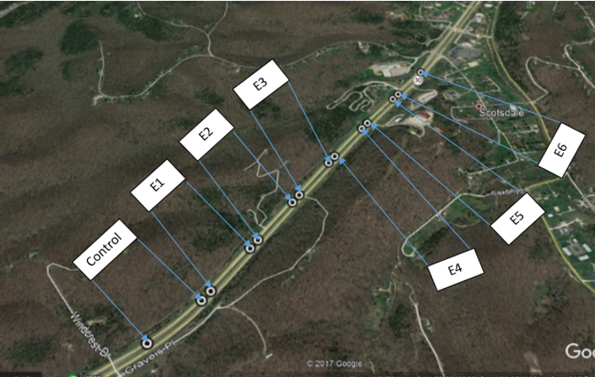
Rte 30
Jefferson County
Test Section | Product Name | Material Supplier
Control | Control
E1 | Biorestor | Asphalt Systems Ohio
E2 | Ravelcheck | Unique Paving Materials
E3 | CRF Maltene Seal | Corrective Asphalt Materials
E4 | RPE | Asphalt Materials, Inc.
E5 | No Product Applied
E6 | No Product Applied

Slide 46
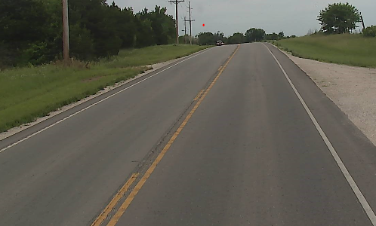
Rte 52 – Existing Conditions
Placed in 2017 w/ typical joint condition

Slide 47
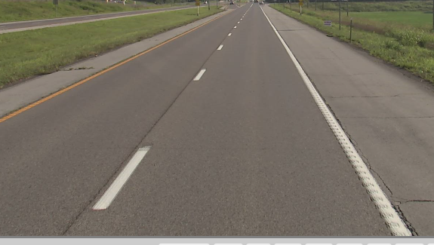
Rte 30 – Existing Conditions
Placed in 2012 with good joint construction

Slide 48
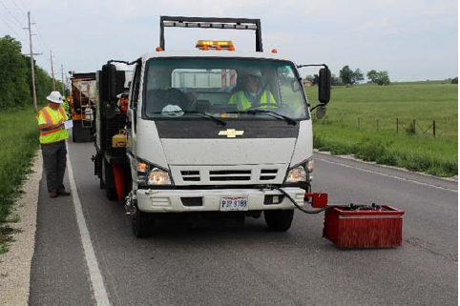
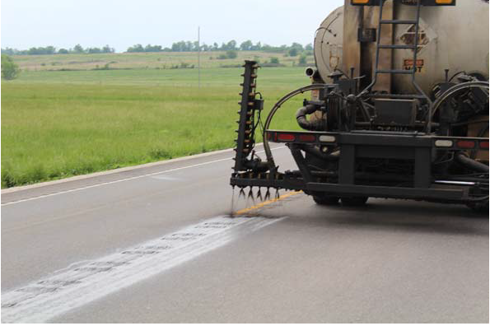
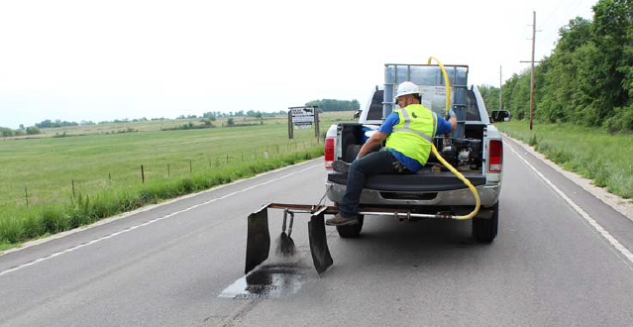
Different Application Methods

Slide 49
Rte 52– Construction of Test Sections
ID | Product Name | Field Application Rates (gal/yd2) | Visual - Fill/Seal Crack
W1 | Biorestor Asphalt Rejuvenator | 0.04 | Not filled/Not sealed
W2 | LCJ 100 | 0.13 | Partially filled/Not sealed
W3 | Ravel Check | 0.10 | Partially filled/Not sealed
W4 | Weather Issues – Invalid Tet Section and Moved to W7
W5 | RPE | 0.15 | Partially filled/Not sealed
W6 | Control
W7 | Joint Bond | 0.12 | Partially filled/Not sealed

Slide 50
Rte 30 – Construction of Test Sections
ID | Product Name | Residual Application Rates (gal/yd2)
E1 | Biorestor | 0.01
E2 | Ravelcheck | 0.04
E3 | CRF Maltene Seal | 0.11
E4 | RPE | 0.04

Slide 51
Rte 52 – Chemical Properties
ID | Product | Asphalt-enes % | Polar Comp. | First Acidaffins | Second Acidaffins | Saturates | MDR Ratio | PC/S Ratio
W1 | Biorestor Asphalt | < 0.1 | 92.5 | 7.4 (Combined) |  | N/A | N/A | N/A
W2 | LCJ 100 | 37.1 | 35.3 | 0.91 | 19.9 | 6.8 | 1.4 | 5.2
W3 | Ravel Check | 21.9 | 40.5 | 3.2 | 22.7 | 11.6 | 1.3 | 3.5
W5 | RPE | 13.4 | 41.8 | 9.9 | 22.6 | 12.3 | 1.5 | 3.4
W7 | Joint Bond | 2.0 | 22.9 | 12.6 | 41.3 | 21.1 | 0.6 | 1.1

Slide 52
Route 52 – Permeability Results
ID | Product | Permeability Prior to Appl. (ft/day) | Permeability; 30 days after (ft/day)
W1 | Biorestor | 1.8 | 1.6
W2 | LCJ 100 | 0.7 | 0.3
W3 | Ravel Check | 2.3 | 0.4
W5 | RPE | 1.6 | 1.0
W7 | Joint Bond | 0.1 | 0.2
Control |  | 0.45 | 0.40

Slide 53
Route 30 & 52 – Retro-reflectivity

Slide 54
Route 52 – 1 year Findings
Permeability testing was inadequate to determine product’s ability to densify/seal the surface.
Retro-reflectivity results are a bust
Distress survey results – To be determined
Product components vs Performance
– To be determined

Slide 55
Interim Summary and Conclusions
Successfully modified ASTM D2006-70 to determine individual chemical components of asphalt and non-asphalt rejuvenators.
Field Permeability testing by MoDOT TM-83 was inadequate in determining sealing/densification of the asphalt surface.
More friction loss was shown with surface sealing products compared to rejuvenator products.

Slide 56
Future Considerations
Incorporating rejuvenators within new asphalt mixtures should be a higher priority in lieu of spray on applications.
Spray on rejuvenator/sealer products should be considered in combination PM treatments.

Slide 57
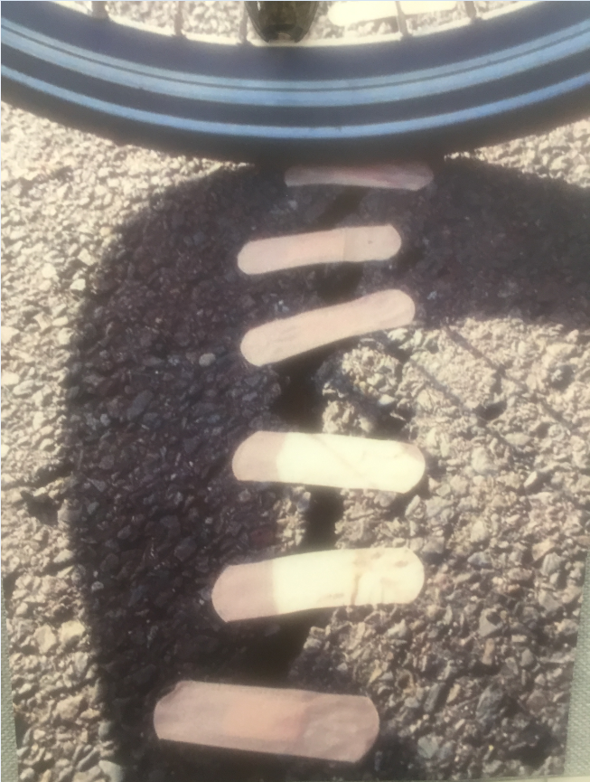
Questions?

