Slide 1
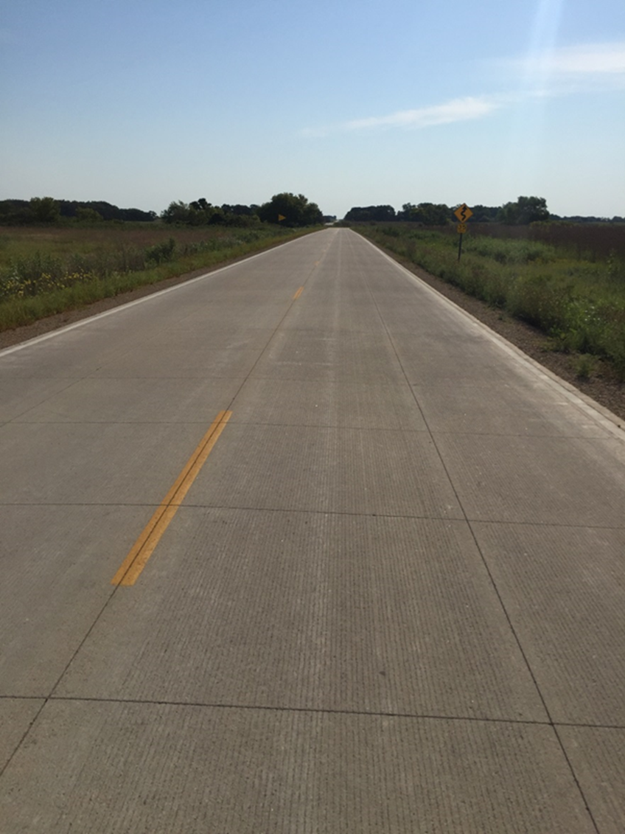

Performance of Whitetopping in Minnesota
Tom Burnham, P.E. | Senior Road Research Engineer
NRRA Pavement Workshop, St. Paul, MN
5/23/2019

Slide 2
Outline
BCOA (Whitetopping) Study
  Objectives
  Field condition surveys
  Performance curves
  Impact of design features
  Life prediction model
Recent findings

Slide 3
Acknowledgements
BCOA project
  Coauthors: Bernard Izevbekhai, Chago Huerta, Joseph Gallagher
  American Engineering Testing
  MnDOT, Q3, and County Traffic Control Forces
  MnDOT Concrete and Pavement Management Units
  Tim Andersen - Technical Liaison
  TAP members

Slide 4
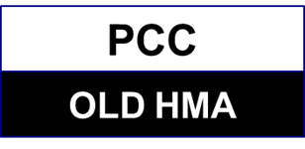
Whitetopping Study Objectives
Review performance in Minnesota
Develop performance curves for MnDOT Pavement Management System
Identify best practices for design, construction, and maintenance in Minnesota

Slide 5
Study Approach
Gather performance data on BCOA projects in Minnesota
Develop performance curve for each project
Identify impact of design features on performance
Develop performance prediction models
Identify best practices

Slide 6
Literature Search
  Louisiana (10+ years)
    4” thick, 4’x4’ panels
    2+ mm faulting after 8 years
    Steady decline in performance over time
Source: Chen, X. 2014

Slide 7
Literature Search
  Illinois (2-14 years)
    Crack counts and FWD testing
    Longitudinal cracking and faulting in large panels
    Slab migration
    Benefits from use of fiber-reinforced concrete
Source: King and Roesler, 2014

Slide 8
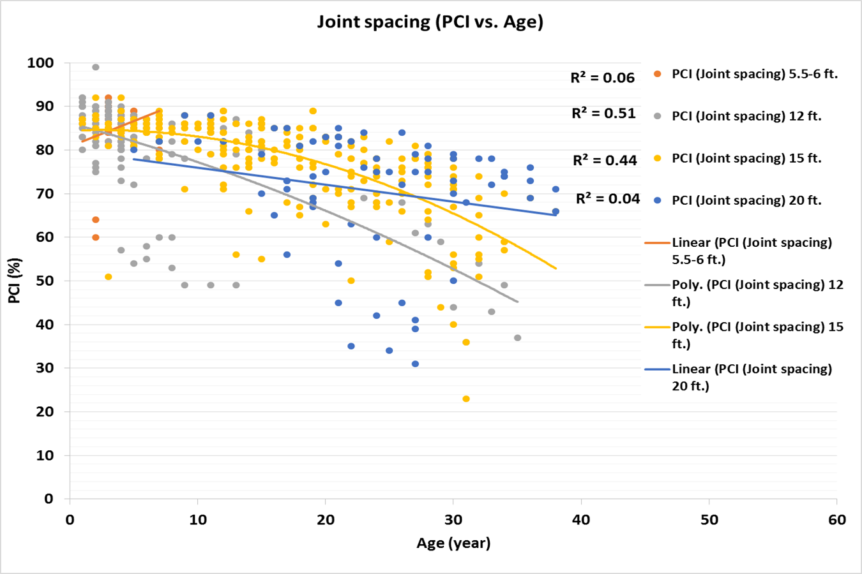
Literature Search
  Iowa (< 10 years of data for short panels)
    Performance measure = PCI
    Less than 40 faulted joints/mile
      Considered low severity joint faulting between 0.12 and 0.24 in (3 and 6 mm)
Source: Gross et al, 2017

Slide 9
Database of Minnesota Projects
26 Large scale projects (built before 2015)
  MnDOT
    TH30 (1993)
    TH212 (2009)
    I-35 (2009)
    TH56 (2010)
    TH24 (2014)
  County
    20 projects (2009-2014)
21 MnROAD test sections
    Test cells (1997-2013)

Slide 10
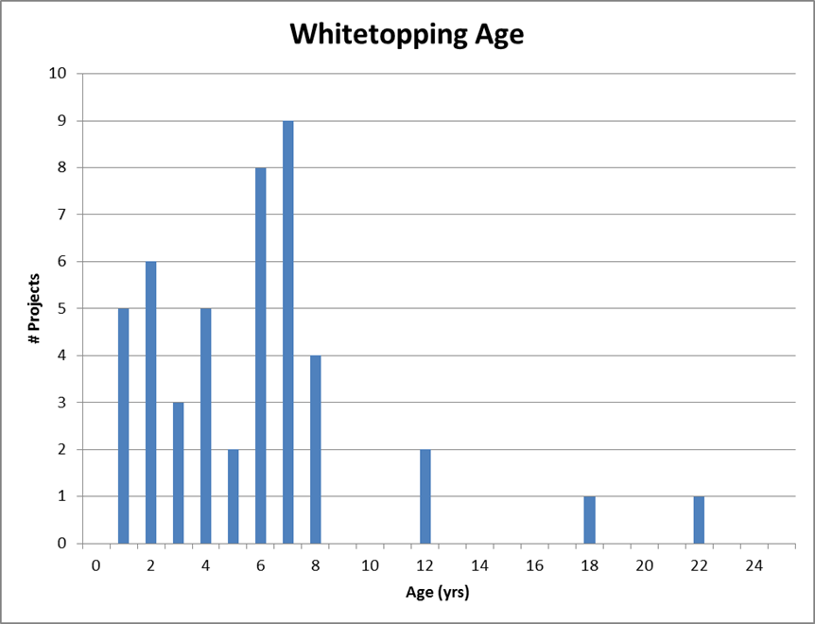
Project Population (pre 2015)
(includes MnROAD sections)

Slide 11
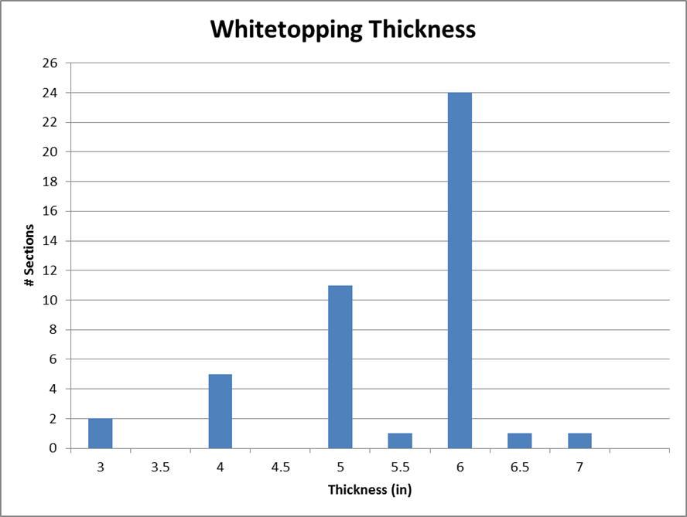
Project Population (pre 2015)
(includes MnROAD sections)

Slide 12
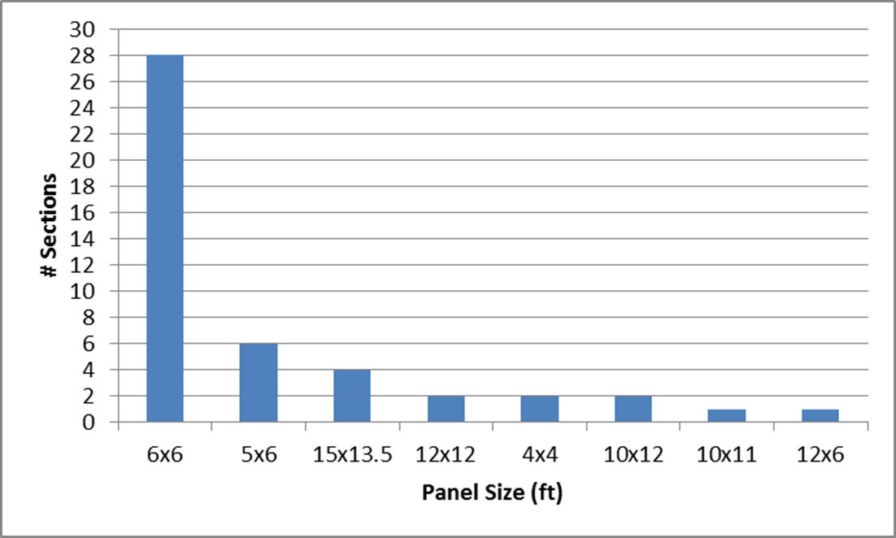
Project Population (pre 2015)
(includes MnROAD sections)

Slide 13
Project Population (pre 2015)
Other design details
  Remaining asphalt thickness from 3” to 14”
  20.5 of 46 projects with unsealed joints
  No network projects with structural fibers
    MnROAD FRC BCOA Cells 160-162 (2013)

Slide 14
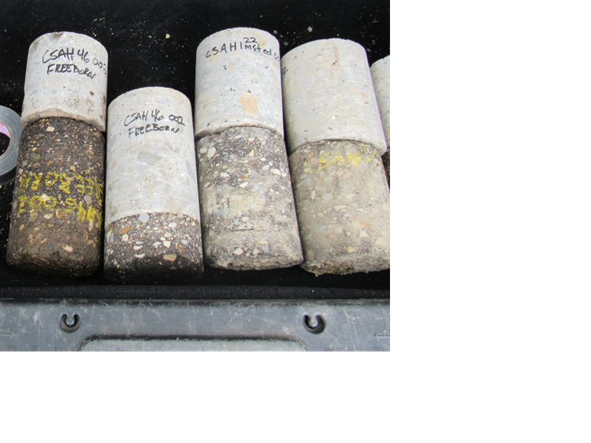
Field Condition Surveys
2015: GPR for thickness variation
2015: 3 core samples from each project
  Assess bond quality
  GPR thickness calibration
  HMA assessment (also used in project selection study)
2015-2018: Visual distress surveys
  Crack counts and characterization
  Photographs
2015-2018: Fault measurements
2015-2018: Ride quality profiles (IRI)

Slide 15
Field Condition Summaries

Slide 16
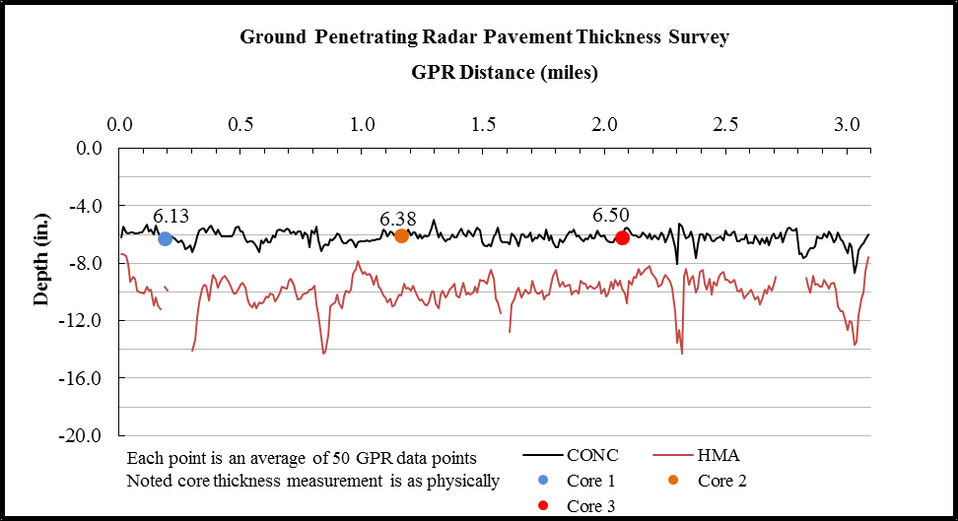
Field Condition Summaries

Slide 17
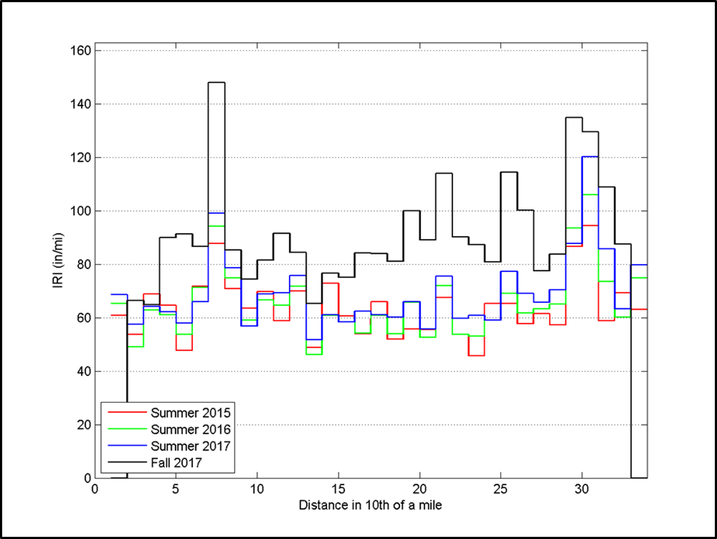
Field Condition Summaries

Slide 18
Field Observations
Most projects are in good to very good condition
  Most less than 10 years old
  Some longitudinal cracking
  Very few transverse reflective cracks
    I-35 cracked early, but has stabilized (no repairs)
Little to no maintenance on most projects
  Typically repairs of construction errors
  Repairs on CSAH 46 - partial dowels in OWP only

Slide 19
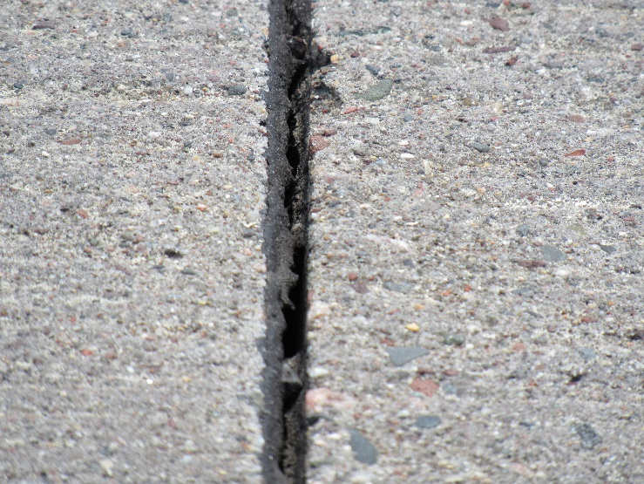
Field Survey Observations
Faulted transverse joints on projects with heavy traffic volumes/loads
  Matching overlay joints to underlying HMA cracks
    Early faulting caused by full-depth vertical movement
  TH22 Olmsted County project: Significant faulting in 5 years
    Retrofit dowels and diamond grind
With shorter joint spacing, not all joints deploy early
  Dominant joints form ~ 60 ft
Joint seals (hot-pour asphalt)
  Often breeched in < 2 years
  Lack of seals can lead to buckling

Slide 20
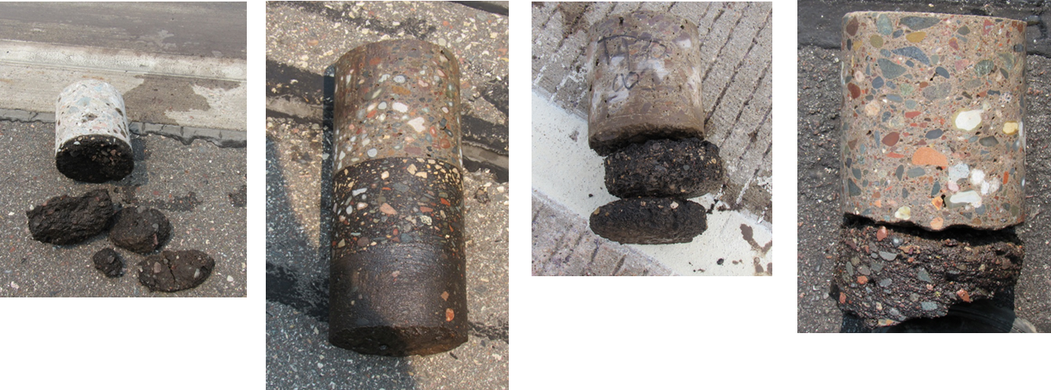
Core Sample Observations
Revealed various bonding and asphalt conditions
Bond affected by age, location in panel
Bond fails first near joints (typically < 5 years)

Slide 21
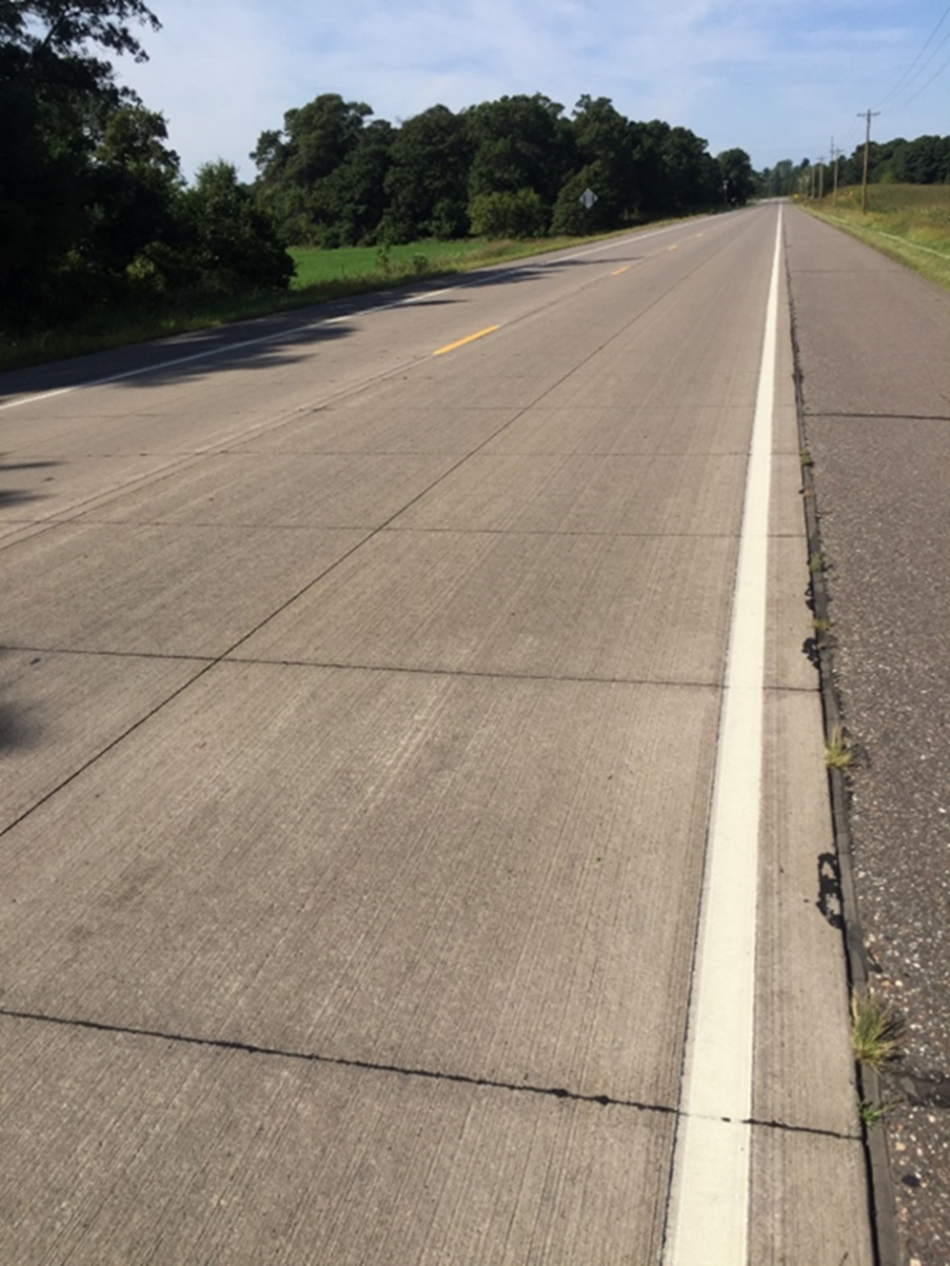
Field Observations
CSAH 18 – Andover, Anoka County (2011)
2017 Conditions
% panels cracked | < 1
Average IRI (in/mi) | 59
Average Faulting (mm) | 0.5
@ age 5 years
6” thick, 6’x6’/6’x7’ panels

Slide 22
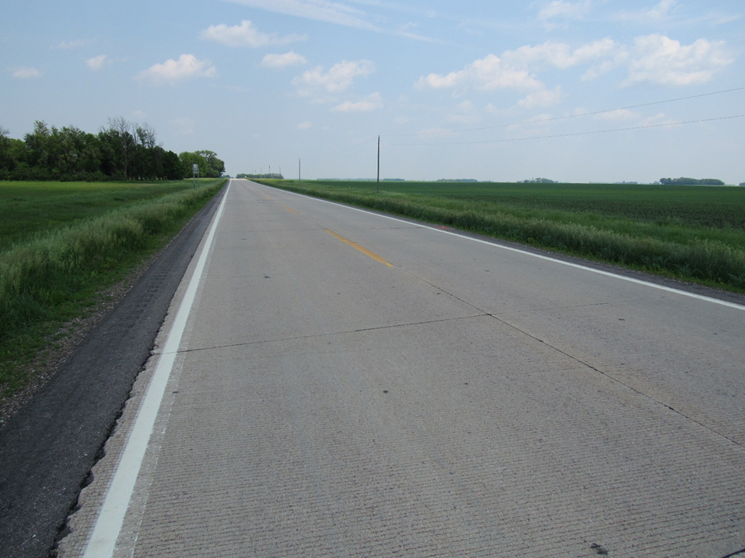
Field Observations
TH 30 – Amboy, MnDOT D-7 (1993)
2017 Conditions
% panels cracked | N/A
Average IRI (in/mi) | 128
Average Faulting (mm) | N/A
Update: 2019 Avg Faulting = 2.5 mm
Max = 6.2 mm
@ age 22 years
6” thick, 12’x12’ panels, skewed joints

Slide 23
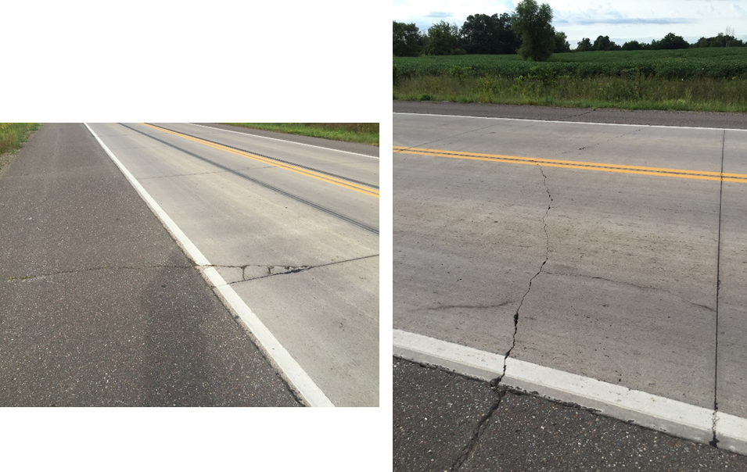
Field Observations
CSAH 9 – Harris, Chisago County (2010)
2017 Conditions
% panels cracked | 17
Average IRI (in/mi) | 76
Average Faulting (mm) | 0.70
@ age 6 years
7” thick, 15’L x 14’W panels, 3 dowels OWP

Slide 24
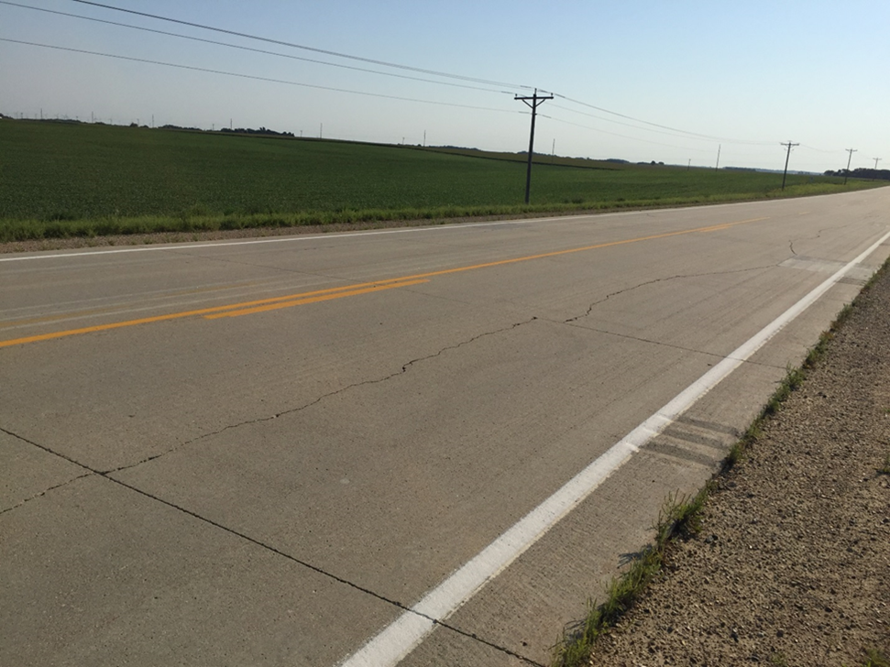
Field Observations
CSAH 46 – Albert Lea, Freeborn County (2009)
2017 Conditions
% panels cracked | 85
Average IRI (in/mi) | 84
Average Faulting (mm) | N/A
@ age 7 years
6” thick, 15’L x 13.5’W panels, 3 dowels OWP

Slide 25
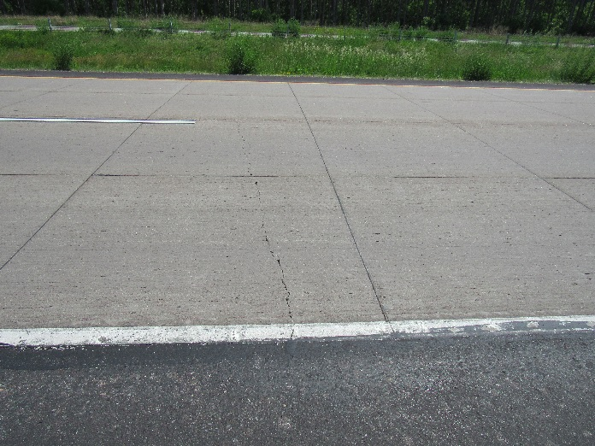
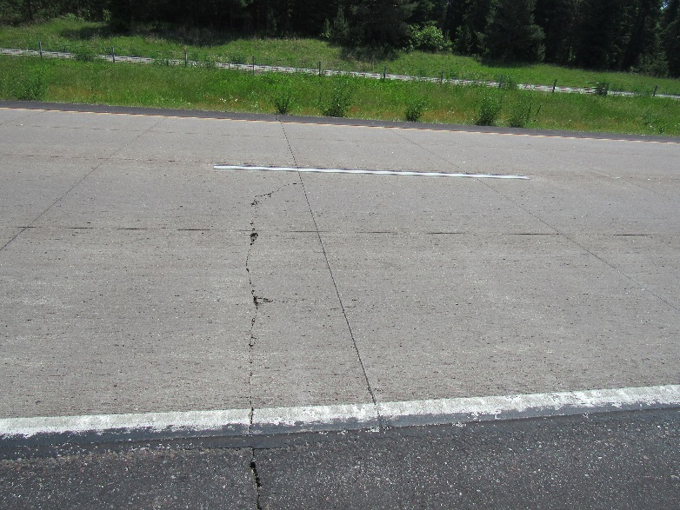
Field Observations
I-35 - North Branch, MnDOT D-Metro (2009)
2017 Conditions
% panels cracked | N/A
Average IRI (in/mi) | 90
Average Faulting (mm) | N/A
@ age 6 years
Update: 2019 Avg Faulting = 1.4 mm
Max = 2.7 mm
6” thick, 6’x6’ panels

Slide 26
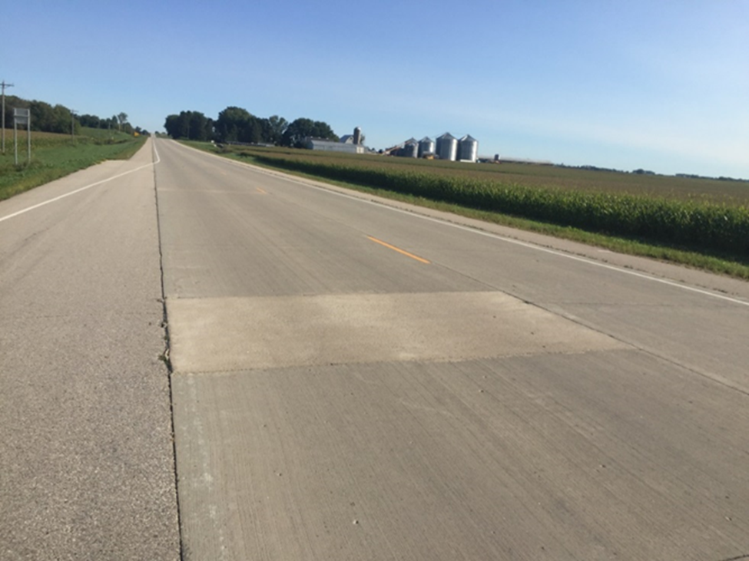
Field Observations
TH 56 – West Concord, MnDOT D-6 (2010)
2017 Conditions
% panels cracked | < 1
Average IRI (in/mi) | 80
Average Faulting (mm) | 0.46
@ age 6 years
6” thick, 15’L x 13.5’W panels, full dowels

Slide 27
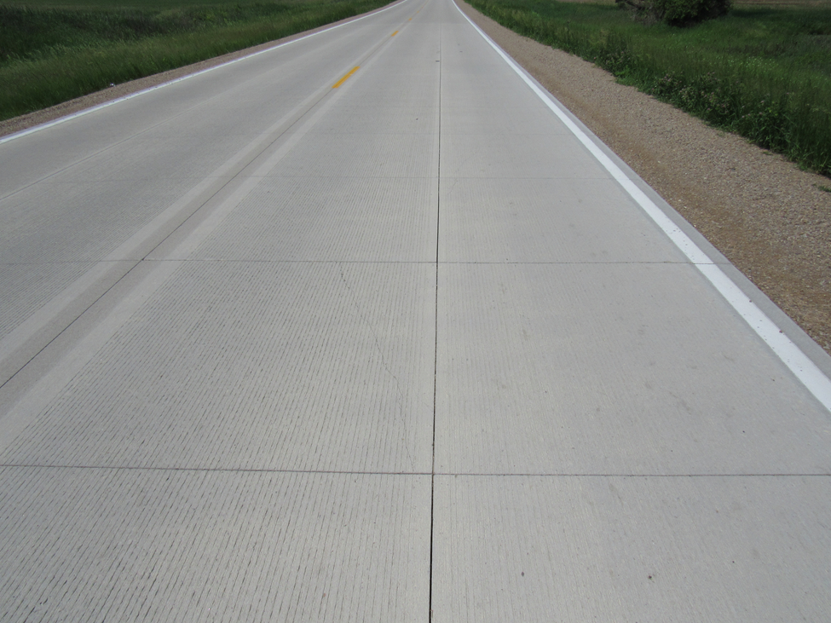
Field Observations
CSAH 1 – Gordonsville, Freeborn County (2014)
2016 Conditions
% panels cracked | < 1
Average IRI (in/mi) | 67
Average Faulting (mm) | N/A
@ age 1 year
5” thick, 6’ x 6’W panels

Slide 28
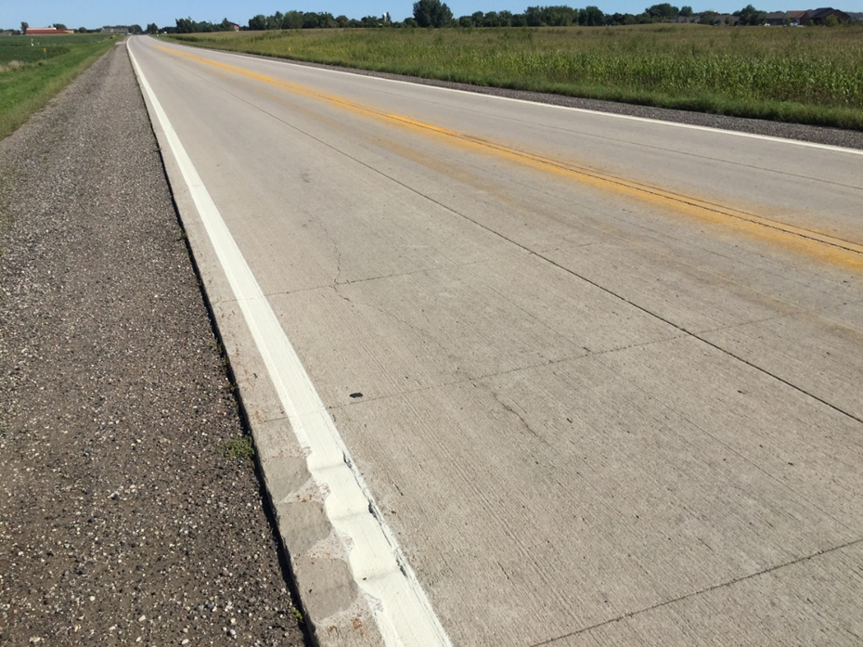
Field Observations
CSAH 7 – Hutchinson, McLeod County (2009)
2017 Conditions
% panels cracked | 7
Average IRI (in/mi) | 85
Average Faulting (mm) | 0.80
Update: 2019 Avg Faulting = 1.0 mm
Max = 2.8 mm
@ age 7 years
5” thick, 6’L(var)x6’W/6’L(var)x7W’ panels

Slide 29
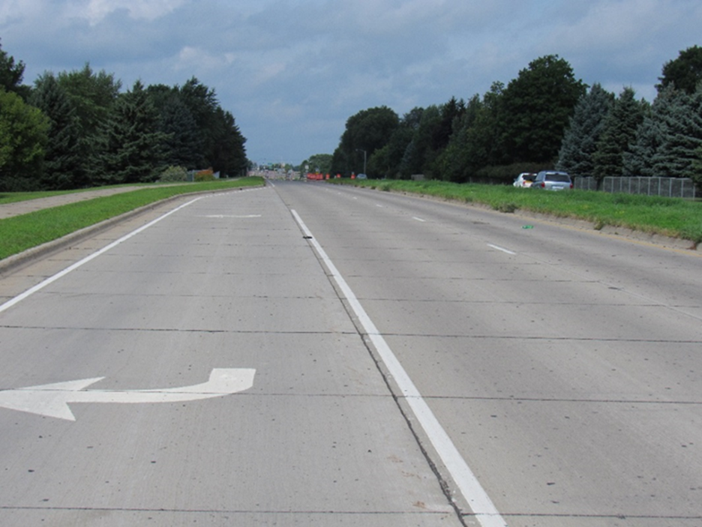
Field Observations
CSAH 22 – Rochester, Olmsted County (2011)
2016 Conditions
% panels cracked | 2
Average IRI (in/mi) | 167
Average Faulting (mm) | 3.4
Retrofit dowels and diamond grind in 2016
@ age 5 years
6.5” thick, 12’ x 12’ panels

Slide 30
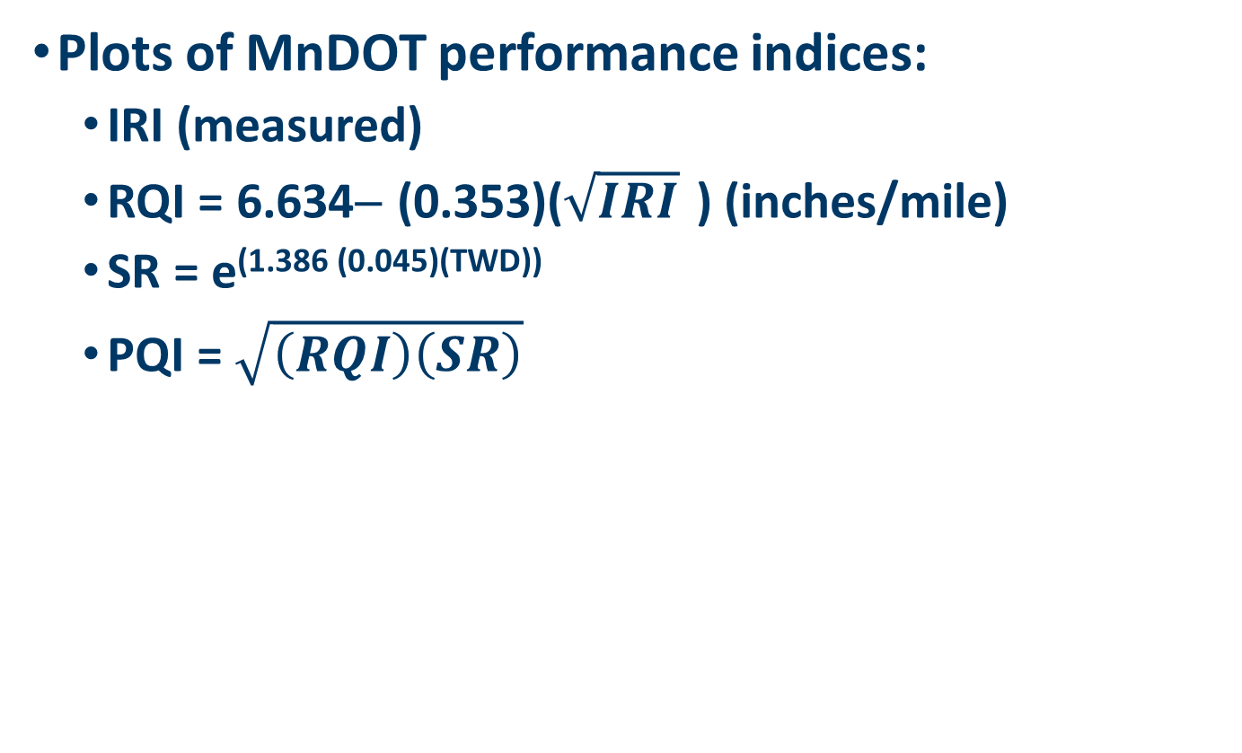
Performance Curves
Plots of MnDOT performance indices:
  IRI (measured)
  RQI = 6.634− (0.353)($\sqrt{IRI}$ ) (inches/mile)
  SR = e^{(1.386 (0.045)(TWD))}
  PQI = $\sqrt{\left(RQI\right)\left(SR\right)}$
Note: RQI, SR, PQI are derived indices based on statistical correlation with MnDOT rating panels, none of which have traveled over short panel whitetopping projects

Slide 31
CSAH 22 – Nowthen: IRI
6” thick, 6’x6’/6’x7’ panels

Slide 32
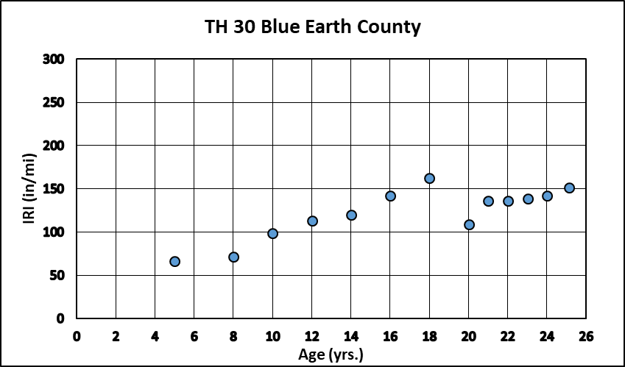
TH 30 – Amboy: IRI
Rehab project
6” thick, 12’x12’ panels, skewed joints

Slide 33
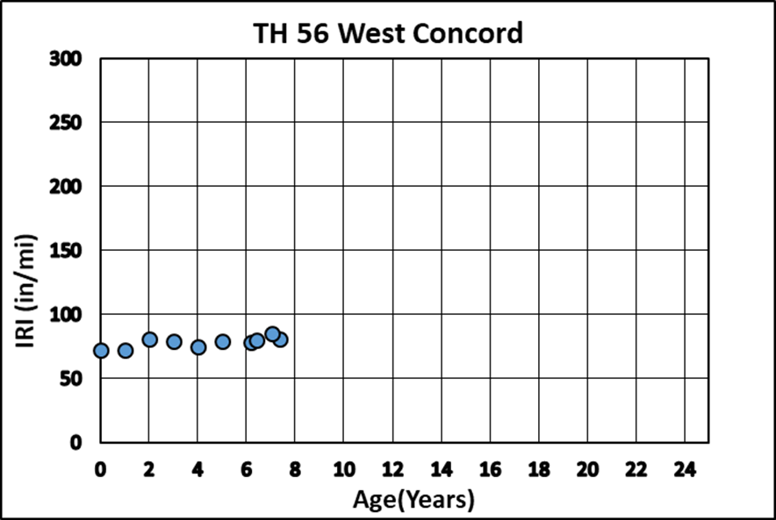
TH 56 – West Concord: IRI
6” thick, 15’L x 13.5’W panels, full dowels

Slide 34
MnROAD – Whitetopping Cells
21 MnROAD test sections (constructed 1997-2013)
  Many variables
    Thickness
    Panel size
    Remain HMA thickness
    Dowels (round @ 2’ c. to c. spacing, plates)
    Fiber-reinforced concrete
    Seal/no seal joints
  Interstate traffic (avg ≈ 1 million ESALs/yr)
  Good for revealing distress mechanisms
  Ride quality not representative of typical projects

Slide 35
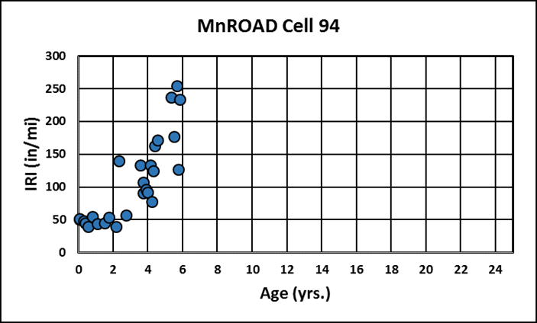
MnROAD – Cell 94: IRI

Slide 36
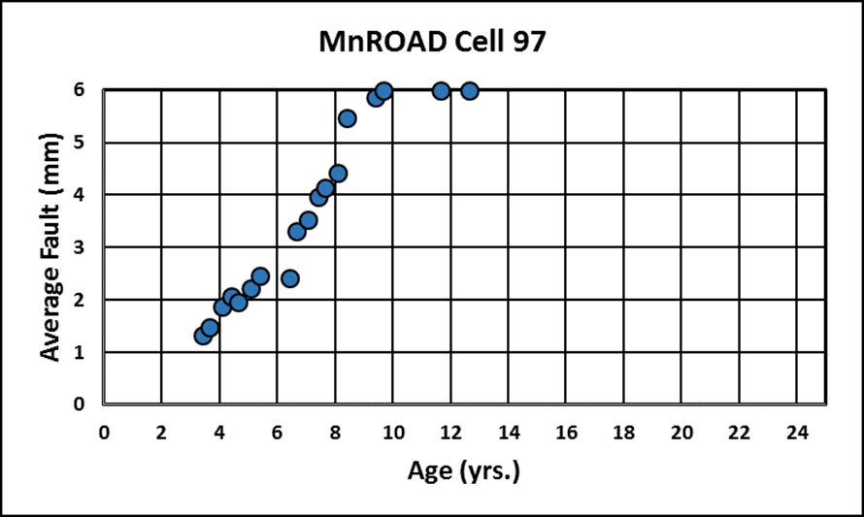
MnROAD – Cell 97: Faulting

Slide 37
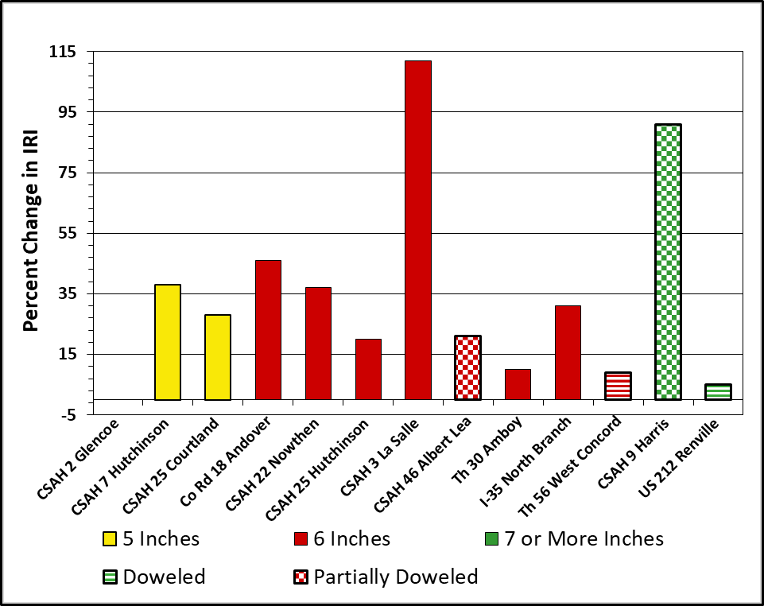
Performance Review
Impact of design features
Thickness vs % change in ride quality (IRI)
Thickness vs cracking
Panel size vs % change in IRI
Panel size vs cracking
Remaining HMA thickness vs % change in IRI
Remaining HMA thickness vs cracking
Traffic vs % change in IRI
Traffic vs cracking

Slide 38
Performance Models
Develop model(s) to predict service life to poor condition
  Predict time to first major rehab (minimal maintenance)
  Not comfortable using MnDOT RQI until calibrated for whitetoppings
  Chose FHWA poor condition IRI limit of 170 in/mi
  Models developed for undoweled whitetoppings on lower volume roads
    Fully doweled projects behave like standard concrete pavement on base

Slide 39
Performance Models
“I/B” (Izevbekhai/Burnham) Model:
  IRI =Const+(TRAF^{α1})+(RRS^{α2})+(DOW^{α3})+(JSL^{α4})+(AGE ^{α5})+(HMA ^{α6})+(PANL ^{α7})
where:
  Const = constant
  TRAF = annual traffic (ESALs)
  RRS = Radius of relative stiffness (in)
  DOW = Dowels present (= 0.7 for full dowels, = 2 for partial dowels, =3 for no dowels)
  JSL = Transverse joint sealed (= 1 sealed, =2 for breached*, =3 unsealed)
  AGE = Age (years)
  HMA = Remaining HMA thickness (in)
  PANL = Panel length (in)
* Based on field observations, a sealed joint is assumed to be breached after 4 years.

Slide 40
Performance Models
“TB” (Tom Burnham) Model:
IRI = Const[e ^{α(AGE)}]
where:
  Const = constant
  AGE = Age (years)

Slide 41
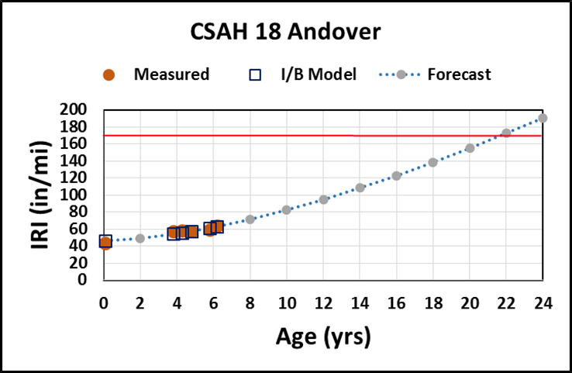
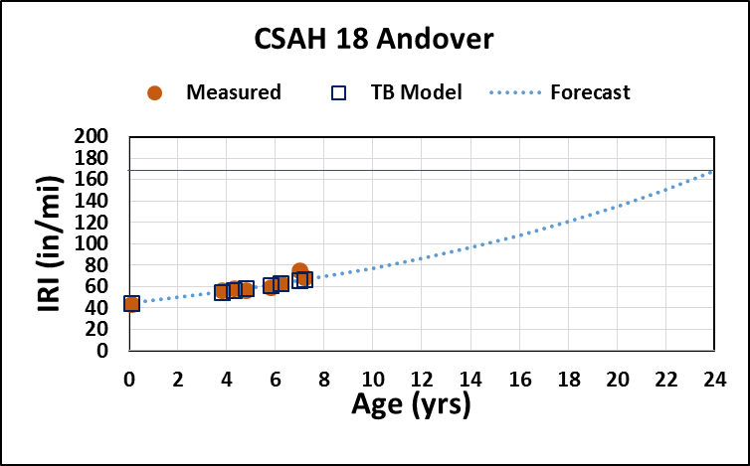
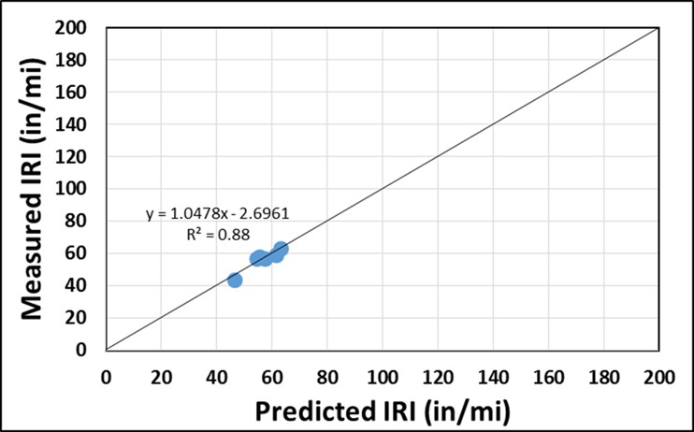
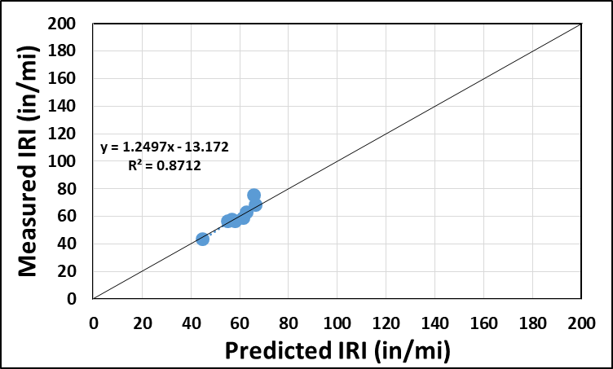
Performance Model Fit

Slide 42
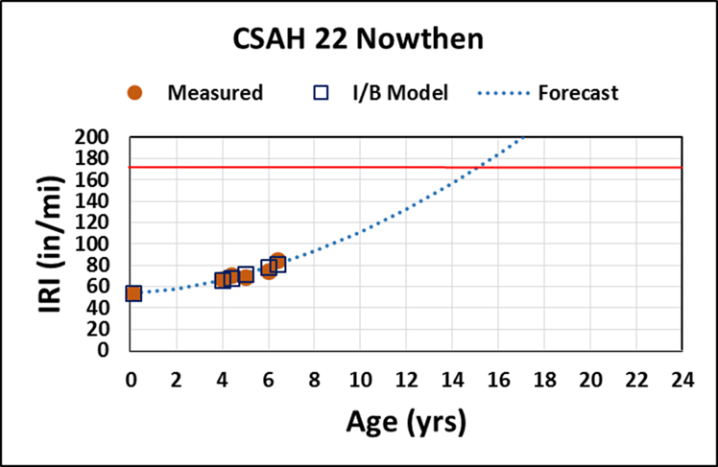
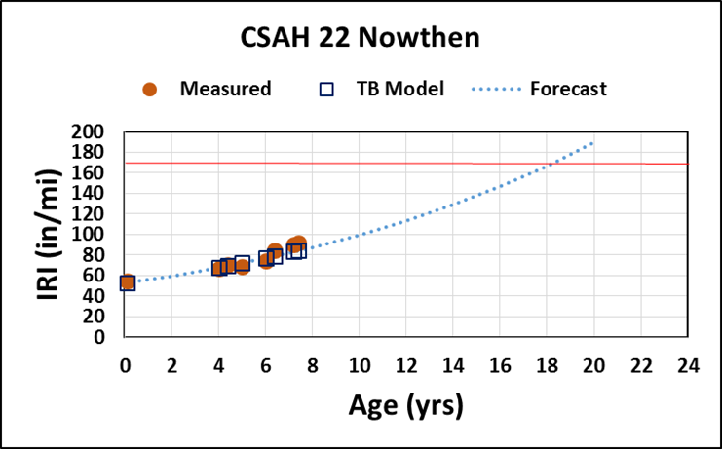
Performance Model Fit

Slide 43
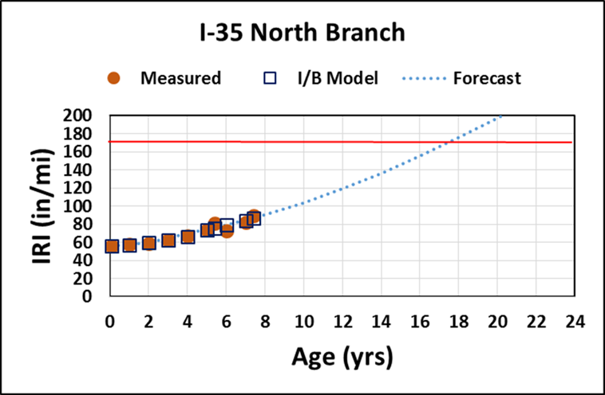
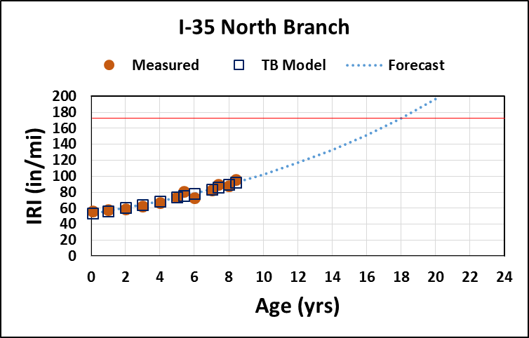
Performance Model Fit

Slide 44
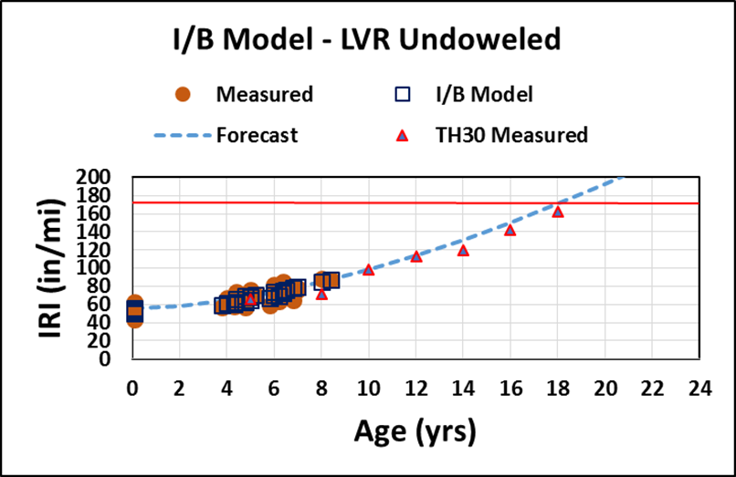
Overall Performance Model
Based on 6 projects with most data (TH 30 used to test fit)

Slide 45
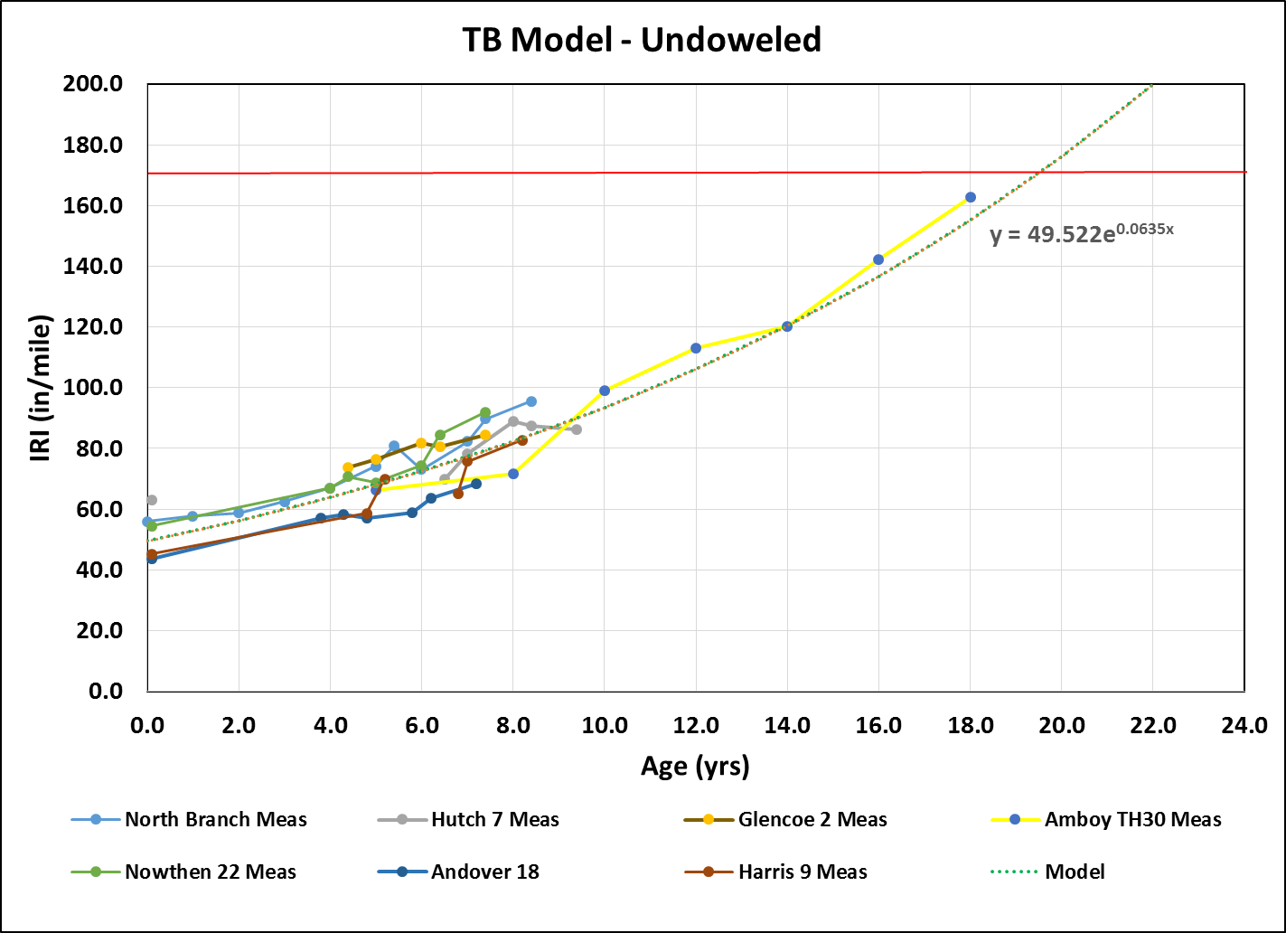
Overall Performance Model
Based on 6 projects with most data (TH 30 used to test fit)

Slide 46
Overall Life Prediction – Undoweled Projects
Typical life to poor condition = 18 years (max ≈ 25 yrs)
  Assumes few construction errors
  Few projects have developed severe faulting yet
    Actual age to reach poor condition may be sooner
  Recent improvements in design, construction and materials may extend performance life
    Profile milling (uniformity of overlay thickness)
    Fiber-reinforced concrete mixes (less faulting)
  Preventive/routine maintenance could extend life (timing?)

Slide 47
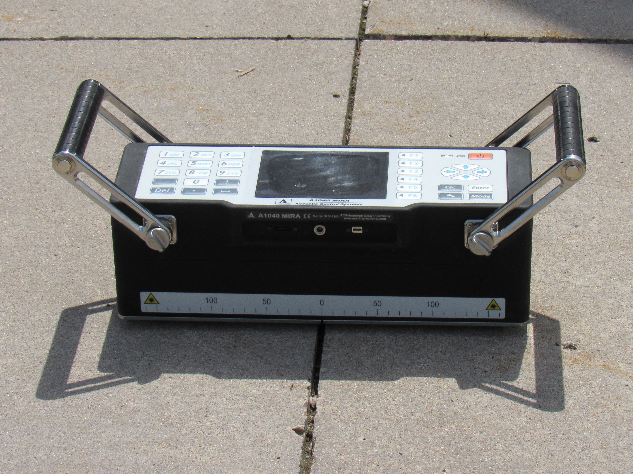
Joint Activation Determination Using MIRA
MIRA = Low-Frequency Ultrasonic Tomographer
  48 Shear-wave transducers
Diagram from Germann Instruments MIRA™ Operation Manual

Slide 48
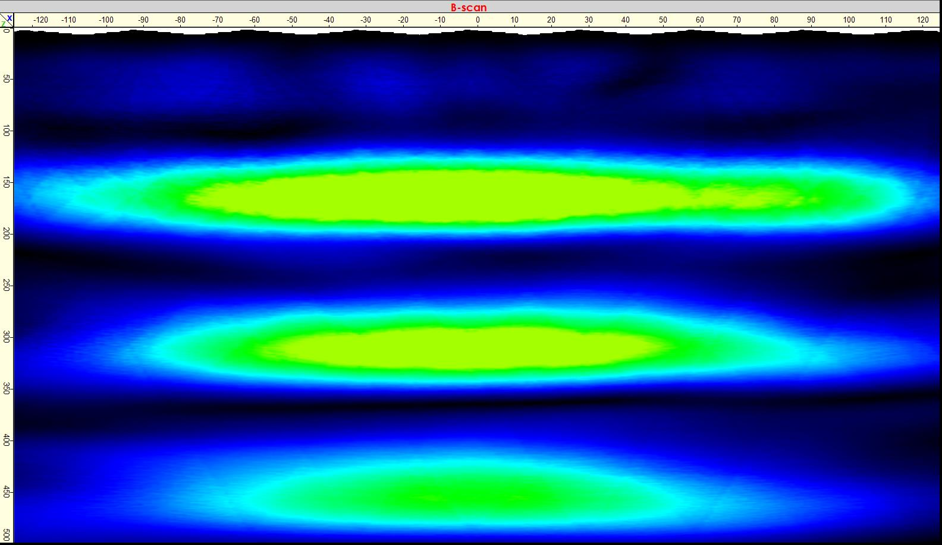
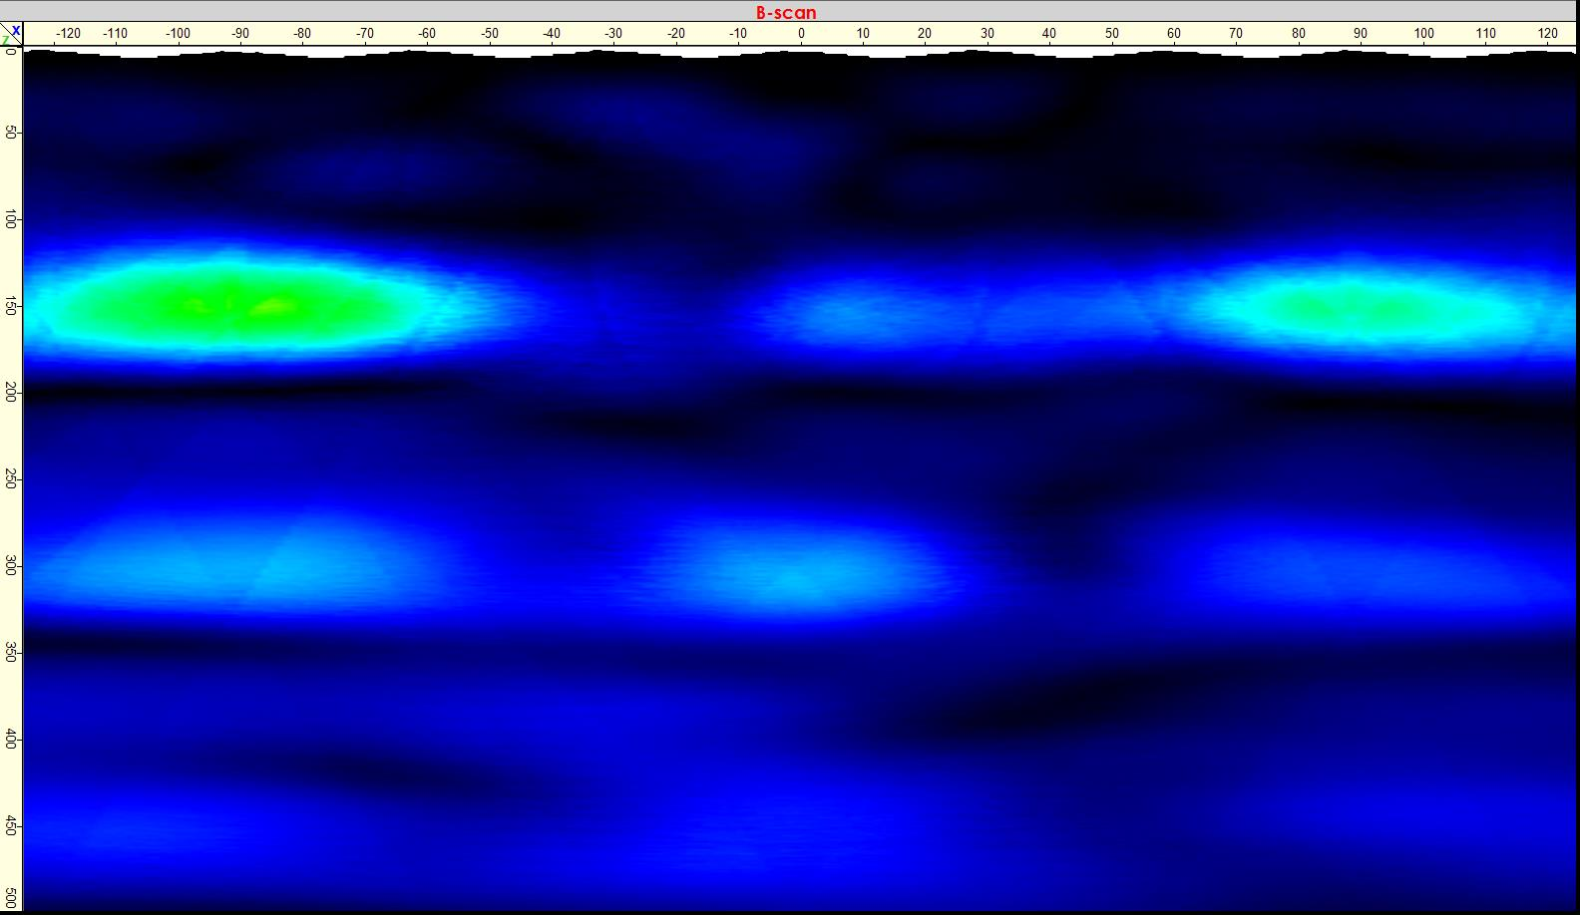
Joint Activation Determination Using MIRA
Joint Not Deployed
Joint Deployed

Slide 49
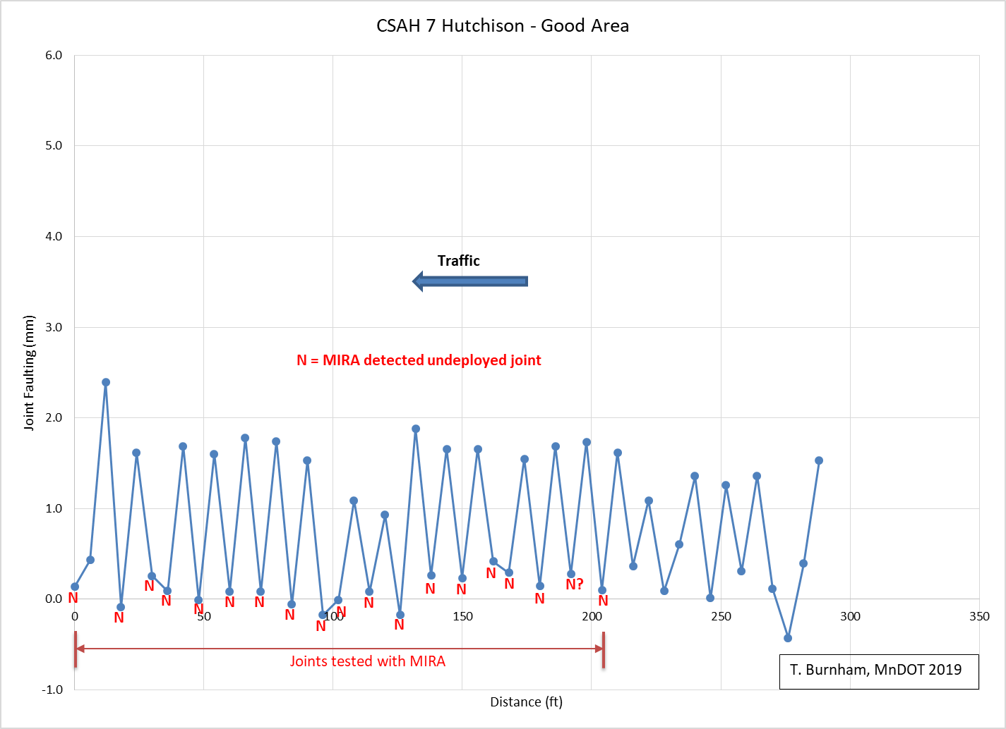
Whitetopping Joint Activation
  Used frequency of 35 kHz based on report by Tran and Roesler (ICT-19-003, March 2019)

Slide 50
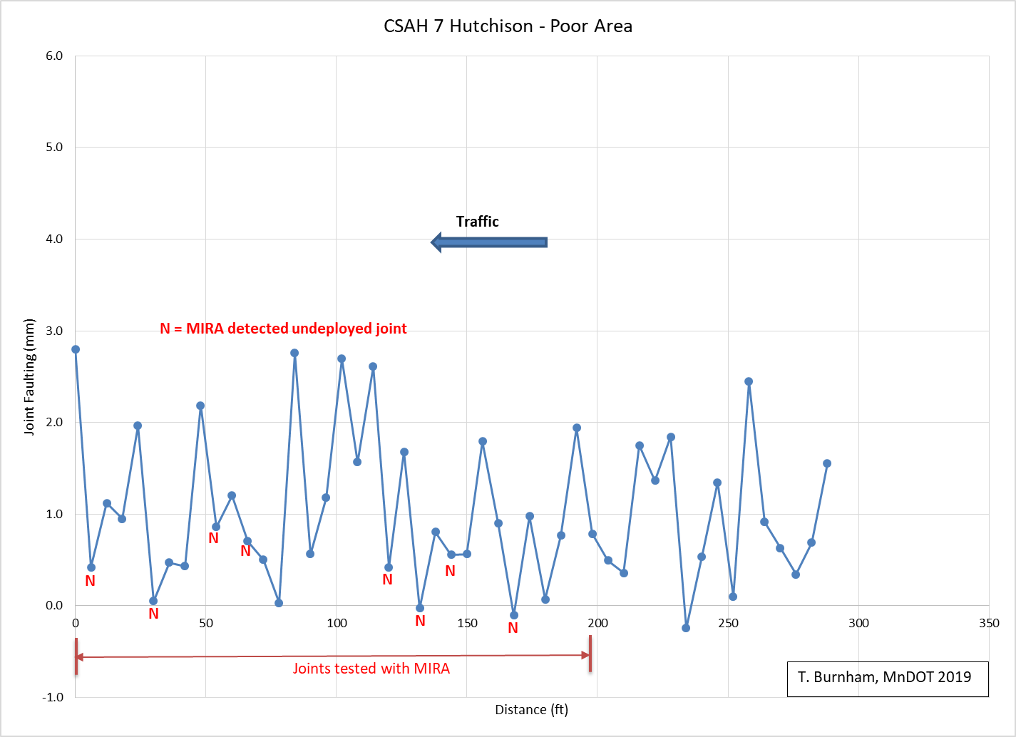
Whitetopping Joint Activation
  Used frequency of 35 kHz based on report by Tran and Roesler (ICT-19-003, March 2019)

Slide 51
Questions?
Tom Burnham
tom.burnham@state.mn.us

