Slide 1


2019 Pavement Workshop
May 21-23, 2019
Determining Pavement Design Criteria for Recycled Aggregate Base and Large Stone Subbase
TPF-5(341)
Bora Cetin
Assistant Professor
Iowa State University
+ 46 Associate Members

Slide 2
RESEARCH TEAM
Iowa State University
Principal Investigator – Bora Cetin
  Assistant Professor – Department of Civil, Construction & Environmental Engineering
Co-Principal Investigator – Ashley Buss
  Assistant Professor – Department of Civil, Construction & Environmental Engineering
Co-Principal Investigator – Halil Ceylan
  Professor – Department of Civil, Construction & Environmental Engineering
Co-Principal Investigator – Junxing Zheng
  Assistant Professor – Department of Civil, Construction & Environmental Engineering
Research Personnel – Haluk Sinan Coban
  PhD Student – Department of Civil, Construction & Environmental Engineering
  University of Wisconsin-Madison
Co-Principal Investigator – William Likos
  Professor – Department of Civil and Environmental Engineering
Co-Principal Investigator – Tuncer B. Edil
  Professor Emeritus – Department of Civil and Environmental Engineering
  Visiting Scholar – Askin Ozocak
  Associate Professor – Sakarya University

Slide 3
OUTLINE
Introduction
Research motivation
Objectives
Research plan
Construction
Field testing
Laboratory testing
What have we learned?
Future expectations

Slide 4
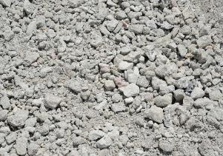
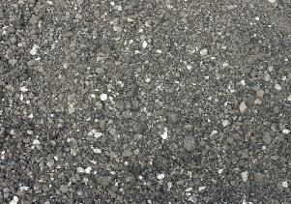
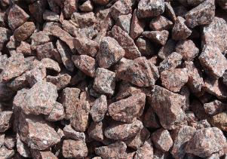

INTRODUCTION
Recycled concrete aggregate (RCA)
  Old & failed concrete pavement surfaces
  Other structures
Recycled asphalt pavement (RAP)
  Old & failed asphalt pavement surfaces
Large stones
  Single crushing operation
  Energy consumption $↓$ (Kazmee et al. 2015)
RCA
RAP
Large stones
https://atlasconcrete.co.nz/benefits-of-recycling-concrete/
https://arthuge.com/dirt_sand_gravel_limestone_fill_sand_prices
https://greelysand.com/shop/decorative-stone-river-rock/granite-stone/

Slide 5
RESEARCH MOTIVATION
Inconsistent design methods & construction specifications
Prediction of engineering properties from index properties
Variety & uncertainty of RCA and RAP
Limitations of the test apparatus for large stones

Slide 6
OBJECTIVES
1st Goal – Determine the field and laboratory performance
FWD, LWD, DCP, intelligent compaction (IC) data
2nd Goal – Develop a method to estimate the stiffness and permeability from
Percent crushing of particles after compaction
Sphericity, angularity, and surface texture
3rd Goal – Prepare a pavement design and construction specification
Performance
Unsaturated & saturated characteristics
Gravel, sand, fines content, gravel-to-sand ratio, D₁₀, D₃₀, D₅₀, D₆₀
Life-cycle cost analysis
Index & engineering properties

Slide 7
RESEARCH PLAN
Task 1 – Literature review and recommendations
Task 2 – Tech transfer “state of practice”
Task 3 – Construction monitoring and reporting
Task 4 – Laboratory testing
Task 5 – Performance monitoring and reporting
Task 6 – Instrumentation
Task 7 – Pavement design criteria
Task 8 & 9 – Draft/final report
Green – Completed
Red – In Progress

Slide 8
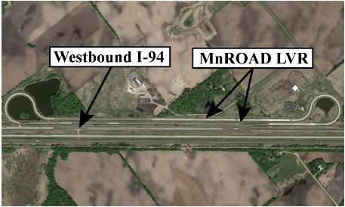
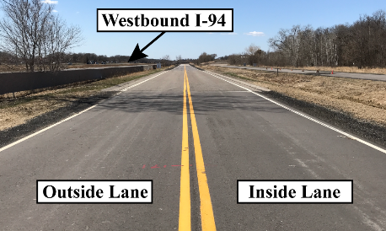
CONSTRUCTION
Test Facility
Minnesota Road Research Project (MnROAD) Low Volume Road (LVR)
  Two-lane closed loop
  Inside lane – traffic simulation
  Outside lane – environmental & dynamic response monitoring

Slide 9
CONSTRUCTION
Test Cells
S. Granular Borrow = Select Granular Borrow
TX = Triaxial Geogrid
BX = Biaxial Geogrid
GT = Nonwoven Geotextile

Slide 10
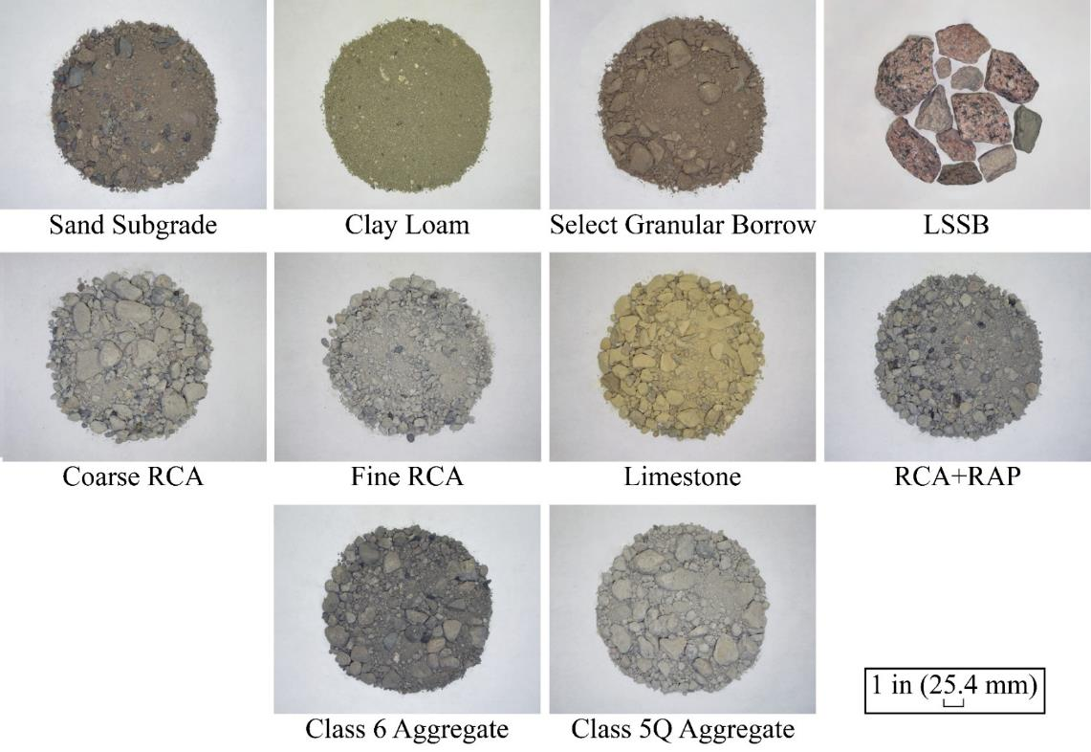
CONSTRUCTION
Test Materials

Slide 11
FIELD TESTING
Field Tests
Lightweight deflectometer (LWD) test
Gas permeameter test (GPT)
Intelligent compaction (IC) test
Automated plate load testing (APLT)
Falling weight deflectometer (FWD) test

Slide 12
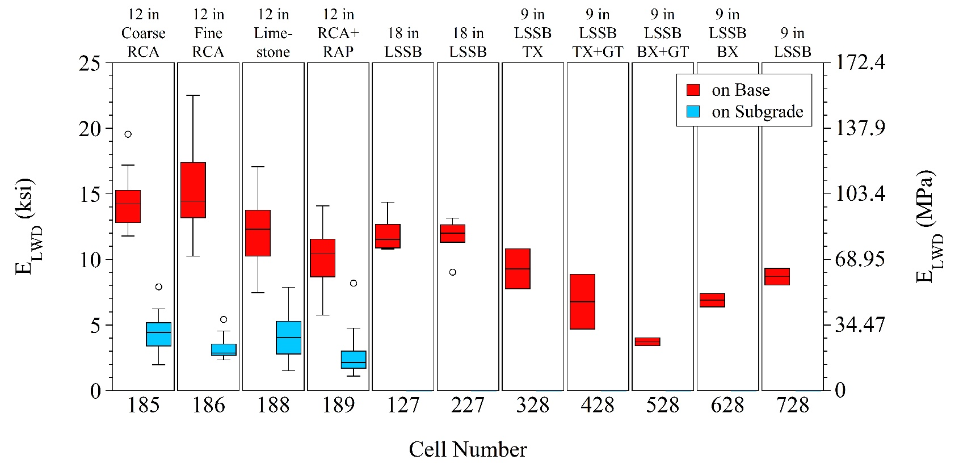
FIELD TESTING

Slide 13
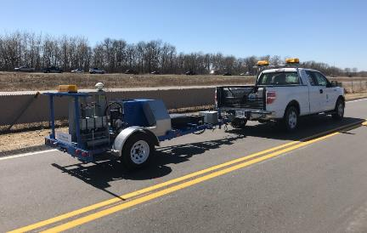
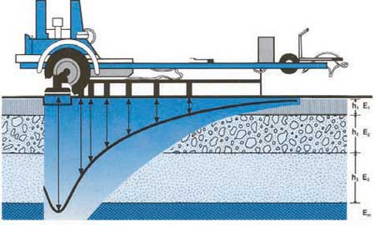
FIELD TESTING
Falling Weight Deflectometer (FWD) Test
Geophones – 0 to 72 in (0 to 1830 mm) away from the center plate
Deflection basin
Influence depth = 1.5 to 2.2 in (0.45 to 0.68 m) (Mooney et al. 2010; Vennapusa et al. 2012)
Dynatest Model 8002 FWD device
https://www.clrp.cornell.edu/nuggets_and_nibbles/articles/2005/fwd.html

Slide 14
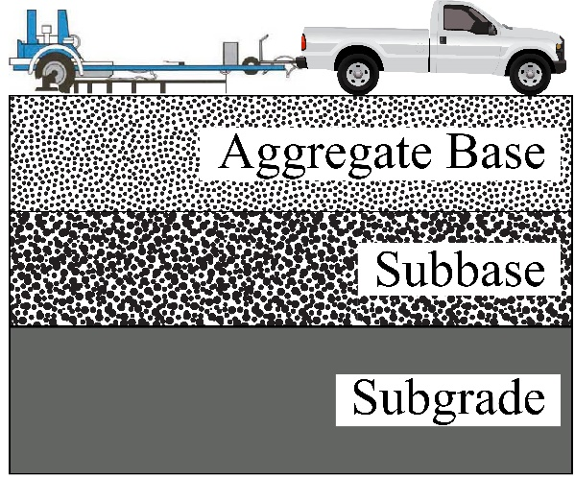
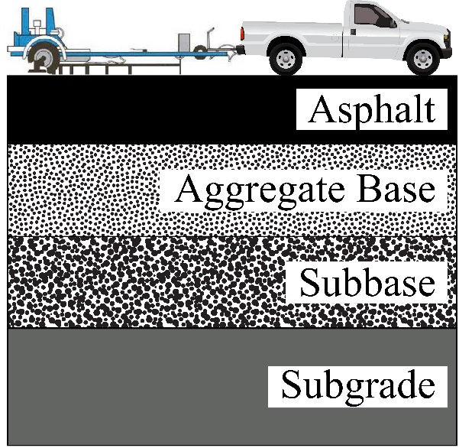
FIELD TESTING
Falling Weight Deflectometer (FWD) Test
Before & after paving
Composite analysis
Layered analysis
  Asphalt
  Base+subbase
  Subgrade
Base+
subbase
Composite
Subgrade
Asphalt
Base+
subbase
Composite
Subgrade

Slide 15
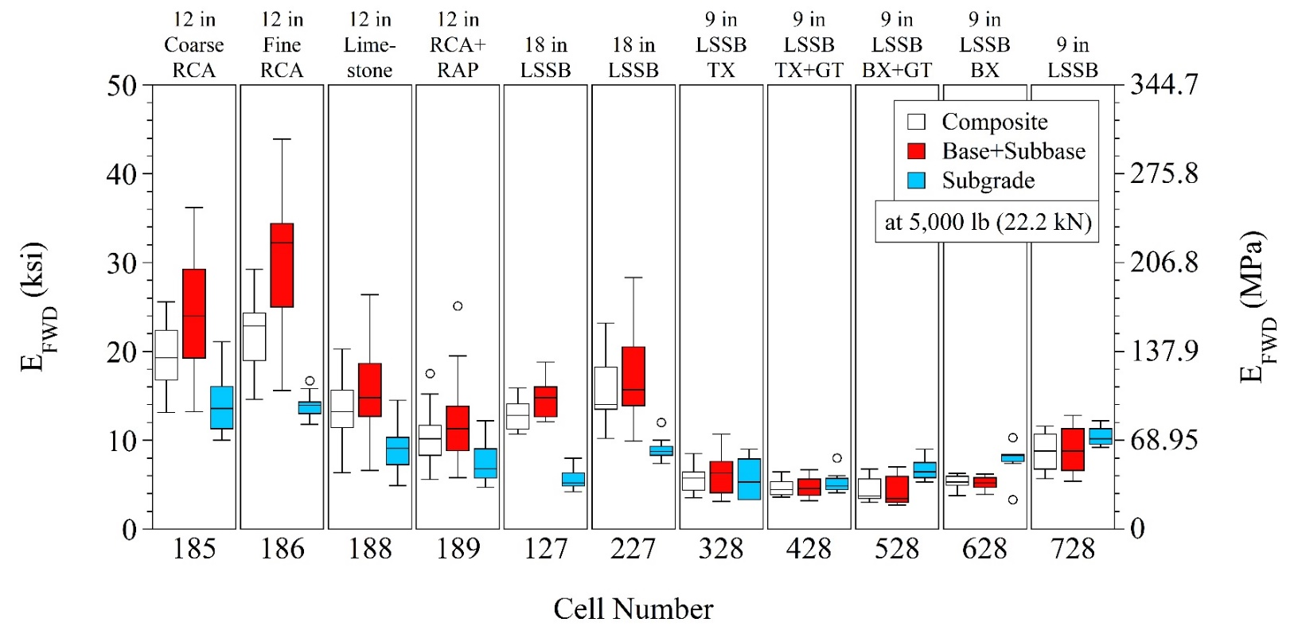
FIELD TESTING
Falling Weight Deflectometer (FWD) Test
Before paving

Slide 16
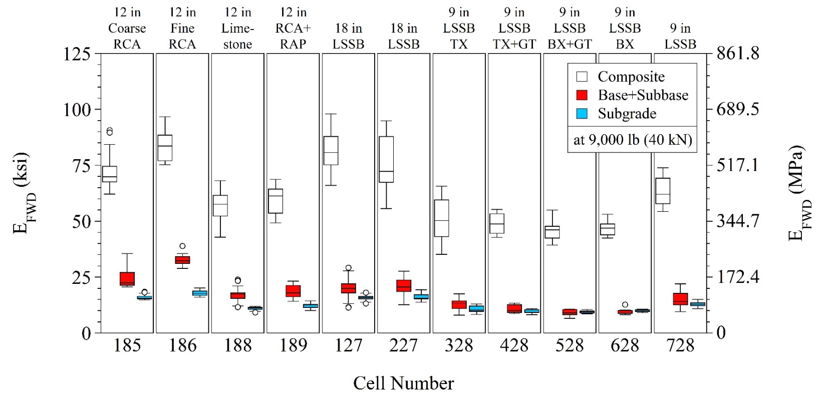
FIELD TESTING
Falling Weight Deflectometer (FWD) Test
After paving

Slide 17
LABORATORY TESTING
Task 4 - Laboratory Testing
Iowa State University
Soil-water characteristic curve
University of Wisconsin-Madison
Sieve analysis & hydrometer test
Gyratory compaction & percent crushing
Contact angle measurement
Atterberg limits
Proctor compaction
Specific gravity & absorption
Image analysis
Asphalt & cement content determination
Permeability
Green – Completed
Red – In Progress

Slide 18
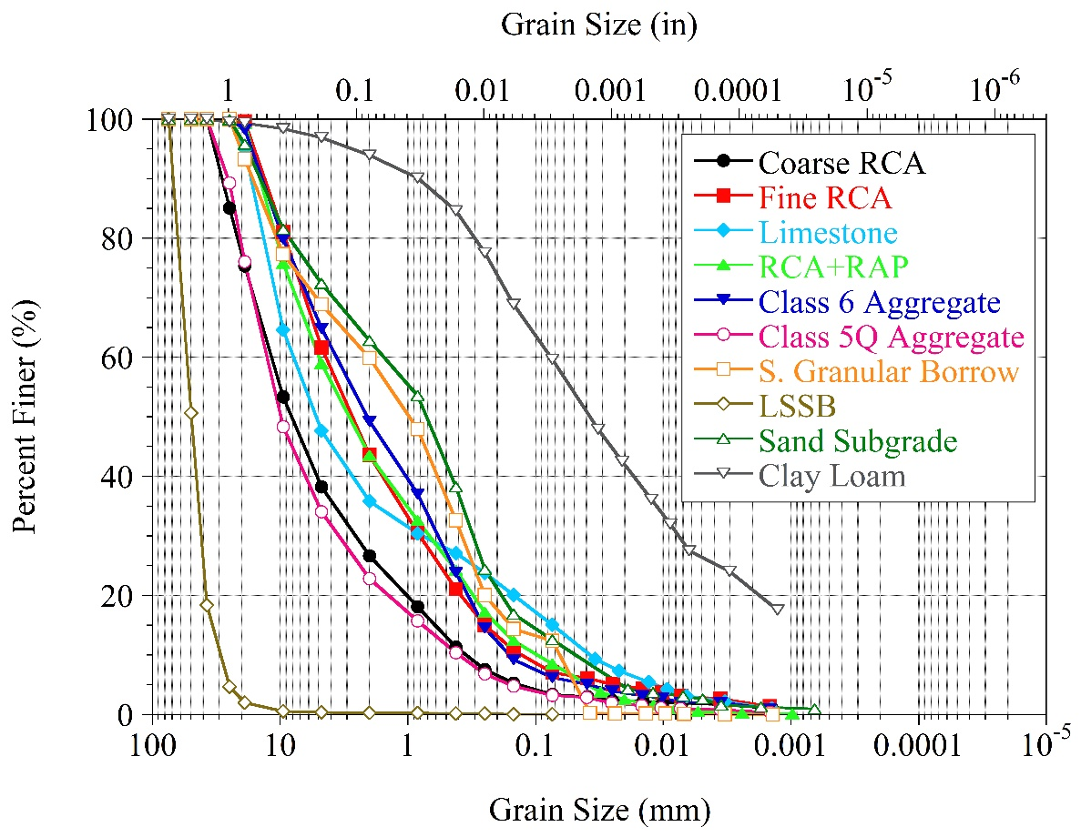
LABORATORY TESTING
Sieve Analysis & Hydrometer Test
ASTM C136 & D6913 – Sieve analysis
ASTM D7928 – Hydrometer test
Material | Gravel (%) | Sand (%) | Fines (%)
Coarse RCA | 61.7 | 34.9 | 3.4
Fine RCA | 38.3 | 54.6 | 7.1
Limestone | 52.3 | 32.6 | 15.1
RCA+RAP | 41 | 50.4 | 8.6
Class 6 Aggregate | 35.1 | 58.6 | 6.3
Class 5Q Aggregate | 65.9 | 30.9 | 3.2
S. Granular Borrow | 31.1 | 56.5 | 12.4
LSSB | 99.6 | 0.3 | 0.1
Sand Subgrade | 27.6 | 59.8 | 12.6
Clay Loam | 3.1 | 37.2 | 59.7
Fines = silt and clay

Slide 19
LABORATORY TESTING
Atterberg Limits
Material | LL | PL | PI
Coarse RCA | NA | NA | NP
Fine RCA | 32.7 | NA | NP
Limestone | 17.9 | NA | NP
RCA+RAP | 27.4 | NA | NP
Class 6 Aggregate | 27.4 | NA | NP
Class 5Q Aggregate | NA | NA | NP
S. Granular Borrow | 18.9 | NA | NP
LSSB | NA | NA | NP
Sand Subgrade | 19.9 | NA | NP
Clay Loam | 36.3 | 23.9 | 12.4
LL = liquid limit; PL = plastic limit; PI = plasticity index; NA = not available; NP = non-plastic

Slide 20
LABORATORY TESTING
Classification
Material | Gravel (%) | Sand (%) | Fines (%) | C_{u} | C_{c} | LL | PL | PI | USCS (ASTM D2487) |  | AASHTO M 145
 |  |  |  |  |  |  |  |  | Symbol | Definition
Coarse RCA | 61.7 | 34.9 | 3.4 | 34.5 | 1.75 | NA | NA | NP | GW | Well-Graded Gravel with Sand | A-1-a
Fine RCA | 38.3 | 54.6 | 7.1 | 33.9 | 1.12 | 32.7 | NA | NP | SW-SM | Well-Graded Sand with Silt and Gravel | A-1-a
Limestone | 52.3 | 32.6 | 15.1 | 211.3 | 1.91 | 17.9 | NA | NP | GM | Silty Gravel with Sand | A-1-b
RCA+RAP | 41 | 50.4 | 8.6 | 49.4 | 0.98 | 27.4 | NA | NP | SP-SM | Poorly-Graded Sand with Silt and Gravel | A-1-a
Class 6 Aggregate | 35.1 | 58.6 | 6.3 | 23.8 | 0.60 | 27.4 | NA | NP | SP-SM | Poorly-Graded Sand with Silt and Gravel | A-1-a
Class 5Q Aggregate | 65.9 | 30.9 | 3.2 | 33.7 | 2.60 | NA | NA | NP | GW | Well-Graded Gravel with Sand | A-1-a
S. Granular Borrow | 31.1 | 56.5 | 12.4 | 30.3 | 1.10 | 18.9 | NA | NP | SM | Silty Sand with Gravel | A-1-b
LSSB | 99.6 | 0.3 | 0.1 | 1.84 | 1.08 | NA | NA | NA | GP | Poorly-Graded Gravel | A-1-a
Sand Subgrade | 27.6 | 59.8 | 12.6 | 33.1 | 1.24 | 19.9 | NA | NP | SM | Silty Sand with Gravel | A-1-b
Clay Loam | 3.1 | 37.2 | 59.7 | NA | NA | 36.3 | 23.9 | 12.4 | CL | Sandy Lean Clay | A-6
Fines = silt and clay; C_{u} = coefficient of uniformity; C_{c} = coefficient of curvature; LL = liquid limit; PL = plastic limit; PI = plasticity index; NA = not available; NP = non-plastic; USCS = unified soil classification system; AASHTO = American Association of State Highway and Transportation Officials

Slide 21
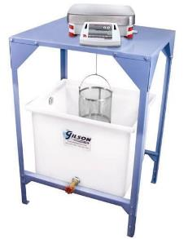
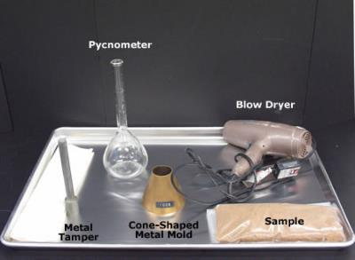
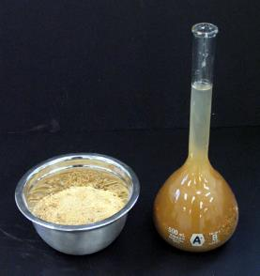
LABORATORY TESTING
Specific Gravity & Absorption
ASTM C127 – for coarse aggregates
ASTM C128 – for fine aggregates
ASTM D854 – for soil solids
ASTM C127
ASTM C128
ASTM D854
https://www.globalgilson.com/specific-gravity-bench
https://www.pavementinteractive.org/reference-desk/testing/aggregate-tests/fine-aggregate-specific-gravity/
https://www.pavementinteractive.org/reference-desk/testing/aggregate-tests/fine-aggregate-specific-gravity/

Slide 22
LABORATORY TESTING
Specific Gravity & Absorption
Material | Oven-Dry (OD) Specific Gravity |  |  | Absorption (%)
 | Coarse Fraction | Fine Fraction | Combined (Coarse + Fine) | Coarse | Fine | Combined (Coarse + Fine)
Coarse RCA | 2.40 | 2.00 | 2.25 | 4.05 | 11.68 | 6.97
Fine RCA | 2.45 | 1.99 | 2.17 | 3.70 | 11.73 | 8.65
Limestone | 2.65 | 2.68 | 2.66 | 1.91 | 1.51 | 1.72
RCA+RAP | 2.47 | 2.15 | 2.28 | 3.09 | 5.22 | 4.34
Class 6 Aggregate | 2.45 | 2.30 | 2.35 | 3.00 | 4.32 | 3.86
Class 5Q Aggregate | 2.39 | 2.07 | 2.28 | 4.62 | 9.62 | 6.32
S. Granular Borrow | 2.70 | 2.58 | 2.62 | 1.14 | 1.71 | 1.53
LSSB | 2.60 | NA | 2.60 | 0.36 | NA | 0.36
Sand Subgrade | 2.70 | 2.56 | 2.60 | 1.08 | 2.13 | 1.84
Clay Loam | NA | 2.68 | 2.68 | NA | NA | NA
Coarse fraction = materials retained on No. 4 sieve; fine fraction = materials passing through No. 4 sieve; combined = weighted average of coarse and fine fractions

Slide 23
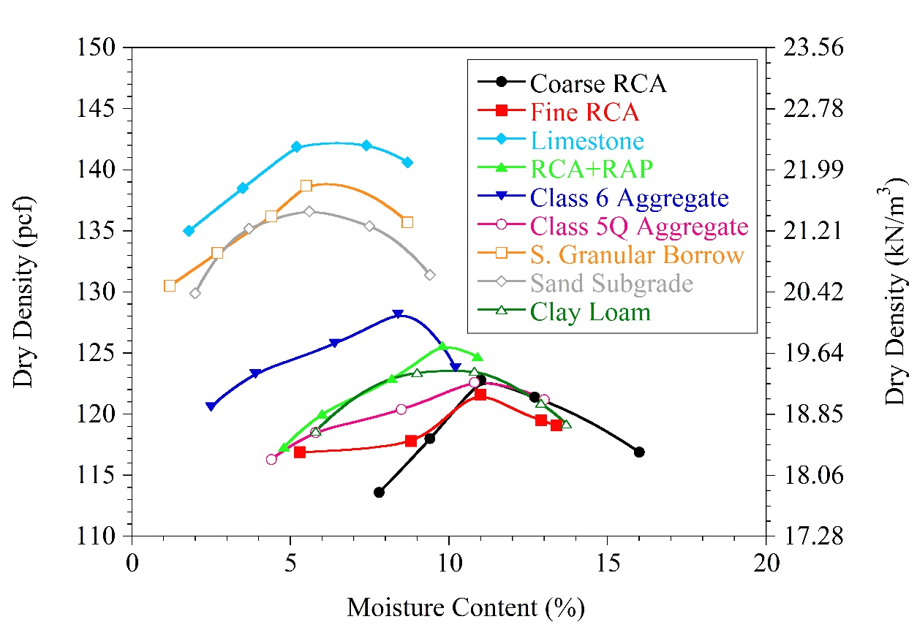
LABORATORY TESTING
Proctor Compaction
Material | MDD |  | OMC (%)
 | (pcf) | (kN/m³)
Coarse RCA | 122.9 | 19.31 | 11.3
Fine RCA | 121.6 | 19.10 | 11.1
Limestone | 142.2 | 22.34 | 6.2
RCA+RAP | 125.6 | 19.73 | 10
Class 6 Aggregate | 128.2 | 20.14 | 8.3
Class 5Q Aggregate | 122.6 | 19.26 | 11
S. Granular Borrow | 138.6 | 21.77 | 5.4
LSSB | NA | NA | NA
Sand Subgrade | 136.6 | 21.46 | 5.7
Clay Loam | 123.9 | 19.46 | 10
MDD = maximum dry density; OMC = optimum moisture content; NA = not available

Slide 24
LABORATORY TESTING
Summary of Other Index Properties
Material | MDD |  | OMC (%) | Combined Oven-Dry (OD) Specific Gravity | Combined Absorption (%)
 | (pcf) | (kN/m³)
Coarse RCA | 122.9 | 19.31 | 11.3 | 2.25 | 6.97
Fine RCA | 121.6 | 19.10 | 11.1 | 2.17 | 8.65
Limestone | 142.2 | 22.34 | 6.2 | 2.66 | 1.72
RCA+RAP | 125.6 | 19.73 | 10 | 2.28 | 4.34
Class 6 Aggregate | 128.2 | 20.14 | 8.3 | 2.35 | 3.86
Class 5Q Aggregate | 122.6 | 19.26 | 11 | 2.28 | 6.32
S. Granular Borrow | 138.6 | 21.77 | 5.4 | 2.62 | 1.53
LSSB | NA | NA | NA | 2.60 | 0.36
Sand Subgrade | 136.6 | 21.46 | 5.7 | 2.60 | 1.84
Clay Loam | 123.9 | 19.46 | 10 | 2.68 | NA
MDD = maximum dry density; OMC = optimum moisture content; NA = not available

Slide 25
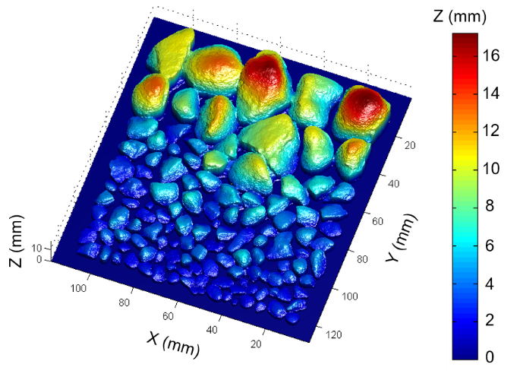
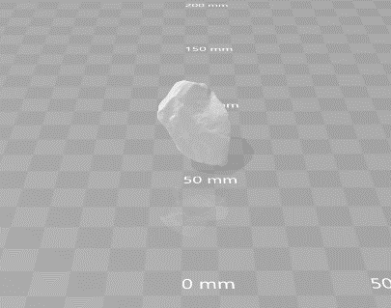
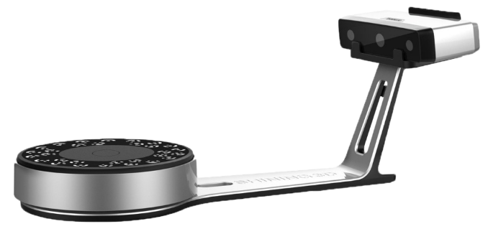
LABORATORY TESTING
Image Analysis
2D Particle Shape Analysis
3D Particle Shape Analysis
  Stereophotography
  Shining 3D – EinScan-SP
Stereophotography
Shining 3D – EinScan-SP
http://junxing.public.iastate.edu/research.html
https://www.dream3d.co.uk/product/shining-3d-einscan-sp/

Slide 26

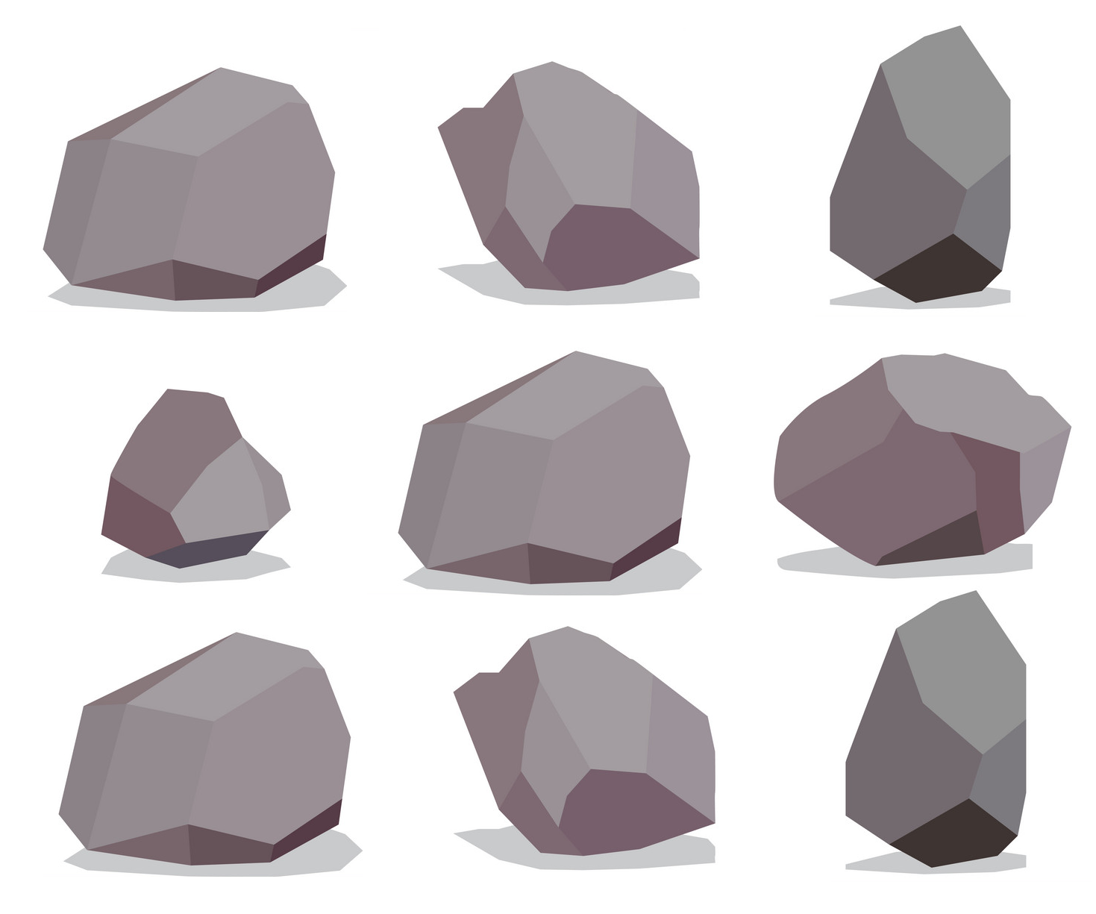
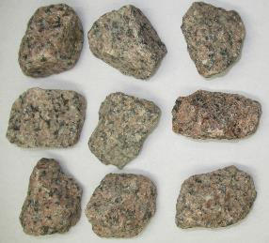
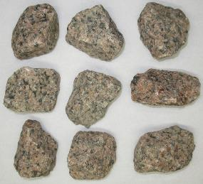
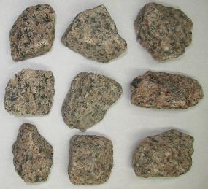
LABORATORY TESTING
Stereophotography
Camera slider
Position 1
(Left)
Position 2
Position 3
(Right)
Camera
Test material
Position 1 (Left)
Position 2
Position 3 (Right)

Slide 27
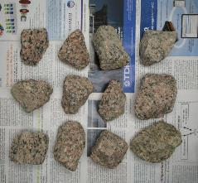
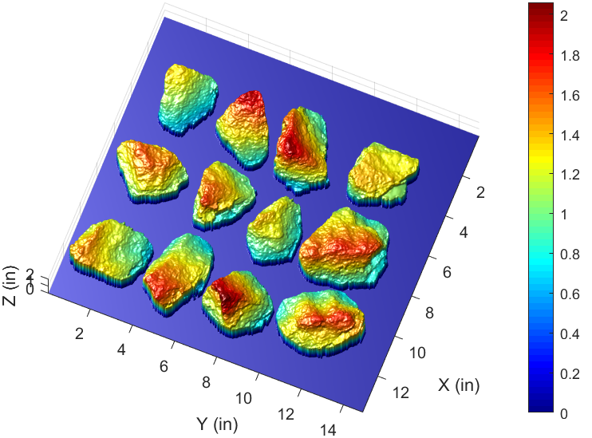
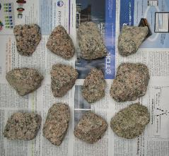
LABORATORY TESTING
Stereophotography
Calibration
Background with text and shapes
for calibration

Slide 28
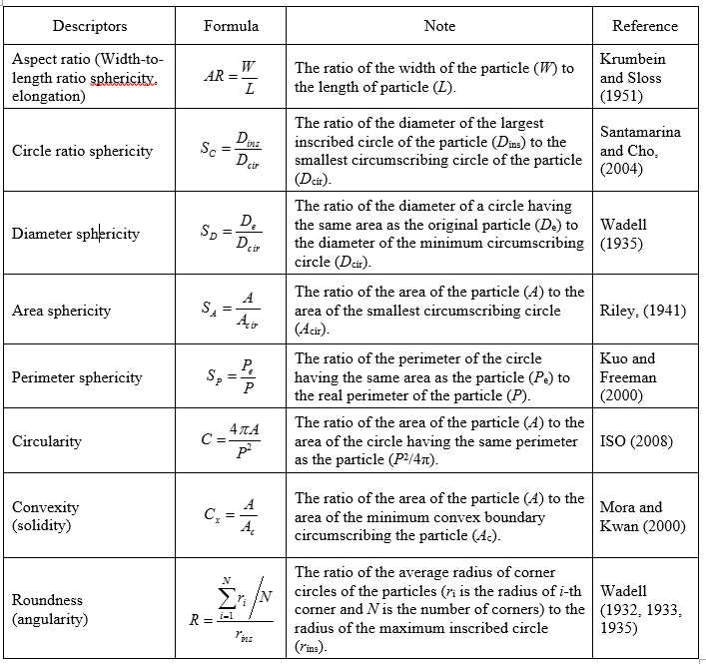
LABORATORY TESTING
Stereophotography
Stereophotography
Parameters
  Area sphericity
  Diameter sphericity
  Circle ratio sphericity
  Perimeter sphericity
  Width to length ratio sphericity
  Circularity
  Convexity
  Roundness
Notes:
Several parameters can be determined by the stereophotography. Parameters are listed and a table is provided with their descriptions and formulas. In addition, their references are provided. This table is taken from one of Quan’s papers (not published yet I guess), who is Dr. Zheng’s PhD student.

Slide 29
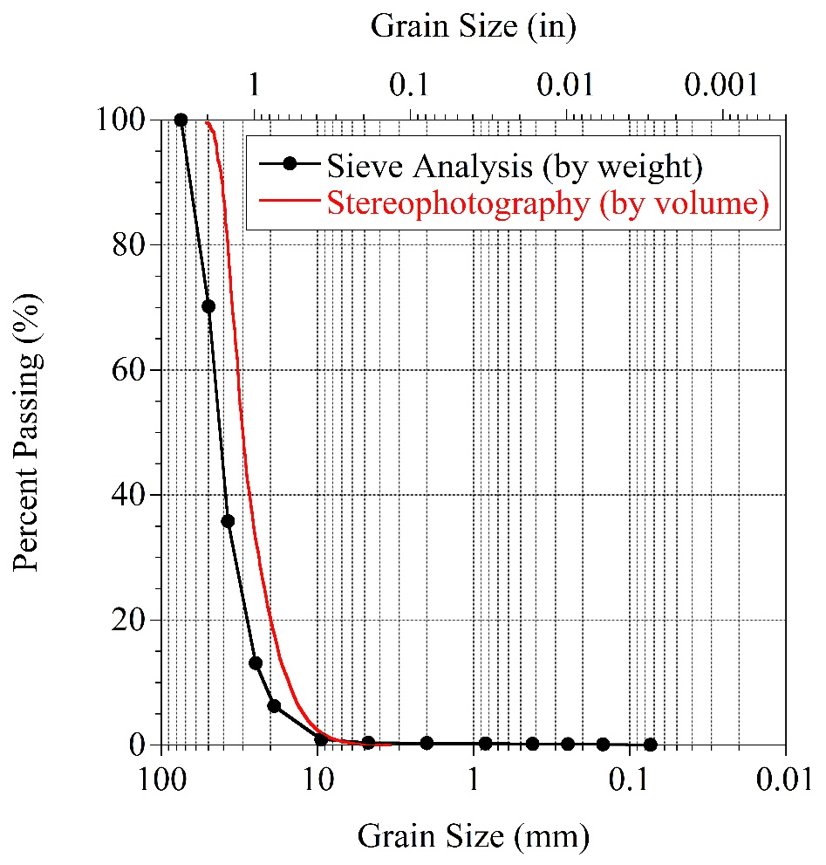
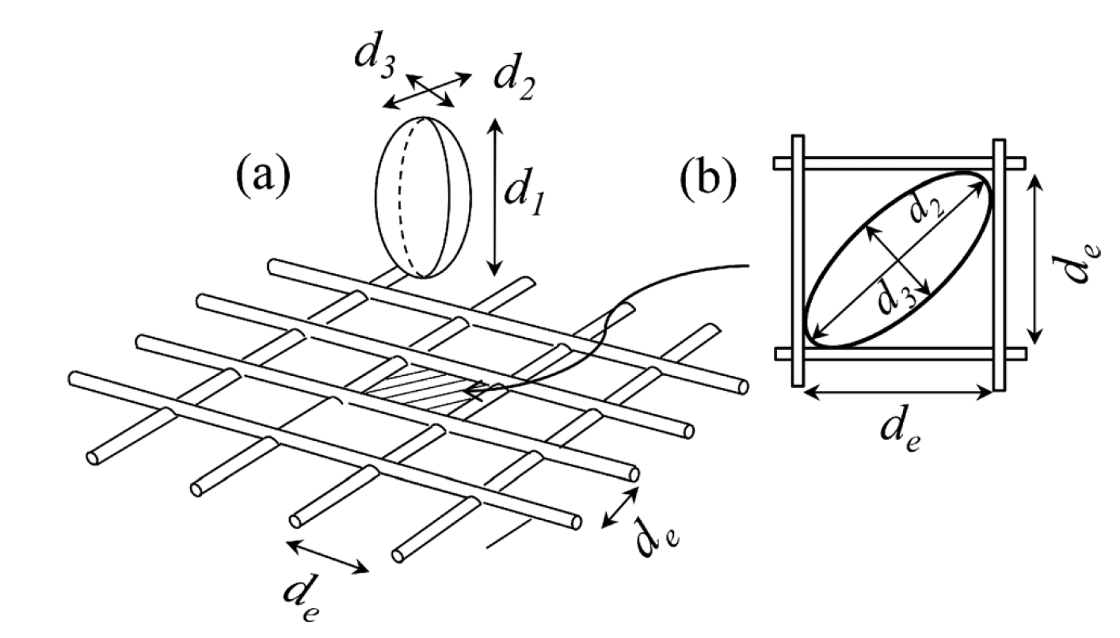
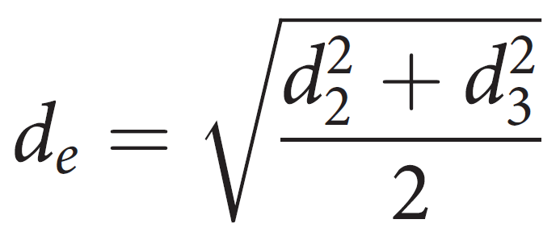
LABORATORY TESTING
Stereophotography
LSSB – 4766 particles (one barrel)
(Zheng and Hryciw 2017)
Notes:
For the large stones, ISU team received 2 barrels from the MnDOT. Stereophotography was performed only for one of the barrels, which contains 4766 large stone particles retained on No. 4 sieve. Particles passing No. 4 sieve cannot be used for image analysis with the current image station setup. d1, d2, d3, and de parameters, which are related to particle sizes, are also obtained by the stereophotogtaphy. The equation of ‘de’ is also provided in this slide.
Particle size distribution of large stones were determined by both conventional sieve analysis and stereophotography. With the sieve analysis, percent passing values are determined by weight. On the other hand, with the stereophotography, percent passing values are determined by volume. As seen from the figure, image analysis and sieve analysis provided similar results. One comment is that now ISU team is working on improving the MATLAB codes to reduce noise and increase accuracy. Therefore, ISU team is expecting that the results will be much closer to each other after modifying the codes.

Slide 30
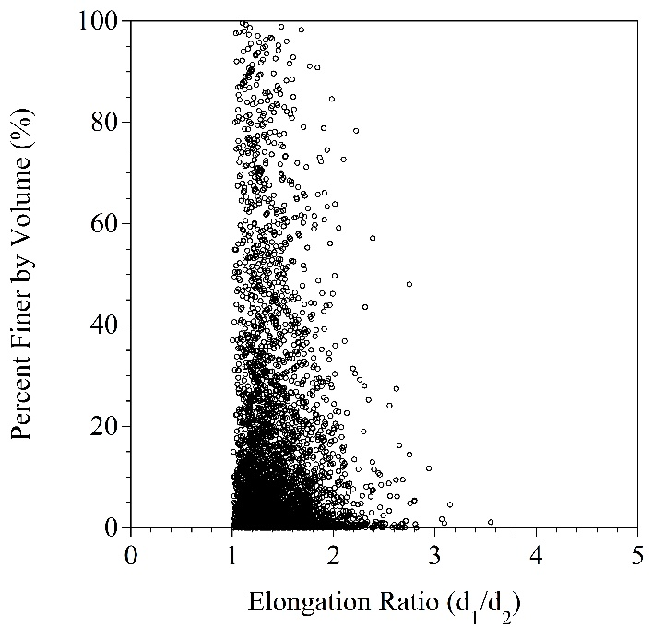
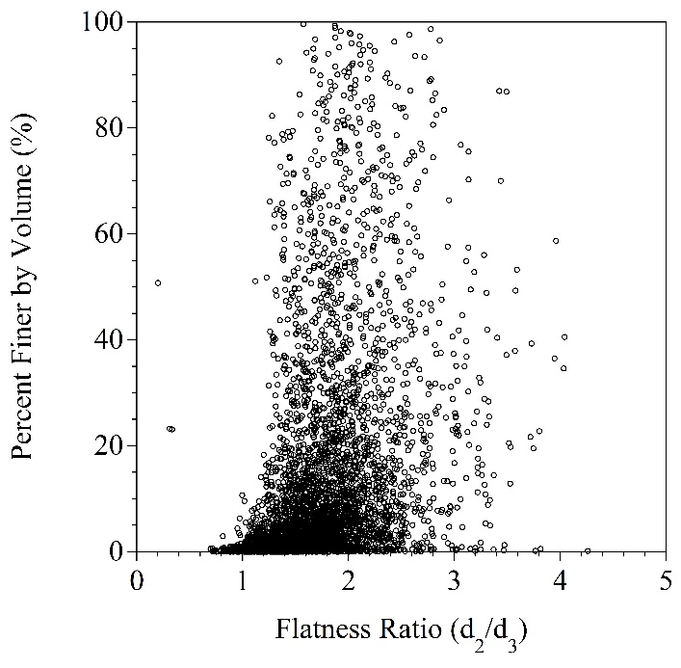
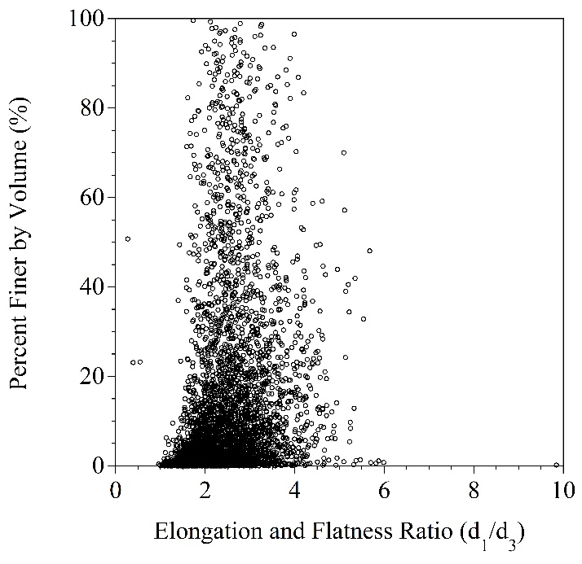
LABORATORY TESTING
Stereophotography
Stereophotography
(Zheng and Hryciw 2017)
Notes:
Elongation ratio, flatness ratio, and elongation and flatness ratio can be determined from the data obtained by the stereophotography. Their scatter plots are provided in this slide. Distribution of the values among 4766 large stone particles are shown. From these figures, distribution of the ratios by percent finer by volume can be observed. Overall or weighted elongation ratio, flatness ratio, and elongation and flatness ratio can be determined. Further numerical analysis has not been performed yet because the ISU team is working on improving the MATLAB codes, which will change the values slightly. More accurate results will be shown later.

Slide 31
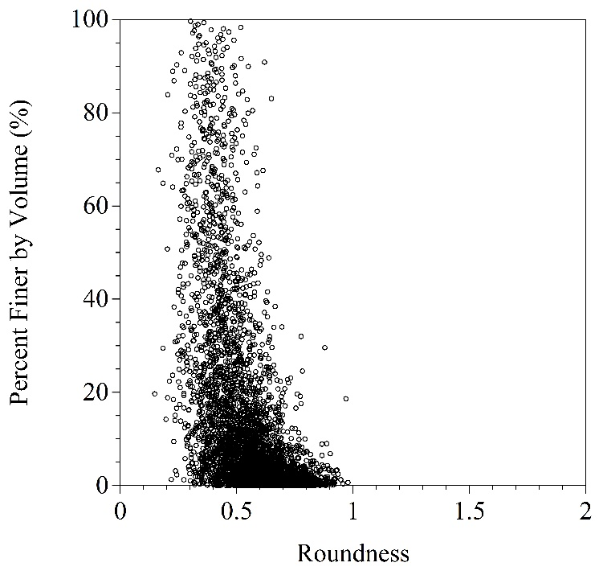
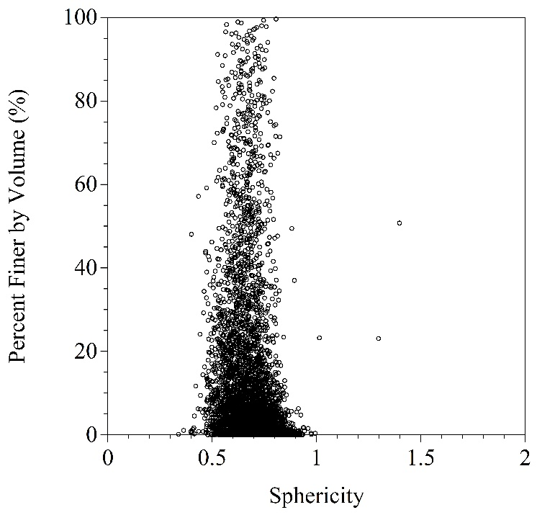
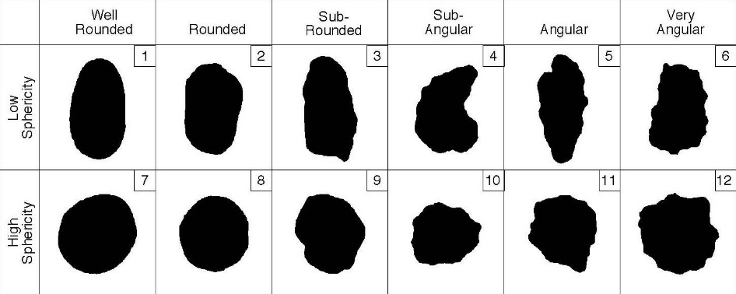
LABORATORY TESTING
Stereophotography
Stereophotography
http://www.sourcecatalog.com/terminology/terminology.html
Notes:
In addition to the previous distributions, roundness (angularity) and sphericity values and their distributions can be determined. As said previously, no further data analysis has not been performed yet.

Slide 32
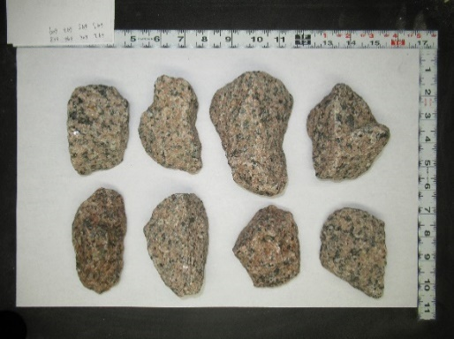
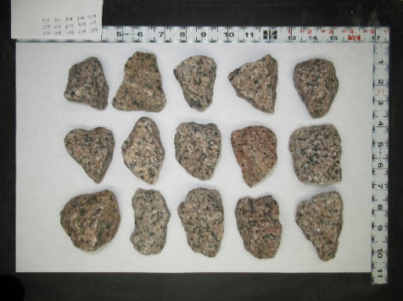
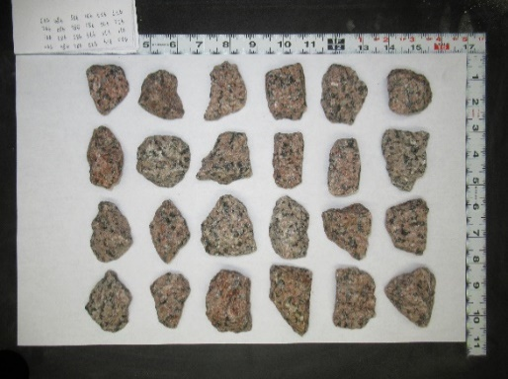
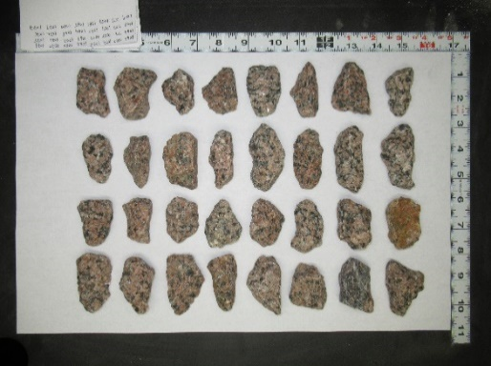
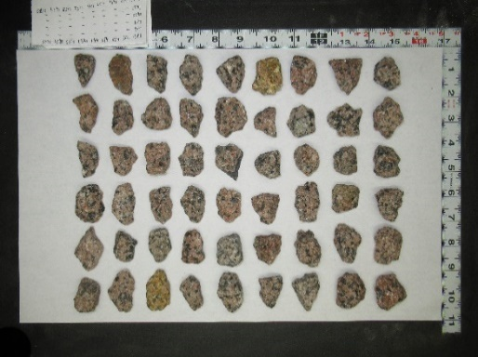
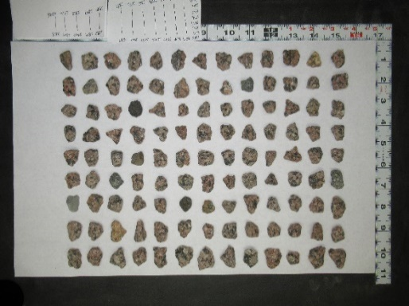
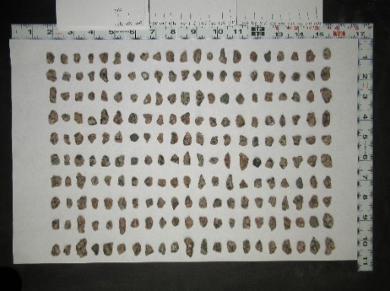
LABORATORY TESTING
Stereophotography vs Shining 3D – EinScan-SP
Comparison
Randomly selected particles
  For each sieve between 2.5-in and No. 4 sieves
Particles retained on 2.5-in sieve
Particles retained on 2-in sieve
Particles retained on 1.5-in sieve
Particles retained on 1-in sieve
Particles retained on 3/4-in sieve
Particles retained on 3/8-in sieve
Particles retained on No. 4 sieve
Notes:
To check the accuracy of the stereophotography, Shining 3D – EinScan-SP 3D scanner is also being used on selected particles. Since we need to scan the large stone particles one by one with the 3D scanner, 175 particles in total was selected for comparison. Sieve analysis was performed and the particles were separated based on their particles sizes. 25 particles from each sieve were collected. The pictures in this slide do not show all 25 particles retained on each sieve. The pictures are provided only to show the differences in particles sizes.
All 3D images were captured and their data are being analyzed right now. 3D image analysis data and their comparison with stereophotography will be provided later.

Slide 33
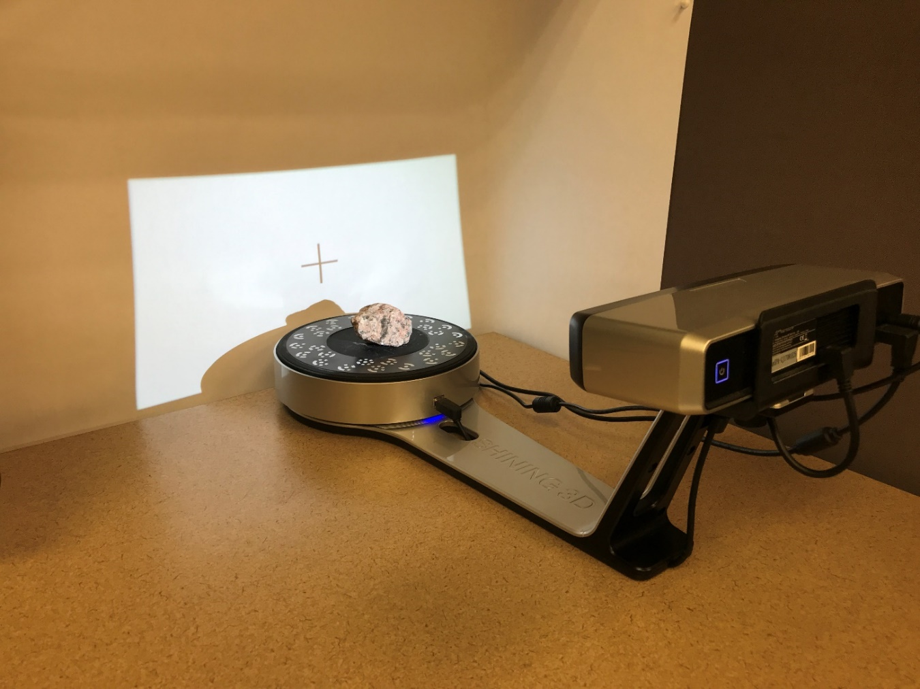
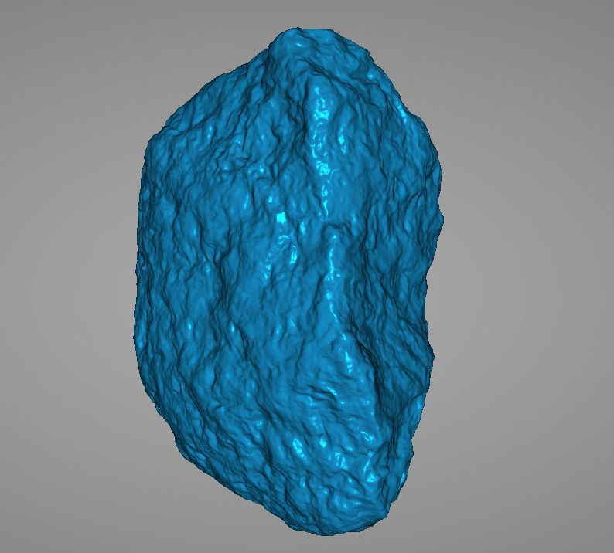
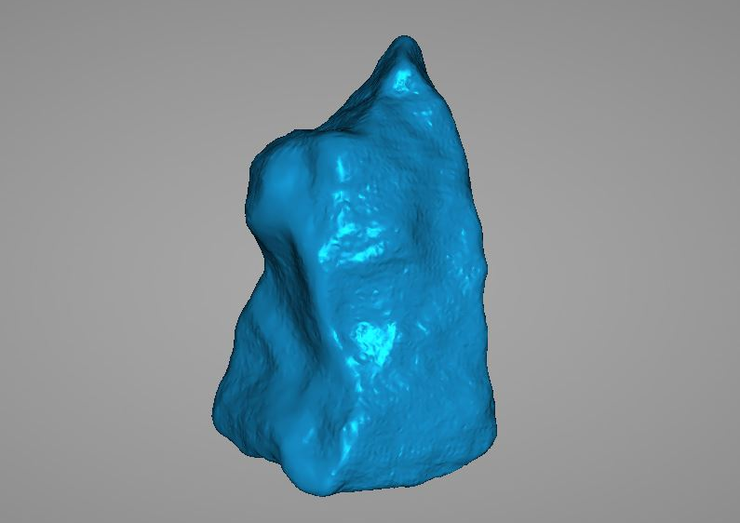
LABORATORY TESTING
Shining 3D – EinScan-SP
White background for noise
elimination
Test material
EinScan-SP
Notes:
This slide shows the Shining 3D – EinScan-SP setup. After several trials, we decided to place a white background to eliminate the noise that occurs frequently during scanning. After the placement of white background, the noise was reduced significantly. On the right-hand side, two examples are shown regarding the 3D images created.

Slide 34
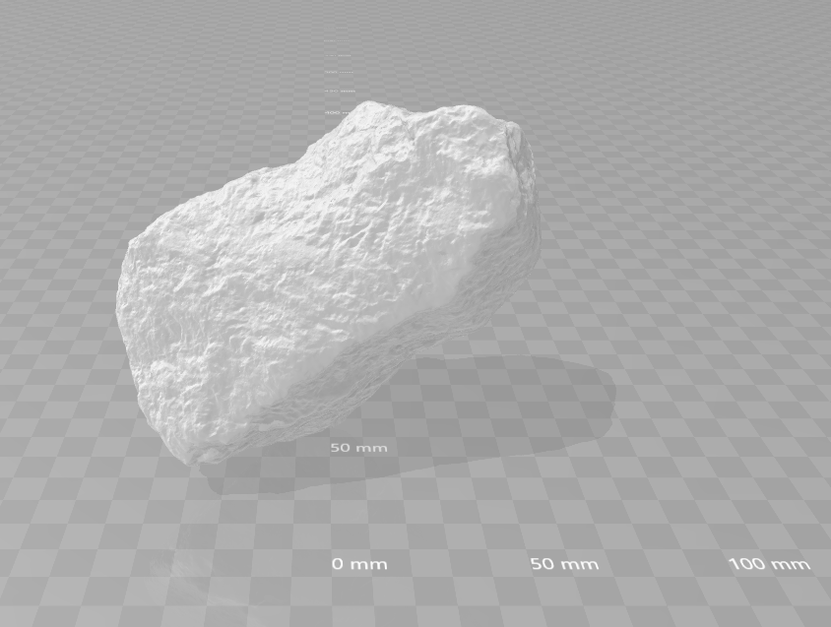

LABORATORY TESTING
Shining 3D – EinScan-SP
Side view
Top view
Notes:
The data is saved in 3D Builder format. This slide only shows side and top views as an example of the created 3D image.

Slide 35


LABORATORY TESTING
Asphalt Content Determination
Quantitative extraction – AASHTO T 164
Ignition method – AASHTO T 308
  RCA+RAP ➔ 3.2% asphalt binder
  Class 6 aggregate ➔ 3.3% asphalt binder
RCA+RAP
Class 6 Aggregate
Notes:
For asphalt content determination, both quantitative extraction and ignition methods were decided to be performed. Loss of fines is expected with the ignition method; therefore, higher-than-actual amount of asphalt binder can be determined. The reason is that fine asphalt particles have very low specific gravity, which means that they are lighter than other particles. During the ignition, burned asphalt turns into ash and collected by the fume hood. In addition to the ash, lightweight fine particles can also be collected by the fume.
Ignition method is very straightforward. To check the accuracy of the ignition method, quantitative extraction will also be used. So far, only two ignition tests could be completed for RCA+RAP and Class 6 aggregate materials. Other tests are in progress and their data will be provided shortly.

Slide 36


LABORATORY TESTING
Permeability Test
ASTM D5084
Specimens prepared in standard compaction mold
Flexible wall permeameter

Slide 37

LABORATORY TESTING
Permeability Test
DOC = degree of compaction

Slide 38

LABORATORY TESTING
Permeability Test
Degree of compaction
  100, 95, and 90%

Slide 39


LABORATORY TESTING
Soil-Water Characteristic Curve (SWCC) Test
ASTM D6836
Hanging column test ➔ Pressure plate test
Cementation of RCA during the test period
Cementation of RCA
Pressure plates
Activity meter

Slide 40


LABORATORY TESTING
Soil-Water Characteristic Curve (SWCC) Test
Van Genuchten (1980) model
$$\text{Θ}\text{ =} \frac{\text{θ}\text{ − }{\text{θ}}_{\text{r}}}{{\text{θ}}_{\text{s}} \text{−}{ \text{θ}}_{\text{r}}} \text{=}{\left[\frac{\text{1}}{\text{1 + }{\left(\text{αψ}\right)}^{\text{n}}}\right]}^{\text{m}}$$
$\text{Θ}$= Normalized volumetric water content
$\text{Θ}$ = Soil volumetric water content
${\text{θ}}_{\text{r}}$ = Residual volumetric water content
${\text{θ}}_{\text{s}}$ = Saturated volumetric water content
$Ψ$ = Matric suction
$\text{α}$, n, and m : Van Genuchten fitting parameters
Parameter | Value
θ_{r} | 0
θ_{s} | 0.2812
α | 0.0317
n | 1.2091
m | 0.1730

Slide 41

LABORATORY TESTING
Soil-Water Characteristic Curve (SWCC) Test

Slide 42


LABORATORY TESTING
Soil-Water Characteristic Curve (SWCC) Test
Degree of compaction $↓$ initial volumetric water content $↑$

Slide 43

WHAT HAVE WE LEARNED?
Recycled Aggregate Base Layers
  No considerable problem during construction
Stiffness of coarse & fine RCA > limestone & RCA+RAP
  Cementation of unhydrated cement
  Higher angularity and rougher surface texture
Stiffness of fine RCA > coarse RCA
  Fines content $↑$ unhydrated cement content $↑$
Stiffness of RCA+RAP $\text{≤}$ limestone
  Literature $→$ RCA & RAP > VA

Slide 44

WHAT HAVE WE LEARNED?
Recycled Aggregate Base Layers
Stiffness of RCA+RAP < coarse & fine RCA
  Literature $→$stiffness of RCA > RAP
  Higher angularity and rougher surface texture
  Hydrophobicity of RAP
Coarse & fine RCA $→$ stress-hardening
Limestone & RCA+ RAP $→$ stress-softening
  Soft or wet subgrade condition

Slide 45
WHAT HAVE WE LEARNED?
Large Stone Subbase with or without Geosynthetics
Problematic construction of LSSB
  Impracticality of two-lift construction for 18 in LSSB
  Subgrade soil pumping due to large opening size of LSSB
  Rutting
Varying stiffness in LSSB sections
  May be due to compactability of LSSB
Stiffness of class 5Q < class 6
Speculations:
  Instability of 9 in LSSB
  Insufficient compaction of class 5Q
  Suitability of 18 in LSSB
Effects of geosynthetics were not discernable

Slide 46

WHAT HAVE WE LEARNED?
Test Materials
Class 6 & class 5Q $→$not natural
  Class 6 has some RAP
  Class 5Q has some RCA
Clay loam $→$ considerably lower K_{sat} than those of aggregates
Degree of compaction $↓$ K_{sat} $↑$
Cementation of RCA during tests
Good integrity between pressure plate and activity meter

Slide 47
FUTURE EXPECTATIONS
Compositions of materials – asphalt & cement content
Other physical properties – image analysis
  Angularity and sphericity
  Particle size distribution
Hydrophilicity & hydrophobicity – contact angle measurements
Degradation – gyratory compaction & percent crushing
Long-term performance evaluation

Slide 48


















































Thank You

Slide 49
REFERENCES
ACPA (2010). Why Recycle Concrete Pavements? TS043.1P. American Concrete Paving Association, Skokie, IL. http://1204075.sites.myregisteredsite.com/downloads/TS/EB0 43P /TS04 3.1P.pdf.
CalTrans (2015). Standard Specifications. California Department of Transportation, Sacramento, CA.
IDOT (2016). Standard Specifications for Road and Bridge Construction. Illinois Department of Transportation, Springfield, IL.
Kazmee, H., Mishra, D., & Tutumluer, E. (2015). Sustainable alternatives in low volume road base course applications evaluated through accelerated pavement testing. In IFCEE 2015 (pp. 409-418).
Kazmee, H., Tutumluer, E., & Beshears, S. (2016). Pavement working platforms constructed with large-size unconventional aggregates. Transportation Research Record: Journal of the Transportation Research Board, (2578), 1-11.
Li, C., Ashlock, J. C., White, D. J., Jahren, C. T., & Cetin, B. (2017). Gyratory abrasion with 2D image analysis test method for evaluation of mechanical degradation and changes in morphology and shear strength of compacted granular materials. Construction and Building Materials, 152, 547-557.
MnDOT (2014a). Building Temperature Sensing Arrays (Thermocouple Trees), http://www.dot.state.mn.us/mnroad/pdfs/BuildingTemperatureSensors-TCTree(April201 4).pdf.
MnDOT (2014b). Moisture Content – EW (EC, ET), http://www.dot.state.mn.us/mnroad/data/ pdfs/Base_Moisture_EC_EW_ET.pdf.
MoDOT (2018). Missouri Standard Specifications for Highway Construction. Missouri Highways and Transportations Comission.
Mooney, M., Rinehart, R., White, D., Vennapusa, P., Facas, N., & Musimbi, O. (2010). Intelligent soil compaction systems. NCHRP Report 676. National Cooperative Highway Research Program, Washington, D.C.
USGS (2018). Mineral Commodity Summaries. US Geological Survey.
Van Deusen, D., Burnham, T., Dai, S., Geib, J., Hanson, C., Izevbekhai, B., Johnson, E., Palek, L., Siekmeier, J., Vrtis, M., & Worel, B. (2018). Report on 2017 MnROAD construction activities. Report No. MN/RC 2018-16. Minnesota Department of Transportation, St. Paul, MN.
Vennapusa, P. K. R., White, D. J., Siekmeier, J., & Embacher, R. A. (2012). In situ mechanistic characterisations of granular pavement foundation layers. International Journal of Pavement Engineering, 13(1), 52-67.
Vennapusa, P. K., & White, D. J. (2009). Comparison of light weight deflectometer measurements for pavement foundation materials. Geotechnical Testing Journal, 32(3), 1-13.
White, D. J., & Vennapusa, P. (2017) 2017 MnROAD unbound layer evaluation using intelligent compaction: Ingios validated intelligent compaction (VIC) results. Report No. 2017-043. Ingios Geotechnics.
WisDOT (2018). Standard Specifications. Wisconsin Department of Transportation, WI.

Slide 50


Thank You!
QUESTIONS??

Slide 51

INTRODUCTION
Flexible pavements
  90% of the paved roads
Load distribution
Aggregate base layer
  Primary load carrying sublayer
  Stiff and permeable
Subbase layer
  Optional
  Secondary load carrying sublayer
  Separation
  Working platform
  Highly permeable

Slide 52


INTRODUCTION
1.33 billion tons of virgin aggregates (VAs) in 2017 (USGS 2018)
76% for roadway construction (USGS 2018)
Price of conventional VAs $↑$(ACPA 2010)
Alternative materials
https://pubs.usgs.gov/of/2011/1119/pdf/OF11-1119_report_508.pdf

Slide 53

LITERATURE REVIEW
For RCA and RAP
Angularity ➔ RCA > RAP
Maximum dry ➔ VA > RCA & RAP
density
Optimum moisture ➔ RCA > VA > RAP
content
Hydrophobicity ➔ RAP > RCA
Permeability ➔ RAP > RCA
Stiffness ➔ RCA & RAP > VA
Strength ➔ RCA > VA > RAP
Durability ➔ RCA > RAP > VA

Slide 54
LITERATURE REVIEW
For LSSB
Limitations of laboratory equipment (Kazmee et al. 2016)
Inconsistent field data (Kazmee et al. 2016)
  Fluctuation of the data
Mobilization of particles (Kazmee et al. 2016)
  Large voids
  Reorientation
Lack of design methods & construction
specifications
Limited applications

Slide 55


CONSTRUCTION
Large Stone Subbase
Non-traditional subgrade preparation
  Weak subgrade
  DCP index between 2.5 – 3.5 in/blow (64 – 89 mm/blow)
  Upper 1 ft (0.3 m)
  Loosening & watering
(Van Deusen et al. 2018)
(White and Vennapusa 2017)

Slide 56





CONSTRUCTION
Sensors
Environmental monitoring
  Thermocouples
  Moisture probes
Dynamic response monitoring
  Dynamic pressure cells
  Geophones
  Dynamic strain gauges
Thermocouple tree
(MnDOT 2014a)
Moisture probe
(MnDOT 2014b)
Dynamic pressure cell
Geophone
Dynamic strain gauge
(Van Deusen et al. 2018)
(Van Deusen et al. 2018)
(Van Deusen et al. 2018)

Slide 57
CONSTRUCTION
Sensors
TC = Thermocouple
EC = Moisture probe
PG = Dynamic pressure cell
GP = Geophone
LE = Longitudinal dynamic
strain gauge
TE = Transverse dynamic
strain gauge
Cell Number | Environmental Sensors |  | Dynamic Response Sensors
 | Thermocouples | Moisture Probes | Dynamic Pressure Cells | Geophones | Dynamic Strain Gauges
185 | 12 | 4 | 2 | 4 | NA
186 | 12 | 4 | 2 | 4 | 4
188 | 12 | 4 | 2 | 4 | 4
189 | 12 | 4 | 2 | 4 | NA
127 | 12 | 3 | 2 | NA | NA
728 | 16 | 4 | 2 | NA | 4

Slide 58
CONSTRUCTION
Recycled Aggregate Base
      Subgrade ➔ Cells 185 & 186 – sand
      Cells 188 & 189 – clay loam
      Subbase ➔ Select granular borrow
      Base ➔ Cell 185 – coarse RCA
      Cell 186 – fine RCA
      Cell 188 – limestone
      Cell 189 – RCA+RAP blend
      Surface ➔ 12.5 mm NMAS Superpave

Slide 59


CONSTRUCTION
Large Stone Subbase
Non-traditional subgrade preparation – cont’d
  Mellowing
Placement of LSSB
Impractical two-lift construction
(White and Vennapusa 2017)
(White and Vennapusa 2017)

Slide 60


CONSTRUCTION
Large Stone Subbase with Geosynthetics
Initial plan
  Only two cells
  No geosynthetics
Problems
  Subgrade soil pumping
  Rutting
(White and Vennapusa 2017)
(White and Vennapusa 2017)

Slide 61

CONSTRUCTION
Large Stone Subbase with Geosynthetics
(Van Deusen et al. 2018)

Slide 62
CONSTRUCTION
Large Stone Subbase with Geosynthetics
Excavation to subgrade layers
Reconstruction
Reconstruction

Slide 63


CONSTRUCTION
Large Stone Subbase with Geosynthetics
Non-traditional subgrade preparation procedure
  DCP index between 2.5 – 3.5 in/blow (64 – 89 mm/blow)
Geosynthetics
  Triaxial geogrid (TX)
  Biaxial geogrid (BX)
  Nonwoven geotextile (GT)
(White and Vennapusa 2017)

Slide 64
FIELD TESTING
Meteorological Data
Air temperature – 40°F (4°C) and 91°F (33°C) during construction
Relative humidity – 15% – 102%
Wind speed & direction
Precipitation

Slide 65

FIELD TESTING
Nuclear Density Test
Direct transmission mode (ASTM D6938) for 60 seconds
  4 in (102 mm), 6 in (152 mm), or 8 in (203 mm) deep test holes
  Calibration with laboratory measurements

Slide 66

FIELD TESTING
Nuclear Density Test

Slide 67

FIELD TESTING
Dynamic Cone Penetrometer (DCP) Test
ASTM D6951
17.6 lb (8 kg) hammer
22.6 in (575 mm) drop height

Slide 68
FIELD TESTING
Lightweight Deflectometer (LWD) Test
ASTM E2835
Applied stress = 27.5 psi (190 kPa) (Vennapusa and White 2009)
Influence depth = 8 to 12 in (200 to 300 mm) (Mooney et al. 2010; Vennapusa et al. 2012)

Slide 69


FIELD TESTING
Gas Permeameter Test (GPT)
GPT device containing a self-contained pressurized gas system with a self-sealing base plate.
  Saturated hydraulic conductivity (K_{Sat}) is derived from gas flow and pressure measurements by using the Darcy’s Law.
(White et al. 2010)
S = saturation level

Slide 70



FIELD TESTING
Intelligent Compaction (IC) Test
Preliminary IC mapping
Automated plate load testing (APLT)
Cyclic stress-dependent resilient modulus (M_{R})
  10 psi (69 kPa) and 30 psi (207 kPa) plate contact stresses
Influence depth = 2.5 to 5 ft (0.8 to 1.5 m) (Mooney et al. 2010; Vennapusa et al. 2012)
Vibratory smooth drum roller
IC mapping
APLT
(White and Vennapusa 2017)

Slide 71

FIELD TESTING
Intelligent Compaction (IC) Test
Before paving
Composite analysis
Layered analysis
  Base+subbase
  Subgrade
Base+
Subbase
Composite
Subgrade

Slide 72

FIELD TESTING
Intelligent Compaction (IC) Test

Slide 73

FIELD TESTING
Automated Plate Load Testing (APLT)
(White and Vennapusa 2017)

Slide 74





FIELD TESTING
Automated Plate Load Testing (APLT)

Slide 75
FIELD TESTING
Falling Weight Deflectometer (FWD) Test
Depth to water table

Slide 76


LABORATORY TESTING
Atterberg Limits
BS 1377-2 – Liquid limit (fall cone penetrometer)
ASTM D4318 – Plastic limit (rolling device)
Materials with fines contents more than 5%
Material | Gravel (%) | Sand (%) | Fines (%)
Coarse RCA | 61.7 | 34.9 | 3.4
Fine RCA | 38.3 | 54.6 | 7.1
Limestone | 52.3 | 32.6 | 15.1
RCA+RAP | 41 | 50.4 | 8.6
Class 6 Aggregate | 35.1 | 58.6 | 6.3
Class 5Q Aggregate | 65.9 | 30.9 | 3.2
S. Granular Borrow | 31.1 | 56.5 | 12.4
LSSB | 99.6 | 0.3 | 0.1
Sand Subgrade | 27.6 | 59.8 | 12.6
Clay Loam | 3.1 | 37.2 | 59.7
Fall cone penetrometer
Rolling device
Fines = silt and clay

Slide 77







LABORATORY TESTING
Atterberg Limits
Material | LL | PL | PI
Coarse RCA | NA | NA | NP
Fine RCA | 32.7 | NA | NP
Limestone | 17.9 | NA | NP
RCA+RAP | 27.4 | NA | NP
Class 6 Aggregate | 27.4 | NA | NP
Class 5Q Aggregate | NA | NA | NP
S. Granular Borrow | 18.9 | NA | NP
LSSB | NA | NA | NP
Sand Subgrade | 19.9 | NA | NP
Clay Loam | 36.3 | 23.9 | 12.4
LL = liquid limit; PL = plastic limit;
PI = plasticity index; NA = not available; NP = non-plastic

Slide 78



LABORATORY TESTING
Specific Gravity & Absorption
Three specific gravity terms (ASTM C127 & C128):
  Oven-dry (OD) or bulk specific gravity
  Saturated surface dry (SSD) specific gravity
  Apparent specific gravity
1.
2.
3.
Dry aggregate
Bulk volume
SSD aggregate
Bulk volume
Dry aggregate
Net volume
http://www.ce.memphis.edu/3137/Powerpoint%20Handouts/3%20-%20Relative%20Density%20and%20Absorption.pdf

Slide 79


LABORATORY TESTING
Proctor Compaction
ASTM D1557 - Modified Proctor
6-in mold
Material | Test Method
Coarse RCA | Method C
Fine RCA
Limestone
RCA+RAP
Class 6 Aggregate
Class 5Q Aggregate
S. Granular Borrow
LSSB | NA
Sand Subgrade | Method C
Clay Loam | Method A
6-in mold
5 layers
56 blows per layer
Material passing 3/4-in sieve
(ASTM D1557)
4-in mold
4-in mold
5 layers
25 blows per layer
Material passing No. 4 sieve
NA = not available
(ASTM D1557)

Slide 80
LABORATORY TESTING
Proctor Compaction
ASTM D4718 – Correction for oversize particles
Uncorrected – Test Data
Corrected
Material | MDD |  | OMC (%)
 | (pcf) | (kN/m³)
Coarse RCA | 122.9 | 19.31 | 11.3
Fine RCA | 121.6 | 19.10 | 11.1
Limestone | 142.2 | 22.34 | 6.2
RCA+RAP | 125.6 | 19.73 | 10
Class 6 Aggregate | 128.2 | 20.14 | 8.3
Class 5Q Aggregate | 122.6 | 19.26 | 11
S. Granular Borrow | 138.6 | 21.77 | 5.4
LSSB | NA | NA | NA
Sand Subgrade | 136.6 | 21.46 | 5.7
Clay Loam | 123.9 | 19.46 | 10
Material | Corrected MDD |  | Corrected OMC (%)
 | (pcf) | (kN/m³)
Coarse RCA | 128.6 | 20.19 | 9.5
Fine RCA | 121.7 | 19.12 | 11.1
Limestone | 143.2 | 22.49 | 6.3
RCA+RAP | 125.8 | 19.76 | 10.0
Class 6 Aggregate | 128.6 | 20.19 | 8.3
Class 5Q Aggregate | 128.0 | 20.11 | 9.6
S. Granular Borrow | 140.3 | 22.03 | 5.3
LSSB | NA | NA | NA
Sand Subgrade | 137.7 | 21.63 | 5.6
Clay Loam | 123.9 | 19.46 | 10.0
MDD = maximum dry density; OMC = optimum moisture content; NA = not available
MDD = maximum dry density; OMC = optimum moisture content; NA = not available

Slide 81



LABORATORY TESTING
Stereophotography
Camera
Test material
Image station
Camera slider

Slide 82



LABORATORY TESTING
Sphericity:
Roundness:

Slide 83
LABORATORY TESTING
Permeability Test
Cell Number | Sample ID | Material Description | w (%) | γ_{d} |  | K_{sat}
 |  |  |  | pcf | kN/m³ | (in/sec) | (cm/sec)
185 | 18517GS002 | Coarse RCA | 10.5 | 122.4 | 19.22 | 3.93E-05 | 9.97E-05
 | 18517GS004 |  | 10.5 | 122.4 | 19.22 | 1.60E-04 | 4.06E-04
 | 18517GS008 |  | 10.5 | 122.4 | 19.22 | 3.28E-04 | 8.34E-04
186 | 18617GS006 | Fine RCA | 10.9 | 121.1 | 19.02 | 2.09E-04 | 5.32E-04
 | 18617GS007 |  | 10.9 | 121.1 | 19.02 | 1.94E-04 | 4.94E-04
 | 18617GS008 |  | 10.9 | 121.1 | 19.02 | 1.33E-04 | 3.38E-04
188 | 18817GS005 | Limestone | 6.6 | 143.0 | 22.46 | 1.90E-05 | 4.82E-05
 | 18817GS006 |  | 6.6 | 143.0 | 22.46 | 1.93E-05 | 4.89E-05
 | 18817GS008 |  | 6.6 | 143.0 | 22.46 | 1.34E-05 | 3.41E-05
189 | 18917GS002 | RCA+RAP | 10.5 | 123.0 | 19.32 | 4.84E-05 | 1.23E-04
 | 18917GS003 |  | 10.5 | 123.0 | 19.32 | 1.91E-04 | 4.85E-04
 | 18917GS006 |  | 10.5 | 123.0 | 19.32 | 1.10E-04 | 2.80E-04
127 | 12717GS001 | Class 6 Aggregate | 4.2 | 112.4 | 17.65 | 3.31E-03 | 8.40E-03
 | 12717GS002 |  | 3.9 | 112.4 | 17.65 | 2.90E-03 | 7.37E-03
 | 12717GS003 |  | 4.4 | 114.2 | 17.95 | 2.78E-03 | 7.05E-03
 | 12717GS004 |  | 4.2 | 110.5 | 17.36 | 5.28E-03 | 1.34E-02
228 | 22817GS001 | Class 5Q Aggregate | 6.6 | 113.0 | 17.75 | 9.41E-03 | 2.39E-02
 | 22817GS002 |  | 7 | 106.1 | 16.67 | 2.07E-03 | 5.26E-03
 | 22817GS003 |  | 5.3 | 111.1 | 17.46 | 4.61E-03 | 1.17E-02
 | 22817GS004 |  | 6.3 | 108.6 | 17.06 | 2.10E-03 | 5.33E-03

Slide 84
LABORATORY TESTING
Permeability Test
Cell Number | Sample ID | Material Description | w (%) | γ_{d} |  | K_{sat}
 |  |  |  | pcf | kN/m³ | (in/sec) | (cm/sec)
185 | 18517SS006 | Sand Subgrade | 4.5 | 119.2 | 18.73 | 8.50E-04 | 2.16E-03
 | 18517SS007 |  | 3.7 | 119.9 | 18.83 | 6.57E-03 | 1.67E-02
186 | 18617SS006 | Sand Subgrade | 4.78 | 115.5 | 18.14 | 1.69E-04 | 4.30E-04
 | 18617SS007 |  | 4 | 119.2 | 18.73 | 2.54E-04 | 6.46E-04
188 | 18817SS006 | Clay Loam | 10.08 | 123.6 | 19.42 | 1.60E-07 | 4.07E-07
 | 18817SS007 |  | 9.79 | 124.2 | 19.52 | 1.95E-07 | 4.95E-07
127 | 12717SS001 | Clay Loam | 10.07 | 123.6 | 19.42 | 3.75E-08 | 9.53E-08
 | 12717SS002 |  | 9.04 | 119.9 | 18.83 | 2.59E-07 | 6.58E-07
 | 12717SS003 |  | 9.7 | 124.2 | 19.52 | 8.19E-08 | 2.08E-07
227 | 22717SS001 | Clay Loam | 9.69 | 121.7 | 19.12 | 1.5E-07 | 3.92E-07

Slide 85
LABORATORY TESTING
Permeability Test
Material Description | Degree of Compaction (%) | w (%) | γ_{d} |  | K_{sat}
 |  |  | pcf | kN/m³ | (in/sec) | (cm/sec)
Coarse RCA | 100 | 10.97 | 123.0 | 19.32 | 5.00E-05 | 1.27E-04
 | 95 | 10.99 | 117.4 | 18.44 | 1.92E-04 | 4.88E-04
 | 90 | 11.5 | 110.5 | 17.36 | 2.63E-04 | 6.68E-04
Fine RCA | 100 | 11.07 | 121.7 | 19.12 | 1.88E-04 | 4.77E-04
 | 95 | 11.06 | 115.5 | 18.14 | 3.90E-04 | 9.90E-04
 | 90 | 11.05 | 109.2 | 17.16 | 3.98E-04 | 1.01E-03
Limestone | 100 | 6.13 | 143.0 | 22.46 | 3.17E-05 | 8.05E-05
 | 95 | 6.11 | 135.5 | 21.28 | 7.52E-05 | 1.91E-04
 | 90 | 6.08 | 128.0 | 20.10 | 1.29E-04 | 3.28E-04
RCA+RAP | 100 | 9.84 | 125.5 | 19.71 | 5.24E-05 | 1.33E-04
 | 95 | 9.76 | 119.9 | 18.83 | 1.89E-04 | 4.79E-04
 | 90 | 9.94 | 113.0 | 17.75 | 5.79E-04 | 1.47E-03
Clay Loam | 100 | 10.78 | 123.0 | 19.32 | 5.39E-08 | 1.37E-07
 | 95 | 10.92 | 116.7 | 18.34 | 5.94E-07 | 1.51E-06
 | 90 | 10.53 | 111.1 | 17.46 | 2.70E-06 | 6.86E-06

Slide 86



LABORATORY TESTING
Soil-Water Characteristic Curve (SWCC) Test
Soil-Water Characteristic Curve (SWCC)
Increasing Suction, Decreasing Saturation
Hydraulic Conductivity Function (HCF)
(Lu and Likos 2004)

Slide 87





LABORATORY TESTING
Soil-Water Characteristic Curve (SWCC) Test
Dry Sand
Saturation = 0.17
Saturation = 0.40
Saturation = 0.70
Saturation = 0.80

Slide 88

LABORATORY TESTING
Soil-Water Characteristic Curve (SWCC) Test

Slide 89
LABORATORY TESTING
Soil-Water Characteristic Curve (SWCC) Test
Parameter | Cell 185 - Coarse RCA |  |  | Cell 186 - Fine RCA
 | 18517GS002 | 18517GS004 | 18517GS008 | 18617GS006 | 18617GS007 | 18617GS008
θ_{r} | 0 | 0 | 0 | 0 | 0 | 0
θ_{s} | 0.2765 | 0.2782 | 0.2866 | 0.3004 | 0.2812 | 0.2846
α | 0.1508 | 0.2313 | 0.1174 | 0.1819 | 0.0317 | 0.0465
n | 1.1597 | 1.1559 | 1.7310 | 1.1650 | 1.2091 | 1.1787
m | 0.1377 | 0.1348 | 0.1475 | 0.1416 | 0.1730 | 0.1515
Parameter | Cell 188 - Limestone |  |  | Cell 189 - RCA+RAP
 | 18817GS005 | 18817GS006 | 18817GS008 | 18917GS002 | 18917GS003 | 18917GS006
θ_{r} | 0.0419 | 0.0221 | 0.0520 | 0.0070 | 0.0120 | 0
θ_{s} | 0.2414 | 0.2467 | 0.2449 | 0.2997 | 0.2987 | 0.2540
α | 0.1728 | 0.1909 | 0.1881 | 0.2805 | 0.2357 | 0.2960
n | 1.6088 | 1.5436 | 1.6808 | 1.2397 | 1.2602 | 1.1700
m | 0.3784 | 0.3522 | 0.4050 | 0.1934 | 0.2065 | 0.1453

Slide 90
SCHEDULE
TASKS | MONTHS
 | 1 | 2 | 3 | 4 | 5 | 6 | 7 | 8 | 9 | 10 | 11 | 12 | 13 | 14 | 15 | 16 | 17 | 18 | 19 | 20 | 21 | 22 | 23 | 24 | 25 | 26 | 27 | 28 | 29 | 30 | 31 | 32 | 33
Task 1
Task 2
Task 3
Task 4
Task 5
Task 6
Task 7
Task 8
Task 9

