Slide 1


2019 Pavement Workshop
May 21-23, 2019
Environmental Impacts on the Performance of Pavement Foundation Layers
Bora Cetin
Assistant Professor
Iowa State University
+ 46 Associate Members

Slide 2
RESEARCH TEAM
Iowa State University
Principal Investigator – Bora Cetin
  Assistant Professor – Department of Civil, Construction & Environmental Engineering
Research Personnel – Patrick Bollinger
  PhD Student – Department of Civil, Construction & Environmental Engineering
  GeoEngineering Consulting, LLC
Co-Principal Investigator – Tuncer B. Edil
  President and Chief Engineer

Slide 3
OUTLINE
Introduction
Research motivation
Objectives
Research plan
Future expectations

Slide 4
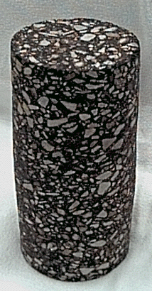
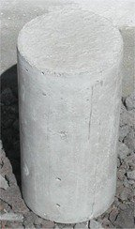
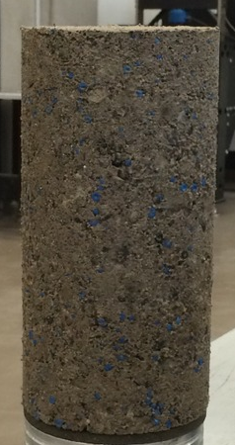
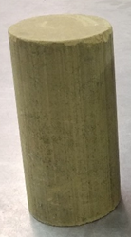
INTRODUCTION
HMA/PCC/Granular
Base Course
Subgrade

Slide 5
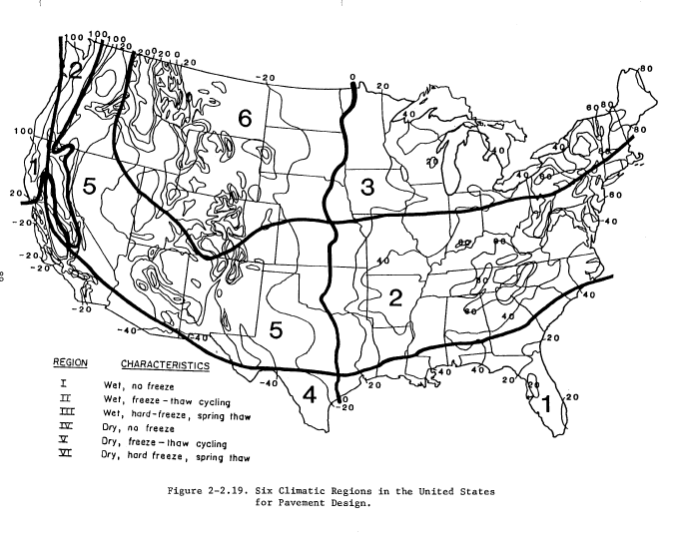
INTRODUCTION
Six climatic regions in the United States for pavement design

Slide 6
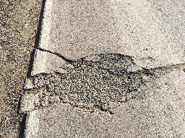
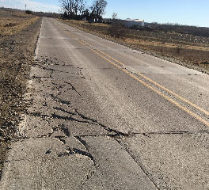
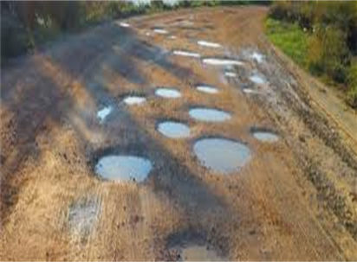
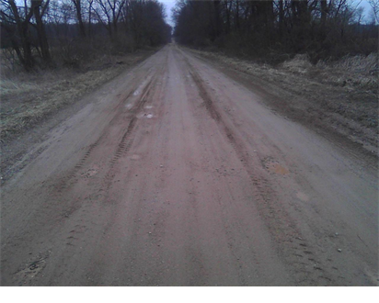
INTRODUCTION

Slide 7
INTRODUCTION
Characterization of Geomaterials
  Stiffness/Resilient modulus
  Permanent deformation
  Shear strength
  Freeze-thaw durability
  Moisture susceptibility
  Drainage

Slide 8
OBJECTIVES
1st Goal – Develop a model to predict:
Maximum/minimum frozen soil depth
2nd Goal – Develop a model to predict the pavement performance after severe freeze-thaw cycles
FWD
Index properties
Moisture changes
Duration of freezing/thawing
Thermo-hydro-mechanic model

Slide 9
RESEARCH PLAN
Task 1 – Initial memorandum on expected research benefits and potential implementation steps
Task 2 – Field data collection
Task 3 – Modelling analyses
Task 4– Draft/final report

Slide 10
Task 2-Field Data Collection
The following data will be collected
      FWD
      Frost heave-thaw settlement
      Temperature
      Moisture
      Matric suction
      Climate data
        Air temperature, wind speed, solar radiation, relative humidity, and precipitation

Slide 11
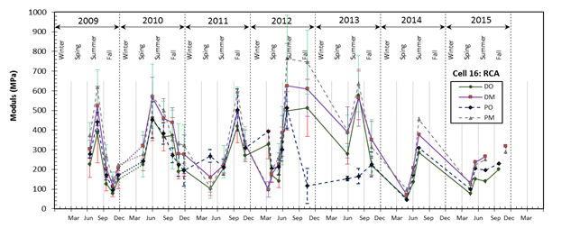
Task 2-Field Data Collection
FWD elastic modulus of RCA base layer during 7 years (Data collected from MnDOT 2008 project).

Slide 12
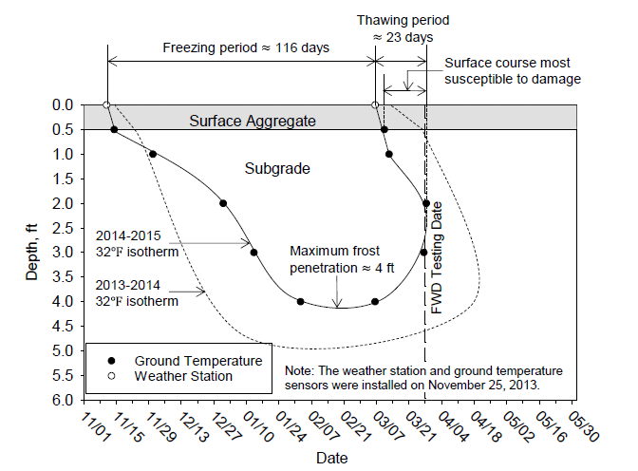
Task 2-Field Data Collection

Slide 13
Task 3-Modelling Analyses
Multi-physics Modelling
  Pavement parameters
  Soil parameters
  Climate data
Software
  SHAW
  COMSOL
  PLAXIS
  TEMP/W

Slide 14
Expected Research Results
Current Sensor Installation at MnDOT
TC = Thermocouple, EC = Moisture probe, PG = Dynamic pressure cell, GP = Geophone, LE = Longitudinal dynamic
strain gauge, TE = Transverse dynamic strain gauge

Slide 15
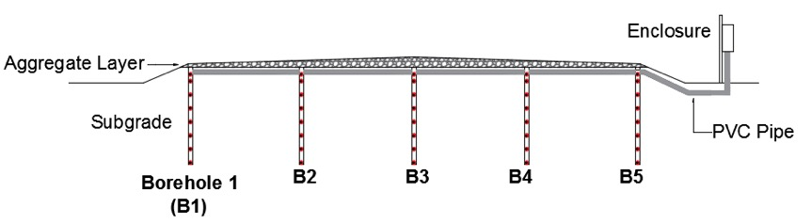
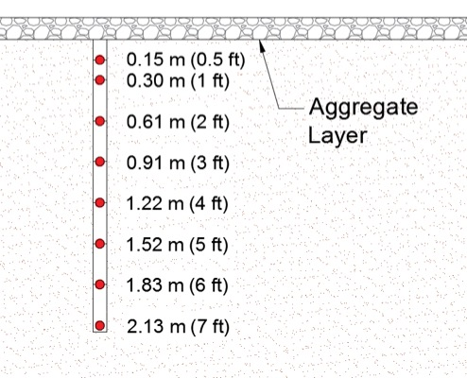
Expected Research Results
Proposed Sensor Installation at MnDOT

Slide 16


Task 4-Draft/Final Report
Notes:
Given the complexity of the system and dynamics of Iowa’s ever-changing granular road conditions due to:
Traffic, seasonal and weather conditions, and heavy ag loading; Conditions can change in hours rather than years, so surface condition (although important to know for maintenance purposes); is an ongoing effort and what we really interested in knowing is whether the system can withstand these pressures and continue to provide the desired service to the public.
GRAMS proposes to develop a user-friendly, systemic, risk-based evaluation tool to
Allow county engineers to better
-Tell the Story of Iowa low-vol roads to the public and elected officials.
-Perform meaningful Technical analysis, Based on objective criteria that supports tried and true rule-of-thumb decision making,
-As well as providing a tool to optimize granular resurfacing strategies and policies.

Slide 17
SCHEDULE

Slide 18


















































Thank You

