Slide 1


2019 Pavement Workshop
May 21-23, 2019
Research Project Geotechnical Team : Mechanistic Load Restriction Decision Platform for Pavement Systems Prone to Moisture Variations
Majid Ghayoomi and Eshan V. Dave
University of New Hampshire
+ 57 Associate Members

Slide 2
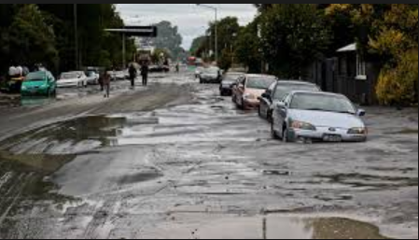

Motivation
A large portion of transportation agencies manage pavement systems with substantial subgrade moisture variations (both seasonal and post-storm)
A large number of pavement subgrade moisture related Load/Traffic Restriction decisions are based on empirical approaches:
  Fixed dates
  Use of ground freeze data from select locations
  Subjective opinion post-flooding
Above approaches do not integrate climate forecasting, soil-moisture state, pavement mechanics and traffic spectrum

Slide 3
Motivation (cont.)
Post-flooding traffic allowance and assessment
  FHWA Flooded Pavement Assessment Study (Daniel et al. 2018)
Reliable pavement bearing capacity and performance assessment system for current and forecasted moisture conditions
A mechanistic (real-time and forecasting) load restriction decision-platform for:
  Damage vulnerability determination
  Access to emergency responders
  Traffic decisions during and after periods of excessive moisture → especially post-flooding
  Maintenance and repair planning

Slide 4
NRRA Study Research Tasks (24 months)
Literature Review
System Dynamics Framework Development
Sensitivity Analysis and Framework Refinement
SLR Toolkit Development
Calibration and Preliminary Validation of the Toolkit using MnROAD Data

Slide 5
Research Approach
A comprehensive surface deflection platform incorporating components with major effects on pavement systems:
Structural Properties
  Pavement layer types, Modulus, Poisson’s Ratio, Thickness, etc.
Climatic Conditions
  Evaporation, Infiltration, Runoff, etc.
Soil Properties
  Soil Type, Density, PI, etc.
Loading Conditions
  Vehicle Type, Load Repetitions, etc.
SURFACE DEFLECTION
Structural Properties
Climatic Conditions
Loading Conditions
Soil Properties

Slide 6
Research Approach
Structural Properties
Climatic Conditions
Loading Conditions
Soil Properties
SURFACE DEFLECTION
System Dynamics for sensitivity assessment and to refine implementation
  Vensim
Decision Tool
  Vensim to User-friendly GUI
Calibration and Preliminary Validation
  MnROAD

Slide 7
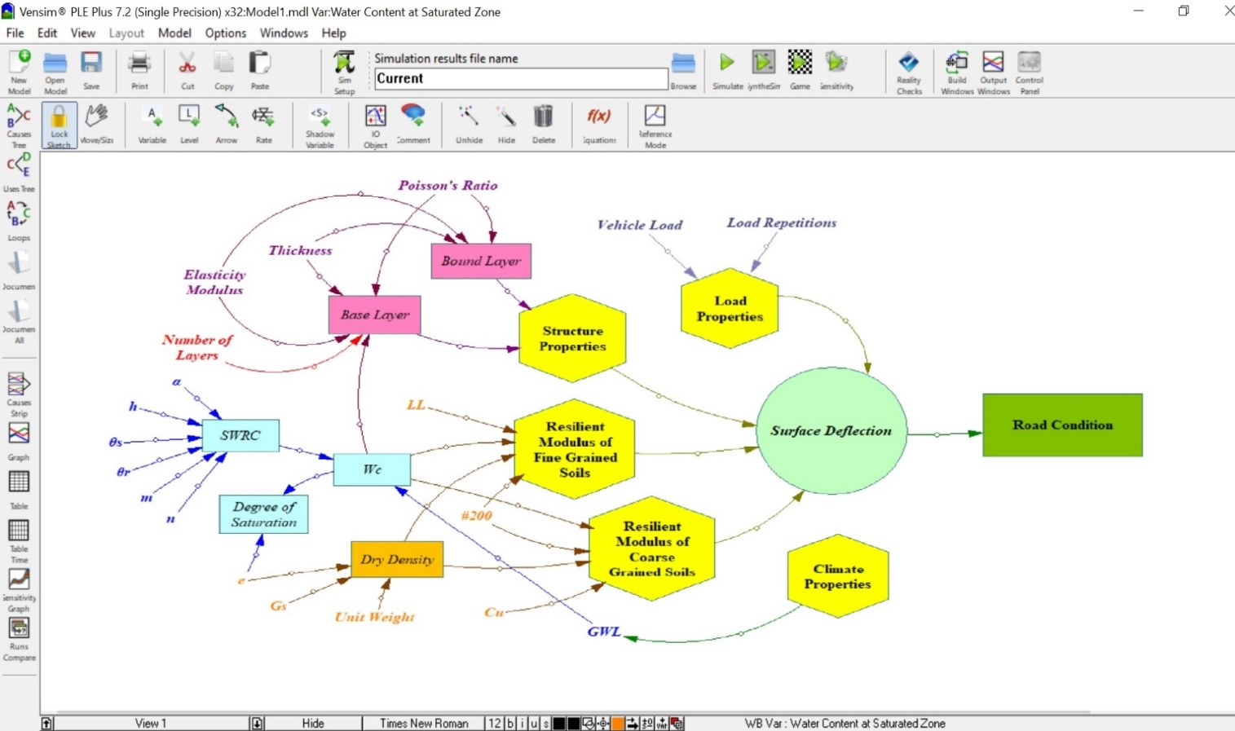
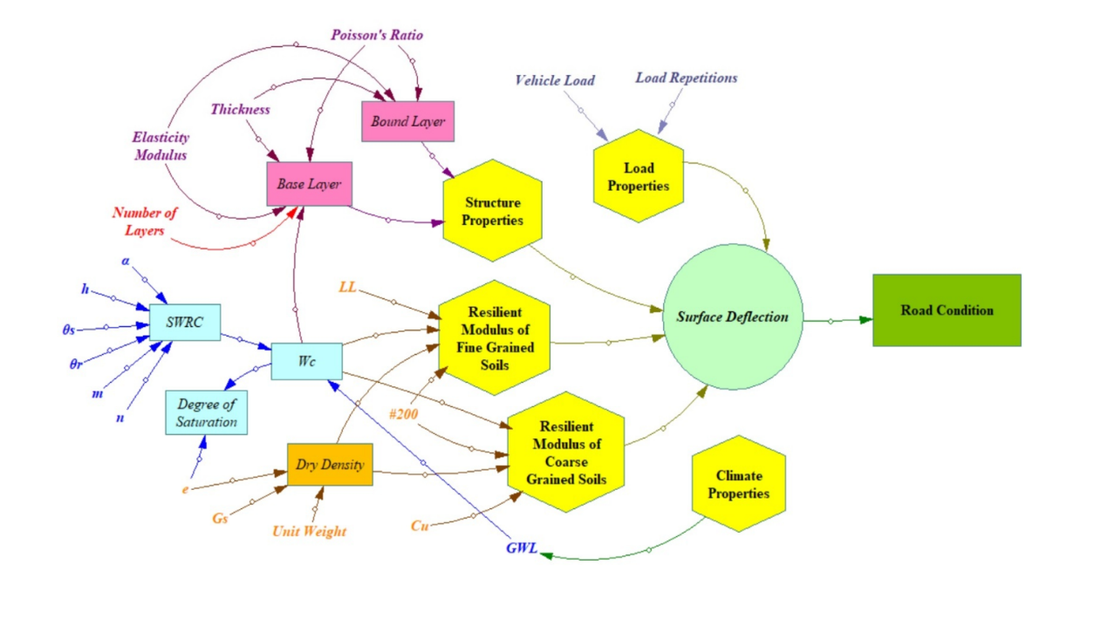
System Dynamics Approach
Vensim is industrial-strength simulation software for improving the performance of real systems.
Capable of conducting
  Sensitivity Analysis
  Reality Checks
  Instant output with continuous simulation
Different Models adopted from literature are related with each other using mathematical relationship among them.

Slide 8
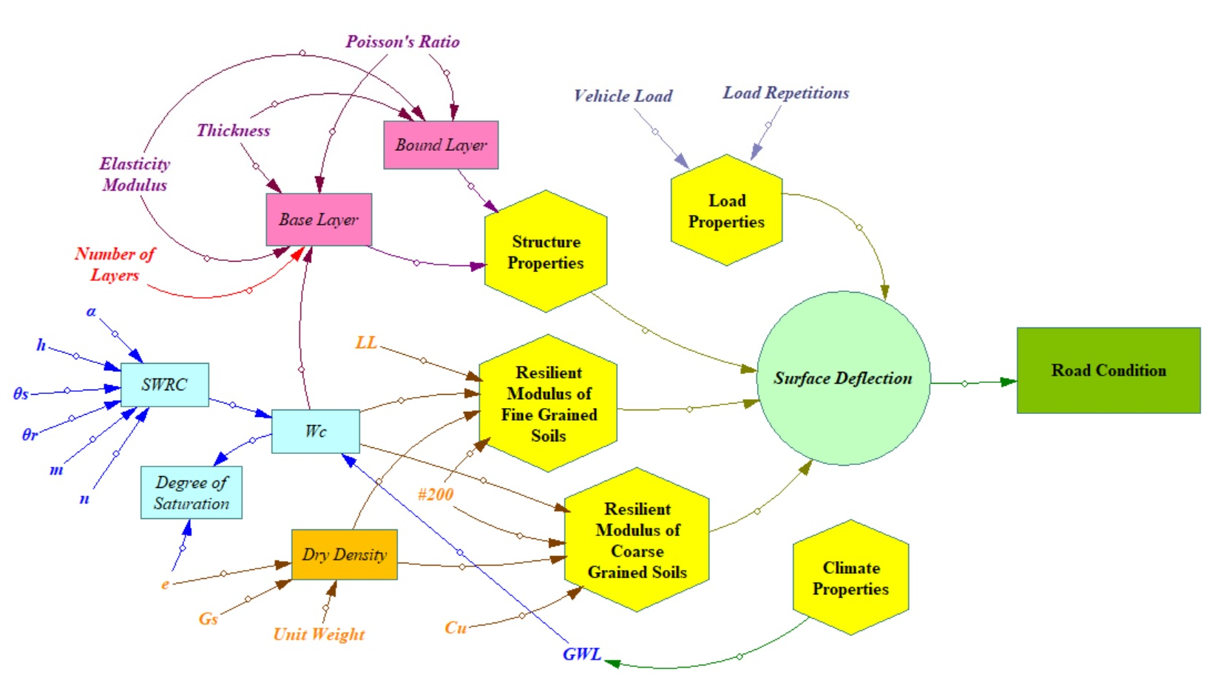

Slide 9
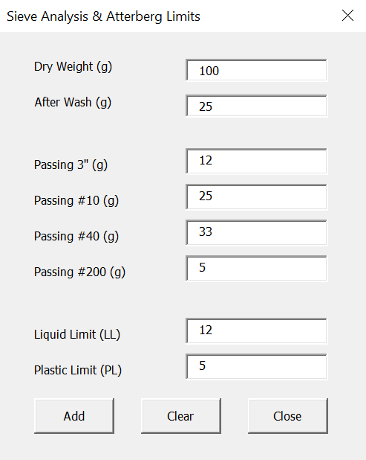
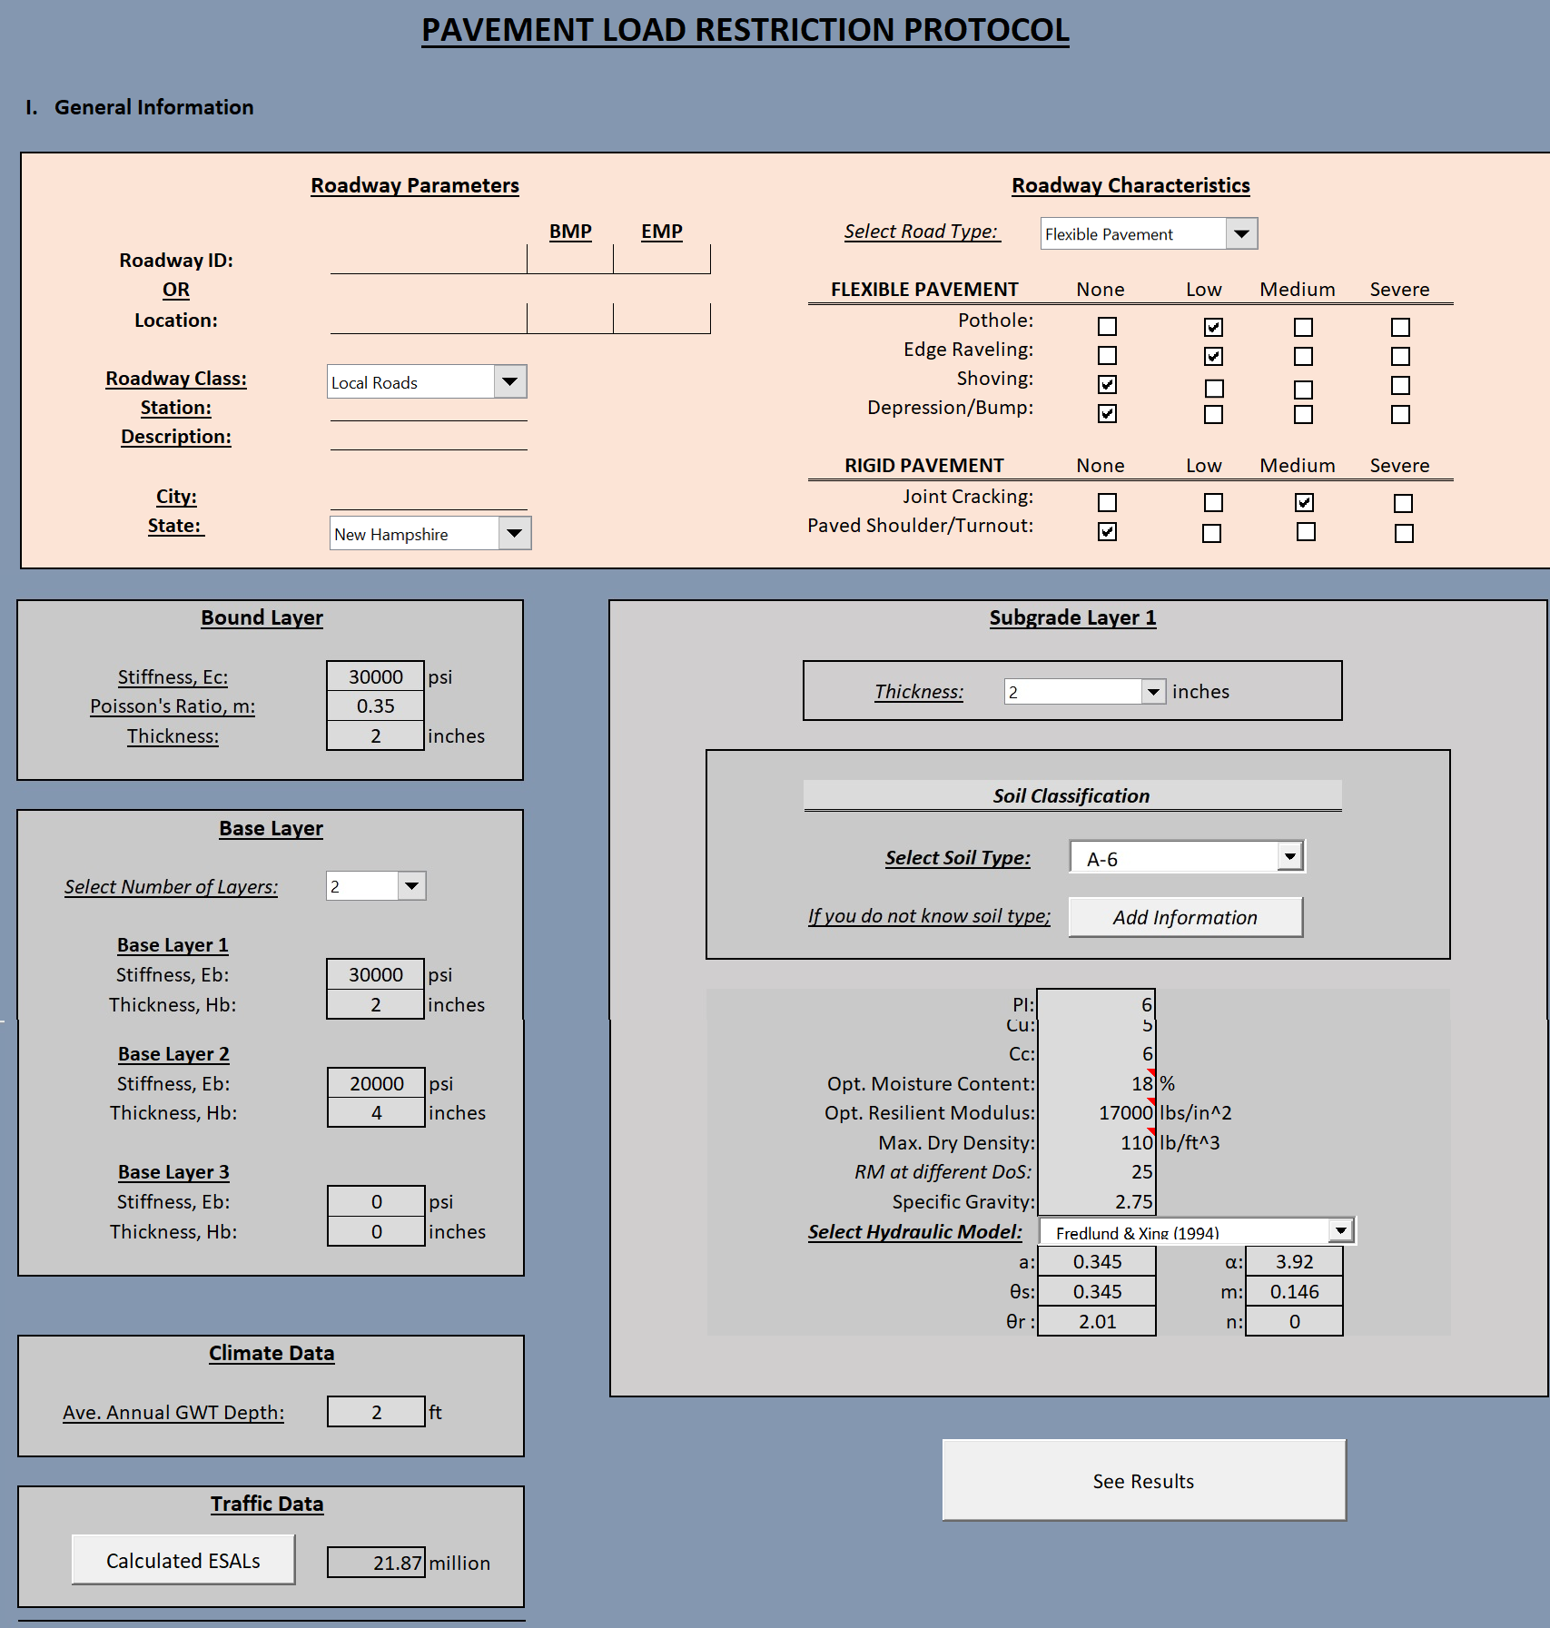
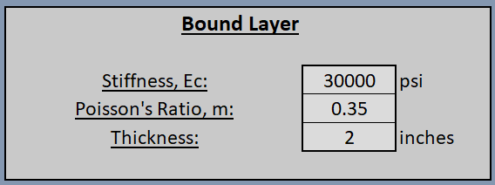
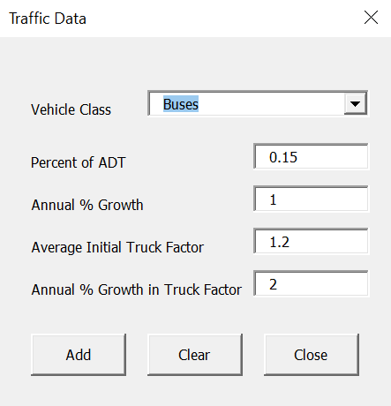
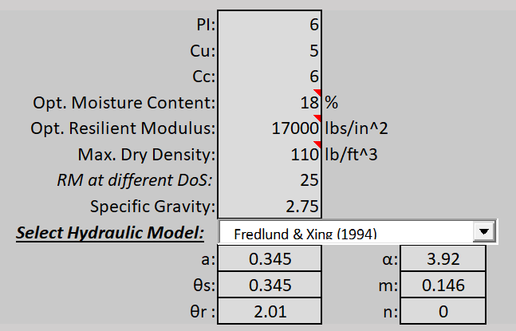
Decision Tool

Slide 10
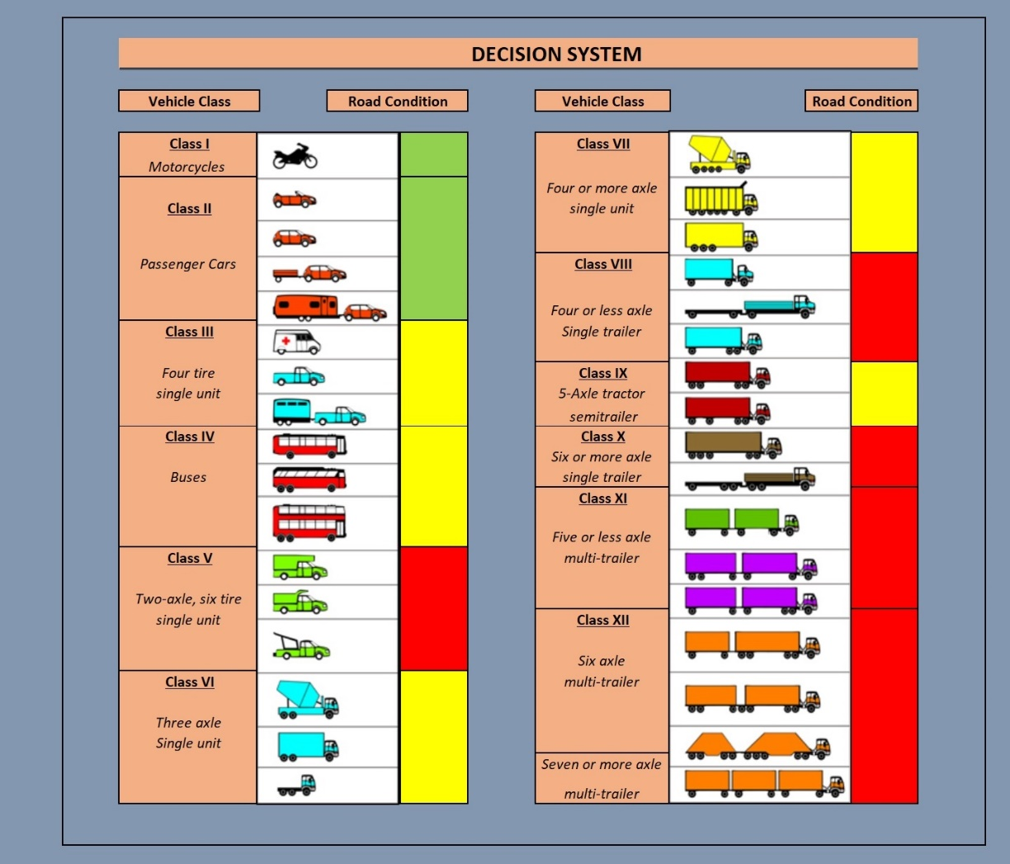
Decision Tool (cont’d)
Structural
Properties
Climatic Conditions
Soil Properties
Load Properties

Slide 11




Thank You!
Contact Information: majid.ghayoomi@unh.edu / eshan.dave@unh.edu

Slide 12
Background (1/2)
Excess pore water pressure may form under repeated action of traffic loads and can demote pavement performance (for example Gao et al., 2014).
    Positive pore pressure
    Reduction in suction
There are records of SLR as means to preserve roadway integrity from as early as 1937 (Ovik et al. 2000).
Past field assessment of flooded pavements; Zhang et al. (2008) for Hurricane Katrina, Clarke and Cosby (2007) for SH24 in McClain County, OK, and Vennapusa et al. (2013) for Missouri River flooding
Development of adaptation approaches to lower risk from flooding damage (Mallick et al. 2018, Knott et al. 2019)
Notes:
Add Zapata reference, Harvey, Flooded Pavement Work.

Slide 13
Literature Review (2/2)
Physical model test: Amiri and Nazarian (2004) «Impact of Moisture Variation on Stiffness Response of Pavements Through Small-Scale Models»
Unsaturated geomechanics and resilient modulus determination (ASU Zapata et al., 2010, 2011, 2015)
Many numerical pavement response models are available, majority of them do not directly incorporate mechanics/dynamics of unsaturated soils
A mechanistic deflection/capacity prediction strategy is needed that includes pore pressure generation/dissipation under dynamic loads and couples it with climate data

Slide 14
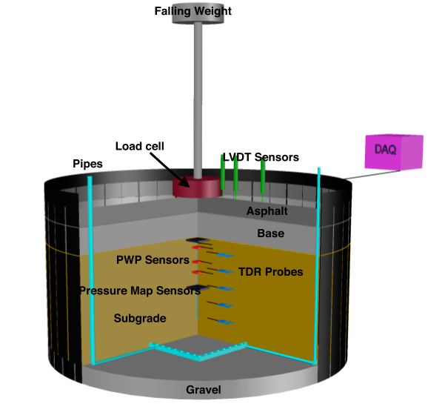
Scaled Physical Model
Loading System | Close-loop controlled servo-hydraulic
Load Cell | Measures applied dynamic load pulse
PWP Sensors/ tensiometers | Measure pore water pressure (placed both in depth and across)
Moisture Sensors | Measure volumetric moisture content (placed both in depth and across)
Tactile Pressure Sensors | Capture pressure distribution
LVDT Sensors | Measure surface deflections
DAQ | SCXI-1580 takes in measurements from sensors

Slide 15
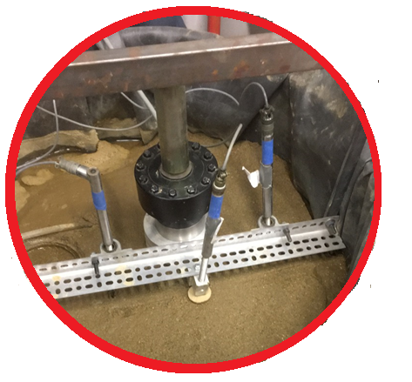
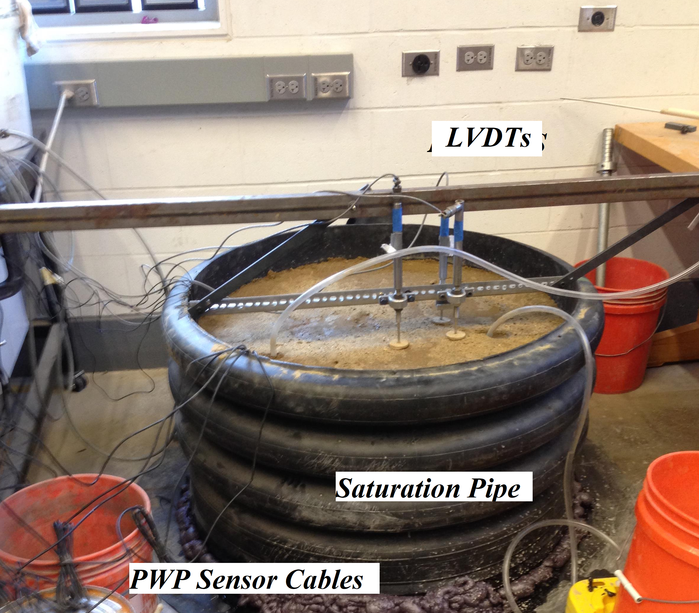

Slide 16
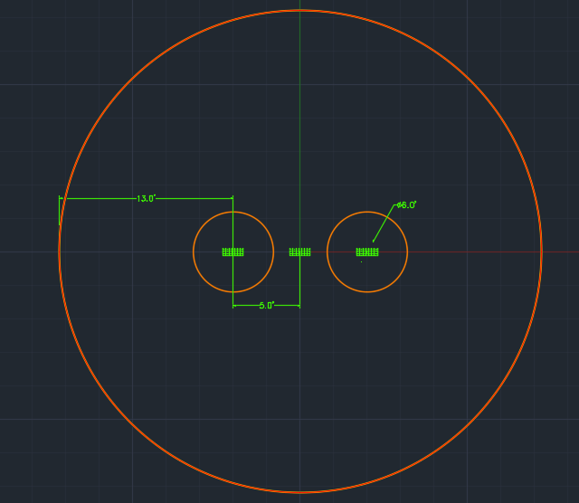
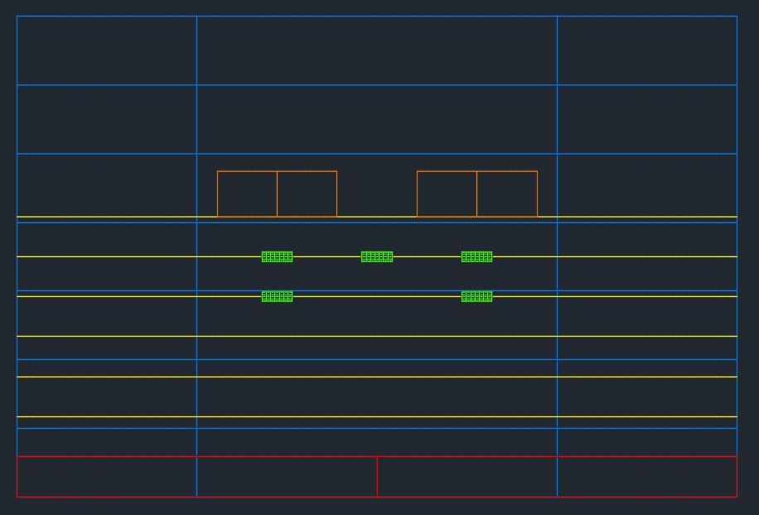
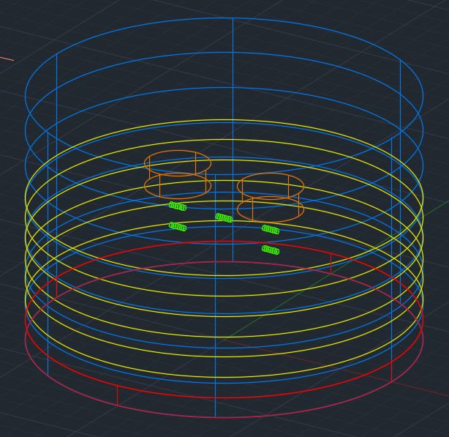
Pore Water Sensor/Tensiometer Placement
Loading plate diameter = 6"
Horizontal spacing between PWPs = 5" (13" to outer edge of model)
Vertical spacing between PWPs = 2"
Top Down View
Side View
3-D View
Notes:
Add label for EPB1 and EPB3

Slide 17
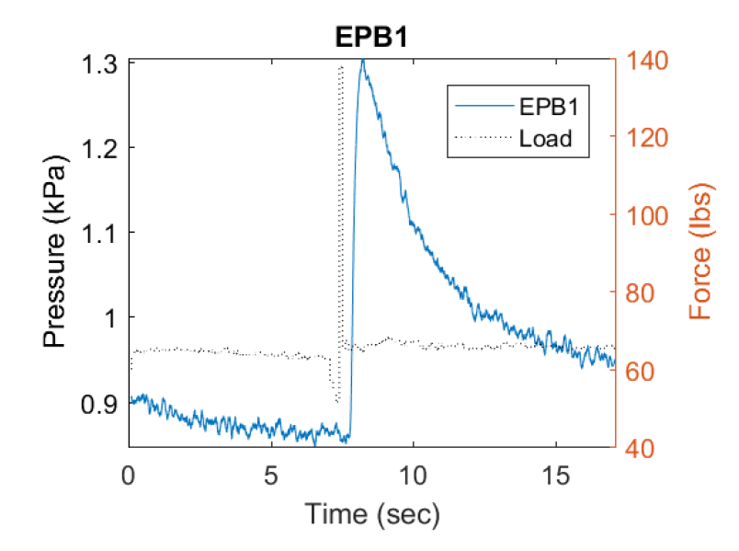
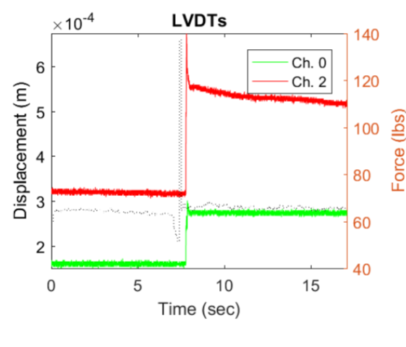
Sample Test Result
Notes:
Remove EPB3 and keep EPB1

Slide 18
Currently Programmed Models
Soil Properties – Resilient Modulus Relationships
  Single-Parameter Models
  Regression-based Equations
  Constitutive Models
Climatic Models
  SWAT
  MIKE SHE Model
  APEX
  Berg, 2003
Seasonal Variation (Moisture Content) – Resilient Modulus Relationships
  Pavement ME
  ASU Zapata et al., 2010, 2011, 2015
  Liang et al., 2008

Slide 19
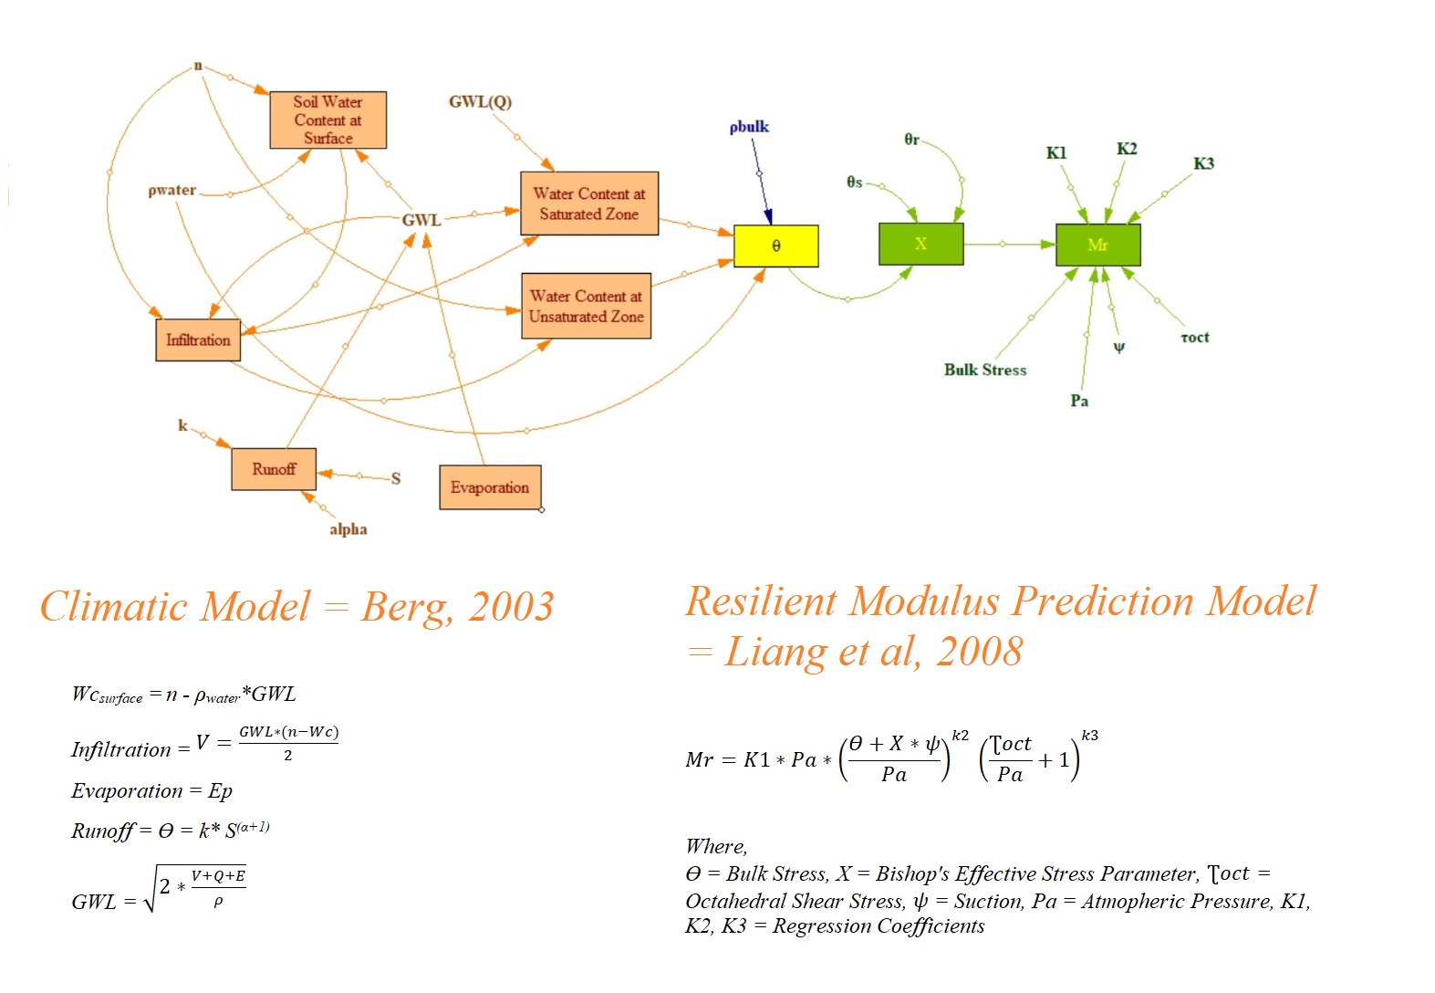


Slide 20
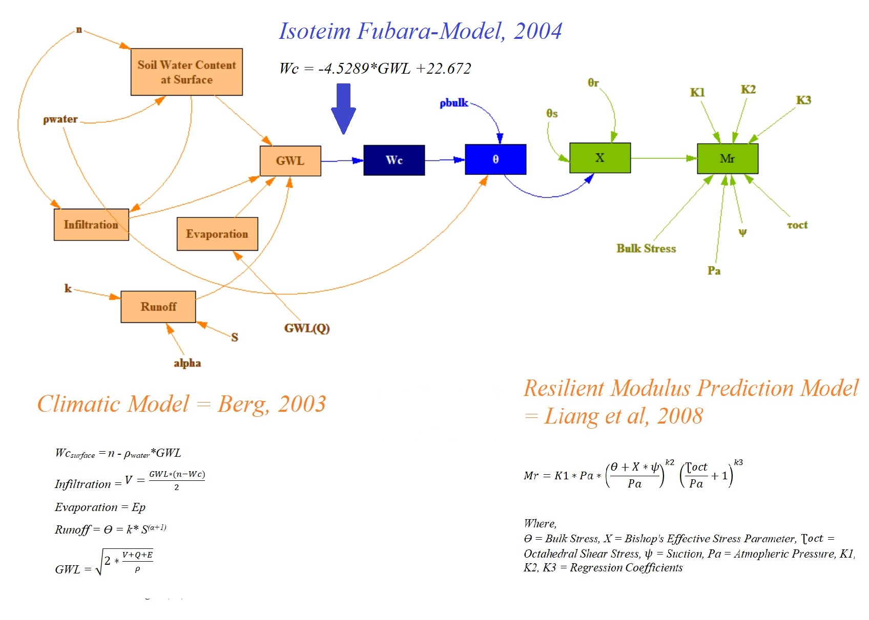

Slide 21
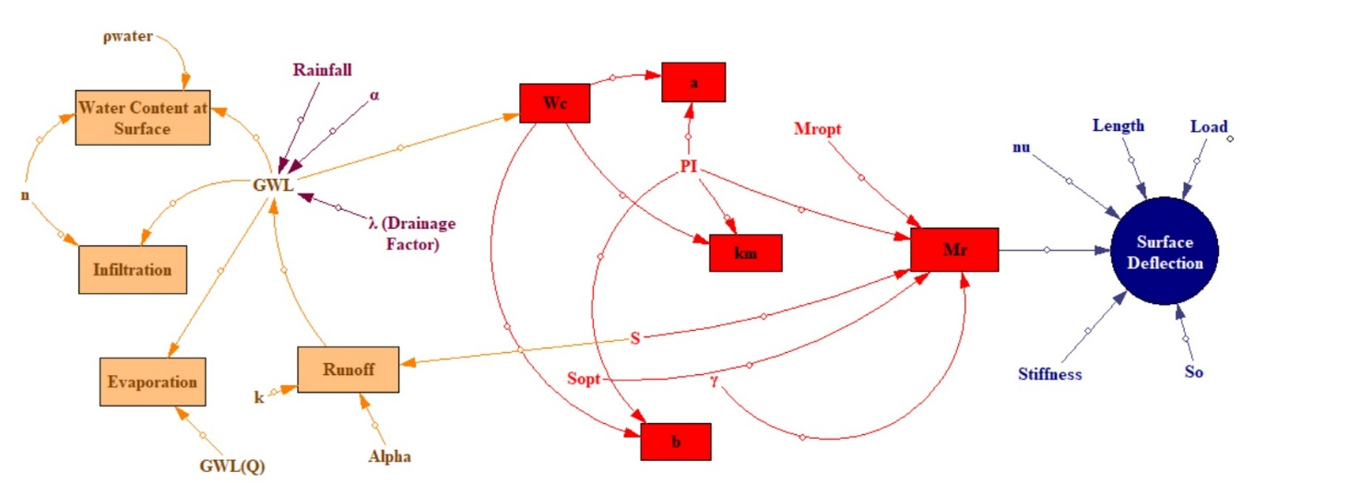
Climate Model
Seasonal Variation Model (Zapata 2010)
Pavement Deflection Model

Slide 22
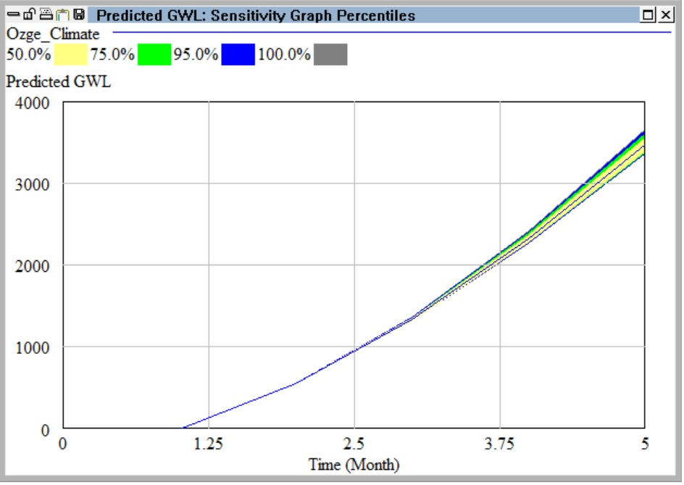
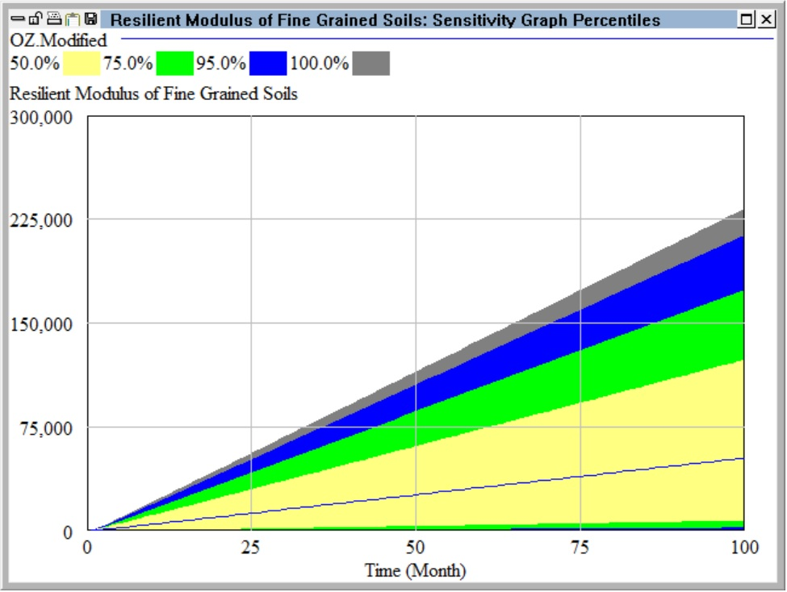
Example Sensitivity Analysis

