Slide 1

Missouri Stringless Paving:
I-35 Unbonded Concrete Overlay
2019 NRRA Pavement Workshop
May 23, 2019
John P. Donahue, P.E.
MoDOT

Slide 2
I-35 in Clay County
Northeast of Kansas City
Project length approximately 8.3 miles in both NB and SB directions.
Constructed in 2010.
Existing pavement consisted of 4-8 inches of HMA on 9-inch JRCP (circa 1966).

Slide 3
I-35 in Clay County
Pavement Design
  Mill HMA completely off.
  Install geotextile interlayer.
  Place 8-inch UBOL on over 7 miles of pavement in both directions ~ 200,000 yd².
  Remaining 1+ mile of pavement at bridge approaches and underpasses reconstructed with 10-inch JPCP.

Slide 4
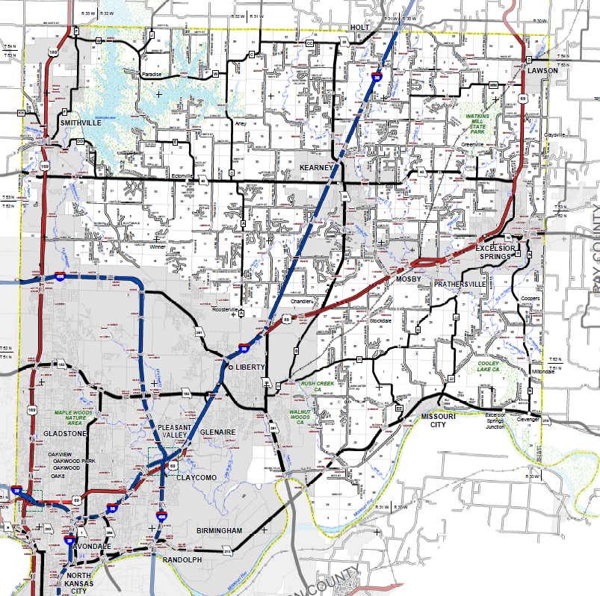
Project Limits

Slide 5
Estimating PCC Quantities
Existing surfaces will have irregularities.
Estimating for a surface that has yet to be uncovered even more daunting.
½” added to I-35 UBOL – part of contract furnishing quantities, but still considered (acceptable) overrun.

Slide 6
How to Pay for a Concrete Overlay
Cubic yards for furnishing and placing
    Contractor has no risk
    Agency faces possible high overruns
    Asphalt already paid for this way (tonnage)
Square yards for furnishing and placing
  Great for agency, no overruns
  High risk for contractor, especially on roads with a lot of surface irregularities

Slide 7
How to Pay for a Concrete Overlay
Square yards for placing / cubic yards for furnishing
  Shared risk for agency and contractor
  Happy medium?
  Method of payment for I-35 UBOL

Slide 8
Optimum Profile
Minimum plan (or structural) thickness
Minimum vertical curve length
Conventional cross-slope
Regular smoothness criteria
vs.
No significant overruns

Slide 9
Optimum Profile
Very difficult to reconcile competing issues!!
I-35 UBOL project set standard.

Slide 10
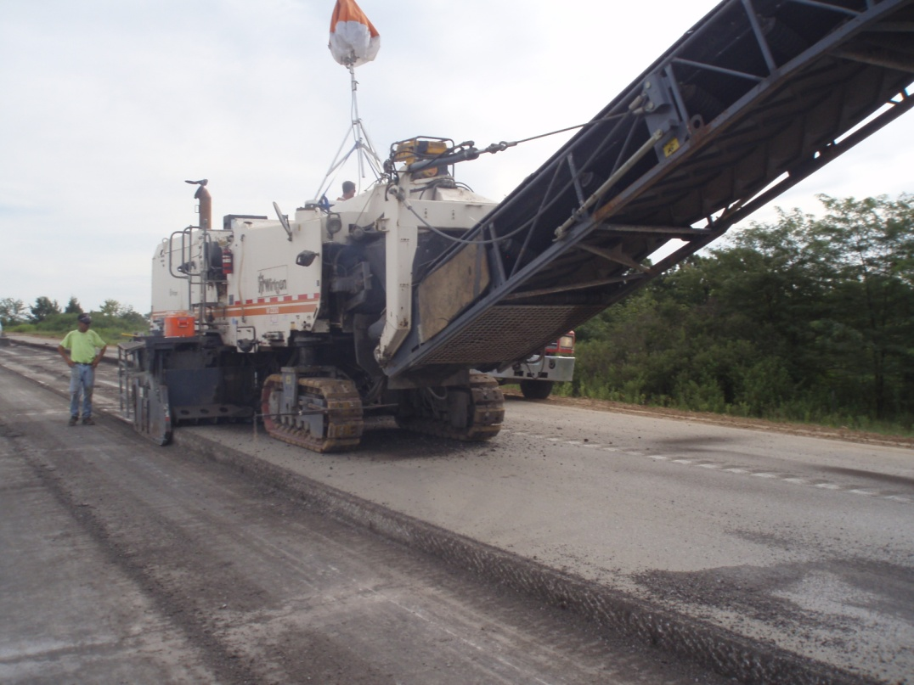

Slide 11
Post-Milling Problems
Milled roadbed shot at 10-foot intervals with Leica Total Stations.
Not surprisingly, old PCC did not consistently exhibit original plan sheet cross-slope of 1.56% (3/16” per foot).
Applying 2.00% cross-slope, minimum 300-foot curve length and design thickness would have yielded ~ 25% PCC overrun (1/2” waste factor allowed ~ 6% overrun).

Slide 12
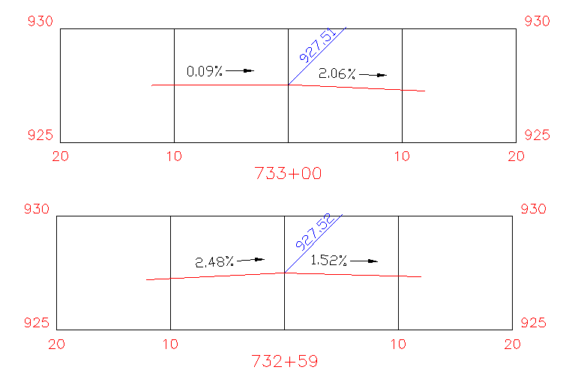
Notes:
12

Slide 13
Profile Solutions
MoDOT allowed
  Cross-slope to fluctuate between 1.56% and 2.25%
  Spot milling (emphasize ‘spot’) up to 2.5 inches in old PCC

Slide 14
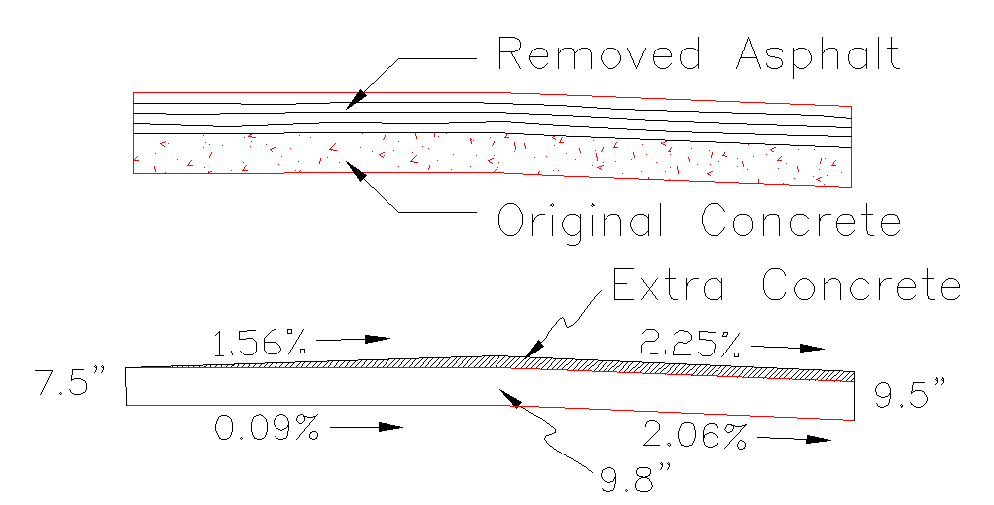

Slide 15
Profile Solutions
Carlson Road Rehab software run in milling mode to create best fit profile.
Bottom of proposed pavement compared to top of existing pavement @ 10-foot intervals to check milling and leveling thicknesses.

Slide 16
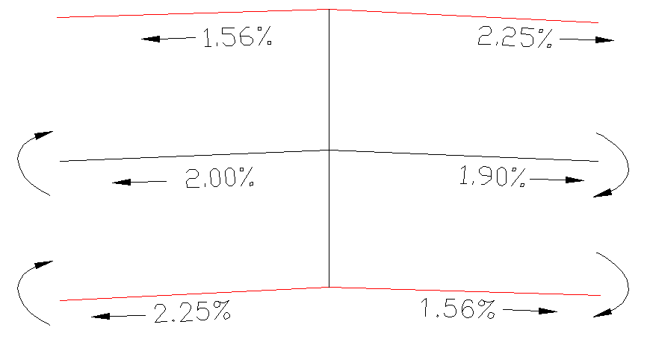
Profile Solutions
Cross-slope changes moderated to eliminate ‘butterfly’ effect.

Slide 17
Profile Solutions
Profile raised or lowered accordingly until excess PCC reduced to ~ 6%.
Milling depth checked for 2.5 inch limit.
Saved 8500 cy or over $600,000 worth of overruns.

Slide 18
Impact of Profile Elevation Change on Total SB Project Length
Elevation Above Control Profile | Cut Volume (CY) | Fill Volume (CY)
0” | 3,044 | 211
½” | 1,998 | 507
1” | 1,176 | 1,027
1 ½” | 612 | 1,805
2” | 280 | 2,815
2 ½” | 111 | 3,987

Slide 19
Segment Example
Volumes by Triangulation (Prisms) | May 13 2010
Sta 829-90 to 907-74 | Raise baseline profile 1.5 inches
Cut volume: 149.90 C.Y. Fill volume: 224.79 C.Y. | Area in Cut : 7,129.5 S.Y. Area in Fill: 13,626.7 S.Y. Total inclusion area: 20,756.2 S.Y.
Average Cut Depth: 0.06 feet Average Fill Depth: 0.05 feet | Cut (C.Y.) / Area (S.Y.): 0.021 Fill (C.Y.) / Area (S.Y.): 0.016
8-inch UBOL Qty: 4612.1 | Concrete Overrun: 4.89%

Slide 20
Stringline Problems
Strings are always corded pin to pin therefore they never truly follow a design profile
Catenary effect (slack in string)
Always in the way
Must be checked constantly
Limit job site access

Slide 21
Stringless Paving Advantages
Eliminate time and effort of staking
Reduce clutter
Improve safety and mobility in work area
Improve speed of construction

Slide 22
Guidance Systems
Gomaco 2800 4-track paver equipped with a Leica PaveSmart 3D Machine Control System
  CAT 140H Motor Grader equipped with a Leica PowerGrade 3D Machine Control System
8 Leica TPS1200 Total Stations

Slide 23
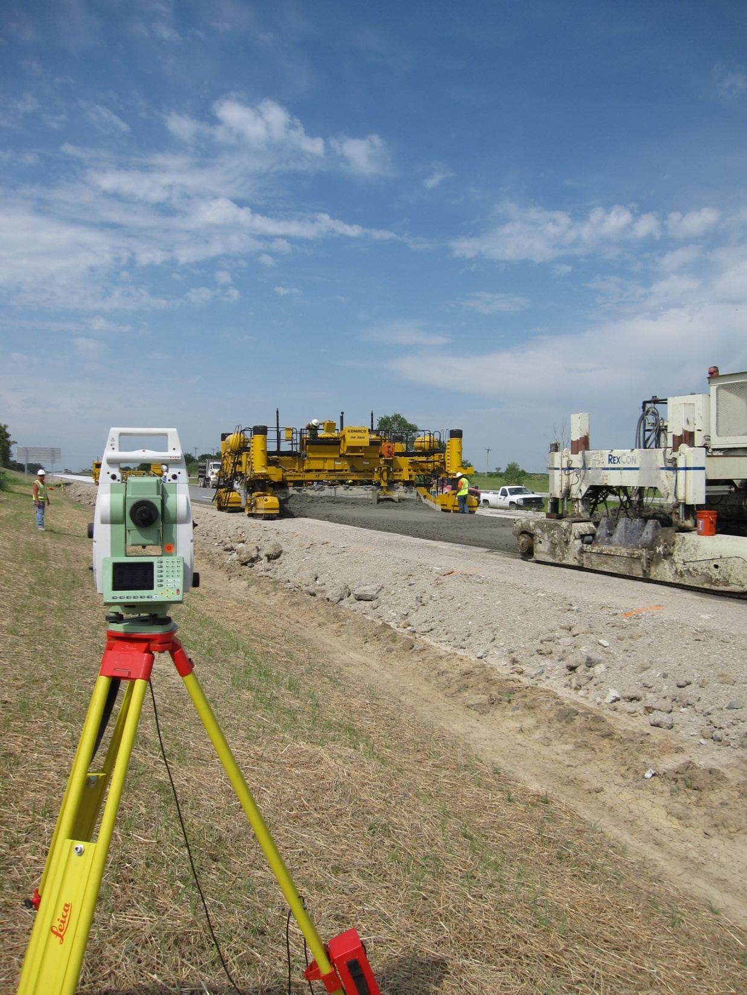
Total Stations were placed approximately every 300 feet for line-of-sight with prisms.
Transition time between Total Stations less than one minute.
Line of Site

Slide 24
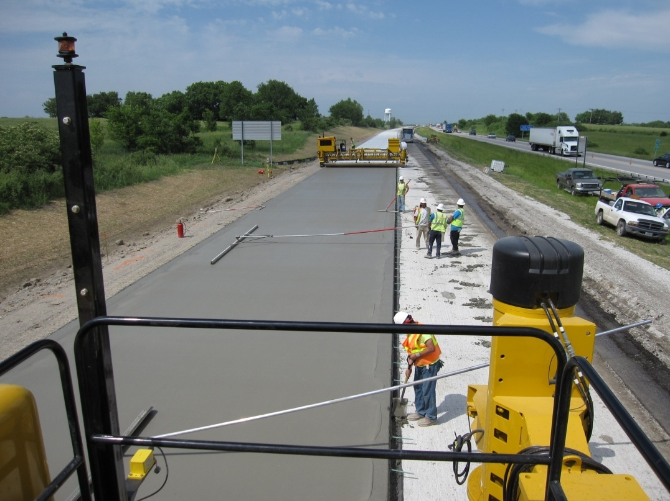

Slide 25
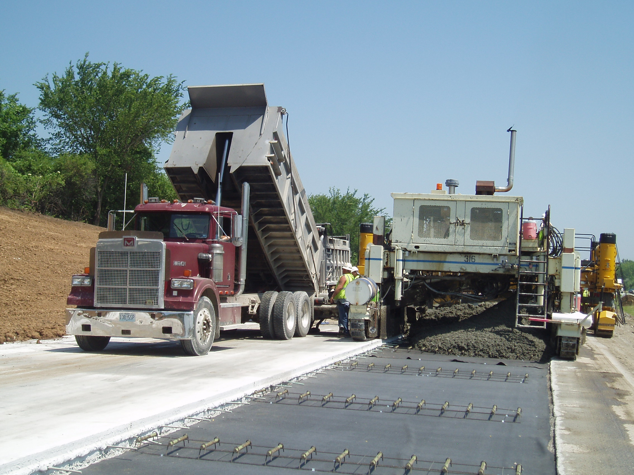

Slide 26
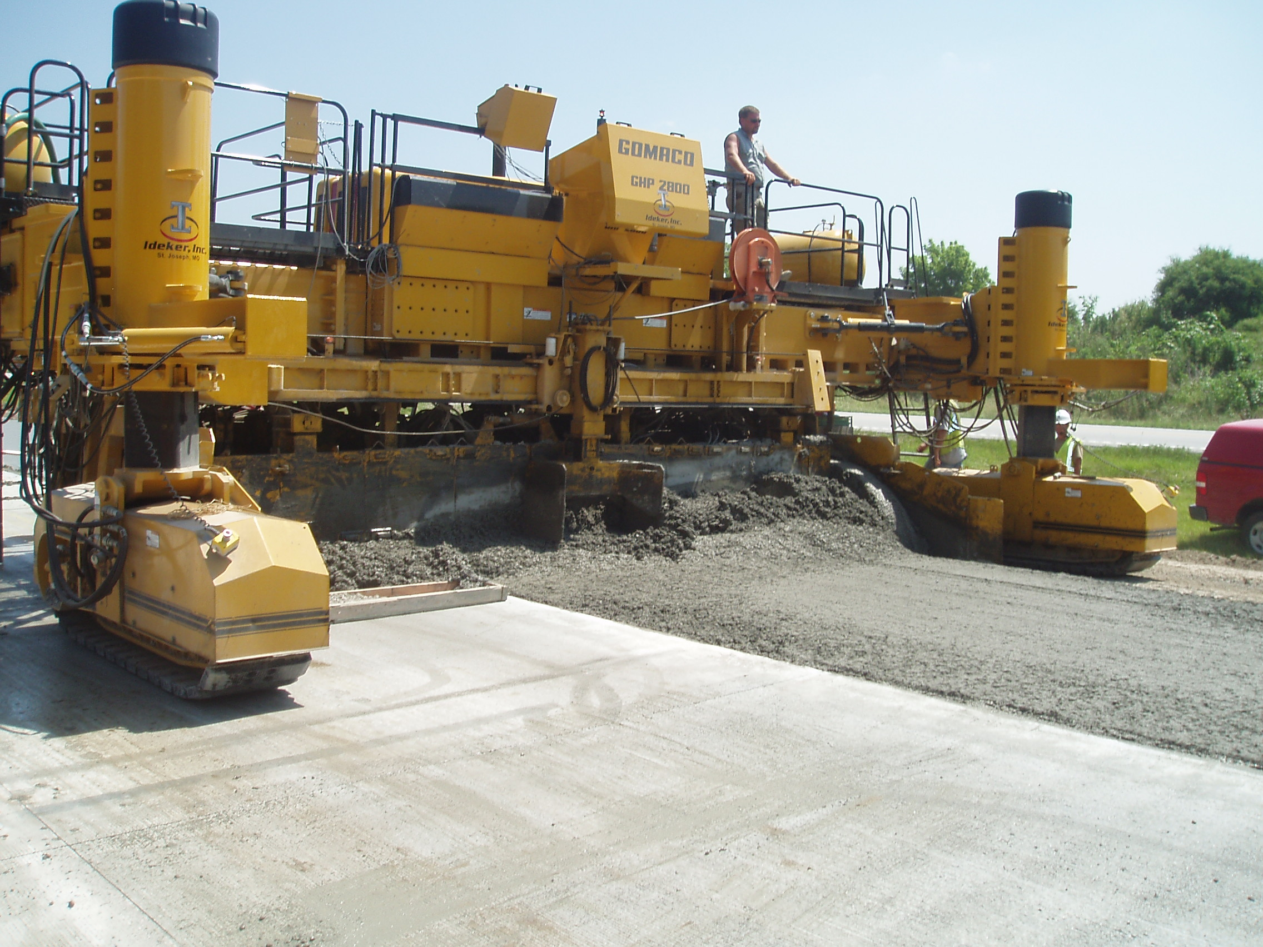

Slide 27
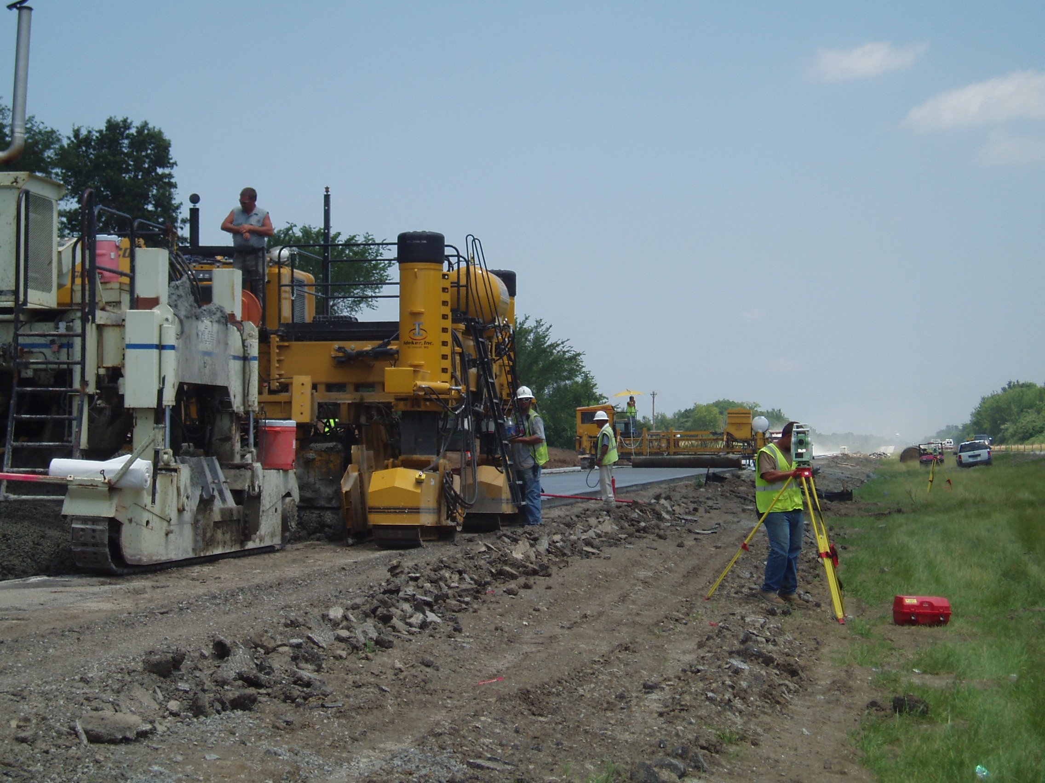

Slide 28
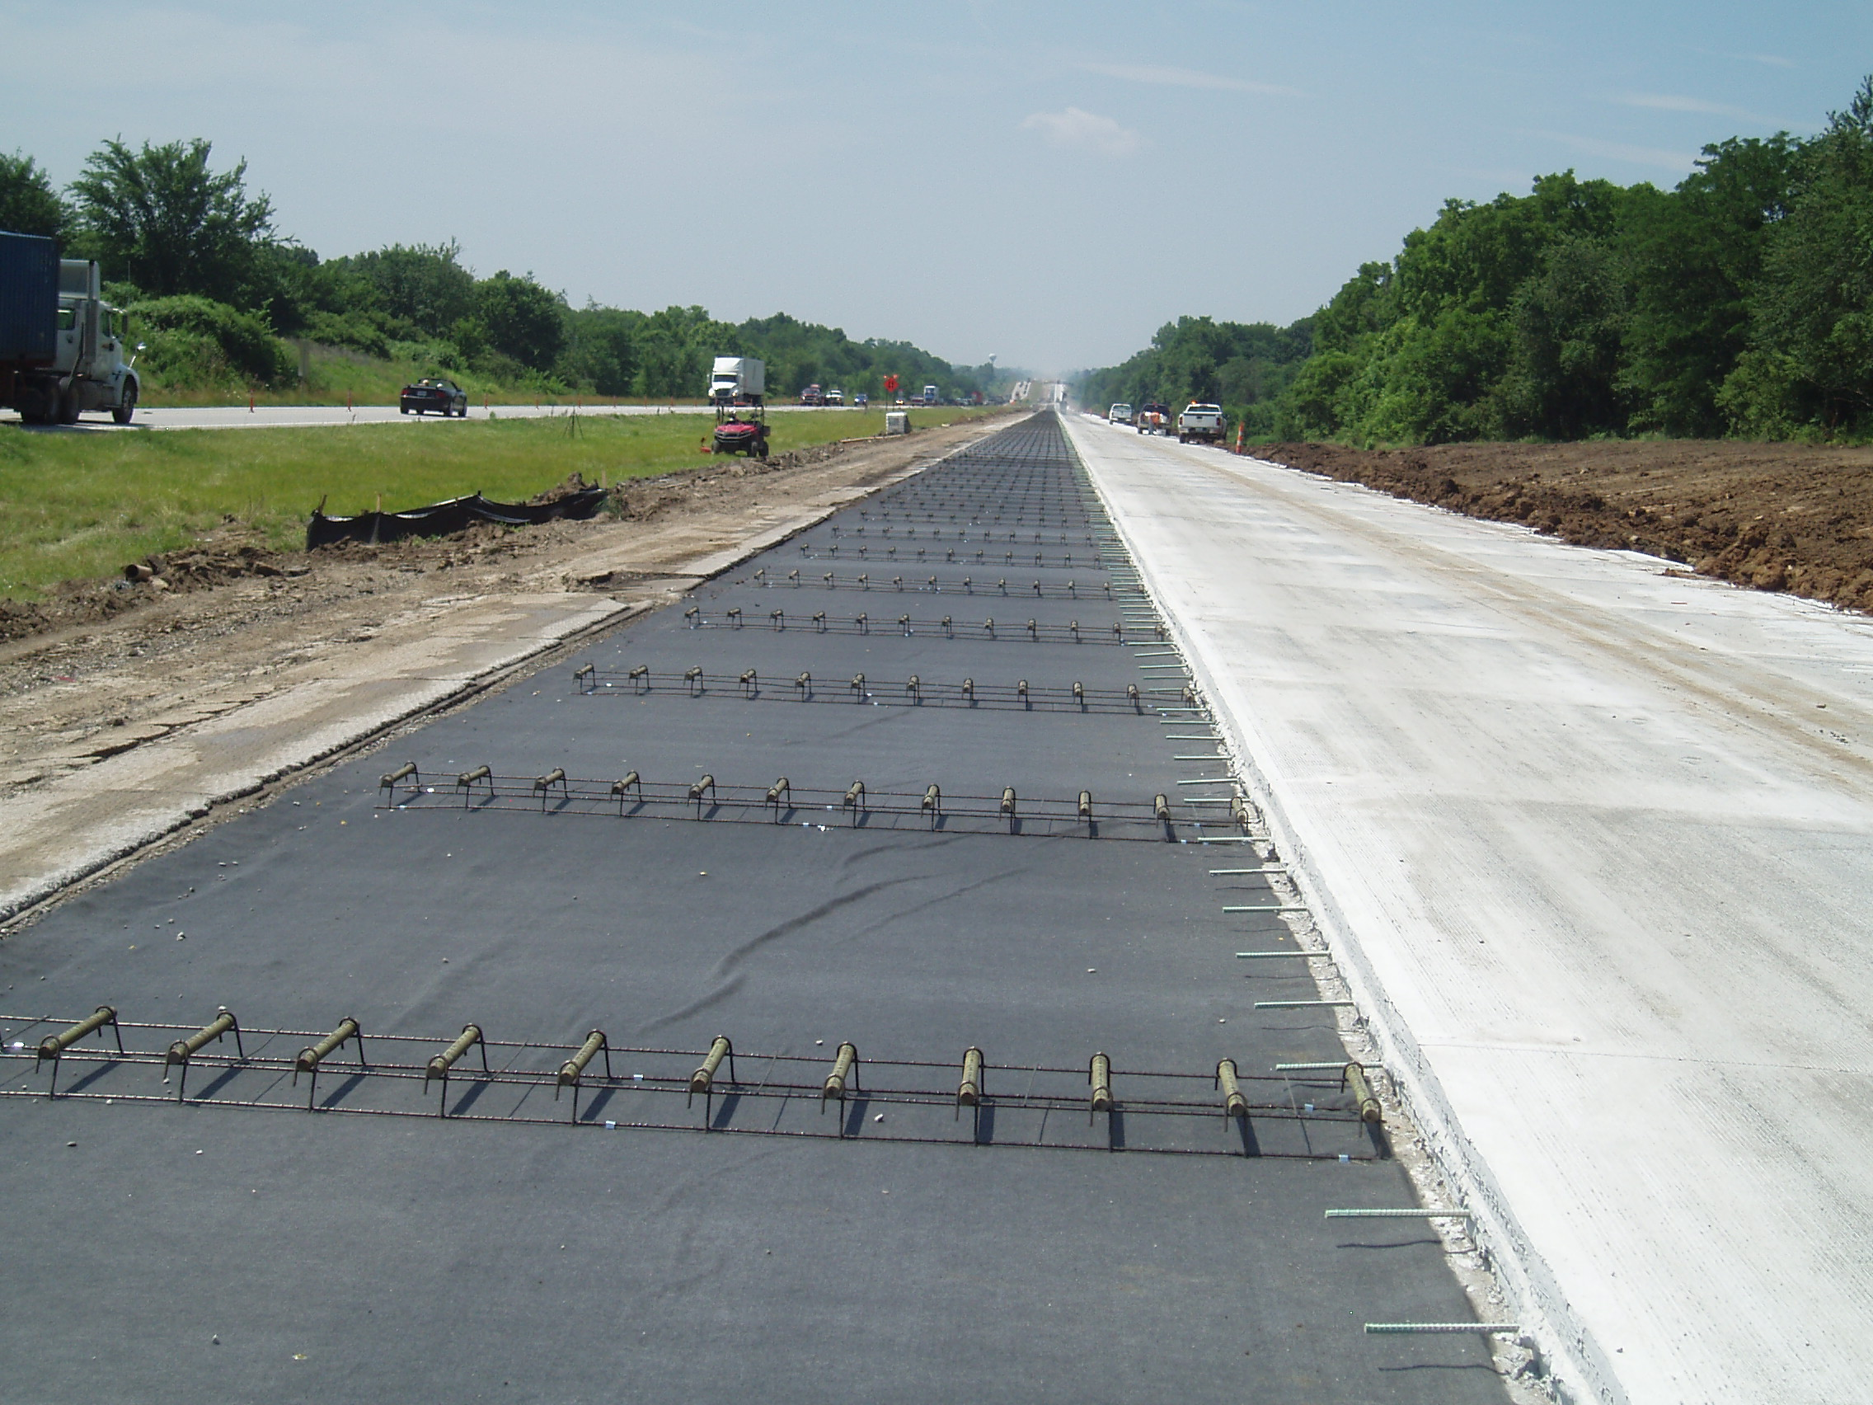

Slide 29
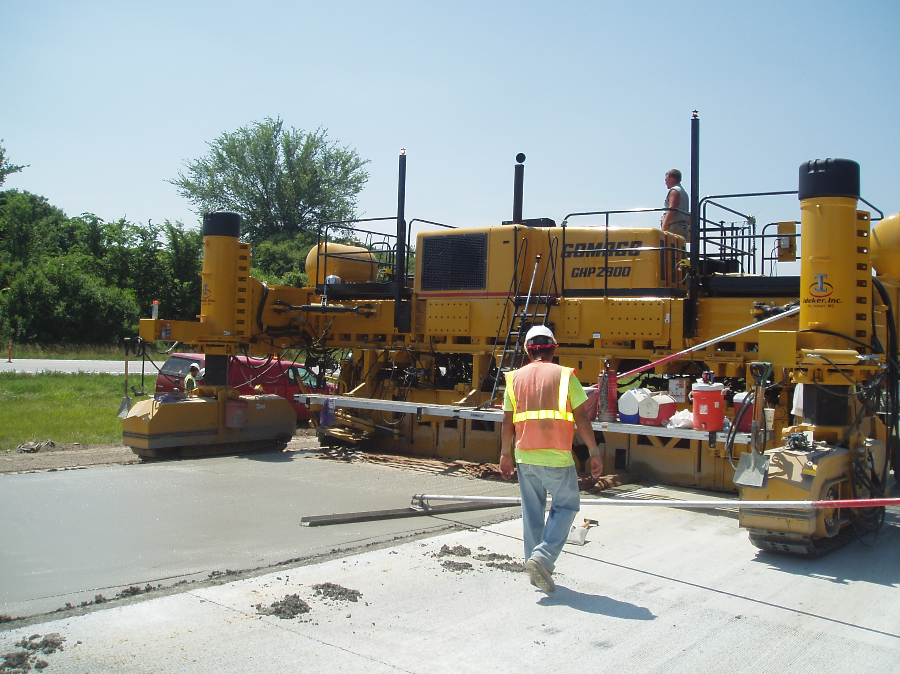

Slide 30
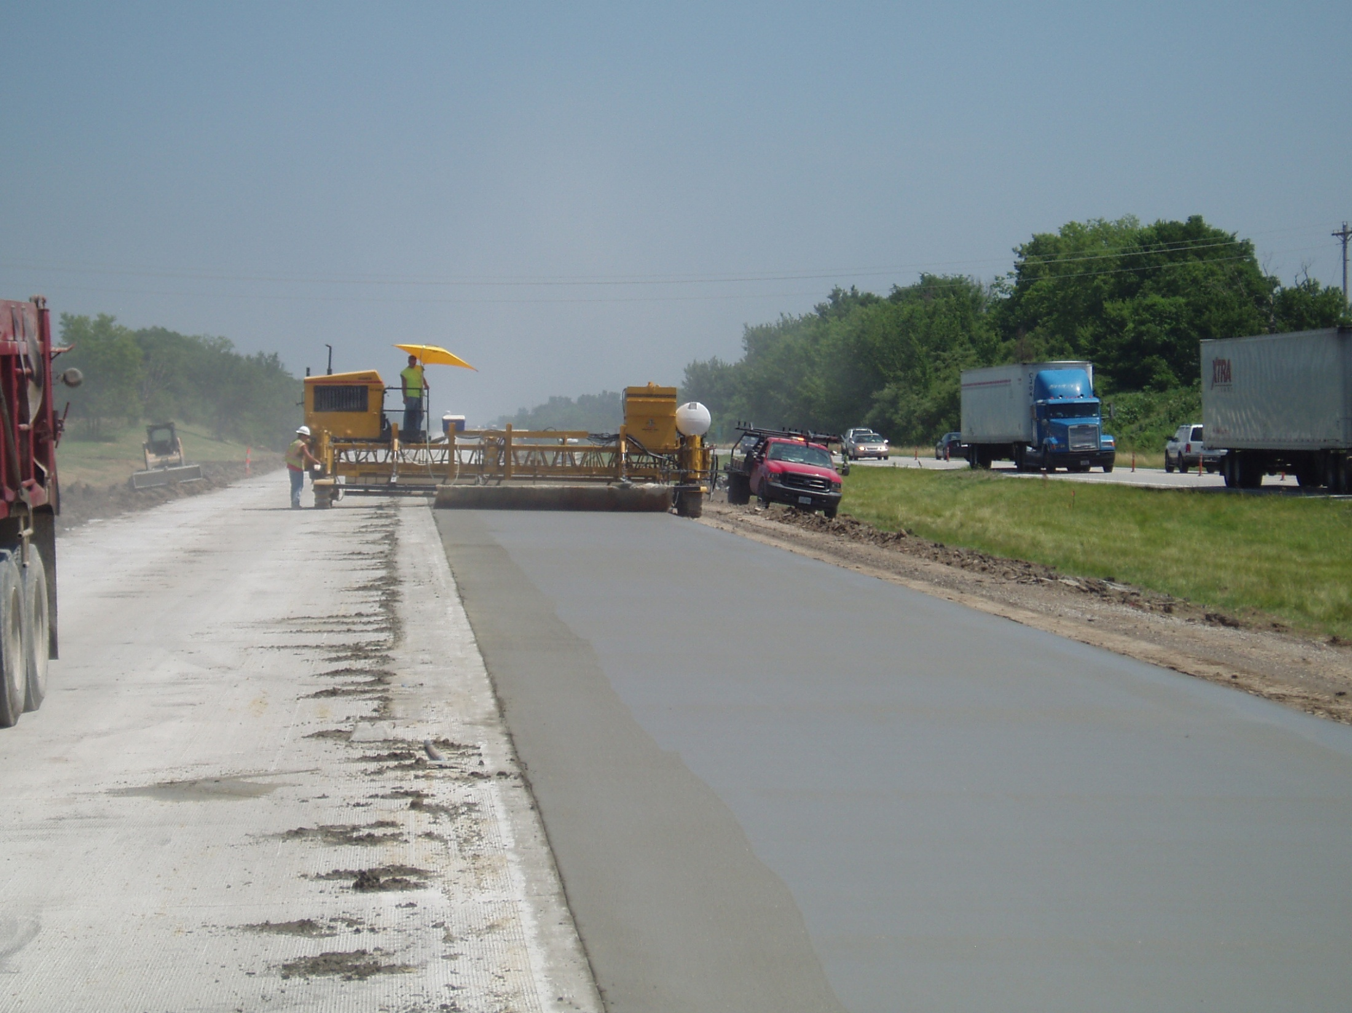

Slide 31
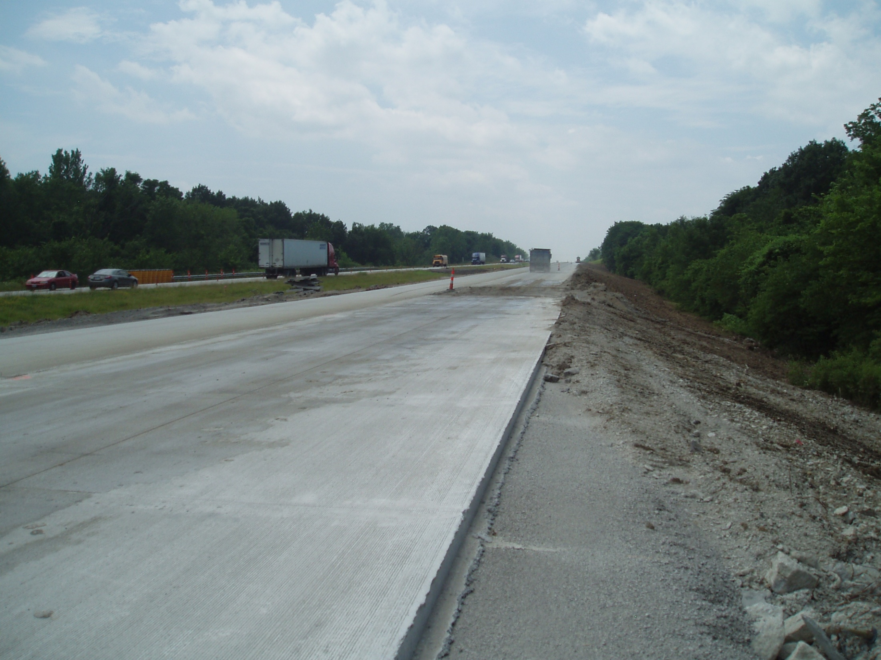

Slide 32
Final Profile
Geometric criteria met.
Minimum structural thickness obtained.
Furnishing PCC overrun limited to ~ 6%.
Paved surface diamond ground.
IRI ranged from 20 to 37 in/mi.

Slide 33
Thank You!
Questions?
john.donahue@modot.mo.gov
(573)526-4334

