Slide 1

National Road Research Alliance
Intelligent Construction Technologies Team Update
Rebecca Embacher(MnDOT)
Advanced Materials and Technology Engineer
rebecca.embacher@state.mn.us

Slide 2
Intelligent Construction Technologies (ICT) Team

Slide 3
NRRA Structure and Teams
Executive Committee
Tech. Transfer
Rigid
Preventative Maintenance
Intelligent Construction Technologies
Geotechnical
Flexible
Added in 2018

Slide 4
NRRA ICT Team | Mission Statement
http://www.dot.state.mn.us/mnroad/nrra/structureandteams/intellconst/index.html
ICT includes innovative technologies for:
Planning
Design
Construction
Real-time quality control/monitoring
Management for the lifecycle of infrastructure construction

Slide 5
NRRA ICT Team | Mission Statement
Activities include:
Short-term & long-term research
Field evaluation and/or demonstration of current and emerging technologies
Partnering with industry to assist with development and deployment of technologies
Creation of tools and resources to assist with deployment efforts
Technology transfer among NRRA partners
Specification development
Providing input to the technology transfer team on what should be marketed

Slide 6

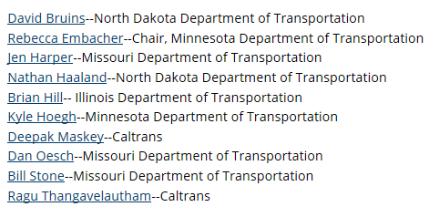




Agency Team Members

Slide 7
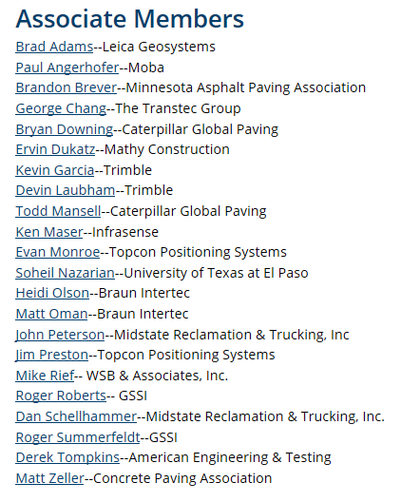
Associate Team Members
Andrea Blanchette -- WSB
Narsingh Laikram -- Wirtgen Group
Tim Kowalski -- Wirtgen Group

Slide 8

















Associate Team Members

Slide 9
ICT Team Initiatives

Slide 10
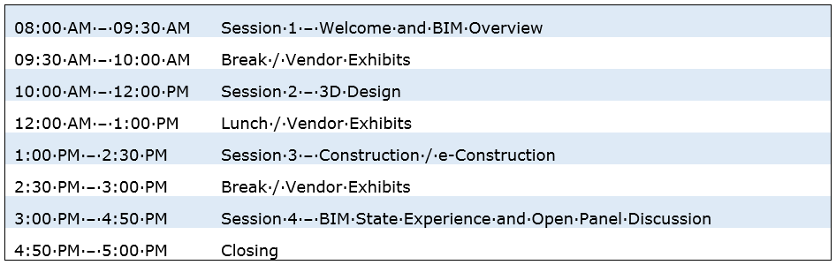
Building Information Modeling (BIM) for Pavements Workshop
…Asset Management, Planning, Design and Construction
Objective: Increase education on BIM for Pavements
Task Completed: May 21, 2019 Workshop

Slide 11
Evaluation of Levels 3-4 Intelligent Compaction Measurement Values (ICMV) for Soils Subgrade and Aggregate Subbase Compaction
Status – Contract Creation
Tasks
  Task 1: Project Management
    Meetings: Kickoff, 2 update meetings
    Reports: 5 Quarterly Progress, Final Report
    Identification of Level 3-4 ICMV Solutions & 1-2 solutions for comparison

Slide 12
Evaluation of Levels 3-4 Intelligent Compaction Measurement Values (ICMV) for Soils Subgrade and Aggregate Subbase Compaction
  Task 2: Level 3-4 ICMV Integration
    Integrate IC systems with Level 3-4 ICMVs
Task 3: Roller Instrumentation and Field Tests
Task 4: Data Analysis and Final Report

Slide 13
Analysis of Dielectric Constant Data in Veta
Status: Executed Contract
  TPF-5 (334) Amendment No. 2
Tasks
  Import GPR dielectric constants data files in the AASHTO Intelligent Construction Data Standard Format
  Add data maps, filters and analyses for dielectric constant data and predicted air voids.

Slide 14
Seismic Approach for Quality Management of Asphalt Pavement
Status: Development of RFP
Objective:
  Develop a field characterization tool and associated data processing software capable of acquiring seismic data in a non-destructive, non-contact, rolling fashion for the measurement of the seismic velocity of newly, constructed asphalt pavement layers.

Slide 15
Questions?

