Slide 1
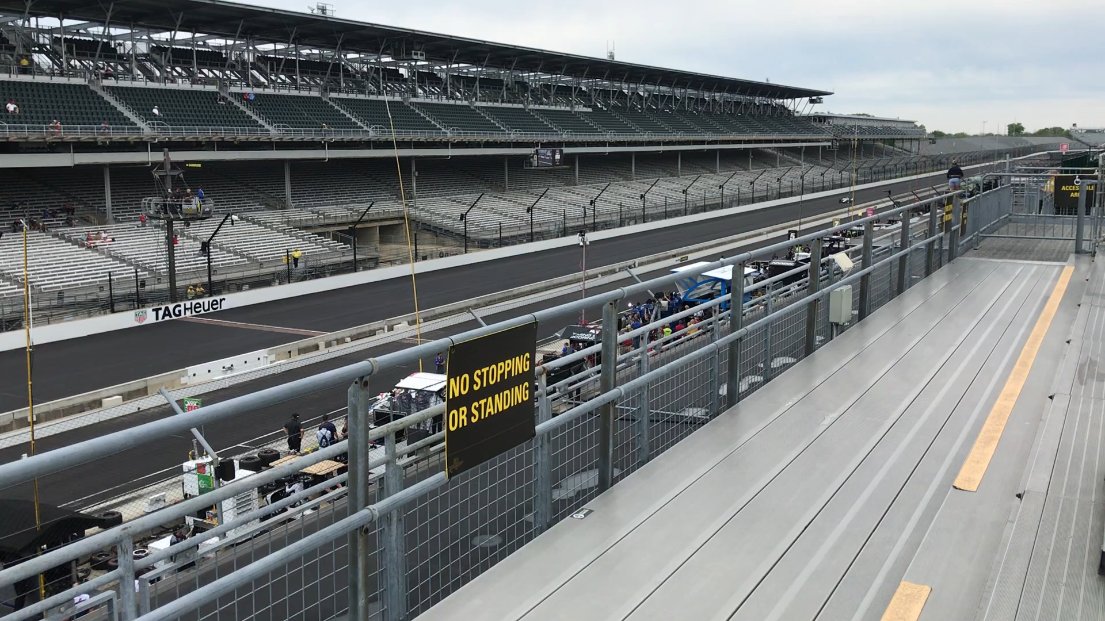
NRRA Future Goals and Direction

Slide 2
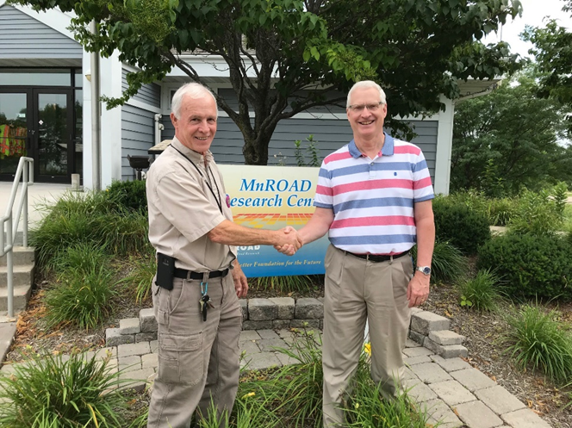
Thanks Again!

