Slide 1
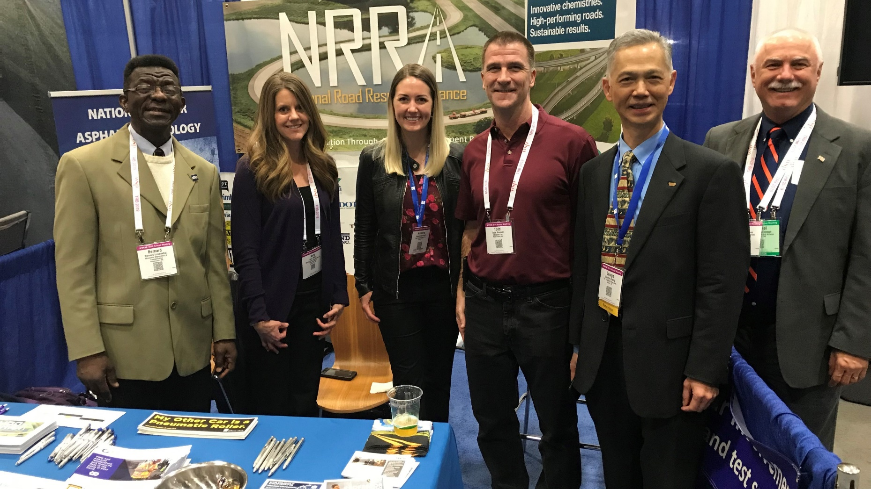
State of the Alliance
Glenn Engstrom, MnDOT Chair of the NRRA Executive Committee

Slide 2
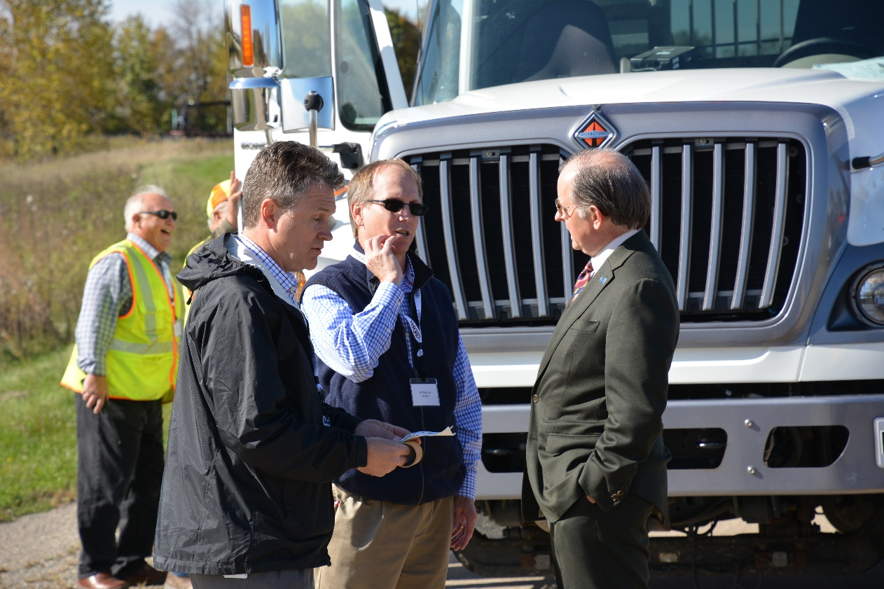
N Double-R A
Start Date
  February 22, 2016
Growth
Accomplishments
Current Opportunities
Survey
Call For Innovation
Future

Slide 3
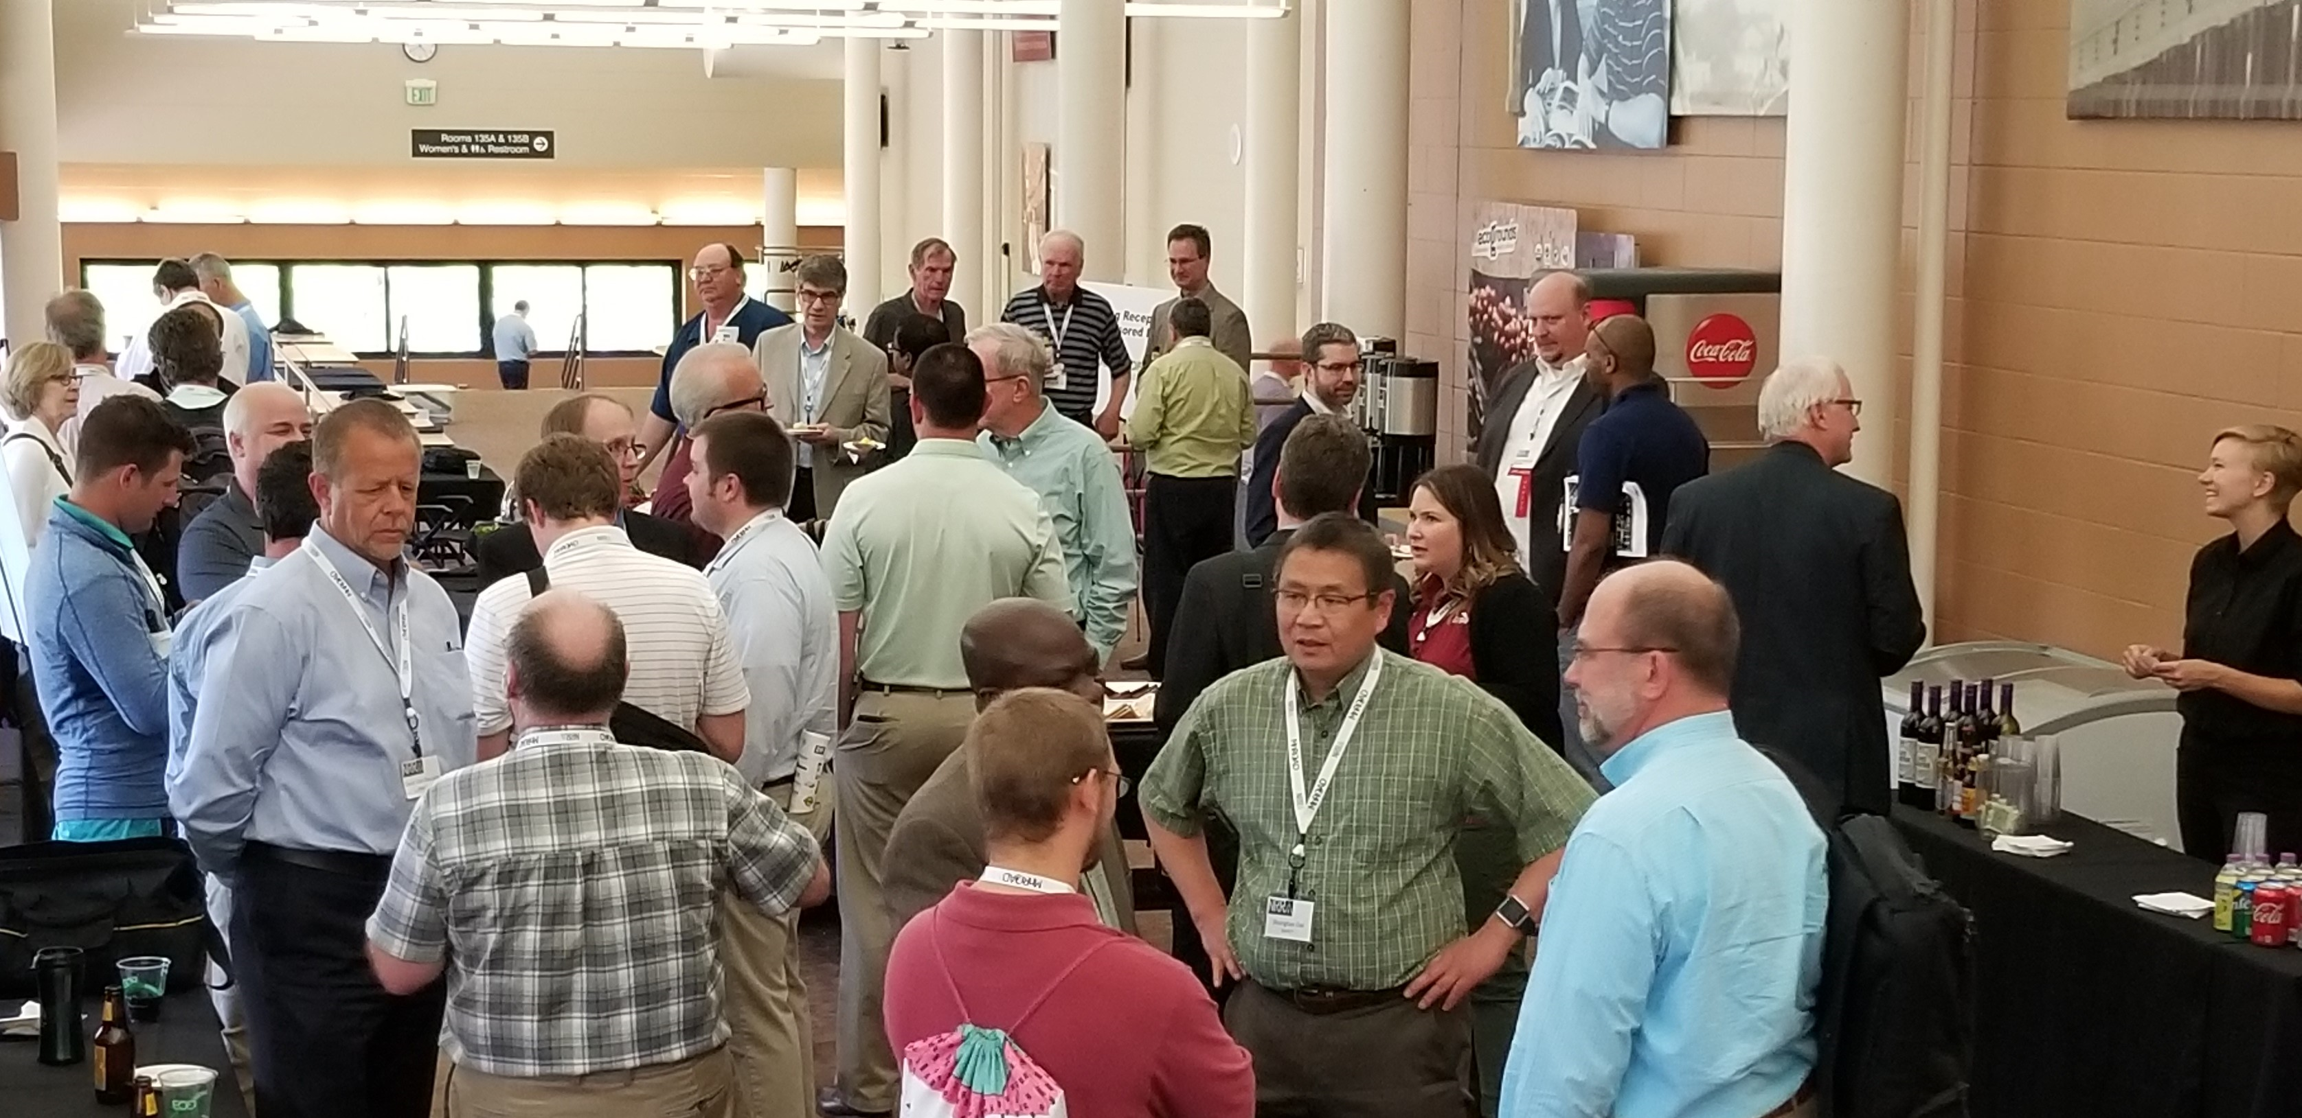
Growth
57 Associate Members
8 State members

Slide 4
























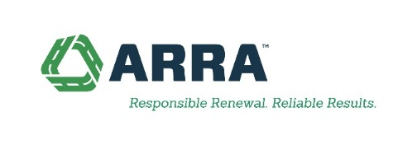











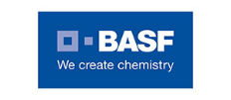












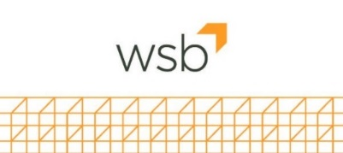










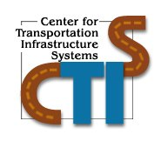





Slide 5
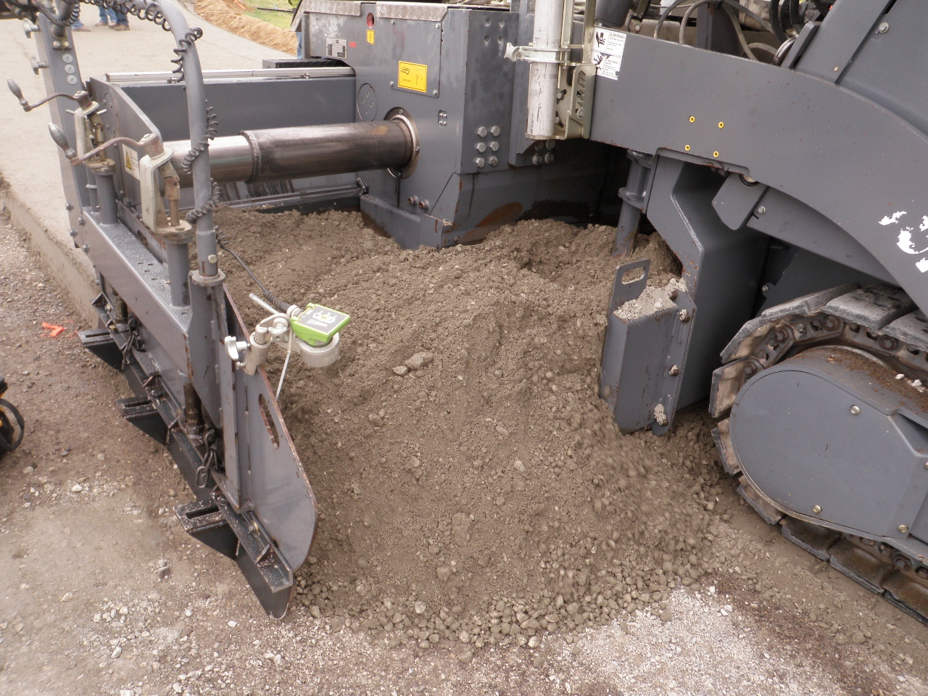
Accomplishments
ICT Visits to Missouri and Illinois
Construction
  2017 MnROAD Design, Construction, Research Projects & Construction Report
  2018 Cargill/Hardrives Construction
  2018 MODOT Roller Compacted PCC

Slide 6
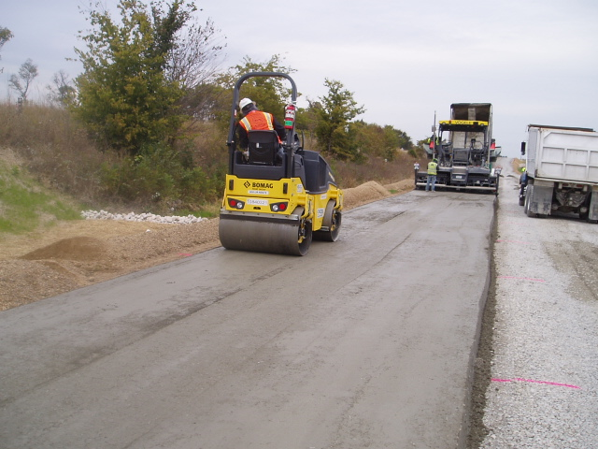
Accomplishments
Technical Teams
  Closer Connections (monthly Meetings)
  Ties to Universities, Associations, Consultants, Industry
  Many specifications shared on team websites

Slide 7
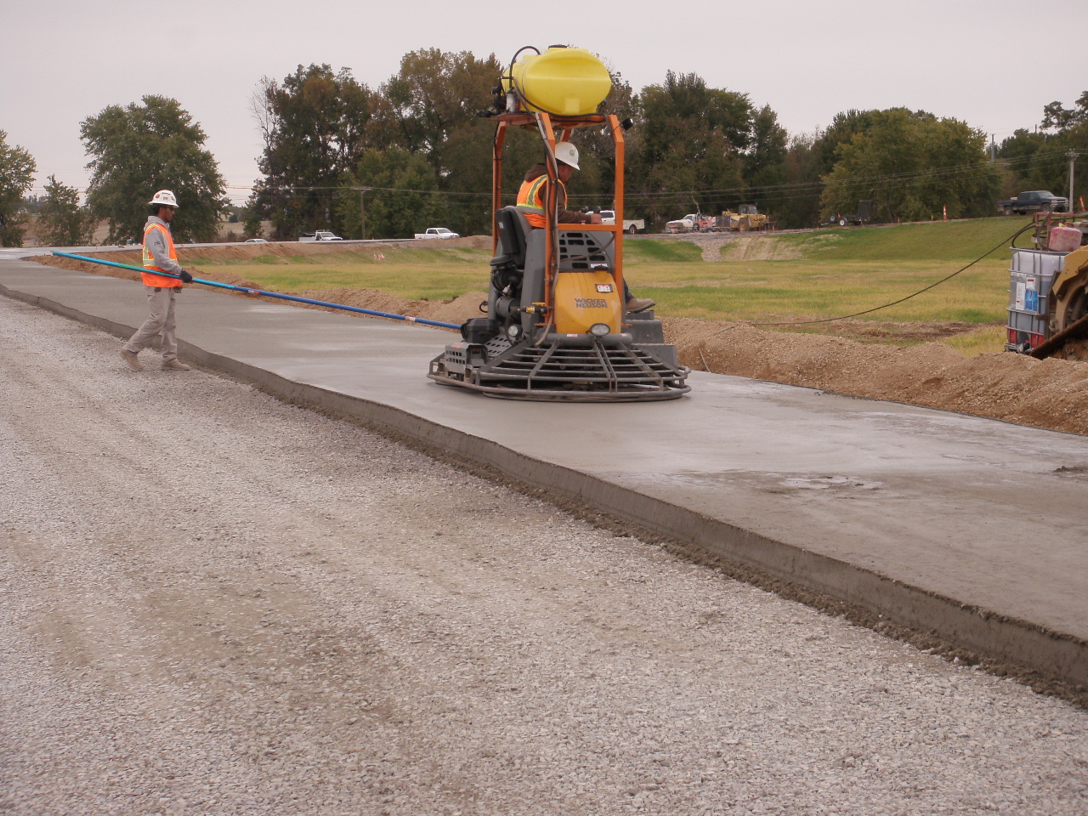
Accomplishments
Research Projects
  Development of Long Term Research around the 2017 construction and 2018 research
  Technical Advisory Panels developed around each effort
  3 Short Term Projects complete + 2 very soon
  Long Term and Short Term

Slide 8
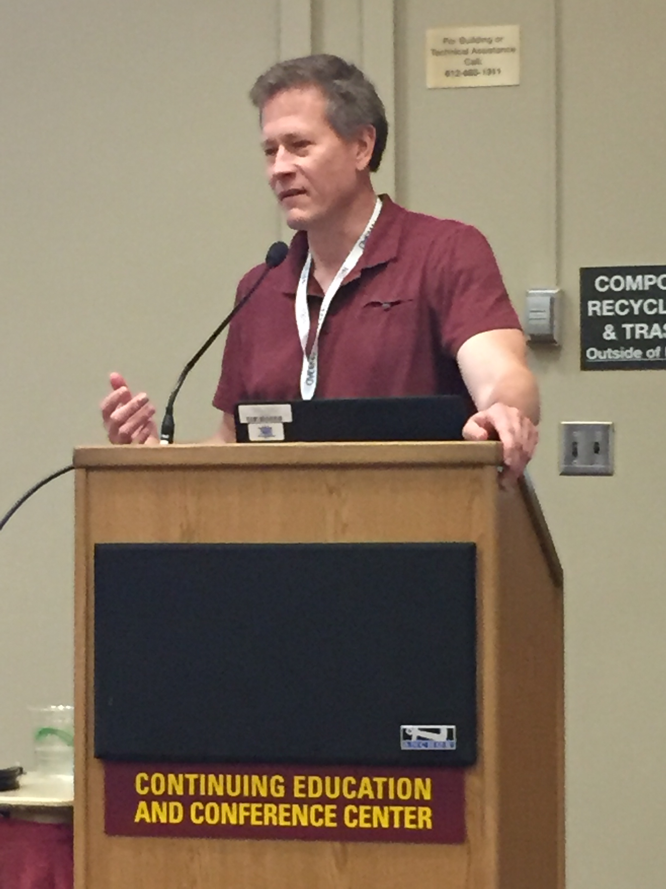
Current Opportunities
NRRA
  Technical Committees
  Research Pays Off
  NRRA Workshop
  Newsletter
  Website
  Long and short term research
  Technology transfer
  TRB
  Call for Innovation

Slide 9
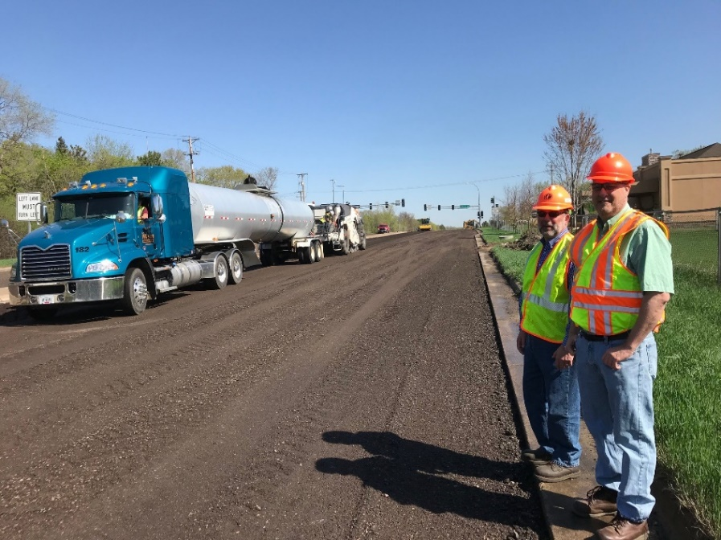
The Survey Says!
39% Response Rate
41% Attend half of the meetings
Too many obligations to attend monthly meetings
Over 90% said that their employer supports their work/time with NRRA
About 60% feel that they could contribute more.

Slide 10
Experience with Monthly Meetings
40%
59%
92%
59%
45%
Notes:
-40% of respondents find monthly meetings convenient
-Almost 60% of respondents feel that they have too many obligations to attend monthly meetings regularly
-Just under half (45%) do not think technology issues are a concern at monthly meetings. Another 37% are indifferent.
-59% of respondents find monthly meeting topics applicable to their work. Only 7% find topics not applicable to their work.
-Over 90% said that their employer supports their work/time with NRRA

Slide 11
Experience with NRRA
Notes:
-85% of respondents agreed that they are satisfied with their NRRA membership
-82% agreed that they are satisfied with the benefits NRRA membership provides
-About ¾ (74%) are satisfied with the information NRRA provides; 11% were not satisfied
-Networking is an important factor to respondents. 74% of respondents think that it is an important benefit.
-About 60% feel that they could contribute more.
-85% of respondents agreed that participating in NRRA is a valuable use of their time.
-70% agreed that they felt comfortable bringing new ideas and/or topics to meetings.
-Almost 80% (77%) use NRRA information in their work. Only 4% disagreed.
-About 90% of respondents felt that information provided is relevant to their work.
-92% agreed that NRRA has innovative ideas and research.

Slide 12
What NRRA can do to Better
Sharing Information
  Monthly written updates in summary form of all NRRA activities.
  Simplify key takeaways and conclusions in reports as much as possible.
  Publish a quarterly or maybe bi-annual summary
  A one-hour web meeting of activity and research results.
NRRA should work hard at better promotion.
Give me more time in a day.

Slide 13
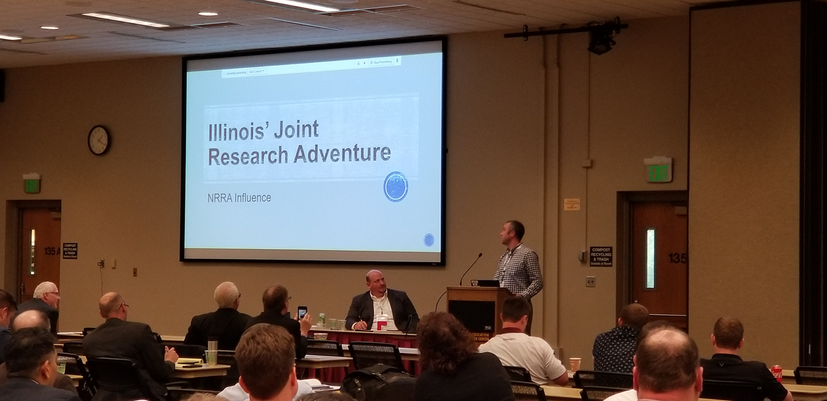
The 4 Big Benefit Themes
Access to MnROAD
Research opportunities and knowledge
Networking
Sharing information

Slide 14
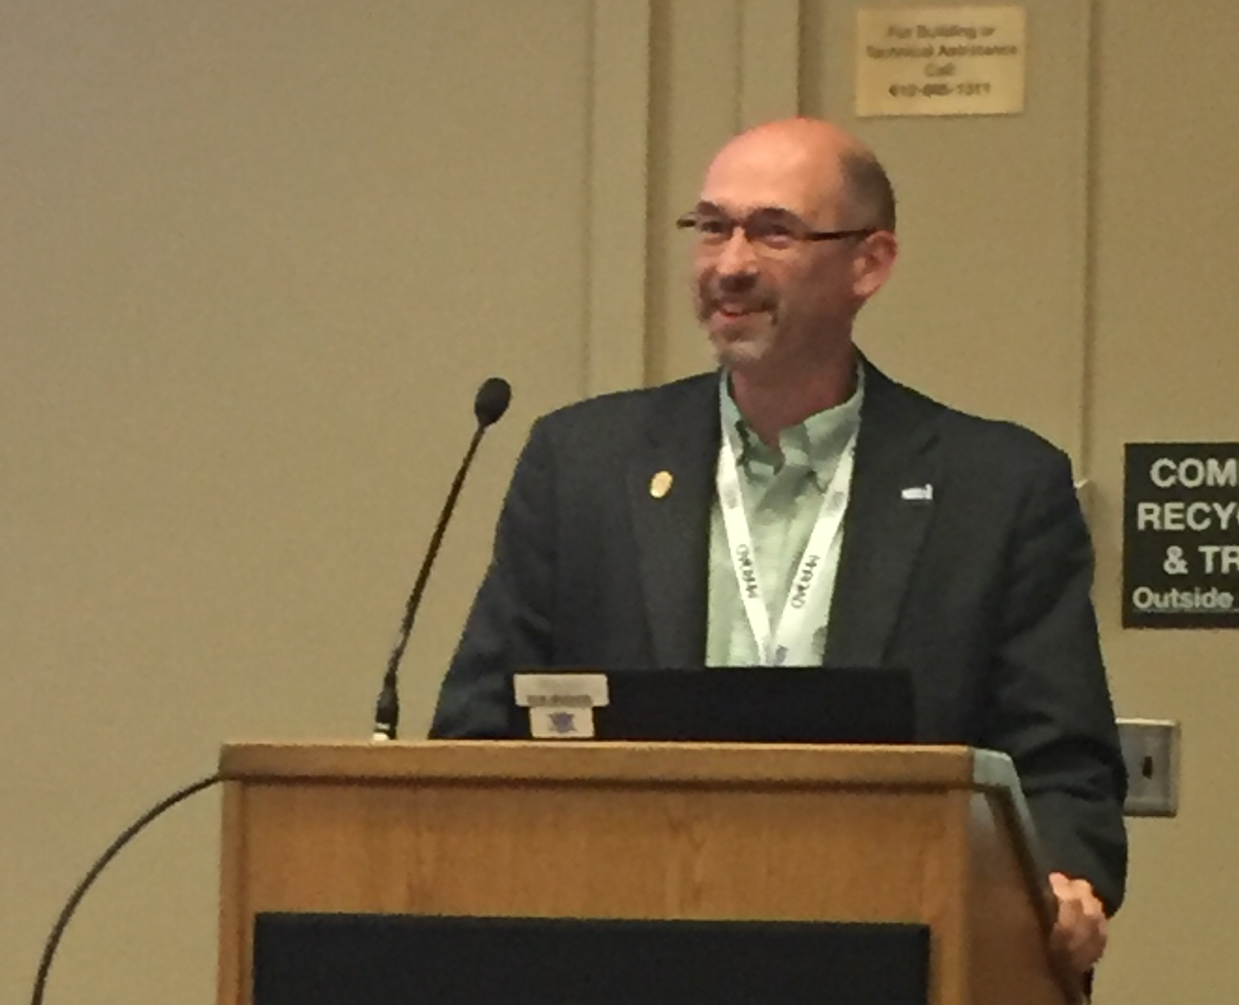
Call For innovation
Ideas that will push us to a new level
$600,000 available
20% match needed
Due August 2, 2019
NRRA Members only

Slide 15
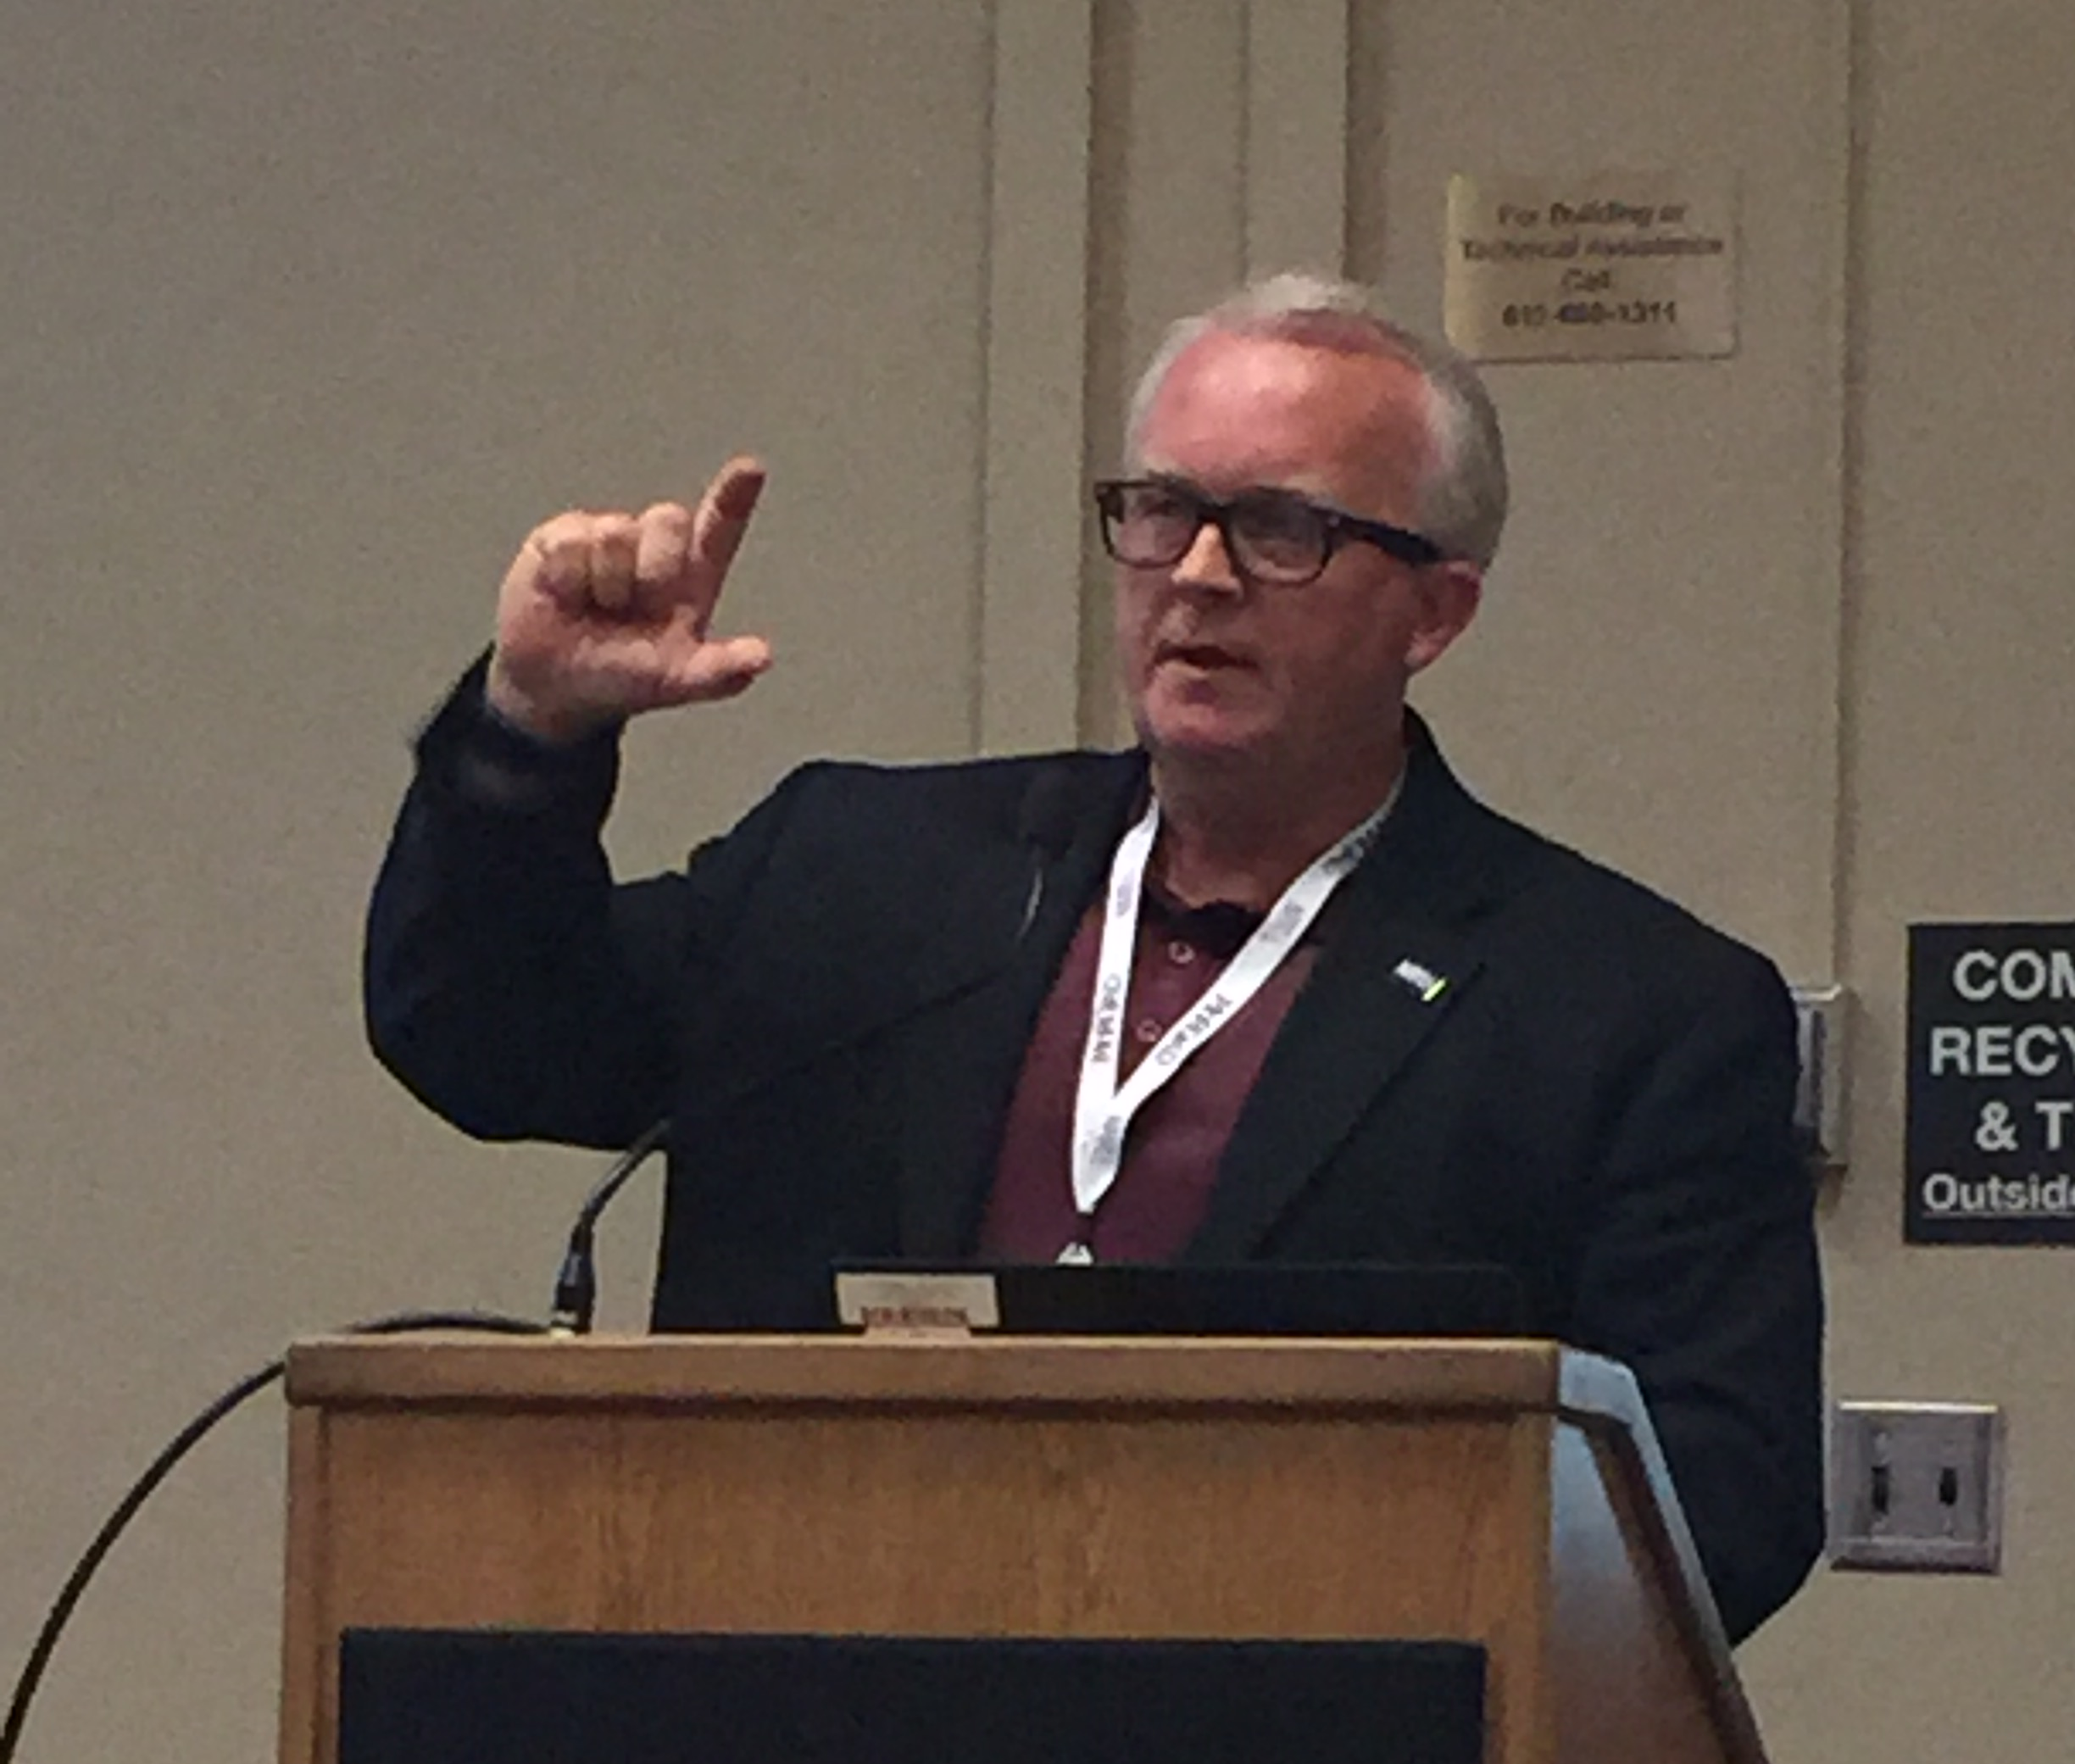
Call For Innovation
Must demonstrate a possible impact to
  Design
  Construction
  Maintenance
  Product testing
  Pilot projects
  Process enhancement
  Materials Testing
Potential for broad national impact.

Slide 16
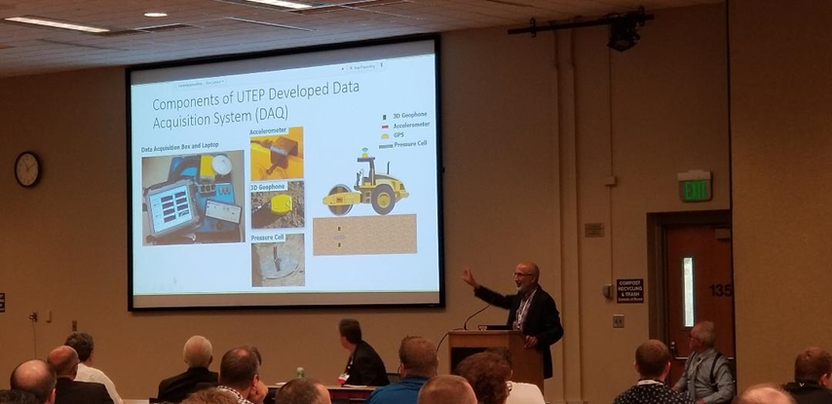
Future
What happens when the current pooled fund project ends in less than 2 years?

Slide 17
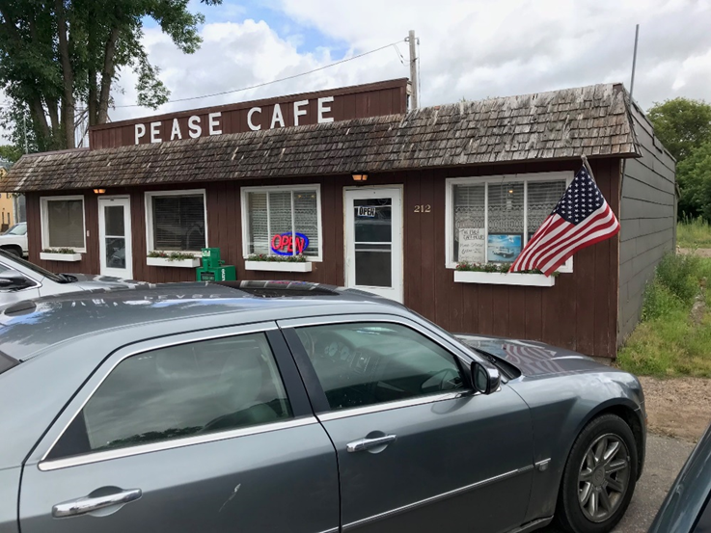
Major Questions
Mission
  Current format
  Problem specific
Structure
Funding Mechanism
Operating Plan

Slide 18


Slide 19
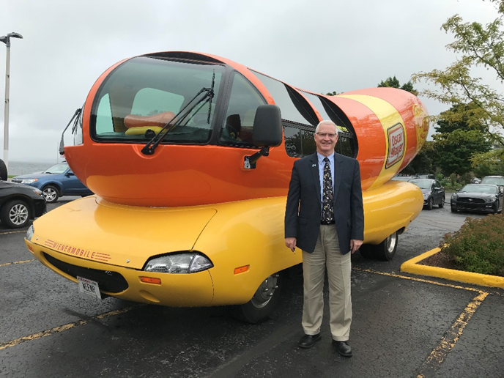
Thanks!

Slide 20
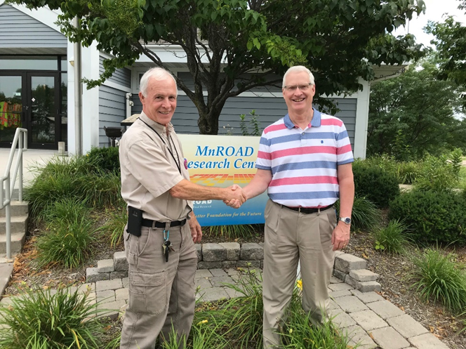
Thanks Again!

