Slide 1
Use of Rejuvenators in HMA
National Road Research Alliance Pavement Workshop
May 23, 2019
Notes:
Based on NCHRP 9-58 The Effects of Recycling Agents on Asphalt Mixtures with High RAS and RAP Binder Ratios

Slide 2






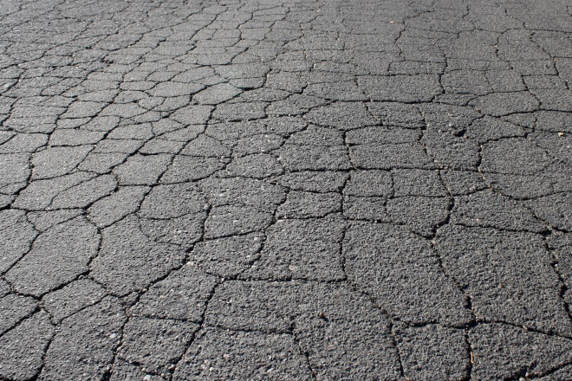
MOTIVATION & CONCERN for High Recycled Binder Ratio (RBR) = High RAP and/or RAS
MN in 2017
  6.9M tons HMA/WMA
  1.3M tons RAP
  15.9k tons RAS
materials savings = $37M
Workability
Compaction
Performance w/Aging
Notes:
High RBR = 0.3 – 0.5
US 2017 (NAPA) (estimated): materials cost savings = $2.2B with 76.2M tons RAP, 1M tons RAS, 380M tons HMA/WMA @ $75/ton
MN 2017 (estimated based on reported #s from 4 companies w/28 plants): 1.3M tons RAP (HIGH 19.5% avg DOT), 15.9k tons RAS, est materials cost savings = $37M, 2M tons HMA/WMA (DOT)
MN 2018: min 80% virgin w/ PG 58-34 (RAS, RAP/RAS, or RAP), min 70% virgin for wear w/other PG grades; no RAs except CIR, CCPR??
the use of recycling agent at 10-15% doses is reasonable to double the RAP content from 20 to 40 percent and save MORE from $6 to $8 per ton HMA/WMA or from $0.30 to $0.40 per 1 percent RAP when virgin material costs are relatively high. This represents approximately 7 to 10 percent of in-place prices for HMA/WMA.
Assess effectiveness of RAs to
partially restore binder rheology
improve mixture cracking performance at optimum dosage rates
Evaluate the evolution of RA effectiveness with aging
Recommend evaluation tools

Slide 3
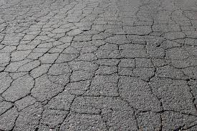

NCHRP 9-58 Objectives
High RBR = 0.3 – 0.5
Assess effectiveness of rejuvenators at selected dose to
partially restore binder rheology
improve mixture cracking performance without adversely affecting rutting resistance
Evaluate the evolution of rejuvenator effectiveness with aging
Recommend evaluation tools
Notes:
“high RBR … is desirable”, w/our RAP/RAS not usually possible due to substitute base binders, PMLC not usually possible due to low field RA dosage
High RBR = 0.3 – 0.5 = higher than DOT control (currently allowed without RA), so field projects exploring RA with higher RBR
TX: DOT control w/ & w/out RA; NV & WI: high RBR w/ & w/out RA
for assessing the effectiveness of RAs and its evolution for specific material combinations at specific locations

Slide 4
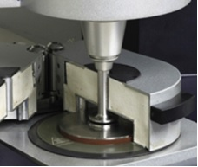
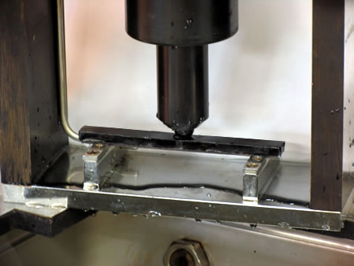

NCHRP 9-58 Binder Blend Evaluation Tools
DSR for PGH, G-R, T_{δ=45}
BBR for ΔT_{c}
G-R$=\frac{G^{∗}{(cosδ)}^{2}}{sinδ}$@ 15°C, 0.005 rad/sec
T_{δ=45°} for G’=G”@ 10 rad/sec
ΔT_{c} @ PAV20 = T_{S} – T_{m}
Notes:
contains polar fatty acids or esters or aromatics, no paraffinic waxes
RMPD Correlation (Base & Recycled) [CT=-2(DTc)+23]
Rejuvenates by moving in G-R BLACK SPACE
RA Type Selection
7 RAs: A1, B1, B2, P, T1, V2, V3
RA & Blends w/ DE PG 64-28 + 0.5 DE RAP
Unaged, RTFO, PAV20, PAV40
Age w/ & w/out RA
FTIR
RTFO Weight Loss
DSR: G-R, T_{δ=45}
RTFO Weight Loss – V2 Lowest, T1 & B1 Highest
+RTFO Weight Loss w/RA
Phase III w/ 0.5 RBR blends w/7 RAs & DE matls + FT-IR and ΔG-R & ΔT_{δ=45} w/aging for RA itself & blends
+ FI of corresponding mixtures
Possibly DSC of RAs to evaluate glass transition
ASTM D4552 – kinematic @ 60C, FP, saturates, viscosity aging ratio w/RTFO - all classify as RA1
Revise AASHTO R 14 w/aging & 50mm DSR
Area from 600-4000 inverse cm – not for HS use
Reduced dispersive power of maltene phase = reduced effectiveness w/aging
Blend w/out modification (not TX 64-22)
V1 could not be evaluated by DSR as the sample became a gel with PAV aging.
The viscosity graph was originally in mPa.s – change the units if using the original axis of the graph
Maybe not show T2 on FTIR? This is ongoing work so it’s probably ok to show more points on FTIR than on DSR

Slide 5
Binder Blend Rheological Evaluation
BLOCK CRACKING ZONE
TRANSITION ZONE
More Aging
Aging
Recycling
Rejuvenation
NO BLOCK CRACKING ZONE
Notes:
G-R = 180, 600 kPa
Field Demo Projects w/high RA dosages to Develop Thresholds for Mixture Cracking Tests
TRB AFK50 Research Idea for Problem Statement = Durability (Aging, Moisture) of high RBR Mixtures

Slide 6
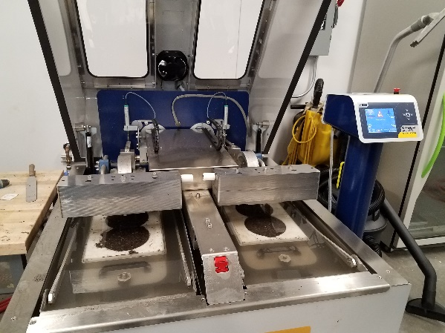
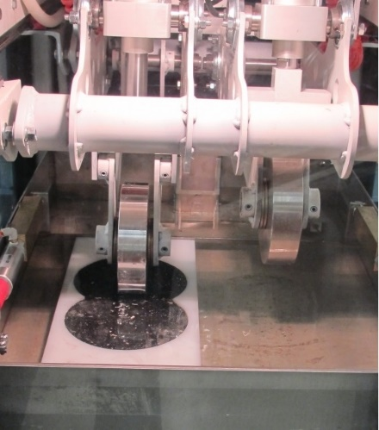
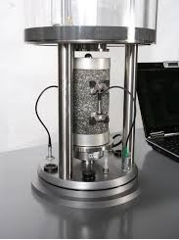
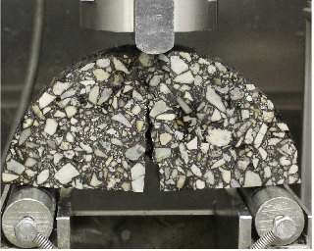
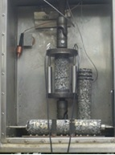
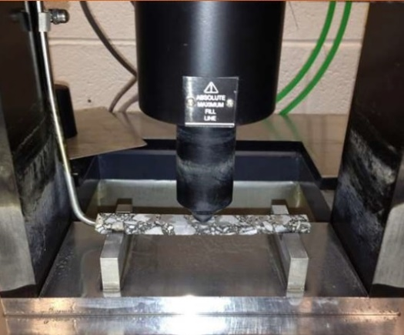
NCHRP 9-58 Mixture Evaluation Tools
HWTT/APA for N_{12.5}
E* for G-R_{m}
@ 20C, 5Hz
I-FIT for FI
BBR_{m} for S_{m} and m-value_{m}
UTSST for CRI_{Env}
Notes:
contains polar fatty acids or esters or aromatics, no paraffinic waxes
RMPD Correlation (Base & Recycled) [CT=-2(DTc)+23]
Rejuvenates by moving in G-R BLACK SPACE
RA Type Selection
7 RAs: A1, B1, B2, P, T1, V2, V3
RA & Blends w/ DE PG 64-28 + 0.5 DE RAP
Unaged, RTFO, PAV20, PAV40
Age w/ & w/out RA
FTIR
RTFO Weight Loss
DSR: G-R, T_{δ=45}
RTFO Weight Loss – V2 Lowest, T1 & B1 Highest
+RTFO Weight Loss w/RA
Phase III w/ 0.5 RBR blends w/7 RAs & DE matls + FT-IR and ΔG-R & ΔT_{δ=45} w/aging for RA itself & blends
+ FI of corresponding mixtures
Possibly DSC of RAs to evaluate glass transition
ASTM D4552 – kinematic @ 60C, FP, saturates, viscosity aging ratio w/RTFO - all classify as RA1
Revise AASHTO R 14 w/aging & 50mm DSR
Area from 600-4000 inverse cm – not for HS use
Reduced dispersive power of maltene phase = reduced effectiveness w/aging
Blend w/out modification (not TX 64-22)
V1 could not be evaluated by DSR as the sample became a gel with PAV aging.
The viscosity graph was originally in mPa.s – change the units if using the original axis of the graph
Maybe not show T2 on FTIR? This is ongoing work so it’s probably ok to show more points on FTIR than on DSR

Slide 7
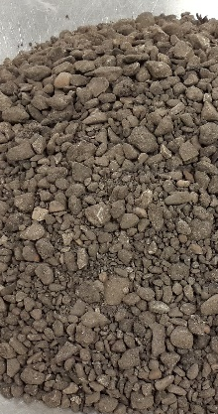
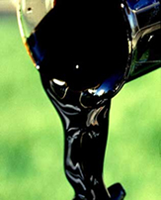
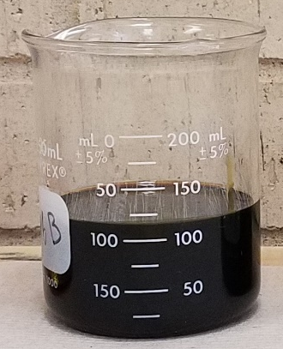
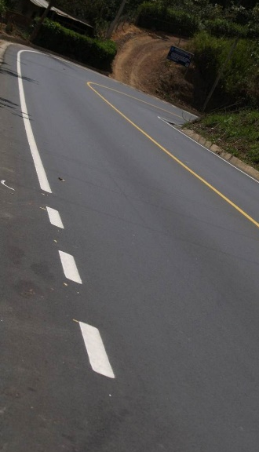
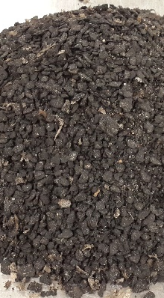
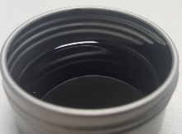
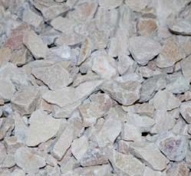
NCHRP 9-58 Materials
(ΔT_{c})
TX PG 64-22 (-4.6), PG 70-22P (-4.9)
NH PG 64-28 (+1.4)
NV PG 64-28P (-3.6)
IN PG 64-22 (-1.2), PG 58-28 (-8.0)
MN PG 58-28 (0.0)
WI PG 58-28 (-3.4), PG 52-34 (+0.4)
DE PG 64-28 (+0.1)
TX
NH
NV
IN
WI
DE
Base
Binder
RAP
Recycling Agents
A1, A2
P
T1, T2
V1, V2, V3
B1, B2
Rejuvenated
Mixture
Rejuvenators
TX MWAS, TOAS
CA TOAS
IN MWAS
DE MWAS
RAS
TX
NV
IN
WI
DE
Rejuvenated
Blend
Virgin Aggregates
Notes:
>30 combos to date
From PHASEIIA:
Improved & Softer Base Binders
Newer RAs
NV & IN field project materials
ALL RAP and equivalent (+balanced) RAP/RAS combos based on PGH
BUILD on / EXPAND from materials & combos used in Field Projects
Field Projects difficult to coordinate, so continual process
Tall Oils, Aromatic Extracts, Vegetable & Modified Vegetable Oils, Bio-based Oil

Slide 8



Draft AASHTO Standard Practice for 0.3-0.5 RBR + Rejuvenator
Rejuvenator Dose Selection & Incorporation Methods
Component Materials Selection & Proportioning Guidelines
Binder Blend Rheological Evaluation Tools
Mixture Performance Evaluation Tools
RAP Binder Availability Factor
Notes:
PRIMARY 9-58 PRODUCT
BALANCED Materials Combination - Base Binder Selection, Limited RASBR, RA Type & Limited Dosage Selection
AGING EFFECTS
TOOLS to assess effectiveness of RA and its evolution in partially restoring binder rheology and improving mixture cracking resistance for specific materials combinations at high RBRs & at specific field locations
MATERIAL SELECTION IMPORTANT
MAX RBR of 0.5 per RFP
MAX RA Dosage of 10-15% per Economic Analysis (only based on RAP from 20 to 40% = save $6-8 per ton or $0.30-0.40 per %RAP w/high virgin material costs)
LIMIT RASBR due to insufficient availability & blending
Future Research = Other Considerations
Moisture Susceptibility
Long-Term Aging
Evaluation of Modified Binders
“high RBR … is desirable”, w/our RAP/RAS not usually possible due to substitute base binders, PMLC not usually possible due to low field RA dosage
High RBR = 0.3 – 0.5 = higher than DOT control (currently allowed without RA), so field projects exploring RA with higher RBR
TX: DOT control w/ & w/out RA; NV & WI: high RBR w/ & w/out RA
for assessing the effectiveness of RAs and its evolution for specific material combinations at specific locations

Slide 9
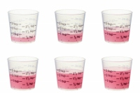

Rejuvenator Dose Selection
& Incorporation
Match Continuous PGH = BALANCED
*1.82 for tall oils, vegetable oils, bio-based oils, 1.38 for aromatic extracts
< Max without sacrificing rutting resistance (8-10%)
Dose as % of total binder (base + recycled)
  RAP only: 100% Replacement of base binder
  w/RAS & > 5% dose: 100% Addition & Check Mixture Rutting
$\%RA={ (PGH}_{Blend}$ $−{ PGH}_{Target}) /{Slope Rate}^{∗}$
${PGH}_{Blend}=\left(RAPBR ×{PGH}_{RAP}\right)+(RASBR ×{PGH}_{RAS})+(BBR×{PGH}_{Base}$)
Notes:
RA MANUFACTURER RECOMMENDATION: 6-8% for economics
ECONOMIC ANALYSIS: the use of recycling agent at 10-15% doses is reasonable to double the RAP content from 20 to 40 percent and save MORE from $6 to $8 per ton HMA/WMA or from $0.30 to $0.40 per 1 percent RAP when virgin material costs are relatively high. This represents approximately 7 to 10 percent of in-place prices for HMA/WMA.
Ultimately, the recycling agent dose should be selected to satisfy binder blend and corresponding mixture performance requirements and be feasible economically.
G-R BLACK SPACE
Restore PGL (and Verify PGH (Round Grade) but Maintain PGL) = TOO LOW = Cracking w/Aging
Achieve ΔT_{c} = -5.0 = TOO HIGH = Rutting
Match Continuous PGH (Actual Grade) = JUST RIGHT
Based on Coatability Results

Slide 10
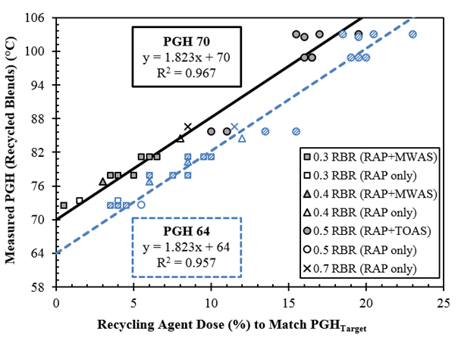
Rejuvenator Dose Selection
${PGH}_{Blend}=\left(RAPBR ×{PGH}_{RAP}\right)+(RASBR ×{PGH}_{RAS})+(BBR×{PGH}_{Base}$)
$\%RA={ (PGH}_{Blend}$ $−{ PGH}_{Target}) /Slope Rate$
Notes:
1.38 for aromatic extracts (A)
These equations were developed using 7 different types of recycling agents (T, A, V, and B), 15 recycled binder blends, and 32 rejuvenated binder blends.
If the change in PGH with % dosage is known for a particular recycling agent, it can be used in the equation as “slope rate”, otherwise 1.82 is a good estimate.
Is it perfect? No, but it gives a good estimate or starting point to start evaluation or know if the RBR is even feasible given economics: usually ~10% dosage is reasonable.
Also allows to re-balance the RAPBR and RASBR to obtain a more reasonable PGHblend and RA dosage.

Slide 11
Component Materials Selection & Proportioning
Base Binder
  PGH < 64°C
  ΔT_{c} @ PAV20 > -3.5°C
RAP
  PGH < 100°C
  ΔT_{c} @ PAV20 > -7.5°C
RAS
  PGH < 150°C
RBR < 0.5
(RAP_{BR}+RAS_{BR})
RAS_{BR} < 0.15
Notes:
RAP PGH precludes TX RAP, RAS PGH precludes TOAS
DTc include WI PG 58-28 and WI RAP, preclude TX PG 64-22 and TX RAP (NV PG 64-28P not considered due to polymer modification)
RASBR = 0.15 = 3.5% by wt mixture
8-10%: 6-8% per manufacturer based on economics
And 10-15% per economic analysis to double RAP from 20-40%

Slide 12
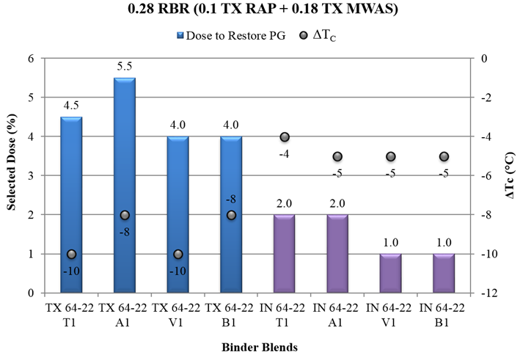
Component Materials Selection
(TX PG 64-22 w/ ΔT_{c} =-4.6, IN PG 64-22 w/ ΔT_{c}=-1.2)
Notes:
TX PG 64-22 (DTc = -4.6)
IN PG 64-22 (DTc = -1.2)
DOT Control w/0.28 RBR (0.1 TX RAP + 0.18 TX MWAS)
With TX PG 82.3-13.3, with IN PG 77.9-21.3
Lower RA doses to restore PGL, Verify PGH (PG 64-22) AND less negative DTc with IN base binder

Slide 13
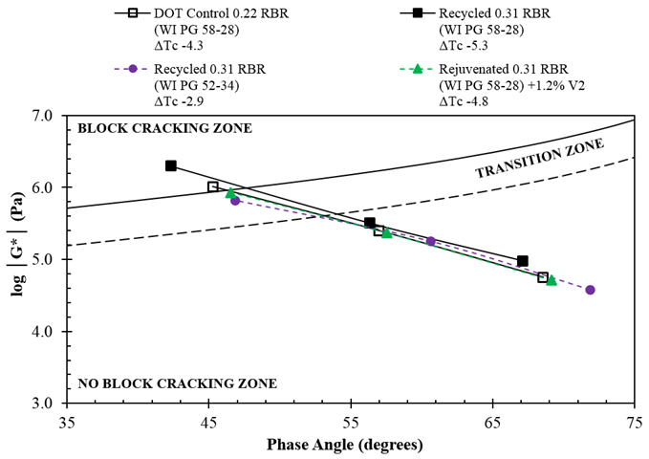
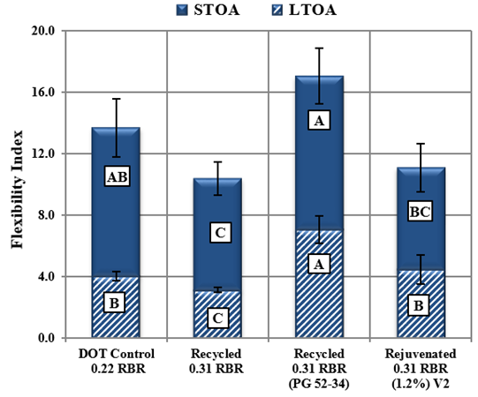
Component Materials Selection
(WI PG 58-28, PG 52-34)
> 7 after STOA
Notes:
WI PG 58-28 (DTc = -3.4, in blend -5.3 w/out RA, -4.8 w/field RA dose)
WI PG 52-34 (DTc = +0.4, in blend -2.9 w/out RA)

Slide 14
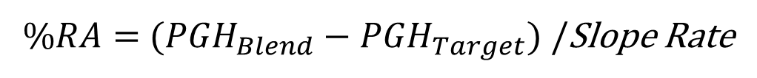
Materials Proportioning / Balance
${PGH}_{Blend}=\left(RAPBR ×{PGH}_{RAP}\right)+(RASBR ×{PGH}_{RAS})+(BBR×{PGH}_{Base}$)
$\%RA={ (PGH}_{Blend}$ $−{ PGH}_{Target}) /$Slope Rate
Base Binder | RAP | RAS | RA Dose | Comments
TX PG 64-22 | 0.25 TX RAP | 0.25 TX TOAS | 19.4 | UNBALANCED Very High Dose
 | 0.4 TX RAP | 0.1 TX TOAS | 13.5 | RAP/RAS High Dose
 | 0.4 TX RAP | 0.1 TX MWAS | 10.9 | RAS Type High Dose
 | 0.4 NH RAP | 0.1 TX MWAS | 7.3 | RAP Type Marginal Dose
MN 58-28 | 0.4 NH RAP | 0.1 TX MWAS | 4.6 | Base Binder Acceptable Dose
Notes:
FOR SPECIFIC REJUVENATOR TYPE
1.38 for aromatic extracts (A)
These equations were developed using 7 different types of recycling agents (T, A, V, and B), 15 recycled binder blends, and 32 rejuvenated binder blends.
If the change in PGH with % dosage is known for a particular recycling agent, it can be used in the equation as “slope rate”, otherwise 1.72 is a good estimate.
Is it perfect? No, but it gives a good estimate or starting point to start evaluation or know if the RBR is even feasible given economics: usually ~10% dosage is reasonable.
Also allows to re-balance the RAPBR and RASBR to obtain a more reasonable PGHblend and RA dosage.

Slide 15
Binder Blend Rheological Evaluation
T & Aging Conditions | Test | Parameter | Suggested Performance Threshold
T_{high} Unaged, Short-Term | DSR | PGH | Target Climate
T_{int} Track w/Aging | DSR | G-R | < 180 kPa after 20-hr PAV < 600 kPa after 40-hr PAV
 | DSR | T_{δ=45°} | < 32° after 20-hr PAV < 45° after 40-hr PAV
T_{low} Long-Term | BBR | ΔT_{c} | > -5.0 after 20-hr PAV
Short-Term Aging = RTFOT; Long-Term Aging = PAV @ 100°C

Slide 16
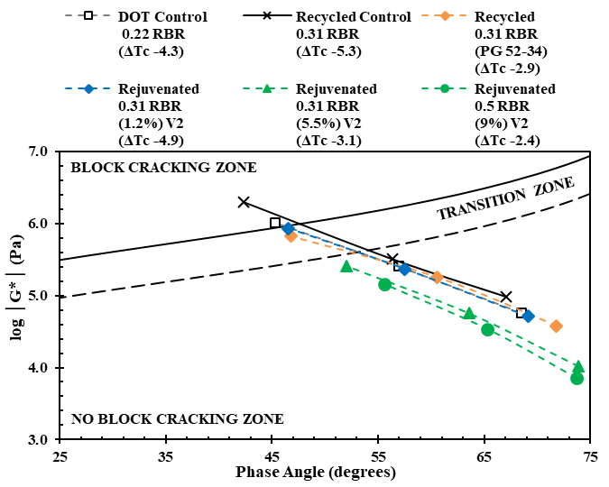
G-R Black Space (WI PG 58-28, PG 52-34)
Notes:
Shift in G* and d; meet cracking limits with aging; no rutting at high d, low G*
Field Demo Projects w/high RA dosages to Develop Thresholds for Mixture Cracking Tests
TRB AFK50 Research Idea for Problem Statement = Durability (Aging, Moisture) of high RBR Mixtures

Slide 17
Mixture Performance Evaluation
T & Aging Conditions | Test | Parameter | Suggested Performance Threshold
T_{high} Short-Term | HWTT or APA | N_{12.5} | > 5,000 for PG 58-XX > 7,500 for PG 64-XX (cold) > 10,000 for PG 64-XX (warm) > 15,000 for PG 70-XX
T_{int} Track w/Aging & Short-Term | E* | G-R_{m} | < 8,000 MPa after STOA < 19,000 MPa after LTOA
 | I-FIT | FI | > 7 after STOA
T_{low} Short- & Long-Term | BBR_{m} | S_{m}, m-value_{m} | < Utah threshold after STOA
 | UTSST | CRI_{Env} | > 17 after LTOA
Short-Term Aging = STOA = 2hr @ 135°C; Long-Term Aging = LTOA = 5d @ 85°C

Slide 18
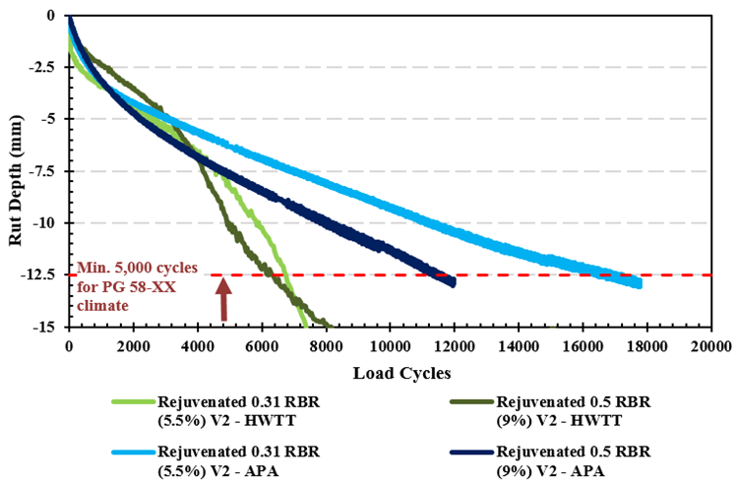
N_{12.5} (WI PG 58-28)
> 5000 for PG 58-XX
Notes:
Selected RA Dose by Method Acceptable Rutting Performance for two RBRs
Field Demo Projects w/high RA dosages to Develop Thresholds for Mixture Cracking Tests
TRB AFK50 Research Idea for Problem Statement = Durability (Aging, Moisture) of high RBR Mixtures

Slide 19
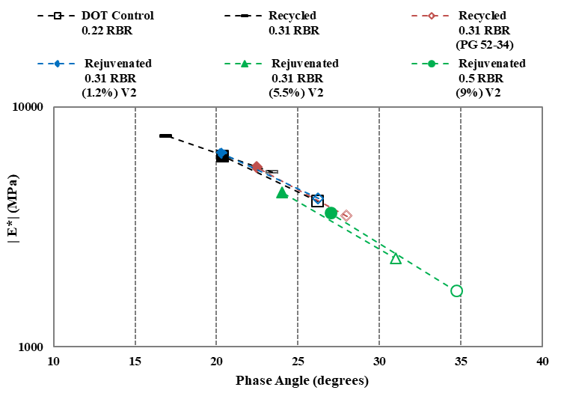
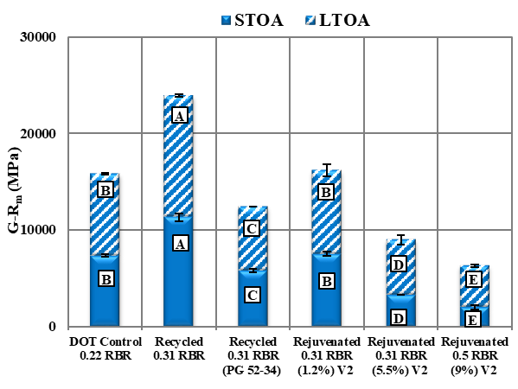
G-R_{m} Black Space
WI PG 58-28, PG 52-34
< 8000 MPa after STOA
< 19,000 MPa after LTOA
Notes:
Field Demo Projects w/high RA dosages to Develop Thresholds for Mixture Cracking Tests
TRB AFK50 Research Idea for Problem Statement = Durability (Aging, Moisture) of high RBR Mixtures

Slide 20
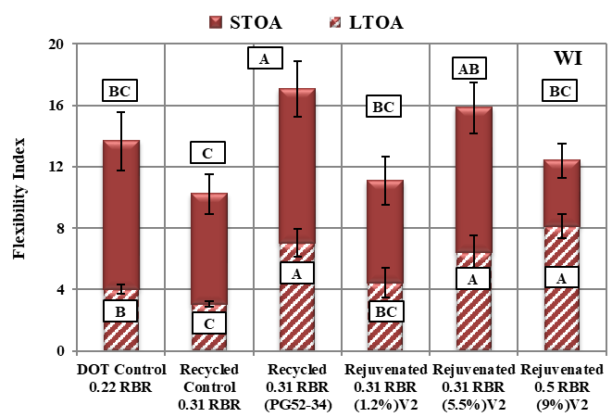
FI (WI PG 58-28, PG 52-34)
> 7 after STOA
Notes:
Field Demo Projects w/high RA dosages to Develop Thresholds for Mixture Cracking Tests
TRB AFK50 Research Idea for Problem Statement = Durability (Aging, Moisture) of high RBR Mixtures

Slide 21
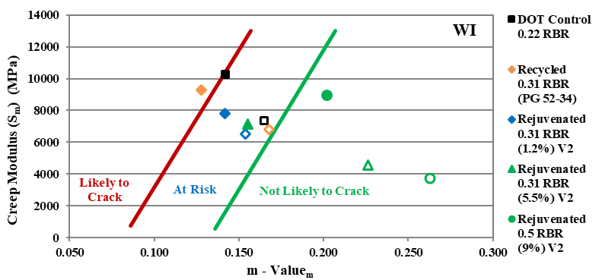
S_{m}, m-value_{m} (WI PG 58-28, PG 52-34)
Low severity cracking (1 year)
Notes:
Most cracking w/softer binder
Field Demo Projects w/high RA dosages to Develop Thresholds for Mixture Cracking Tests
TRB AFK50 Research Idea for Problem Statement = Durability (Aging, Moisture) of high RBR Mixtures

Slide 22
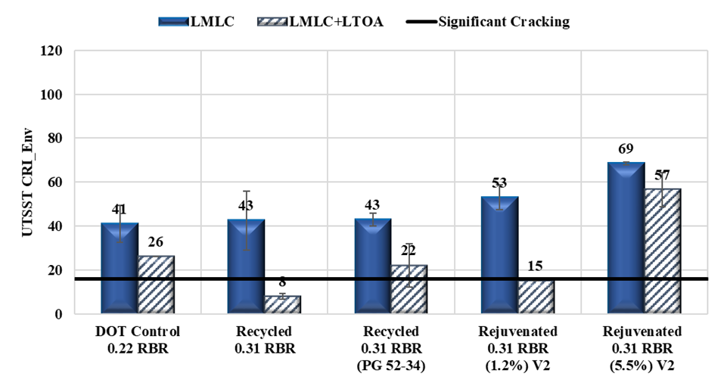
CRI_{Env} (WI PG 58-28, PG 52-34)
> 17 after LTOA
STOA
LTOA
Notes:
Field Demo Projects w/high RA dosages to Develop Thresholds for Mixture Cracking Tests
TRB AFK50 Research Idea for Problem Statement = Durability (Aging, Moisture) of high RBR Mixtures

Slide 23

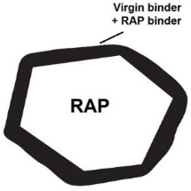
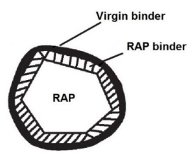
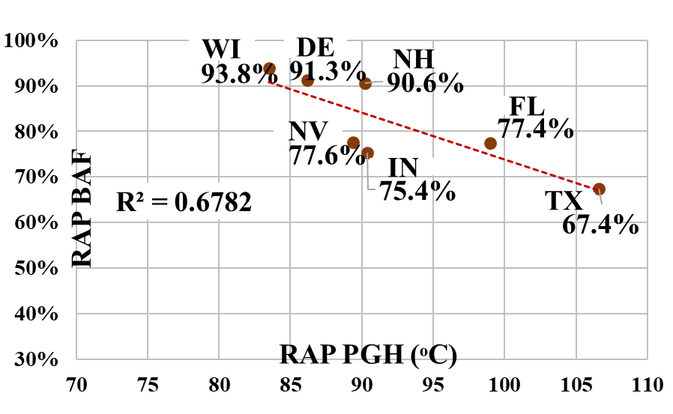
RAP Binder Availability Factor
PARTIAL BLENDING
100% Available
0% Available
Black Rock
Add Rejuvenator &
Add Rejuvenator to RAP
only effective for high PGH (FL, TX)
$RAPBAF=−0.010 x{ PGH}_{RAP}+ 1.771$ for 150°C mixing
Notes:
Different coefficients for 140C mixing: -0.014, 1.898
Variability with method – only RAP of specific size
WI PG 58-28 + NH PG 64-28
T_{mix}: 150 °C + 140 °C
STOA for 2 hrs + 4 hrs
No RA, ADD RA to Base Binder, ADD RA to RAP
Superheat Aggregate to 207 °C
SEE effects of STOA time and Superheating AGG for TX and NV ONLY
SEE effects of adding RA and RA Addition method for high PGH RAPs in TX and FL ONLY

Slide 24







Implementation & Future Research
Review of State Specs on RBR
Field Demonstration Project with Selected Rejuvenator Dose
Contractor
Guidelines
Capturing Durability of High RBR Mixtures
  Moisture Susceptibility
  Aging
Rejuvenator Selection
Binder Availability & Blending
Notes:
Durability - AASHTO COMP/TRB AFK50 Research Idea for Problem Statement
3 TxDOT, MNDOT, IDOT
RA Selection FDOT + other related upcoming
NAPA contractor guidelines

Slide 25
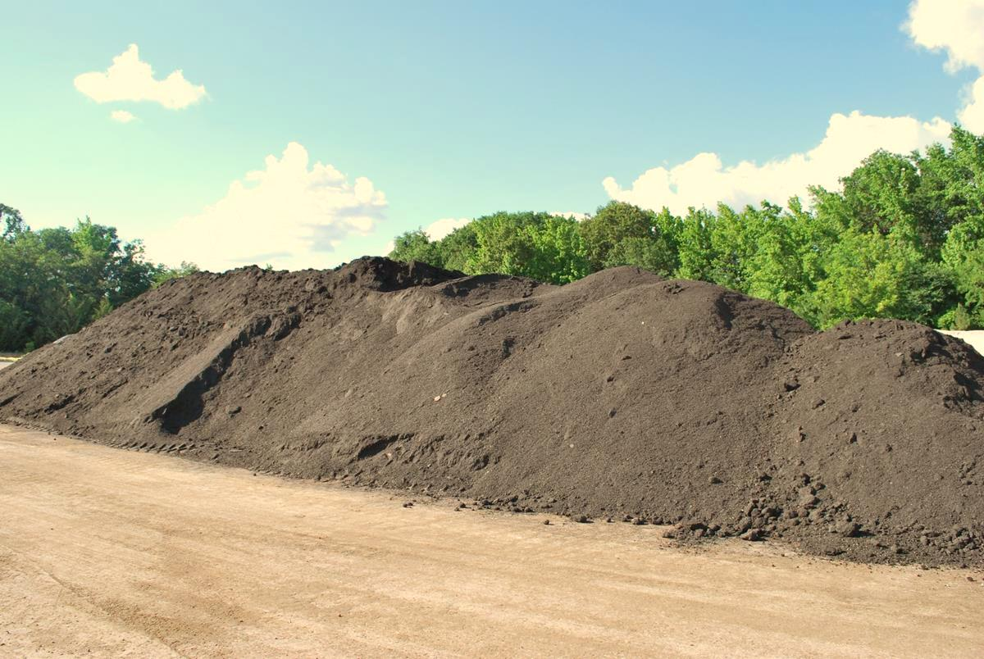
THANK YOU!
Amy Epps Martin
(979) 862.1750
a-eppsmartin@tamu.edu
Acknowledgements
TTI, UNH, UNR, Gayle King
TX, NV, IN, WI, DE DOTs, APAs, & Contractors
Recycling Agent Manufacturers

