Slide 1
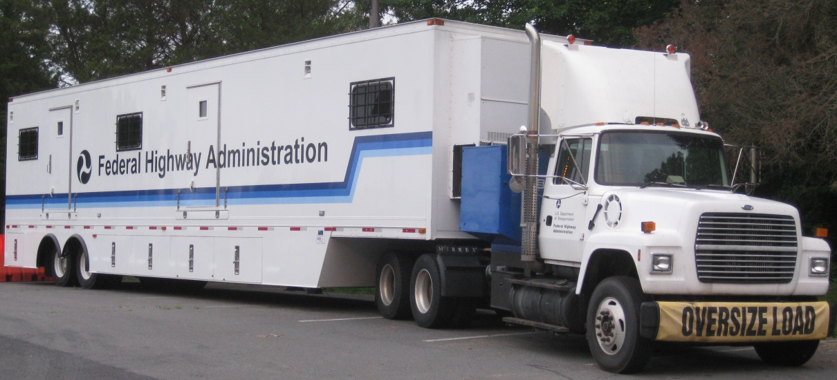
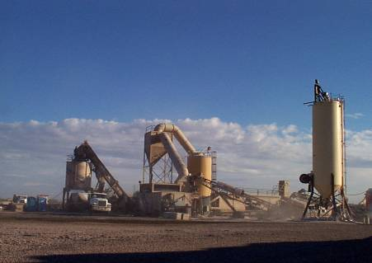
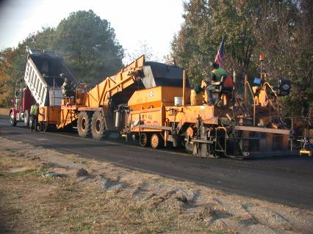
Asphalt Performance Testing
Images: FHWA
Mobile Asphalt Testing Trailer Program (MATT)
Long-Life Asphalt Pavements for the 21st Century
Amir Golalipour, Ph.D., P.E.
Leslie Myers McCarthy, Ph.D., P.E.
National Road Research Alliance Workshop
May 23, 2019  Saint Paul, MN
Office of Preconstruction, Construction, and Pavements

Slide 2
Agenda
FHWA Pavement and Materials
Asphalt Mixture Performance Tester (AMPT)
Mixture Performance Tests
  Small Specimen Geometry
Recent Visits
Questions

Slide 3
Acronyms
AASHTO: American Association of State Highway and Transportation Officials
ABCD: Asphalt Binder Cracking Device
ABTL: Asphalt Binder Testing Laboratory
AIMS: Aggregate Imaging System
AMPT: Asphalt Mixture Performance Tester
BBR: Bending Beam Rheometer
CAA: Coarse Aggregate Angularity
CC: Concentric Cylinders
DSR: Dynamic Shear Rheometer
DTT: Direct Tension Tester
ETG: Expert Task Group
Gmb: Bulk Specific Gravity
GTR: Ground tire rubber
HMA: Hot mix asphalt
MATT: Mobile Asphalt Testing Trailer
MSCR: Multiple Stress Creep and Recovery
NCHRP: National Cooperative Highway Research Program
PAV: Pressure Aging Vessel
PEMD: Performance-engineered mixture design
PG: Performance Grading
PRS: Performance Related Specification
QA: Quality Assurance
RAP/RAS: Reclaimed Asphalt Pavement/Reclaimed Asphalt Shingles
RTFO: Rolling Thin-film Oven
RV: Rotational Viscometer
TFHRC: Turner-Fairbank Highway Research Center
WMA: Warm Mix Asphalt
Note: FHWA does not endorse products or manufacturers. Trade or manufacturers’ names appear in this presentation solely for informational purposes.

Slide 4
Pavement & Materials Discipline
Program Office
  Office of Preconstruction, Construction, and Pavements (FHWA HQ, Washington, DC)
    Mobile Asphalt Testing Trailer (MATT)
Research and Development
  TFHRC (McLean, VA)
Technical Services
  Resource Center
Divisions
Notes:
Added R&D, Tech Services, and Divisions

Slide 5
MATT Program History
Projects began in 1988
  Demonstration Project 74: Field Management of Asphalt Mixes Using Volumetric Quality Control
Transition to Superpave implementation
  Early 1990s
  Classroom and hands-on training
Transition to performance-related specifications
  Shadow testing
  AMPT user since 2003
Innovative materials and practices
  WMA, GTR, RAP/RAS, increased density

Slide 6
MATT Visits Since 2007
PR
Field Work
Workshop/Hands-on Training/Presentation/
Open House/Technical Assistance
Both
Notes:
NEW SLIDE

Slide 7
History of the MATT in Minnesota
1990 – Demo project: Commercial Asphalt – Scandia
1994 – Field Management & Mix Design:
MN DOT Materials Lab – Minneapolis
2004 – Superpave Mix Design: Commercial Asphalt Co. – Newport
2007 – Acid Modified Binder: Commercial Asphalt Co. – MnRoad Track, Maple Grove
2008 – Hi-RAP & WMA Mixes: MnROAD – Albertville
2012 – Hi-RAP & RAS Mixes: Dunn Blacktop Co (Mathy Co) – US route 14, Fabian Pit, St. Charles
NOW! –2019 NRRA Workshop – Saint Paul
Notes:
NEW SLIDE

Slide 8
Recent Implementation Status

Slide 9
Example: WMA
40 State DOTs and all Federal Lands Divisions have a specification &/or contractual language that allows WMA on Federal-aid or Federal Lands projects.
By December 2012, at least 18 State DOTs achieved set targets for WMA usage.
Project in Indiana: 2010 – WMA (foam) with 25% RAP
Notes:
NEW SLIDE

Slide 10
Example: Asphalt Rubber
Seven projects between 2013 to 2015.
Collaboration with four State DOTs to evaluate their specifications based on project results.
Working with FHWA ETG to develop AASHTO standard for asphalt rubber testing.
Notes:
NEW SLIDE

Slide 11
What Do We Do?

Slide 12
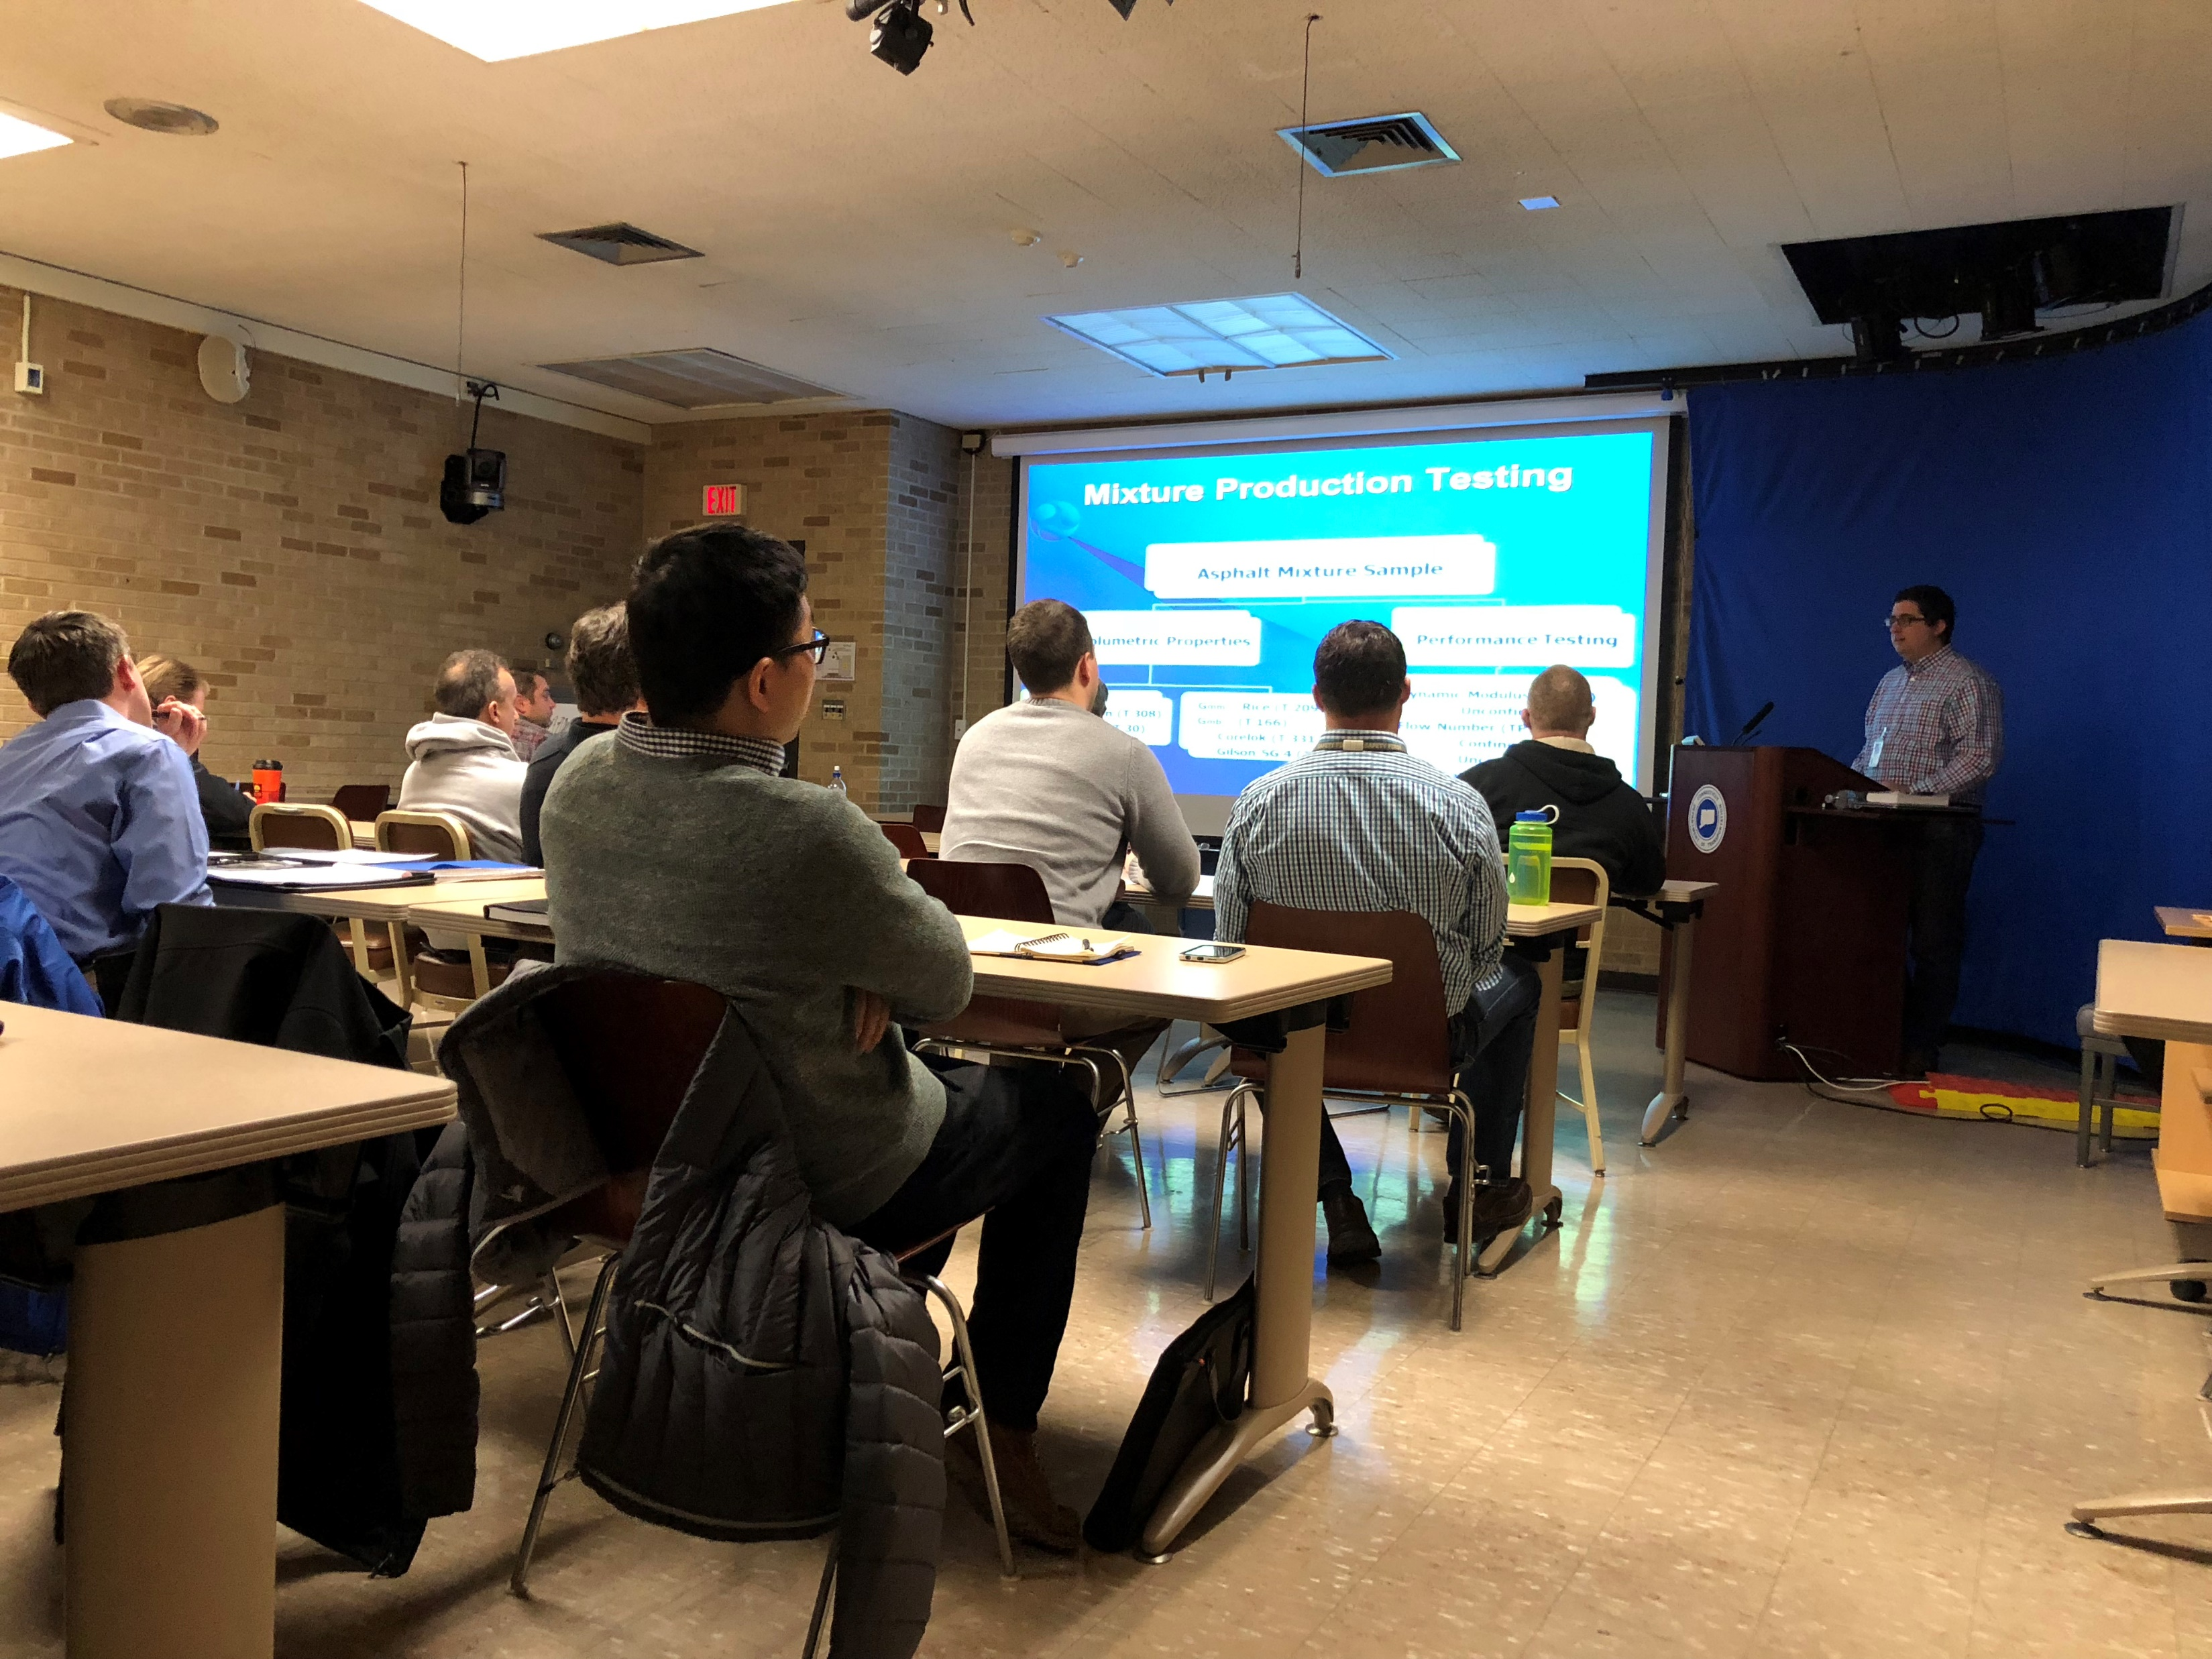
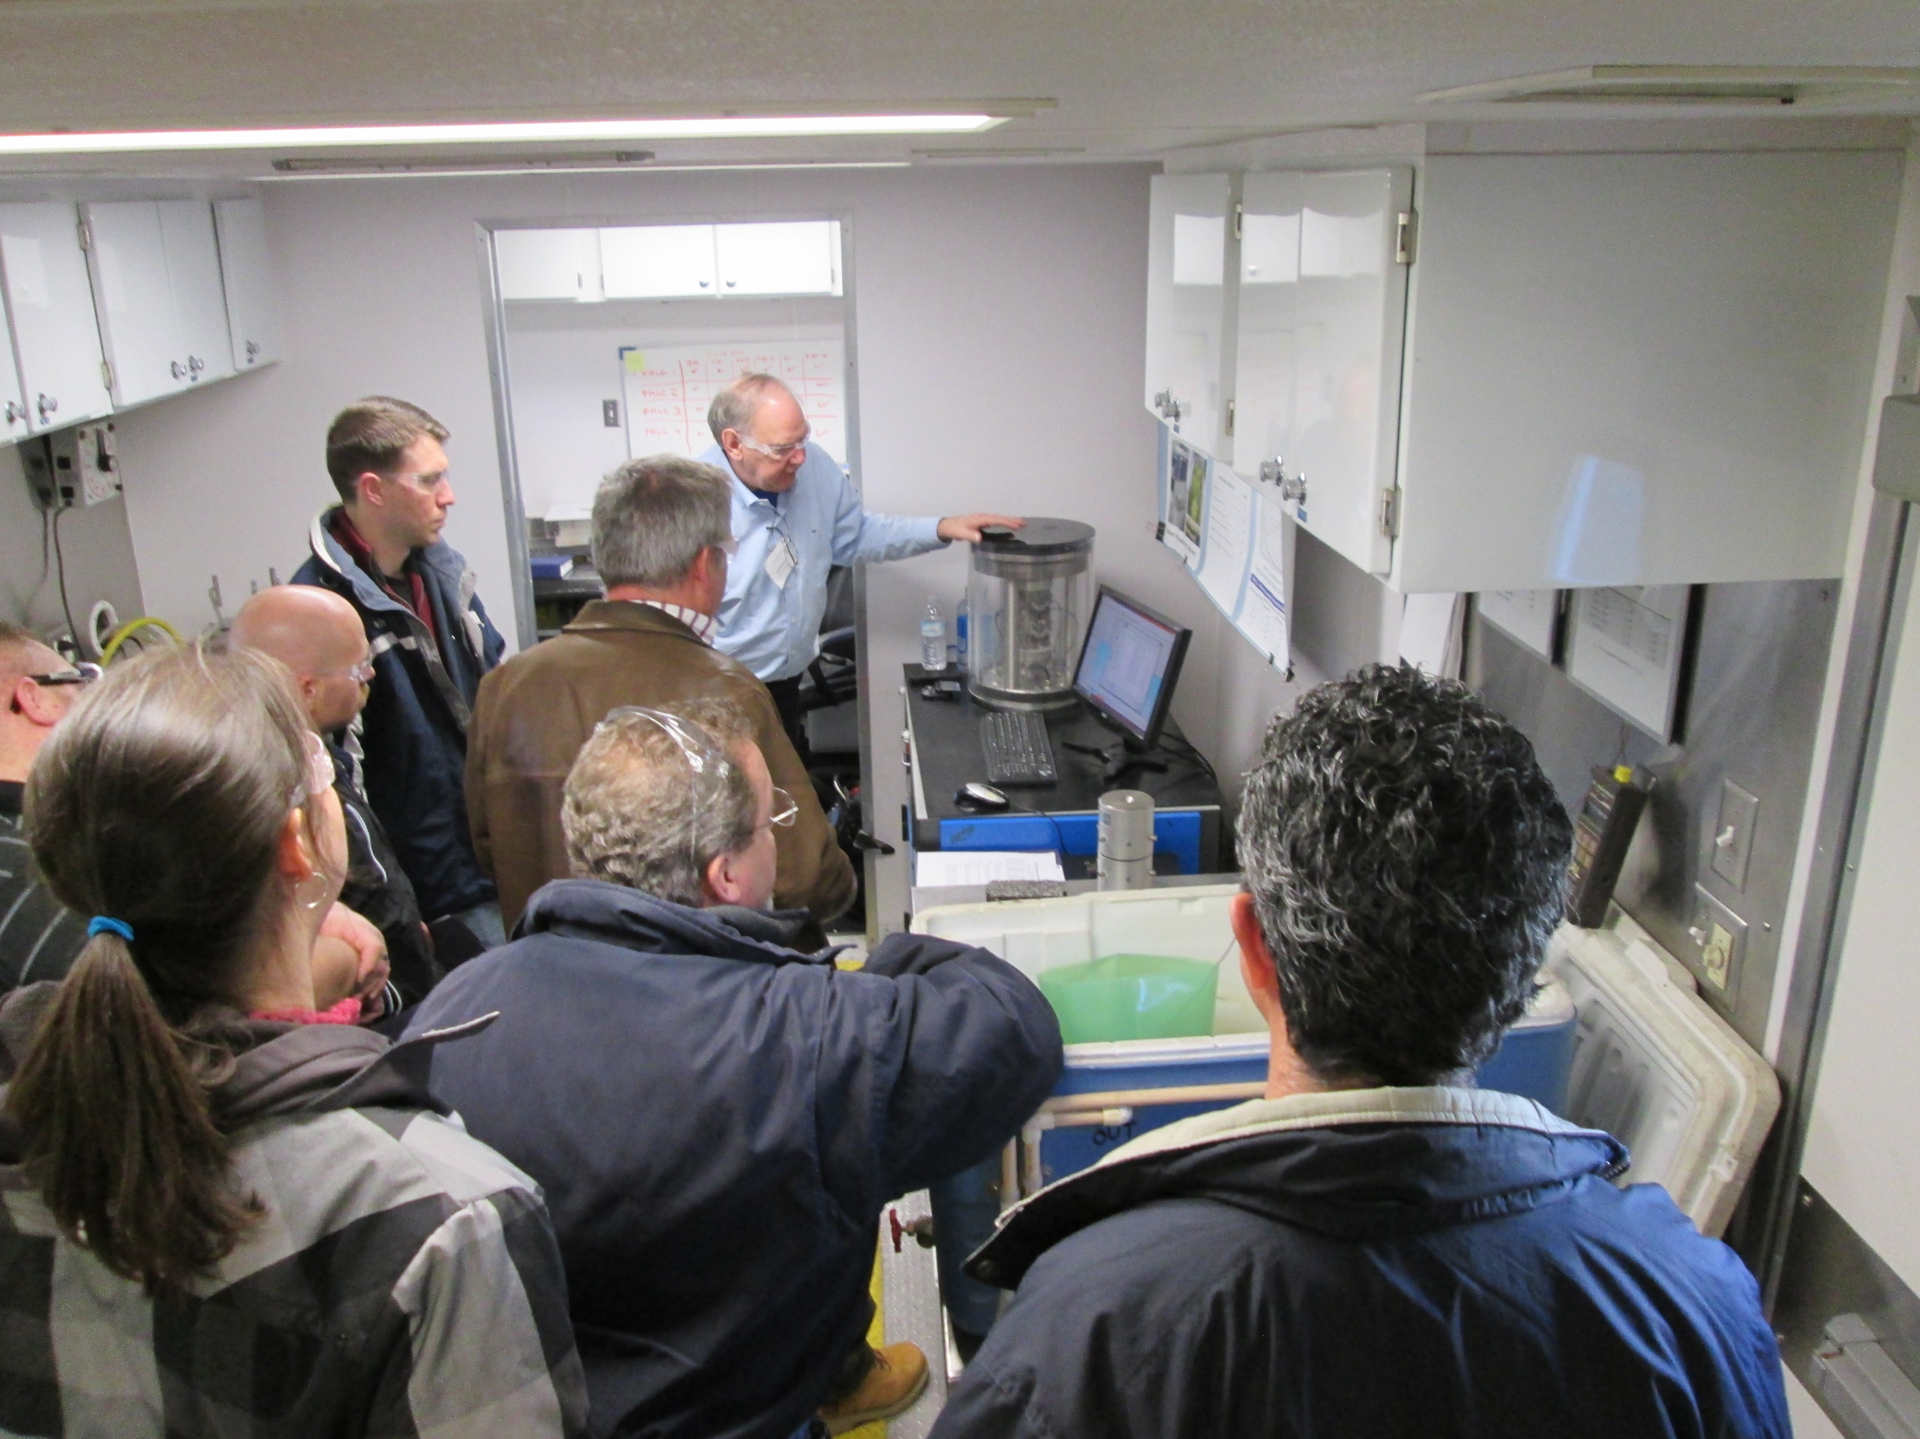
Technical Workshops
Images FHWA
Notes:
NEW SLIDE

Slide 13
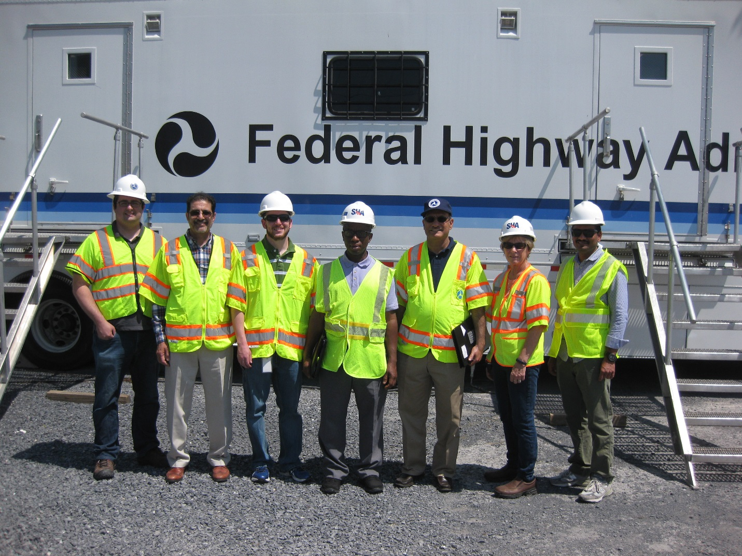
Training
Training for the Maryland State Highway Administration staff
Image: FHWA
Notes:
NEW SLIDE

Slide 14
Program Mission
Provide guidance, leadership, and technology for the delivery of long life pavements.
Advance new and improved technologies and innovations into common practice.
Raise awareness, assist, support, and provide guidance to FHWA field offices, State Highway Agencies, and their industry partners.
Notes:
NEW SLIDE

Slide 15
Program Objective
Provide Support to National Initiatives
  Mixture Performance Testing and the AMPT
  Increased Pavement Density
  Development of New QA Concepts for HMA
  Performance Engineered Mix Design (PEMD)
  Understanding Asphalt Rubber Testing
  Binder Performance Testing
  Long-Term Aging

Slide 16
Mixture Activities

Slide 17
Mixture Production Testing
Asphalt Mixture Sample
Volumetric Properties
P_{b} – Ignition (T 308)
Gradation – (T 30)
Gmm – Rice (T 209)
Gmb – (T 166)
- Corelok (T 331)
- Gilson SG 4 (TP 82)
Performance Testing
Dynamic Modulus (T 378)
- Unconfined
Flow Number (T 378)
- Confined
- Unconfined
Cyclic Fatigue (TP 107)

Slide 18
Performance-Engineered Mixture Design (PEMD)
A method to address today’s problems
Mix designs accepted on passing performance indices in combination with volumetric targets (Go/No-Go)
Part of a performance continuum
PEMD
Production testing (as-built condition/QA)
Performance predictions and comparisons (PEMD to as-built)
Notes:
NEW SLIDE

Slide 19
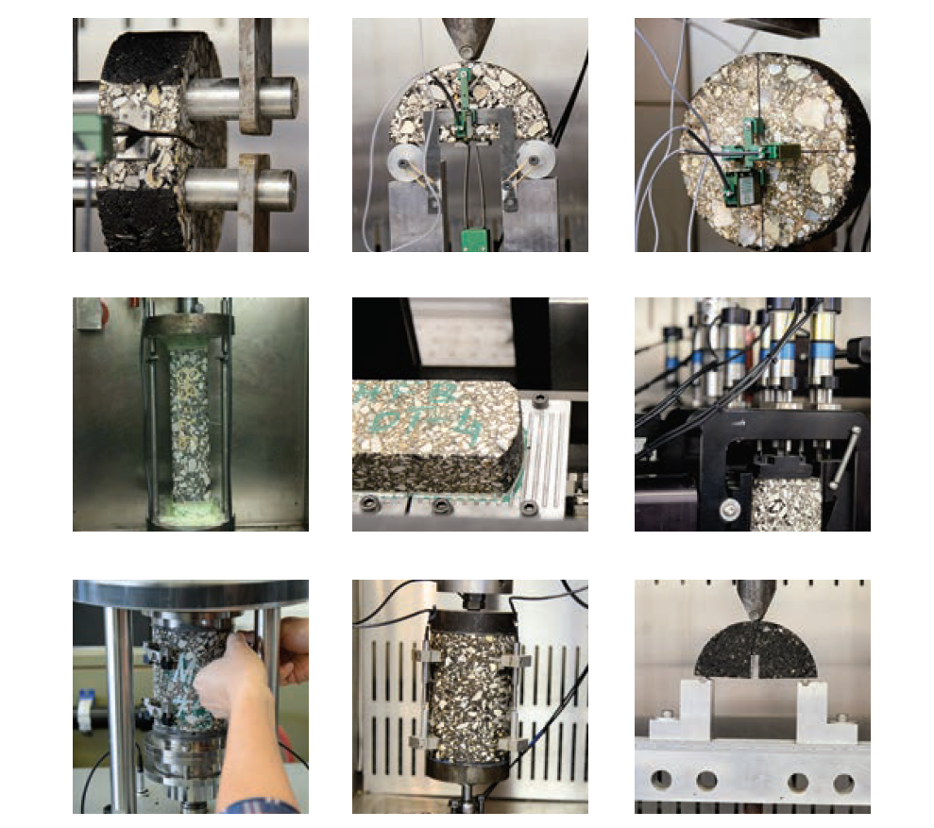
NCHRP 9-57: Selected Cracking Tests
Image: NCHRP 9-57 booklet
Notes:
NEW SLIDE

Slide 20
List of Cracking Tests
Disc Compact Tension (DCT)
Semi-Circular Bending (SCB)
  University of Minnesota – Low Temperature
  Louisiana Transp. Research Center – Intermed. Temp
  University of Illinois – Intermed. Temp
Overlay Tester (OT)
Indirect Tension Test (IDT)
Bending Beam Fatigue (BBF)
Cyclic Fatigue Test (TP 107)
Notes:
NEW SLIDE

Slide 21
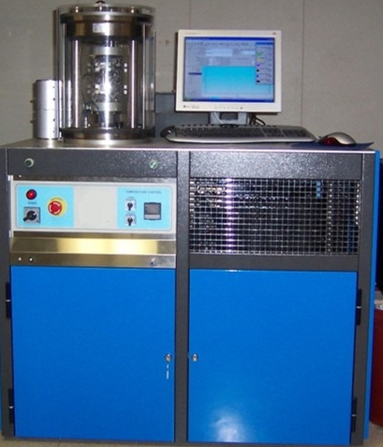
Performance Characteristics
Asphalt Mixture Performance Tester
Image: IPC Global

Slide 22
AMPT – Addressing a Need
Late 1980s-Early 1990s: Strategic Highway Research Program
  Superpave mixture design approach
  Performance grade binders
  No viable performance tests for mixture
National Cooperative Highway Research Program
  9-19: Identify simple performance tests for Superpave (rutting, fatigue)
    Dynamic modulus, flow number, flow time
  9-29: Produce test methods and prototype, conduct ruggedness and interlaboratory studies
    Simple Performance Tester (now known as AMPT) was born!

Slide 23
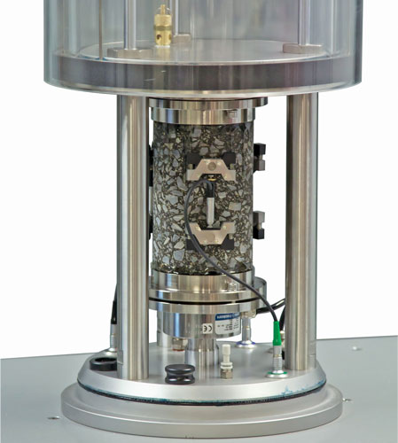
AMPT
Servo-hydraulic loading machine
Temperature range from 4° to 70°C
Computer-controlled device
  Software built-in for various test procedures
Fundamental tests
  Stress and strain modeling
  “Bulk testing”
  Pavement ME
Kits available for other tests
Image: FHWA

Slide 24
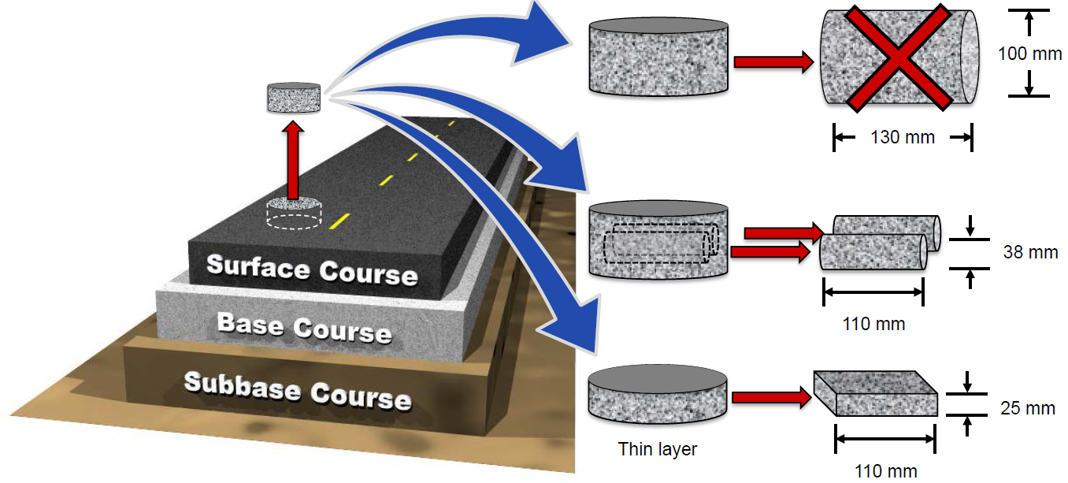
Small Specimen Testing
Proposed to enable field core testing
To improve the efficiency of laboratory specimen fabrication
Image: North Carolina State University

Slide 25
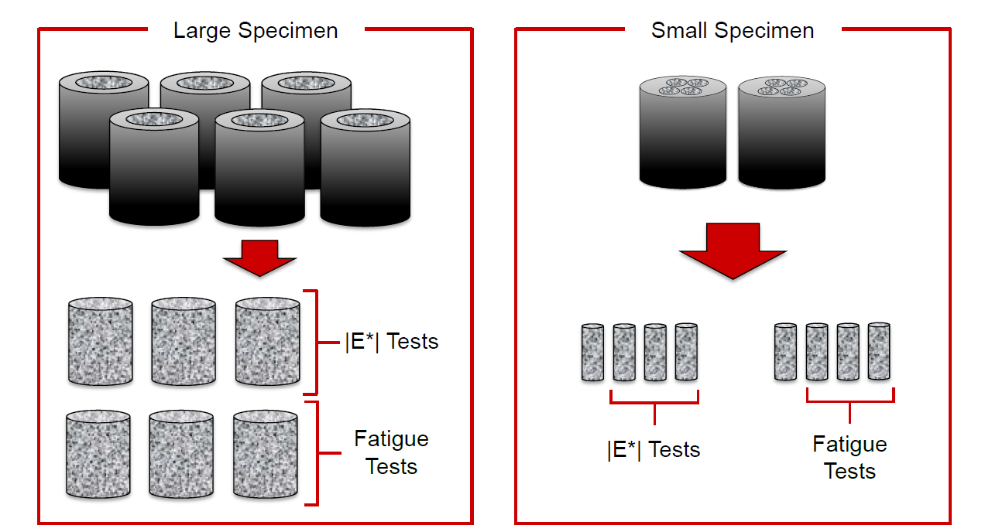
Small Specimen Geometry
Need less material to complete testing matrix
Image: North Carolina State University

Slide 26
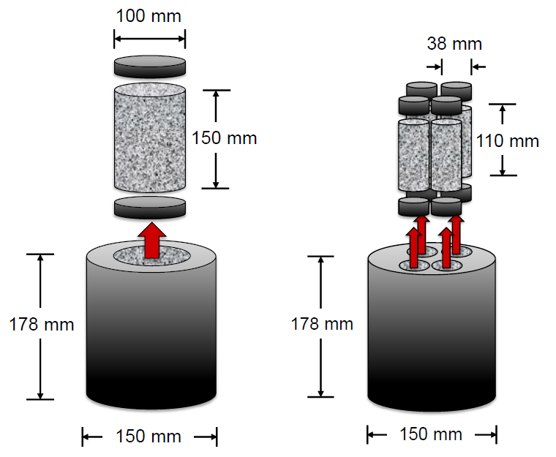
Small Specimen Geometry
Imag: North Carolina State University

Slide 27
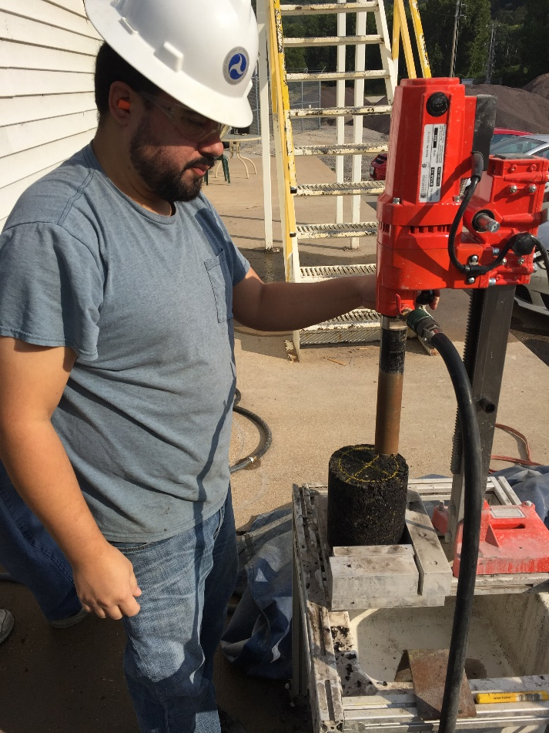
Small Specimen Fabrication
Image: FHWA
Image: NCHRP 20-30 (NCHRP-IDEA) project
Notes:
27

Slide 28
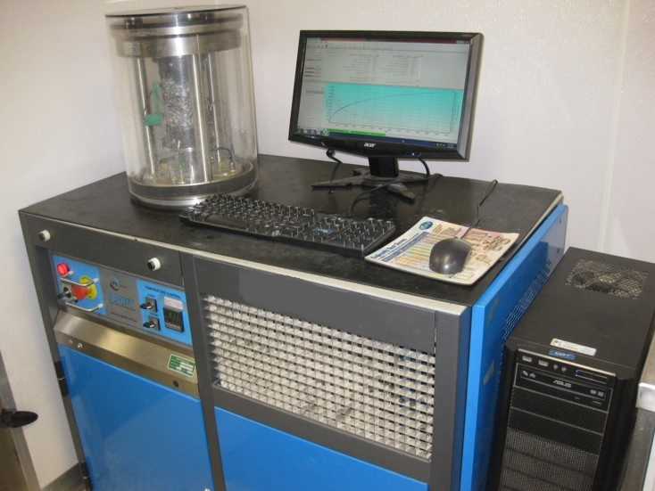
Performance Testing
AASHTO T 378 (former TP 79)
  Dynamic Modulus
    Mixture Stiffness
    Rutting
    Fatigue Cracking
  Flow Number
    Rutting
AASHTO TP 107
  Cyclic Fatigue
    S-VECD
Image: FHWA

Slide 29
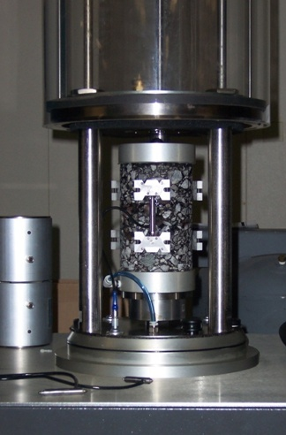
Dynamic Modulus Test
Mixture Stiffness
Rutting
Fatigue Cracking
σ
ε
Stress
Strain
0
0
Τ
Image: FHWA
l
Dynamic Modulus
Phase Angle
Τ
p
σ
Time
Τ
E*
=
0
φ
=
l
(360°)
ε
Τ
0
p

Slide 30
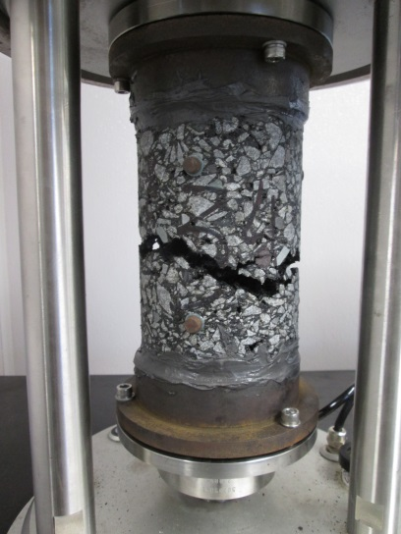
AMPT Cyclic Fatigue
Fundamental, repeated loading test
  Based in sound engineering principles, not empirical
  Direct tension
AASHTO TP 107-14 Determining the Damage Characteristic Curve of Asphalt Mixtures from Direct Tension Cyclic Fatigue Tests
  |E*| Linear Viscoelastic (LVE) Test
  |E*| Dynamic Modulus (Finger Print) Test
  A typical mid-specimen failure
  Predicted Nf & Failure properties

Slide 31
Test Procedure
Controlled strain cyclic tension test
  pull-pull load test
  A constant frequency of 10 Hz
  Temperature is based on Intermediate Grade (TP 107)
Failure is determined by a sharp decrease in phase angle

Slide 32
AMPT Cyclic Fatigue Summary
Fundamental, repeated loading test
Direct tension
Small-specimen testing available
AASHTO TP 107/AASHTO TP 1xx
Material behavior across all possible loading conditions!

Slide 33
AMPT Cyclic Fatigue Advantages
Standard sample preparation
AASHTOWare Pavement ME compatible
Ruggedness, precision and bias underway
Spreadsheet analysis & formulation available
Predicts performance
Material behavior across all possible loading conditions

Slide 34
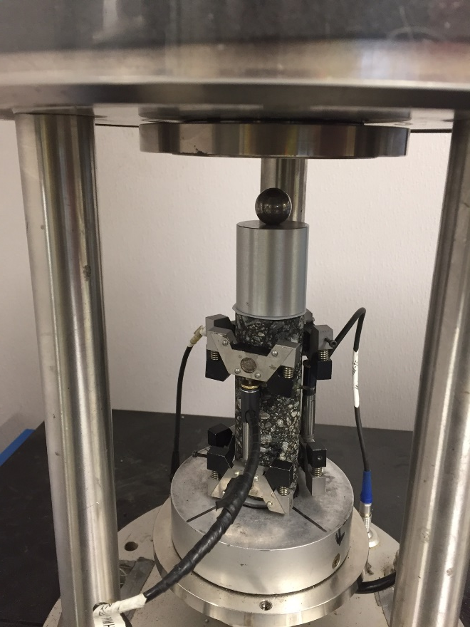
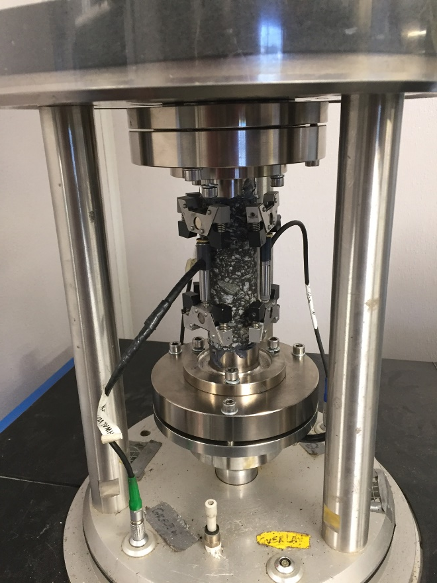
Types of Small Specimen Testing
Small Scale Dynamic Modulus
Small Scale Cyclic Fatigue
Images: FHWA
Notes:
34

Slide 35
AMPT Small Specimen Advantages
Field core testing
Reduced sampling and material requirements for testing
Same data output generated from small scale testing as full scale testing

Slide 36
Stress Sweep Rutting (SSR) Test
Draft procedure ready for consideration by AASHTO
FlexMATTM -Rutting available
  Single tab spreadsheet
Confined testing (10 psi)
Model predicts permanent deformation at all loading conditions!
Notes:
No slide number.

Slide 37
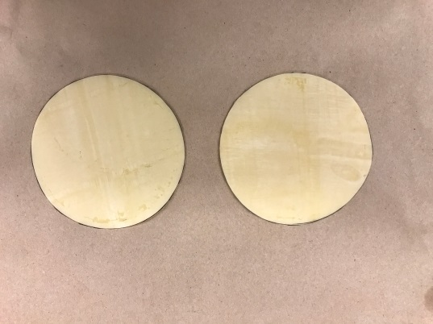
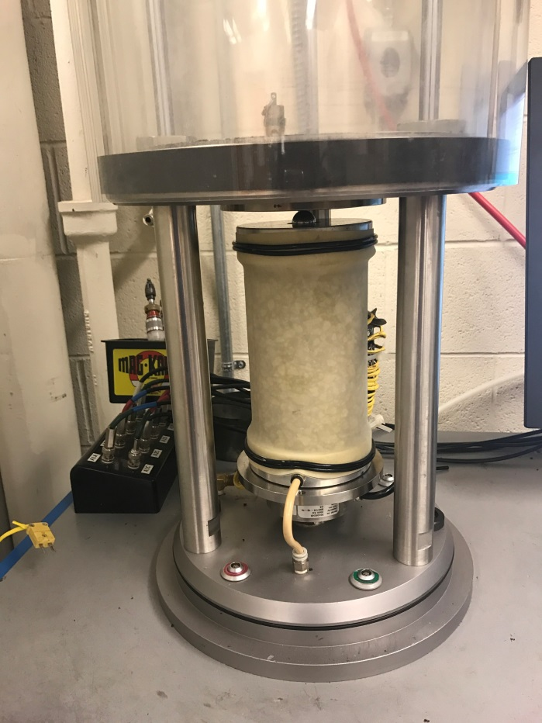
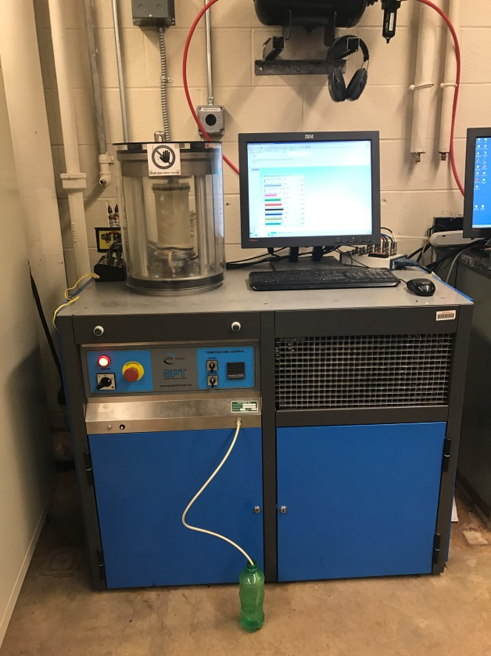
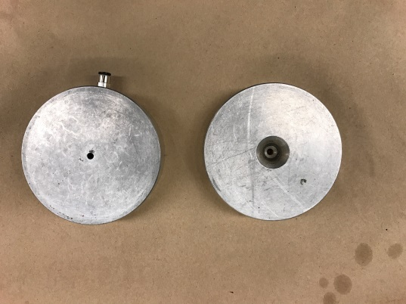
SSR Test Setup
Images: North Carolina State University
Notes:
No slide number.

Slide 38
Performance-Engineered Mixture Design (PEMD)
A method to address today’s problems
Mix designs accepted on passing performance indices in combination with volumetric targets (Go/No-Go)
Two indices:
  S_{app} – fatigue resistance
  Permanent strain – rutting resistance
Upcoming NCHRP 20-07 report to detail steps to implement a performance test!
  AMPT cyclic fatigue is well on its way in many of these steps!
Notes:
NEW SLIDE

Slide 39
S_{app} trends

Slide 40
S_{app} trends
% AV Increases
% AV Increases
Finer Gradation

Slide 41
S_{app} Criteria
Traffic (million ESALs) | S_{app} Limits | Tier | Designation
Less than 3 | S_{app} <= 8 | Light | L
Between 3 and 10 | 8 < S_{app} <= 18 | Standard | S
Between 10 and 30 | 18 < S_{app} <= 25 | Heavy | H
Greater than 30 | 25 < S_{app} <= 30 | Very Heavy | V
Greater than 30 and slow traffic | S_{app} > 30 | Extremely Heavy | E
Notes:
National data set – 120 mixes including Manitoba, CA
University of Georgia has put together a table like this, Final report has been provided to the DOT.
Maine, Missouri, Ontario -> plan to put together this for their state

Slide 42
AMPT Implementation
Transportation Pooled Fund Study (TPF(5)-178)
  Purchase, installation of 29 AMPTs
  NHI Course (over 80 trainees)
  Interlaboratory study on effect of air voids
  National workshop
  Equipment specification, and others
Test standard development, improvement, and revision
Instructional videos, TechBriefs
PRS shadow implementation (TFHRC-led)
MATT projects/training
User groups at TRB and regional meetings

Slide 43
AMPT Users Groups
National/International
  TRB annual meeting
  Discussion of issues, best practices, future efforts
  195 members, 28 DOTs present
Regional
  User-producer groups
  State asphalt paving association meetings

Slide 44
Recent Visit: State Lab Workshop – Nov. 2018
State agency expressed concern related to difficulty with 3/8” Superpave Mixes not passing rutting criteria
  Inconsistency among contractors for production of 3/8” Superpave mixes
  Forensic study to investigate the mix and aggregate sources
  Conduct image analysis testing for material from aggregate stockpiles
Highlights
  Provided 1-day training for the state agency personnel
  Discussed the importance of aggregate quality on rutting behavior
  Used AIMS test and Bailey method data to explain the observations
  Renewed interest in using Bailey’s method to evaluate mix properties
  State to review their spec to possibly include new testing/criteria

Slide 45
Recent Visit: Virginia DOT Workshop – Jan. 2019
Asphalt Mixture Performance Tester Training
  Full & Small-scale specimen preparation: Sawing, Coring, & Bulking
  Small-scale Dynamic Modulus & Fatigue testing
  Flow Number & SSR tests demonstrations
  Analysis software overview for F_{n}/SSR/FAT/E*
Highlights
  Provided 3 days hands-on training for VDOT & VTRC personnel
  VTRC to explore using AASHTO-approved AMPT method for small specimen testing
  Detailed discussion was provided on data analysis for performance tests & pavement performance predictions

Slide 46
Technical Assistance
If you have upcoming projects for which you would like MATT technical assistance, contact:
  Leslie Myers McCarthy
  leslie.mccarthy@dot.gov, 202-981-2875
  Amir Golalipour
  amir.golalipour.ctr@dot.gov, 202-366-3982
  https://www.fhwa.dot.gov/pavement/asphalt/trailer/
Notes:
UPDATED WEBPAGE LINK

Slide 47
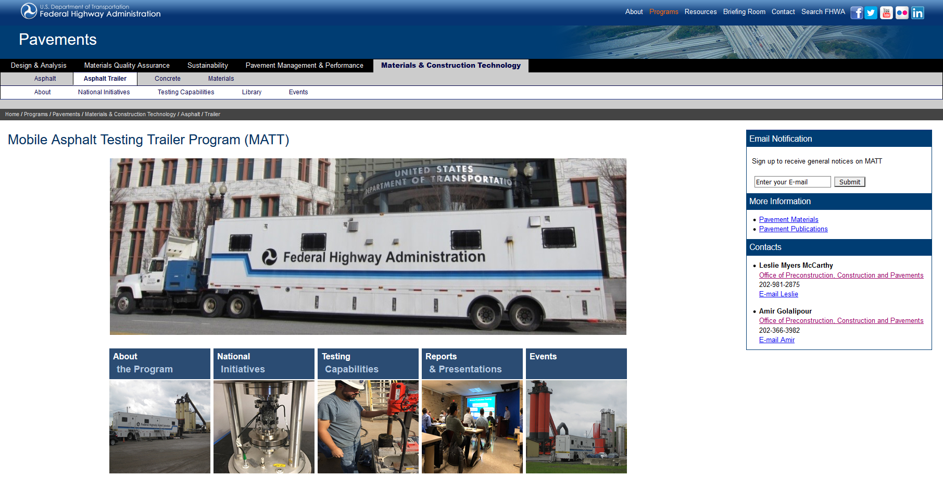
Thank You – Questions?
We’re here to assist! Please stop by anytime for more discussion.

