Slide 1
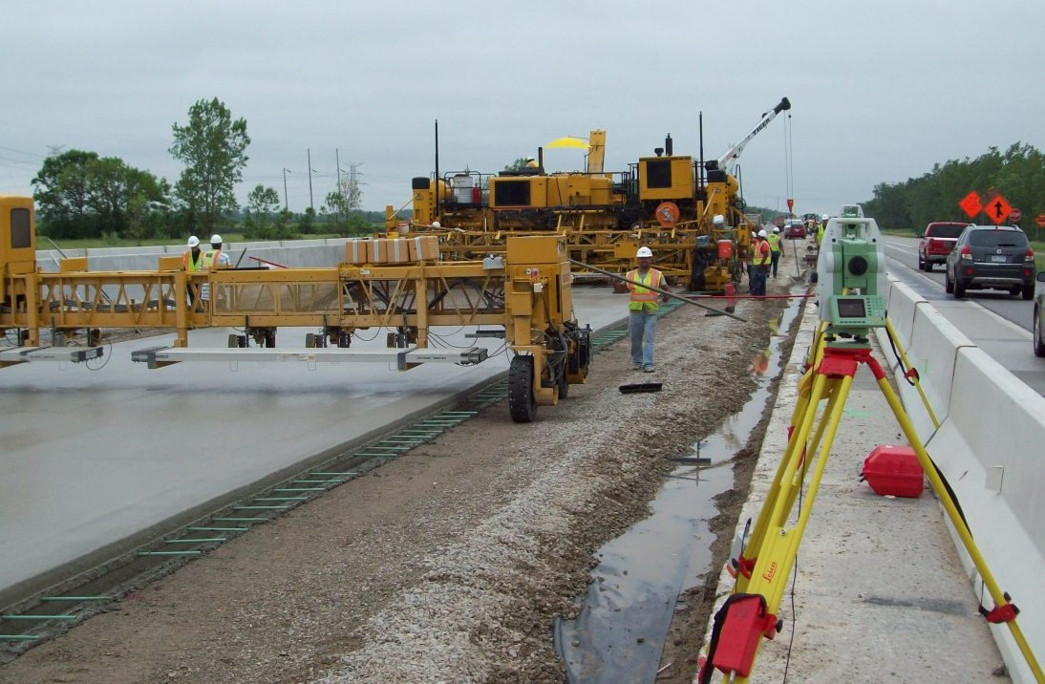
3D Highway Design Model Benefit Cost Analysis
NRRA Pavement Workshop
May 21, 2019
Jon Gustafson - WSP

Slide 2
Outline
Background
Results of Surveys and Interviews
Statistical Analysis of Historical Data
Return-on-Investment (ROI)
Recommendations and Conclusions

Slide 3
Objectives
Document use of 3D models as RID
Quantify costs and benefits to calculate ROI
Find ways to streamline plan production
Improve downstream use of elements from contractual 3D models
Analyze potential and actual risk reduction

Slide 4
Results of Surveys and Interviews

Slide 5
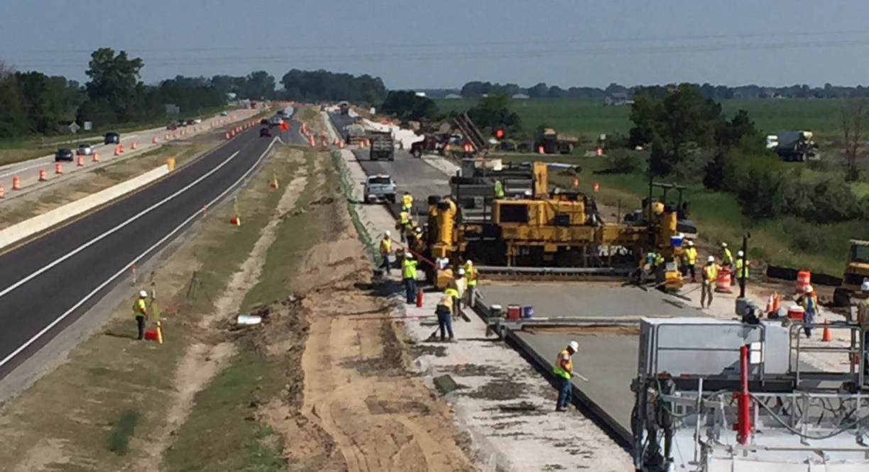
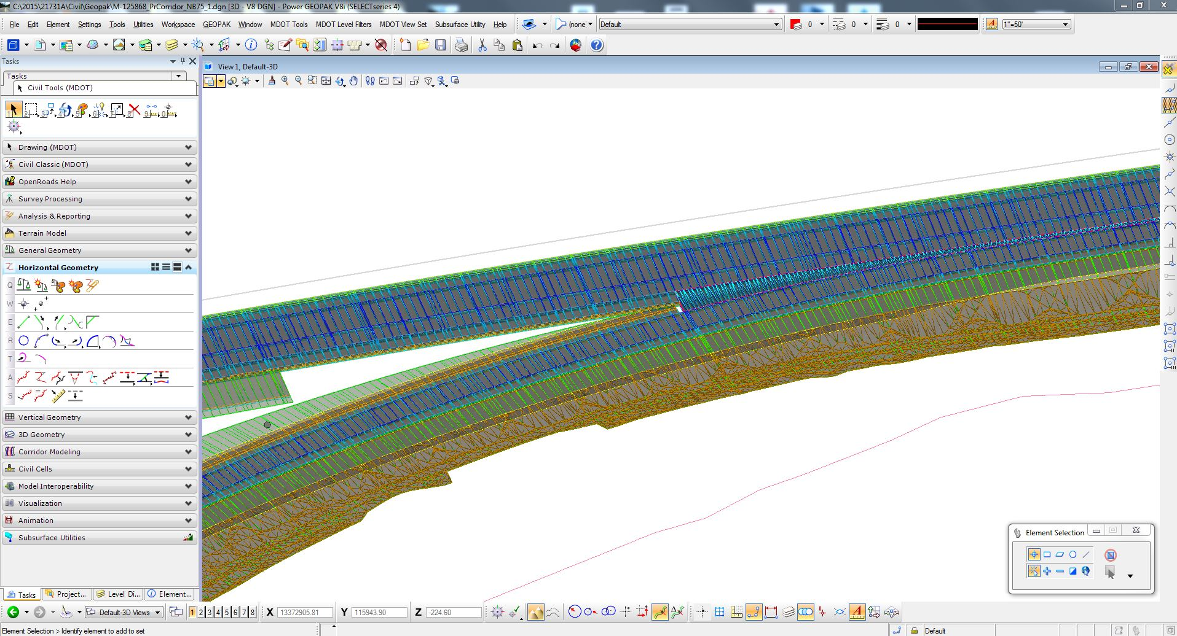
Contractors Feedback
Results of Surveys and Interviews
How do you use RID 3D models?
Design Firms Feedback
Satisfied with quality of RID 3D models
AMG construction equipment
Performing QTO for bidding
Compare RID files to plans
Validating independent 3D models
Determine storage locations
Creating 4D models
Constructability reviews with MDOT staff
Computing earthwork and subbase quantities
Evaluating right-of-way impacts
Establishing slope stake lines and construction layout
Developing detail grades and clearances
Checking drainage design items

Slide 6
Results of Surveys and Interviews
Financial Impact
Contractor Feedback
Design Firm Feedback
Estimators spend less time in QTO
Better understanding of design intent
Cost between 0.5 and 3% of overall construction contract value
RID 3D models save between 25-50% time to create AMG models ($750/mile)
AMG for earthwork saves 30-40% on production cost
Cost to produce RID 3D models and plans is <10% of design contract (or 1% of construction contract)

Slide 7
Results of Surveys and Interviews
Software and File Types
Contractors Feedback
Design Firms Feedback
Software Packages Used
  Agtek
  AutoCAD/C3D
  Carlson
  MicroStation/Geopak/ PowerGEOPAK
  Leica Captivate
  Topcon Magnet
  Trimble Business Center
Beneficial or Essential Files
  LandXML for alignments, profiles and surfaces
  DGN files
Software Used
  MicroStation/Geopak
  Autodesk (outside of DOT)
  Geotechnical information
Digital Data Delivered (DB)*
  3D surfaces
  3D line strings
  Coordinate geometry
  *LandXML, DGN, DWG

Slide 8
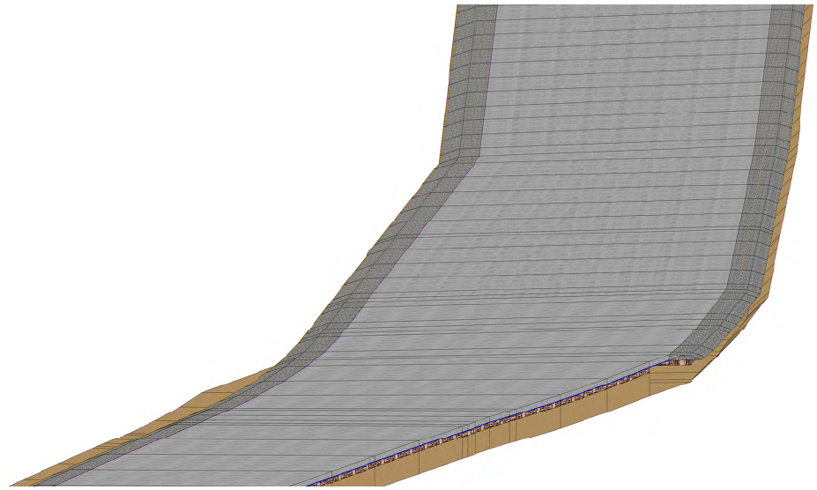
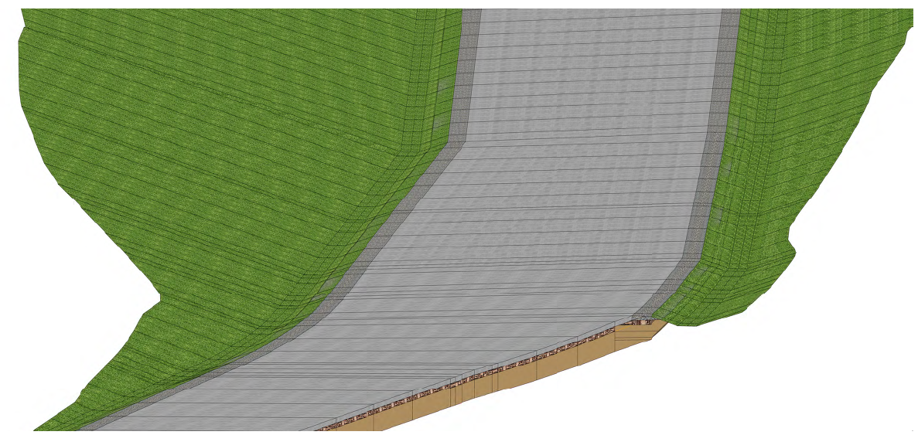
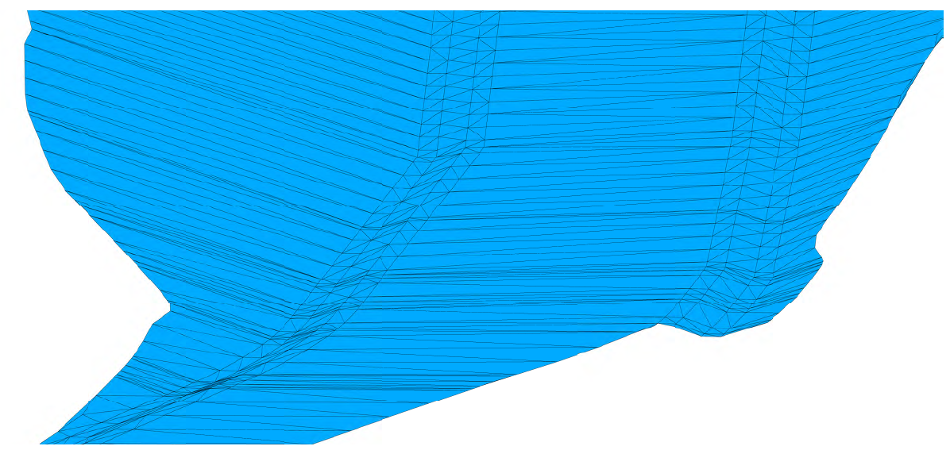
Results of Surveys and Interviews
Contractor Feedback
Finished surface and all pavement layers without the side slope conditions
What type of information should be included in the model?
All detailed information, including all pavement layers and side slopes
Only the top finished surface with/without shoulders and side slope conditions

Slide 9
Results of Surveys and Interviews
Considerations for making 3D models contractual
Contractor Feedback
Design Firm Feedback
Use special provision
Consider industry learning curve
Suggest experience QA staff for certifying grades
Simply/eliminate horizontal alignment, pavement marking and signing sheets
Model without proper documentation is high risk
Consider updating compensation based model-centric milestones
Accelerated timelines don’t allow for proper reviews
Consider compensation for duplicate effort to finish contract plans & models
Suggest defining authorized uses for the models

Slide 10
Results of Surveys and Interviews
Considerations for making 3D models contractual
What items take the longest to develop for the RID process:
  Proposed finish grade surface
  Alternate surfaces (e.g. subbase)
  3D line string
  Drainage networks and structures
  Utilities and cross sections
  Unique areas where geometry is not simple (e.g. roundabouts)

Slide 11
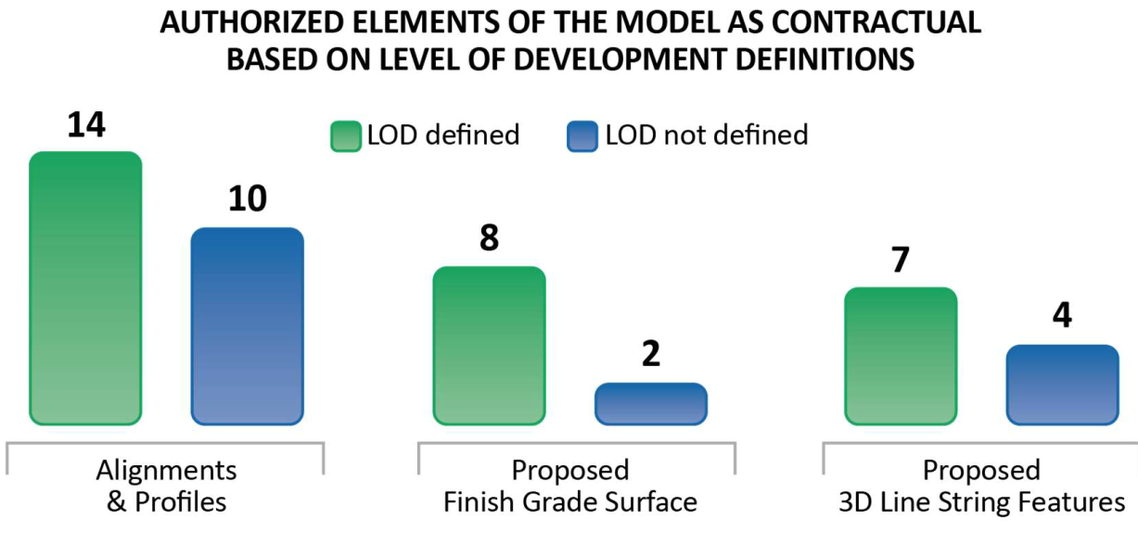
Results of Surveys and Interviews
Considerations for making 3D models contractual
Respondents indicated that LOD will drive what elements could become contractual.
Alignments & profiles could be contractual right away
Proposed finished grade surface and 3D line string features could become contractual ONLY if LOD was defined

Slide 12
Results of Surveys and Interviews
MDOT Construction Staff Feedback
  Major challenges identified with AMG projects
    Consistent coordination with the contractor
    Lack of guidance and established processes for managing digital data
    Either inadequate tools and training to work with 3D models
    Sometimes inaccurate representation of existing conditions
  Benefits of 3D models and RID
    Less change orders and claims avoidance
    Improved safety
    Allow to achieve aggressive timelines

Slide 13
Statistical Analysis of Historical Data

Slide 14
Statistical Analysis of Historical Data
Hypothesis Testing and Analysis Approach
  Does the use of 3D models as RID result in overall lower bid prices when compared with those projects using traditional 2D plans?
  How do 3D models as RID compare with conventional 2D plans in establishing accurate project estimates
  Given the variability in site conditions and project scope of work among the projects, is the observed evidence consistent enough to conclude that the use of 3D models as RID results in significant financial benefits to MDOT?

Slide 15
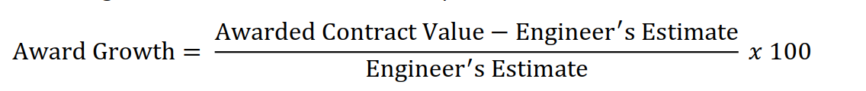
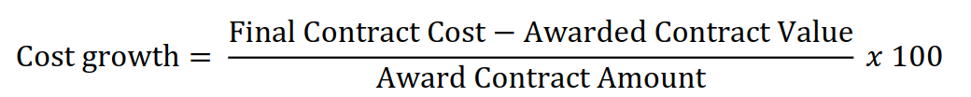
Statistical Analysis of Historical Data
Definitions of Metrics

Slide 16
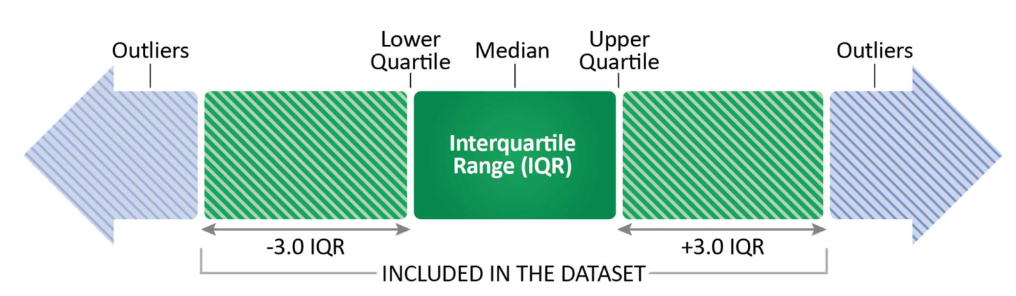
Statistical Analysis of Historical Data
Method of Analysis -Outliers
  To compare the metrics for two population samples
    RID 3D model projects
    2D plan sheet projects
  Outliers
    Started 261 total projects
    Outliers identified by a computation of interquartile range

Slide 17
Statistical Analysis of Historical Data
Method of Analysis – Population Samples
Table 5. Population samples used in the hypothesis testing for cost growth.
Table 4. Population samples used in the hypothesis testing for award growth.
Population Sample | Statewide Population Size | Regional Population Size
RID 3D Models Projects | 65 | 24
Traditional 2D Plans Projects | 193 | 61
Population Sample | Statewide Population Size | Regional Population Size
RID 3D Models Projects | 64 | 24
Traditional 2D Plans Projects | 188 | 60

Slide 18
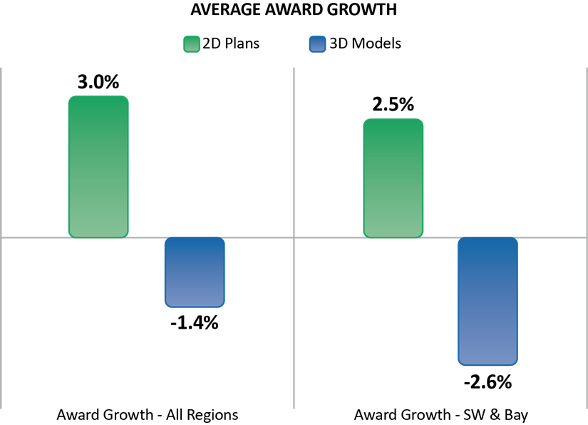
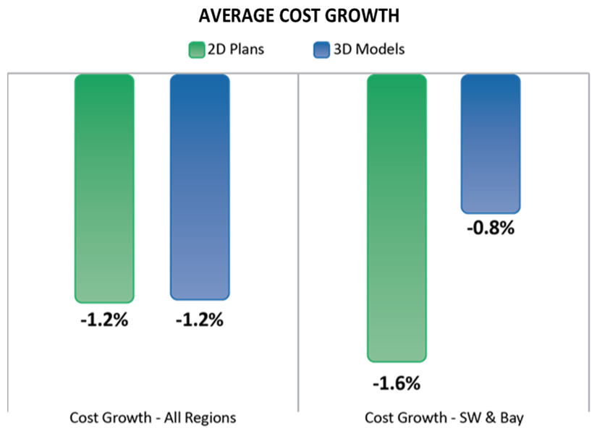
Statistical Analysis of Historical Data
Method of Analysis – Award and Cost Growth

Slide 19
Statistical Analysis of Historical Data
Method of Analysis – Results
Table 15. Award growth results by project size (statewide)¹
Table 16. Cost growth results by project size¹.
Project Size | 2D Plans | 3D Models | Evidence in Favor of 3D Models (Confidence Level)
< $5 M | 3.1% | 0.4% | Moderate (84%)
$5 M - $20 M | 2.8% | -6.1% | Very Strong (99.4%)
> $20 M² | 1.2% | -1.1% | N.A.
Project Size | 2D Plans | 3D Models | Evidence in Favor of 3D Models (Confidence Level)
< $5 M | -1.8% | -0.9% | Moderate² (80%)
$5 M - $20 M | 0.3% | -2.3% | Strong (90%)
> $20 M³ | 3.5% | 7.3% | N.A.
¹ The benchmark is the engineer’s estimate.
² Hypothesis testing using T-tests was not conducted as the sample size was too small to draw reasonable conclusions.
¹ The benchmark is the project award amount.
² The cost growth for this project size is more favorable to 2D plans.
³ Hypothesis testing using T-tests was not conducted as the sample size was too small to draw reasonable conclusions.

Slide 20
Statistical Analysis of Historical Data
Method of Analysis – Results
Table 17. Overall cost savings and overruns of 3D models versus 2D plans (millions of dollars, statewide).
Note: Totals may not add due to rounding.
Categories | 2D Plans | 3D Models
Total Engineer’s Estimates | $1,148.9 | $288.3
Total Bid Costs | $1,159.2 | $277.4
Total Final Contract Costs | $1,168.1 | $275.4
Net Cost Savings at Award | -$10.2 | $11.0
Net Cost Savings at Project Closeout | -$8.9 | $2.0
Net Program Cost Savings | -$19.2 | $12.9
Percent Program Cost Savings | -1.7% | 4.5%
Table 18. Summary of overall calculated benefits of 3D models versus 2D plans (millions of dollars, statewide)
Description of Benefits | Calculated Benefits
Cost Savings of 3D over 2D | $32.2
Percent Cost Savings of 3D over 2D | 2.2%

Slide 21
Statistical Analysis of Historical Data
Method of Analysis – Missed Opportunities
Table 19. Design elements identified as high or low risk.
Design Element | Risk
Structures (general, bridges, and walls) | High
Drainage/Utilities | High
Earthwork | Low
Electrical/ITS | Low
Traffic Control /Signs | Low

Slide 22
ROI Framework

Slide 23
ROI Framework
Spreadsheet
Cost categories
Benefit categories
Other benefits to consider (not captured in study)

Slide 24
Recommendations and Conclusions

Slide 25
Recommendations and Conclusions
Outreach, Education, and Multi-disciplinary Collaboration
Outreach to educate internal and external stakeholders
  When does digital data works well (use cases)?
  What tools are available to produce, view and share information?
  How do we get there together?
Establish a framework for multi-disciplinary collaboration
  Collaborative milestone review (clash detection, constructability)
  Data exchanges between disciplines (survey, design, bridge, hydraulics, etc.)
Develop training for construction inspection digital processes
  Data, tools, processes, and people.

Slide 26
Recommendations and Conclusions
Outreach, Education, and Multi-disciplinary Collaboration
Table 22. Recommendations for development of core knowledge area topics and training framework.
Core Knowledge Area | Suitable Topics | Training Medium
Policy and procedures Updates to construction specifications and manuals should be made to ensure alignment with the use of digital data (e.g., items to be checked, tolerances, timing). | Overview of policies and specifications for 3D model-centric activities. Overview of model-based inspection activities. Selection of appropriate survey equipment for different activities based on accepted tolerances. | Live webinar for initial regional training. Online videos and updated construction guidelines and specifications.
Surveying basic concepts General overview of mapping fundamentals. It may be beneficial to work with local colleges to develop a basic online course. | Coordinate systems, project scale-factors, and site localization. | Online video tutorials Quick reference sheets.
Survey hardware and software skills Instructions for using modern surveying equipment. It may be beneficial to work with equipment vendor or surveying consultants to develop a sustainable training program. | Overview of survey equipment setup, data collection and analysis techniques. Equipment use, demonstrations, situational learning, troubleshooting, and train-the trainer opportunities. | Initial “train-the-trainer” hands-on training. Equipment and software training manual. Online video tutorials and on-the-job training.
Digital data software skills Instructions on using various programs on specific hardware, including mobile applications, CADD software, and databases. | Operation of data collection software and the use of digital to verify location and elevations and measure quantities. Reviewing and updating CADD data. | Initial “train-the-trainer” instructor-led and hands-on training. Online video tutorials and on-the-job training
Data Management Instructions for managing data files, including version control, review and validation of data, and collaboration tools. | Naming convention, workflows for data management, file types, and acceptable formats. | Live webinar for initial regional training. Online videos and updated CADD guidelines and specifications.

Slide 27
Recommendations and Conclusions
Framework for Contractual 3D Model Requirements
General Requirements
Model Development Specifications
Data Management Guidelines
Special Provisions
Lean Processes

Slide 28
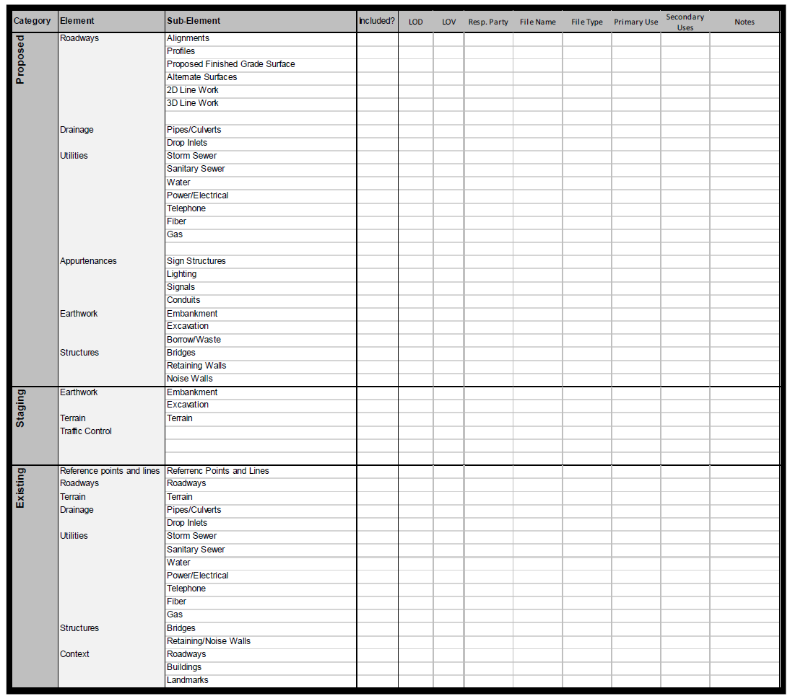
Recommendations and Conclusions
Framework for Contractual 3D Model Requirements

Slide 29
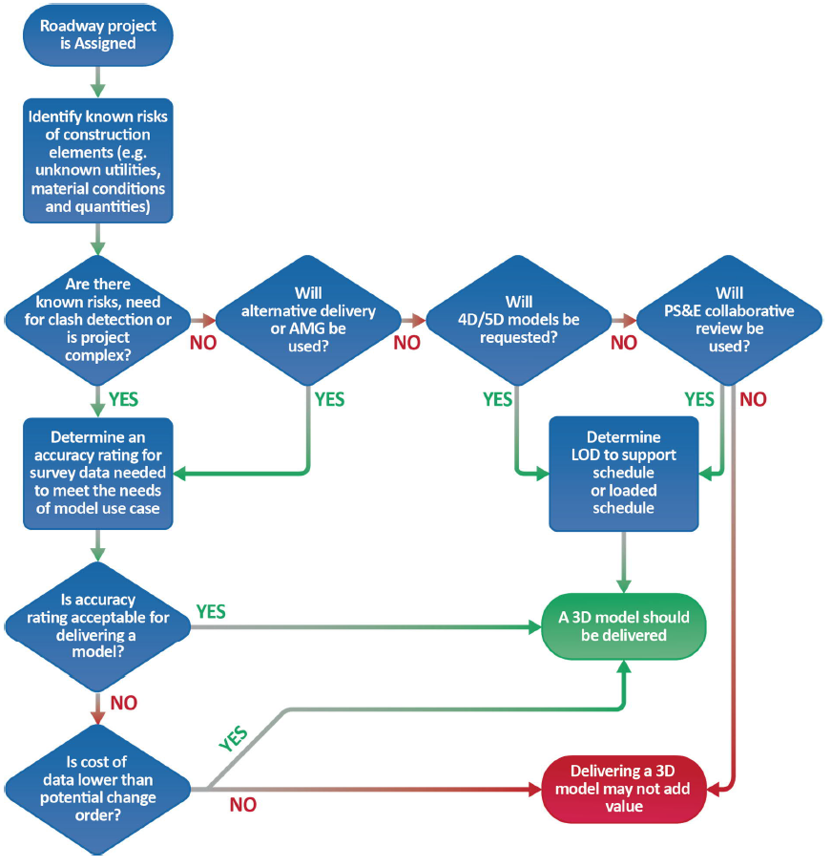
Recommendations and Conclusions
Framework for Contractual 3D Model Requirements

Slide 30
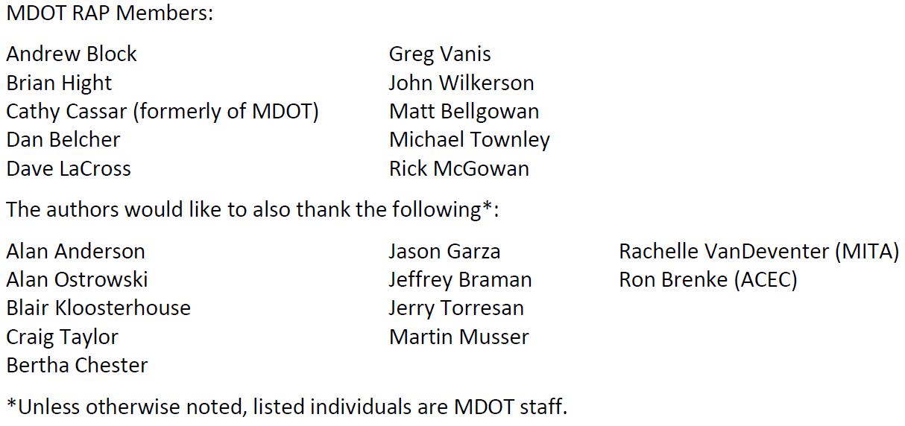
Acknowledgements
Research Team:
WSP (Alexa Mitchell – PI, Elyssa Gensib, Dr. Suri Sadasivam, Jon Gustafson, and Tim Day)
SSI (Jeff Bartlett, and Todd Bonzelet)

Slide 31
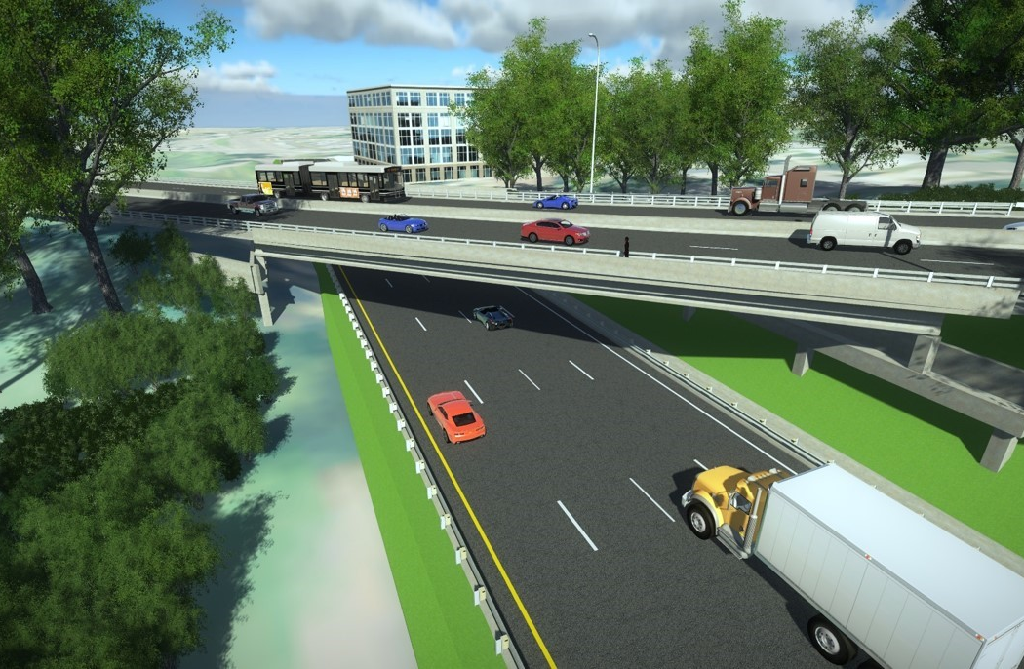
Thank You
Principal Investigator:
Alexa Mitchell (WSP)
Alexa.Mitchell@wsp.com
Investigator:
Jon Gustafson (WSP)
Jon.Gustafson@wsp.com

Slide 32
Map

