Slide 1
Density Profiling System: Toward Coreless Continuous Compaction Assessment
Kyle Hoegh, MnDOT (presenter)
Shongtao Dai, MnDOT
Eyoab Zegeye, MnDOT

Slide 2
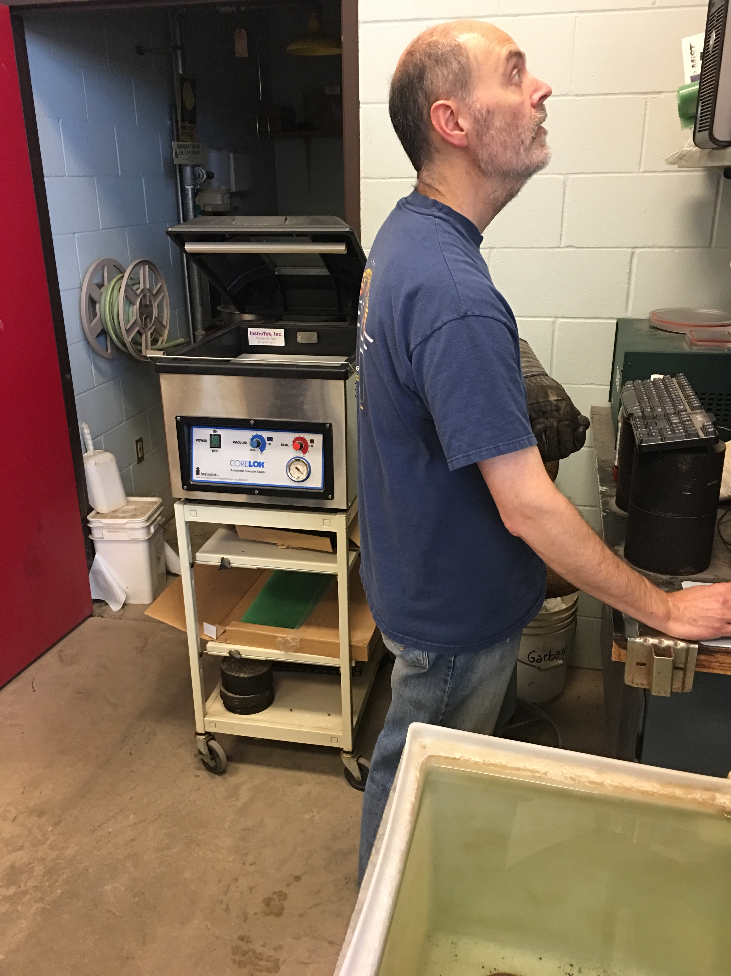
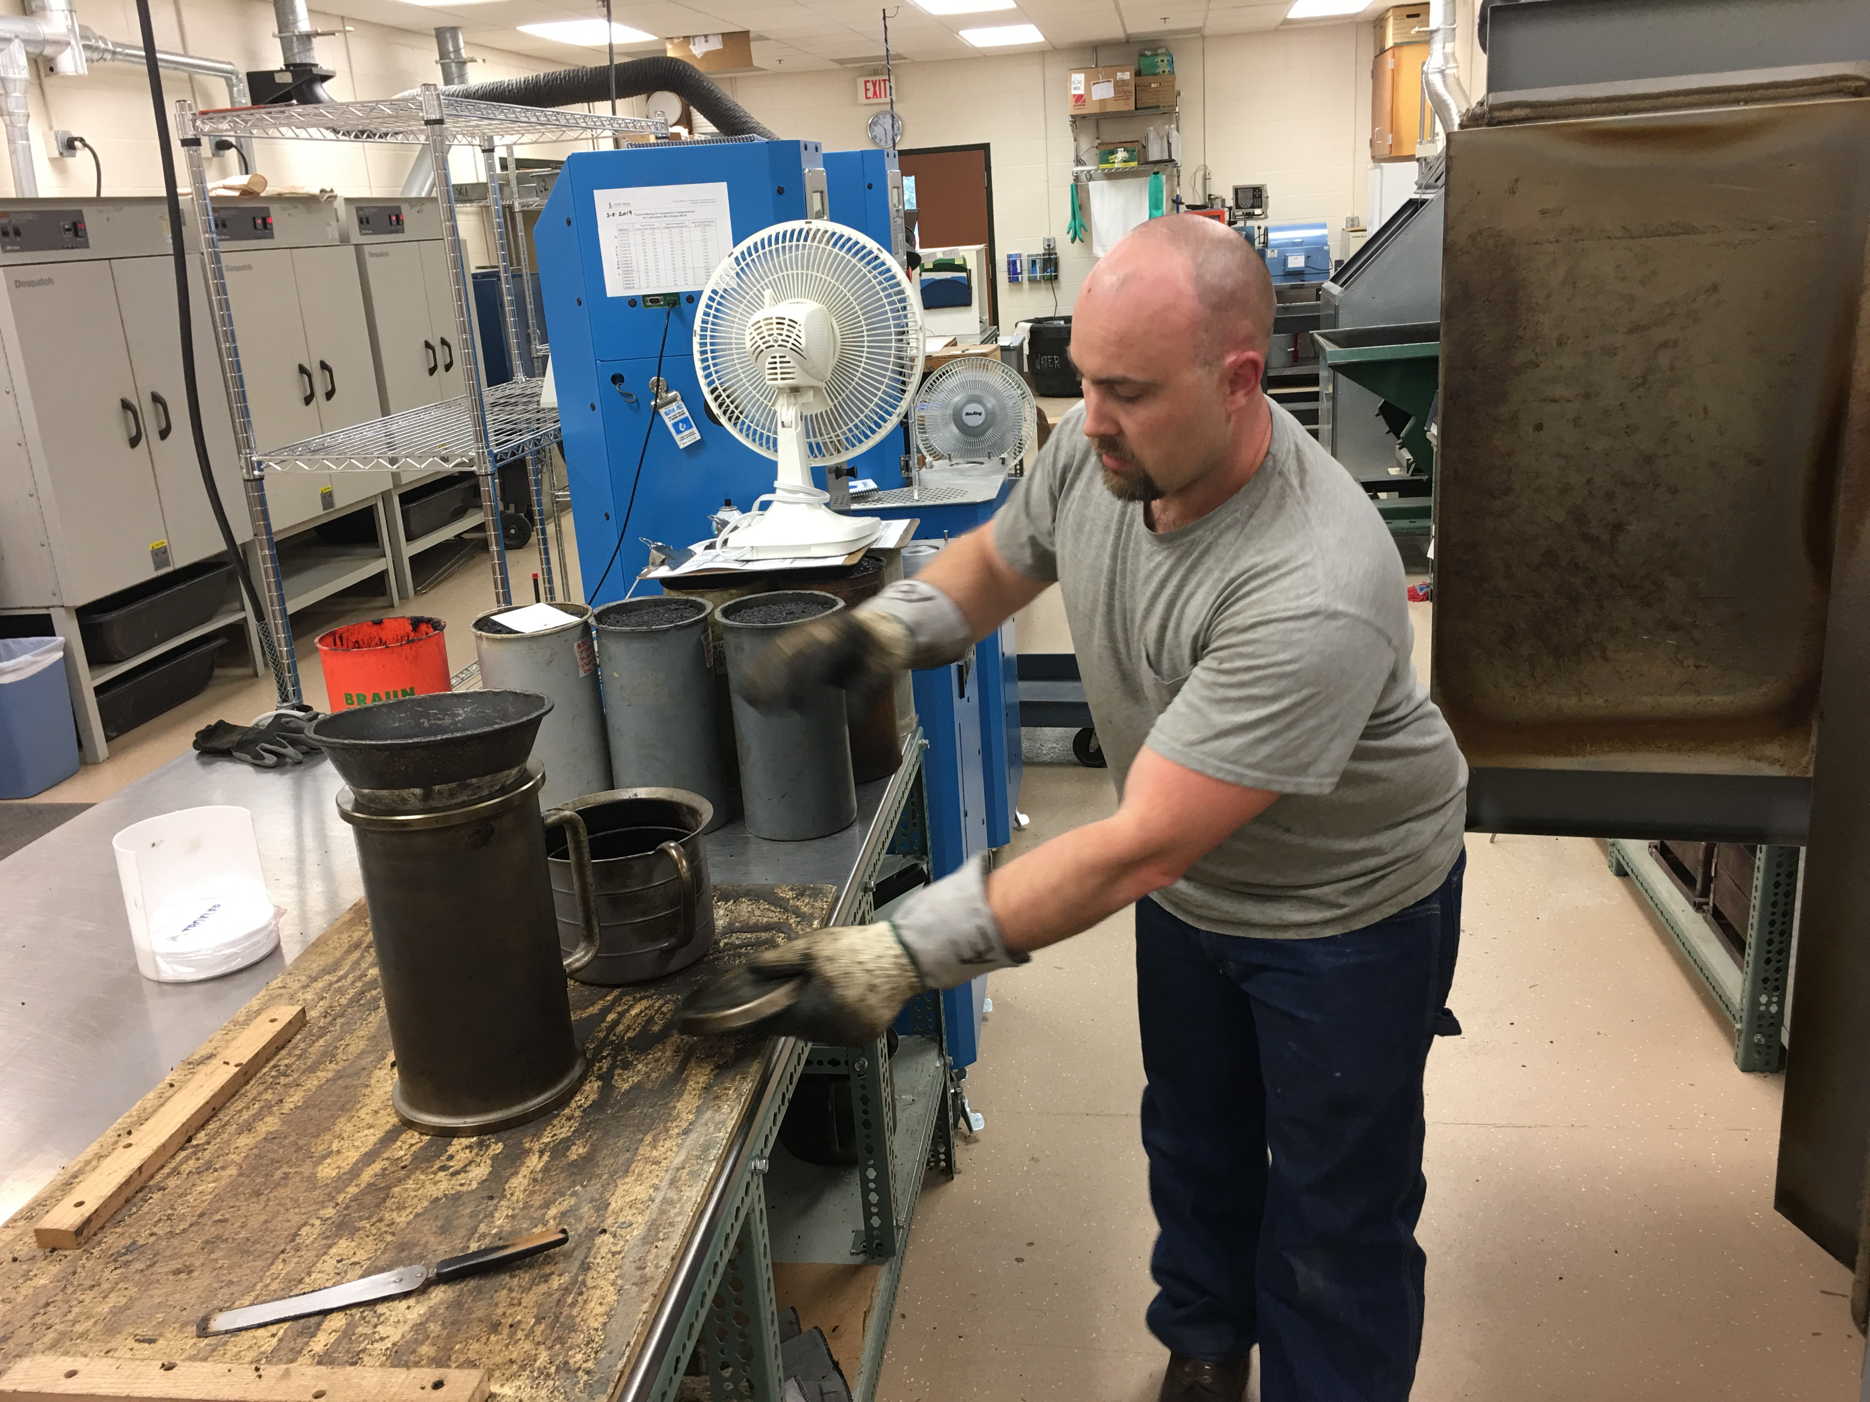
Acknowledgements
FHWA/AASHTO
GSSI
MnDOT Districts
MnDOT Bituminous Office
Contractors

Slide 3
Goals
Use Density Profiling System (DPS) to assess field asphalt compaction in a manner that is:
  Continuous and accurate
  Understandable and timely
  Safe, non-invasive, and robust
Eliminate acceptance cores by using density profile
Reduce early pavement failures due to low compaction (ex. longitudinal joint deterioration)
Enhance IC and PMTP
    IC&PMTP measure processes affecting compaction continuously
    DPS can evaluate achieved compaction continuously

Slide 4
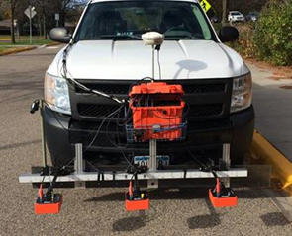
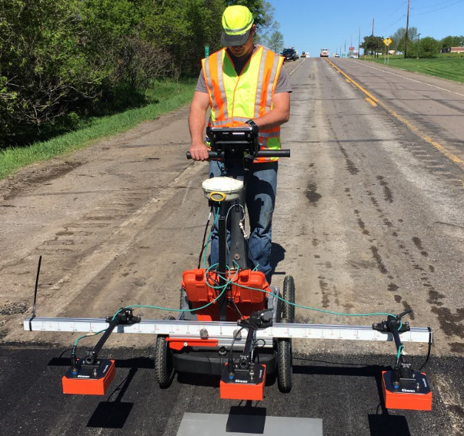
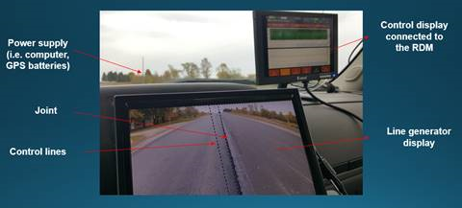
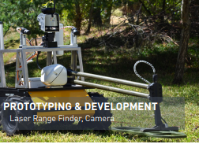
Method Overview: Data Collection
Vehicle Mounted RDM
Push Cart Type DPS
Robotic
(Project with UMN)

Slide 5
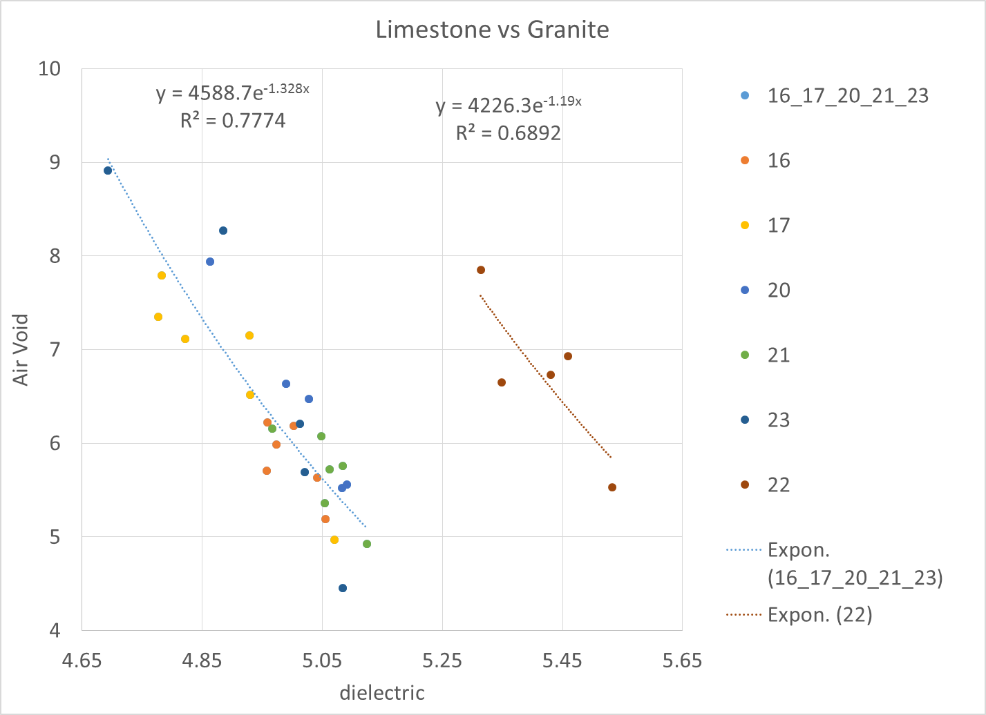
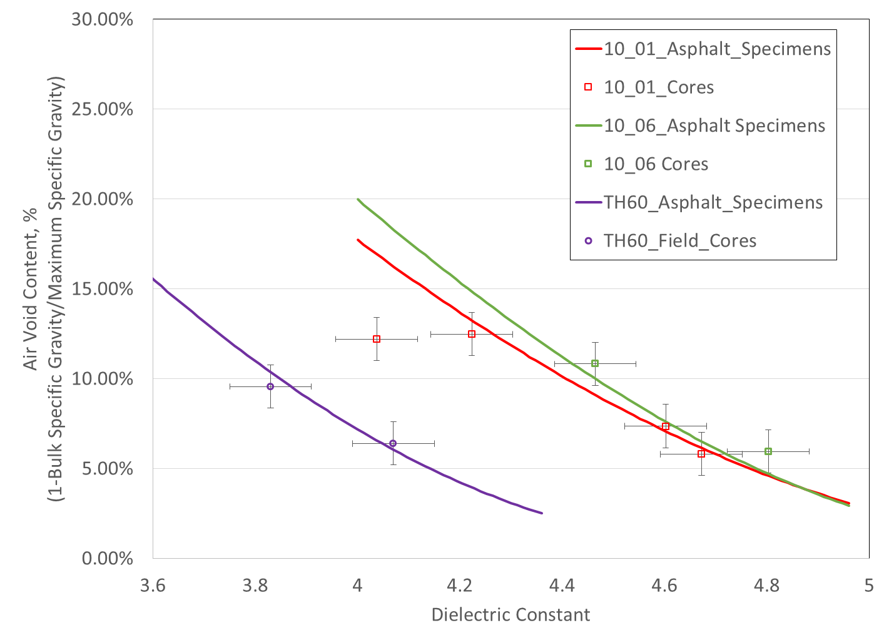
Method Overview: Dielectric to Air Voids
Gyratory Compacted “Puck” Coreless Calibration
Field Core Calibration

Slide 6
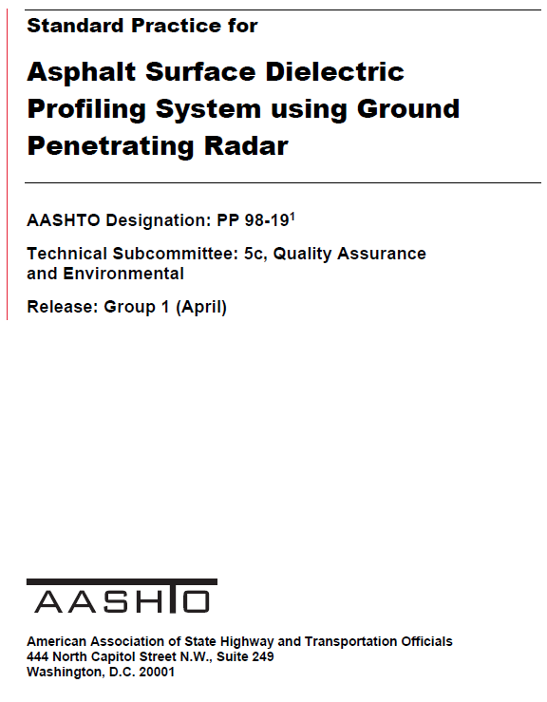
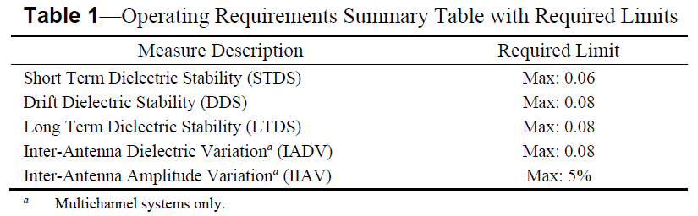
Method Overview: Required Precision
The method requires an instrument capable of
  Scanning at a rate that allows for continuous collection behind the paving operation
  Measuring an accurate dielectric
Developed method based on plastic with known dielectric constant (HDPE)
Published 2019!

Slide 7
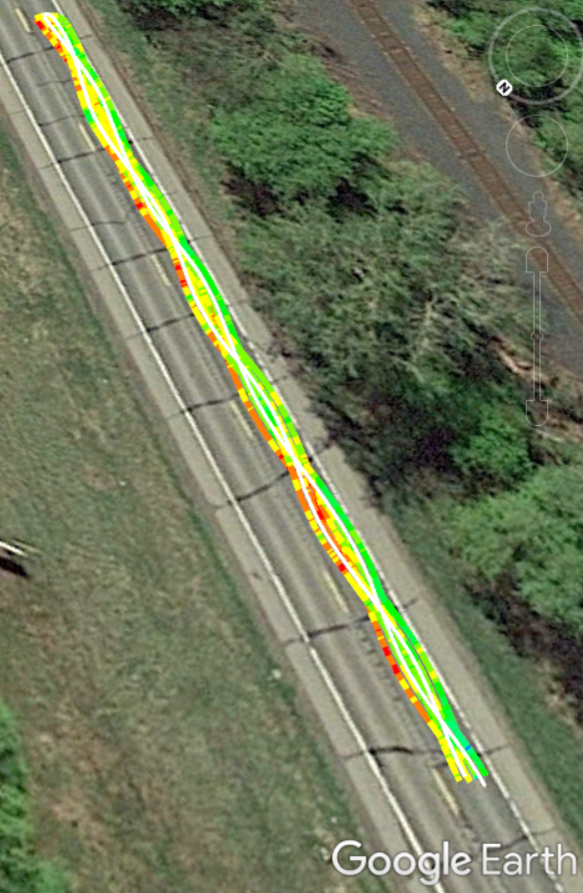
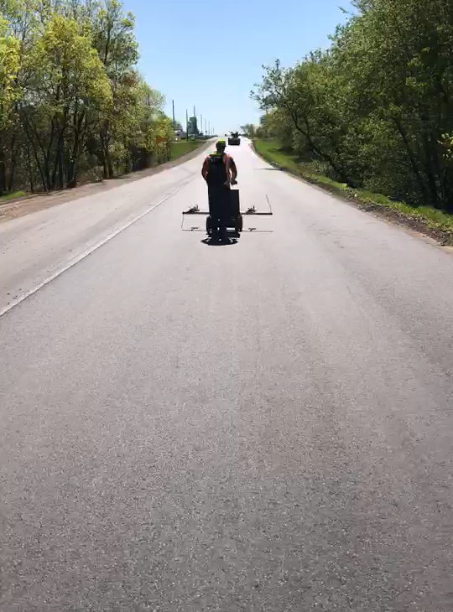
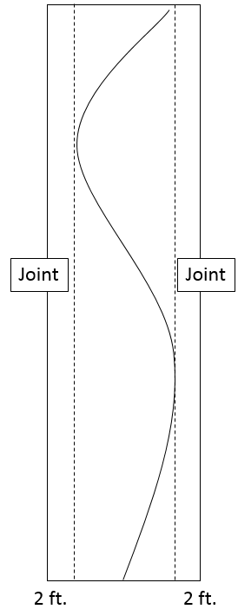
Method Overview: Field Calibration
Swerve Survey

Slide 8
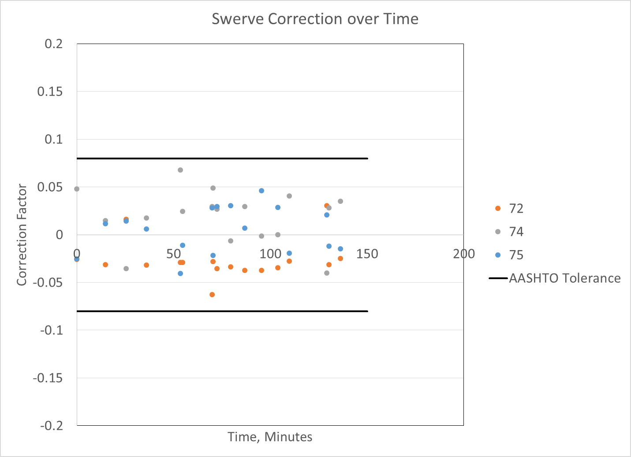
Method Overview: Field Calibration

Slide 9
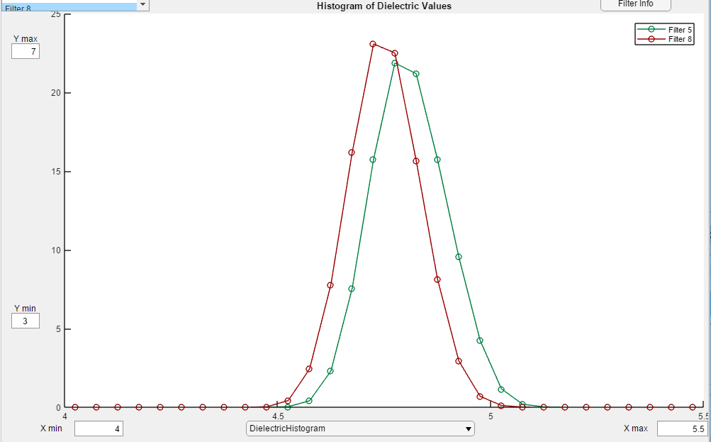
Method Overview: Swerve Correction
Results: Contractor vs. MnDOT
MnDOT vs Contractor Prior to Swerve Correction
4.5 ft MnDOT
4.5 ft Contractor

Slide 10
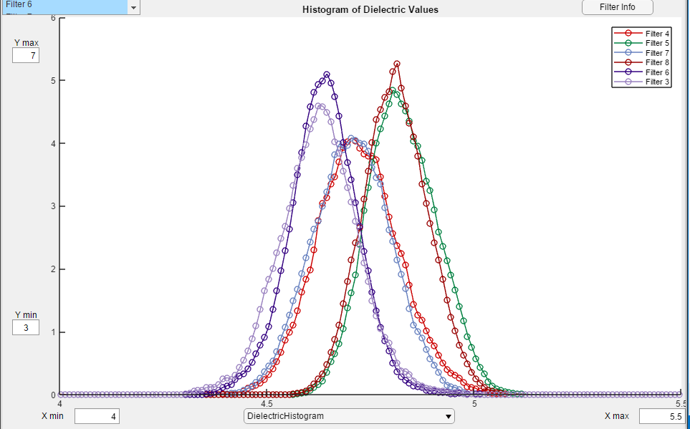
Method Overview: Swerve Correction
Results: Contractor vs. MnDOT
Contractor vs. MnDOT after Swerve Correction
0.5 ft
2.5 ft
4.5 ft

Slide 11
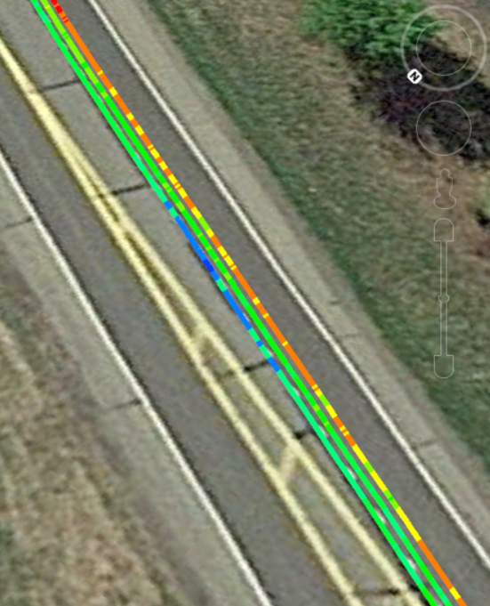
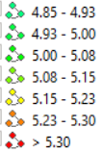
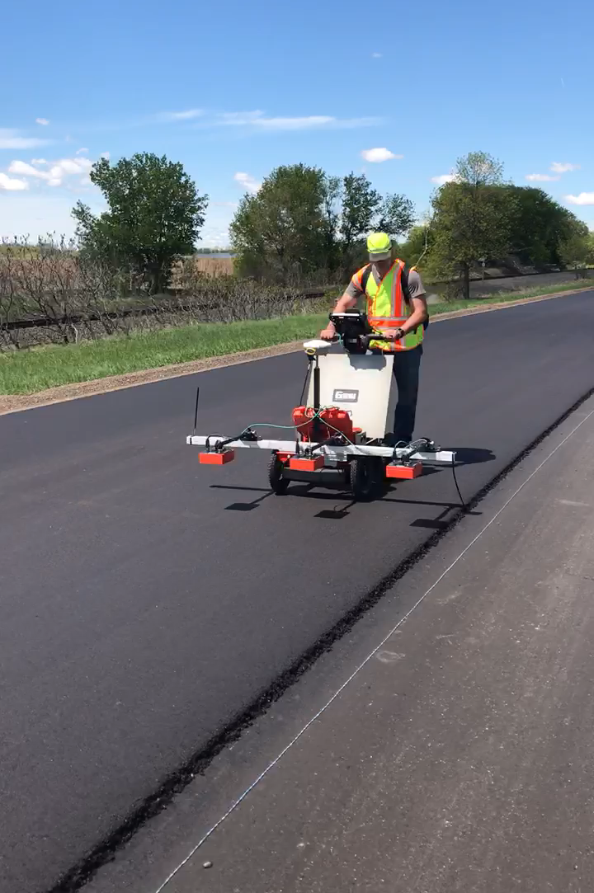
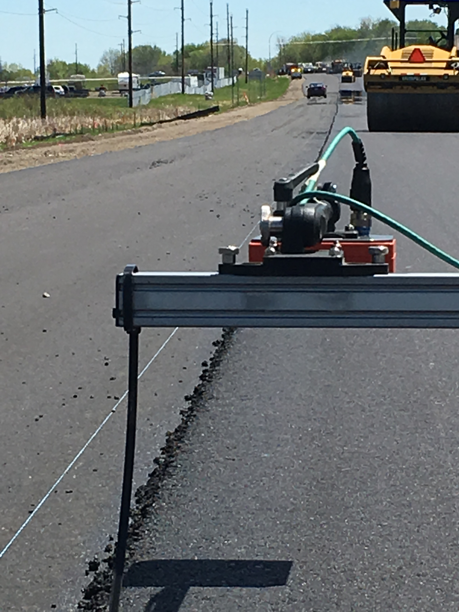
Analysis: 100% Joint Coverage
Geospatial Representation

Slide 12
Analysis: Mat Compaction
“Random Cores on Steroids”
Nondestructive
Many Samples
Swerve Survey

Slide 13
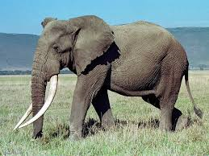

Coreless Calibration: Importance
Better Coverage
  100% joint AV%
  Random Mat sampling (random cores on steroids)
  Reduce field cores!
Elephant = 6 tons
Hedgehog < 1 pound
For every 100 elephants of mix, we sample and test two hedgehogs (cores)
THAT’S IT?

Slide 14
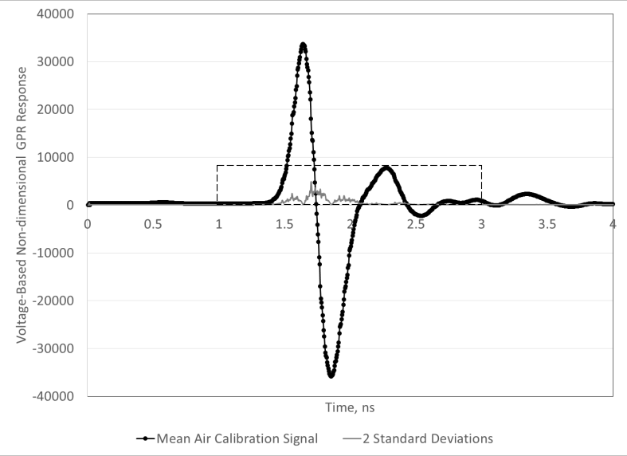
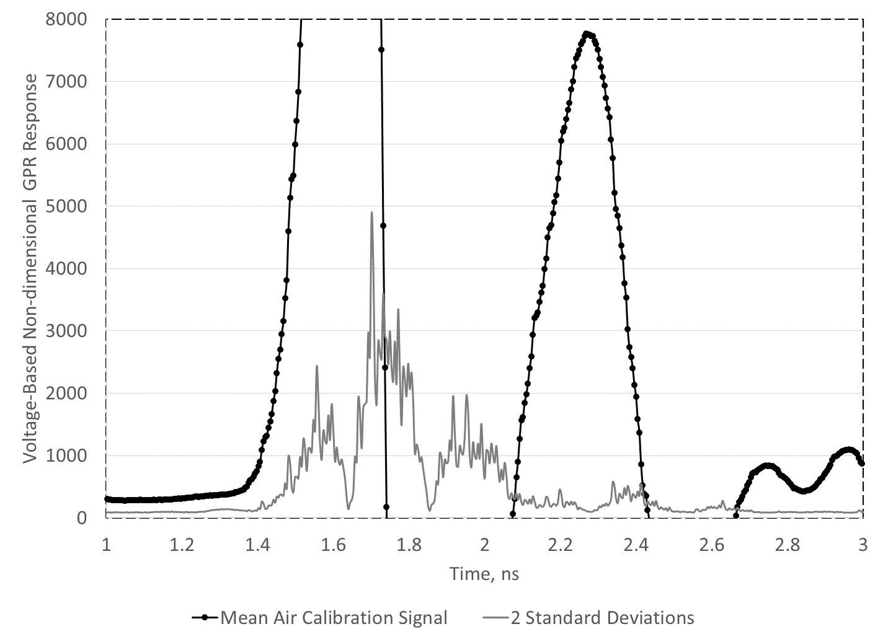
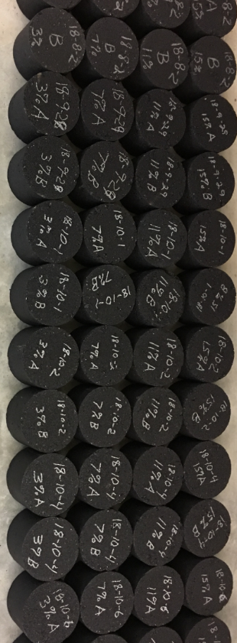
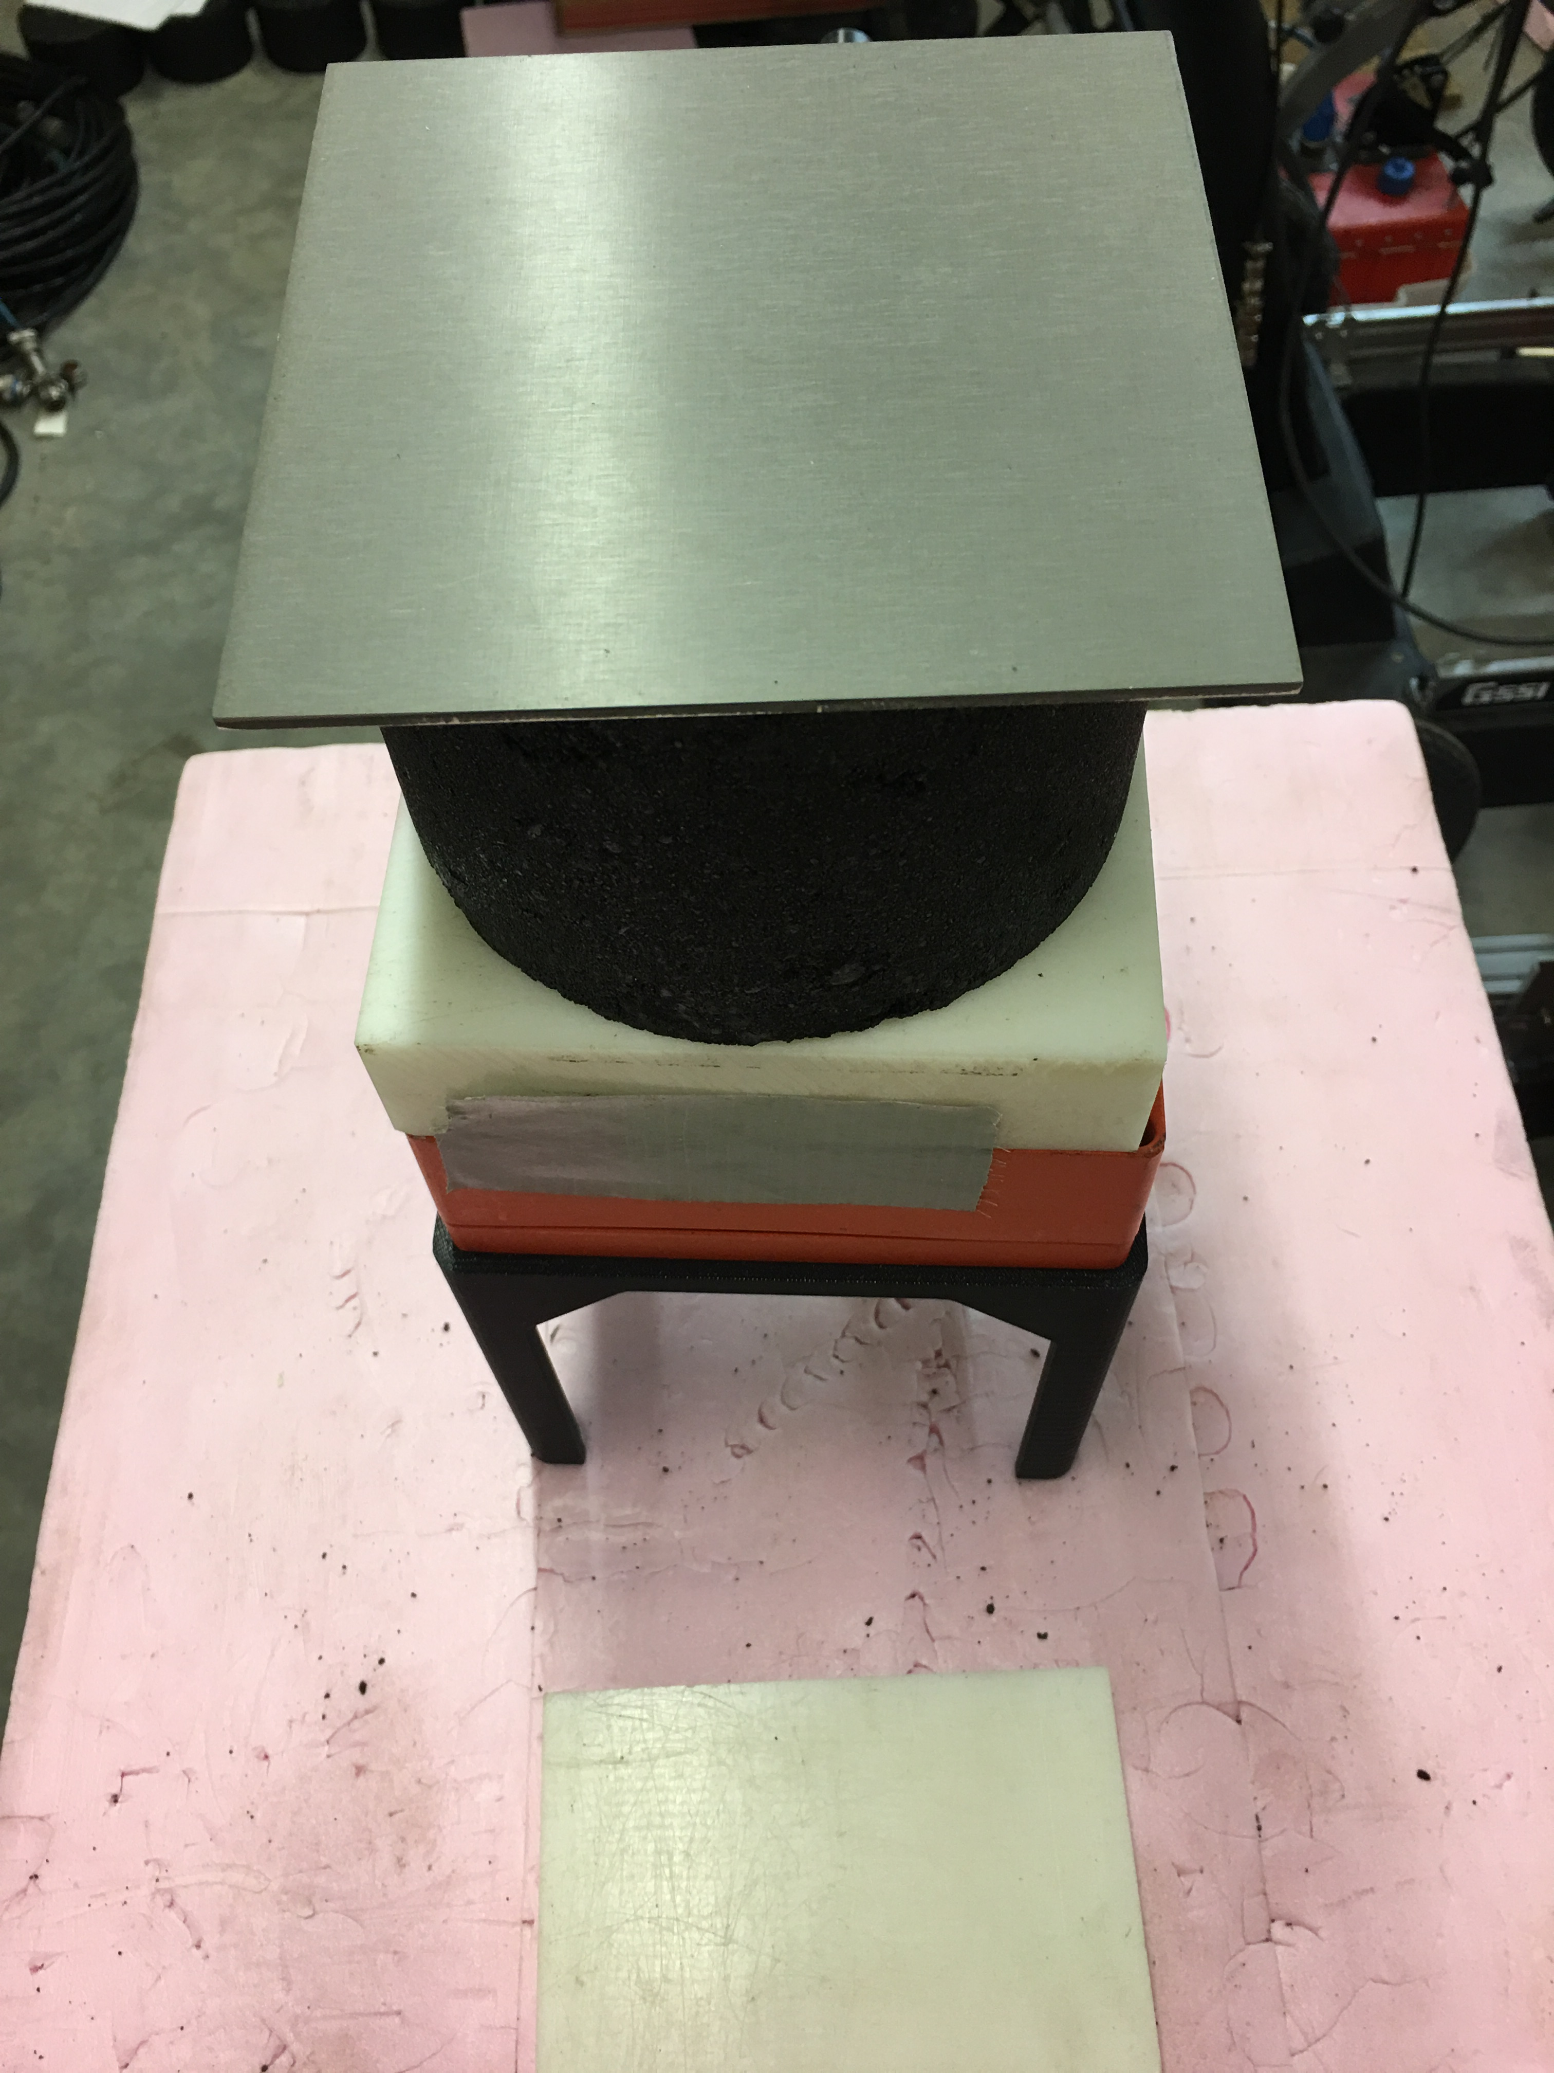
Coreless Calibration: Method

Slide 15
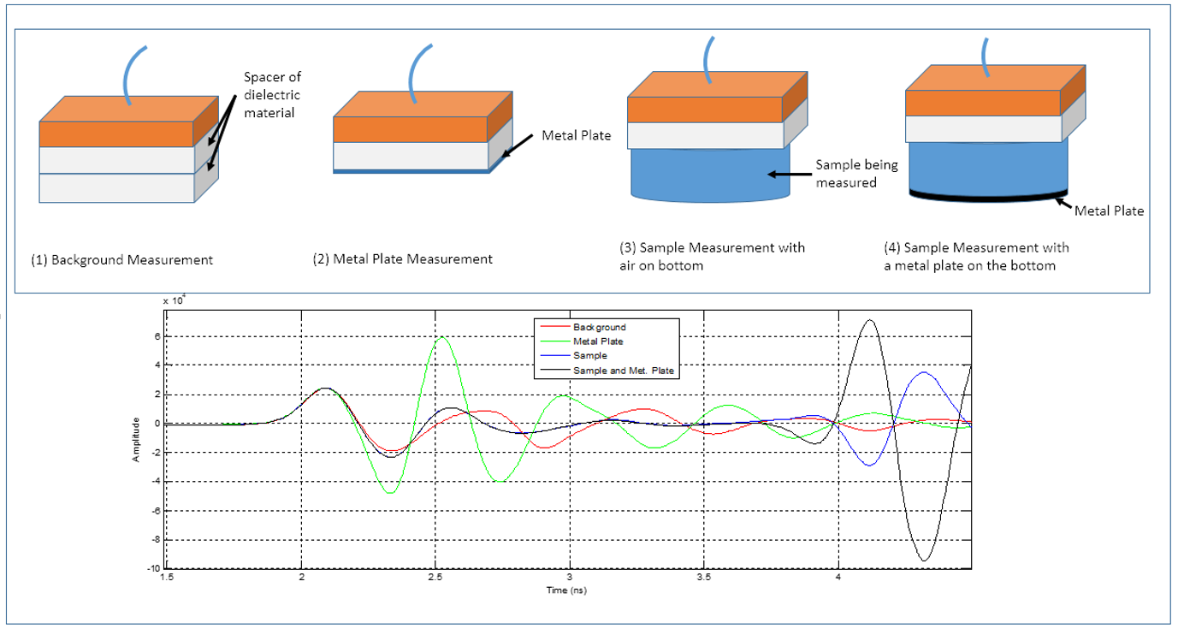
Core Locator Application
Coreless Calibration: Method
4 Measurements used to calculate puck dielectric using travel time at known thickness.

Slide 16
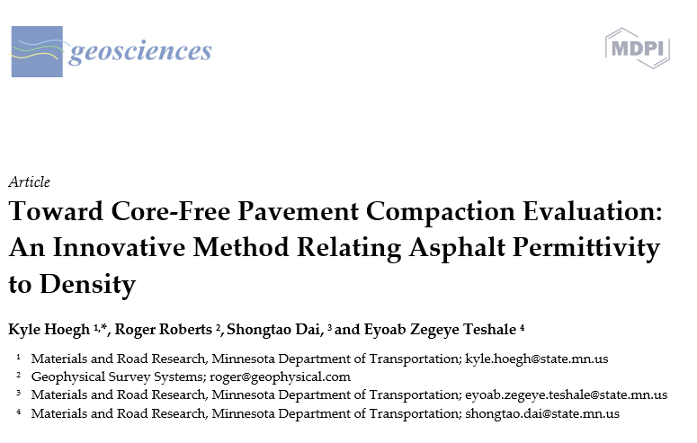
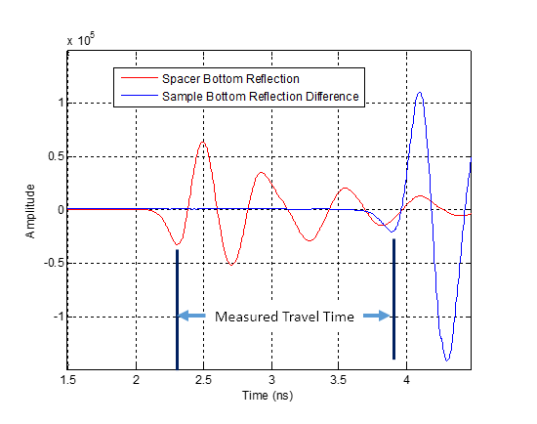
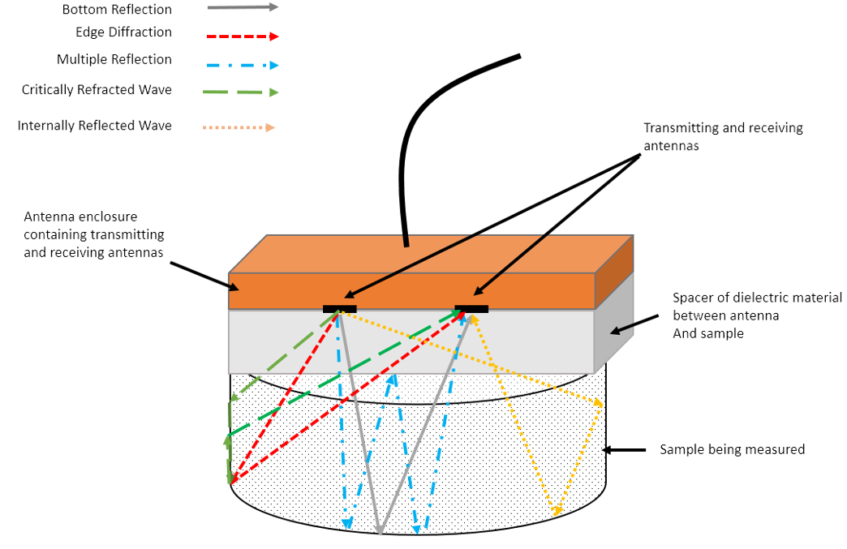
Coreless Calibration: Method
Initial Manuscript to Submit this Week
Isolated Reflection
for travel time calculation

Slide 17
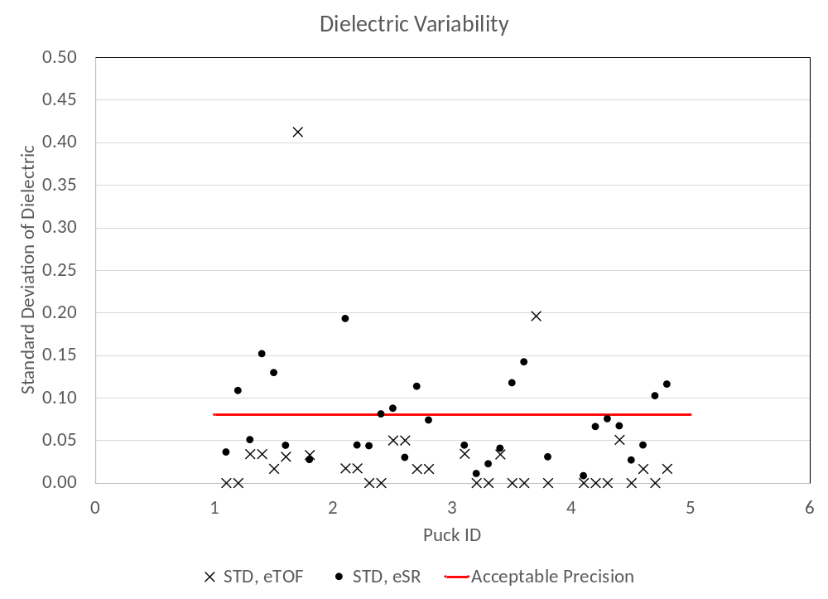
Coreless Calibration: Variability

Slide 18
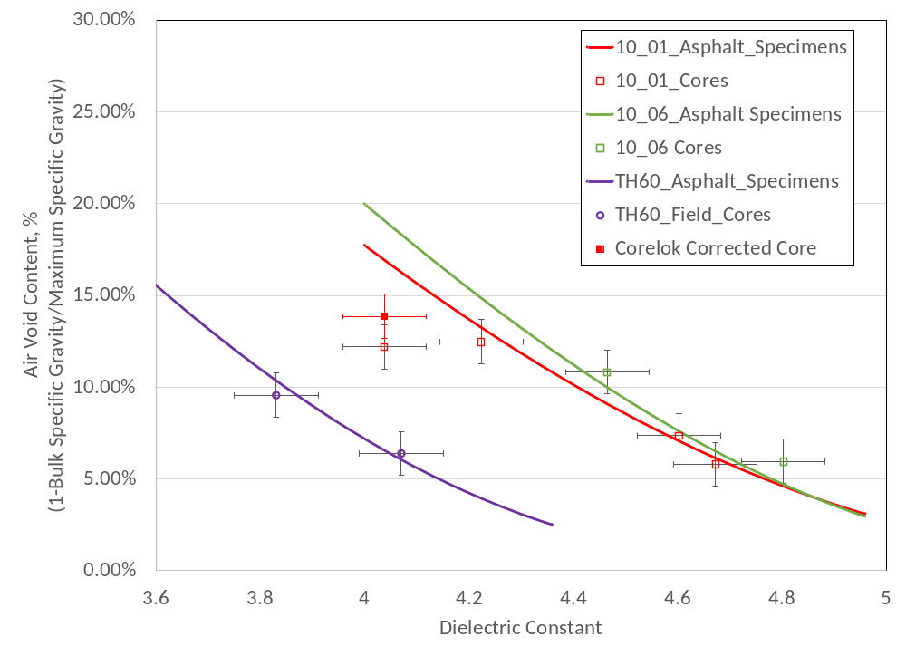
Coreless Calibration: Results

Slide 19
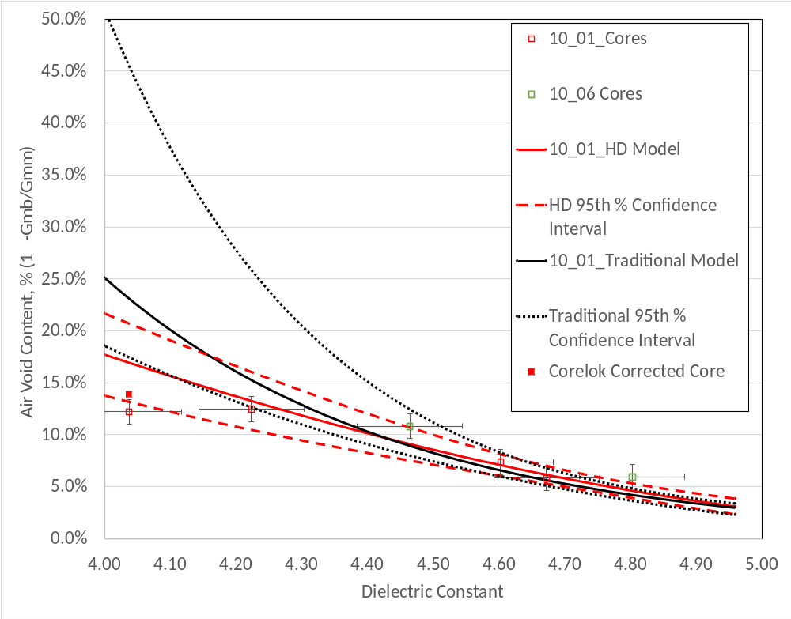
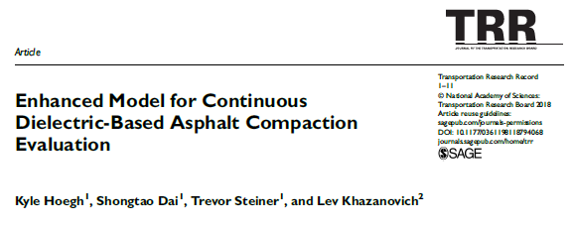
Coreless Calibration: Results
HD-Model

Slide 20
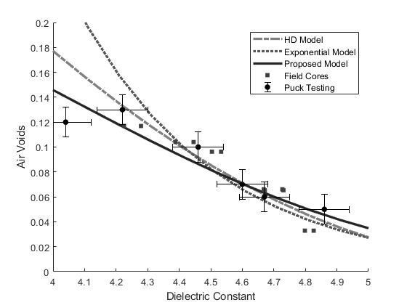
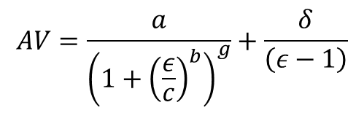
Coreless Calibration: New Model Fit
New Model
Even better match for field data at exremes
$$AV=\frac{a}{{\left(1+{\left(\frac{ε}{c}\right)}^{b}\right)}^{g}}+\frac{δ}{\left(ε−1\right)}$$
Logistic function with an asymptotic term.
Logistic function from
Gottschalk, Paul G., and John R. Dunn. "The five-parameter logistic: A characterization and comparison with the four-parameter logistic." Analytical Biochemistry. 23 May 2005. Academic Press. 09 May 2019

Slide 21
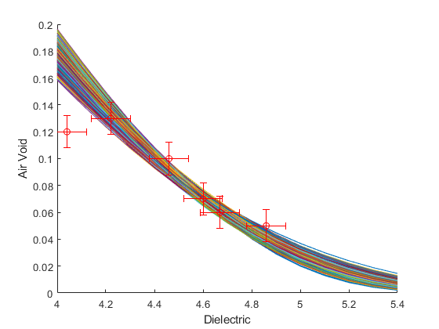
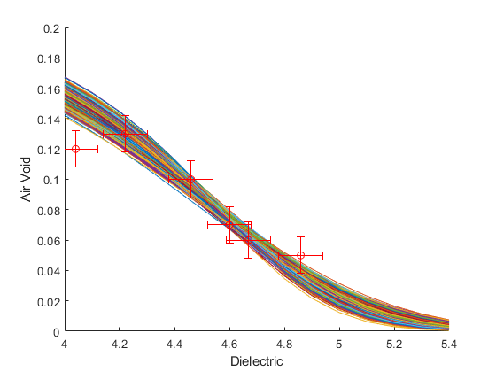
Coreless Calibration: New Model Fit
HD-Model
New Model

Slide 22
Coreless Calibration Case Study:
May 20th 2019 TH55 Testing

Slide 23
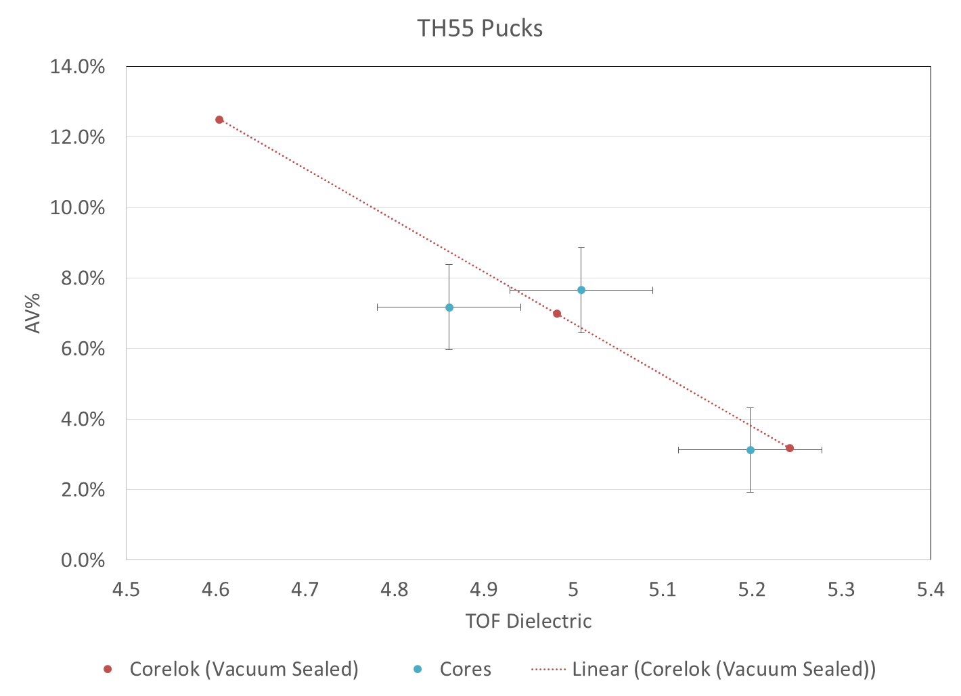
Coreless Calibration Case Study:
Puck Vs Cores
District Lab ran pucks at low (3.2%), medium (7.0%), and high (12.3%) air voids, field cores taken at low and high dielectrics.
  Only ran SSD to get Gmb to determined how much grams to add or remove to hit high and low air voids
  Tested using Corelok and dielectric in Materials and Road Research Lab
  Confirmed reasonableness of coreless puck predictions by day 2 of production!

Slide 24
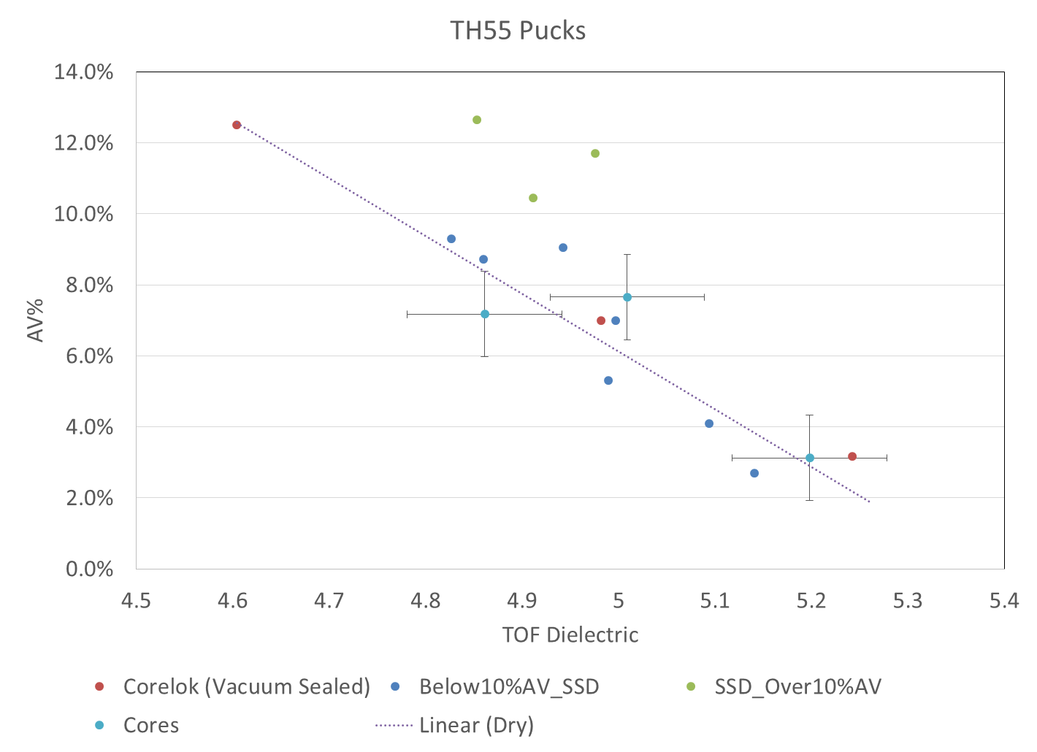
Coreless Calibration Case Study:
Puck Vs Cores
Water effect
Do dielectric measurement prior to SSD, especially at high air voids
Or, Corelok (vacuum seal)
Or, core dry?

Slide 25
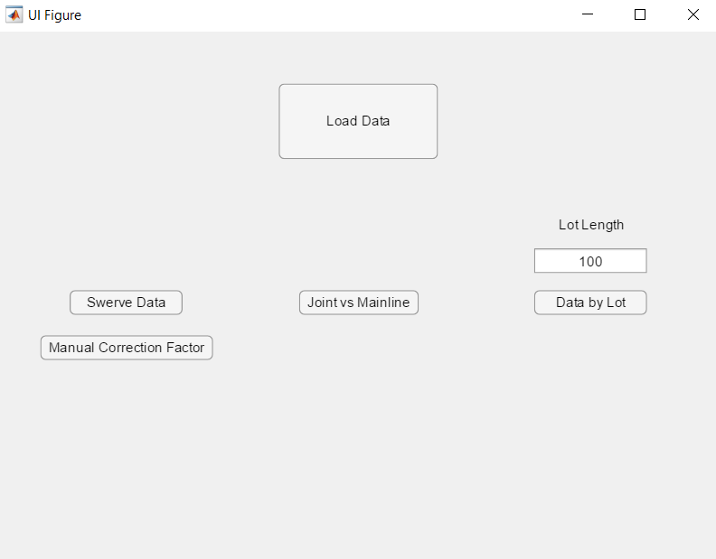
Coreless Calibration Case Study:
TH 55 Daily Report

Slide 26
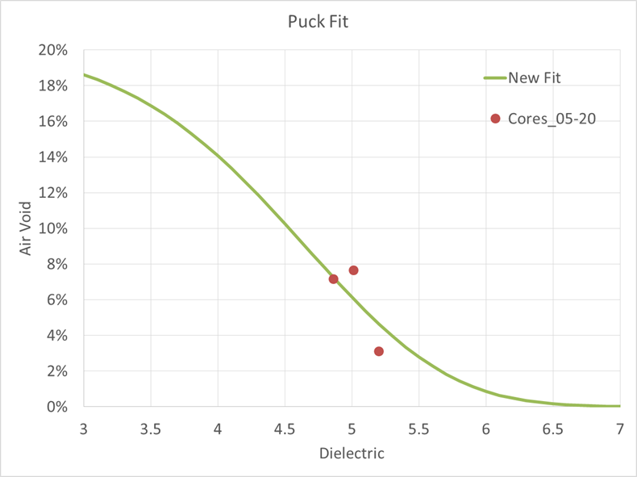
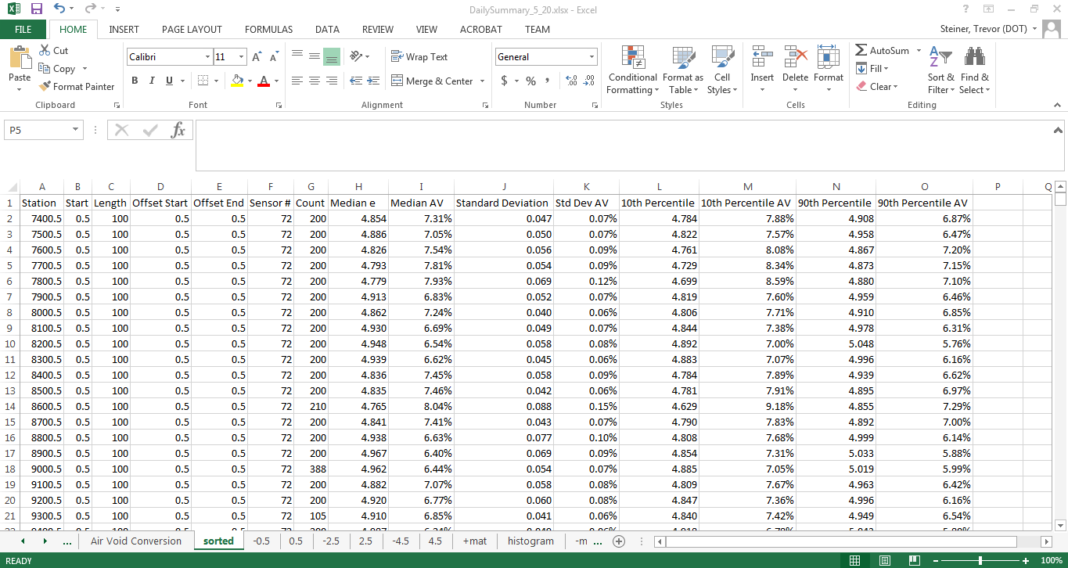
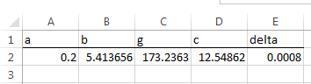
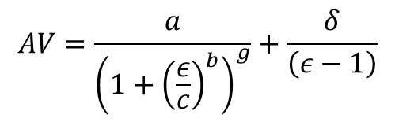
Coreless Calibration Case Study:
TH 55 Daily Report
$$AV=\frac{a}{{\left(1+{\left(\frac{ε}{c}\right)}^{b}\right)}^{g}}+\frac{δ}{\left(ε−1\right)}$$

Slide 27
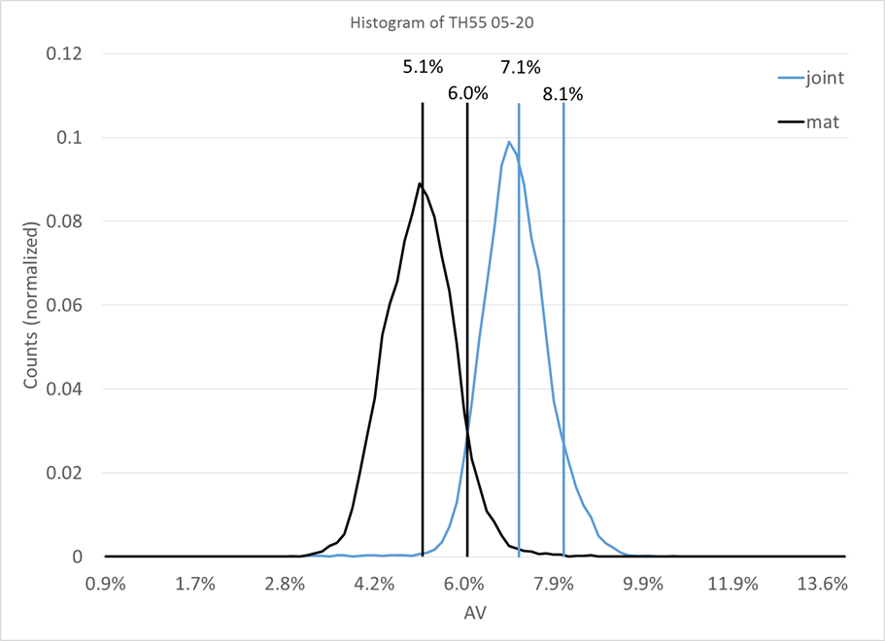
Coreless Calibration Case Study:
TH 55 Daily Report

Slide 28
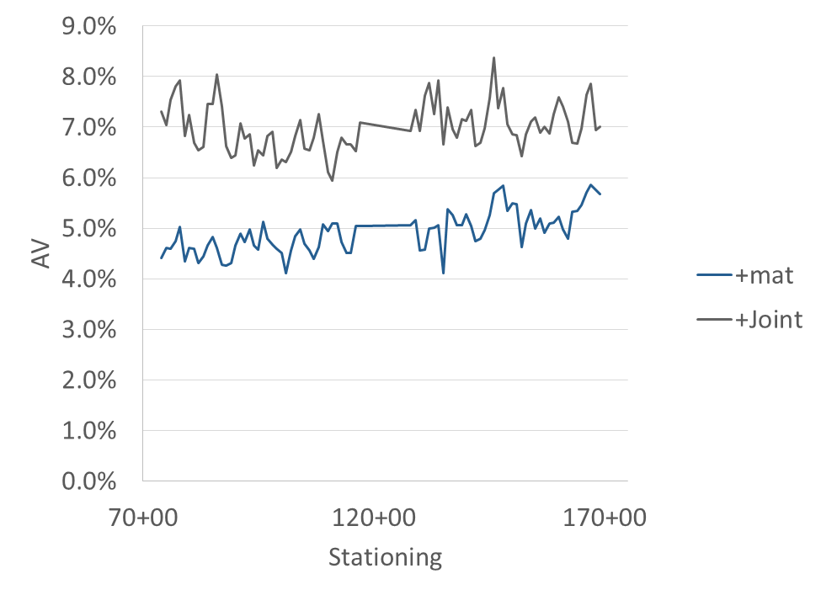
Coreless Calibration Case Study:
TH 55 Daily Report

Slide 29
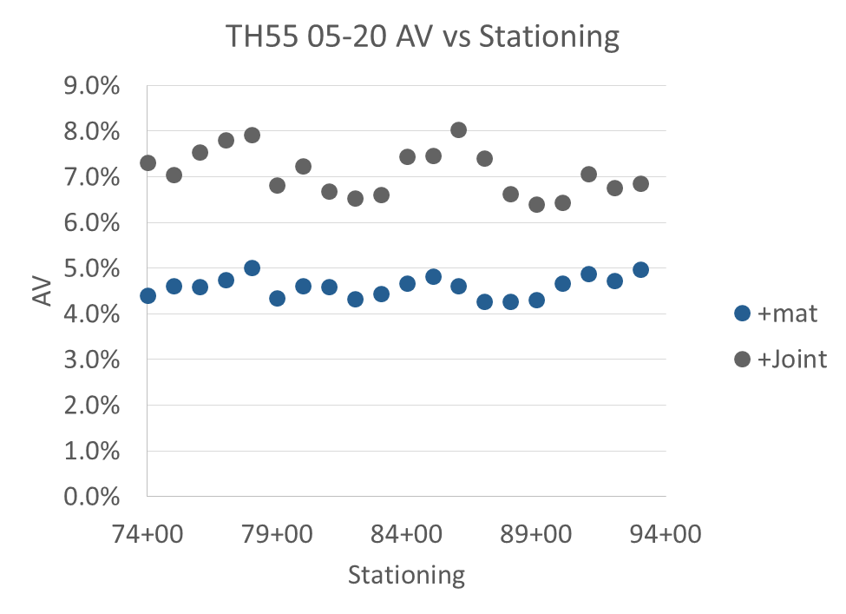
Coreless Calibration Case Study:
TH 55 100 ft. Lot Analysis

Slide 30
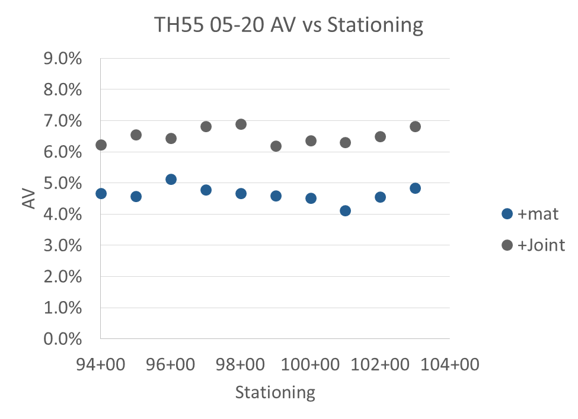
Coreless Calibration Case Study:
TH 55 100 ft. Lot Analysis

Slide 31
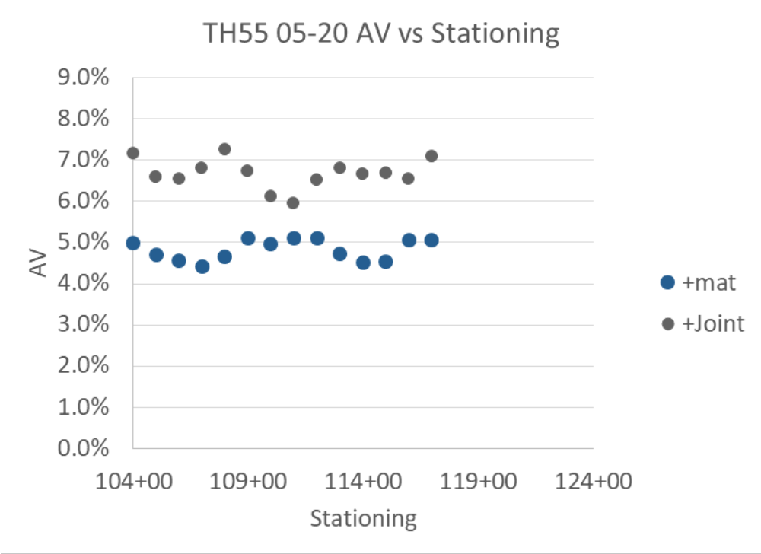
Coreless Calibration Case Study:
TH 55 100 ft. Lot Analysis

Slide 32
Discussion
DPS is a good tool for mapping a continuous coverage of the relative compaction levels (higher dielectric = higher compaction)
Histograms and general statistics can be used to give a complete assessments of the in-place compaction
Potential to eliminate field coring for DPS calibration:
    Calibrate dielectric to mix with variable air void pucks
    Validate DPS air void prediction with cores
    Monitor mix changes with puck tests in plant (do 60 second dielectric test prior to SSD on Gmb pucks)
    Will want occasional validation cores in field to confirm DPS air voids good
Potential Uses:
    Assess compaction density and uniformity for QC/QA.
    Provide on-site feedback to contractor of high and low compaction locations that they can cross-check with differences in mix or paving strategies in those locations to determine optimal construction procedures
    Identification of trends in the air void content maps that can be cross-checked with IC and other data to determine the most critical factors in achieving higher density

Slide 33
Thanks!
Questions?

Slide 34
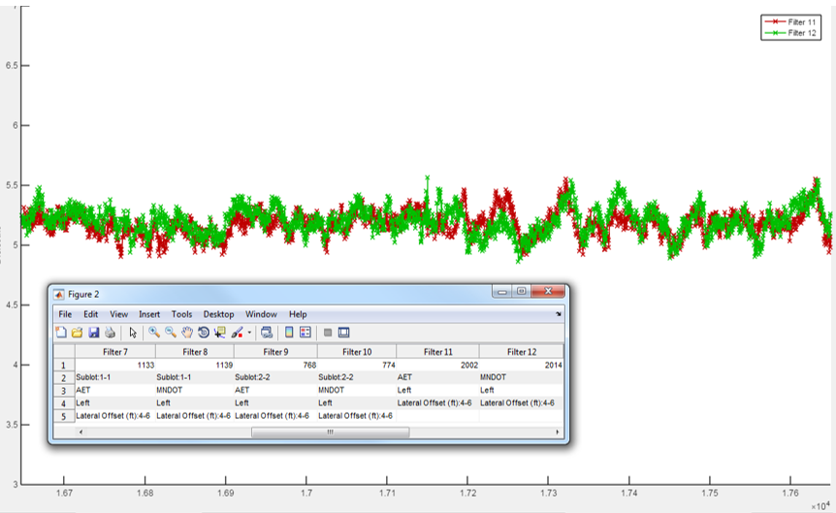


Method Overview: Field Validation
Green-MnDOT with Vehicle Mounted RDM
3 Dielectric 7
166+50 Stationing, ft. 176+50
0 Relative Frequency 35
Red – Consultant with Walking Cart RDM
4.0 Dielectric 6.5

Slide 35



Summary Field Use: 2018 TH371 contractor experience – equipment validation
Good agreement between Contractor and
MnDOT data: Median dielectric difference < 0.05
Good agreement with field cores: r^2 = 0.87

Slide 36


Field Use: Evaluate
Mix Design or Construction Operations
Comparison of Test Sections
  Mix B (3/4-) to A(1/2-): not much difference on compaction.
  Adding a roller: density slightly increased on this project.
  .
Median Density:
Blue: 94.1%
Red: 94.2%
Yellow: 93.5%
Green: 93.3%

Slide 37

Field Use: Roller Technique Evaluation
Group Name | Stationing range, ft. | Offset range, ft. | Color | Samples | Core Taken at 10th %, Air Void Content
Roller Technique #1 | 920+00 to 925+00 | Centered on Joint | Red | 1000 | 9.6%
Roller Technique #2 | 935+00 to 940+00 | Centered on Joint | Green | 1000 | 7.7%
Example 500 ft section where 2 different echelon breakdown roller techniques were used on the joint:
  On-site RDM dielectric indicated greater compaction using technique 2
  Core taken at 10th percentile indicated greater compaction in technique 2
On-site dielectric can be used to give feedback as to what techniques are more effective for compaction
Relative Frequency (Bin Count/Group Samples)
0 30
4.0 Dielectric 5.5

Slide 38

IC and PMTP Technology
Reduced Paver Speeds
Additional Rollers
Delivery Method Changes
Equipment Considerations
Increased Fleet Management
Tarping Trucks
Modification to Rolling Patterns
Steps to Reduce Number of Paver Stops
Monitor Stockpiles
Requesting Paving Crew Summaries
Caring and taking Pride
Process Changes

Slide 39

Field Use: 2018 TH14 pick-up machine breakdown investigation
Colormap of all sensors close to 89.2 relative density core location (1413+25) ranging from 1413+00 to 1415+00. The red arrow indicates the location where both core and dielectric results showed low density.

Slide 40

Field Use – QC Contractor Feedback
On-Site Feedback
Contractor could identify low and high density locations
R01 – dielectric 4.1
R02 – dielectric 4.6
Corresponded to 87.8% and 94.2% relative density respectively

Slide 41

Field Use: GPS based Core Locator

Slide 42




Field Use – Core Locator
automatically guide field person to location for field verification

