Slide 1


Superpave5
Superpave Design at Five Percent
Air Voids
March 11, 2019

Slide 2
Question?
Is there a way?
To improve asphalt
pavement performance
WITHOUT
Increasing COST?

Slide 3
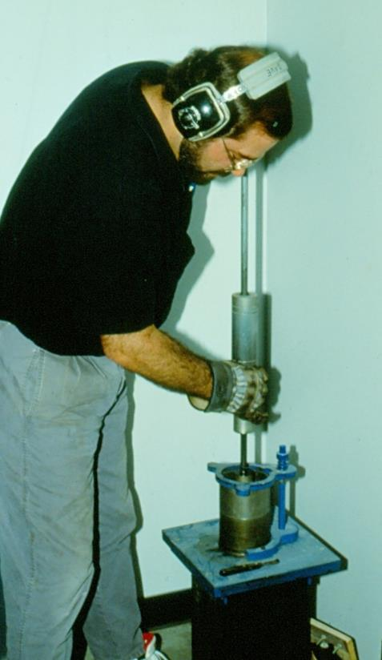
Marshall Mix Design
Design Air Voids 3-5%
Field Compaction
  8% after rolling
  4% after traffic
Construction (8%)
Decreases to
Service Life (4%)

Slide 4

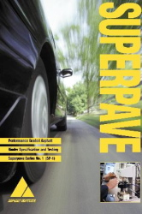
Strategic Highway
Research Program
“Marshall” carried forward
Design air voids fixed at 4%
Recommended compaction set at 92% Gmm

Slide 5
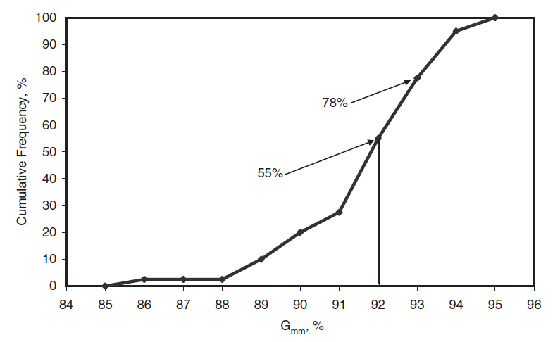
As-Constructed Air Voids?
NCHRP Report 573

Slide 6
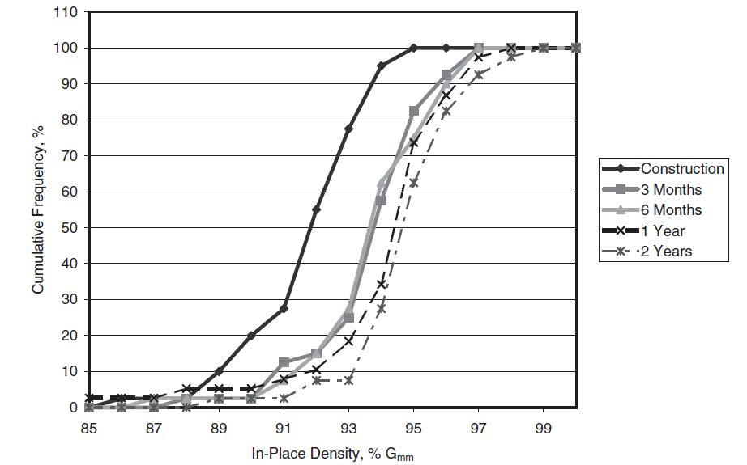
Typical Final Density
91.8%
94.6%
NCHRP Report 573
Figure 4.8

Slide 7
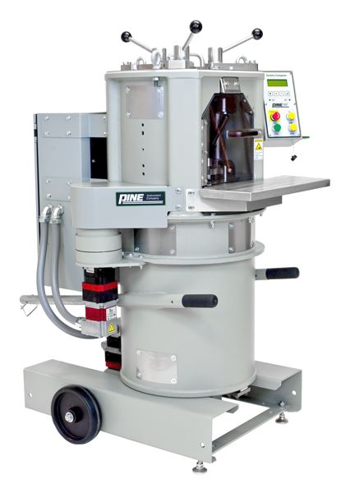
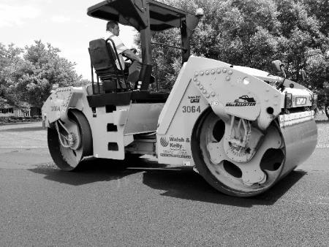
Superpave5 Concept
Field Compaction
95% Gmm
Mix Design
5% air voids
No change in
asphalt content

Slide 8
Does it Change Asphalt Content?
 | Superpave4 |  | Superpave5
NMAS | VMA | Effective Asphalt (volume) | VMA | Effective Asphalt (volume)
9.5 | 15.0 | 11.0 | 16.0 | 11.0
12.5 | 14.0 | 10.0 | 15.0 | 10.0
19.0 | 13.0 | 9.0 | 14.0 | 9.0
25.0 | 12.0 | 8.0 | 13.0 | 8.0

Slide 9
Does it Change Asphalt Content?
Asphalt Content
Stays Same
 | Superpave4 |  | Superpave5
NMAS | VMA | Effective Asphalt (volume) | VMA | Effective Asphalt (volume)
9.5 | 15.0 | 11.0 | 16.0 | 11.0
12.5 | 14.0 | 10.0 | 15.0 | 10.0
19.0 | 13.0 | 9.0 | 14.0 | 9.0
25.0 | 12.0 | 8.0 | 13.0 | 8.0

Slide 10
Asphalt Content
Gradation
Changes
 | Superpave4 |  | Superpave5
NMAS | VMA | Effective Asphalt (volume) | VMA | Effective Asphalt (volume)
9.5 | 15.0 | 11.0 | 16.0 | 11.0
12.5 | 14.0 | 10.0 | 15.0 | 10.0
19.0 | 13.0 | 9.0 | 14.0 | 9.0
25.0 | 12.0 | 8.0 | 13.0 | 8.0

Slide 11
Asphalt Content
Gyrations
Change
 | Superpave4 |  | Superpave5
NMAS | VMA | Effective Asphalt (volume) | VMA | Effective Asphalt (volume)
9.5 | 15.0 | 11.0 | 16.0 | 11.0
12.5 | 14.0 | 10.0 | 15.0 | 10.0
19.0 | 13.0 | 9.0 | 14.0 | 9.0
25.0 | 12.0 | 8.0 | 13.0 | 8.0

Slide 12
Design Gyrations??
 |  | Mixture Type
ESAL | Gyrations | 9.5-mm | 19.0-mm
3-10 million | 70 | x
 | 50 | x
 | 30 | x
10-30 million | 70 | x | x
 | 50 | x | x
 | 30 | x | x
Purdue University
Evaluated
Engineering Properties

Slide 13
Conclusions
100 gyrations
Designs at 4% Air Voids
And 93% Gmm Compaction
Designs at 5% Air Voids
And 95% Gmm Compaction
Stiffness, Rutting ≈
30 gyrations

Slide 14
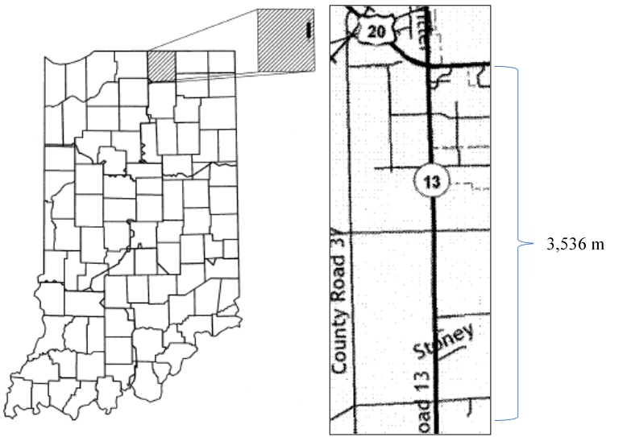
SR 13, Middlebury, Indiana
2013 Trial Project
  13,400 AADT
  19% heavy trucks
First
Project

Slide 15
Mix Designs
 | Superpave4 | Superpave5
#11 Steel Slag | 40 | 43
#12 Limestone | 20 | 17
Stone Sand | 15 | 18
Natural Sand | 18 | 15
RAS (Shingles) | 7 | 7
 | Superpave4 | Superpave5
Gyration | 100 | 30
Asphalt Content | 5.1% | 5.4%
Recycled Binder Ratio | 0.206 | 0.193
Air Voids | 4.0 | 5.0
VMA | 15.5 | 17.0

Slide 16
Gradation

Slide 17
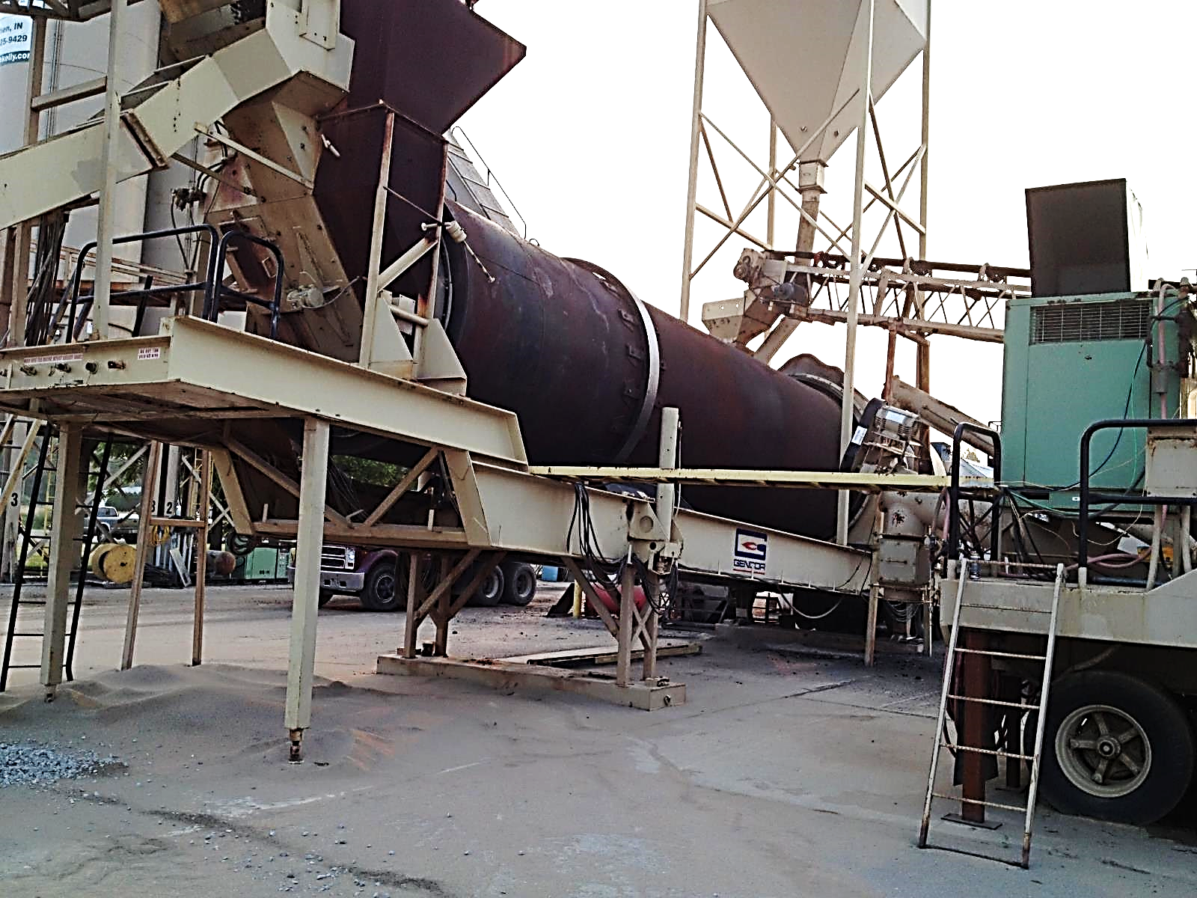
Counter-Flow Drum Mix Plant

Slide 18
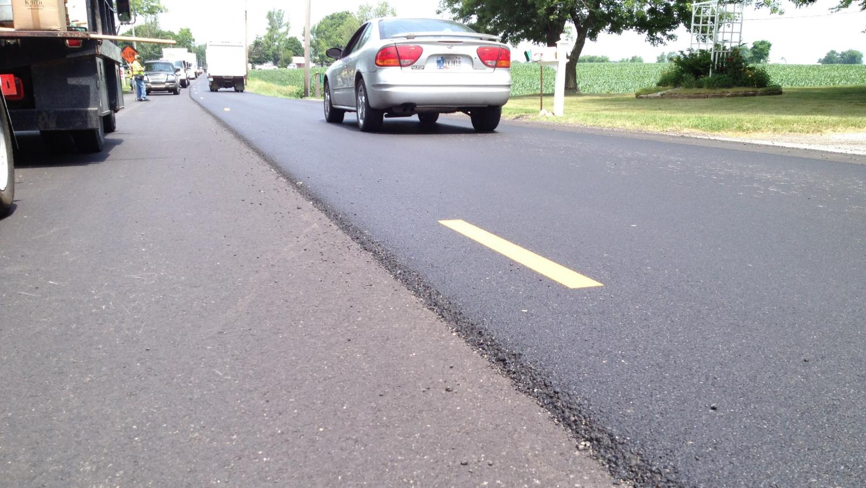
Superpave4

Slide 19
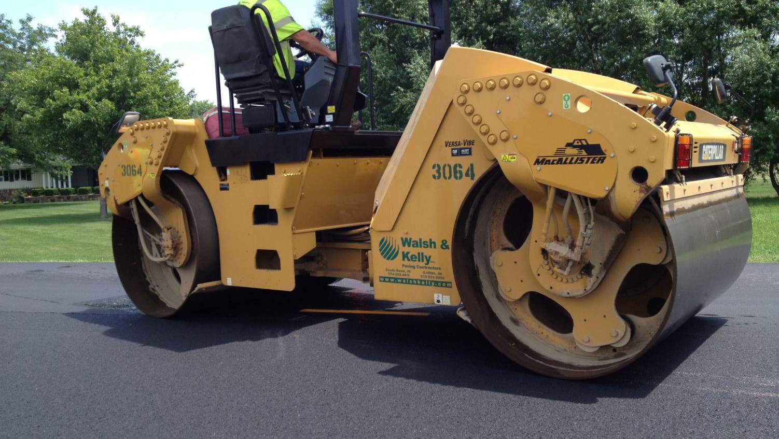
Superpave5 Compaction
Same Rolling Train

Slide 20
Mix Construction Properties
 | Superpave4 |  |  | Superpave5
 | Design | QC | QA | Design | QC | QA
Asphalt, % | 5.1 | 5.1 | 5.0 | 5.4 | 5.5 | 5.2
Air Voids, % | 4.0 | 3.5 | 4.1 | 5.0 | 4.5 | 4.0
Density, %Gmm | - | - | 91.6 | - | 94.7 | 96.9

Slide 21
2018 Core Locations
Location | Superpave4 | Superpave5
1 | 206+66 | 155+95
2 | 147+37 | 180+25
3 | 124+74 | 214+74

Slide 22
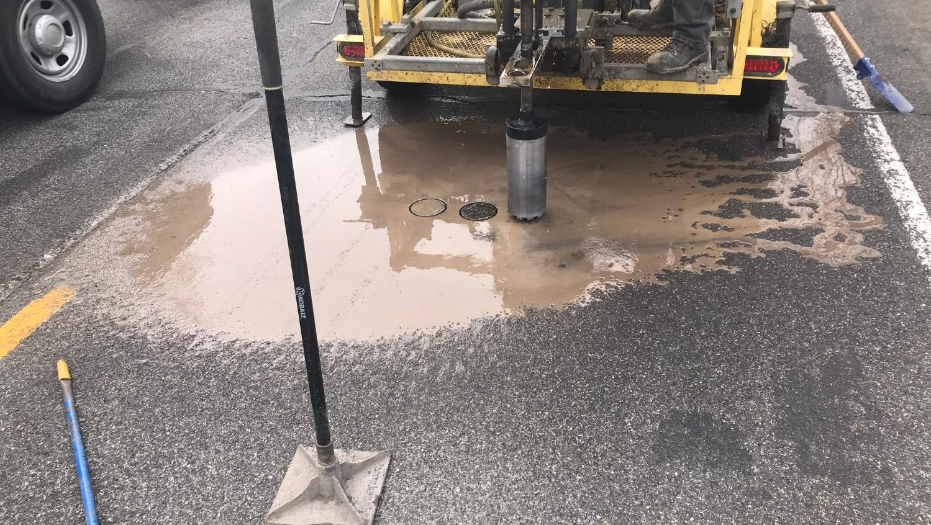
Six Cores At Each Location

Slide 23
Core Properties
 | Superpave4 |  |  | Superpave5
 | Loc 1 | Loc 2 | Loc 3 | Loc 1 | Loc 2 | Loc 3
Thickness, mm | 37.3 | 37.7 | 34.5 | 35.2 | 36.2 | 42.8
Asphalt, % | 5.34 | 5.35 | 5.56 | 5.67 | 5.36 | 5.82
Density, %Gmm | 91.8 | 94.0 | 92.3 | 95.7 | 93.6 | 96.6
Average Values

Slide 24
Permeability

Slide 25
Recovered Asphalt Binder Grade
 | Superpave4 |  |  |  | Superpave5
Location | High Fail Temp., °C | Low Fail Temp m, °C | Low Fail Temp, S, °C | ∆Tc, °C | High Fail Temp, °C | Low Fail Temp, m, °C | Low Fail Temp, S, °C | ∆Tc, °C
1 | 99.1 | -15.6 | -24.8 | -9.2 | 95.4 | -20.5 | -24.9 | -4.4
2 | 97.0 | -20.4 | -25.8 | -5.4 | 96.5 | -18.5 | -23.4 | -4.9
3 | 103.9 | -12.7 | -23.1 | -10.4 | 90.1 | -24.1 | -25.7 | -1.5
Average | 100.0 | -16.2 | -24.6 | -8.3 | 94.0 | -21.0 | -24.7 | -3.6

Slide 26
Asphalt Binder Grade

Slide 27
Correlation PG High Temp to
In-Place Air Voids

Slide 28
Correlation PG Low Temp to
In-Place Air Voids

Slide 29
Correlation Delta Tc to
In-Place Air Voids

Slide 30
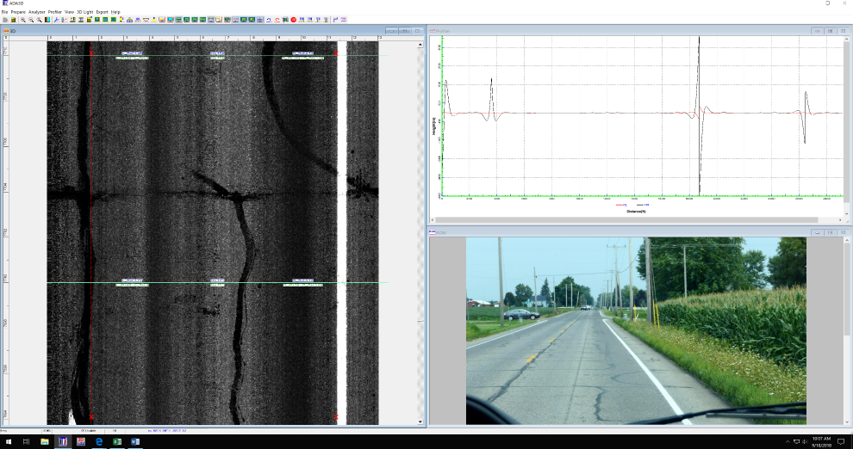
Pavement Condition Collection

Slide 31
Smoothness and Rut Depth from Van
 | Superpave4 |  |  |  | Superpave5
 | IRI (in/mi) |  | Rut Depth (in) |  | IRI (in/mi) |  | Rut Depth (in)
 | LWP | RWP | LWP | RWP | LWP | RWP | LWP | RWP
Average Three Locations | 43 | 91 | 0.22 | 0.31 | 28 | 120 | 0.14 | 0.22
Entire Project | 47 | 119 | 0.13 | 0.26 | 53 | 206 | 0.14 | 0.26

Slide 32
Crack Data from Automated Collection
 | Superpave4 |  | Superpave5
Location | Length (ft/100 ft) | Crack Density (% area) | Length (ft/100 ft) | Crack Density (% area)
Average Three Locations | 142 | 1.39 | 171 | 2.04
Entire Project | 141 | 1.80 | 299 | 1.97

Slide 33
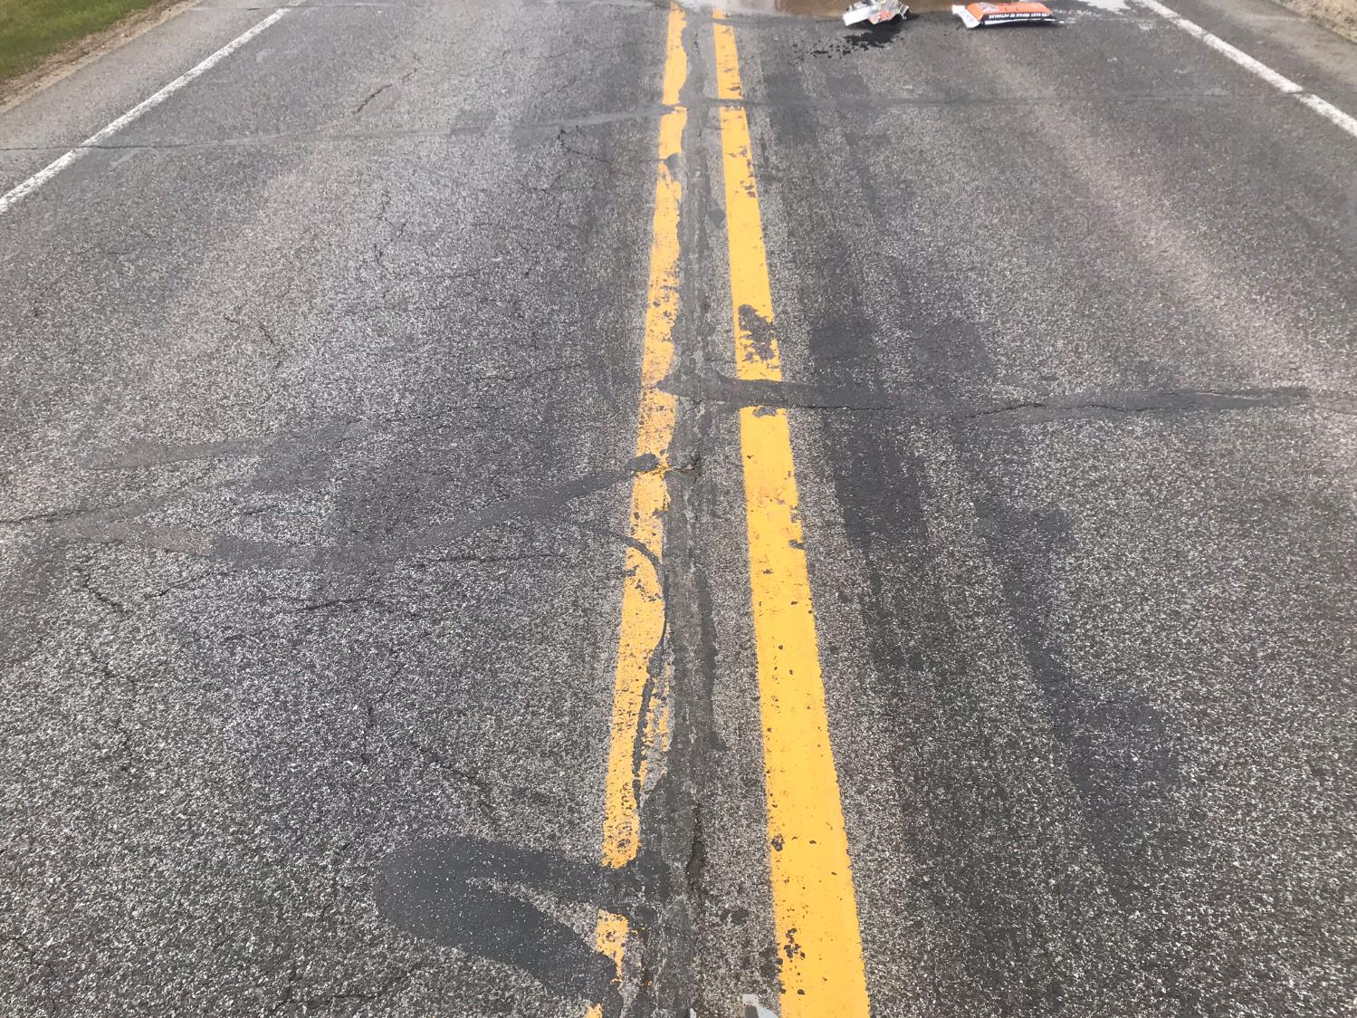
Superpave4
Superpave5

Slide 34
Superpave4

Slide 35
Superpave5

Slide 36
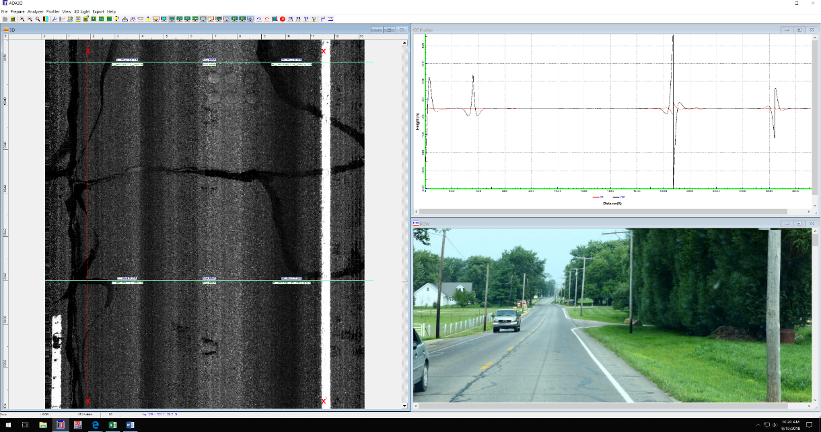
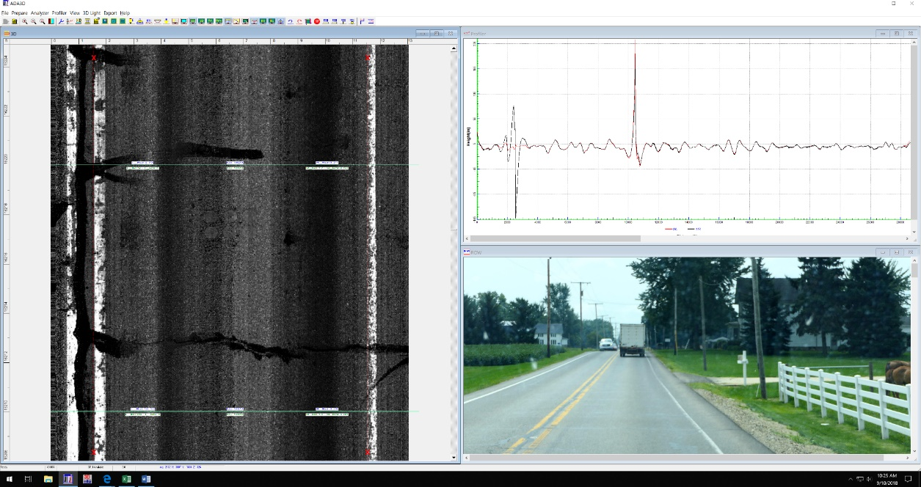
Superpave4 Superpave5

Slide 37
What Did We Learn?
Aging of Asphalt Binder
Directly Related to
In-Place Air Voids

Slide 38
What Did We Learn?
Changes to Mix Design
Can Reduce Aging

Slide 39
Asphalt Binder Properties
Construction
  80% PG 70-22
  20% PG 130 -0 (est.)
Five Years in Service
  Superpave4 PG 100-16
  Superpave5 PG 94-21
Effect on
Life?

Slide 40
US 40, Richmond, Indiana
2016 Trial Project
  17,800 AADT
  5% heavy trucks
High Density
Trial Project

Slide 41
Mix Designs
 | Superpave4 | Superpave5
#11 Limestone | 50.5 | 46.5
#12 Limestone | 10.0 | 8.0
Stone Sand | 22.0 | 27.0
RAP Fine | 14.5 | 14.1
RAS (Shingles) | 3.0 | 2.9
 | Superpave4 | Superpave5
Gyration | 100 | 50
Asphalt Content | 6.7% | 7.1%
Recycled Binder Ratio | 0.23 | 0.21
Air Voids | 4.0 | 5.0
VMA | 15.6 | 16.7

Slide 42
November 2016
40°F to 55°F

Slide 43
Mix Construction Properties
 | Superpave4 |  | Superpave5
 | Design | QA | Design | QA
Asphalt, % | 6.7 | 6.48 | 7.1 | 6.83
Air Voids, % | 4.0 | 4.76 | 5.0 | 5.88
VMA, % | 15.6 | 14.88 | 16.7 | 16.69
Density, %Gmm | - | 93.3 | - | 95.4

Slide 44
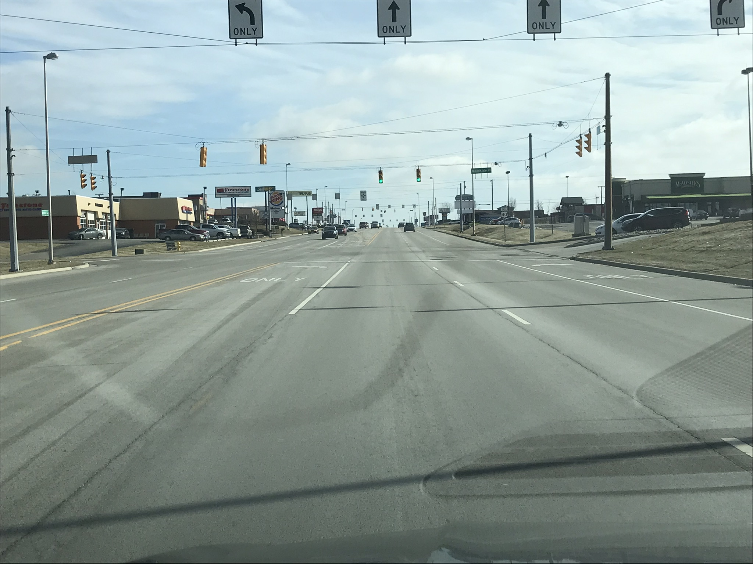
Superpave5
Superpave4

Slide 45
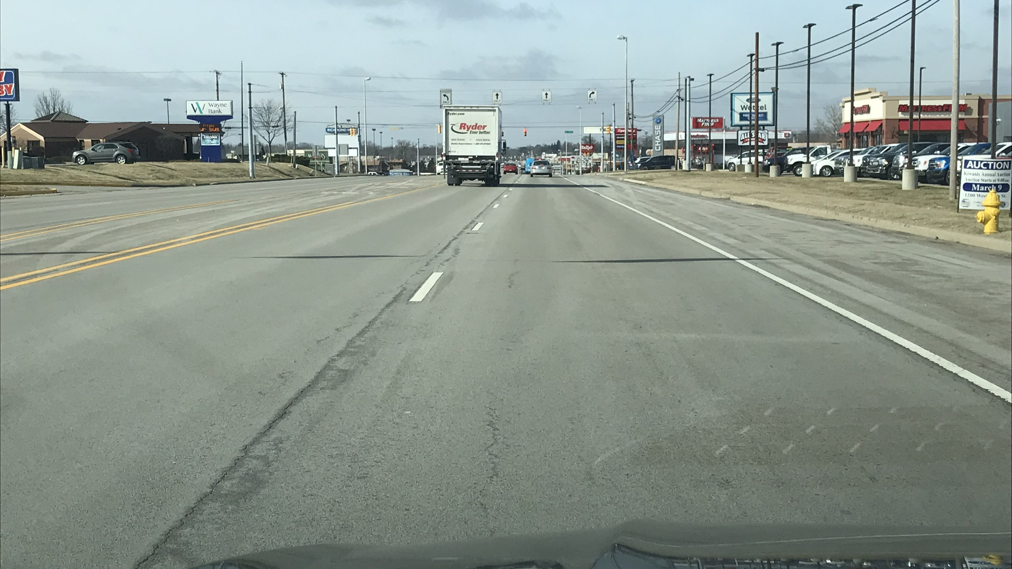
Superpave4
Superpave5

Slide 46
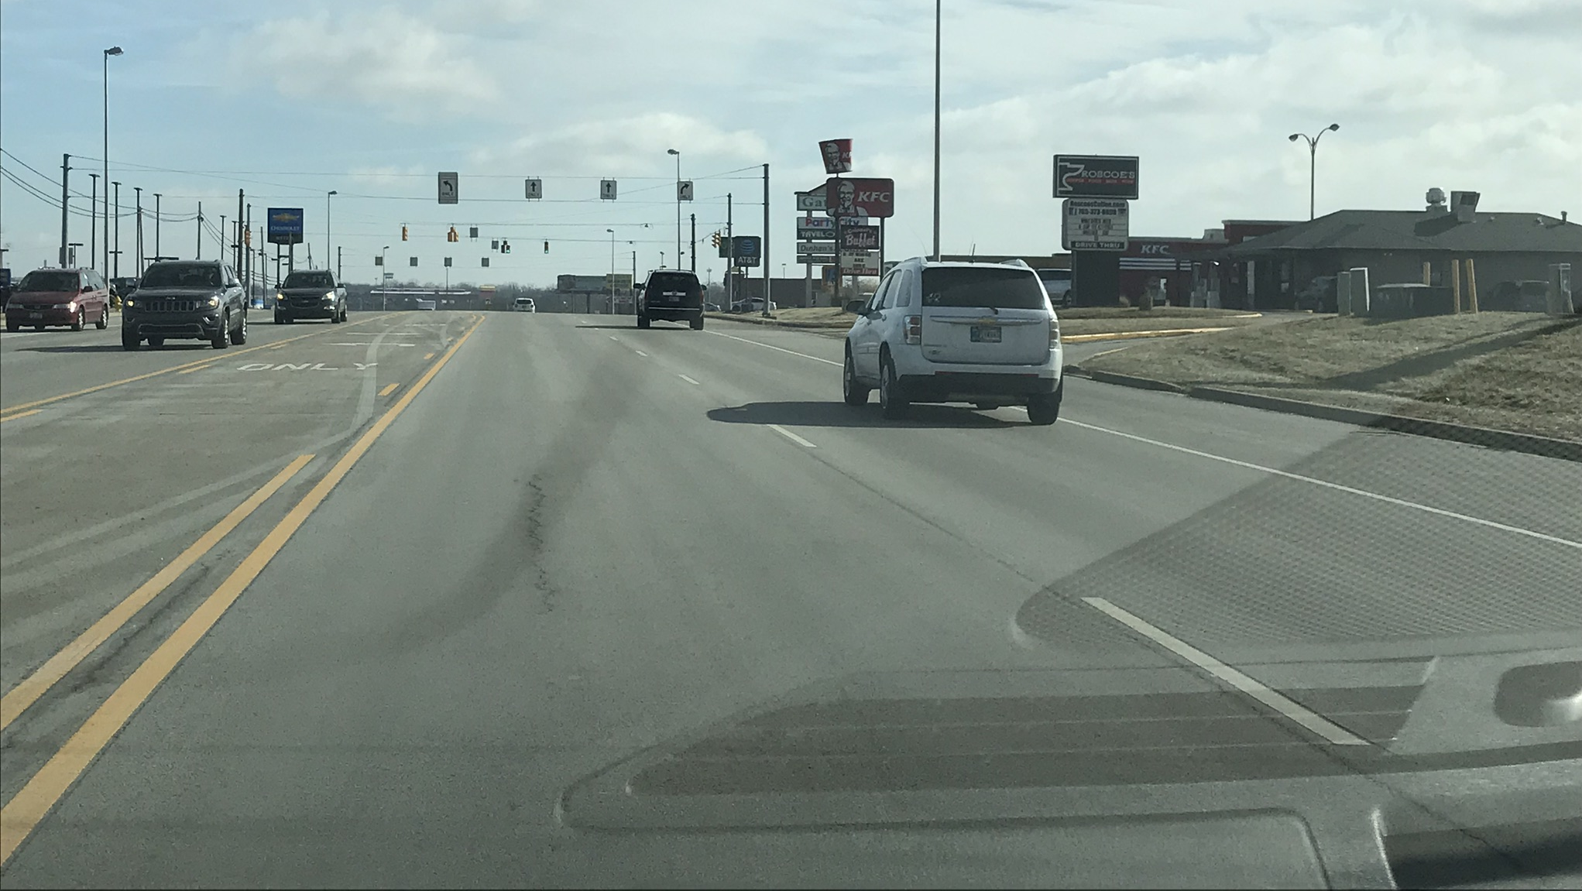
Superpave5
Superpave4

Slide 47
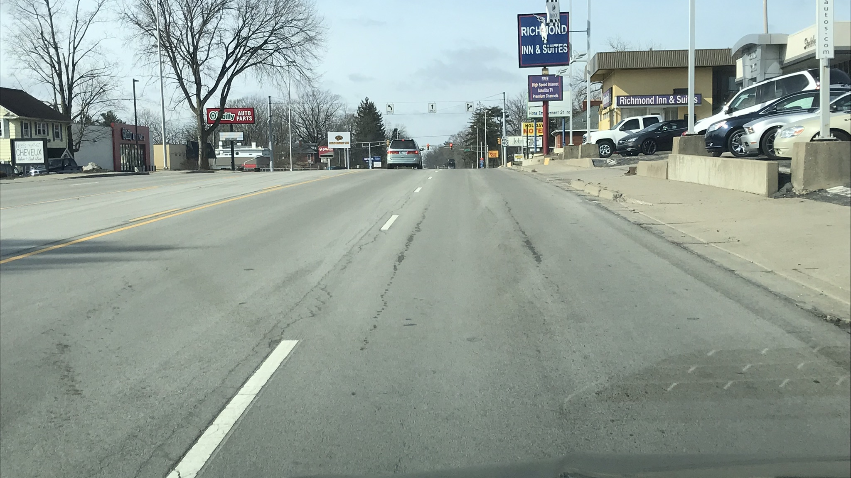
Superpave5
Superpave4

Slide 48
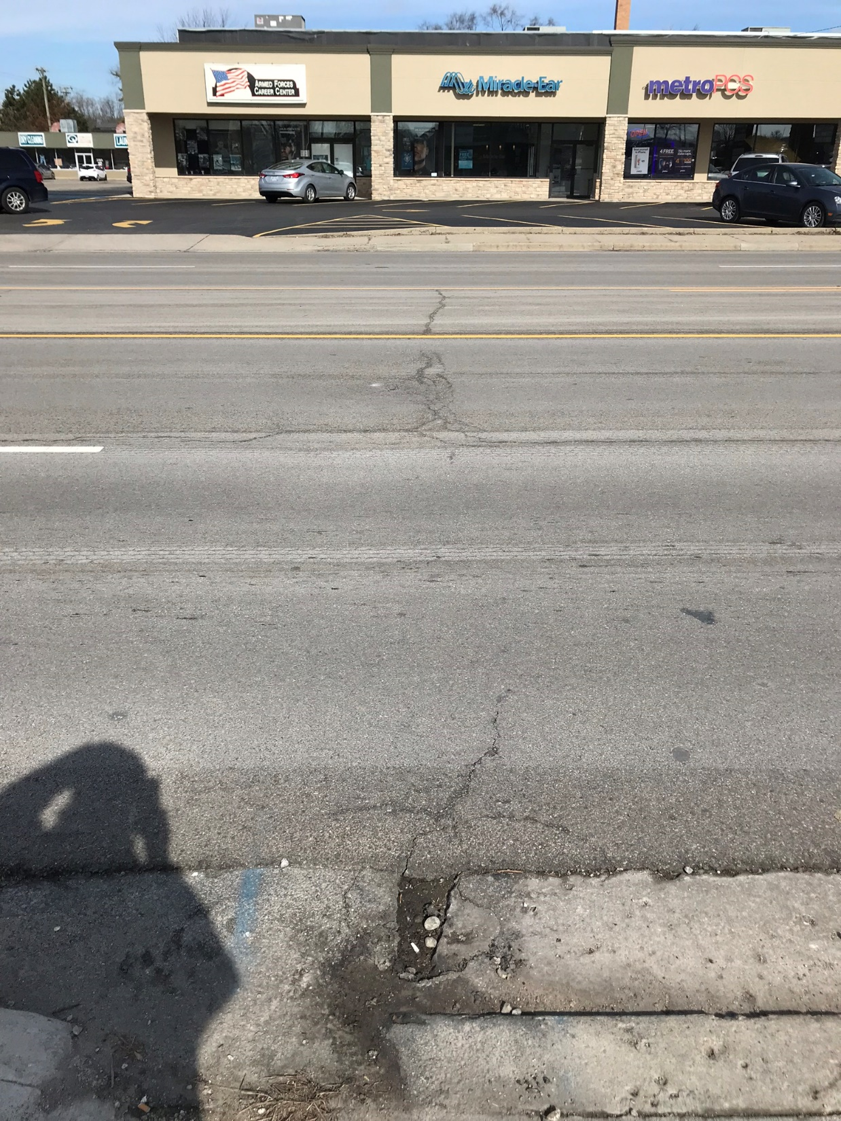
Superpave4
Superpave5

Slide 49
Indiana DOT Implementation
<3 million ESALs 30 gyrations
3 million to >30 million ESALs 50 gyrations

Slide 50
Superpave5
2018
  12 projects let as Superpave5
  9 projects built or partially built
  11 mix designs
    Four 19.0-mm
    Seven 9.5-mm
2019
  Standard specifications changed
  January 2019
  Specification effective
  September 2019
  For 2019, option to change Superpave4 projects to Superpave5
Implementation

Slide 51
2018 Superpave5 Projects
How did they
turn out?

Slide 52
OK.
Gyratory Voids
4.58%
Density
93.82%
6.18% voids
1.50% difference

Slide 53
Not so good.
Gyratory Voids
4.37%
Density
93.93%
6.07% voids
1.70% difference

Slide 54
Good.
19.0 mm Intermediate
  Gyratory Voids
  5.42%
  Density
  93.73% Gmm
  (6.27% voids)
  0.85% difference

Slide 55
Good.
Gyratory Voids
5.19%
Density
94.24%
5.76% voids
0.57% difference

Slide 56
Another DOT Implementation
<3 million ESALs 30 gyrations
3 million to >30 million ESALs 50 gyrations

Slide 57
Performance Testing
Design
  Use Ndesign gyratory specimens
    Hamburg or APA Rut Testing
    DCT or SCB
Construction
  Use Ndesign gyratory specimens from QC or QA
    Hamburg or APA Rut Testing
    DCT or SCB

Slide 58

Superpave5
Increased Life
No Increased Cost
B/C ratio?

