Slide 1
AASHTO Perspective on Electronic Data
Michael J. Kennerly PE
Director of The Design Bureau
Iowa Department of Transportation
2019 NRRA Workshop
May21, 2019

Slide 3
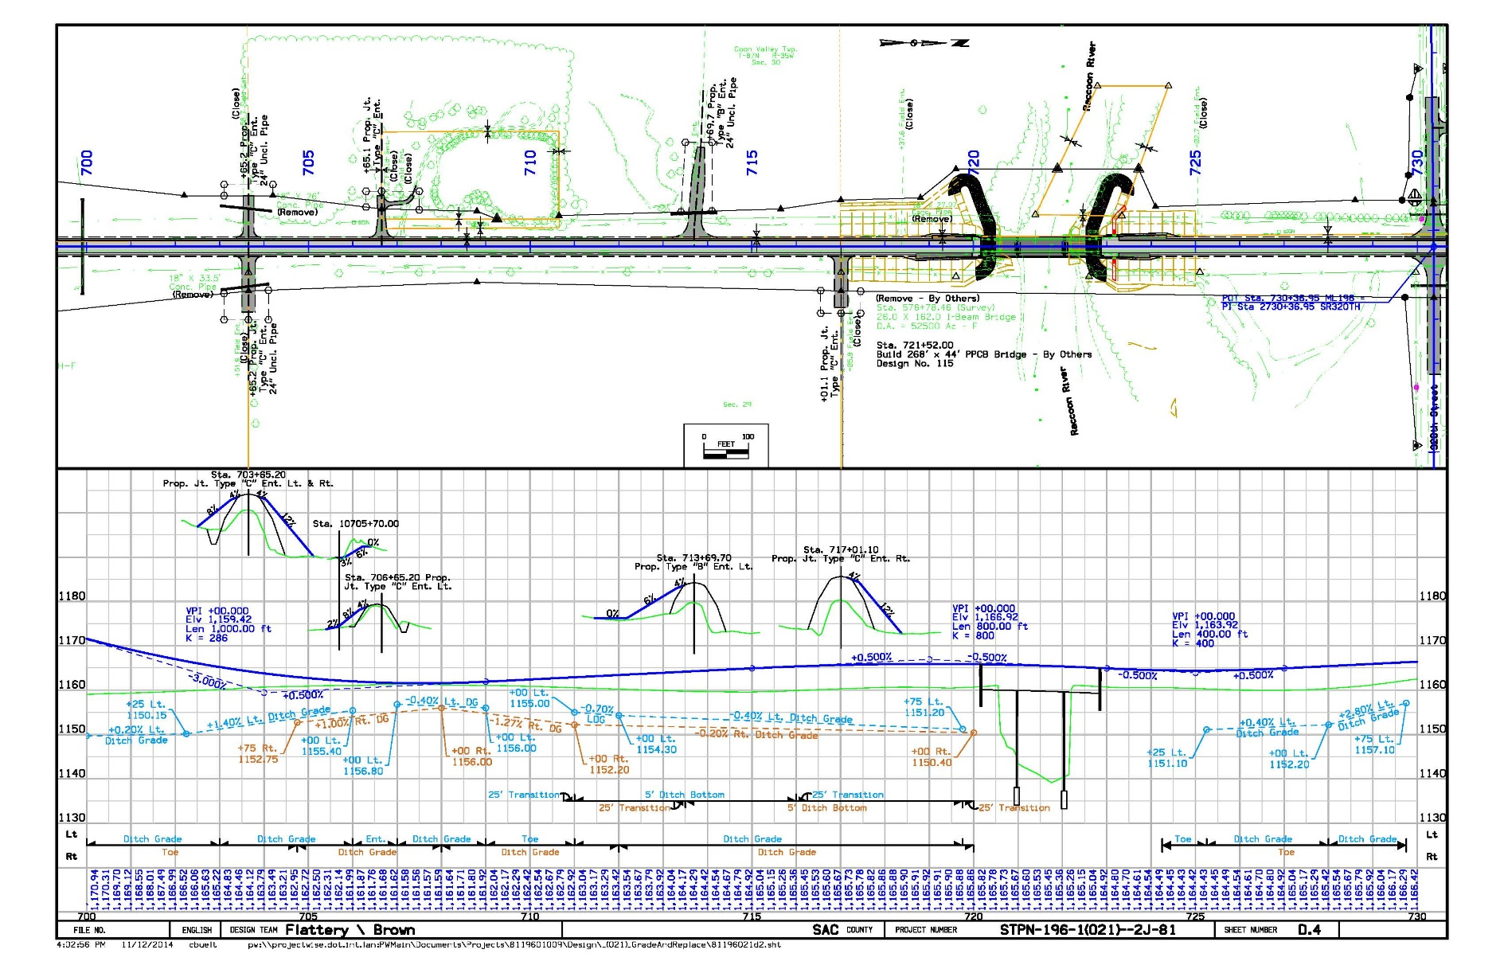
IA 196 at the Raccoon River

Slide 4
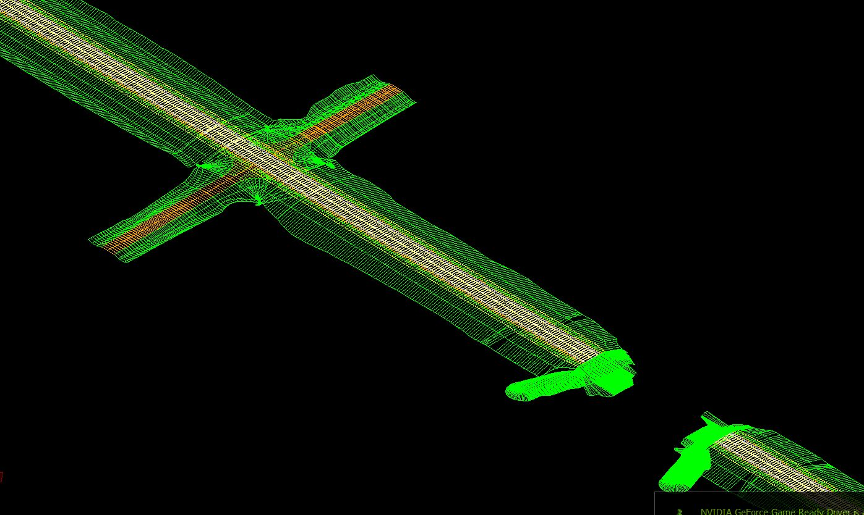
IA 196 at the Raccoon River

Slide 5
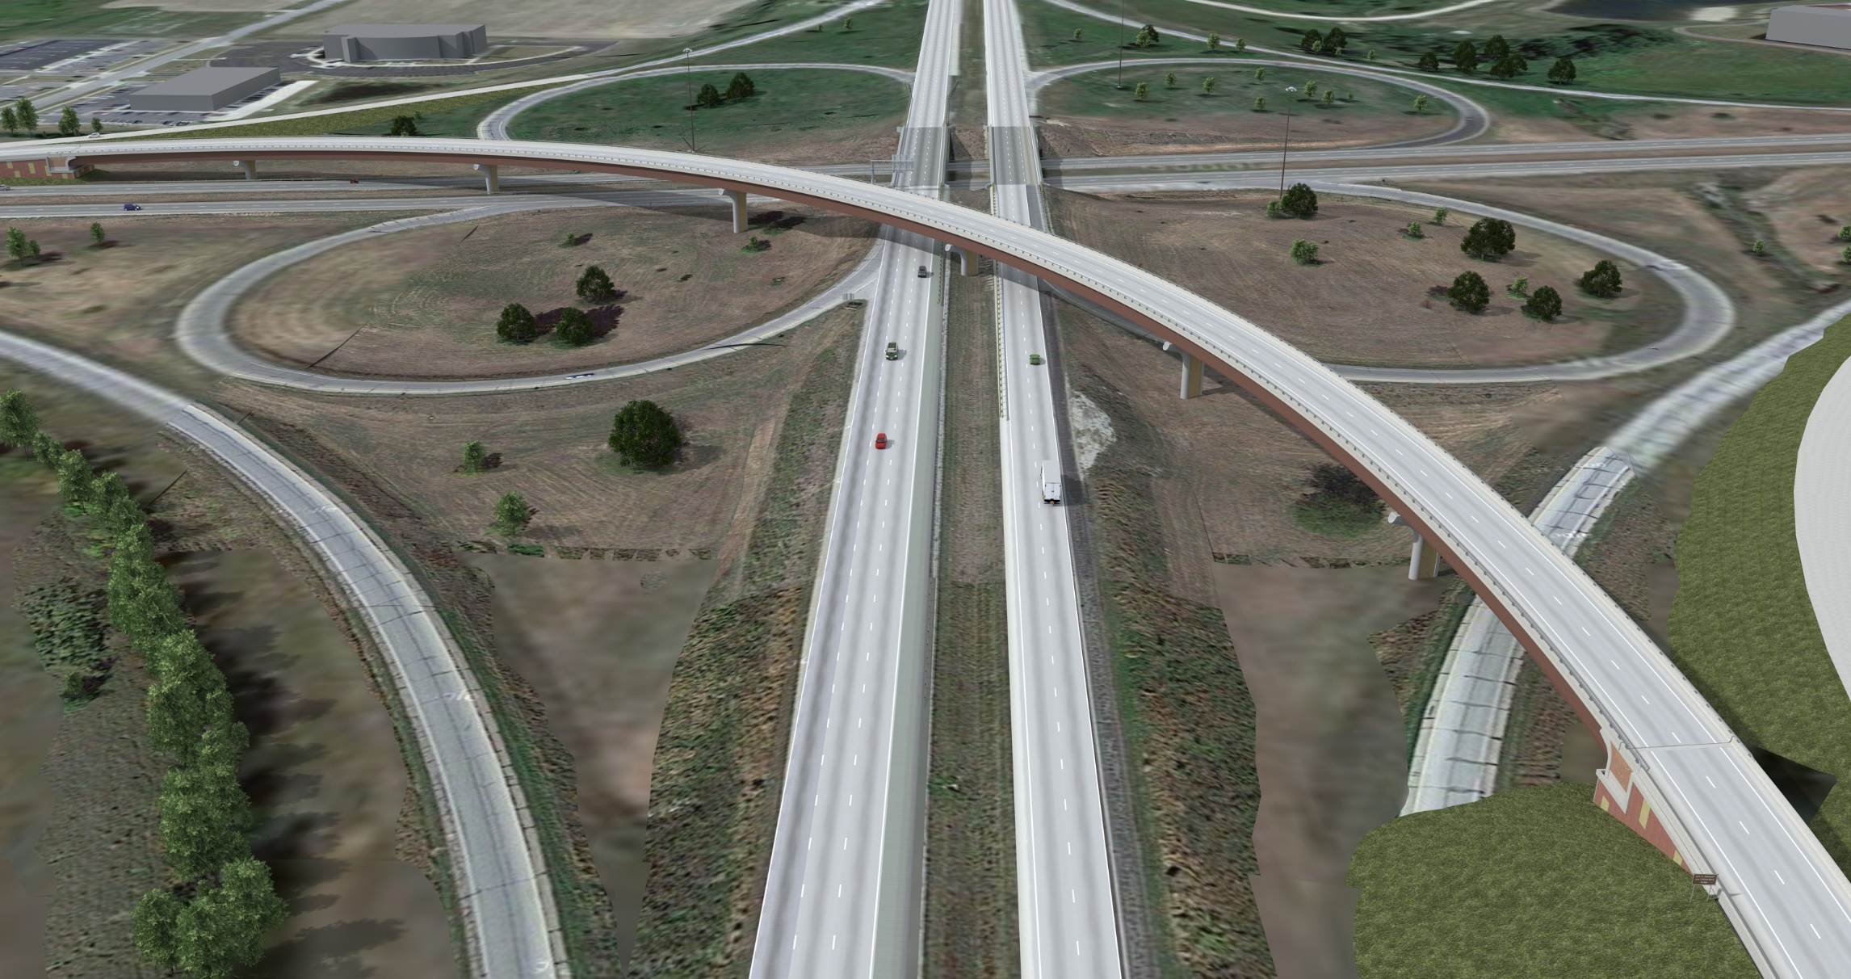
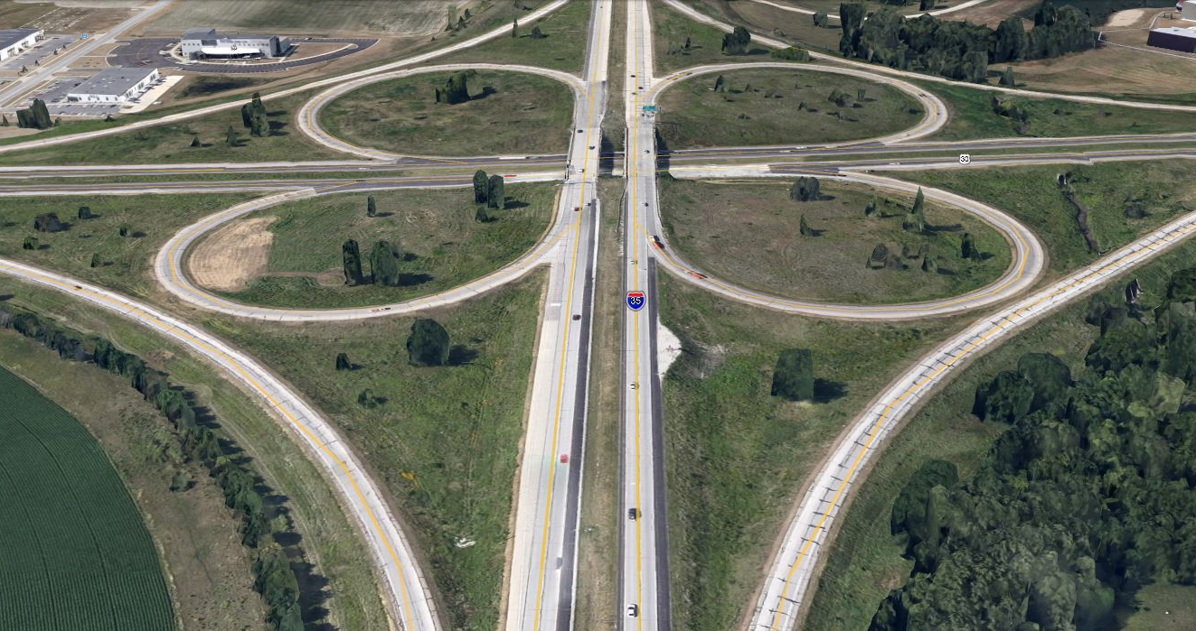
I-35/US 30 Interchange

Slide 6

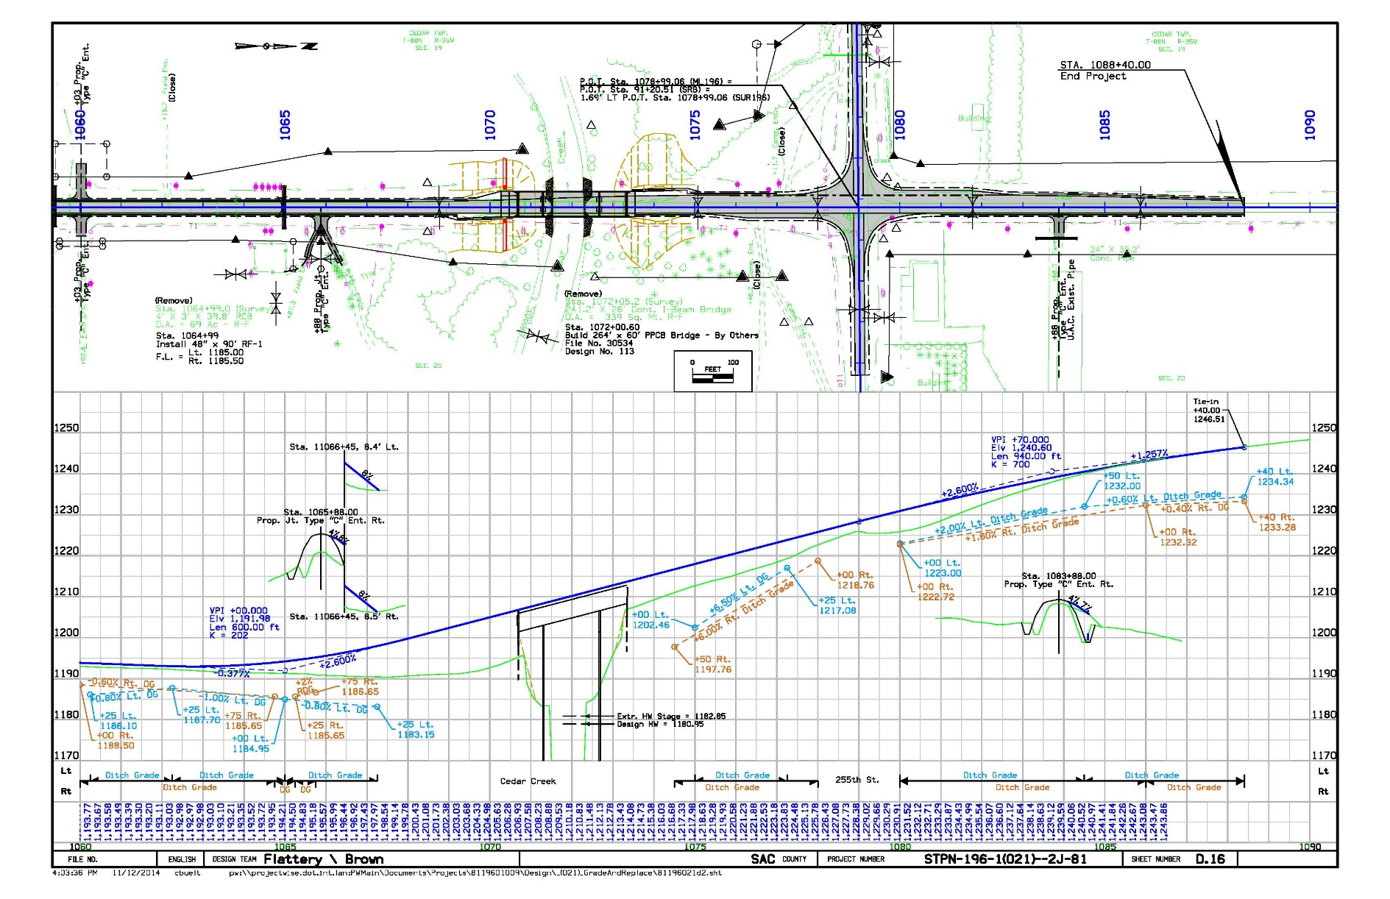
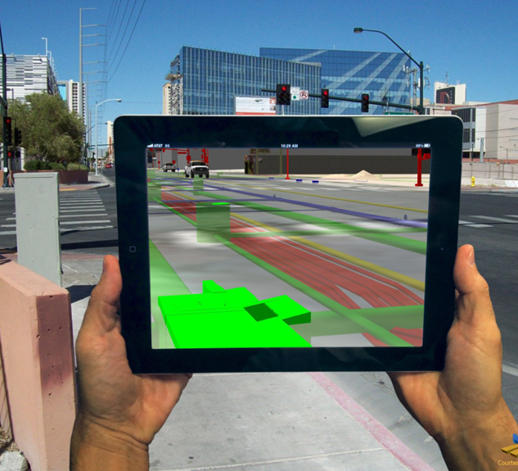
The Next Step
The move to 3D design opens a number of exciting possibilities for transportation agencies.
Renderings
Virtual Reality
Augmented Reality
Interactive animations
Intelligent Plans\Building Information Models
Electronic As-Built
Asset Management
Images courtesy of VPN Engineering taken from the October 2013 edition of Underground Construction magazine article entitled; “Augmented Reality’ Peers Below The Surface: Technology Could Revolutionize Underground Engineering, Design and Construction” by Jeff Griffin with contributions from Mark Wallbom of United Imaging Technologies.

Slide 7
Joint Technical Committee on Electronic Engineering Standards
Chair: Michael Kennerly: Iowa DOT
Vice Chair: Jennifer Lloyd; TDOT
Joe Squire: Oregon DOT
17 State Transportation Agencies
2 Consulting firms (HDR, CDM Smith)
Bentley
Autodesk
Trimble
AGC

Slide 8
Goals of the Committee
Identify the data that needs to be transferred at various stages of project delivery, construction, maintenance and asset management. The goal is to ensure data can be transferred seamlessly, thereby minimizing rework, and ensuring that agencies and our industry partners have the information they need to effectively and efficiently manage these transportation assets throughout their lifecycle.
The industry has long recognized the need for a non-proprietary or open file format that ensures interoperability and is accepted as the industry standard. Although several non-proprietary and open formats have been developed no single standard or group of standards have been adopted. The goal of the committee would be to develop and recommend a plan to adopt and industry standard.
Conduct a synthesis of best practices on implementing 3D infrastructure information models. The synthesis should focus on the issues associated with creating 3D models and progressing from models that are for information only to models that are the controlling document and serve as a source of data for asset management

Slide 9
JTCEES Work Plan
Conduct a survey to determine where we need to focus our efforts and where the industry is headed.
Develop guidance on level of detail, level of development, and level of accuracy in a model centric environment.
Recommend direction for enhancing interoperability
Develop guidance on an electronic\intelligent plan of Building Information Model (BIM)

Slide 10
Conduct a Survey of Needs
Of Contractors
Of DOT’s
Of Equipment manufacturers of the industry
Activity: Survey the AGC on information needs and issues associated with using the model for construction. Survey State Transportation Agency’s on the current state of the practice regarding the information they provide. Survey, or get feedback from equipment manufacturers on file type, size, format, and interoperability.
Use: This information would serve as the foundation for recommendations to STA’s on how to structure their deliverables to minimize rework\adjustments required by the end user. This information could also be used by the group working on interoperability.

Slide 11
Plan Detail
Level of Development
Level of Detail
Level of Accuracy
Activity: Develop outlines for a Level of Development specification or template, that STA’s can modify to fit their individual workflows and business model. I do not believe this effort has to nail down every detail because each agency will be different, but it should provide a framework that can be built upon that gives agency’s a jump start. The same would be true for outlining the role and connection with Level of Accuracy and Level of Detail.
Use: LOD specifications are extremely important in the vertical industry because the teams or contractors and designers working on projects may not work together that often. Therefore, a common language and understanding of what is required and what needs to be provided at various stages of development among all those involved is critical to success.

Slide 12
Plan Detail
If we take the approach I outlined previously in terms of the basic structure for LOD in our industry LOD is already somewhat defined by our current workflows, although they would need to be expanded upon to include detail and accuracy, and the model.
    LOD 100-Concept
    LOD 200-Prelimibary Plans
    LOD 300-Final Plans
    LOD 350-Specifificates, Estimates, Final Quantities, Tabulations Plan Notes, etc. (essentially PS&E)
    LOD 400-As Let Plans, which would include all addendums and changes after the plan was turned in for advertising
    LOD 500-As Built Plans
This is also very important for STA’s when working with consultants in determining level of effort and defining deliverables at various stages of development.

Slide 13
Interoperability
Use of TransXML
Use of IFC Road
Industry Solution
Activity: Review the existing efforts by IFC, the work previously done for TransXML and what the vendors are doing to address interoperability. The key is whether it is IFC, TransXML, or a vendor led effort the objective is interoperability. The question is whether we want to make a recommendation as to which direction we should go as STA’s?
IFC already has a lot of momentum internationally, the US is involved, and we share many of the same software vendors. We could simply allow that process to work its way through and adopt it once it is complete. However; if we do not believe that will meet our needs in terms of content or time frame, we could look at what it would take to expand TransXML to serve as an industry standard in the US. The other option would be to evaluate progress by the industry on interoperability and assume market forces were accomplish what we need.
Use: We need to establish a direction for STA’s that we believe will address our interoperability needs and move forward.

Slide 14
Electronic\Intelligent Plan\BIM
Specifications
Model of Record
Platform
Asset Management
Activity: Outline the issues associated with providing an electronic model that can supplant the need for traditional paper plans, serve as the model of record and provide a seamless transition of data from design to construction to asset management.
Use: The ultimate goal is a model that does not simply replace paper plans but serves and a transfer vehicle for data through the development process. It should have the ability to assign intelligence or attributes directly to the features that can be summarized in tabular form for bidding and can be updated through construction and ultimately harvested for asset management. One of the keys to success in any effort is to begin with the end in mind. As we look at all the other issues it is important to keep in mind or address how they would be influenced or impact the ultimate goal. Conversely, knowing the ultimate goal should influence how we address the other issues as well.

Slide 15

Questions

