Slide 1

TPF(5)-169: Development of
an Improved Design Procedure
for Unbonded Concrete Overlays
Lev Khazanovich, PhD
Julie M. Vandenbossche, PhD, PE
Steven G. Sachs, PhD
May 23, 2019
2019 NRRA Pavement Worlshop

Slide 2
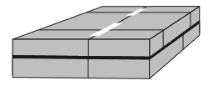
Unbonded Overlays
Concrete overlay
Interlayer
Existing concrete pavement

Slide 3
TPF-5(269) Development of an Improved Design Procedure for Unbonded Concrete Overlays
Original Project
University of Minnesota (PI: Lev Khazanovich)
University of Pittsburgh (co-PI: Julie Vandenbossche)
Dr. Mark Snyder (consultant)
Since November 2017
University of Pittsburgh (Lev Khazanovich and Julie Vandenbossche)
Dr. Mark Snyder (consultant)

Slide 4
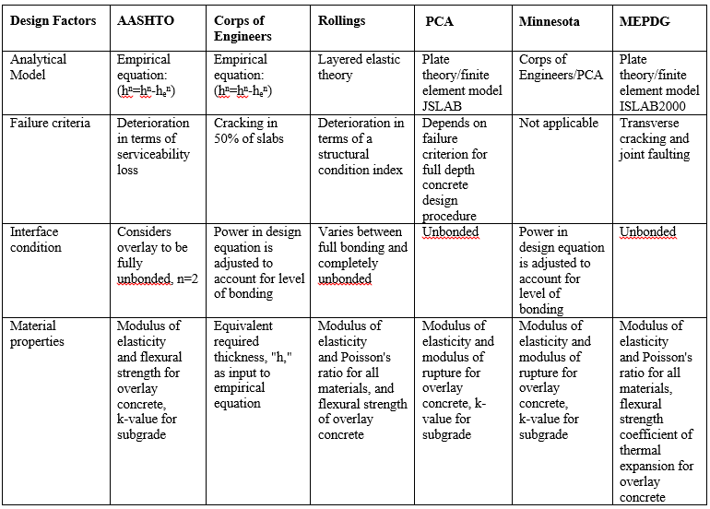
Design Procedures

Slide 5

MEPDG
Adopted MEPDG performance prediction models for new pavements
Empirical stiffness reduction factors for distresses in the existing pavement
  C_{BD}: Coefficient Reduction Factor for existing pavement
  0.42 to 0.75 for “Good” condition
  0.22 to 0.42 for “Moderate” condition
  0.042 to 0.22 for “Severe” condition
$E_{BASE/DESIGN}=C_{BD}×E_{TEST}$

Slide 6
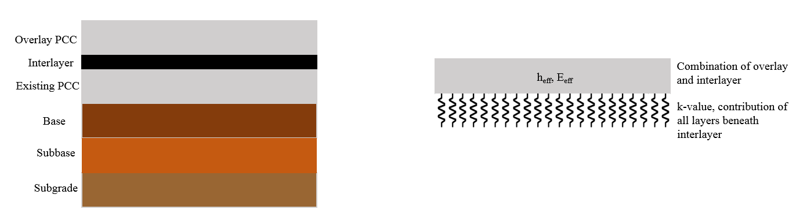
MEPDG Structural Model
Modeled as newly constructed JPCP
Joints in the overlay match joints in the existing slab
Deflection basins of the overlay and the existing pavements are the same
Interlayer deterioration is ignored

Slide 7
Pavement ME Example
Location: Rochester, MN
Design life: 20 years
Traffic:
  Two-way initial AADTT: 8,000
  Linear yearly increase: 3.0%
  Axle spectrum: Pavement ME default
Existing pavement:
  Thickness: 8 in
  Modulus of elasticity: 4,000,000 psi
Interlayer thickness: 1 in
Overlay joint spacing: 15 ft
Untied PCC shoulder
Unbonded overlay flexural strength: 650 psi.

Slide 8
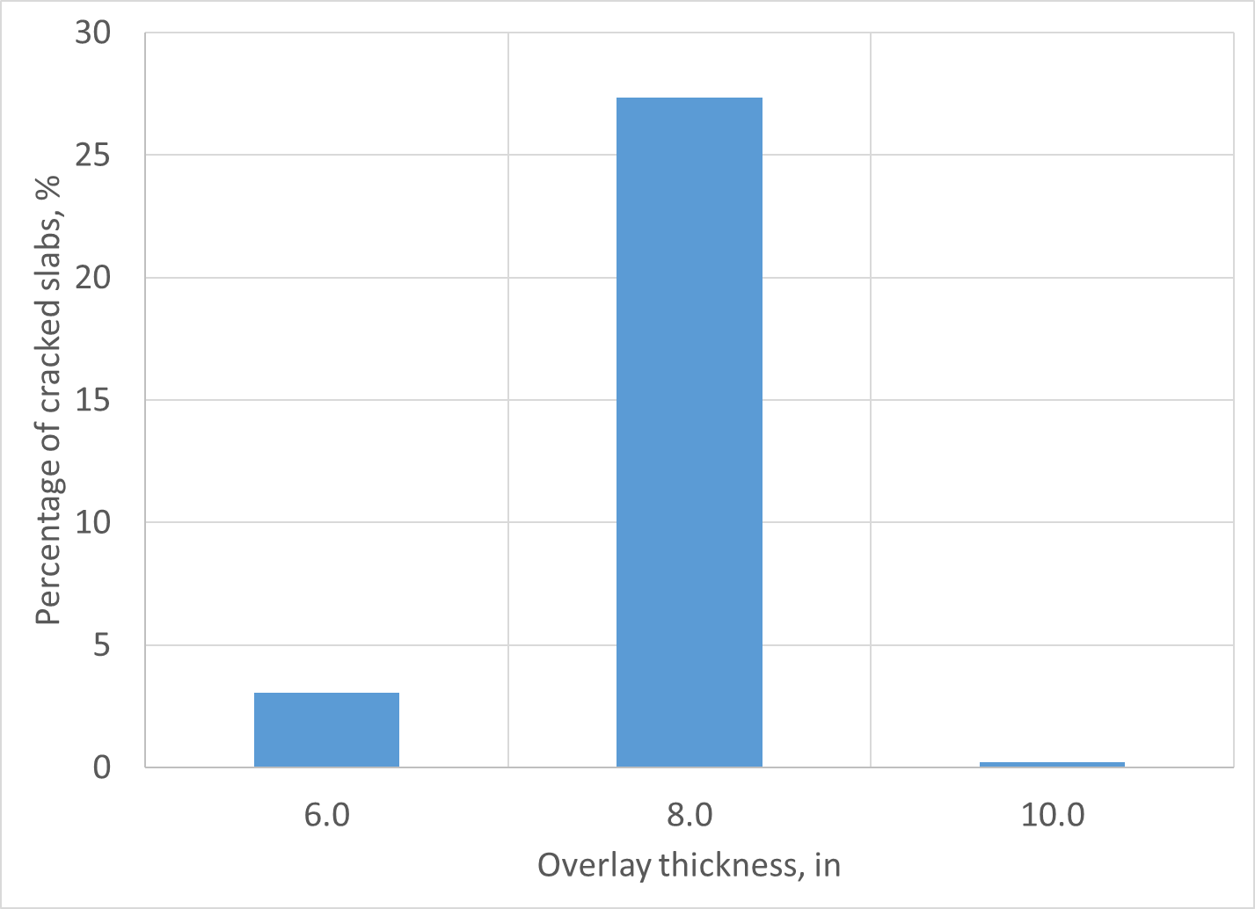
Pavement ME Example

Slide 9
Interlayer
Separates horizontal movements of the overlay and existing pavement
Provides uniform support to the overlay
May provide additional drainage
Many overlay failures are attributed to poor performance of the interlayer
Design recommendations (if any) are prescriptive
The use of non-woven fabric interlayers has been recently proposed
  C_{BD}: Coefficient Reduction Factor for existing pavement
  0.42 to 0.75 for “Good” condition
  0.22 to 0.42 for “Moderate” condition
  0.042 to 0.22 for “Severe” condition

Slide 10
TPF-5(269)
Field studies
Laboratory testing
Analytical modeling
Performance modeling

Slide 11
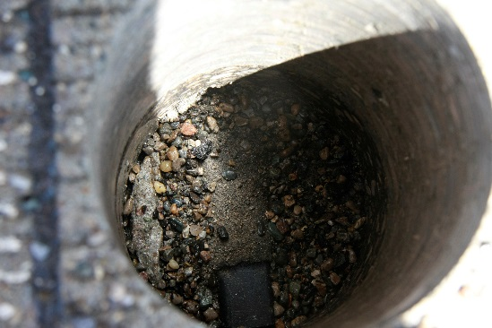
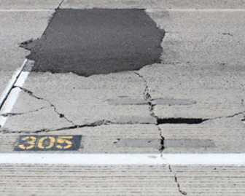
Factors affecting interlayer performance
Field studies: lessons learned
Erodibility – Stripping of interlayer adjacent to joints
Strength/stiffness – Potential for consolidation or crushing of interlayer adjacent to transverse joint
Permeability – Drainage within interlayer reduces pressure build-up
US 23 in MI (courtesy of Andy Bennett)
MnROAD Cell 305

Slide 12
Laboratory Study
Mechanisms Investigated:
  1. Ability to prevent reflective cracking
    Structural model inputs
    Interlayer performance
  2. Stiffness of interlayer – LTE & deflections
    Structural model inputs
    Min. strength or stiffness criteria
  3. Friction along interlayer system
    Structural model inputs
    Joint activation
  4. Vertical resistance to uplift – pull off
    Interlayer performance

Slide 13
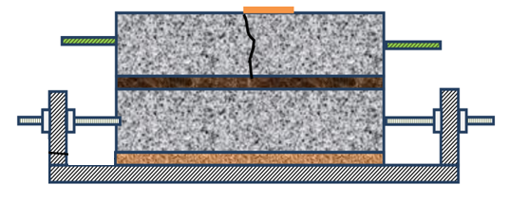
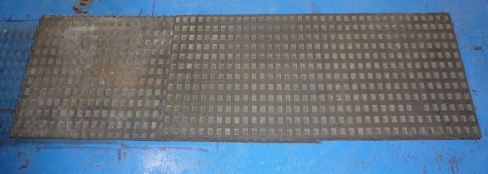
Specimen setup
Overlay Concrete
Conventional Paving Mix
Target flexural strength = 650 psi
Interlayer
Geotextile fabric
Open & Dense HMA
Threaded Steel Rods
Two layers of neoprene pad
Fabcell-25
k = 200 psi/in
Existing Concrete
HES Mix – simulate aged concrete
Target flexural strength = 850 psi
OR in-service PCC from composite pavement (asphalt IL)

Slide 14
Interlayers
Roadway | Asphalt Description | Ave. Asphalt Thickness | Specimen Designation
US-131, MI | Old, dense graded | 1 in | MIDAU
US-131, MI | Old, open-graded | 2 in | MIOAU
I-94, MnROAD | Old, dense graded, milled | 0.875 in | MNDAM
I-94, MnROAD | Old, dense graded, unmilled | 2.75 in | MNDAU
US-169, MN | New, open graded (PASRC) | 1.75 in | MNONU
SR-50, PA | New, dense graded | 1 in | PADNU
Propex Reflectex - 15 oz/yd² fabric = F15
Propex Geotex 1001N – 10 oz/yd² fabric = F10

Slide 15
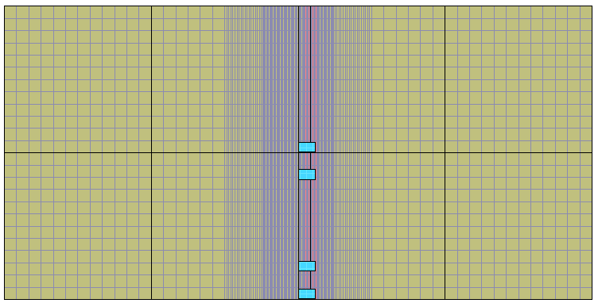
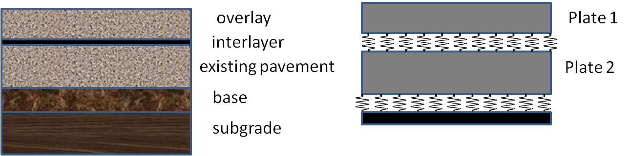
Totski Model
Model accounts for
  overlay
  existing slab
  subgrade support
  “cushioning” property of the interlayer using Totski springs layer
Joints in the overlay do not necessarily match joints in the existing pavements
Unlike AASHTO M-E, the structural model does not convert the existing pavement and overlay into a single-layer system

Slide 16
Totski Model
Advantages of Totski approach:
  Computationally efficient (big concern for finite element models)
  Already incorporated into ISLAB2005
  Can be adopted for more sophisticated models (e.g., 3D joint faulting)
  Modeling of gaps between the overlay and existing pavement
Requires estimate of interlayer spring coefficient

Slide 17
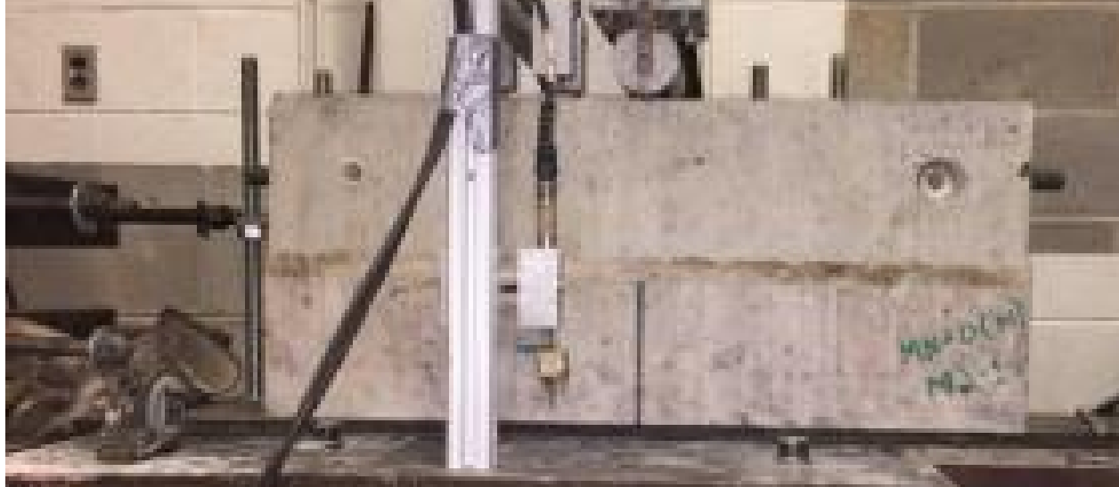

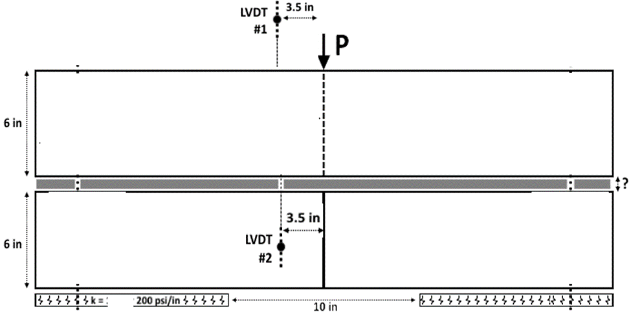
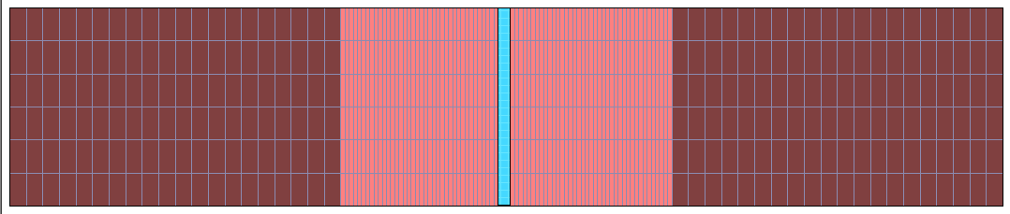
Modeling reflective cracking beam behavior and interlayer response
2D finite element simulation of reflective cracking beams using ISLAB2005
Factorial of simulations created for exact beam dimensions and support conditions
  Interlayer coefficient varied from 10 to 50,000

Slide 18
Totski Interlayer k-value
Deflection data from reflective cracking test
  Test setup modeled in ISLAB
  1 kip response for different k-values

Slide 19
Totski Interlayer k-value
Interlayer Type | Average Totski k-value (psi/in) | Standard Deviation (psi/in)
F15 | 337 | 63
F10 | 372 | 55
MNDAU | 3342 | 1262
MNDAM | 3613 | 1175
MNONU | 2555 | 901
MIDAU | 4046 | 966
MIOAU | 3566 | 1095
PADNU | 3391 | 1533
Average lab and FWD for asphalt yields Totski k-value of approximately 3500 psi/in
Average lab and FWD results is 425 psi/in for nonwoven geotextile fabric interlayer

Slide 20
Totski Interlayer k-value Backcalculation
FWD data from
MnROAD used to
establish k-values
for Cells 105 - 605
Comparison between means of established Totski k-values | P-value of t-test for difference in means
Fabric LAB vs. MnROAD Fabric FWD | 0.126
MNONU LAB vs. MnROAD Asphalt FWD | 0.137
MnROAD Fabric FWD vs. MnROAD Asphalt FWD | <0.001

Slide 21
Elastic Deflection and Permanent Deformation
Blue - Orange = permanent deformation
Fabric interlayers appear different from one another
Elastic responses of the fabric are different from all asphalt interlayers
MN open graded asphalt appears different from other asphalts

Slide 22
Cracking Model
PavementME (MEPDG) framework:
  Effect of PCC age on concrete strength and stiffness
  Axle load spectrum
  Curling analysis
  Effect of built-in curling
  Incremental damage analysis
Significant modifications
  Toski model for structural responses
  Interlayer deterioration
  Independent curling of the overlay and existing pavement
  Composite bending behavior
  Mismatched joints in the overlay and existing pavements
  Modified furling analysis

Slide 23
PCC Strength Gain
5.4
860
5.3
840
5.2
820
5.1
Modulus of Rupture, Mr
800
Modulus of Elasticity, E
Modulus of Rupture, Mr
Modulus of Elasticity, E
5
780
4.9
760
4.8
740
4.7
720
0
50
100
150
200
250
300
350
Time, months
Uses MEPDG Level 3 curves

Slide 24
Traffic Analysis
MEPDG default axle spectrum distribution
AADTT for the first year
Linear traffic volume growth model

Slide 25
Curling Analysis
EICM is used to predict hourly temperature profile through PCC based on historical hourly climatic data
Both daytime (positive) and nighttime (negative) thermal gradient probability distributions are obtained

Slide 26
TPF(5)-169 Cracking Model
Toski model for structural responses
  Independent curling of the overlay and existing pavement
  Composite bending behavior
  Mismatched joints in the overlay and existing pavements
Modified temperature frequency analysis
Interlayer deterioration

Slide 27
TPF(5)-169 Cracking Model
Modified built-in curling analysis (NCHRP 1-51 approach)
Longitudinal edge and transverse cracking analysis
Monte Carlo-based reliability analysis (MnPAVE Rigid-based approach)

Slide 28

Curling Analysis
EICM used to predict hourly temperature profile through PCC based on historical hourly climatic data
For each hour, the temperature distribution is approximated using quadratic distribution

Slide 29
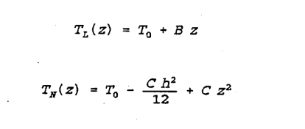


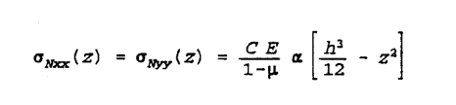
Curling Analysis
Linear gradient and non-linear stresses at the surfaces are determined (Choubane and Tia 1992, Khazanovich 1994)
Frequencies of combinations of B and C are determined (Hiller and Roesler 2010)
$$∆$$

Slide 30

Frequency Table
C
$$∆$$
*Adjusted for built-in curling

Slide 31
EICM Analysis
59 weather stations
Overlay thickness 4, 6, 8, and 10 in
Frequency tables generated for each case
Interpolation for other thicknesses

Slide 32
Stress Analysis
  Several factorials of ISLAB2000 Totski model runs (more than 100,000 cases)
  Several NNs for top-down cracking and joint damage analysis
    w/o voids in the interlayer
    with voids in the interlayer

Slide 33
Stress Analysis
Bottom-up transverse cracking

Slide 34
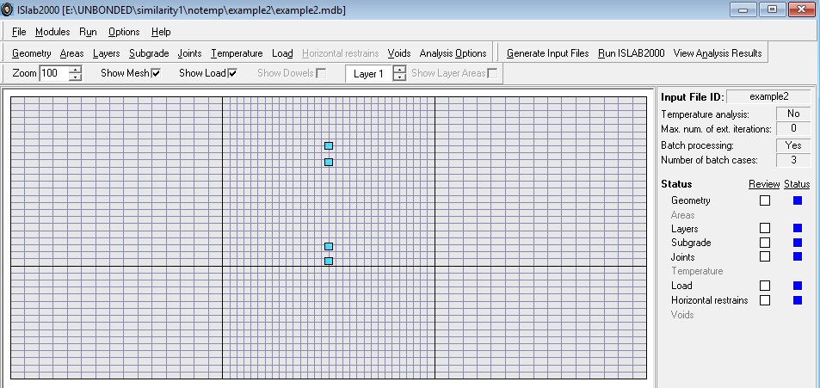
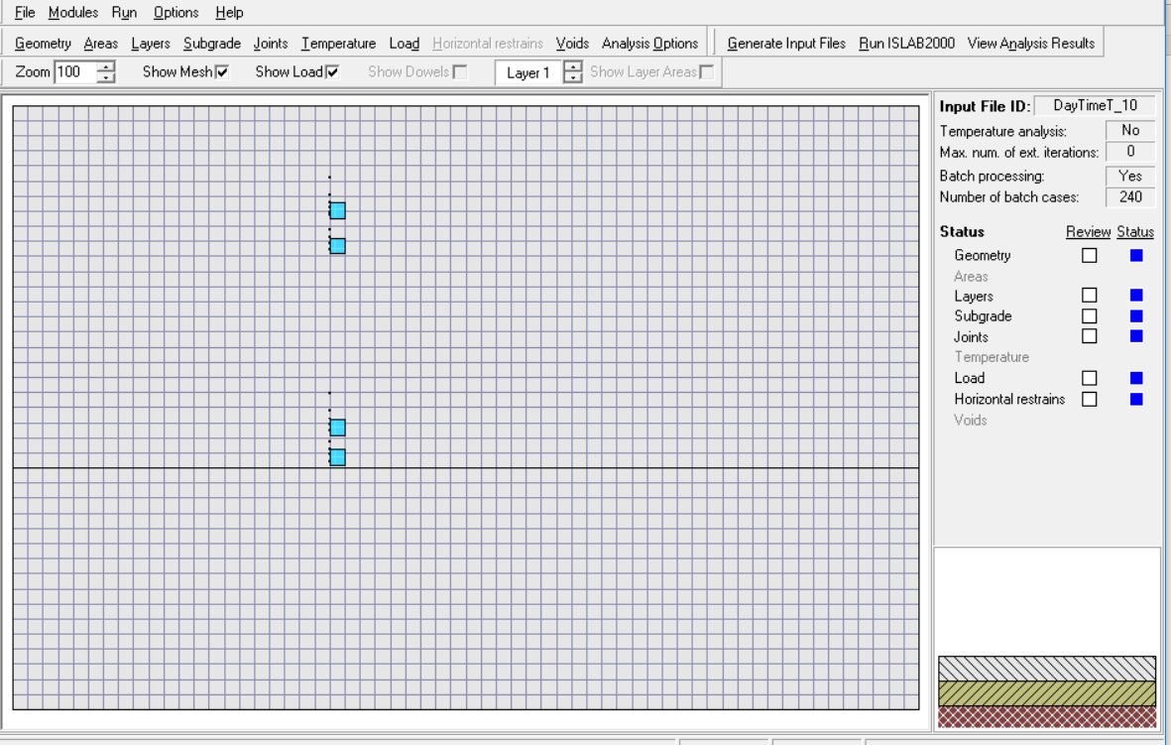
  ISLAB2000 Models for Conventional Overlays

Slide 35
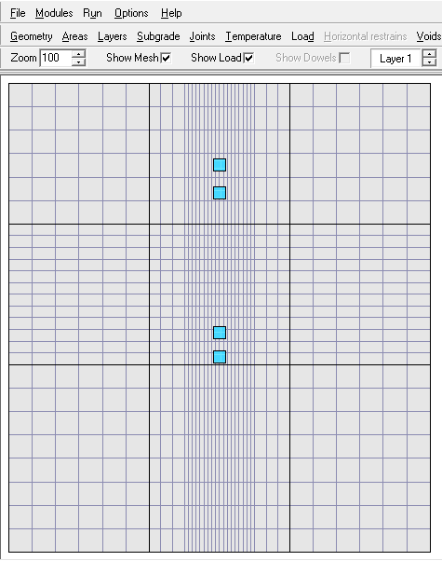
  ISLAB2000 Models for Short Slab Overlay

Slide 36
Stress Analysis
Top-down and joint damage

Slide 37
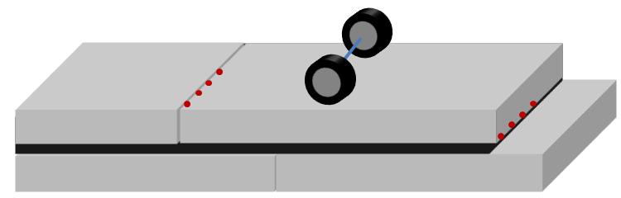
  Effect of Interlay Erosion
Erosion
2 cases
No void
24-in long, lane-wide void

Slide 38
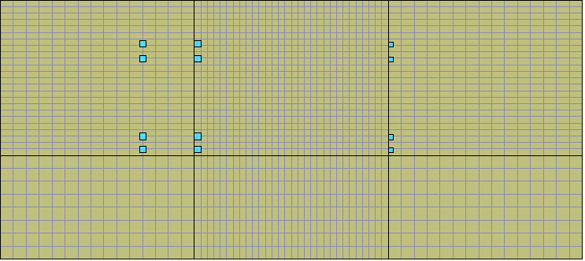
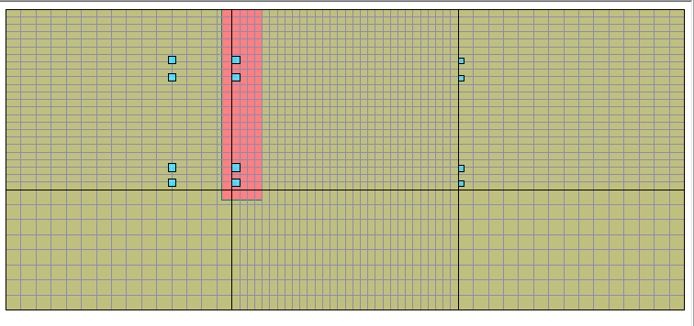
  ISLAB2000 Models for Conventional Overlays
No voids
Void in
the interlayer

Slide 39
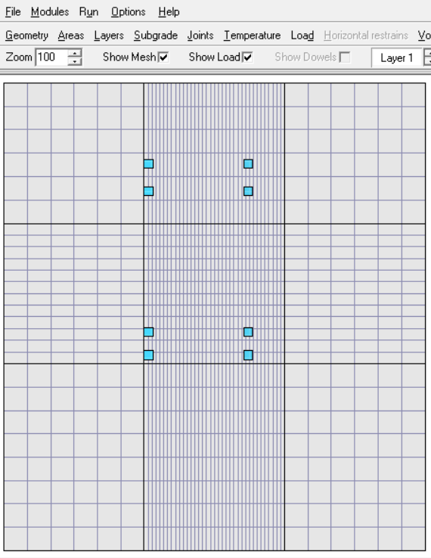
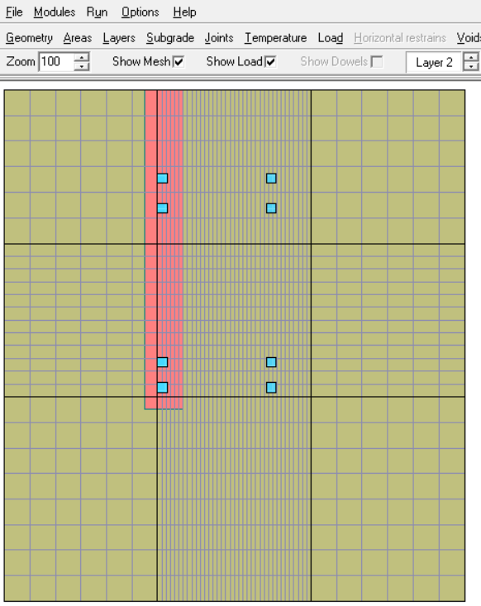
  ISLAB2000 Models for Short Slab Overlays
No voids
Void in the interlayer

Slide 40
  NNs for Top-down and Joint Damage Analysis
Overlay radius of relative stiffness
Axle weight/overlay weight ratio
Axle spacing
Transverse joint LTE
Korenev’s non-dimensional temperature gradient
Overlay/shoulder LTE
Void/no void

Slide 41

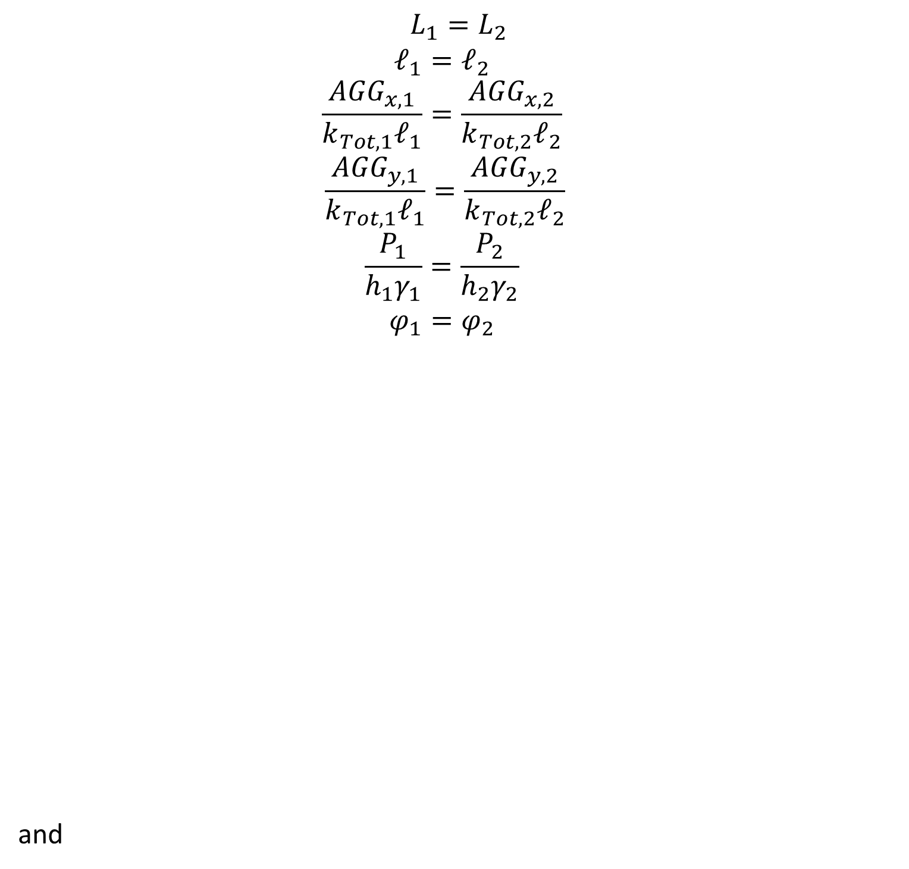
Similarity Concept
Two overlay structures are similar if
$$L_{1}=L_{2}$$
$$ℓ_{1}=ℓ_{2}$$
$$\frac{{AGG}_{x,1}}{k_{Tot,1}ℓ_{1}}=\frac{{AGG}_{x,2}}{k_{Tot,2}ℓ_{2}}$$
$$\frac{{AGG}_{y,1}}{k_{Tot,1}ℓ_{1}}=\frac{{AGG}_{y,2}}{k_{Tot,2}ℓ_{2}}$$
$$\frac{P_{1}}{h_{1}γ_{1}}=\frac{P_{2}}{h_{2}γ_{2}}$$
$$φ_{1}=φ_{2}$$
and
= unit weight
Korenev’s (1962) nondimensional
temperature gradient

Slide 42
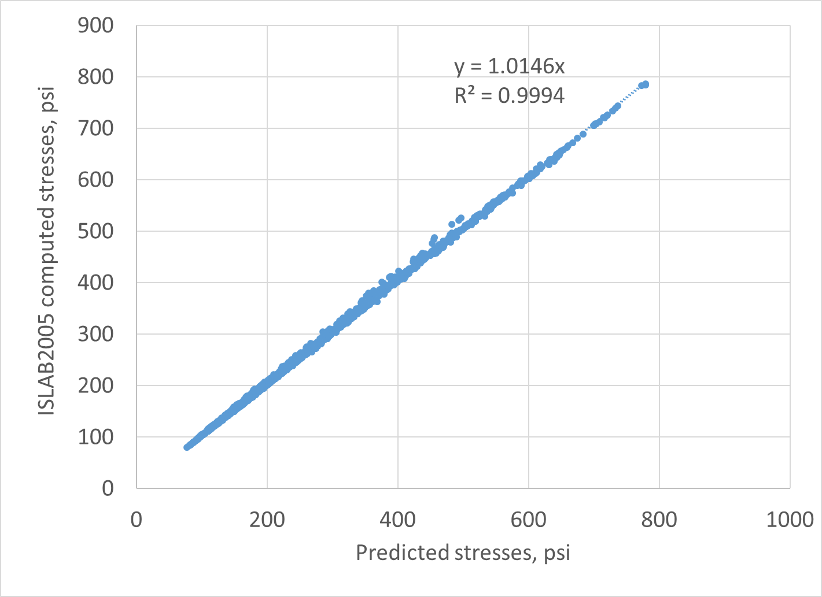
NNs verification

Slide 43
  Incremental Damage Calculation
Increment: 1 year
Frequencies for linear and non-linear temperature gradients
Stress and damage computations with and w/o void
Four types of fatigue damage
  Longitudinal edge, bottom overlay surface (transverse bottom-up cracking)
  Longitudinal edge, top overlay surface (transverse bottom-up cracking)
  Transverse joint, top overlay surface (longitudinal/corner cracking)
  Transvers joint, bottom overlay surface (longitudinal cracking)

Slide 44

  Incremental Damage Calculation
Damage computation for the increment
: interlayer deterioration index for the increment i.
Depends on the interlayer age and properties
$${DAM}_{i}={(1−Λ_{i}) DAM}_{i, w/o void} + {Λ_{i}DAM}_{i, w void}$$
$$Λ_{i}$$

Slide 45
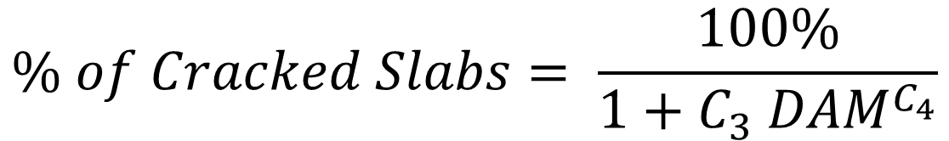
  Cracking Analysis
$$\% of Cracked Slabs= \frac{100\%}{1+C_{3} {DAM}^{C_{4}}}$$
Step 1
  Top-down transverse cracking
  Bottom-up transverse cracking
  Top-down longitudinal cracking
  Bottom-up longitudinal cracking

Slide 46
  Cracking Analysis
Step 2
  Transverse cracking
  Longitudinal cracking
Step 3: Total cracking
$TRCRACK=({TCRK}_{\text{Bottom}\text{_}\text{up}}$ + ${TCRK}_{\text{top}\text{−}\text{down}}−{TCRK}_{\text{Bottom}\text{_}\text{up}} \text{∗} {TCRK}_{\text{top}\text{−}\text{down}}$)100%
$LCRACK=({LCRK}_{\text{Bottom}\text{_}\text{up}}$ + ${LCRK}_{\text{top}\text{−}\text{down}}−{LCRK}_{\text{Bottom}\text{_}\text{up}} \text{∗} {LCRK}_{\text{top}\text{−}\text{down}}$)100%
$CRACK=(TRCRACK$ + $LCRACK−TRCRACK\text{∗}LCRACK$) * 100%

Slide 47
  Reliability Analysis
Inputs:
  Reliability Level
  Coefficient of variation of overlay thickness
  Coefficient of variation PCC strength
  Allowable cracking level at the end of the design life
Procedure
  Perform simulation for a factorial of PCC overlay thicknesses and strengths
  Determine the overlay thickness resulting in the percentage of
  thickness/strength combinations with cracking less than the specified allowable level

Slide 48
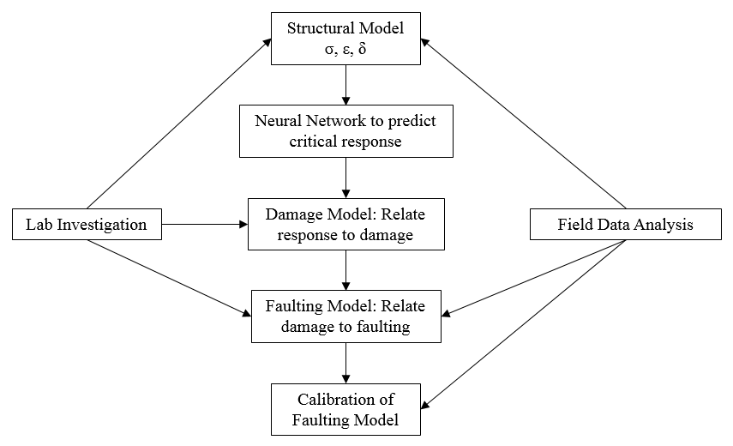
Faulting Model Framework

Slide 49
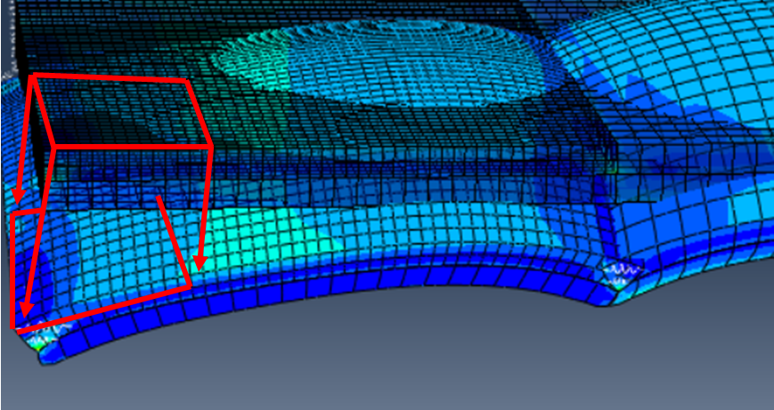
Predictive Model Response

Slide 50
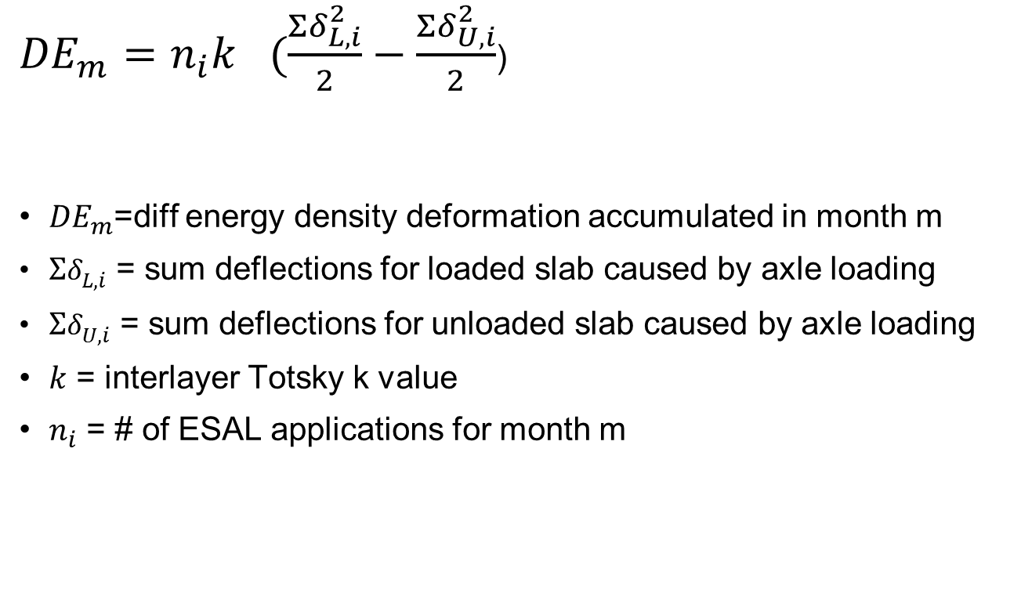
Differential Energy
${DE}_{m}=n_{i}k_{}(\frac{{Σδ}_{L,i}^{2}}{2}−\frac{{Σδ}_{U,i}^{2}}{2}$)
${DE}_{m}$=diff energy density deformation accumulated in month m
${Σδ}_{L,i}^{}$ = sum deflections for loaded slab caused by axle loading
${Σδ}_{U,i}^{}$ = sum deflections for unloaded slab caused by axle loading
$k$ = interlayer Totsky k value
$n_{i}$ = # of ESAL applications for month m

Slide 51










Faulting Model
$$F_{0}=\left(C_{1}+C_{2}∗{FR}^{0.25}\right)∗δ_{curl}∗{\left[C_{5}∗E\right]}^{C_{6}}∗log(WETDAYS∗P_{200})$$
$$F_{i}=F_{i−1}+C_{7}∗{C_{8}∗DE}_{i}∗{\left[C_{5}∗E\right]}^{C_{6}}$$
$$∆{Fault}_{i}=\left(C_{3}+C_{4}∗{FR}^{0.25}\right)∗{\left(F_{i−1}−{Fault}_{i−1}\right)}^{}∗{C_{8}∗DE}_{i}$$
$${Fault}_{i}={Fault}_{i−1}+∆{Fault}_{i}$$
$$C_{1}=8.3$$
$$C_{5}=0.17$$
$$C_{2}=0.9$$
$$C_{6}=4$$
$$C_{3}=2.3$$
$$C_{7}=4.4$$
$$C_{4}=0.001$$
$$C_{8}=0.0000036$$

Slide 52

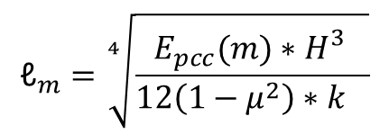



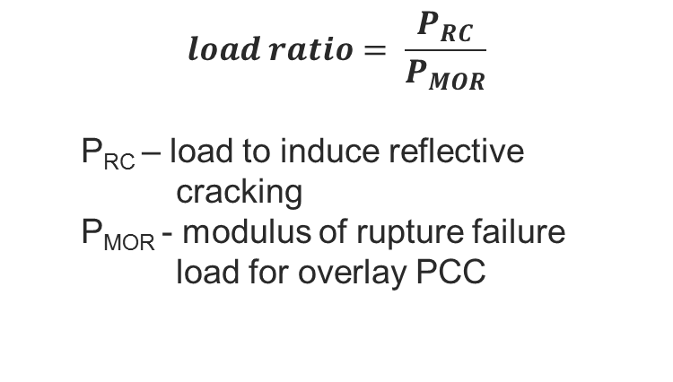




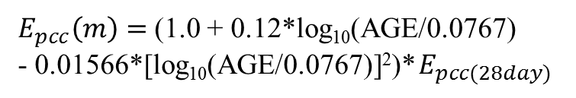
Erosion
$$α=log⁡(1+a∗\%Binder+b∗\%AV+c∗P_{200})$$
$$α=Erodibility index$$
$$\%Binder=Percent binder in asphalt interlayer$$
$$\%AV=Percent air voids in asphalt interlayer$$
$$P_{200}=Percent passing No. 200 sieve in interlayer$$
$$a, b, c=Calibration coefficients (0.196, 0.202, 0.00368)$$
$$(1.1974∗α^{2}−0.9933∗α+0.306)$$
$$Undoweled pavements$$
$$E=$$
$$(1.0178∗α^{2}−0.8443∗α+0.26)$$
$$Doweled pavements$$
$$(1.0178∗α^{2}−0.8443∗α+0.1)$$
$$NWGF sections$$

Slide 53








Faulting Model
$$F_{0}=\left(C_{1}+C_{2}∗{FR}^{0.25}\right)∗δ_{curl}∗{\left[C_{5}∗E\right]}^{C_{6}}∗log(WETDAYS∗P_{200})$$
$$F_{i}=F_{i−1}+C_{7}∗{C_{8}∗DE}_{i}∗{\left[C_{5}∗E\right]}^{C_{6}}$$
$$∆{Fault}_{i}=\left(C_{3}+C_{4}∗{FR}^{0.25}\right)∗{\left(F_{i−1}−{Fault}_{i−1}\right)}^{}∗{C_{8}∗DE}_{i}$$
$${Fault}_{i}={Fault}_{i−1}+∆{Fault}_{i}$$
$$C_{1}=1.29$$
$$C_{5}=0.011$$
$$C_{2}=1.1$$
$$C_{6}=1.39$$
$$C_{3}=0.0175$$
$$C_{7}=0.307$$
$$C_{4}=0.0008$$
$$C_{8}=0.000002$$

Slide 54



Erosion
$$α=log⁡(1+a∗\%Binder+b∗\%AV+c∗P_{200})$$
$$α=Erodibility index$$
$$\%Binder=Percent binder in asphalt interlayer$$
$$\%AV=Percent air voids in asphalt interlayer$$
$$P_{200}=Percent passing No. 200 sieve in interlayer$$
$$a, b, c=Calibration coefficients (0.196, 0.202, 0.00368)$$
$$(0.4993∗α^{2}−0.4327∗α+0.1228)$$
$$Undoweled pavements$$
$$E=$$
$$(0.4224∗α^{2}−0.3678∗α+0.1044)$$
$$Doweled pavements$$
$$(0.4993∗α^{2}−0.4327∗α+0.1)$$
$$NWGF sections$$

Slide 55
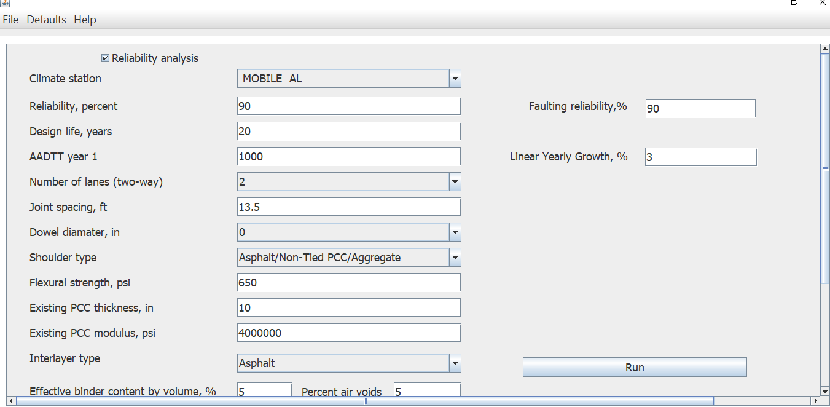
  Rudimentary Software

Slide 56
  Rudimentary Software
Software demonstration

Slide 57
Conclusions
Design of unbonded PCC overlays is a challenging problem
Proper accounting for structural contribution of the interlayer is an important step toward improvement of ME procedure for this type of overlays
Totski model provides a simple yet robust approach for modeling of interlayer
Significant progress have been made toward development of improved faulting and cracking models

Slide 58
Acknowledgements
Dr. Derek Tompkins, former UMn
U of Pittsburgh students
U of Minnesota students
Tom Burnham, MnDOT – project Technical Liaison
TPF-5(269)-participating state DOTs

Slide 59
Thank You
Any Questions?

