Slide 1
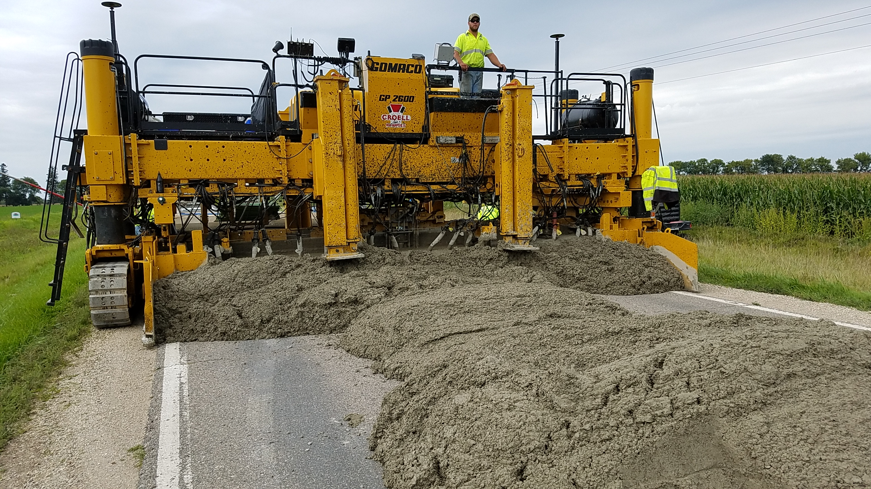


Industry’s Perspective on Stringless Paving in Iowa:
Research, Trials & Implementation
Dan King, E.I.T.
Iowa Concrete Paving Association

Slide 2
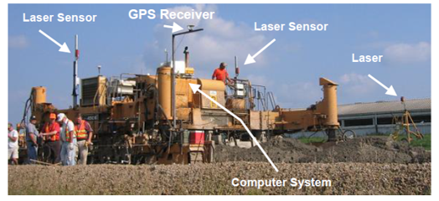

Getting Started
2003: Iowa’s first research project investigating stringless paving
  Test areas on two pavements built in Washington County
  Paver controlled using a GPS-based system
Images: Cable et al. 2004
Notes:
GeoLogic Computer Systems + CMI paver

Slide 3
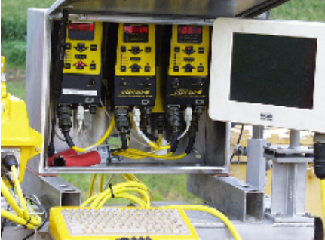
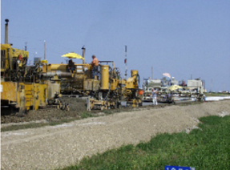
Getting Started
Outcomes:
  Successful demonstration of stringless paving
  Effective guiding the paver (x-y)
  Vertical control was sufficient for yield, depth and elevation…
Images: Cable et al. 2004

Slide 4
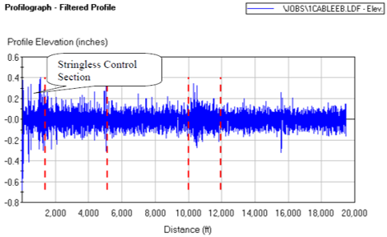
Getting Started
Outcomes:
  …but not sufficient for achieving smoothness incentive
  No further development/implementation of machine control for paving in Iowa at that time
Images: Cable et al. 2004

Slide 5
Next Steps
2009: Large research project, “Improving Concrete Overlay Construction”
  Variety of new construction methods/technologies for concrete overlays were tested across five projects
    Geotextile interlayer
  Two projects were to be completed using stringless paving systems
    US 65 in Worth County
    County Highway V18 in Poweshiek County

Slide 6
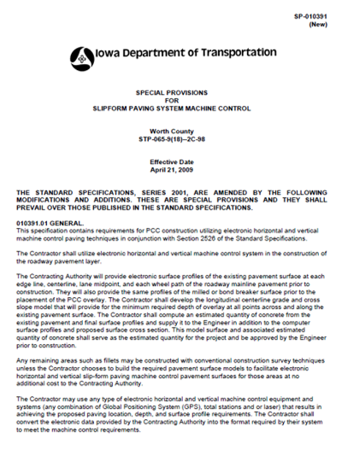
2009 Projects
Iowa DOT included a special provision & bid item on these two projects
  “Contractor may use any type of electronic horizontal and vertical machine control equipment and systems”
  Contractor responsible for selecting equipment and developing model

Slide 7
2009 Projects
Two different contractors won the projects
  Bid item lump sum costs: $32,000 and $158,000
  Two different paving machines
  Both contractors opted to use Leica total station system

Slide 8
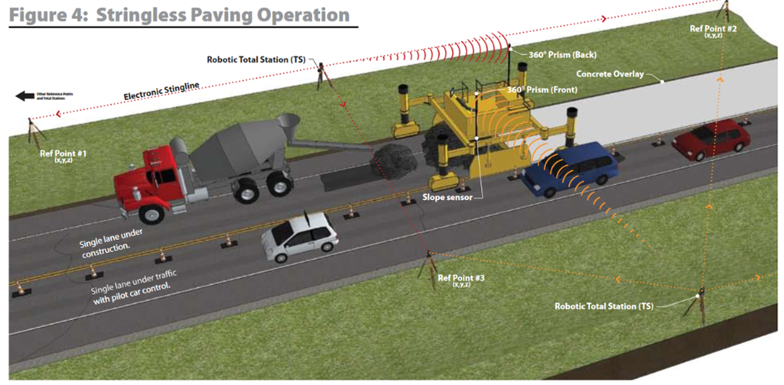

2009 Projects

Slide 9
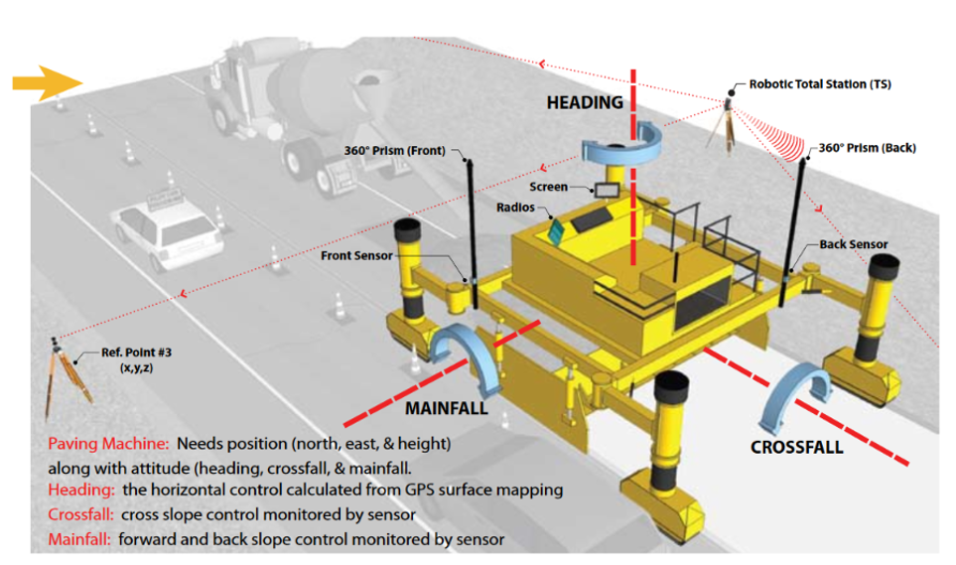
2009 Projects

Slide 10
2009 Projects
Leica worked extensively with contractors and paving equipment manufacturers to ensure successful implementation
Strong collaboration between above partners and DOT, county, and research team

Slide 11
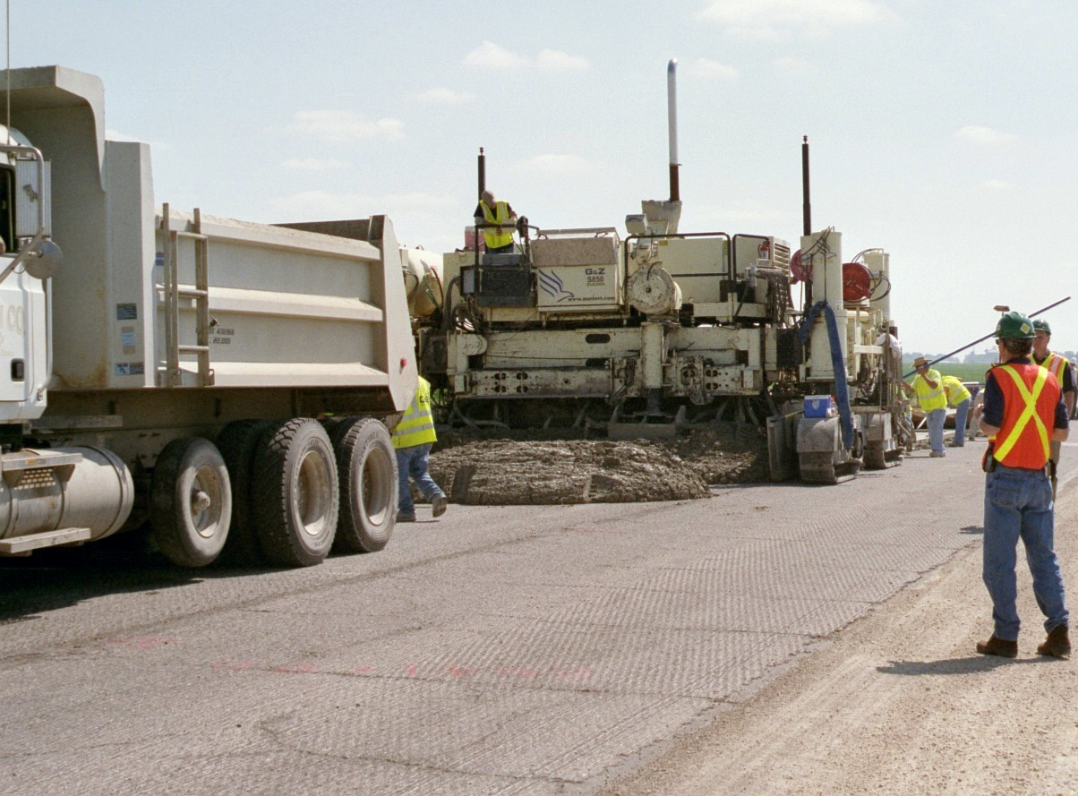
2009 Projects
US 65, Worth County:

Slide 12
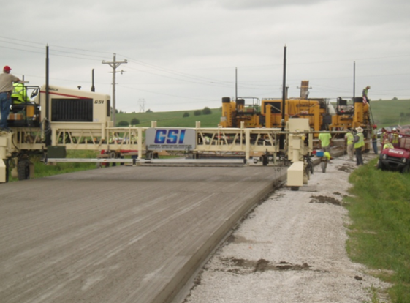
2009 Projects
Poweshiek County: real-time smoothness
Image: Wiegand et al. 2010

Slide 13
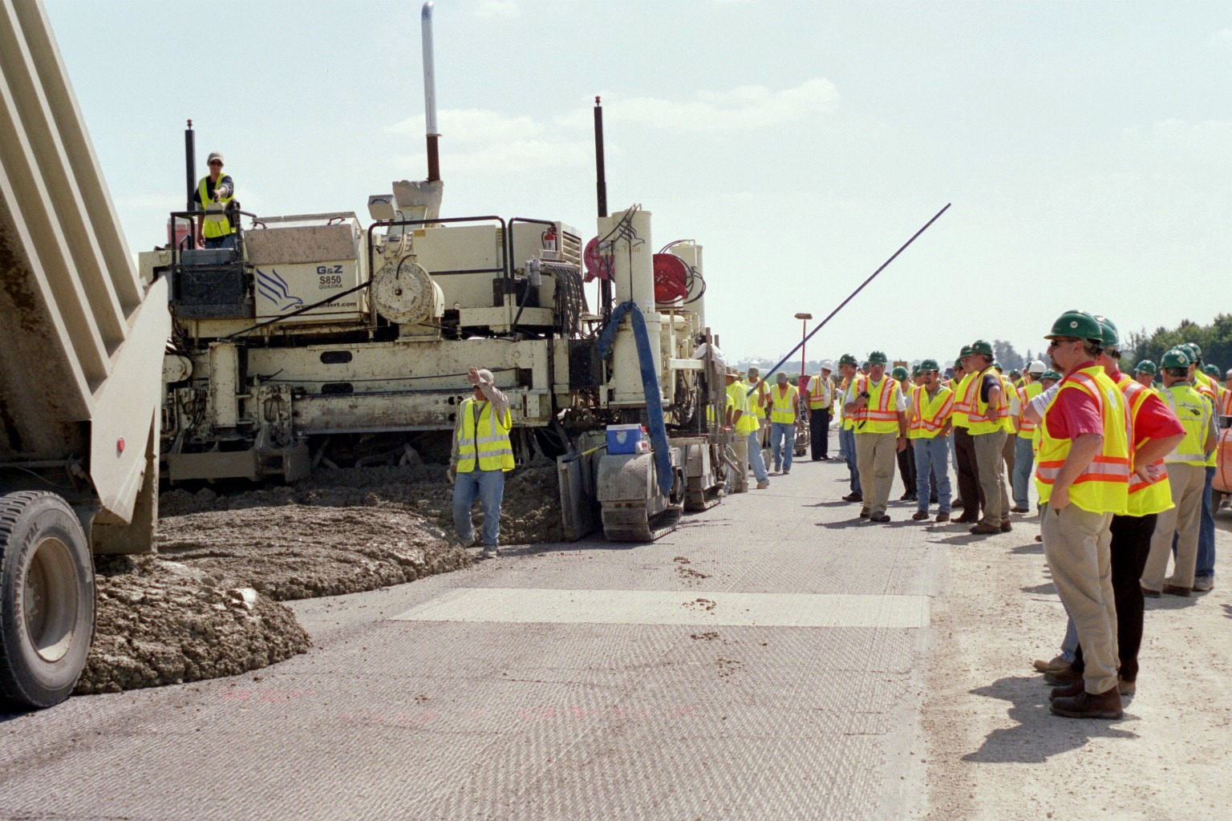
Aftermath of 2009 Projects
Both 2009 research projects were successful
  Demonstrated ability of total station-based machine control system
  Contractors satisfied with ability to achieve smoothness
  Open house was held to introduce technology to wider audience

Slide 14
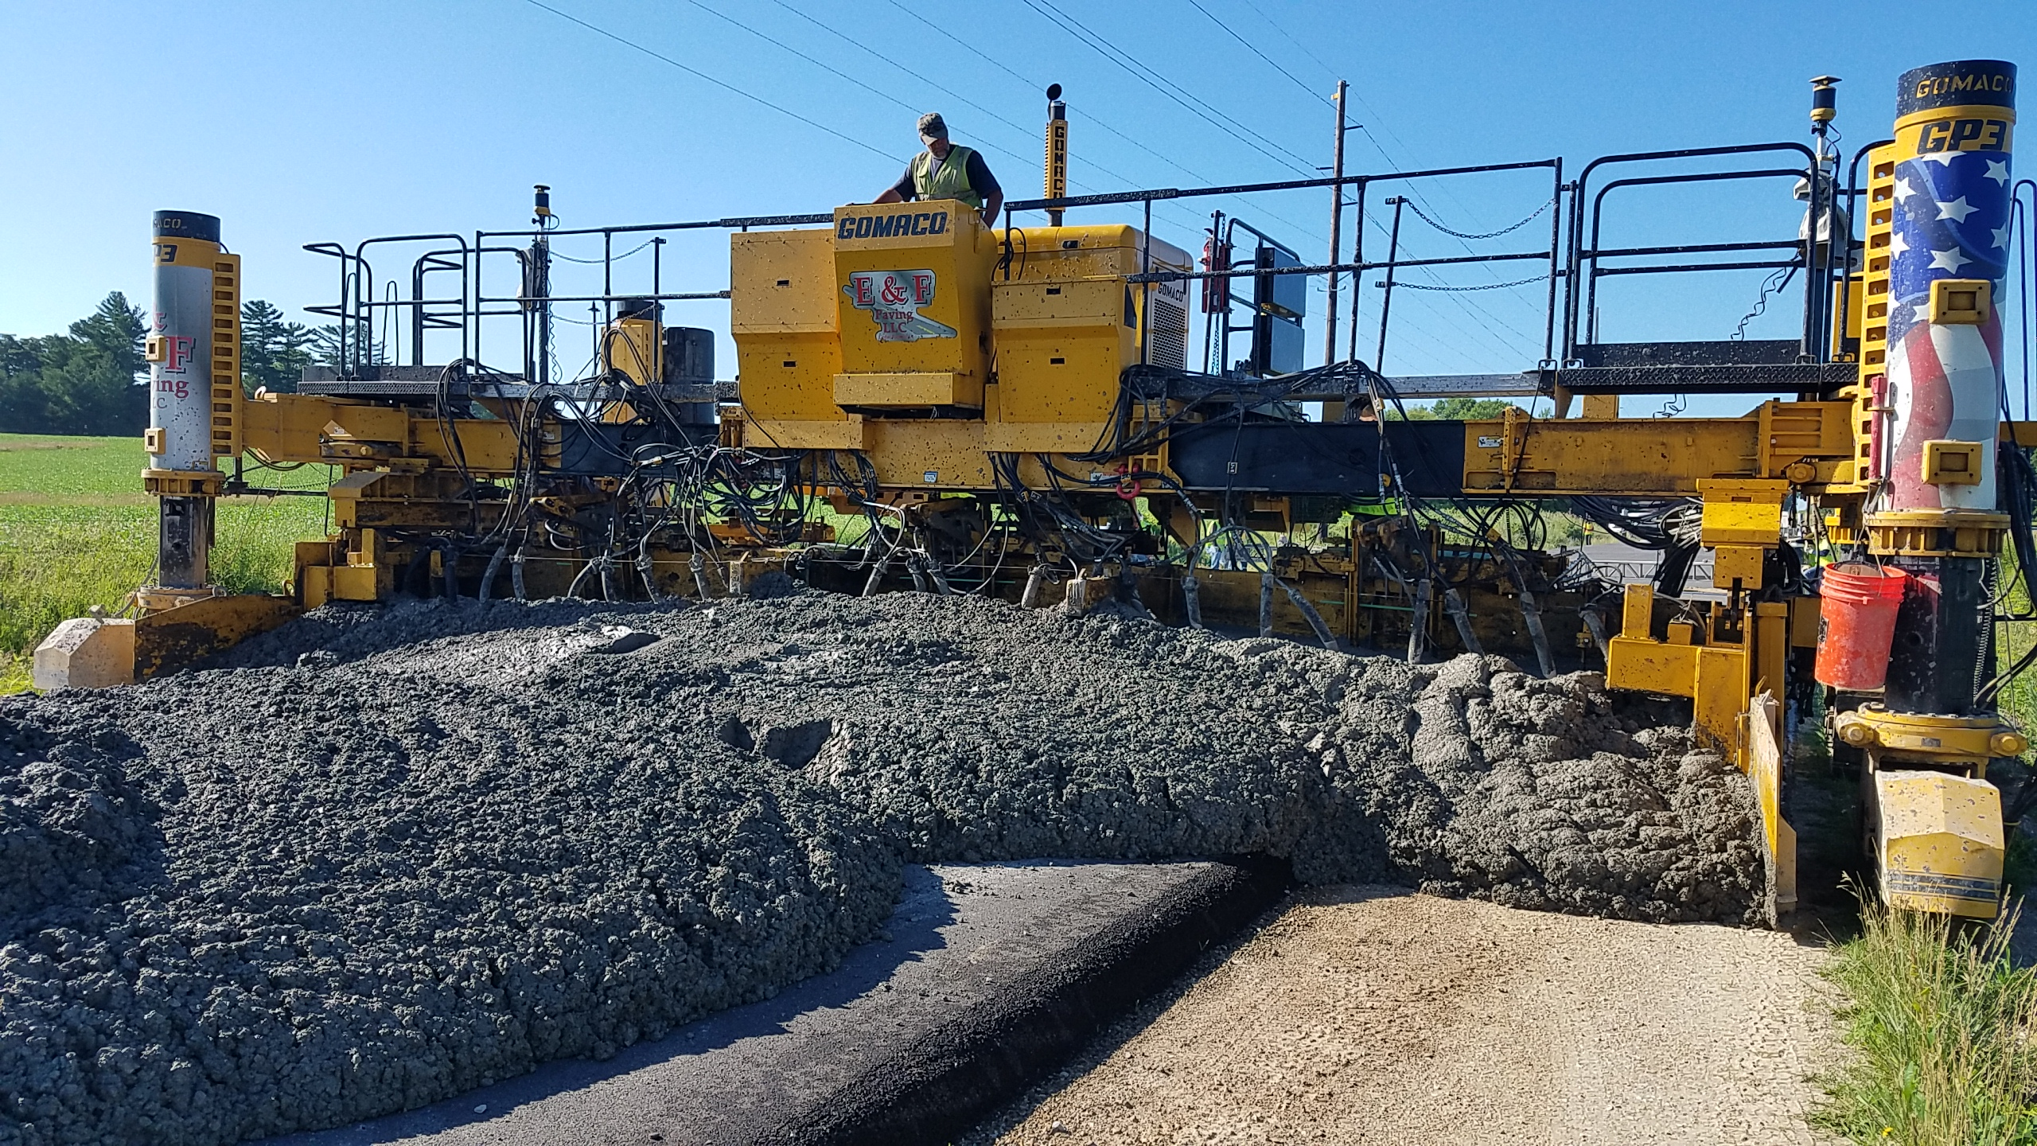
Aftermath of 2009 Projects
Next construction season: both contractors began requesting to use machine control on all projects
  DOT had not planned any immediate follow-up projects, nor did they provide any further incentives

Slide 15
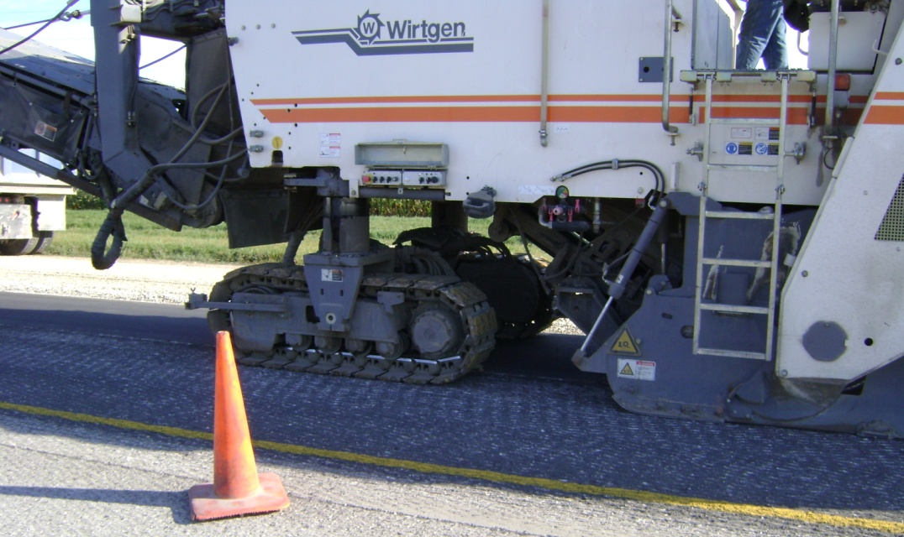
Wide-scale Implementation
Other contractors in the state quickly followed implementing stringless paving systems
  Continued building their own model from profile grade
Within a few years, extended to nearly all DOT and county concrete paving projects in Iowa
  Also milling operations
Image: Tim Tometich, Manatts

Slide 16
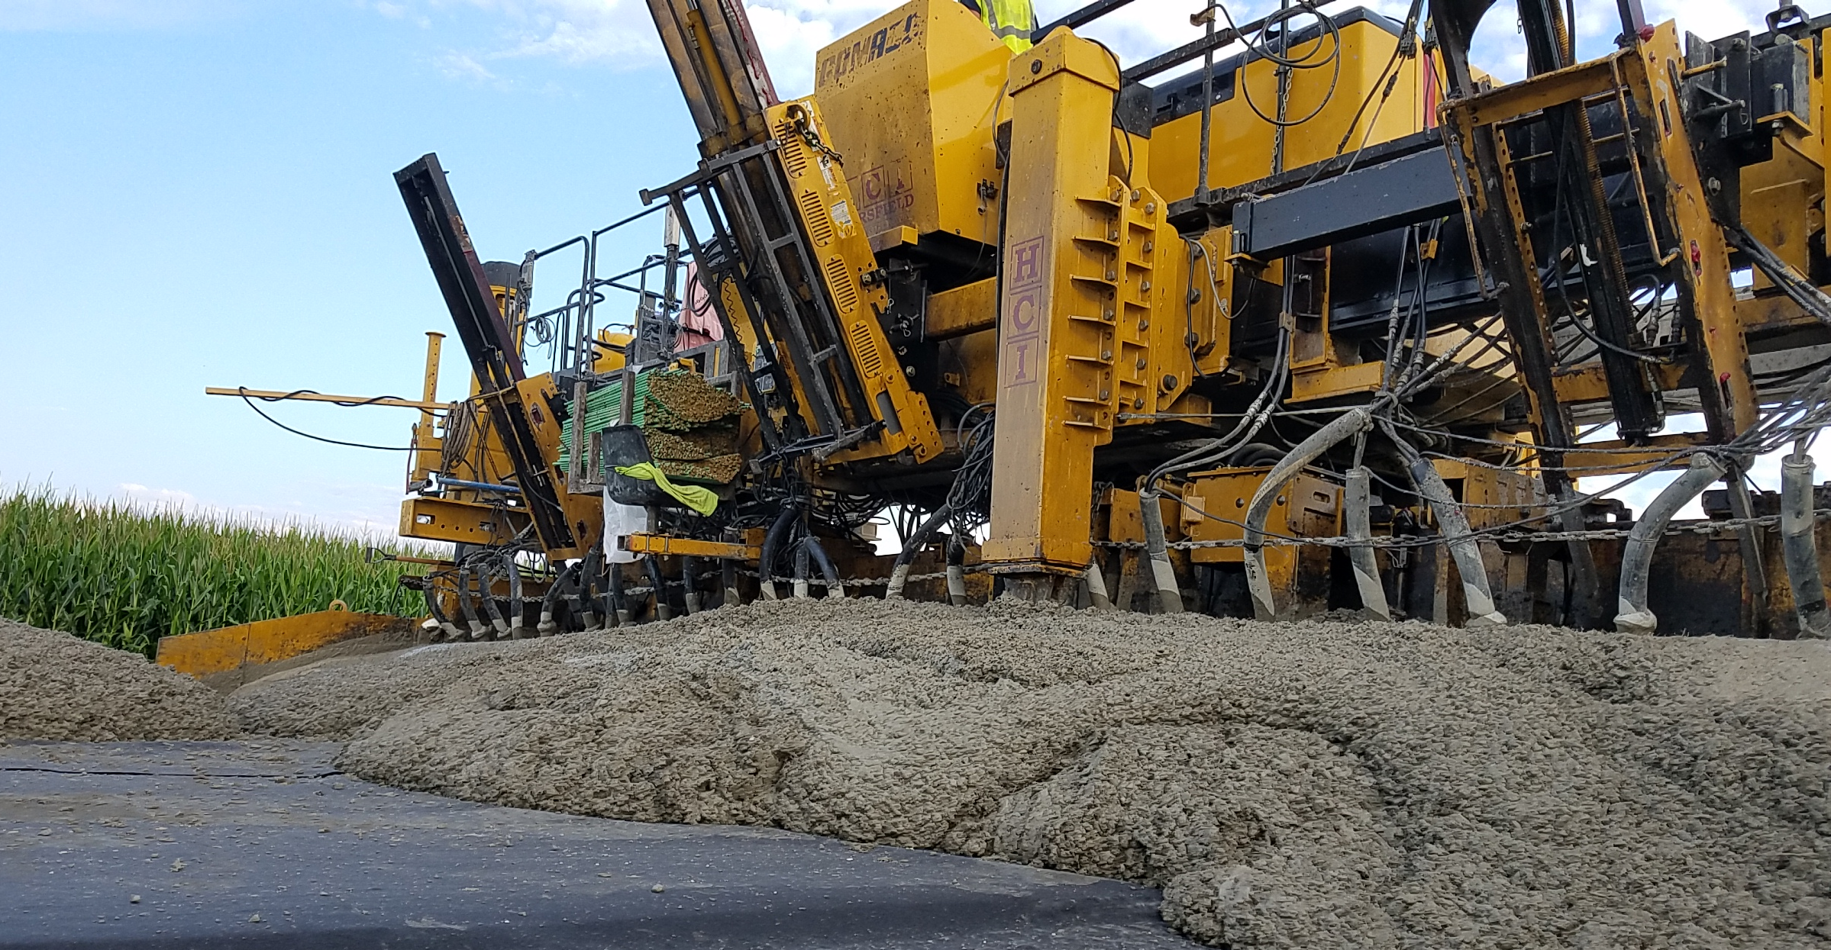
Wide-scale Implementation
With wide-scale adoption, Iowa DOT began building models in-house and including with design files
Contractor usually still develops their own model for county and city projects
Not currently required (or disallowed) by any Iowa agencies

Slide 17
Wide-scale Implementation
As of 2019:
  Most statewide and regional mainline concrete paving contractors exclusively use stringless paving
  Some contractors still pave using stringline, while some use stringless situationally
    Less common for city street projects
  Overall adoption trend seems to be similar in many other states (different timelines)

Slide 18
Industry’s perspective
What are the benefits of stringless paving?
  Safety!
  Reduces time and cost of surveying, staking
    Less labor and equipment
    Shifts some survey work from field to office
  Eliminates stringline errors and need to monitor, adjust
  Can achieve accuracy within 0.01-0.02 ft
  Easier paths for haul roads, can back-in ready mix trucks
  Eases width constraints
  Smoothness?

Slide 19
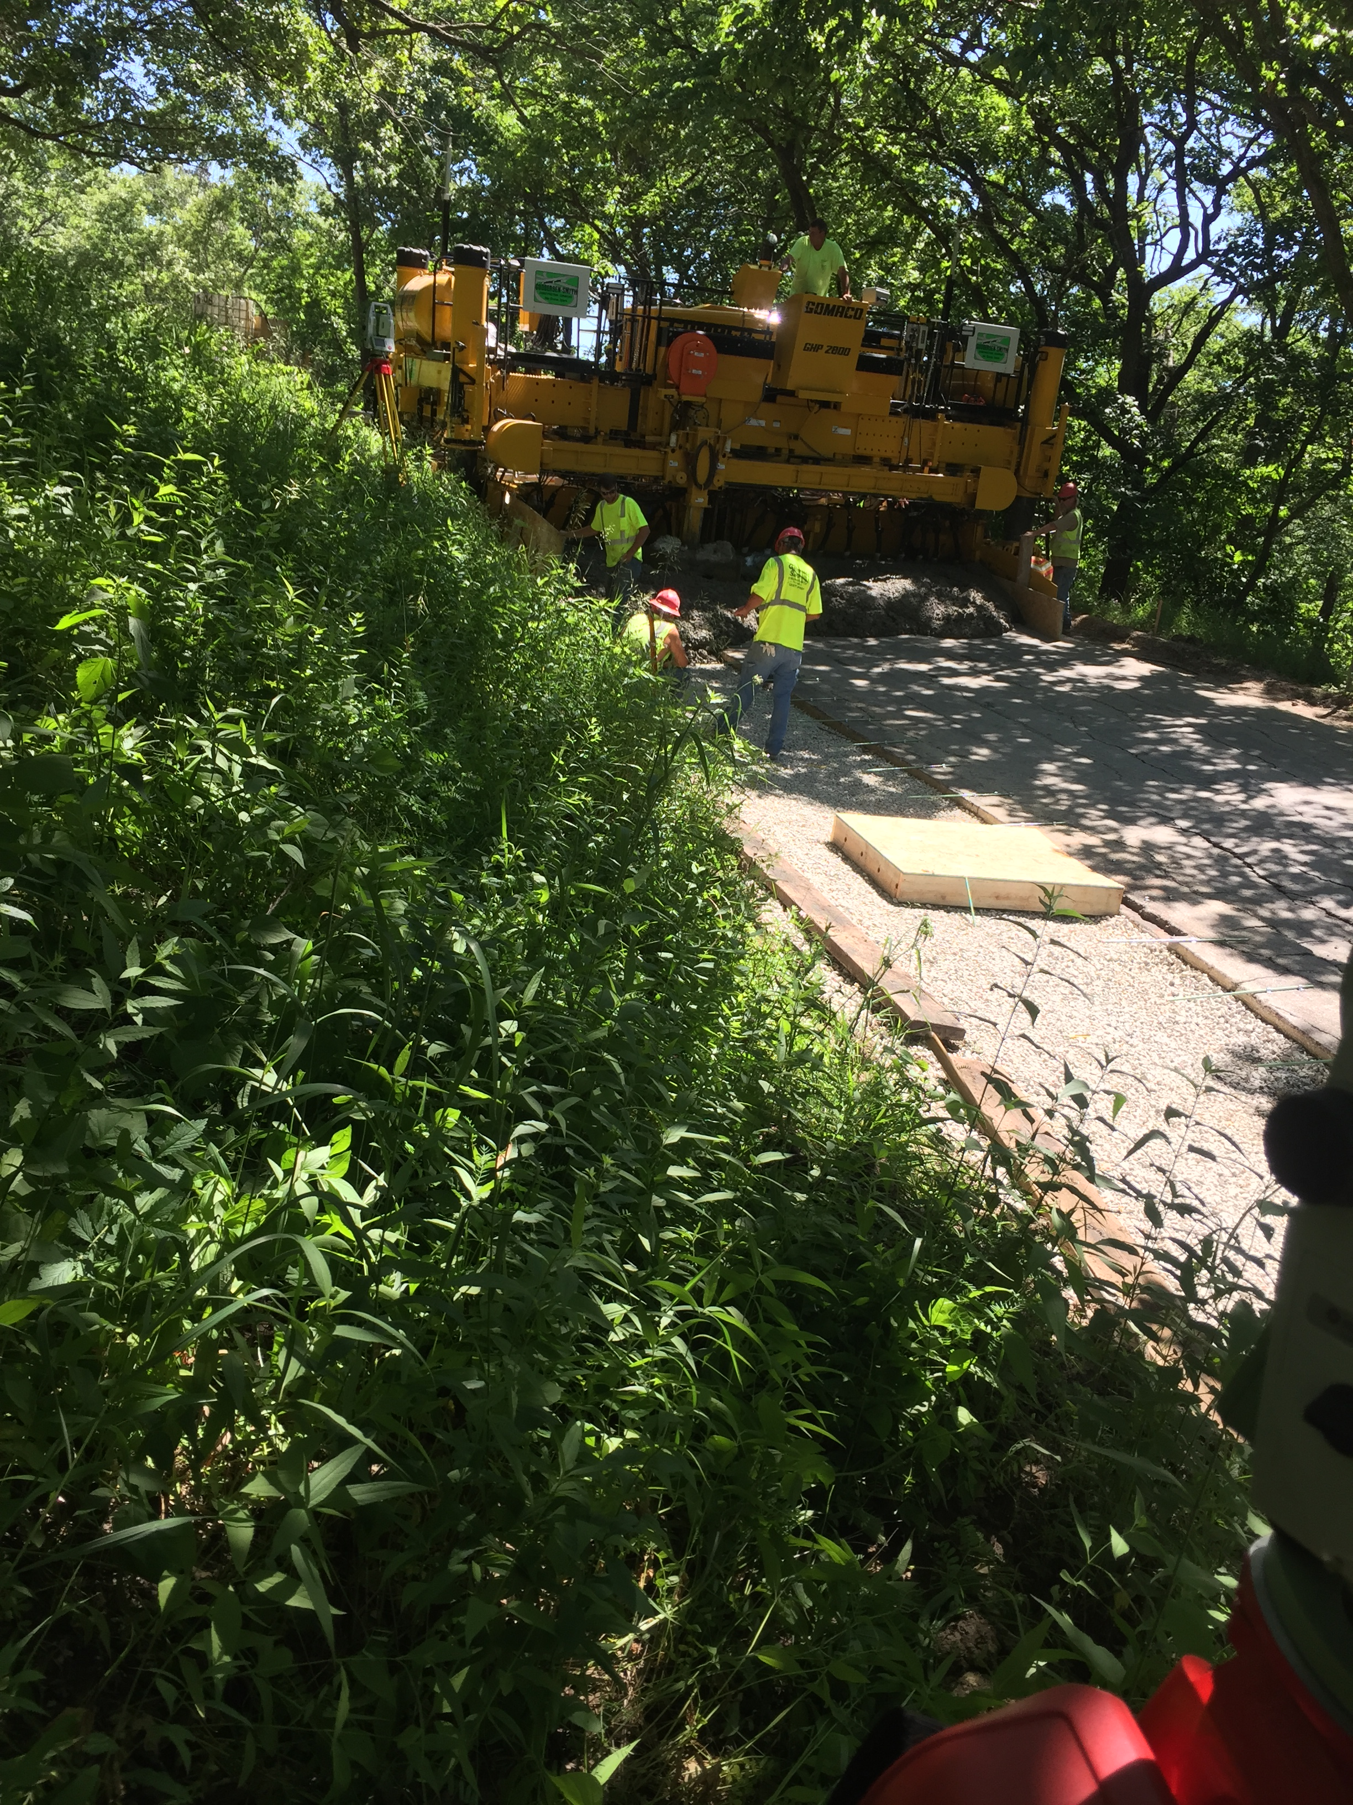
Industry’s Perspective
Challenges
  Electronic files
    Survey/design accuracy
    Attention to detail
    Special areas
  City streets: plan for tight, congested working areas and overhead obstructions
Images: Brett Potthoff, Godbersen-Smith

Slide 20
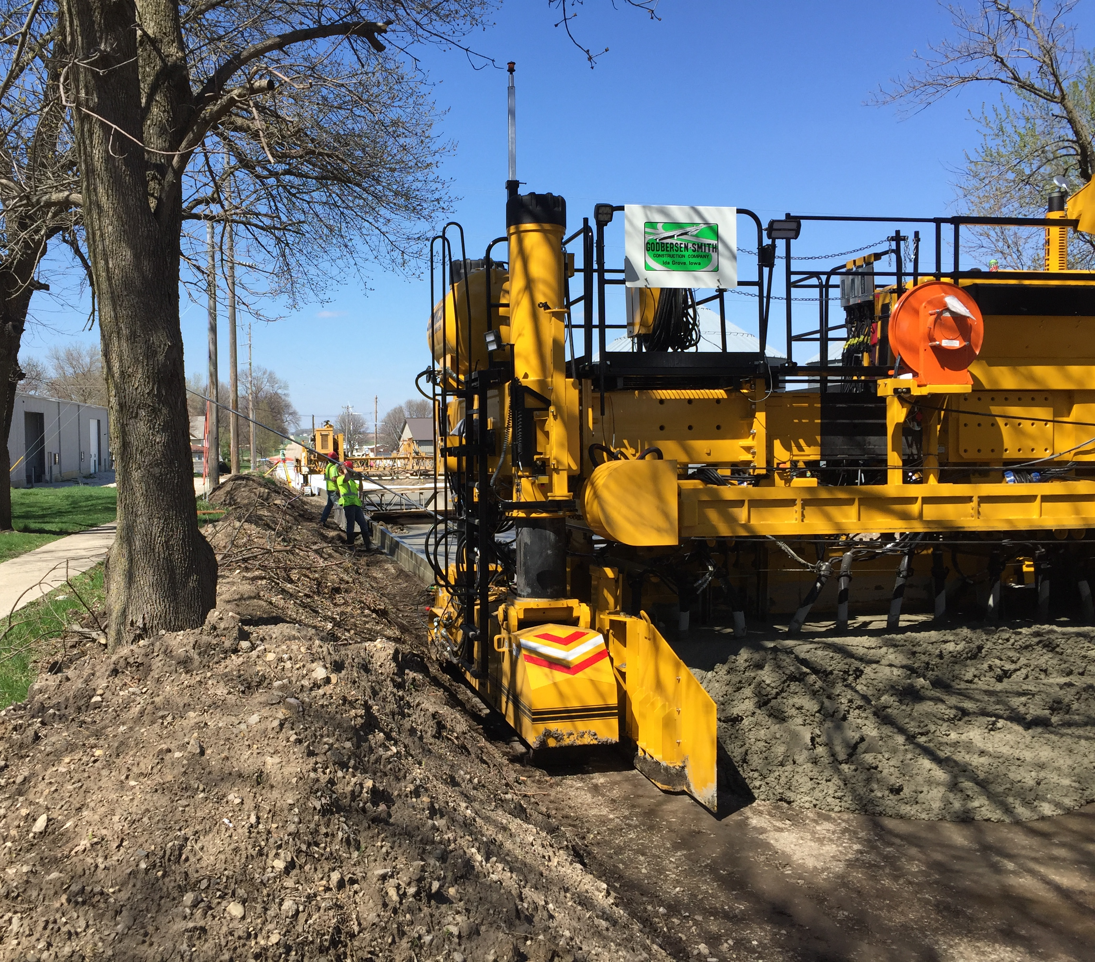
Industry’s Perspective
Challenges
  Electronic files
    Survey/design accuracy
    Attention to detail
    Special areas
  City streets: plan for tight, congested working areas and overhead obstructions
  Still useful for width constraints!
Images: Brett Potthoff, Godbersen-Smith

Slide 21
Conclusions
After initial research and trial projects, stringless paving was widely and quickly adopted in Iowa
Major benefits include improvements to safety, productivity and cost-effectiveness
Close collaboration between research and project partners can lead to positive results and help speed adoption of new practices and technologies

Slide 22
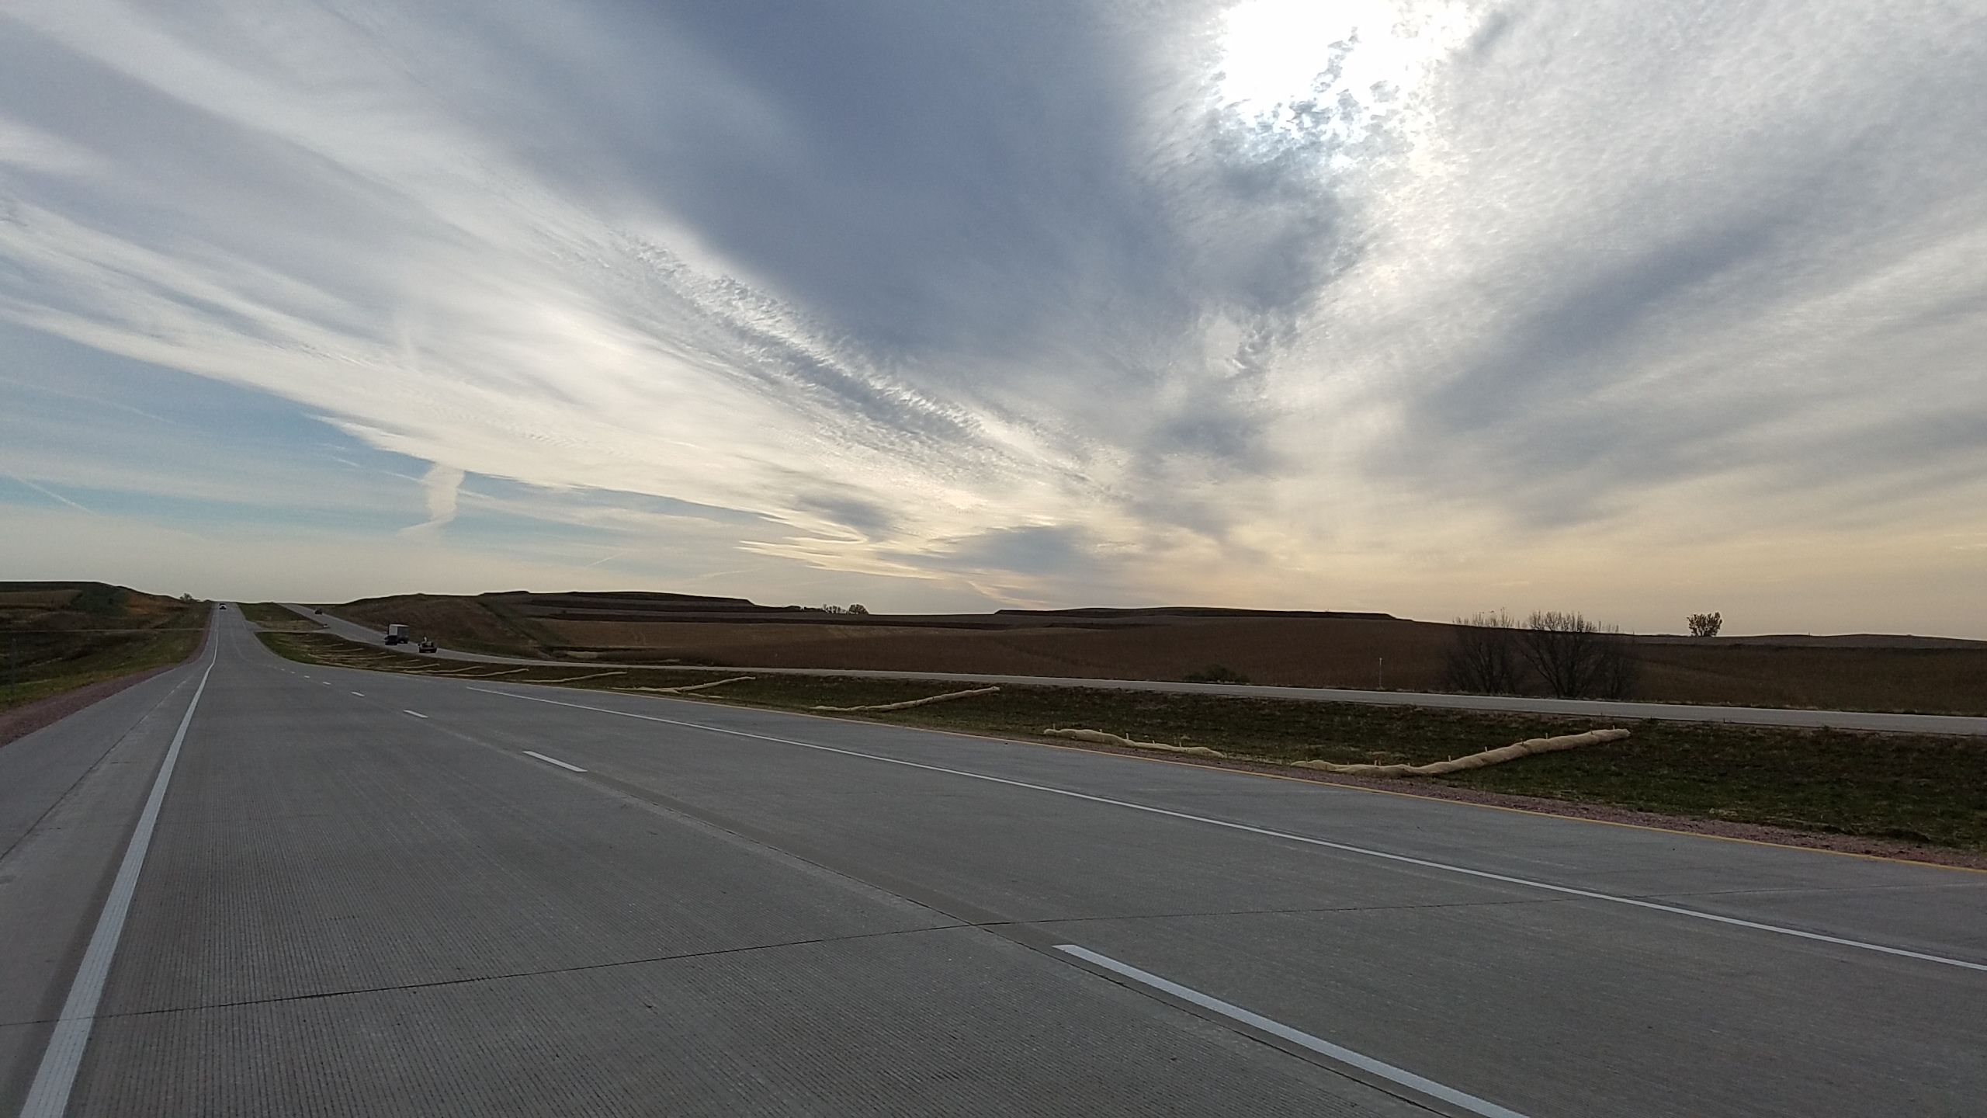
Thank You!

