Slide 1


NRRA Pavement Workshop 2019
NRRA Preventive Maintenance Team
Technology Transfer
Short Term Research
Joe Korzilius
Senior Associate
SRF Consulting Group, Inc
+ 46 Associate Members

Slide 2
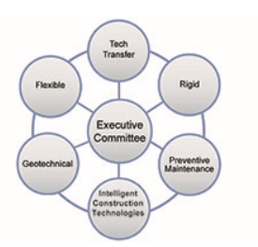
Project Objective
To assist in the coordination and writing of up to eight NRRA short term research projects.
“State of Practices”
Each NRRA Technical Team has identified a series of short term research topics and developed an Initial Research Request.
Flexible
Rigid
Geotechnical
Preventative Maintenance
Intelligent Construction Technologies

Slide 3
What are the Short Term Synthesis Projects
Preventive Maintenance Team
Surface Characteristics of Diamond Ground PCC Surfaces - 75% DRAFT SENT TO TAP
Pavement preservation approaches for lightly surfaced roadways - Project Need being reviewed
Flexible Team
Tack Coats - COMPLETE
Longitudinal Joint Construction Performance - COMPLETE
Rigid Team
Design and Performance of Concrete Unbonded Overlays - 95% DRAFT SENT TO TAP
Repair of Joint Associated Distress Pavements - Survey will be conducted Summer 2019
Intelligent Construction Technologies Team
Validation of e-Ticketing; Digital Material Delivery Tickets - 95% DRAFT SENT TO TAP
Geotechnical Team
Larger Subbase Materials - DELETED
Subgrade Design for New and Reconstructed - Starting Project June 2019

Slide 4
Pavement Preservation for Lightly Surfaced Roadways
Initial Research Request:
The Need Statement was recently updated and survey will be complete during the summer of 2019.
The objective of this tech transfer project is to compile and report a synthesis of preservation approaches NRRA Member states use to maintain their lightly surfaced roads and to further document successful and unsatisfactory experiences with performance, case studies.
For this study a Lightly Surfaced Pavement Treatment is in general the application of an asphalt surface treatment to an aggregate base having an applied thickness of about 1/2 – inch or less. These treatment types are considered non-structural and rely on the strength and quality of the underlying base and subbase structures.
Task 1: Brief Literature Review
Task 2: Develop survey questions and transmit to NRRA members
Task 3: Summarize each states current activity
Design Methods Used
LST’s typically constructed
LST cost by alternative application type
Review of LST performance
Review of Surface Maintenance alternatives

Slide 5
Surface Characteristics of Diamond Ground PCC Surfaces
Initial Research Request: Project Overview
States have been diamond grinding concrete pavements, historically conducted on existing pavements as a preservation technique/treatment for smoothness improvement and friction enhancement.
In more recent times, diamond ground textures have been used for noise reduction on both new and existing pavements as well as bridge decks.
The introduction of Next Generation Concrete Surface (NGCS) has extended the use of diamond grinding to new construction as well.
Additionally the MnROAD facility has conducted extensive testing and collected extensive data including smoothness, friction, and noise for diamond ground surfaces at the MnROAD facility.

Slide 6
Surface Characteristics of Diamond Ground PCC Surfaces
Initial Research Request: Project Overview
Objective: To determine the change in surface characteristics of diamond ground textures for both new and existing pavements.
Explore the state of practice of diamond grinding PCC surfaces and the benefits:
  At what point is diamond grinding best applied or required?
  Is there a particular depth that is required in order to obtain a certain level of benefit?
  What kind of improvements in smoothness, noise and friction are being obtained?
  Does diamond grinding expose the aggregates to early polishing and environmental effects that accelerate materials related distresses (D-cracking and ASR)?
  Identify changes in surface characteristics of diamond ground textures over time.
A number of states that use diamond grinding as an integral part of their concrete paving program have conducted research that can add to the collective knowledge base of this process.

Slide 7
Surface Characteristics of Diamond Ground PCC Surfaces
Initial Research Request: Tasks
Identify Textures for Evaluation:
  Identify test cells at MnROAD and test sections within the MnDOT PMS system that can be used as candidate sections for evaluation.
Develop Before and After Texture Performance Curves:
  Where possible develop the pre-treatment and post-treatment performance curves for smoothness, noise, and friction for each of the candidate projects. For projects where textures were installed on new construction, evaluate the initial test values as well as the change in characteristics over time. For candidates where the treatment was installed on existing pavements, identify the percent improvement at the time of construction and the change in characteristics over time.
Investigate the use of Grinding in Other States.
  The use of grinding in other states (CA) will be investigated in search of research reports, data collection etc. This information will be compared to that obtained from MNROAD sources and used in the development of a synthesis/white paper.
Prepare a Synthesis/White Paper:
  Prepare a synthesis/white paper identifying the characteristic behavior of diamond ground textures over their service period.

Slide 8
Identify Textures for Evaluation:
 | FHWA/ IGGA/ | NGCS | CA | IA | MI | MN | MO | ND | WI
Groove Width (in.) | 0.125 | 0.125 | 0.08 - 0.12 | 0.09 - 0.11* | 0.09 - 0.15 | 0.125 | 0.22 - 0.24 | 0.125
Groove Depth (in.) | 0.125 - 0.25 | 0.125 - 0.19 (1/8 - 3/16) | 0.06 - 0.08 | 0.06 - 0.19 (1/16 - 3/16) | 0.13 - 0.19 | 0.125 | 0.03 (1/32) | 0.1875 | 0.06 - 0.19 (1/16 - 3/16)
Groove Land Area (in.) | 0.625 | 0.375 - 0.5 (3/8 - 1/2) | + 0.65 |  | 0.75 | 0.125 |  | 0.625
Groove Spacing (in.) | 0.75 | 0.5 - 0.625 (1/2 - 5/8) | 0.75 |  | 0.84 - 0.90 | 0.25 |  | 0.75
Grooves per Foot Width | 55 |  | 55 - 60 | 50 - 60 | 53 - 60** |  | 50 - 55
Identify test cells at MnROAD and test sections within the MnDOT PMS system that can be used as candidate sections for evaluation.
What is the best way to identify textures ?
What we did: Collected and Summarized State criteria and specifications for blade spacing, and grinding width, depth, spacing or land area of grooves in the pavement surface.

Slide 9
Project Tasks
Literature Review
Collect Data from NRRA States
Analysis of Data
Draft Final Report
Final Report
We are here!

Slide 10
Develop Before and After Texture Performance Curves:
Develop pre- and post-treatment performance curves for:
Smoothness (Ride in IRI)
Noise
Friction
For projects where textures were installed on new construction, evaluate the initial test values as well as the change in characteristics over time.
For candidates where the treatment was installed on existing pavements, identify the percent improvement at the time of construction and the change in characteristics over time.
Call for DATA ………………

Slide 11
Data We Have Requested:
Develop pre- and post-treatment performance curves for:
Smoothness (Ride in IRI)
Noise
Friction
1. Any before/after data available related to performance - smoothness, noise, friction, etc.
2. When is diamond grinding best applied or required ?
3. Identify texture differentiation and improvement at the time of construction
4. Identify change in characteristics over time, how long do improvements last
5. Summarize benefits and potential performance reduction for both new and existing pavements

Slide 12
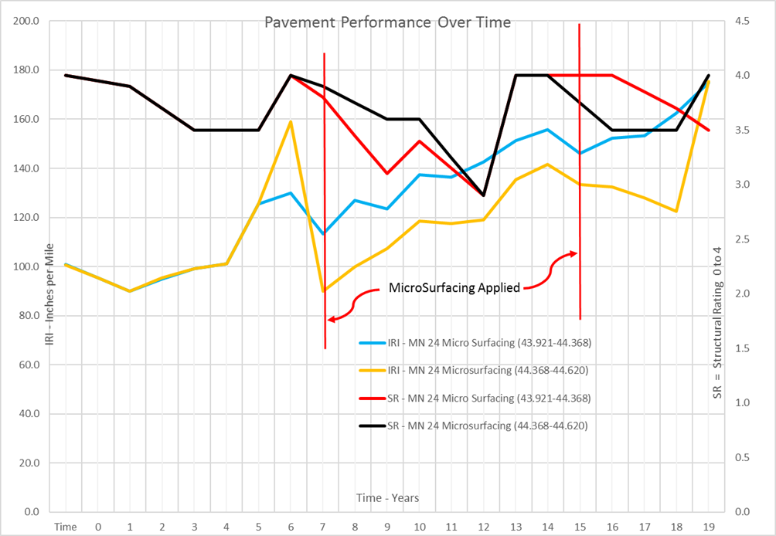
Data We Need:
Comparisons
IRI vs. Time Initial Construction
IRI vs. Time after Grinding
Friction vs. Time Initial Construction
Friction vs. Time after Grinding
Noise vs. Time Initial Construction
Noise vs. Time after Grinding
If available:
A description of the distresses ?
Why is the pavement deteriorating ?
Why Diamond Grinding Selected ?
Performance Period

Slide 13
Summary
The primary focus of this report is on the identification of treatments and/or materials that can be used to extend the service life of pavements in poor condition.
Efforts were made to evaluate performance by comparative economic and environmental life-cycle cost analyses. Cost effectiveness looked at agency costs, agency benefits and user costs including safety.

Slide 14
Questions?
Joe Korzilius
Jkorzilius@srfconsulting.com

Slide 15


















































Thank You

