Slide 1


NRRA Pavement Workshop 2019
Maintaining Poor Pavements
NRRA Preventive Maintenance Team
Long Term Research Project
Joe Korzilius
Senior Associate
SRF Consulting Group, Inc
+ 46 Associate Members

Slide 2
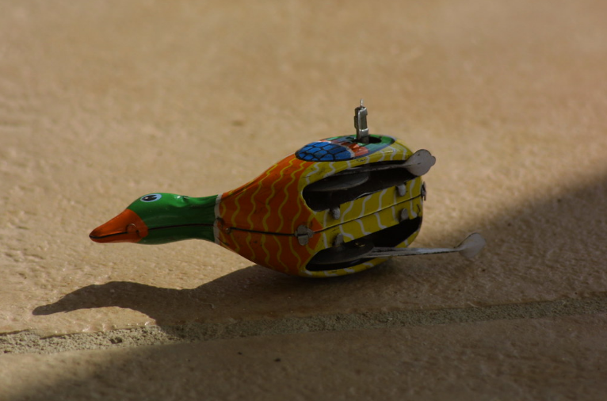

Slide 3
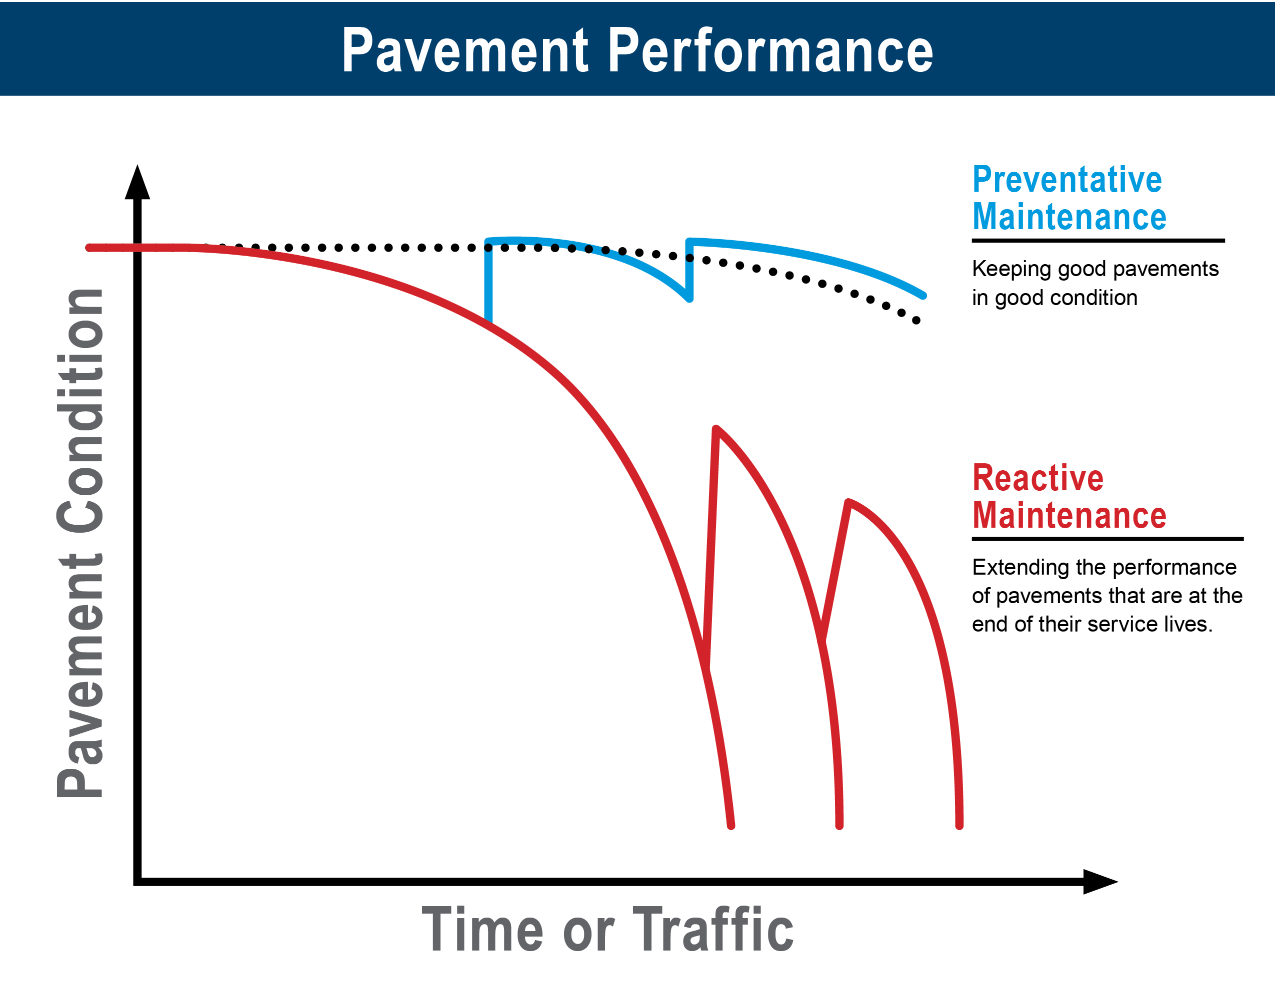
Project Objective
To identify performance improvement and durability that can be expected for Hot Mix Asphalt (HMA) pavement in poor condition from the application of a thin pavement rehabilitation treatment.

Slide 4
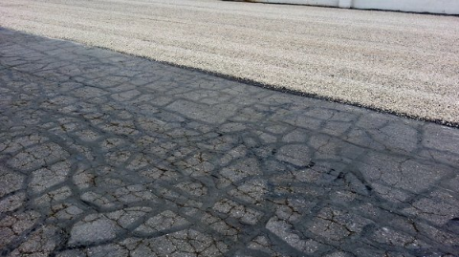
Project Goal
What are the Practices
What are the Results
To summarize practices being performed and collect performance and cost data from NRRA states to then provide guidance to consider for extending service life of lower volume roadways

Slide 5
Project Tasks
Literature Review
Definitions
Collect Data from NRRA States
Analysis of Data
Draft Final Report
Final Report
Complete

Slide 6
Literature Review
Completed in May 2018
Reviewed existing literature
  relative to management of pavements in poor condition
  use of thin surface treatments as stop gap measures to improve ride and prolong useful life
Established definitions of applied treatments
  Limited to those that are considered
  “Thin” = less than a 2" depth.
General Treatments Considered in the Study
Thin Overlay (with or without milling) | 10. Fibermat Chip Seal
2. Thinlay (with or without milling) | 11. Scrub Seal
3. Hot in-place recycling (HIR) | 12. Cape Seal
Open Graded Friction Courses (OGFC)/Plan Mix Seal Courses | 13. Fog Seal
5. Texas Under Seal | 14. Rejuvenating Fog Seal
Ultra Thin Bonded Wearing Course/ Paver Placed Surface Seal/Nova Chip | 15. Bio Fog Seal
Microsurfacing | 16. Otta Seal
8. Slurry Seal | 17. Scratch Course
9. Chip Seal | Mastic Surface or Crack Treatment

Slide 7
“Development of Holding Strategies for Deteriorated Low Volume Roads and Evaluation of Performance of Iowa Test Sections”
Iowa DOT and Iowa State University, Ames.
Objective:
To develop strategies for maintaining lower volume highways that are near the end of their service life to a satisfactory level in order to delay the larger expense of rehabilitating or reconstructing them.
The strategies employed would typically have shorter than expected performance life and degrade much more quickly than when used in traditional preventive maintenance or rehabilitation approaches

Slide 8

Finding: A holding strategy can be successfully employed by selecting treatments that use a combination of thin hot mix overlays, surface treatments and in-place recycling.
This study is not final, a final report will be available at the conclusion of Phase II. Phase II investigates placing surface treatments on composite (HMA over PCC) pavements.

Slide 9
(2014 - MnDOT)
“Cost Effective Means of Managing Pavements in Poor Condition” Univ. of Wis. Madison, Dept of Civil and Environmental Engineering.
National Center for Freight and Infrastructure Research
Goal: Identify treatments or materials that could be used to extend the service life of pavements in poor condition.
Objectives:
  Establish a basis for evaluating end-of-life pavement treatments using user needs, cost-effectiveness, and environmental impact.
  Create tools for selecting and analyzing strategies
  Suggest design strategies in resurrecting roads in poor condition.

Slide 10
Summary
The primary focus of this report is on the identification of treatments and/or materials that can be used to extend the service life of pavements in poor condition.
Efforts were made to evaluate performance by comparative economic and environmental life-cycle cost analyses. Cost effectiveness looked at agency costs, agency benefits and user costs including safety.

Slide 11
Project Tasks
Literature Review
Collect Data from NRRA States
Analysis of Data
Draft Final Report
Final Report
We are here!

Slide 12
Collect Data from NRRA States
Questions for Data Gathering: May 2018
Compiling performance and cost data from NRRA Member States.
Data is intended to identify
  performance improvements
  durability to be expected from the application of a thin surface treatment to an HMA pavement in poor condition

Slide 13
Questions
Q: What Measurement is used for Collecting Roughness and Distress Data ?
A: Missouri
Roughness is IRI to the nearest 0.1 inch measured at Highway Speed.
Pavement distresses are visually rated on a scale of 1 – 10 similar to PASER Rating System
A: Minnesota
IRI Measured at Highway Speed in inches per mile converted to a Ride Quality Index (RQI).
Cracking, rutting, etc. … visually measured and summed in in a Structujral Rating (SR) and Pavement Quality Index (PQI).

Slide 14
Questions
Q: How Does Your State Define Poor Pavement?
A: Missouri
Provides a Definition for “Good” Pavement Only
  Major Road ➔ IRI < 100, and Condition Index ≥ 6
  Minor Road ➔ IRI < 140 – OR – IRI < 170 and a Condition Index ≥ 6
  Low Volume Road ➔ IRI < 170 – OR – IRI < 220 and a Condition Index ≥ 6
A: Minnesota
RQI between 0 and 1.0 = Very Poor
RQI between 1.1 and 2.0 = Poor
* An RQI of 2.0 Roughly Equates to an IRI of 200

Slide 15
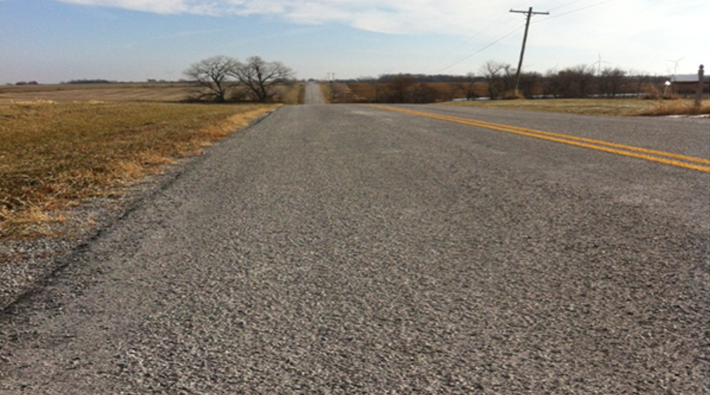
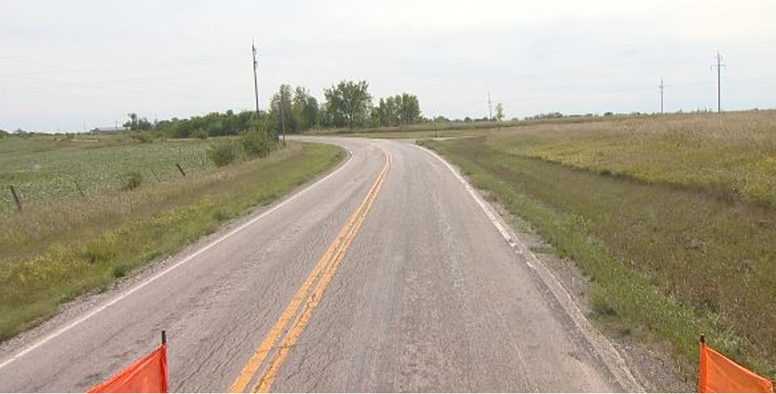
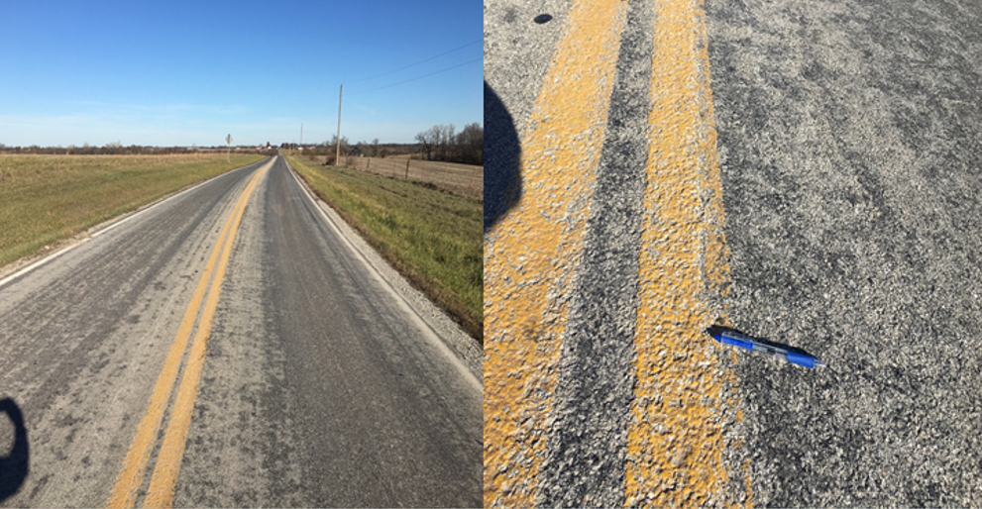
Q: Please Provide Pavement Sections That Were In Poor Condition a
Where a Thin Surface Treatment was Applied ?
A: Missouri
Route CC, Caldwell County Traffic 250 ADT 2013 2017
    Distresses: Rutting, Alligator Cracking, and Raveling IRI ≈ 244 IRI ≈ 155
    Scratch Course Followed by a Chip Seal Applied in 2014 Condition Index = 5.6 Condition Index = 7
    Cost per Mile ≈ $50,000.00
2014
2017
2013

Slide 16
Q: Please Provide Pavement Sections That Were In Poor Condition a
Where a Thin Surface Treatment was Applied ?
A: Minnesota - IRI

Slide 17
Q: Please Provide Pavement Sections That Were In Poor Condition a
Where a Thin Surface Treatment was Applied ?
A: Minnesota – Structural Rating SR

Slide 18
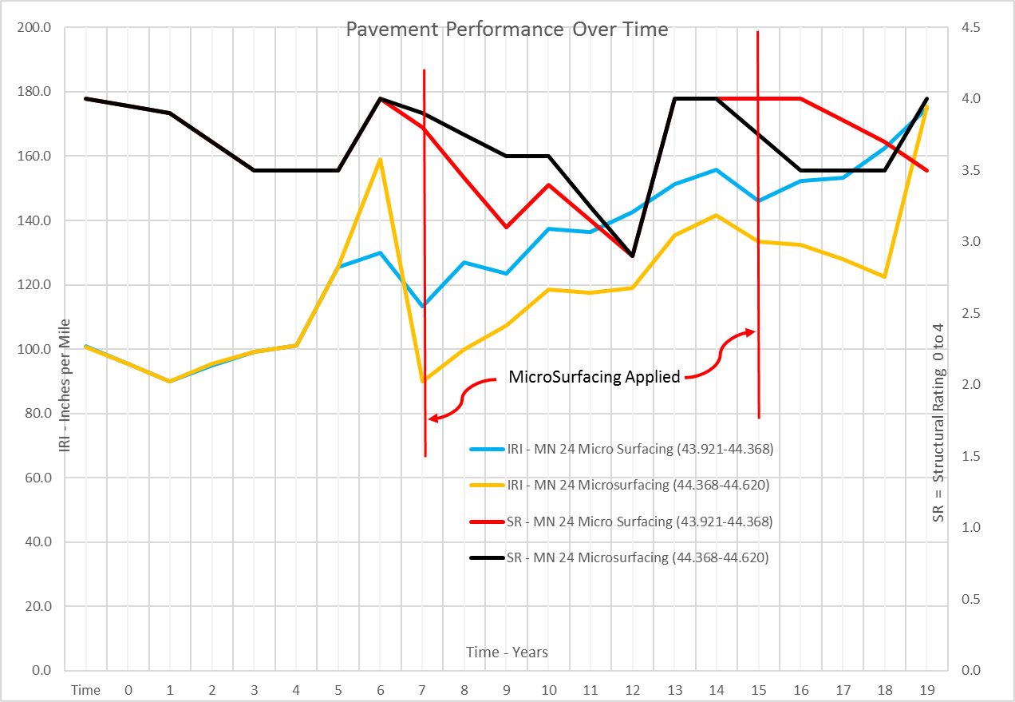
Q: Please Provide Pavement Sections That Were In Poor Condition a
Where a Thin Surface Treatment was Applied ?

Slide 19
Analysis of Data
Data analysis will focus on
  Effectiveness
    Initial improvement to ride quality after application of various thin rehabilitation treatments
  Performance
    Rate of loss of ride quality after treatment application
  Comparison of Treatment Performance
    Do multiple passes or patching improve durability
  Cost of Treatment
    Cost Benefit Analysis
    Life Cycle Cost Assessment

Slide 20
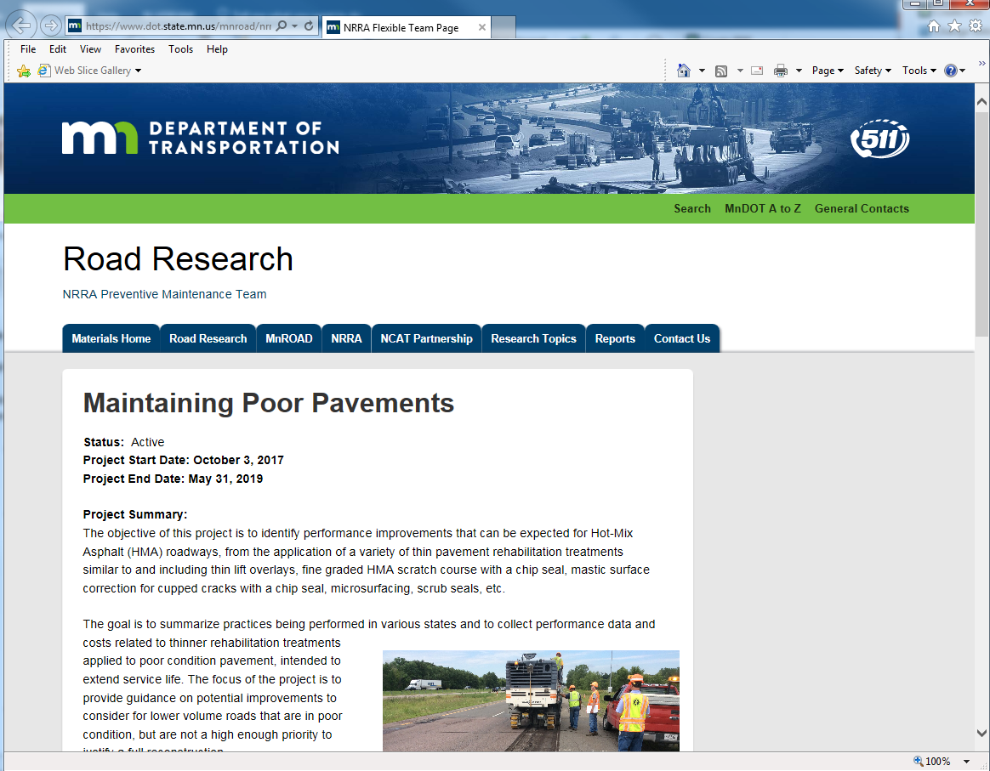
Final Report
Final Report
  Expected May 2020
  Will provide member State’s with information related to the cost and performance of various treatments intended to help make planned decisions for maintaining pavements in poor condition.
The project’s NRRA Study web page:
https://www.dot.state.mn.us/mnroad/nrra/structureandteams/preventivemaintenance/longterm1.html

Slide 21
Questions?
Joe Korzilius
Jkorzilius@srfconsulting.com

Slide 22


















































Thank You

