Slide 1

National Road Research Alliance
___ Team Update
Justin Lashley
Concrete Engineer – Concrete Lab Manager
jlashley@braunintertec.com

Slide 2
NRRA - Effective Long Lasting Partial Depth Joint Repairs for Challenging Conditions
Technical Liaison: Ben Worel (MnDOT)
Project Technical Advisory Committee (TAP)
Jerry Geib (MnDOT)
Mark Gawedzinski (IL)
Maria Masten (MnDOT)
Tom Burnham (MnDOT)
John Roberts (IGGA)
Gordy Bruhn (MnDOT)
Timo Saarenketo (RoadScanners)
Eshan Dave (UNH)
MK Kang (WisDOT)

Slide 3
What are we trying to do?
Can an “emergency” patch be more than temporary
Can typical equipment be used to mix and place the patch material
Document the installation of the patch material
Document the performance of the patch material

Slide 4
What did we do?
Patches were placed on I-94 (westbound) – adjacent to MnROAD
Patching completed October 2017
Utilized a milling machine to create the patch areas
Not all patches were sand blasted
All were air blasted followed by utilizing a leaf blower to clean the patches
15 test sections
16 different patching materials

Slide 5
Typical Patches

Slide 6
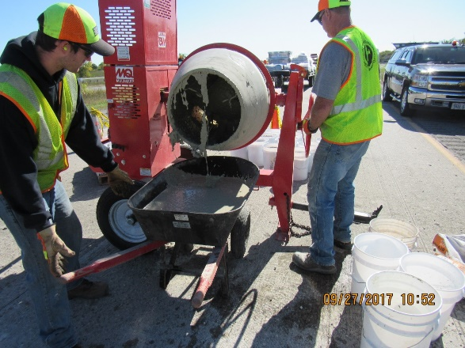
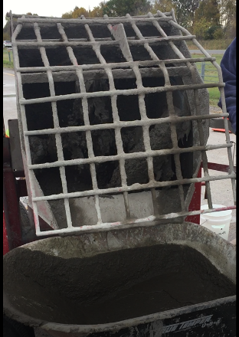
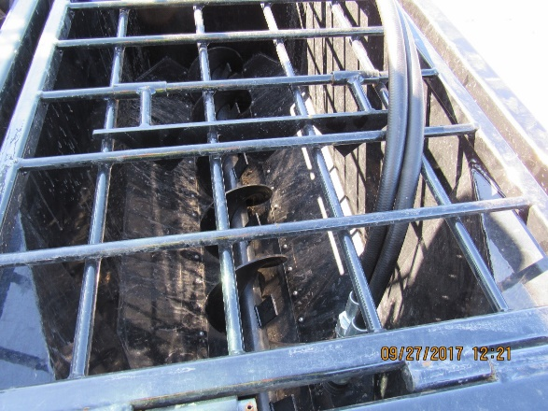
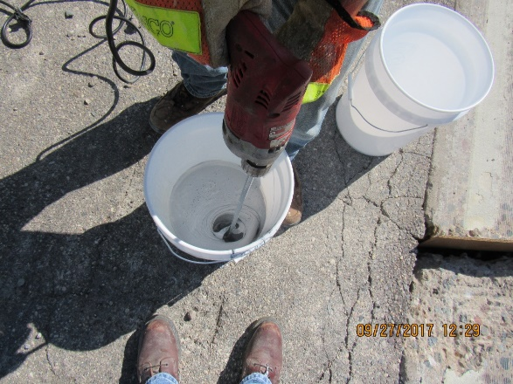
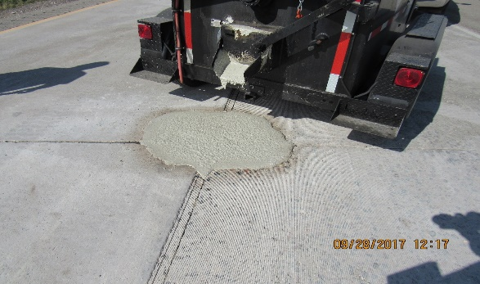
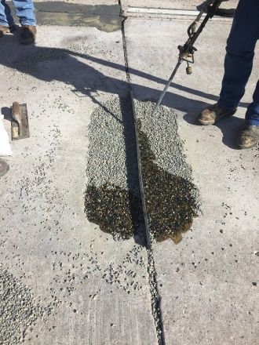
Mixing Equipment
trailer

Slide 7
What has been occurring?
Memorial Day 2018
  One test cell has failed, patch material is virtually gone
  Minor surface wear was showing on some of the patches (cosmetic)
  Commencement of repairs to the repairs is starting

Slide 8
What has been occurring?
Fall 2018
  Several repairs have taken place
  The deterioration is hard to “catch”
    Material looks fine and then it is gone

Slide 9
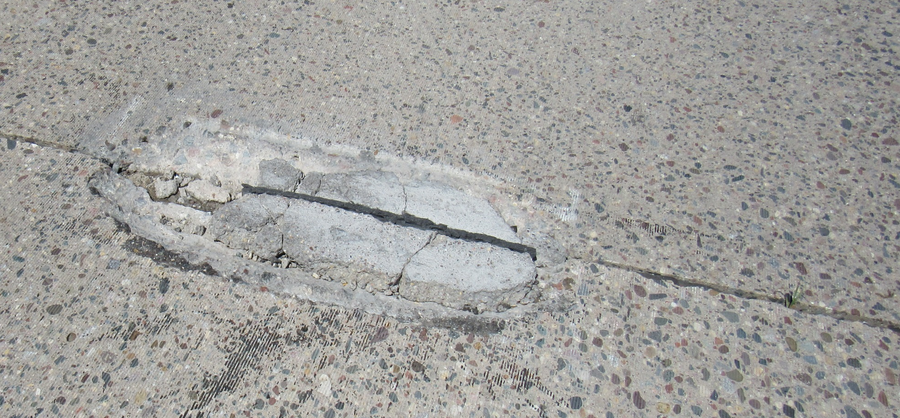
What has been occurring?

Slide 10
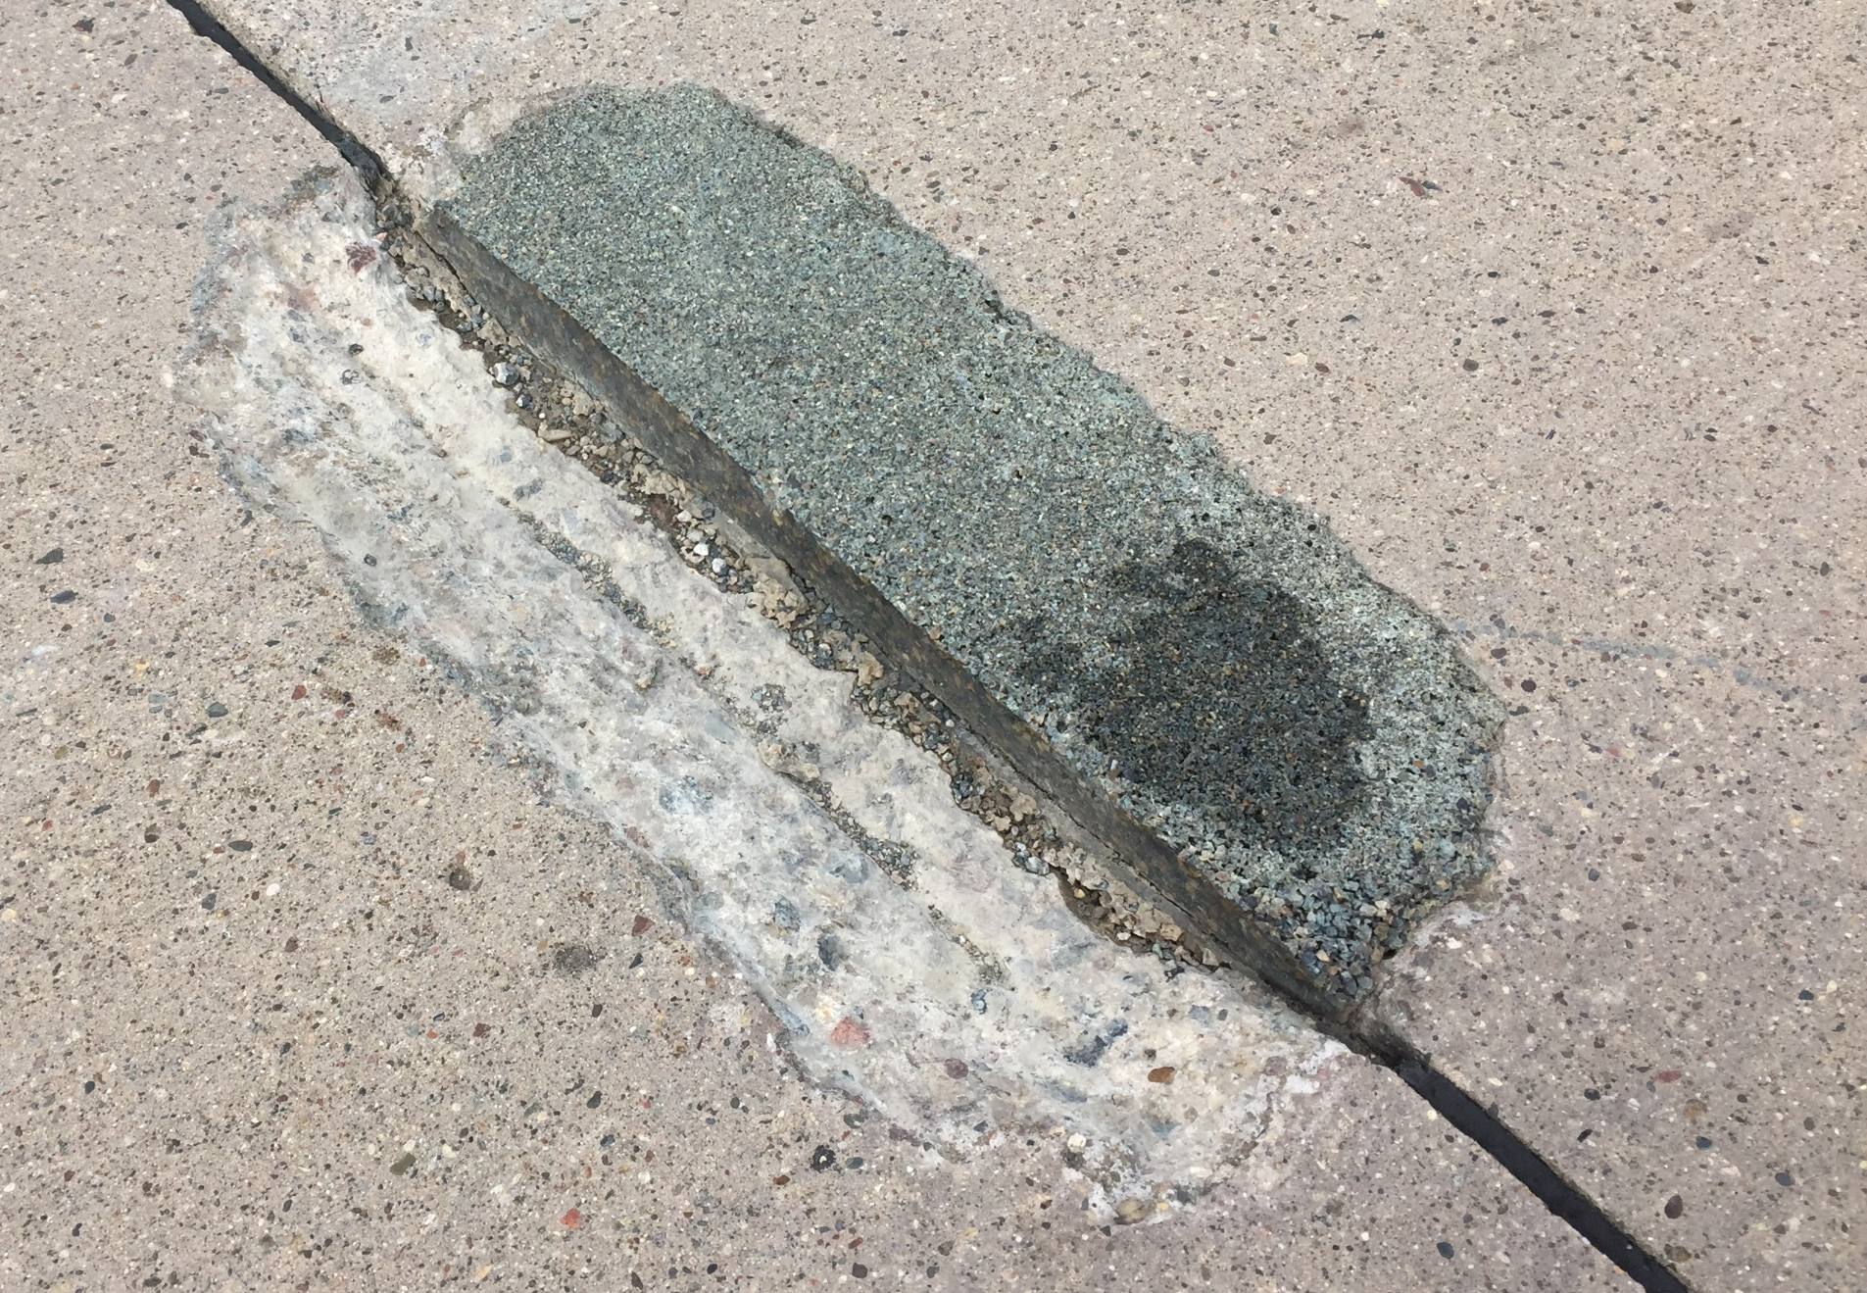
What has been occurring?

Slide 11
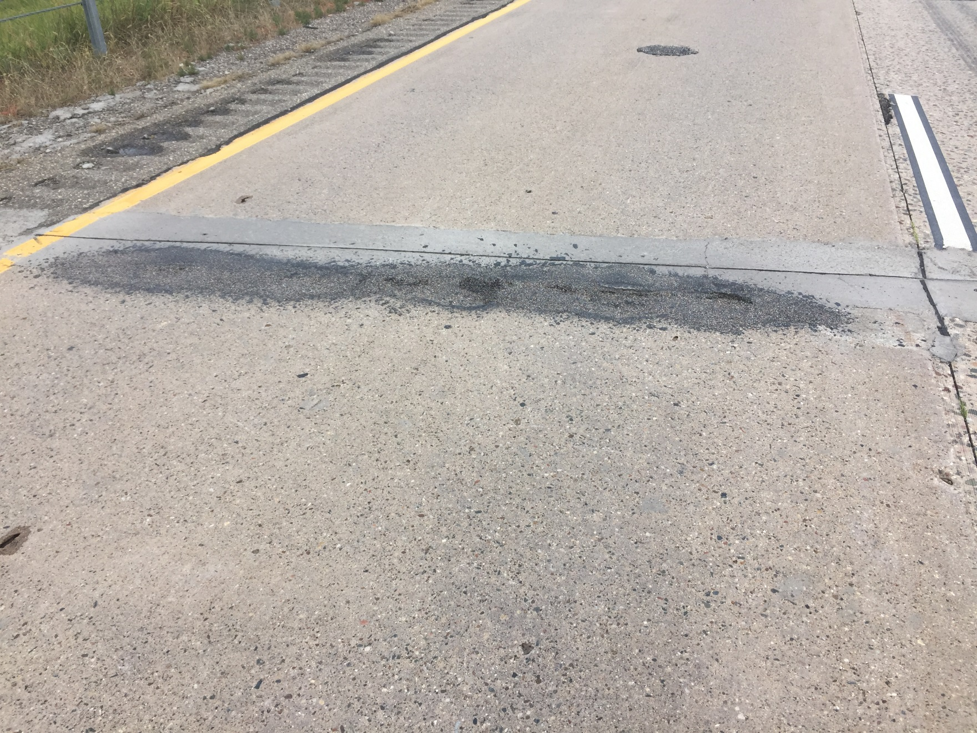
What has been occurring?

Slide 12
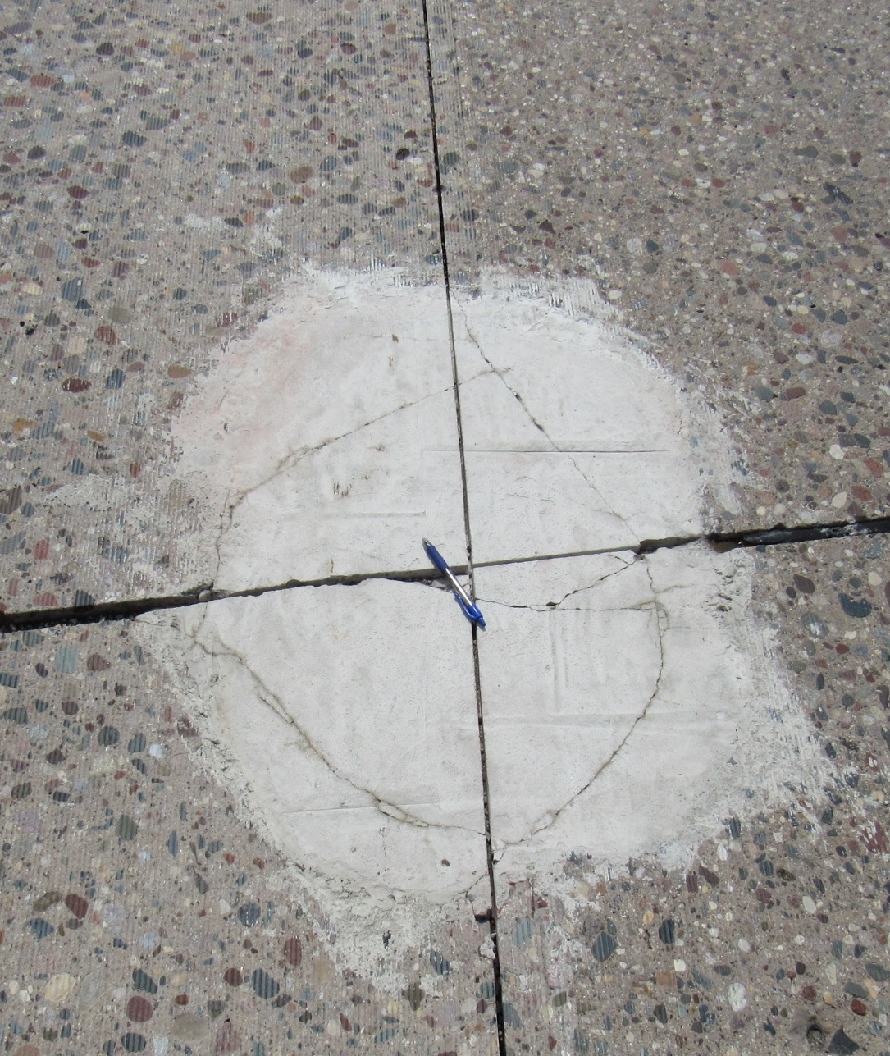
What are my thoughts?

Slide 13
What are my thoughts?
The importance of surface preparation was confirmed
  Sand blasting the patch before placing the material seems to make a huge difference
The patch material either holds or it doesn’t
  It seems like it just disappears quickly, hard to catch the distress
  Based on luck related to timing to catch anything

Slide 14
What are my thoughts?
The best product needs to fit the application.
  Emergency repairs (small patches areas): ease of mixing for small repairs, buckets and drill mixers
  Planned repairs (larger patch areas or volume of patches): ease of mixing and placing for larger scale repairs, bags and large mixer
What is the best way to preparer the patch.
  Sand blast for an emergency repair

Slide 15

































































Questions or Comments?

