Slide 1
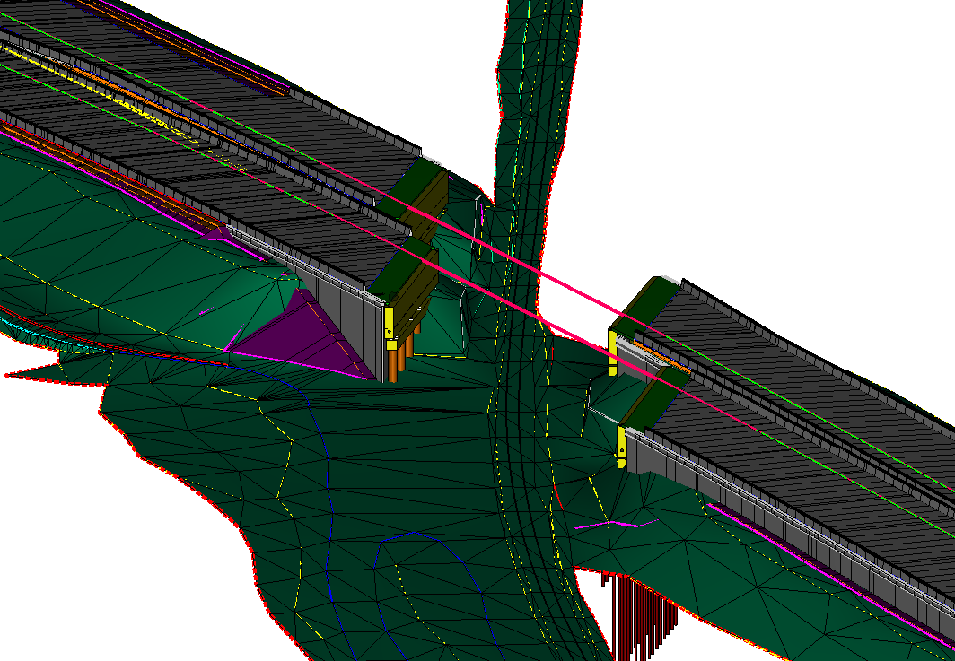
Model-Based Design and Construction:
the UDOT Experience
MBDC Overview - What & Why
Implementation Strategy
Lessons Learned
Projects
Challenges and Successes
What’s Next?
Presentation Outline

Slide 2
MBDC Overview – What & Why
DESIGN
CONSTRUCTION
OP / MAINT.

Slide 3
DESIGN
CONSTRUCTION
OP / MAINT.
3D Model
MBDC Overview – What & Why

Slide 4

MBDC Overview – What & Why
DESIGN
CONSTRUCTION
OP / MAINT.
3D Model
2D Plans

Slide 5

MBDC Overview – What & Why
DESIGN
CONSTRUCTION
OP / MAINT.
3D Model
3D Model
2D Plans

Slide 6

MBDC Overview – What & Why
DESIGN
CONSTRUCTION
OP / MAINT.
3D Model
3D Model
2D Plans
As-Builts

Slide 7

MBDC Overview – What & Why
DESIGN
CONSTRUCTION
OP / MAINT.
3D Model
3D Model
2D Plans
As-Builts
Asset Database
LIDAR

Slide 8
MBDC Overview – What & Why
DESIGN
CONSTRUCTION
OP / MAINT.

Slide 9
MBDC Overview – What & Why
DESIGN
CONSTRUCTION
OP / MAINT.
3D Model

Slide 10
MBDC Overview – What & Why
DESIGN
CONSTRUCTION
OP / MAINT.
3D Model
3D Model

Slide 11
MBDC Overview – What & Why
DESIGN
CONSTRUCTION
OP / MAINT.
Asset Database
3D Model
3D Model

Slide 12
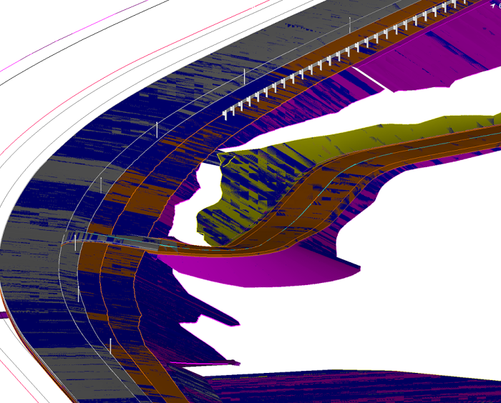
MBDC Overview – Implementation Strategy
IMPLEMENTATION STRATEGY – 2015/2016
Visit Iowa
FHWA 3D Engineered Models for Construction Workshop
Short-term Implementation Plan
Make electronic plans available on all projects FIO
Risk Workshop ➔ Brainstorm Workshop
Mid-term Implementation Plan

Slide 13
MBDC Overview – Implementation Strategy
IMPLEMENTATION STRATEGY
Project Selection Project Type – Example Project Delivery
Rural Location/Widening
Low Risk, Low Complexity Dirt & Pavement/Low AADT
CMGC
Success?

Slide 14
MBDC Overview – Implementation Strategy
IMPLEMENTATION STRATEGY
Project Selection Project Type – Example Project Delivery
Rural Location/Widening
Low Risk, Low Complexity Dirt & Pavement/Low AADT
CMGC
No – Lesson Learned Yes
Success?
Increase
Complexity

Slide 15
MBDC Overview – Implementation Strategy
IMPLEMENTATION STRATEGY
Project Selection Project Type – Example Project Delivery
Rural Location/Widening
Low Risk, Low Complexity Dirt & Pavement/Low AADT Bid Build
Higher Risk, Medium Complexity Urban Reconstruct CMGC
Higher Risk, Higher Complexity Urban Reconstruct Bid Build

Slide 16
MBDC Overview – Implementation Strategy
IMPLEMENTATION STRATEGY
Project Selection Project Type – Example Project Delivery
Large Dollar Interstate
High Risk, High Complexity Bridges & Structures CMGC
Large Dollar Interstate
Highest Risk, Highest Complexity Bridges & Structures Bid Build

Slide 17
MBDC Overview – Long-term
FINAL PROCESS – ALL PROJECTS WITH MODELS
Design a 3D model
Advertise for construction using the model as the legal document (MALD)
Construct & Inspect using the 3D model
Update the 3D model during construction
Add feature information to asset management database after construction via 3D model

Slide 18
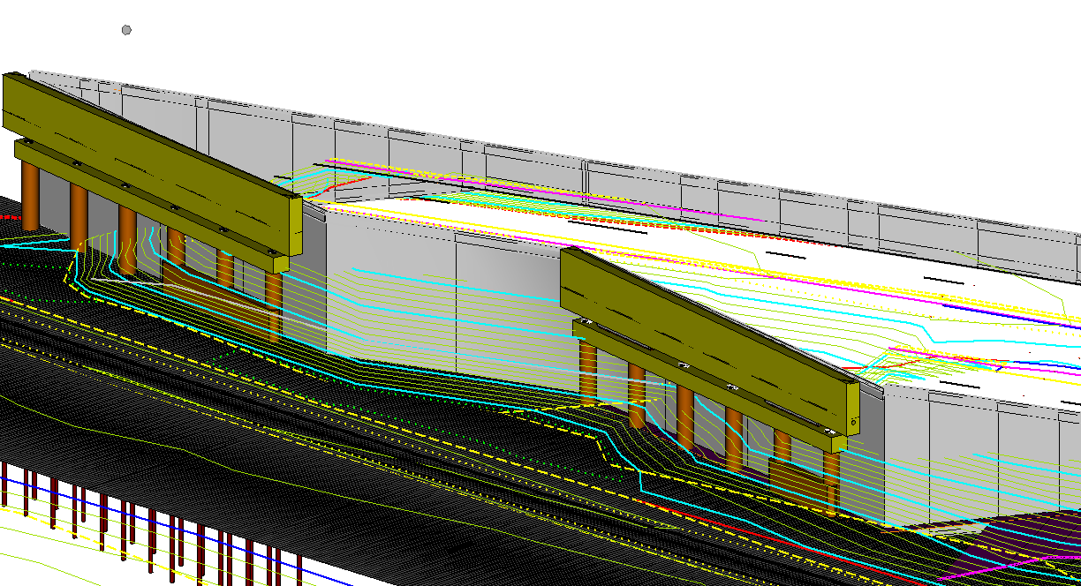
MBDC Overview – What & Why
GOALS:
Produce a more optimal design
  Provide clash detection, grading, details, etc.
  Fully develop the model i.e. all design elements attributed/all meta-data
  Balance the design intent to construction
Improve information transfer
  Quantities
  Reduce Risk

Slide 19
MBDC Overview – What & Why
GOALS: (cont)
Obtain and manage quality data to improve decision making
  Prevent rework from project to project
  Collect asset management information
Improve efficiency
  Minimize the recreation of data
  Eliminate the practice of 3D design to 2D
  (paper) to 3D Construction
  Improve procedures and processes
  Improve workflows to reduce overlap
  and unnecessary work

Slide 20
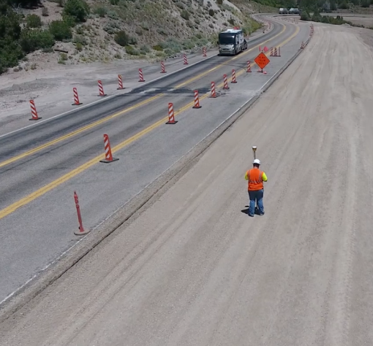
Pilot Project, Lessons Learned
Pilot projects – CMGC
SR-20, MALD, Rural/low ADT/low risk, Constructed 2016, Sheets FIO, in-house
SR-10, MALD, low-medium risk/rural reconstruct, 2018-2019, Sheets FIO
SR-68, MALD, medium risk/urban reconstruct, 2017-2018, Sheets FIO
I-80, MALD, medium risk/passing lane, 2018, Sheets FIO
I-80, MALD, medium-high risk/bridge project, 2018, Sheets FIO

Slide 21
Pilot Project, Lessons Learned
Pilot projects, bid build:
I-70, MALD, medium risk, constructed 2017, Sheets FIO, in-house
SR-193, MALD, low-medium risk/Greenfield Connector, constructed 2017, sheets FIO, in-house
I-15, MALD, medium risk/climbing lane, awarded 2018, Sheets FIO, in-house
SR-209, MALD, medium-high risk/urban reconstruct, awarded 2018, NO SHEETS!

Slide 22
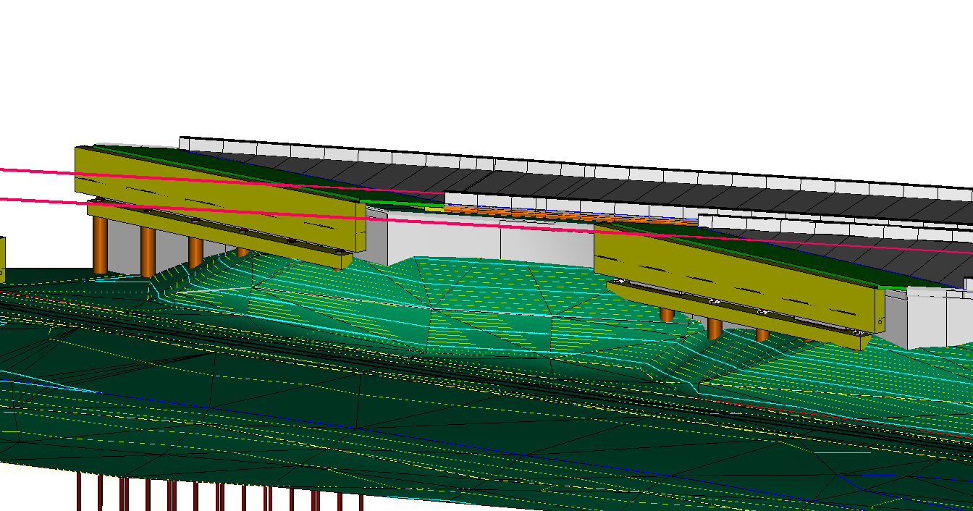
Pilot Project, Lessons Learned
SR-20 (CMGC) – Before/during DESIGN:
Implemented Bentley OpenRoads
Software issues/Bentley Workshop
Design mature at kickoff
Bentley/Trimble/Topcon .icm format visit
Contractor uses, but rejects use of .icm
3 months for designer/contractor to have equivalent models (OR/TBC)
Final dirt/asphalt quantities within 1 yd

Slide 23
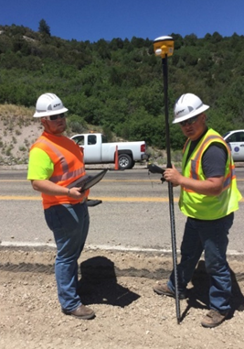
Pilot Project, Lessons Learned
during construction:
Stakeless/Stringless
Rugged mountain terrain – survey issues
Four to eight hour turn around on model update – no time lost
Mobile devices – not user friendly, but once learned were very valuable
Used ORN/Masterworks in the field
Employee Engagement & Empowerment
90 day project completed almost three weeks early; attributed to MALD/Masterworks

Slide 24
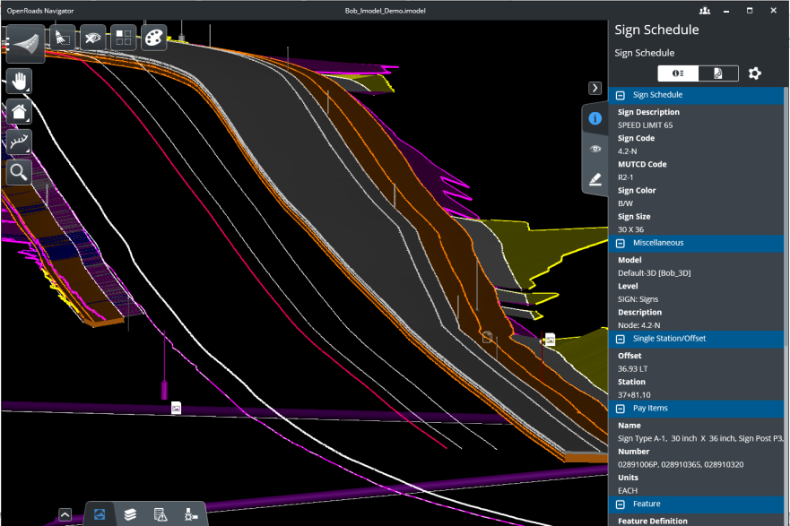
Other Projects
SUCCESS STORIES:
SR-20 Success CMGC ➔ I-70/SR-193/I-15 Bid-Build
  .dgn legal document
  XML, .alg, .dtm, .icm, etc. FIO
  Implemented Google Sites; Held
  contractor summit
  I-15 awarded, completed 2018
  I-70/SR-193 construction completed 2017

Slide 25
Other Projects
SUCCESS STORIES:
SR-68 CMGC Success ➔ SR-209 Bid-Build
  No plan sheets
  Awarded June 2018 – CY18/19
  Six bids – two addenda
  Collaboration – designer, contractor, Bentley, Trimble to fix .icm file issues

Slide 26
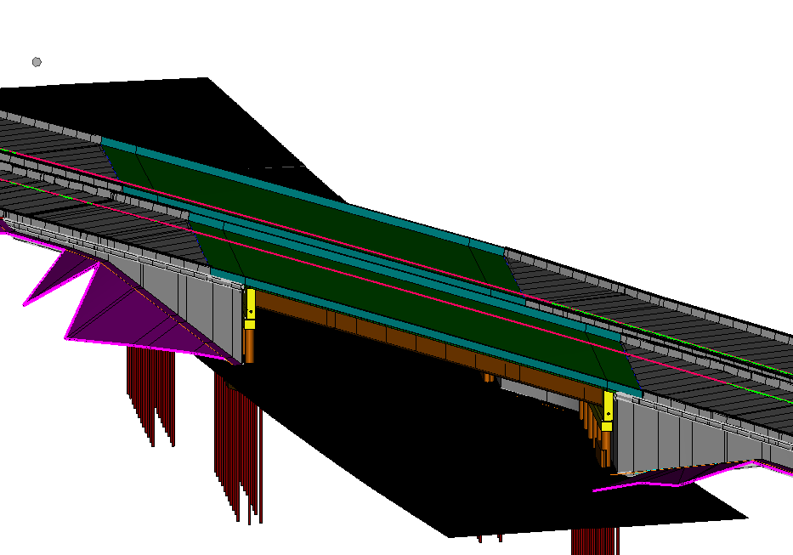
Challenges & Successes
CHALLENGES
Design/contractor 3D modeling software platforms
Review/Construction/field tools
Quantities – advertising for contractors and construction management
Validating surfaces – which model?
Validating surfaces – Owner procedure
Design focus from plan development to model development
Sub-contractors

Slide 27
Challenges & Successes
MILESTONES/SUCCESSES
Confidence to award projects with MALD
Collaboration with consultants/contractors/software industry
Workshops to address issues
In-house GIS Field Tool Solution using Collector for ArcGIS
Award MALD without plan sheets on low-medium risk projects
Some Sub-contractors are using mobile devices for bidding/contracting
UDOT Digital Delivery of MBDC Committee
Contractor estimator workshop Feb 2019 with designers (UDOT/consultants), contractors (modelers/estimators/subs), Industry (Trimble, Esri, Autodesk, Bentley, Topcon, Onstation, RDV Systems)
  Preparing deliverables guidance document to implement MALD and no plan sheets on these type projects. Expect distribution June 2019

Slide 28
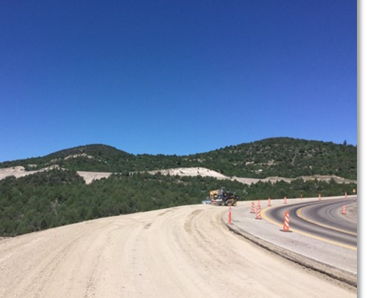
What’s Next?
Civil Integrated Management (CIM)
Automate using FME and MALD
Expand meta-data and system features in existing condition database
Generate surfaces by drone/lidar to confirm design
Integrate design and construction software
Develop tools to support design and construction

Slide 29
What’s Next?
Build a repeatable Process
Current process is plan sheets – design, review, QC, advertising, contractor modeler, contractor estimators and construction crews are familiar
As-builts are redlined plans scanned and stored
Model development standards ➔ file publishing that review, QC, contractor modelers/estimators, and construction crews can easily utilize.
Specify what data will define as-built, what format to collect and what to actually do with the data.

Slide 30
What’s Next?
Bridges and Structures
Integrated Management (BIM)
Alternate structures design approach
  Contains notes for the majority of elements
  Summarizes quantities
Simplified situation and layout
  Provides general layout information
  Supports Federal Highway coordination
Details, includes items not in the model

Slide 31
Model-Based Design and Construction:
the UDOT Experience
George Lukes: glukes@utah.gov

Slide 32
Thank you

