Slide 1

Reflections on a Career in Asphalt
Rebecca S. McDaniel,
Gene Skok Presentation, NRRA
May 23, 2019

Slide 2

Reflections on Gene Skok
44 years as Secretary-Treasurer of AAPT
Retirement in 2013
Scrapbook comments
  Heart and soul of AAPT
  Icon, mainstay, role model
  Welcoming, caring, unassuming, warm
  Dedication, service, guidance, leadership
  Lifelong friends
  Huge impact on young engineers, new members

Slide 3
Reflections on Gene Skok
44 years as Secretary-Treasurer of AAPT
Retirement in 2013
Scrapbook comments
  Heart and soul of AAPT
  Icon, mainstay, role model
  Welcoming, caring, unassuming, warm
  Dedication, service, guidance, leadership
  Lifelong friends
  Huge impact on young engineers, new members
Betty too!

Slide 4
A little about me
My dad was a civil engineer and surveyor.
I went to college to become an astrophysicist or archeologist.
Changed major to English.
Took a summer job with Indiana State Highway Commission.
Loved it!
Finished English degree and enrolled in Civil Engineering.
Fellowship for Masters degree.
Spent 11 years (!) completing PhD while working for INDOT.

Slide 5

In the Working World
Joined loaned staff of Strategic Highway Research Program.
  Moved to Washington, DC, for six months.
  Met leaders in Civil Engineering.
  Learned about research administration.
  Later wrote history of the SHRP Asphalt Research Program.
  Superpave Mix Design System: Anatomy of a Research Program, NCHRP Web-Only DocuThement 186 http://www.trb.org/Main/Blurbs/166871.aspx).

Slide 6




In the Working World
Got involved in professional organizations.
  Association of Asphalt Paving Technologists (AAPT)
  ASTM International (formerly American Society for Testing and Materials)
  Transportation Research Board (TRB)
  Long Term Pavement Performance (LTPP)

Slide 7

Joined the NCSC in 1995
One of five regional centers established by FHWA.
  Assist states and industry with implementation of Superpave.
  Continue research to refine Superpave.
Research, Training, Technology Transfer, Technical Support and Third Party Testing.

Slide 8
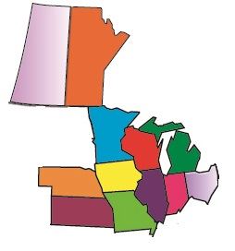
Regional Center
Illinois
Indiana
Iowa
Kansas
Michigan
Minnesota
Missouri
Wisconsin
Nebraska
Ohio
Manitoba
Saskatchewan
Industry and agency partners.

Slide 9

NCSC Research Topics/Emphasis Areas
Lab Testing
Recycling/Sustainability
Materials and Mix Designs
Surface Characteristics
Tire/Pavement Noise
Pavement Performance
Practical, applied research.
  Make pavements last longer, perform better.
  Make pavements safer and quieter.
  Make pavements more economical.

Slide 10
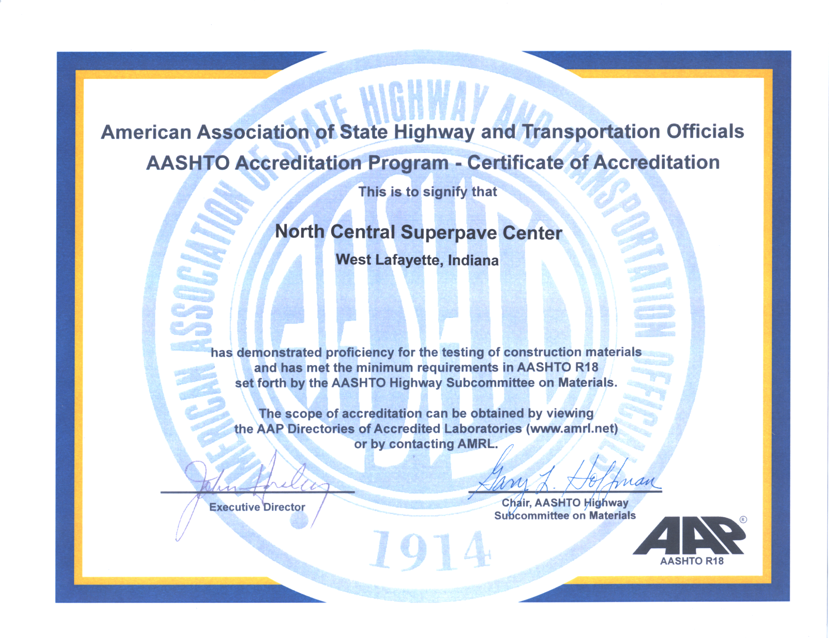

Slide 11

Recycling/Sustainability
Asphalt pavement is the most widely recycled material in the USA.
  Over 80 million tons reclaimed annually.
  99+% is reused or recycled.
  $2.1+ billion in savings each year.
Slag, shingles, crumb rubber, waste oils, etc.
Warm mix asphalt can lower fuel usage/emissions (1/3 of mixes).

Slide 12
Recycling/Sustainability
Incorporation of Reclaimed Asphalt Pavement in the Superpave System
  National study with Asphalt Institute.
  How to include RAP in Superpave mix designs.
  Showed that RAP could be used up to 20 to 40% with appropriate changes to material selection and proper mix design.
  RAP mixes can perform as well as virgin mixes given proper attention to design and construction.
Changes in 2 + 1 new AASHTO standards in 2001 still used today.

Slide 13
RAP Recycled into New Mixes
National average RAP content = 20.5%
(Source: NAPA 2016)

Slide 14
Recycling/Sustainability
Use of RAP under Superpave Specifications
  Regional Pooled Fund Project – 11 states
  National guidelines work with typical Midwestern materials
Evaluation of Reclaimed Asphalt Pavement for Surface Mixtures
  Effects of RAP with unknown properties on surface friction
  RAP can be used if blended with quality virgin aggregates
Investigation of Low and High Temperature Properties of Plant-Produced RAP Mixtures
  Expanded research from lab to plant

Slide 15
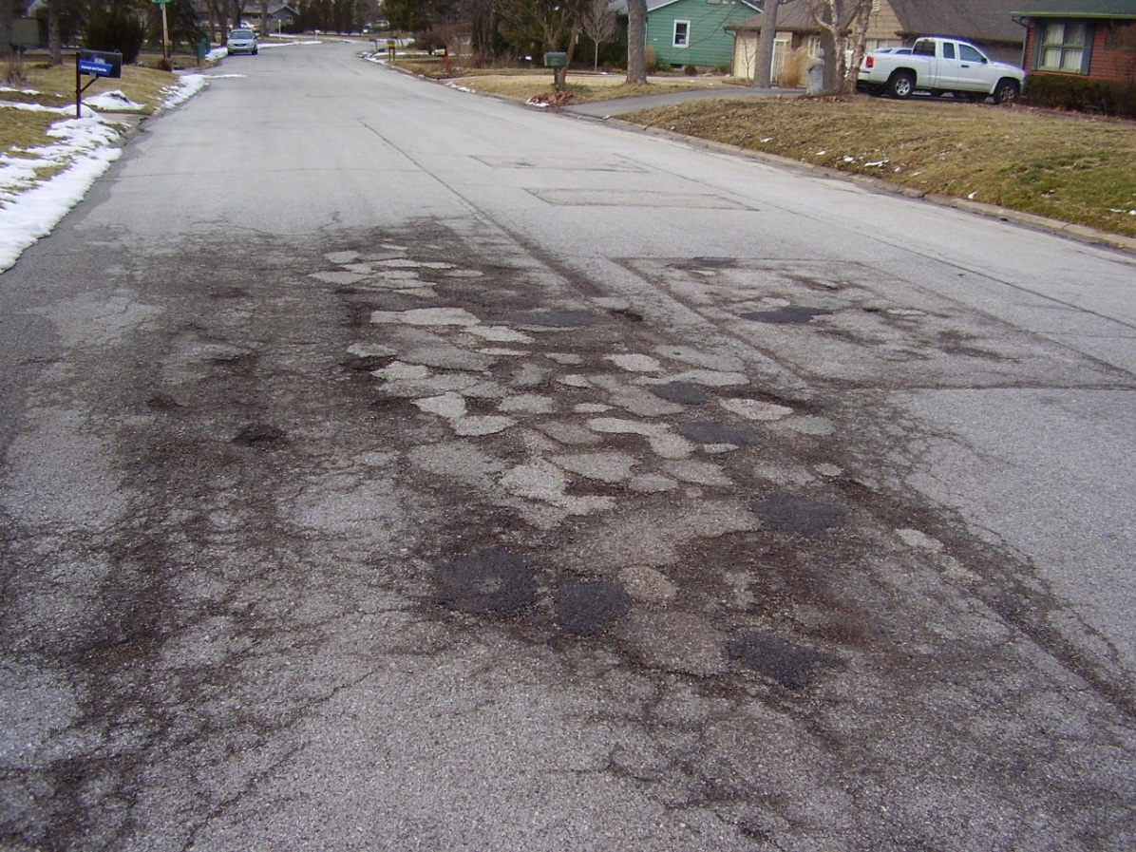
Materials and Mixtures
Need to improve asphalt durability!

Slide 16
Impact of High Voids
Raveling increases as air content increases.
Service life reduced about 10% for each 1% air voids over 7%!

Slide 17
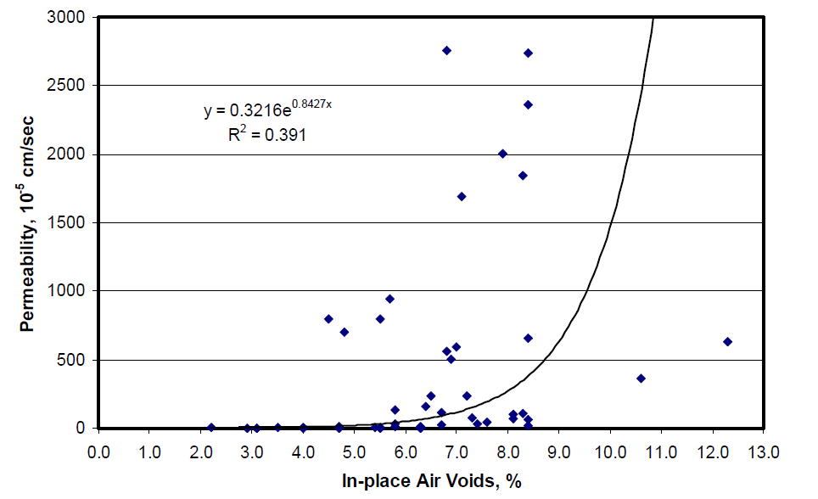
NCAT Study (Report 03-02, Mallick et al.)

Slide 18
Indiana’s Approach – Superpave5
Reduce air voids in field to reduce permeability, improve durability without sacrificing rutting resistance.
Design mixes at 5% air voids.
Keep effective binder content constant for durability.
Then compact to 5% air voids in the field.
Based on French design method.

Slide 19
Optimizing Mixture Compaction
With same aggregate stockpiles.
  Same crushed faces, FAA and hardness
Decreasing gyrations→
  Change in gradation and proportions,
  Lower mix stiffness in lab,
  Easier compaction in field.
Need equal or better final mechanical properties to prevent traffic densification.

Slide 20
Experimental Matrix
Traffic Level | No of Gyrations | Mixture Type
 |  | 9.5 mm | 19.0 mm
3 – 10 million | 30 | X
 | 50 | X
 | 70 | X
 | 100 | *
10 – 30 million | 30 | X | X
 | 50 | X | X
 | 70 | -- | X
 | 100 | * | *

Slide 21
Lab Findings
With changes in gradation, mixes can be designed at 5% air voids in the lab
Re-designed mixes at 5% air can have higher stiffnesses and higher rut resistance than mixes designed at 4% air and compacted to 7% air
Concept looked promising
Field trials recommended and identified

Slide 22
Spoiler Alert
Three field trials in 2013 to 2016; ~12 in 2018
Possible to design mixes at 5% air voids and maintain effective binder using mostly the same materials.
Properties equal to or better than conventional designs.
50 gyrations seems reasonable for most mixes.
Mixes designed at 5% air in lab can be compacted to 5% in the field with minimal to no changes in compaction process.
Potential 2-3 years additional life; $20-30 million savings a year.

Slide 23
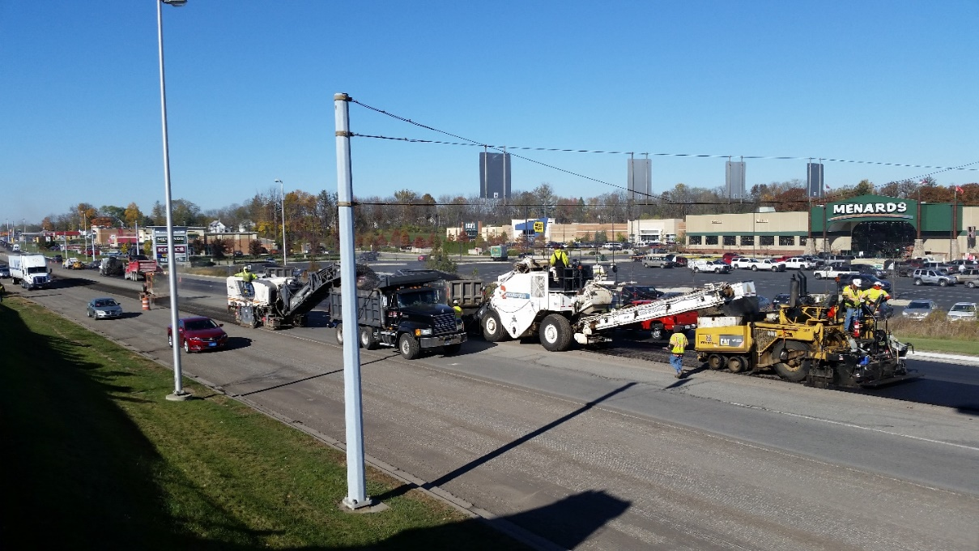
FHWA Enhanced Density Initiative

Slide 24
What’s Next?
Optional in 2019
About 1/3 of mix designs submitted were at 5%
  Superpave4 ±92.6%
  Superpave5 ±94.2%
Mandatory in September 2019

Slide 25
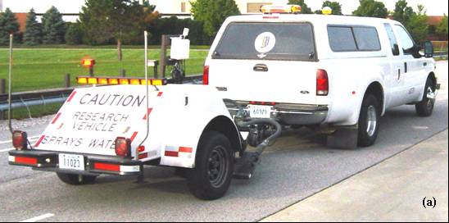
Surface Characteristics
Friction, Texture

Slide 26
Problem
Have historical data on known aggregates.
But, mix design or production issues can still result in low friction.
Adequate friction can also be provided using some marginal materials when blended with good ones.
  Developed ITM 221 in 2015
Can we test mixtures at design or during/after construction to estimate performance?

Slide 27
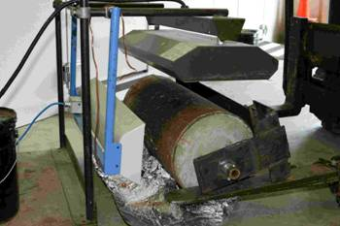
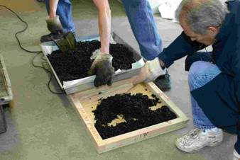
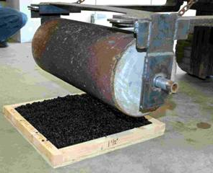
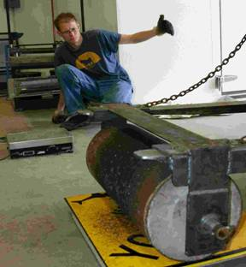
(a)
(b)
(c)
(d)

Slide 28
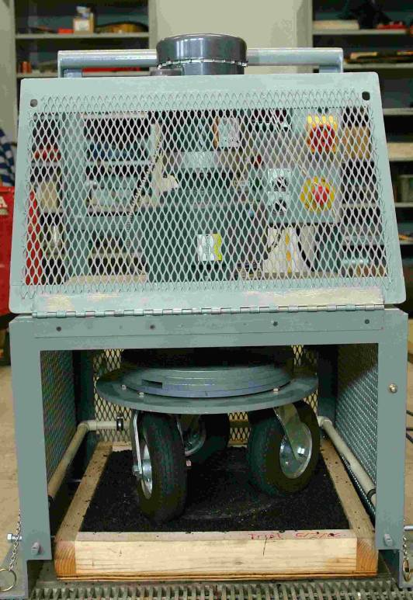
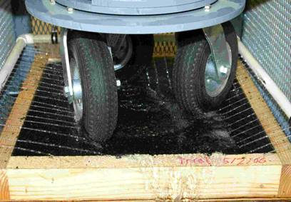

Slide 29
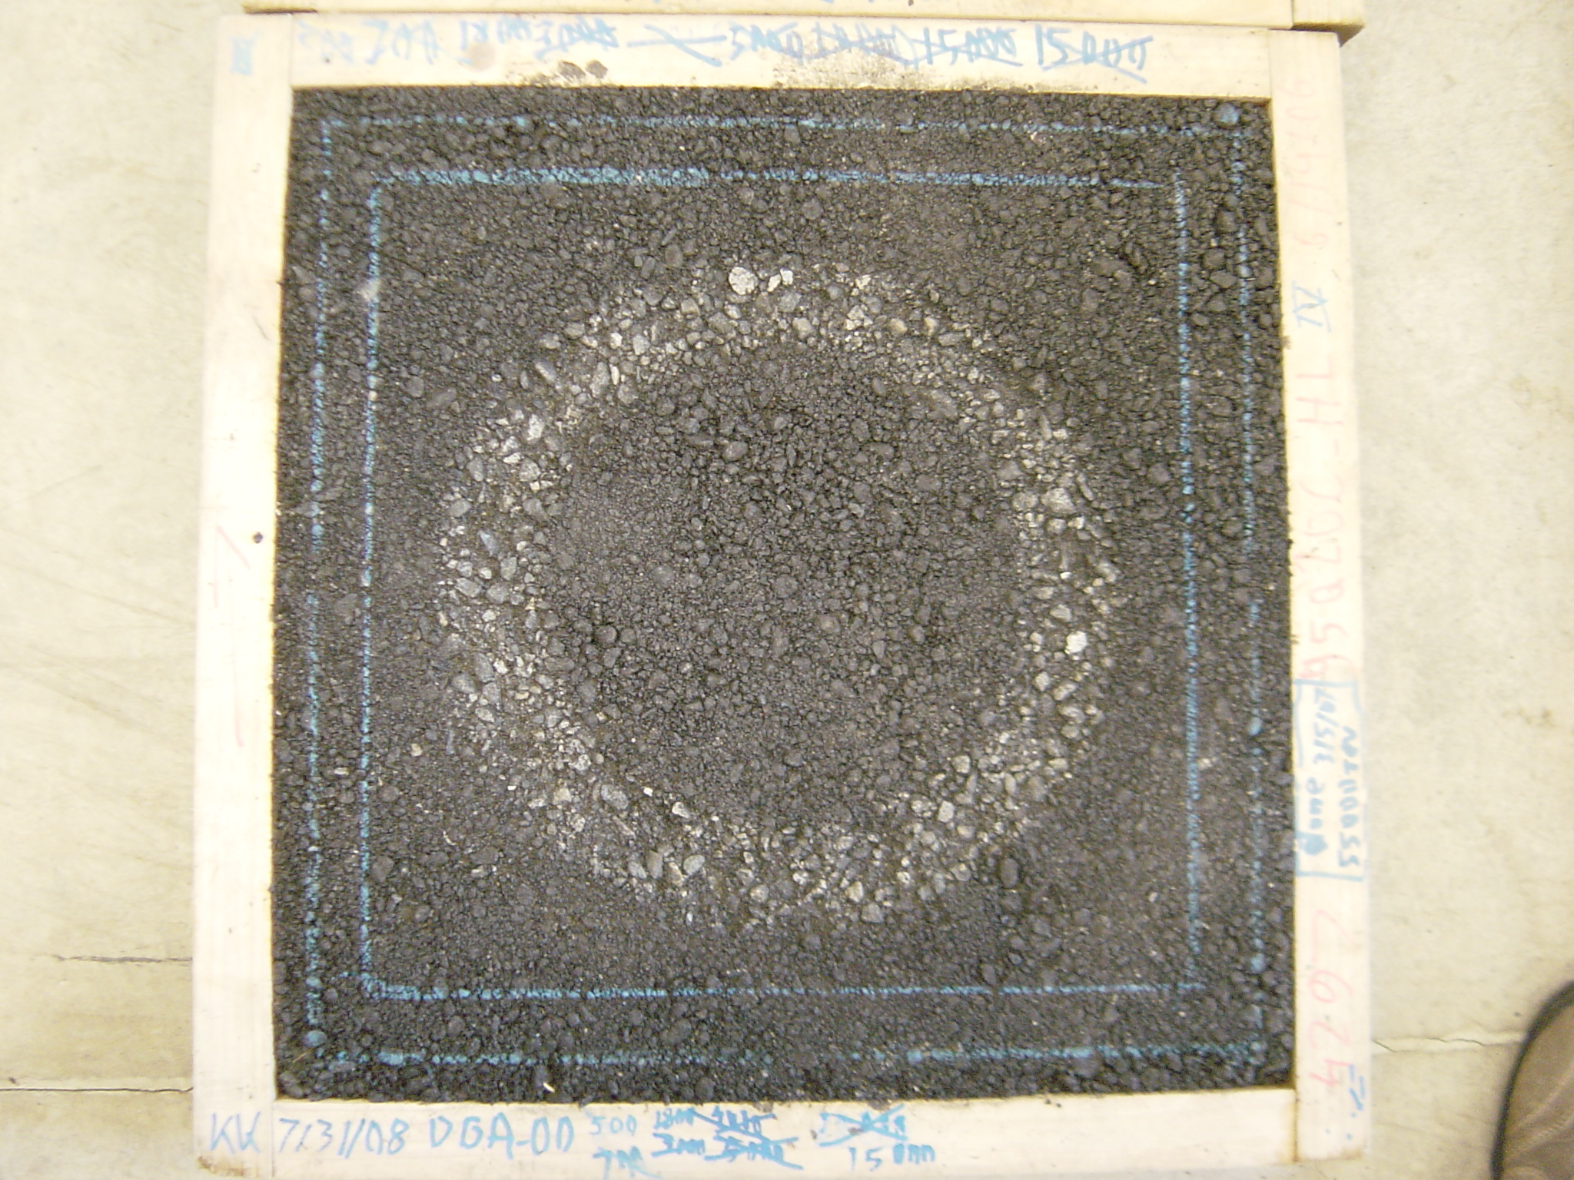
284mm diameter

Slide 30
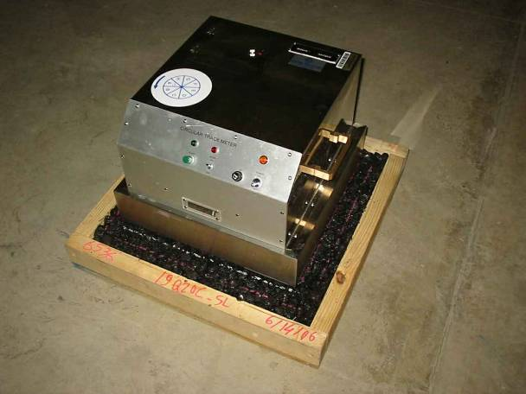
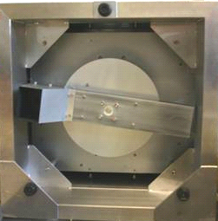

Slide 31
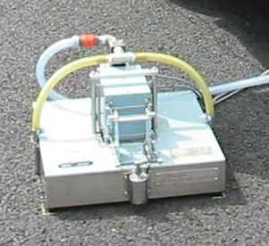

Slide 32
IFI (F60)

Slide 33
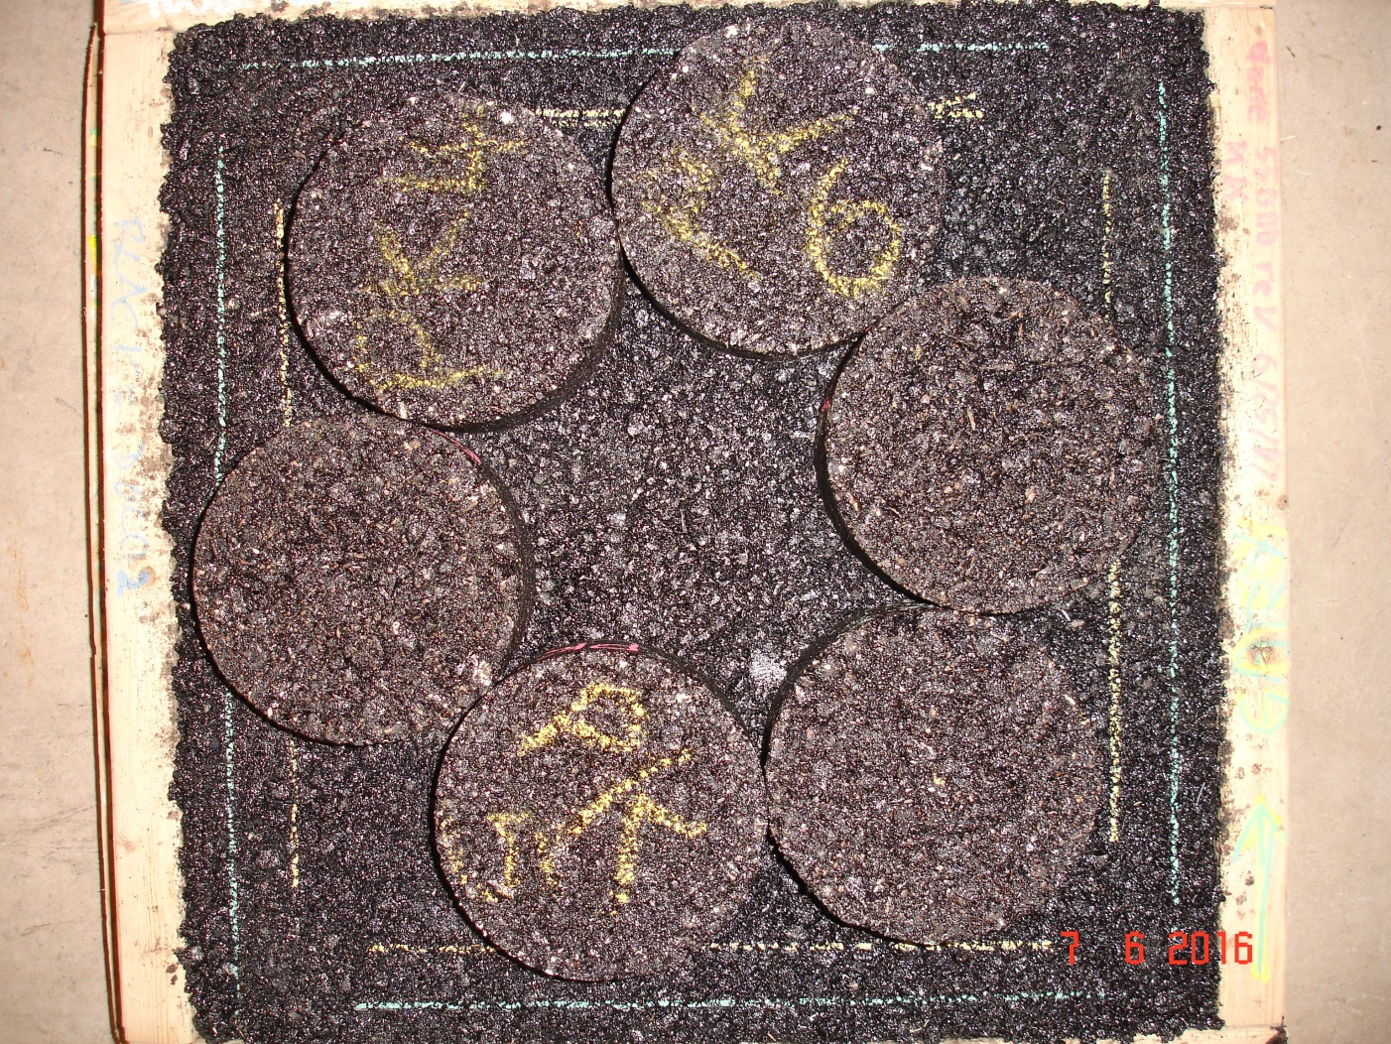
Can We Modify Method to Test Cores/Pills?

Slide 34
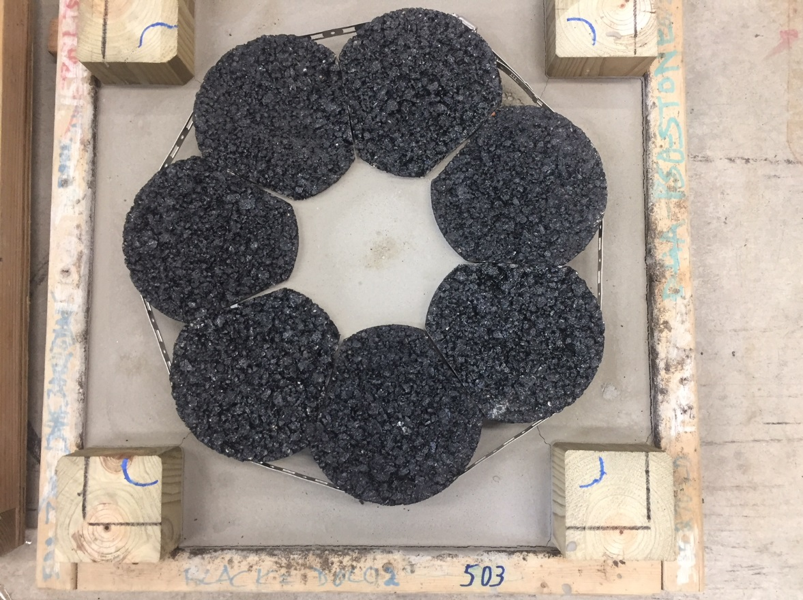
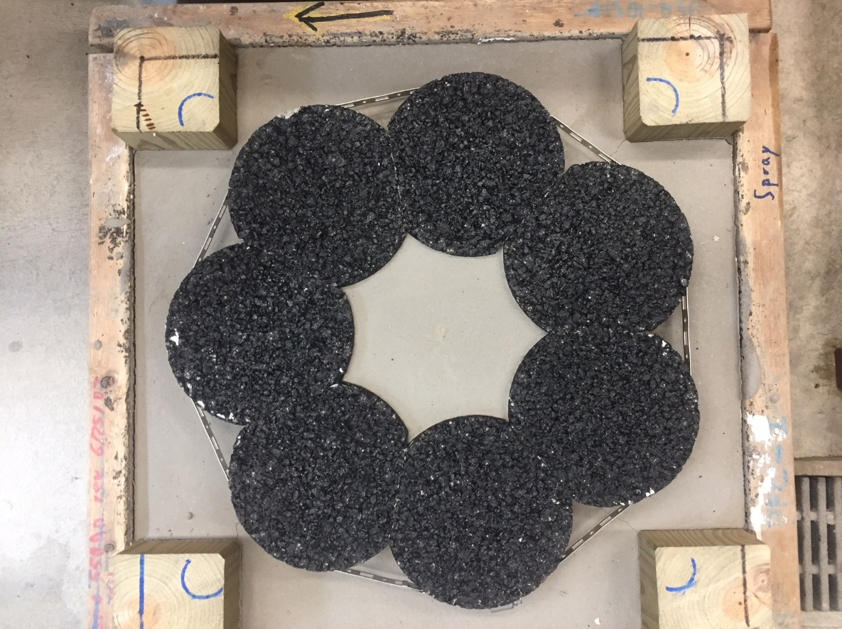

Slide 35
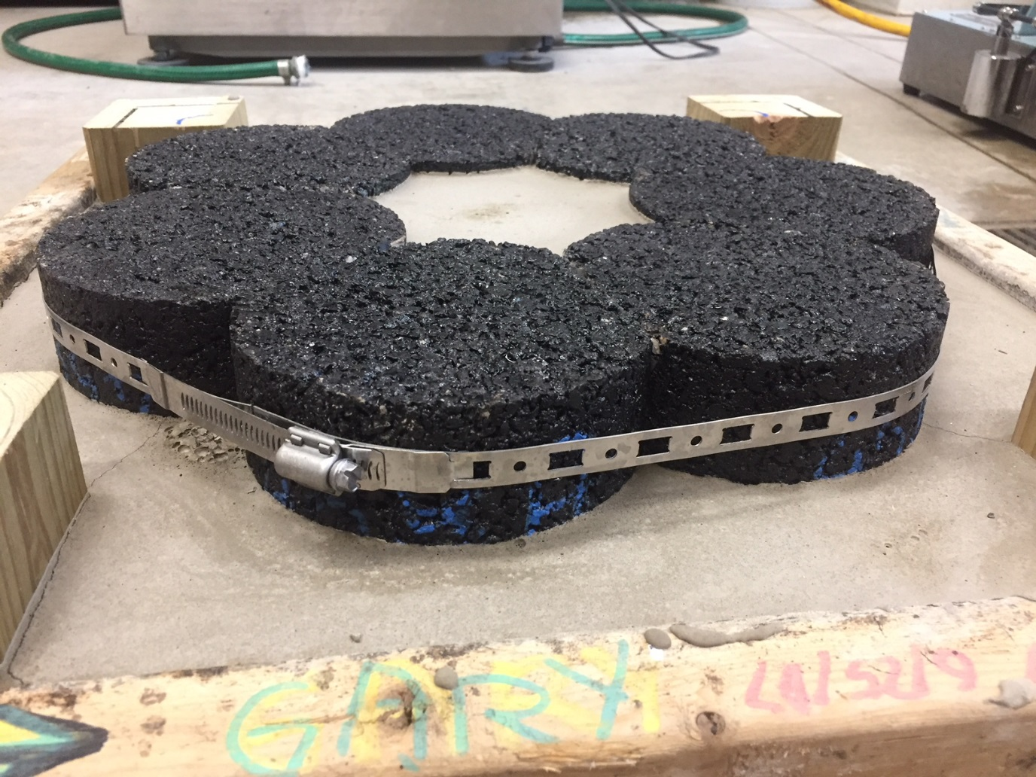
Clamping mechanism and self-leveling cement mortar.

Slide 36
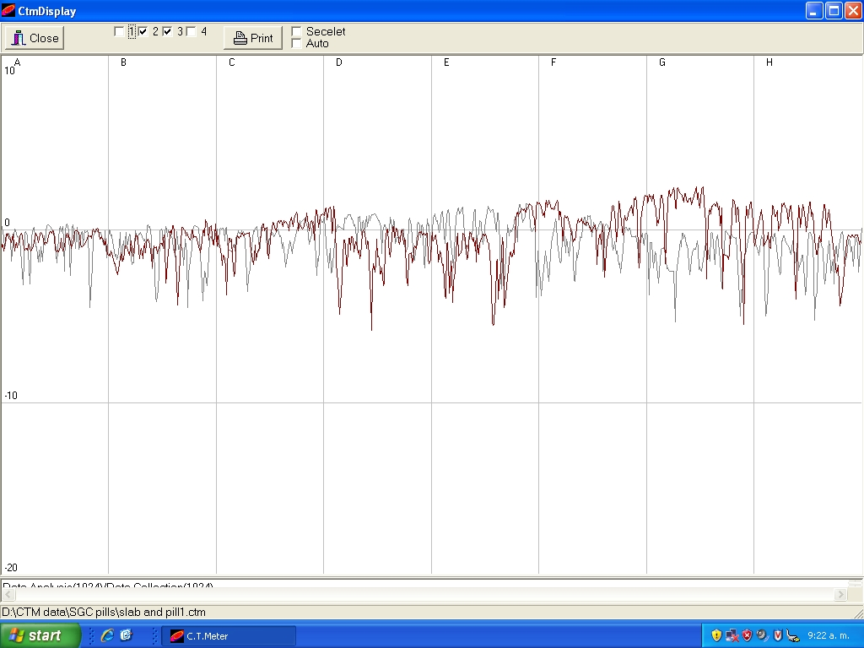
Texture Comparison
Grey = slab Red = pills

Slide 37
Proof of Concept
Geometry | DF | MPD (mm) | IFI
Slab | 0.328 | 0.74 | 0.23
Slab | 0.352 | 0.70 | 0.23
Pills | 0.354 | 0.65 | 0.23
Nominally 7.5 ± 0.5% air.

Slide 38
Tire-Pavement Noise
Field Evaluation of Porous Asphalt Pavements
PFC is similar to Georgia’s Porous European Mix (PEM)
Interconnected voids
  High permeability provides drainage and prevents clogging
Increased friction, especially wet
Reduced noise
Improved wet weather visibility

Slide 39
Design Gradations
100
80
control points
60
Cumulative % Passing
40
PFC
SMA
20
HMA
0
0.075 0.15 0.6 1.18 2.36 4.75 9.5 12.5
Sieve

Slide 40
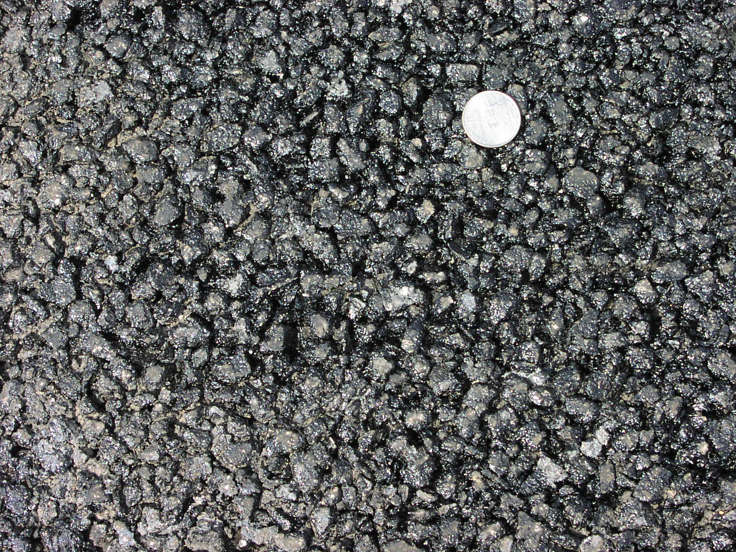
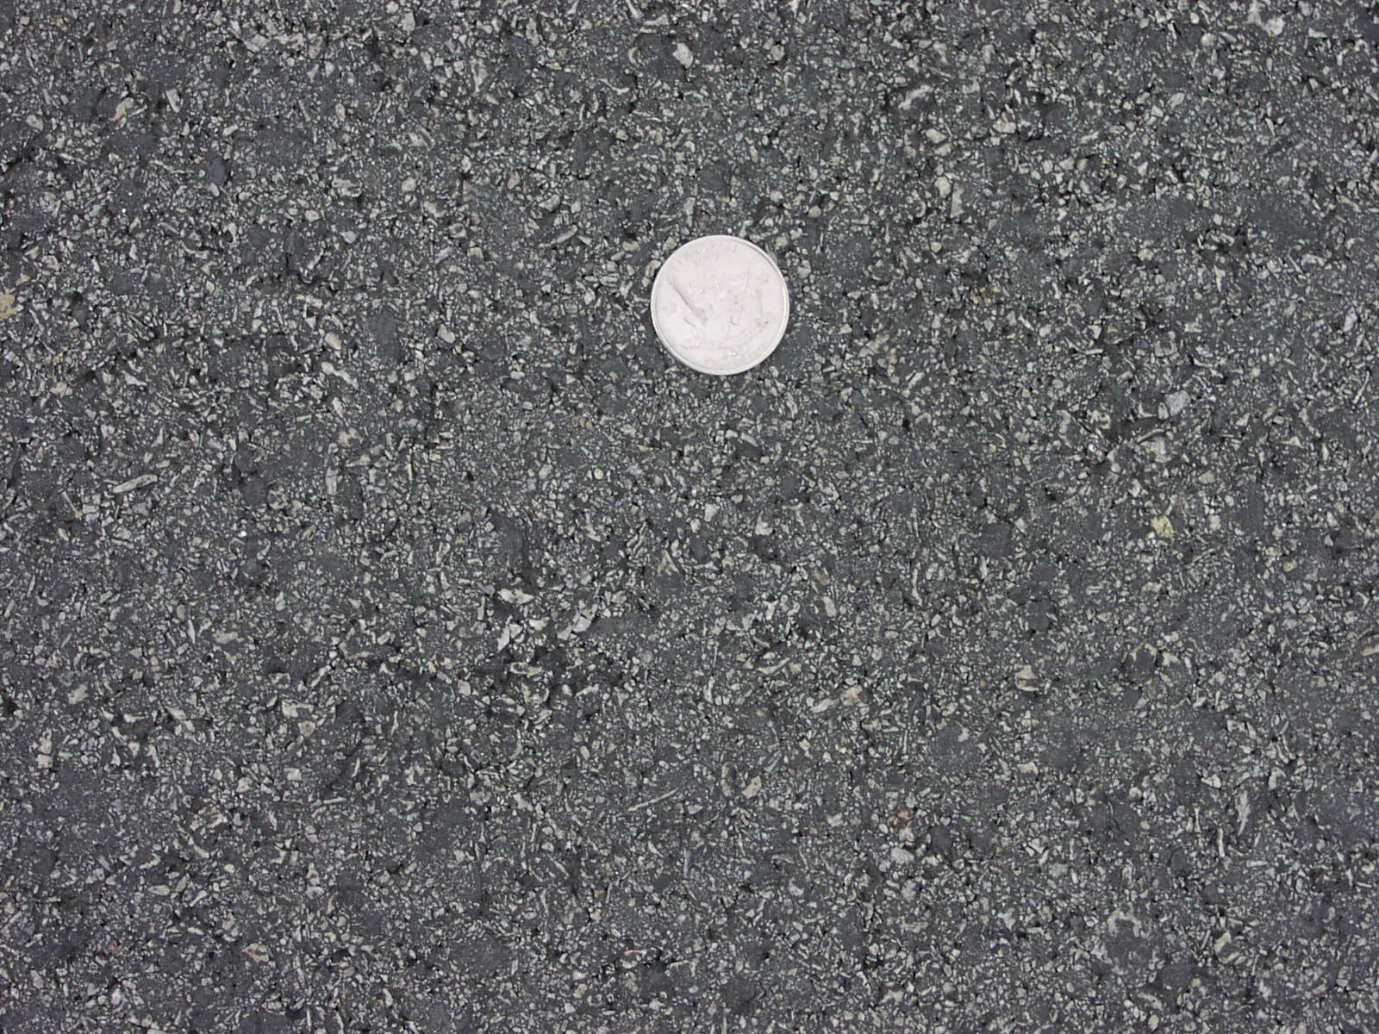
PFC vs Conventional Superpave

Slide 41
Field Data Comparison
Surface | DFT 20 | CTM | F60
Porous | 0.51 | 1.37 | 0.36
SMA | 0.37 | 1.17 | 0.28
HMA | 0.52 | 0.30 | 0.19
Porous and SMA tested before trafficking.

Slide 42
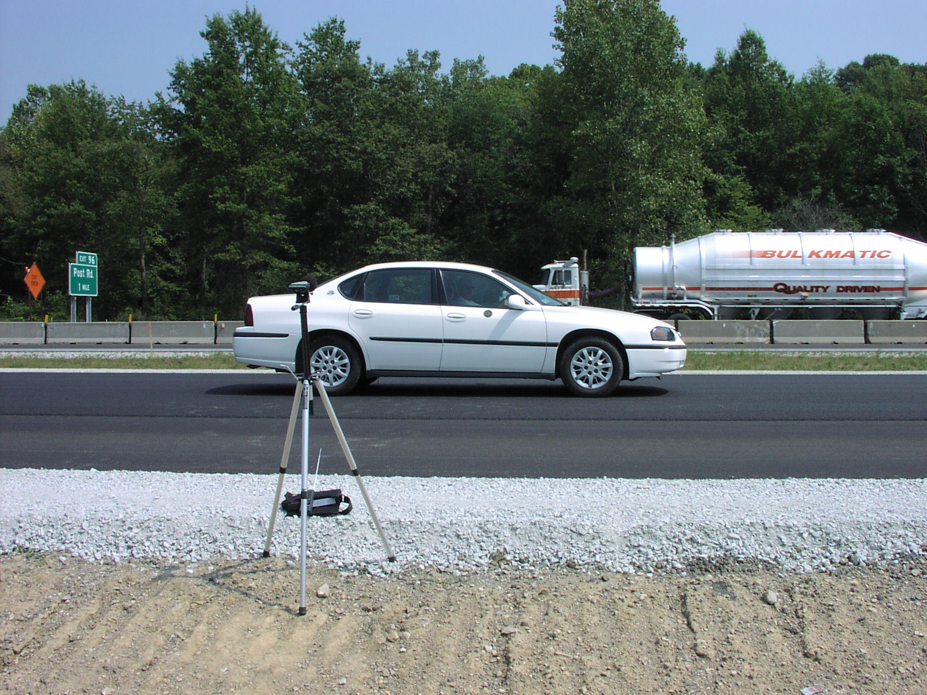
Sideline Noise Measurements

Slide 43
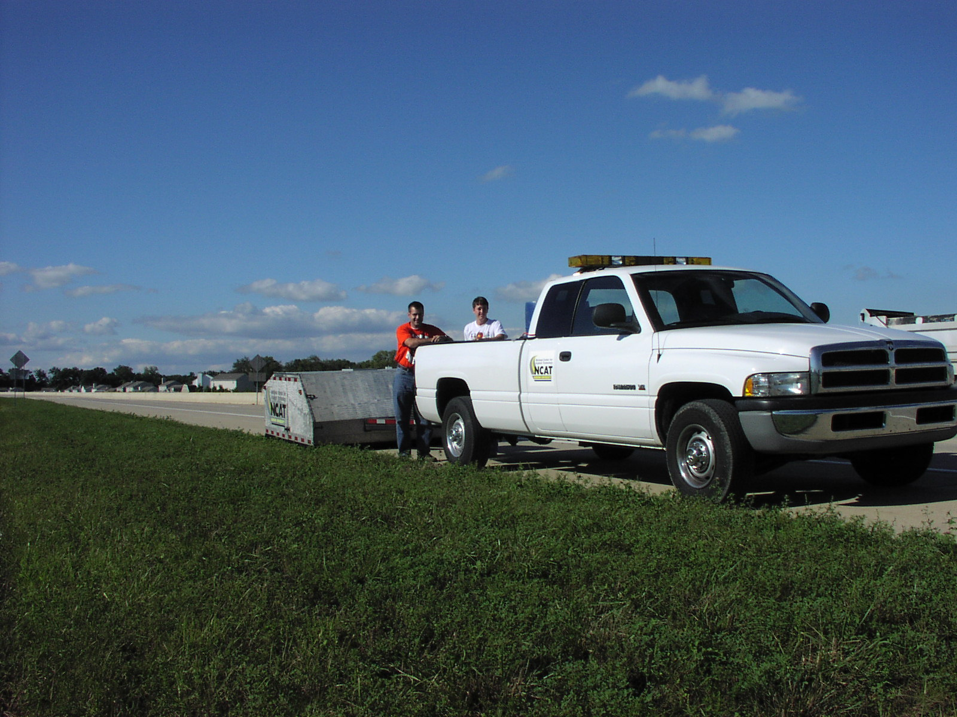
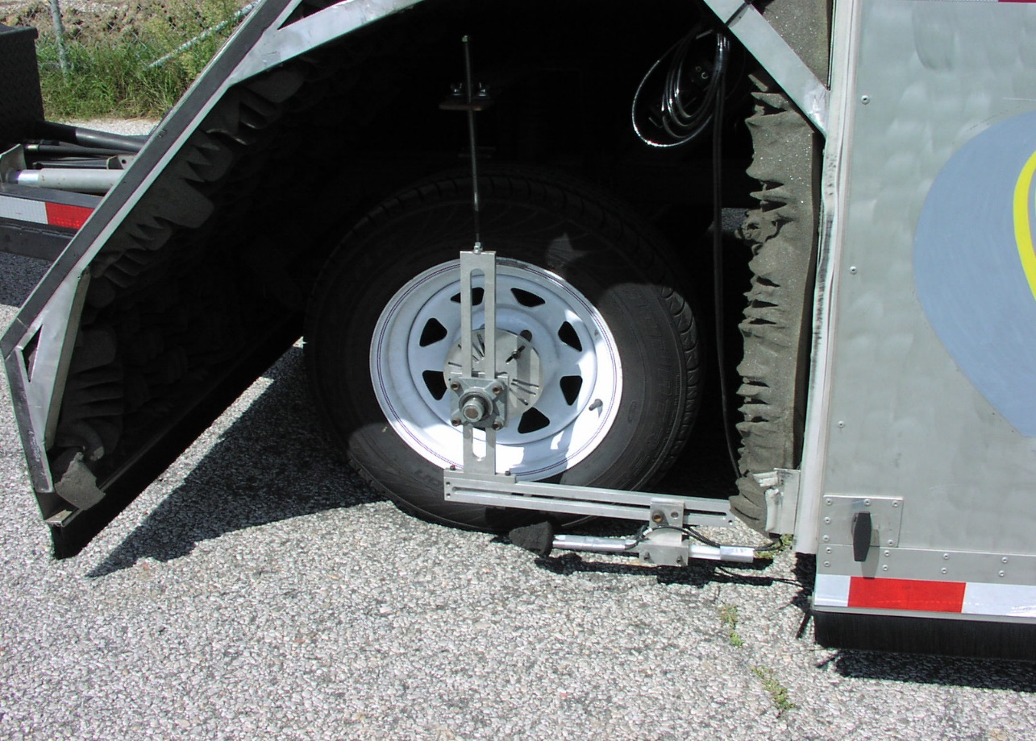
Close Proximity Trailer

Slide 44
CPX Data (dBA)
Speed | HMA | SMA | PFC
72 kph | 93.0 | 94.2 | 89.7
97 kph | 96.4 | 97.6 | 92.6

Slide 45
Comparison of Noise Levels
Surface | Sideline | CPX
PFC | 0 | 0
HMA | 2.1 dB higher | 3.6 dB higher
SMA | 5.9 dB higher | 4.8 dB higher

Slide 46
Tire-Pavement Noise
Hot Mix Asphalt Surface Characteristics Related to Ride, Texture, Friction, Noise and Durability
Developed models to predict noise based on texture, modulus (FWD), temperature.
MnROAD data

Slide 47
NCHRP Synthesis Projects
Pavement Patching Practices
  Patching practices for asphalt and concrete pavements.
  onlinepubs.trb.org/onlinepubs/nchrp/nchrp_syn_463.pdf
  Fiber Additives for Asphalt Mixtures
  Fibers for dense, open and SMA mixtures.
  onlinepubs.trb.org/onlinepubs/nchrp/nchrp_syn_475.pdf
Impact of Asphalt Lift Thickness on Pavement Quality
  In publication

Slide 48
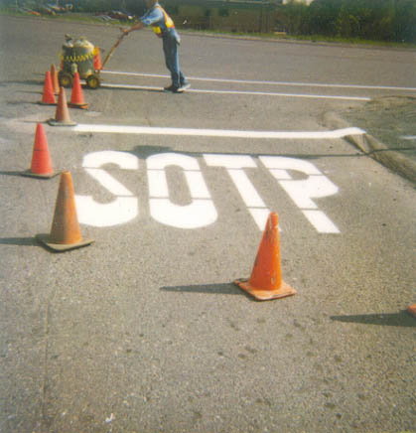


Rebecca McDaniel rsmcdani@purdue.edu
765/463-2317 ext 226 engineering.purdue.edu/NCSC https://docs.lib.purdue.edu/jtrp/

