Slide 1


Intelligent Compaction for Grading Materials

Slide 2
Intelligent Compaction Status
Natural Progression
Constraints
Quality
Acceptance
(Design Modulus
Met)
Quality Control
(ICMV Map)
Process Control
(Number of Passes)
One pass of roller provide one piece of information (ICMV) that influenced by several layers
ICMV is not an instantaneous value but an average value over the width of the roller and some length of project
Density and stiffness are not necessary related
Uncertainty in nonuniformity of soils and aggregates should be considered in solution
2

Slide 3
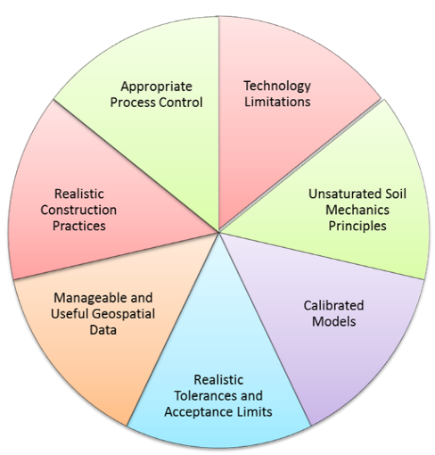
Motivation of Study
There are many known advantages to IC
Significant progress in theoretical, interpretation and instrumentation aspects of IC have been made
How come IC is not implemented more widely?

Slide 4

Intelligent Compaction Parameters
For Quality Control
(Uniformity)
For Quality Acceptance
(Stiffness Extraction)
CMV
E_{vib}
CCV
K_{b}
MDP
VCV
4

Slide 5
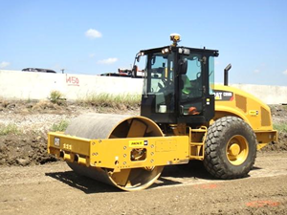
Ultimate Goal
“to develop procedure(s) that measure
mechanical properties
of earth materials to
facilitate adoption
of IC technologies for field
acceptance”
E (Modulus, MPa)
k (Stiffness, MN/m)
Straightforward specification
Solid to minimize dispute
5

Slide 6
Framework of Proposed IC Specifications
Step 1: Estimate properties of all layers as done in design
Step 2: Obtain target ICMV and target modulus
Step 3: Pre-map layer of interest to assess uniformity and condition of foundation layer
Step 4: Let contractor perform compaction to achieve target ICMV/stiffness in his/her judgement
Step 5: Map compacted layer
Step 6: Post-Processing to Extract Mechanical Properties
6

Slide 7
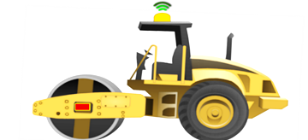
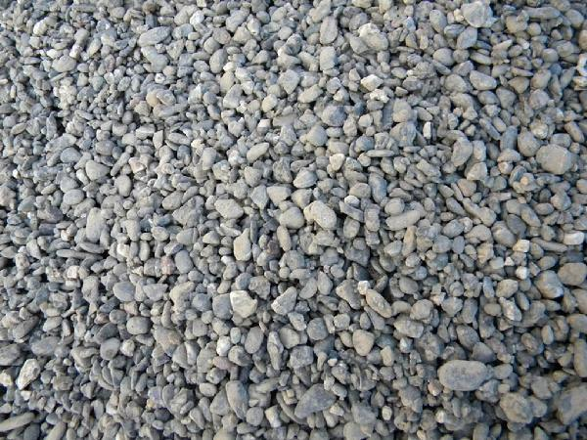
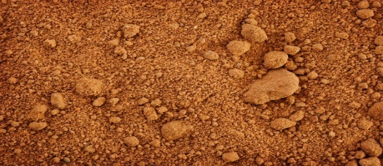
Definition of Mechanical Property
Only Mapping
Premapping & Mapping
A single value
  Equivalent modulus down to influence depth of roller.
Two values
  Modulus of a top layer
  Equivalent Modulus of foundation layers down to influence depth of roller.
h
h
7

Slide 8

Desire for Straightforward Specification
From a Blackbox
To Well-Defined Process
E_{vib}
K_{b}
VCV
8

Slide 9
Desire to Minimize Dispute
Owners
Contractors
Discuss all aspects of quality management with IC
Deliberate all assumptions
Agree on acceptable assumptions that all can live with
Define criteria for acceptance
Discuss remedial solutions
9

Slide 10
Practical IC Specification for Earthwork (Some Major Items)
Best Approach to Measure Mechanical Properties of Geomaterial
    Setting Target Value, ・Extracting Mechanical Properties
Optimal Simulation Method for Estimating Target Value
    Minimizing Calculation Time, Maximizing Accuracy
Optimal Inverse (Backcalculation) Algorithm
    Ensure Required Level of Accuracy , ・Minimize Amount of Time,
    Consider Depth of Influence of IC Roller
Considering Impact of Non-uniformity on ICMV
    Material-Related, ・Moisture-Related
Practicalities
    Optimal Combination of Roller Size/Vibration Frequency/Amplitude/Speed
    Optimize contractors’ desire for accelerating production vs. obtaining high quality and uniform product, ・How to present the results
10
10

Slide 11
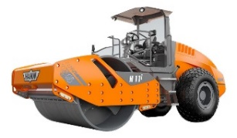
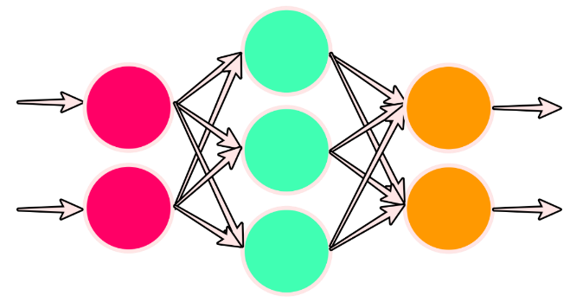
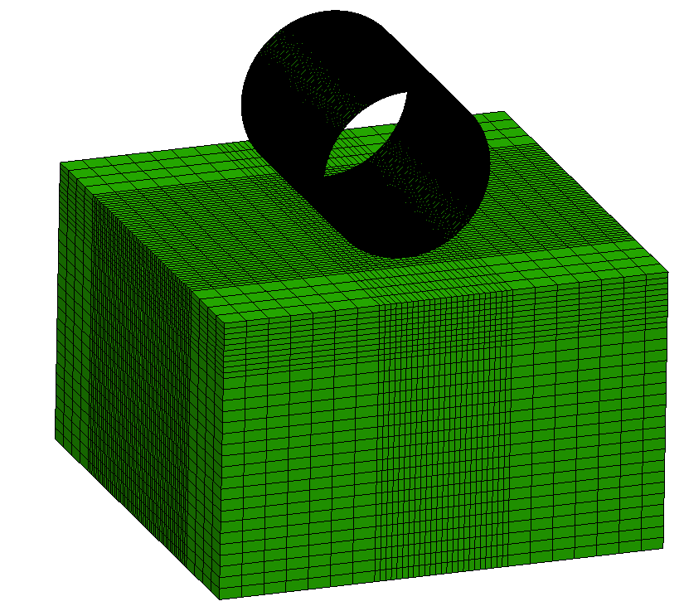
How to Set Target ICMV
Set at the time of Pavement Design
Soft Computing
Simulation of Roller Measurements (Forward Model)
Select Roller Parameters
Select Material Type for Layers
Estimate Layer Properties
inputs
output
Understand Behavior then Simplify
Sensitivity Analysis
Static vs.
Dynamic
Stationary vs. Vibratory
Linear vs.
Nonlinear
Layer Thickness
Drum Dimensions
Nonlinear k Parameters
Inputs
?
11

Slide 12
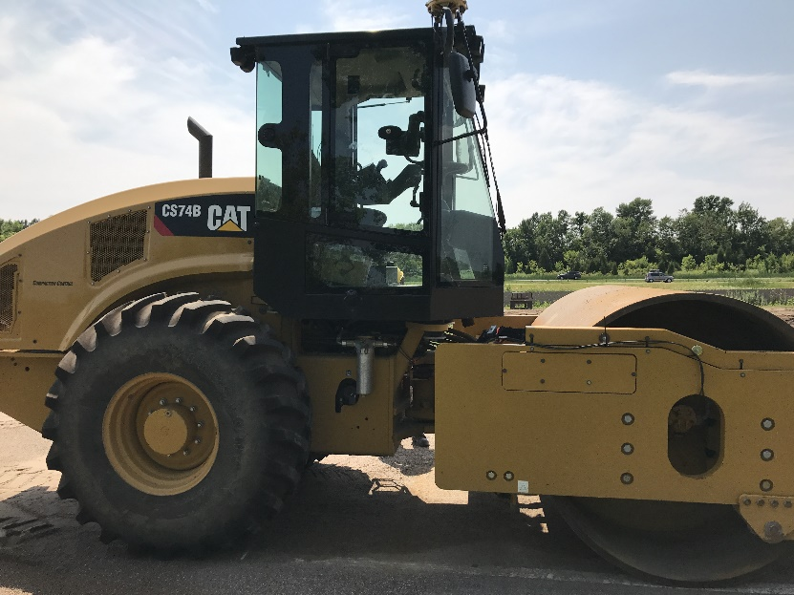
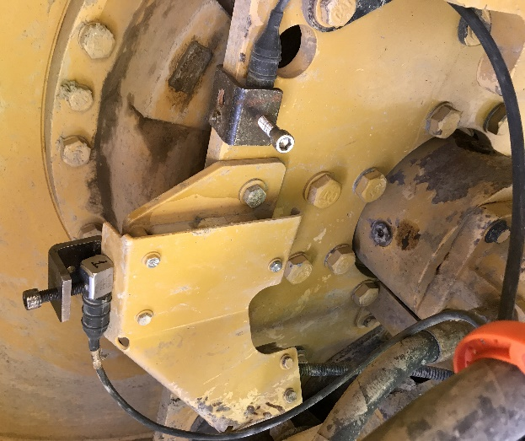
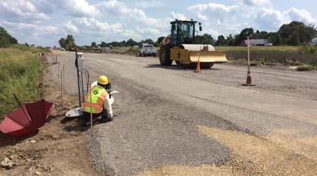
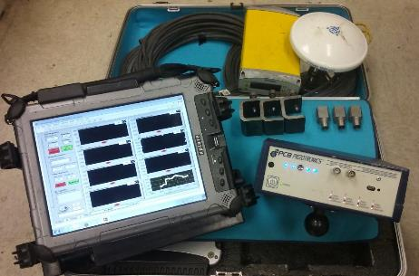
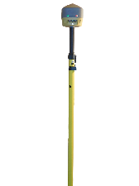
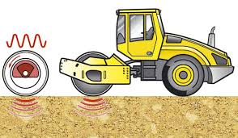
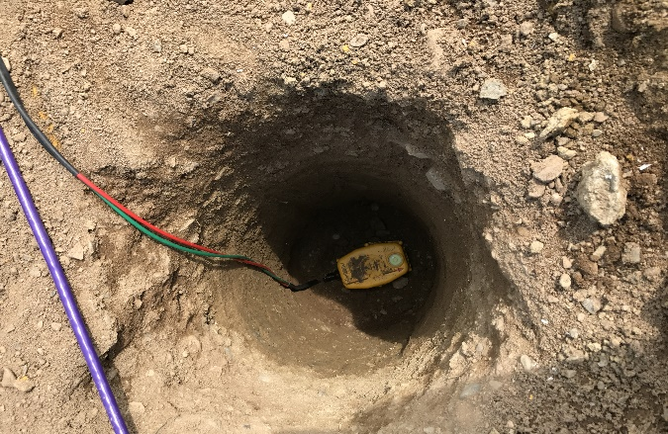
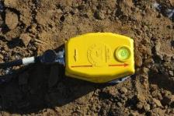
Calibration of Model
GPS Antenna
Accelerometers and Connections to DAQ
Accelerometers
Data
Acquisition
Box
Moving Direction
Moving Direction
GPS
Antenna
Mounted
Accelerometer
Geophones
Roller DAQ
Ground DAQ
h₁
h₂
Embedded
Geophones
12

Slide 13

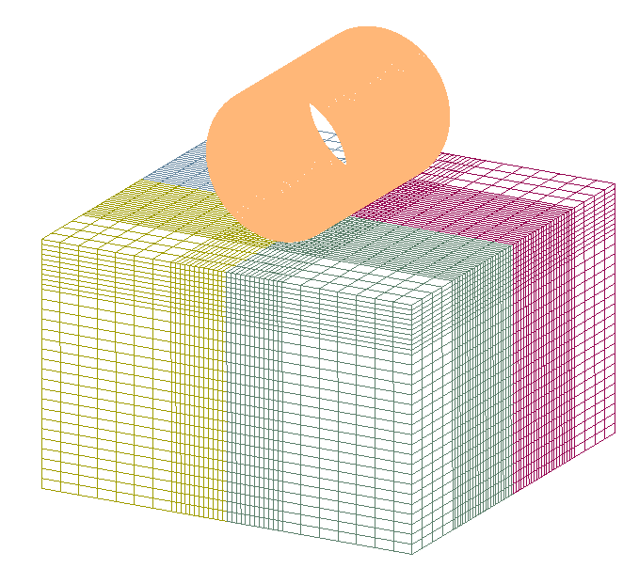
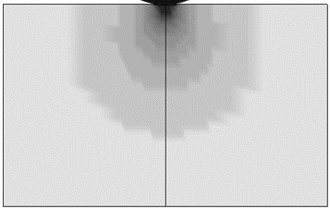
Calibration of Model
Moving Direction
Moving Direction
GPS
Antenna
Roller DAQ
Mounted
Accelerometer
h₁
Ground DAQ
h₂
Embedded
Geophones
Calibration
Drum
FE Model
Pavement
Geophone
Depths
13

Slide 14
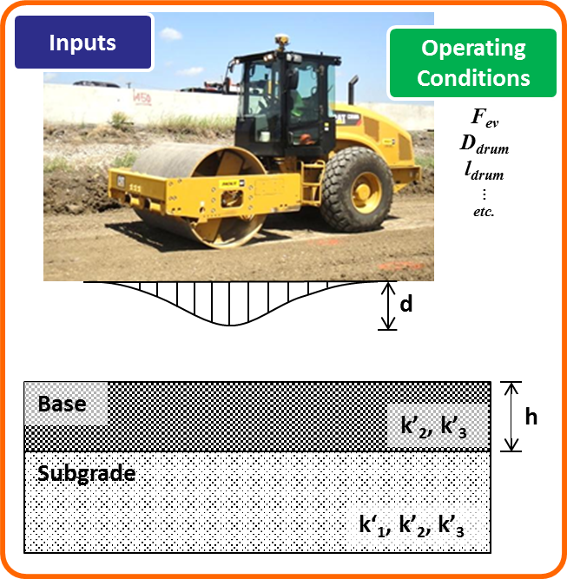
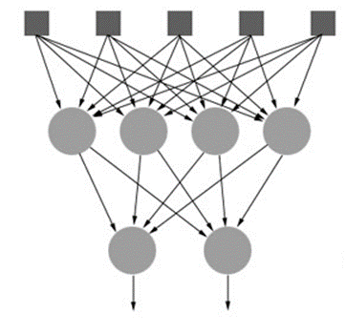
Development of Artificial Neural Network (ANN)
Number of input parameters | 5
Number of hidden layers | 1
Number of neurons in hidden layer | 20
Inputs pre-processing function | Sigmoid function
Outputs post-processing function | Linear function
Neural network type | Feed-forward
Network training algorithm | Bayesian Regularization Backpropagation
Number of epochs (maximum number of training iterations before training is stopped) | 1000
Training ratio | 70%
Validation ratio | 15%
Testing ratio | 15%
ANN
Validation
Optimize
14

Slide 15
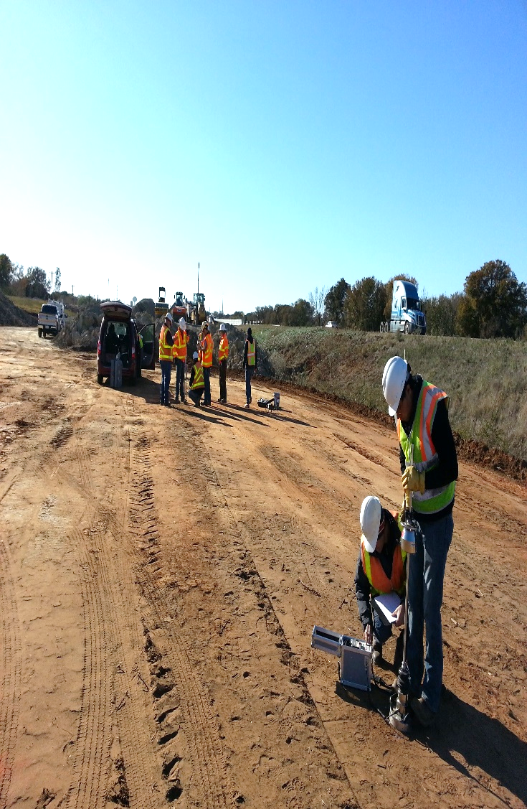
Modulus
Local Calibration
LWD
15

Slide 16
Improve colormaps
Mazari et al. (2017) Impact of Geospatial Classification Method on Interpretation of Intelligent Compaction Data
16

Slide 17
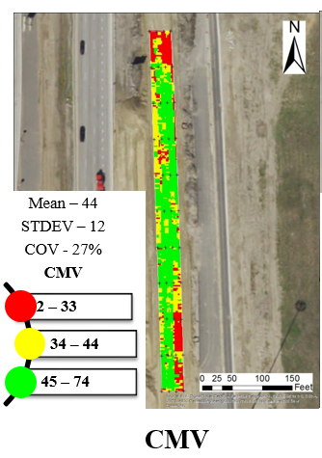
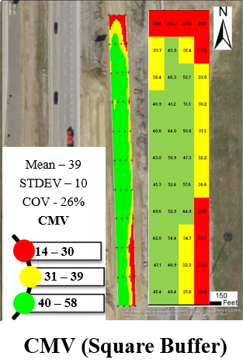
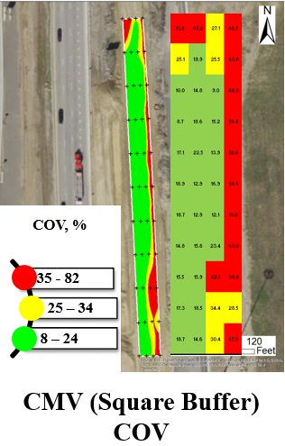
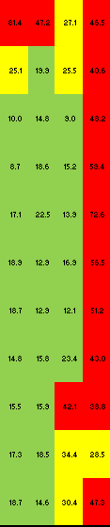
ICMV Distribution
17

Slide 18
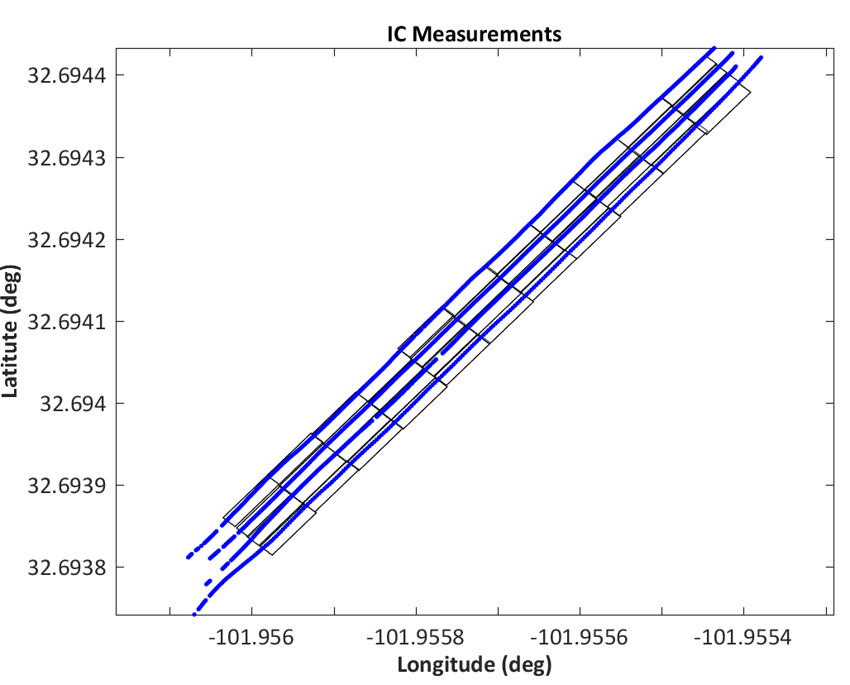
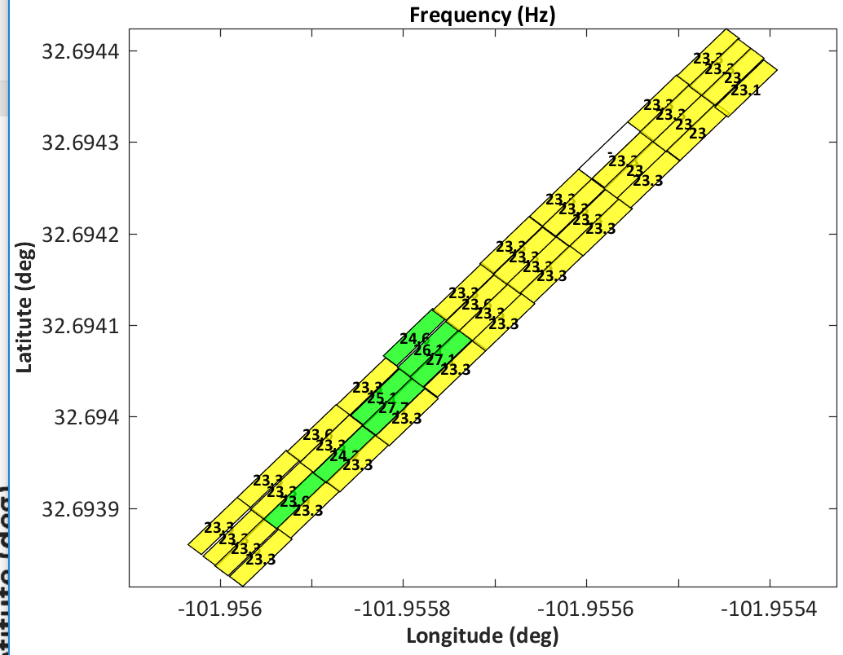
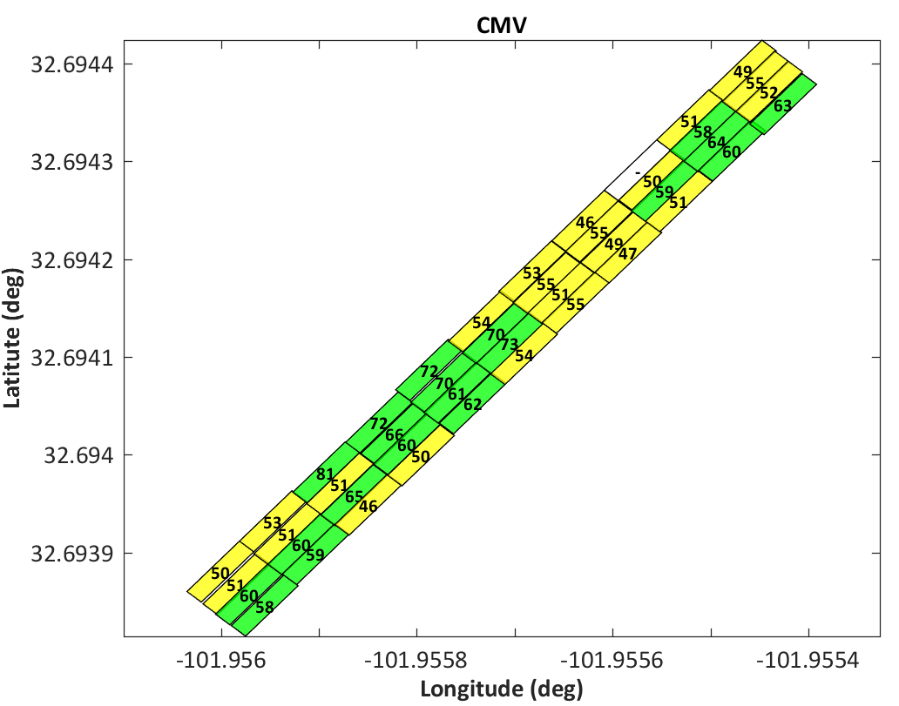
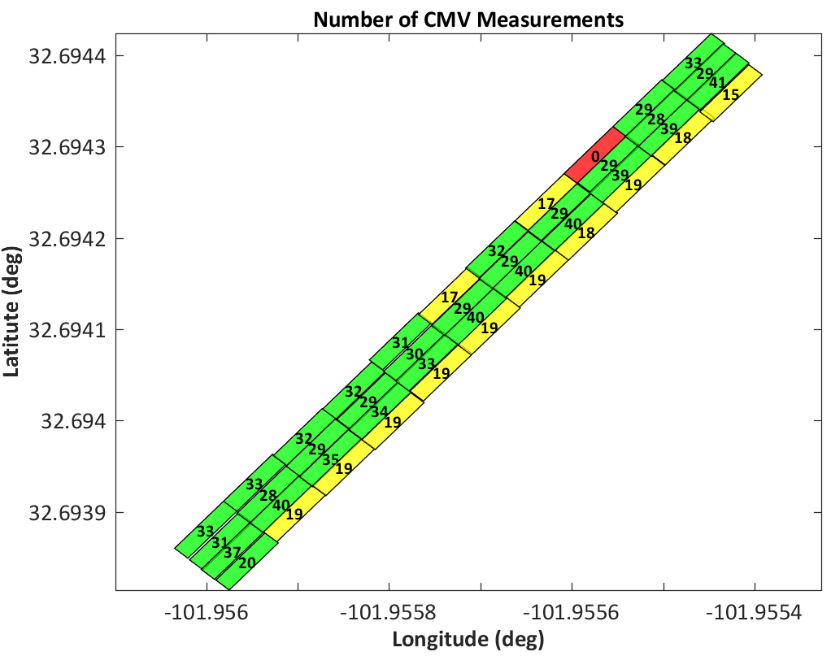
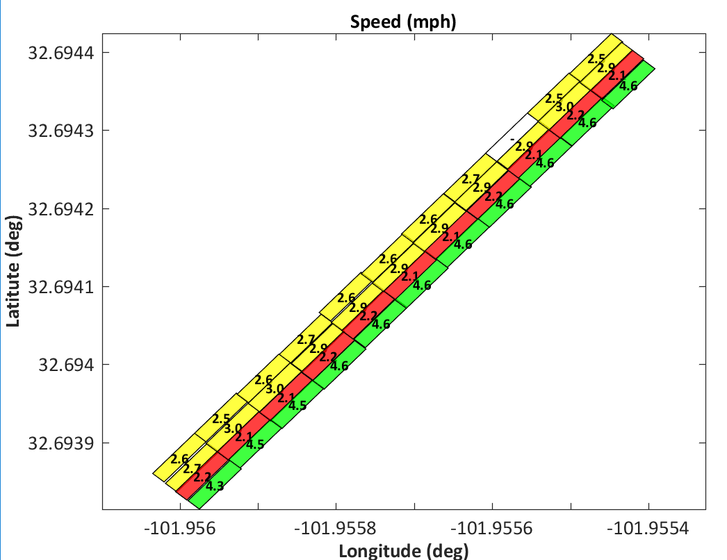
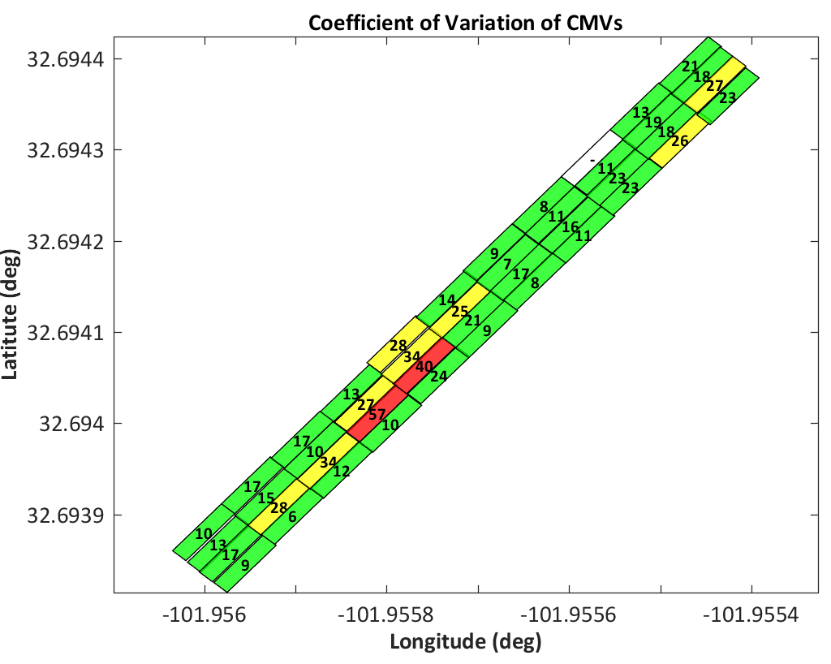
Achieving Real Time Data Analysis & Quality Control
18

Slide 19
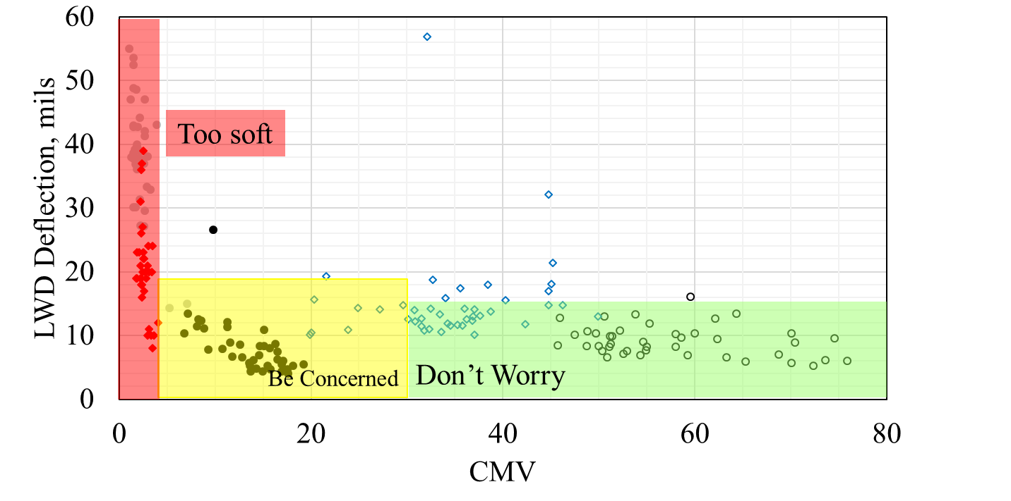
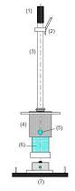
Our Observations
Too soft
Be Concerned
19

Slide 20
Proposed Final Protocol
Proof-Map Lot
Cells with high COV
COV > 50%
Cells with low COV
COV < 35%
Cells with moderate COV
35%<COV < 50%
Rework
Uniformity not achieved
CMVs > 30
30 > CMV > 5
CMVs > 5
CMVs ≤ 5
Accept with 3 LWD Tests
Accept with 7 LWD Tests
7 LWD
Tests in Red Areas
Rework
Too soft to test!
20

Slide 21
What have we learned
Achieving density is necessary but not sufficient
  Density and modulus are not directly related.
  A number of sites that achieved density failed to yield moduli that met design requirements (sometimes by wide margin).
  Areas with low subgrade moduli propagate all the way to the surface.
Earthwork final product is inherently variable, we need to manage it (not ignore it)
  A reasonable amount of variability should be accepted to be practical
  IC can quantify variability in a real time manner
  Use average results of more data points with a faster field tests
    time to run 3-7 LWD = time to perform one NDG
TxDOT 0-6903 - 21
21

Slide 22
Final Words
IC technology for quality management makes perfect sense to make sure that
  final product is uniform (achievable now)
  design modulus has been met (achievable in near future)
Even though conceptually mature, there are still institutional and technical details to work out
These details can be worked out in a straightforward manner if we work together
22

Slide 23


Happy IC’ing!!
23

Slide 24






Thank you!!

