Slide 1

National Road Research Alliance
Flexible Team Update
Barry Paye, PE – Wisconsin DOT
Chief Materials & Pavement Engineer
Barry.paye@dot.wi.gov

Slide 2
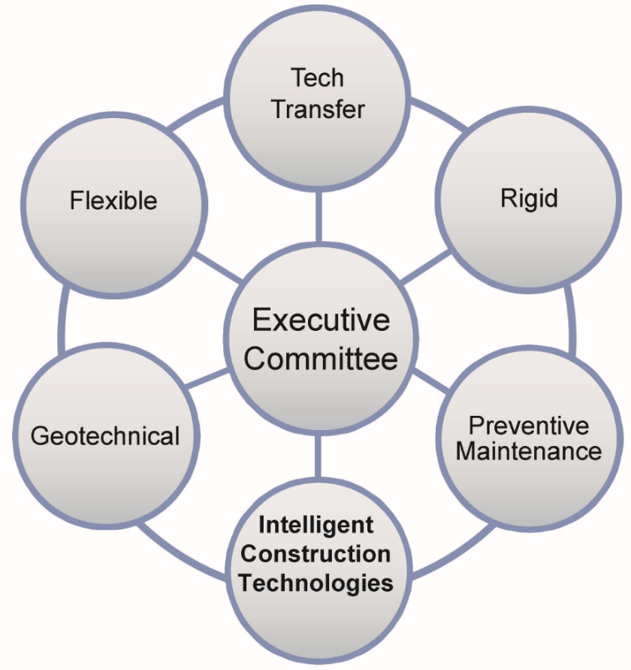
NRRA - Flexible Team Update
Team Members
Agency Members
Paul Denkler, Missouri Department of Transportation
Shongtao Dai, Minnesota Department of Transportation
James Foldesi, St. Louis County Minnesota
Kee Foo, Caltrans – California Department of Transportation
John Garrity, Minnesota Department of Transportation
Steve Hefel, Wisconsin Department of Transportation
Kevin Kennedy, Michigan Department of Transportation
Dan Kopacz, Wisconsin Department of Transportation
Dan Oesch, Missouri Department of Transportation
Greg Olson, North Dakota Department of Transportation
Barry Paye (Chair), Wisconsin Department of Transportation
Raghubar Shrestha, Caltrans – California Dept of Transporation
Jim Trepanier, Illinois Department of Transportation
Charles Wienrank, Illinois Department of Transportation
Tyler Wollmuth, North Dakota Department of Transportation

Slide 3
NRRA - Flexible Team Update
Team Members
Associate Members
Jay Bianchini--Collaborative Aggregates
Justin Black--Cargill
Brandon Brever --Minnesota Asphalt Pavement Association (MAPA)
Tom Brovold--Testquip
Gina Buccelato--3M Transportation Safety Division
Mike Byrnes--Mathy Construction Co.
Andy Cascione--Flint Hills Resources
Jo Sias Daniel--University of New Hampshire
Stacy Glidden--Payne & Dolan
Kris Hansen-- 3M Transportation Safety Division
David J. Jones--University of California Pavement Research Center
Nathan Just--Caterpillar Paving Products
Lev Khazanovich--University of Pittsburgh
Brett Lambden--Husky Energy
Todd Mansell--Caterpillar Paving Products

Slide 4
NRRA - Flexible Team Update
Team Members
Associate Members - Continued
Mihai Marasteanu--University of Minnesota – Twin Cities
Ken Maser--Infrasense
Kiran Mohanraj--Transtec Group
Dave Rettner--American Engineering Testing
Mohammad Reza Sabouri--Braun Intertec
Guy Sisler--Husky Energy
Dan Staebell--Asphalt Pavement Alliance (APA)
Brandon Strand--Asphalt Pavement Alliance (APA)
Kim Tolzmann--Hardrives
Randy West--National Center for Asphalt Technology (NCAT)
Jason Wielinski, ARRA
Chris Winiecki--Payne & Dolan
Zhanping You--Michigan Tech Transportation Institute

Slide 5
NRRA - Flexible Team Update
Team Members
Friends & Supporting Staff
Ryan Baasen, Minnesota Department of Transporation
Brian Bennes,North Dakota Department of Transportation
Tim Clyne, Minnesota Department of Transportation
Dave Van Deusen, Minnesota Department of Transportation
Curt Dunn, North Dakota Department of Transportation
Mohamed Elkashef--University of California Pavement
Research Center
Jerry Geib, Minnesota Department of Transportation
Kevin Kliethermes, FHWA
Joe Korzilius, SRF Consulting
Renae Kuehl, SRF Consulting
Korby Seward, North Dakota Department of Transportation
Ben Worel, Minnesota Department of Transportation

Slide 6
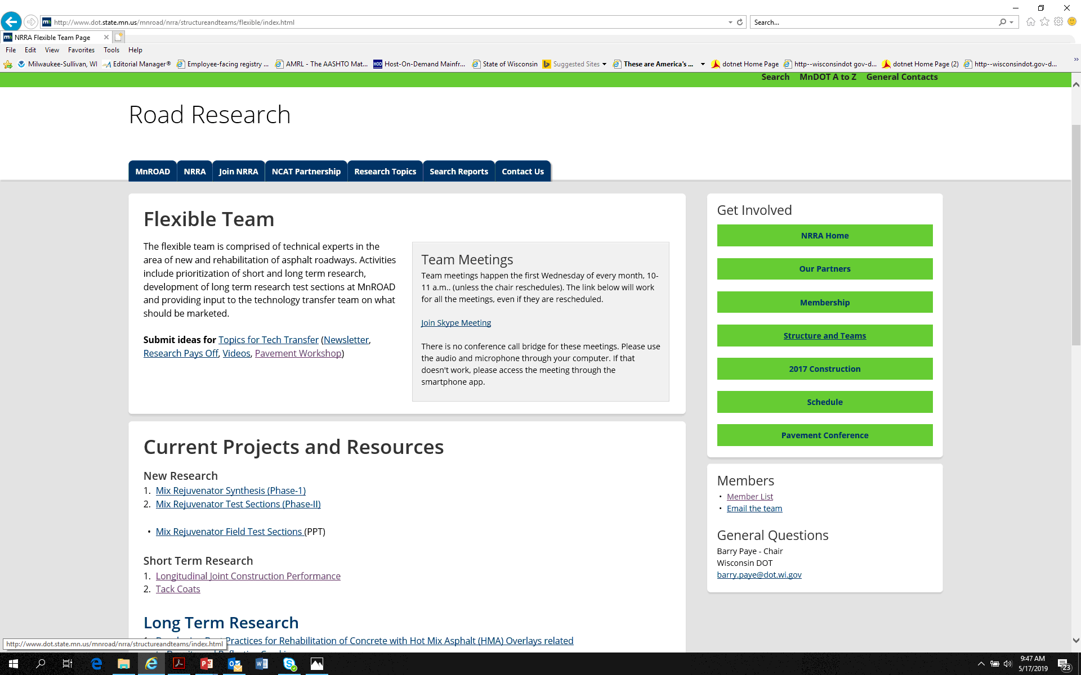
NRRA - Flex Team Update
Website

Slide 7
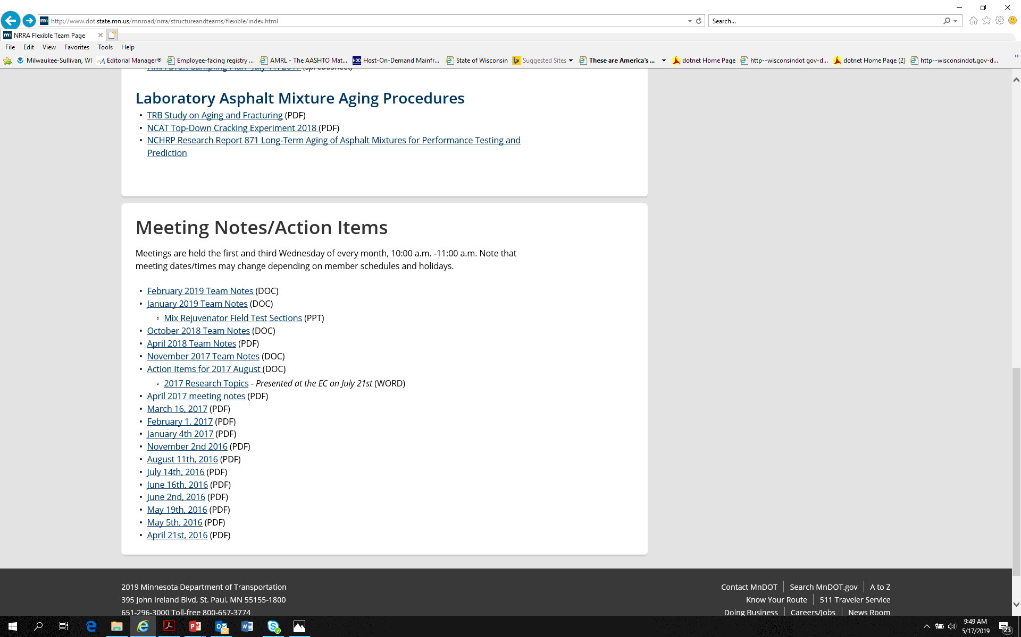
NRRA - Flex Team Update
Website

Slide 8

2017 Short Term Research
NRRA Team | Topic
Flexible | Tack Coats
 | Longitudinal Joint Construction Performance
Rigid | Design and Performance of Concrete Unbonded Overlays
 | Repair of Joint Associated Distress Pavements
Geotechnical | Larger Subbase Materials
 | Subgrade Design for New and Reconstructed Roadways
Pavement Maintenance | Surface Characteristics of Diamond Ground PCC Surfaces
 | Pavement Preservation Approaches for Lightly Surface Roadways
SRF Consulting
Notes:
Team Leads Discuss each topic

Slide 9

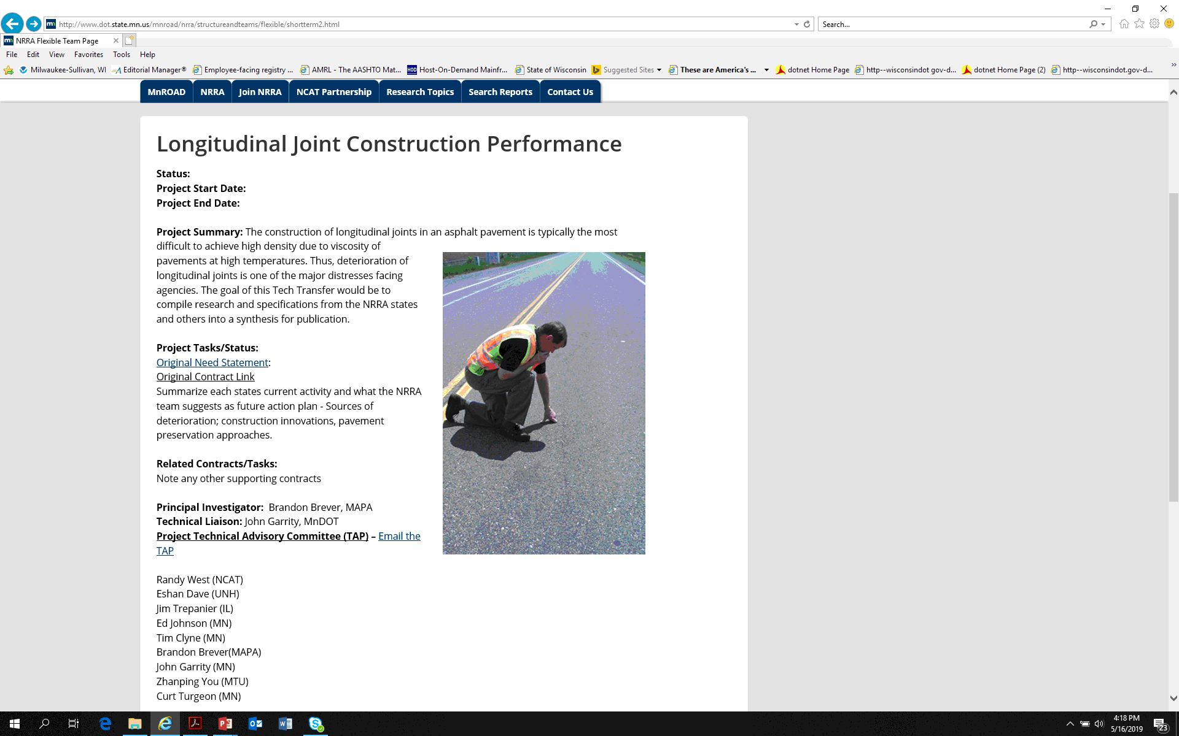
Short Term Research – Longitudinal Joints
Notes:
From the Preventive Maintenance , home page, click on links to all the project web pages.

Slide 10
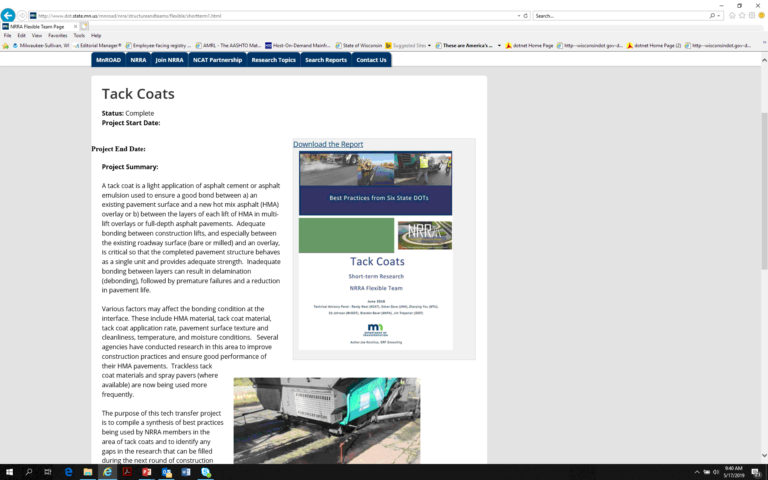
Short Term Research – Tack Coats
Notes:
From the Preventive Maintenance , home page, click on links to all the project web pages.

Slide 11
2019 Short Term Research
Technology Transfer
NRRA Team | Topic
Flexible | NRRA - Mix Rejuvenator Synthesis (Phase-1) – 1:00 on Thursday
Pavement Maintenance | NRRA Spray on Rejuvenator Synthesis
 | Service Life Enhancement of Substrates Overlaid with Thin Overlays (UTWBC, Chip Seals & Microsurfacing)
 | Concrete Pavement Restoration (CPR) for Bonded Concrete Overlays of Asphalt (BCOA)
SRF Consulting
Notes:
Team Leads Discuss each topic

Slide 12

Long Term Research
Flexible Team
Team | Projects | Contractor
2017 Flexible | HMA Overlay of PC and Methods of Enhancing Compaction | University of New Hampshire
 | Cold Central Plant Recycling | American Engineering and Testing
2019 Flexible | Mix Rejuvenator Test Sections (Phase-II) | TBD
Notes:
Team Leads Discuss each topic

Slide 13
Long Term Research
Flexible Team
Team | Projects | Contractor
2017 Flexible | HMA Overlay of PC and Methods of Enhancing Compaction | Update – 12:45 Today
 | Cold Central Plant Recycling | Update – 12:45 Today
2019 Flexible | Mix Rejuvenator Test Sections (Phase-II) | TBD
Notes:
Team Leads Discuss each topic

Slide 14
2017 - HMA Overlay and Rehab of Concrete and Enhancing Compaction

Slide 15
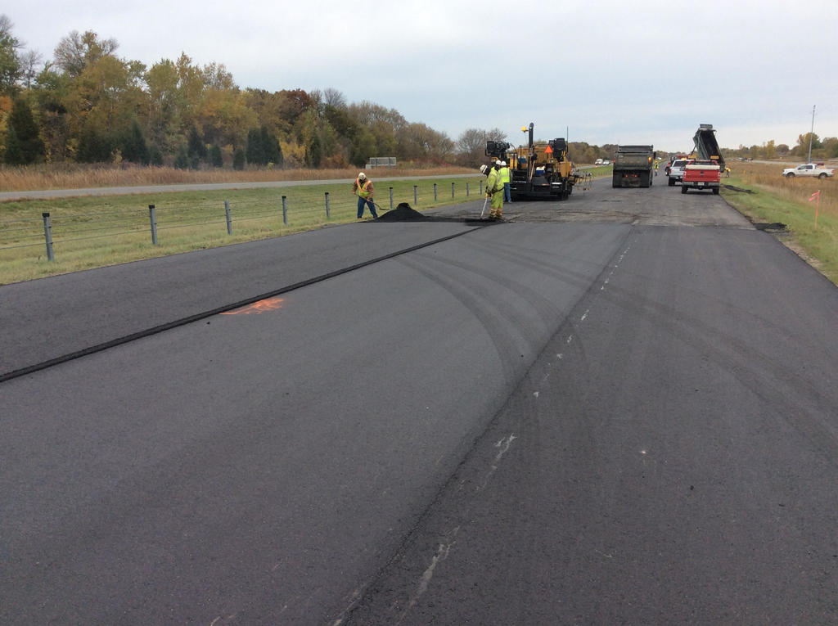
HMA Overlay and Rehab of Concrete and Methods of Enhancing Compaction
DESCRIPTION | CELL | DEPTH (inch) | MIX DESCRIPTION (NMAS, mm) | BINDER | DESIGN VOIDS
Control Section | 983 | - | - | - | -
HMA over PCC (1 lift) | 984 | 1.50 | Superpave (9.5) | 58H-28 | 4.0
 | 985 | 1.50 | Superpave (12.5) | 58H-28 | 4.0
 | 986 | 1.75 | Superpave (12.5) | 58H-28 | 4.0
HMA over PCC (2 lifts) | 987 | 1.50 | Superpave (9.5) | 58H-28 | 4.0
 |  | 2.50 | Superpave (19.0) | 58H-28 | 4.0
HMA over PCC (2 lift) | 988 | 1.75 | Superpave (12.5) | 58H-28 | 4.0
 |  | 2.25 | Superpave (19.0) | 58H-28 | 4.0
 | 989 | 1.75 | Superpave 95/5 (12.5) | 58H-28 | 5.0
 |  | 2.25 | Superpave (19.0) | 58H-28 | 4.0
 | 990 | 1.75 | Regressed voids design (12.5) | 58H-28 | 3.0
 |  | 2.25 | Superpave (19.0) | 58H-28 | 4.0
 | 991 | 1.75 | Superpave (9.5) | 58H-28 | 4.0
 |  | 2.25 | Superpave (19.0) | 58H-28 | 4.0
HMA over PCC w/interlayer | 992 | 1.50 | Superpave (9.5) | 58H-28 | 4.0
 |  | 1.00 | Crack inhibiting interlayer (4.75) | 58E-34 | 2.0-3.0
HMA over PCC w/PASSRC | 993 | 1.50 | Superpave (9.5) | 58H-28 | 4.0
 |  | 1.00 | Permeable interlayer mix | 64S-22 | -
HMA over PCC (1 lift) | 994 | 1.50 | Superpave (9.5) | 58H-28 | 4.0
 | 995 | 0.75 | Ultra-Thin Bonded Wearing Course with PCC/Soil Stabilization | 58V-34 | -
  12 Test Sections + 1 Control
  7 unique Mixes
  3/4” - 1.5” - 4” Overlays
  1 Undersealing PCC

Slide 16
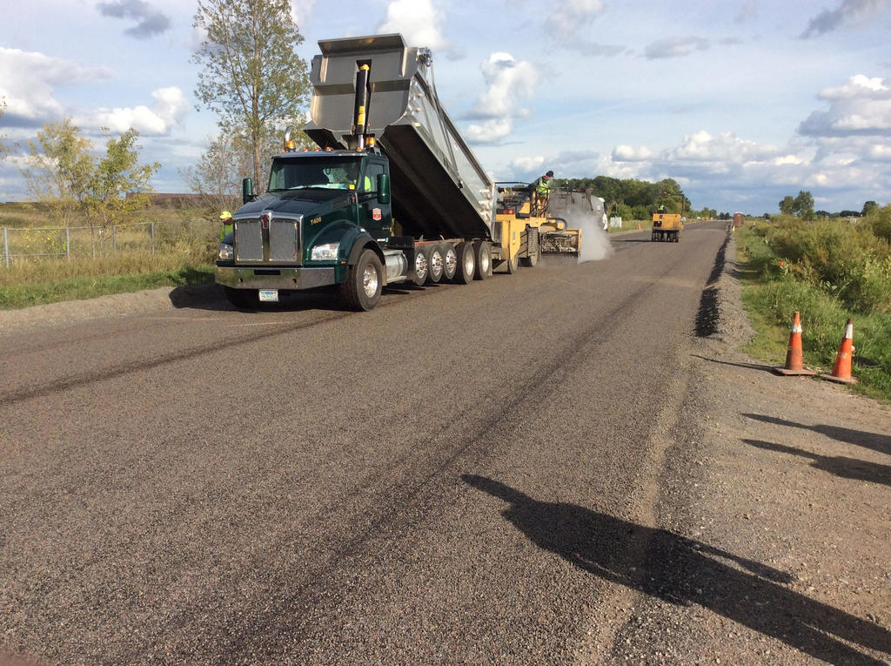
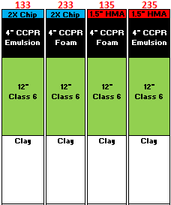
Cold Central Plant Recycling
  4 Test Sections
    Foam vs Emulsion
    2X Chip vs 1.5” HMA Overlay
  How can states be green in recycling but not impact long term performance?

Slide 17
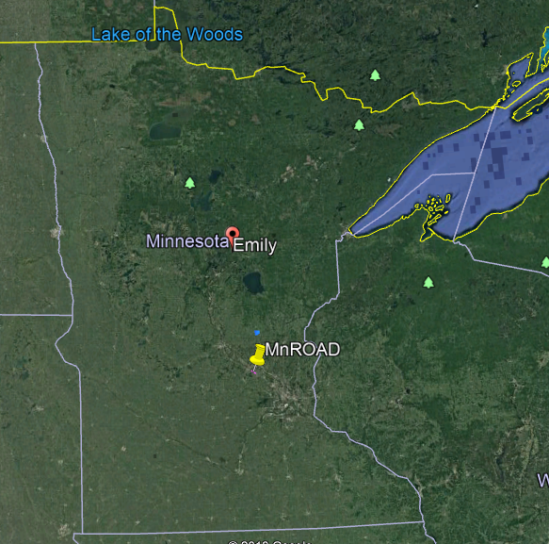
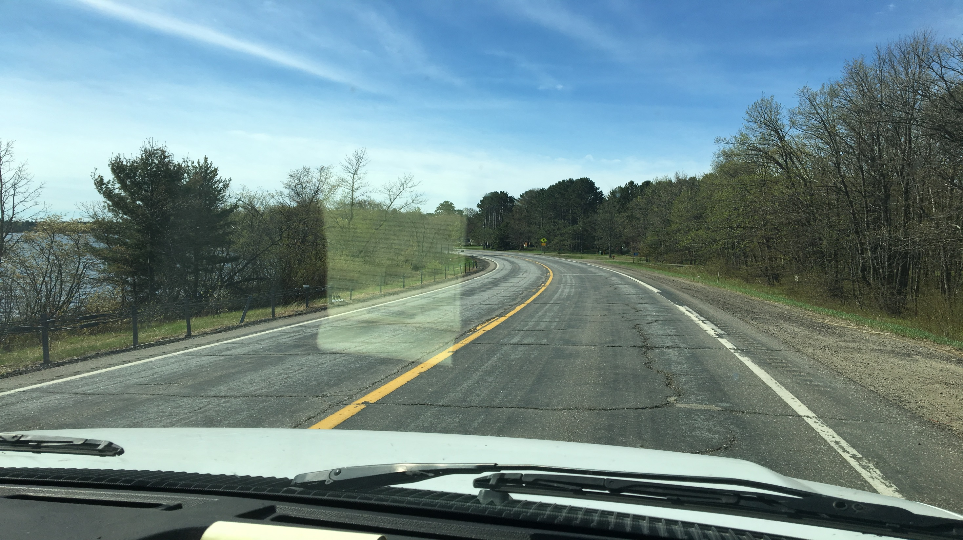
NRRA – Flex Team Update
Rejuvenator Project
TH 6 from Emily to Outing
Save for Rejuvenator project map and companies
Format Suggested (28 font)
  Details (24 font)
    Details (24 font)

Slide 18
NRRA – Flex Team Update
Rejuvenators
Anticipated Participants:
Cargill
Collaborative Aggregates
Asphalt and Wax Innovations
Superior Bowen
Mathy
Kraton
Georgia Pacific
Poet
Ingevity
U.S. Soybean Board
Testing Program:
Laboratory Testing
Field Performance Monitoring

Slide 19
NRRA – Flex Team Update
Any Questions?
Barry Paye, PE
Wisconsin DOT
Barry.paye@dot.wi.gov
608-246-7945

Slide 20

































































Questions or Comments?

