Slide 1


e-Ticketing for asphalt delivery
Presenter: Korby Seward, pe, nddot – devils lake district

Slide 2

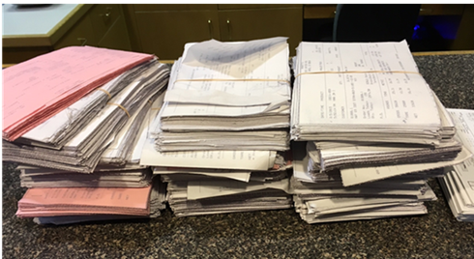
Current System
Trucks are loaded with material and weighed at the pit
A paper ticket is printed and handed to the driver
Material is delivered to the project.
Truck Driver hands the ticket to the inspector
Inspector adds up the tickets by hand
Inspector compares tickets to haul sheet and certifies the haul sheet

Slide 3
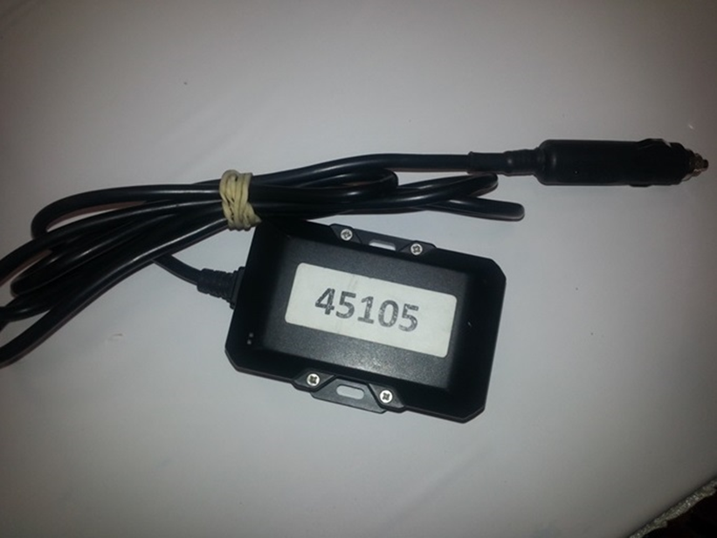
What is e-ticketing?
Each load is stored electronically
Trucks and Pavers are tracked by GPS
Ticket information is viewed on a mobile device or computer
All information is saved electronically and can be recalled later

Slide 4
Why use e-ticketing?
Provides a safety aspect. Ticket Takers would be obtaining electronic tickets through a mobile device vs. having to grab a hard copy ticket from each truck driver.
Contractor benefits are:
  Monitor in real-time the production numbers at the plant
  Tool to evaluate cycle times and identify inefficiencies
e-Ticketing is part of an overall goal for the NDDOT to be 100 percent paperless on construction projects from the pre- to post-construction stages

Slide 5

100% paperless? That is not possible….right?
Iowa DOT reached the paperless milestone back in 2016. It is possible…

Slide 6

Benefits of e-Construction as defined by FHWA:
e-Construction Benefits:
  Reduction or elimination of paper (sustainable solution)
  Operation in a secure environment
  Ease of document access
  Real-time document access
  Standardization of report or forms
  Reduced storage and lost paperwork
  Faster document approval
  Ability to sign electronic documents remotely
  Faster, more accurate payments to contractors
  Transparency-documents available for viewing by all project partners

Slide 7
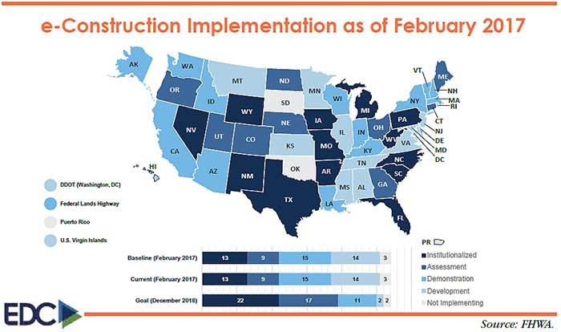
e-Construction Implementation

Slide 8




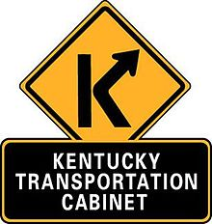





DOT’s participating in e-ticketing…

Slide 9
E-ticketing Compatibility
Fleetwatcher, in most circumstances, can integrate with loadout software made by following software vendors: WEM, JWS/APEX, ASTEC, LIBRA W/ DISPATCH MODULE, GLOBAL, & SELTEC
Min. requirements for real-time data delivery:
  System running all modern versions of MS Windows are supported
  Python 2.6 installed on system
  STABLE INTERNET CONNECTION
  Connectivity to the scale loadout software’s database

Slide 10
NDDOT e-ticketing pilot project history:
Dec. 15-16, 2015: NDDOT, IOWADOT, and FHWA participated in a peer-to-peer exchange on e-Construction. An e-ticketing pilot project was discussed by IOWADOT and the benefits it provided.
2016 Construction Season: NDDOT participates in first e-ticketing pilot project
2018 Construction Season: NDDOT participated in second e-ticketing pilot project

Slide 11

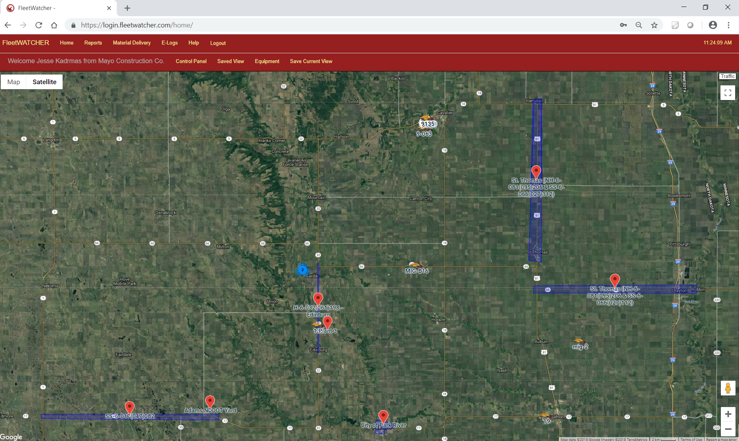
FleetWATCHER

Slide 12
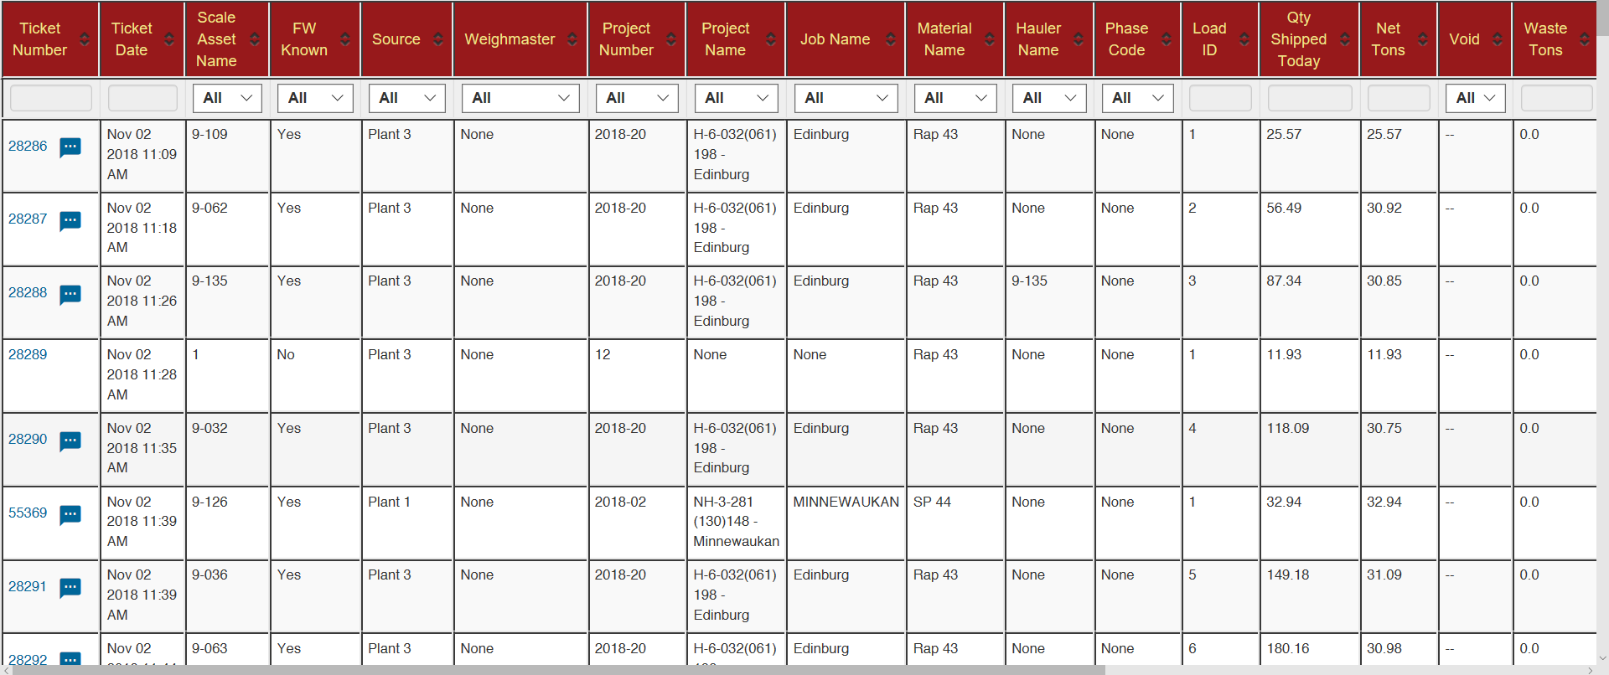
Scale Ticket Summary

Slide 13
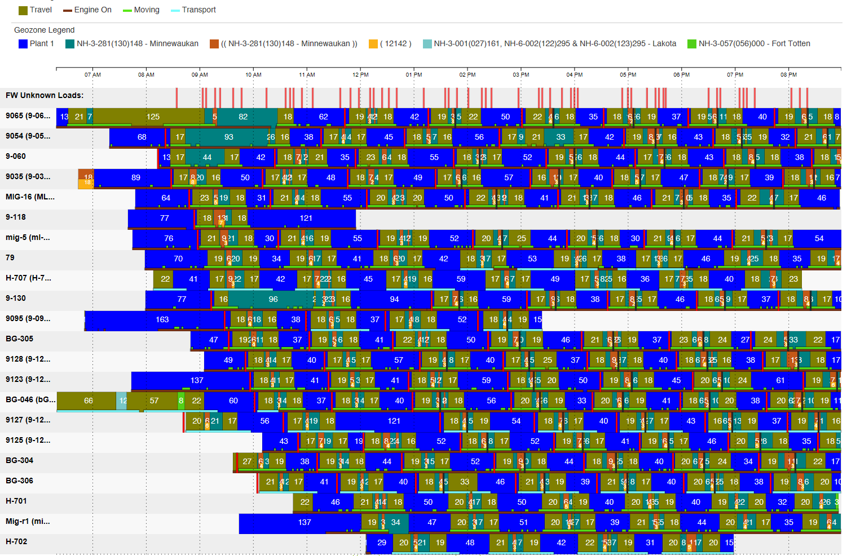
Load Cycle Analysis

Slide 14
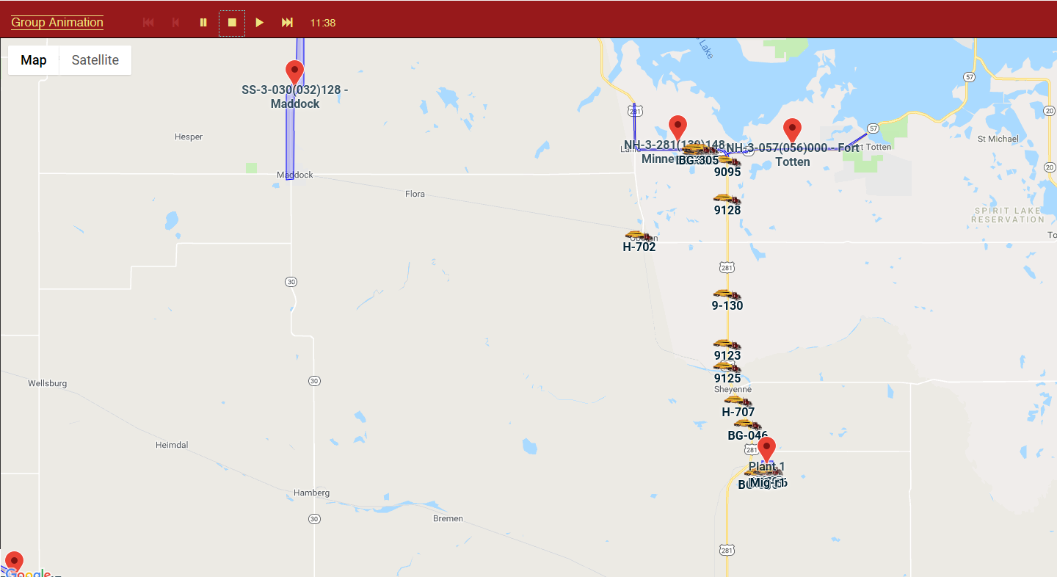
Map

Slide 15
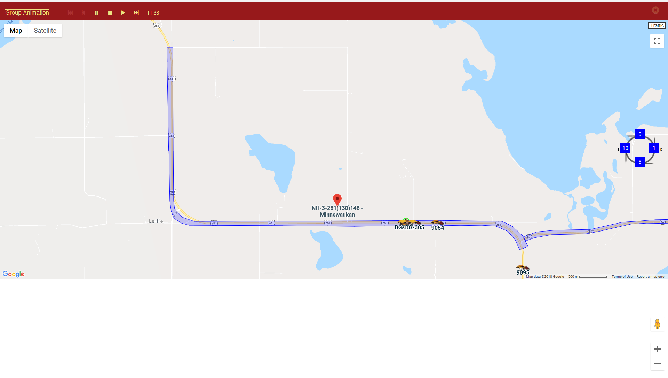
Project Geozone

Slide 16
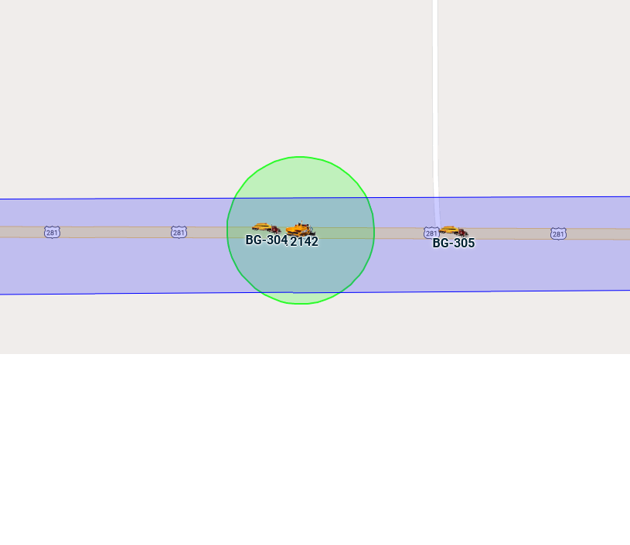
Paver Geozone

Slide 17
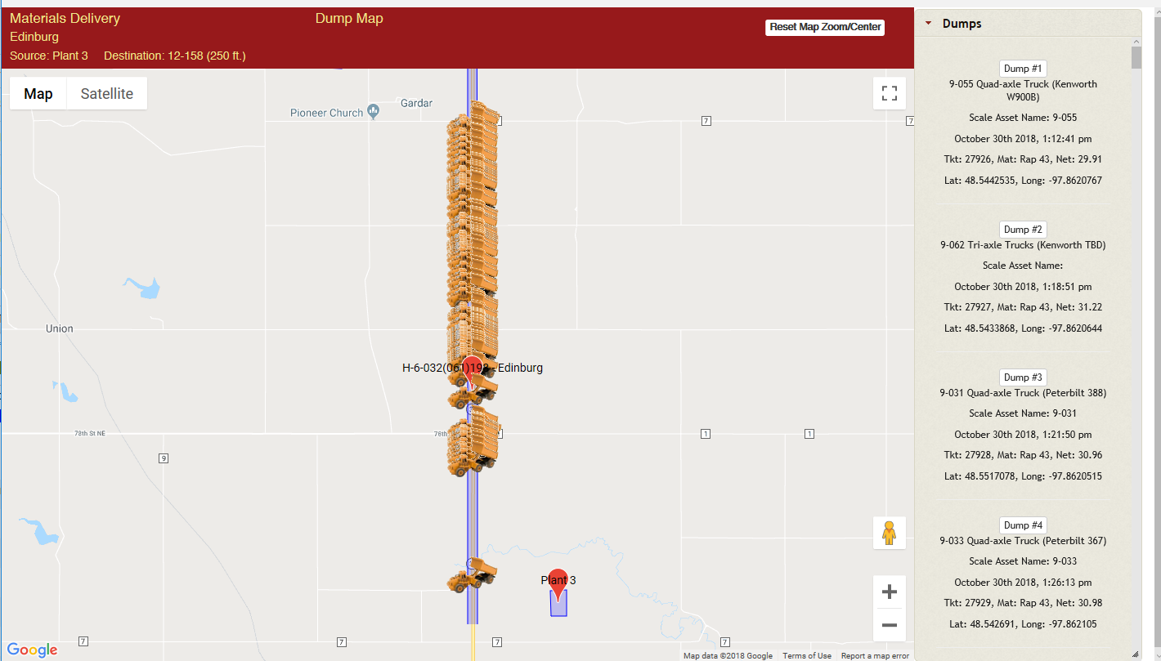
Dump Map

Slide 18
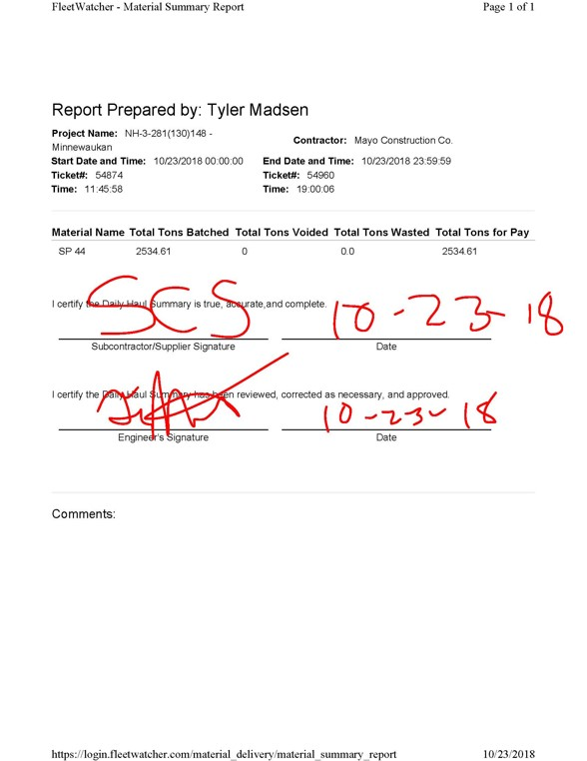
Haul Sheet Summary

Slide 19
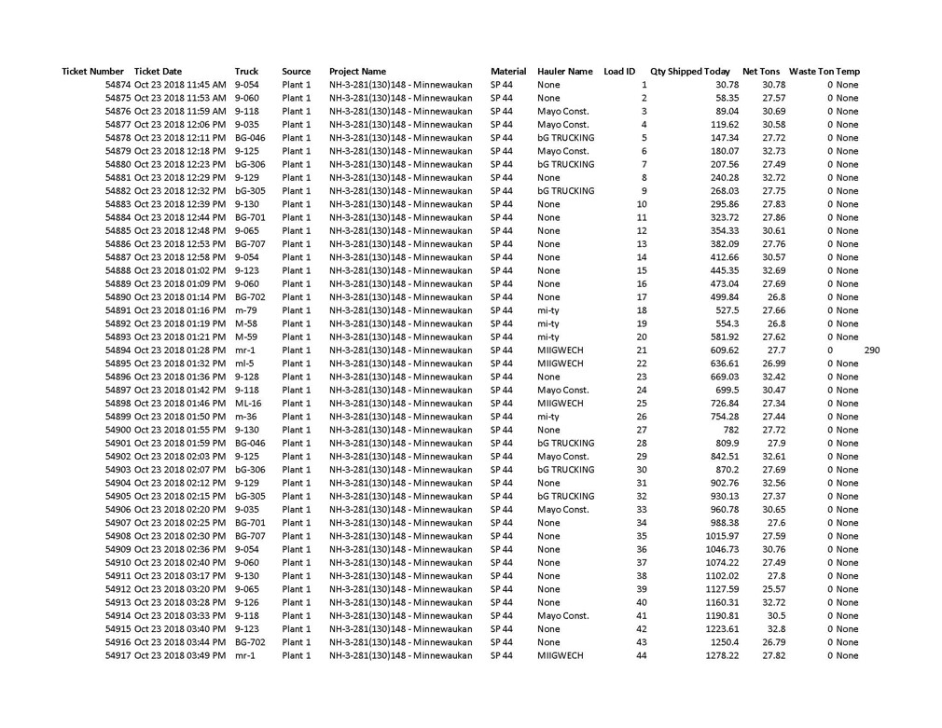
Scale Ticket Summary

Slide 20
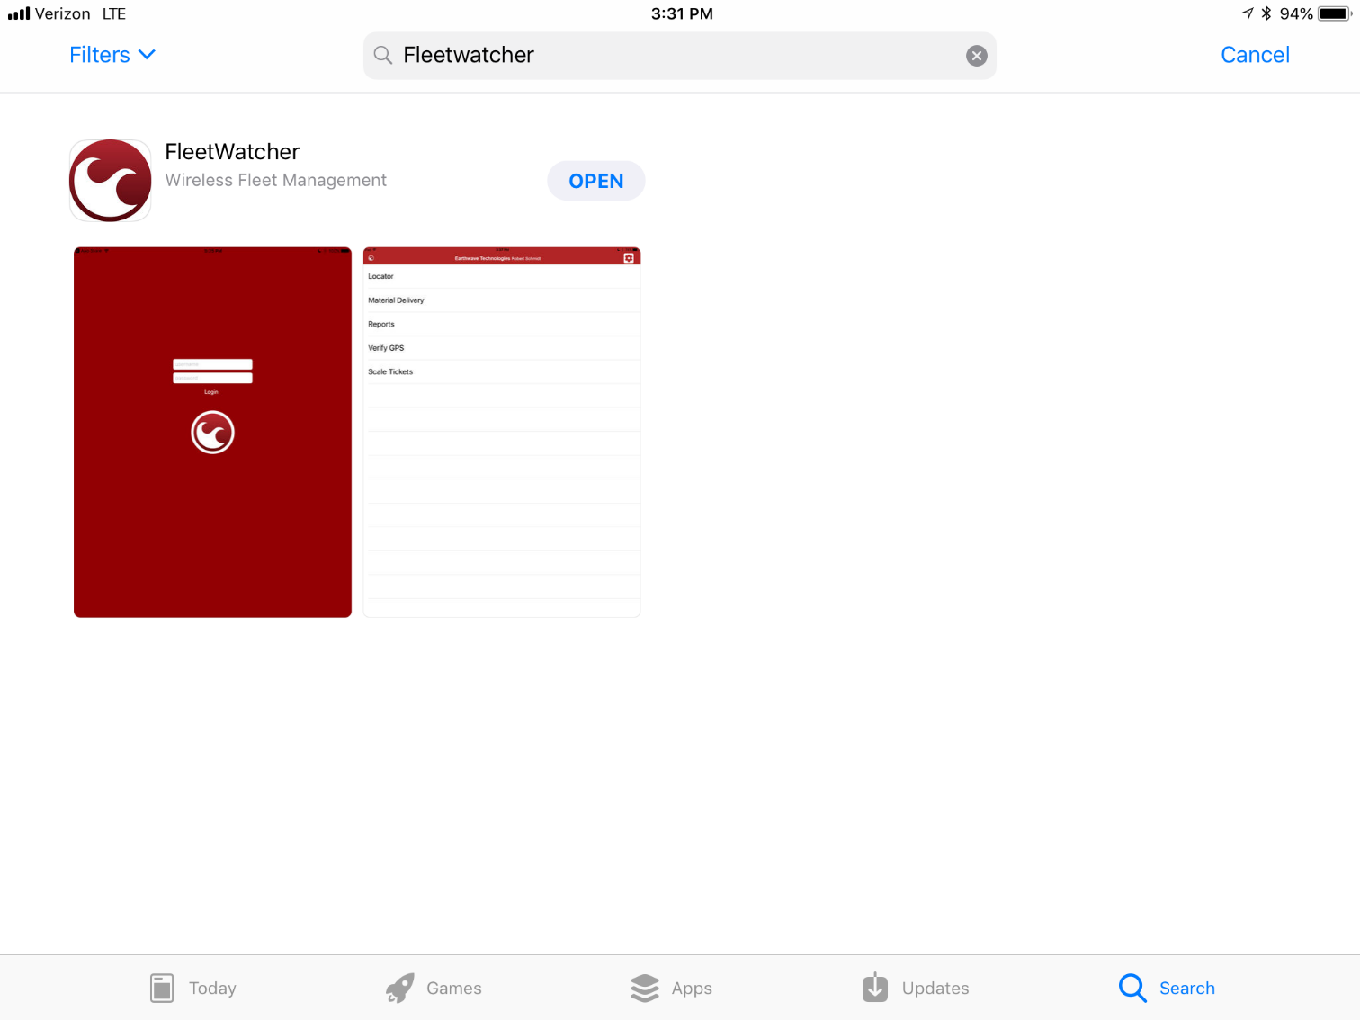
Mobile Version

Slide 21
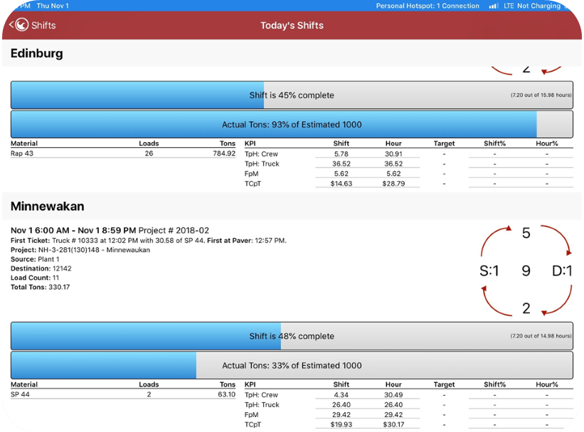
Shifts

Slide 22
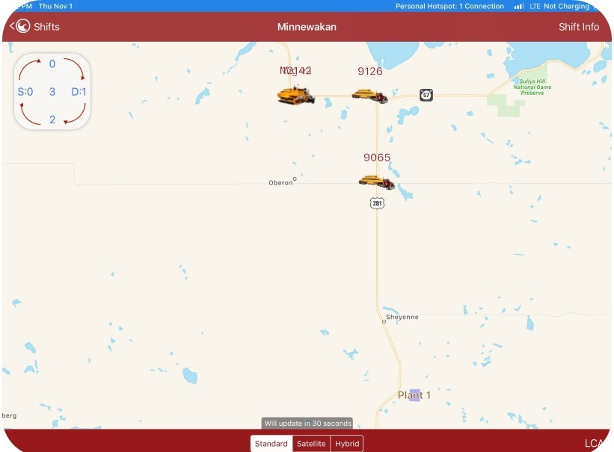
Shifts (Map)

Slide 23
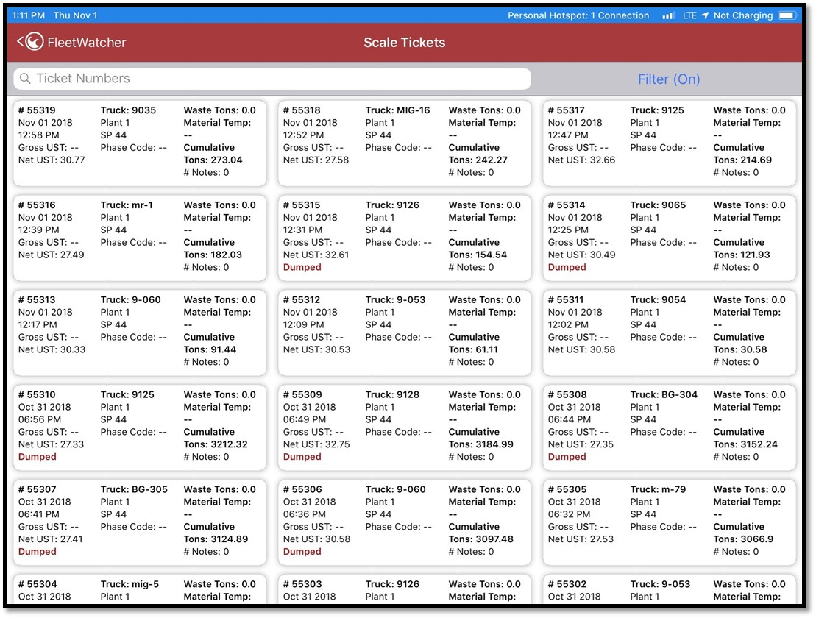
Scale Tickets

Slide 24
Questions?

