Slide 1

2019 Pavement Workshop
May 21-23, 2019
Cold Central Plant Recycling (CCPR) – Update 2019
Derek Tompkins
Principal Civil Engineer
American Engineering Testing, Inc.

Slide 2
What is CCPR?
CIR methods with stockpiled RAP
Add binder as required
Pave as usual
Avoids possible concerns about in-place material
Stockpiling with fractionating allows for the development of a consistent material
Additional costs of CCPR for storing, processing, etc
CCPR vs CIR
5/22/2019 | NRRA Workshop | 2

Slide 3
Survey and Lit Review
Recent NCAT/Virginia DOT study is known well
Most states have limited experience with CCPR – initial respondents discuss in terms of CIR
Extensive experience with CCPR on the West Coast dating back to 1970s
  Survey is reaching out to states, municipalities, and contractors out west
Respondents have pointed out difficulties of cost comparison – literature reinforces these difficulties
More to follow as survey completes and tech briefs are produced
5/22/2019 | NRRA Workshop | 3

Slide 4

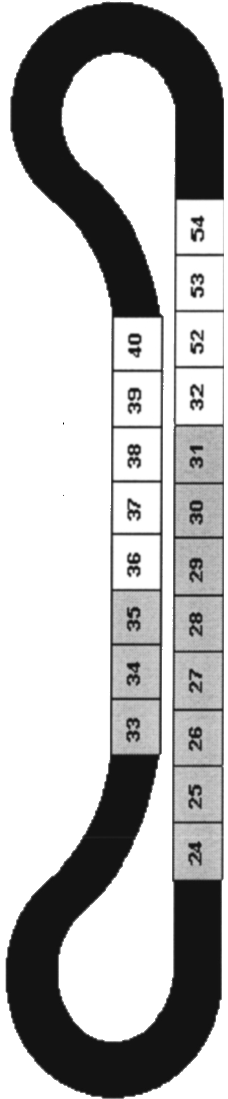
MnROAD field sections
Single-source RAP
Constructed Fall 2017
3.5” CCPR lift after compaction
Placed on 12” Class 6, clay/loam subgrade
CELL | SURFACE | SPEC | BINDER | LTC req.
133 | Double chip seal FA-3/FA-2.5 | Emulsion (58S-28) | CIR-EE (H) | -21.4°C
233 | Double chip seal FA-3/FA-2.5 | Foam (58S-28) | 58S-28 | -21.4°C
135 | 1.5” HMA SPWEB340C | Foam (XX-34) | 52-34 | -21.4°C
235 | 1.5” HMA SPWEB340C | Emulsion (XX-34) | CIR-TEC M | -21.4°C
5/22/2019 | NRRA Workshop | 4

Slide 5
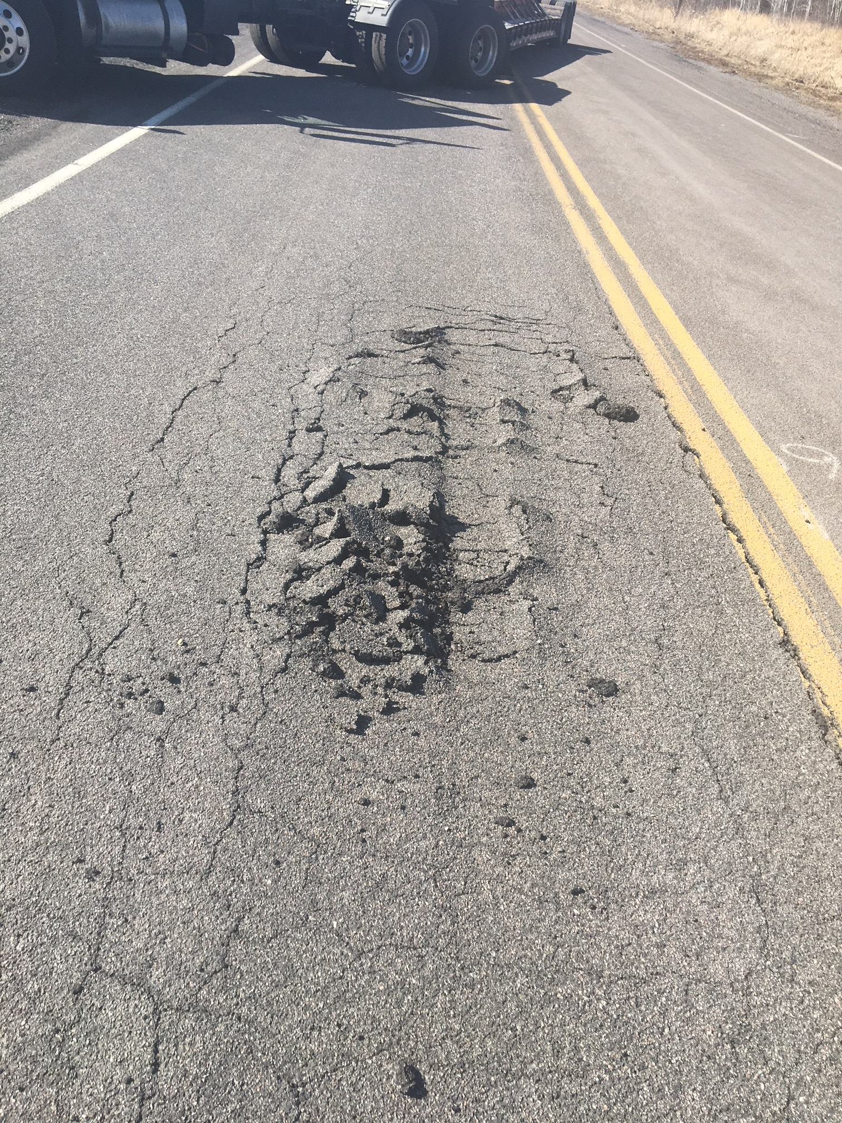
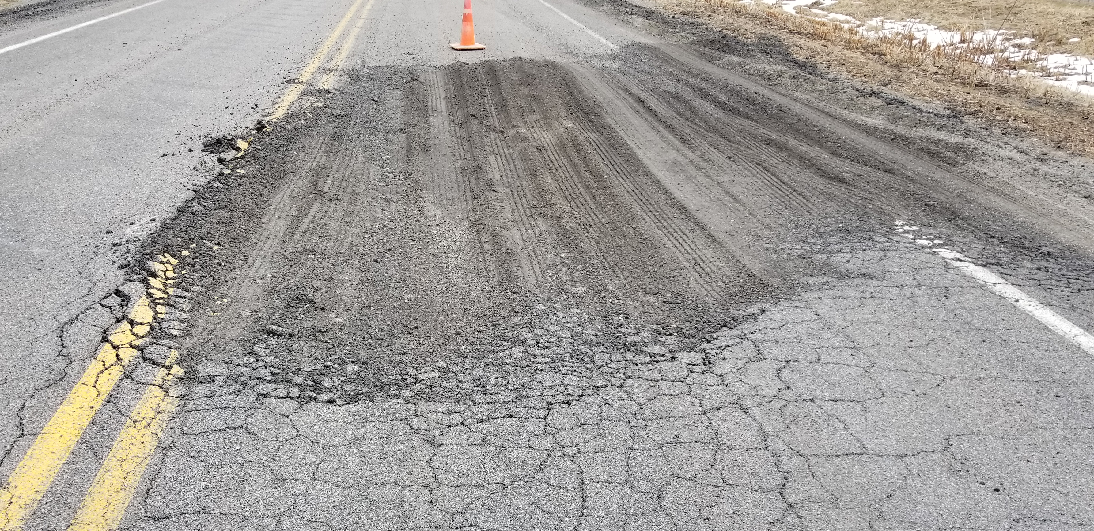
MnROAD Performance: Cell 233
March 2018
April 2018
Cell 233
Foamed 58S-28, Double Chip
5/22/2019 | NRRA Pavement Workshop | 5

Slide 6
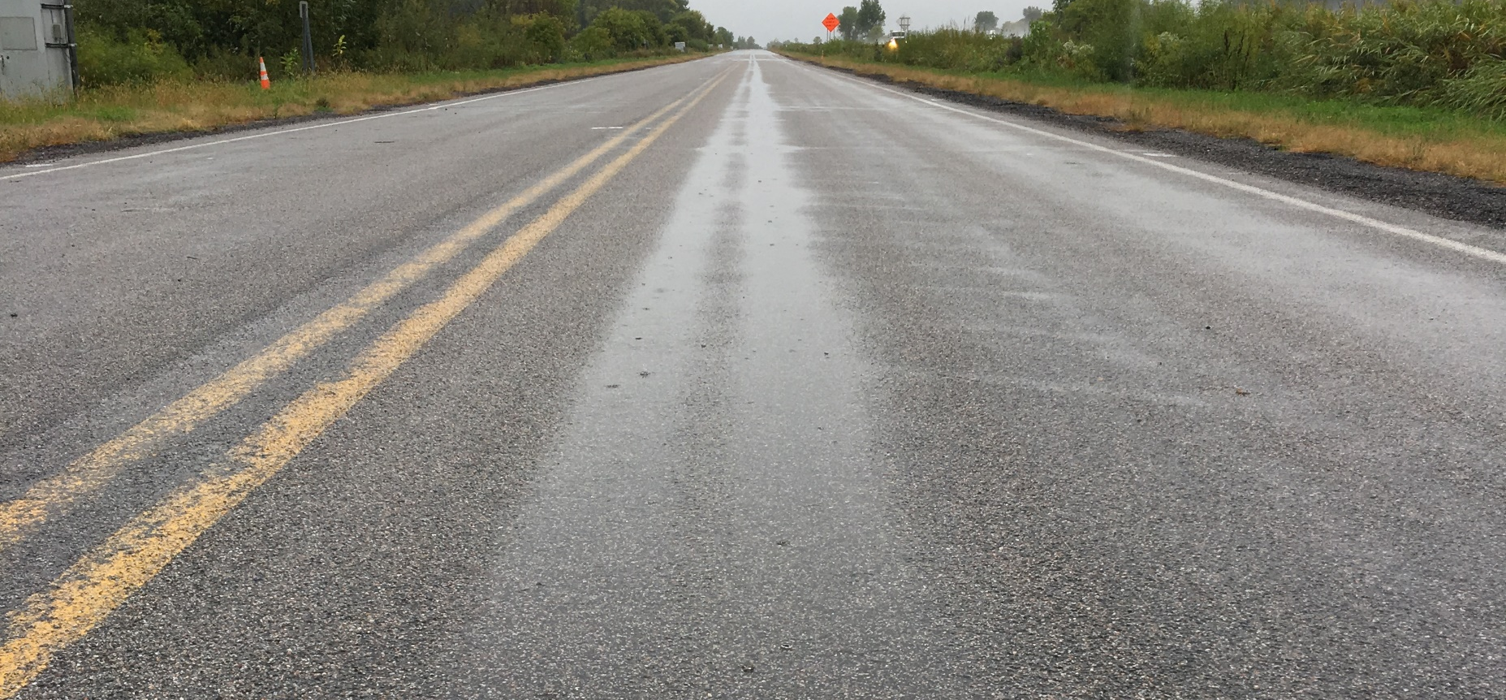
Rutting, Cells 133 & 233
September 2018
Cells 133, 233
Double Chip (F28, E28)
5/22/2019 | NRRA Pavement Workshop | 6

Slide 7

Transverse Cracking, Cell 133
May 2018
Cell 133
Emulsion 58S-28, Double Chip
5/22/2019 | NRRA Pavement Workshop | 7

Slide 8
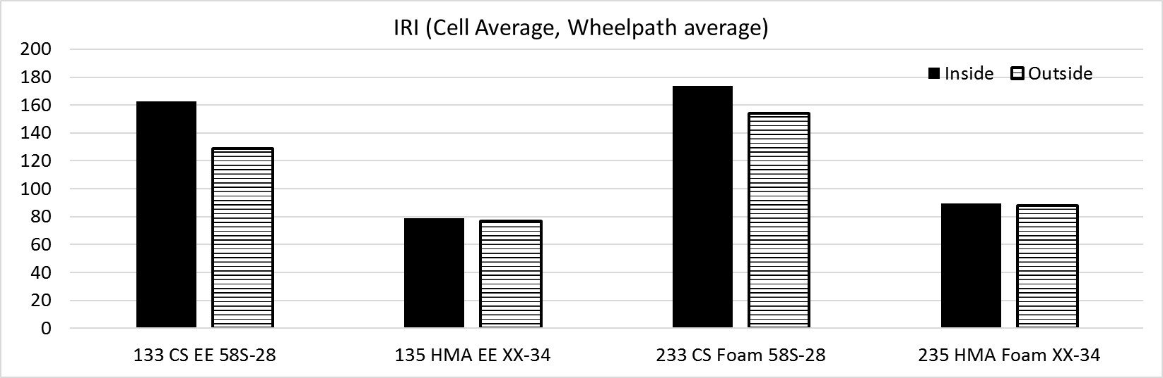
MnROAD CCPR: Roughness
5/22/2019 | NRRA Pavement Workshop | 8

Slide 9
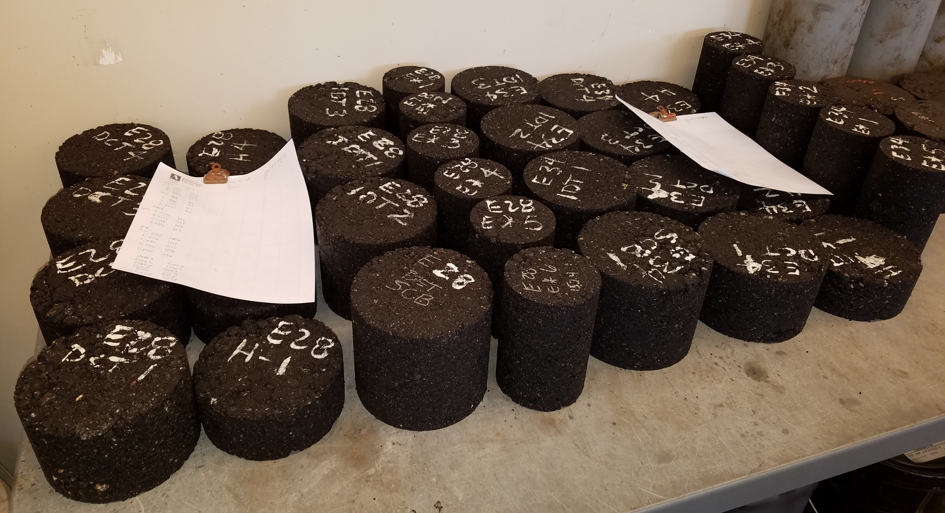
Lab Testing
Special emphasis on low temperature performance
  DCT and SCB @ -18 C
Indirect tension (IDT) AASHTO T 322
Hamburg wheel tracking AASHTO T 324
Dynamic modulus (E*) using SPT
5/23/2019 | NRRA Workshop | 9

Slide 10
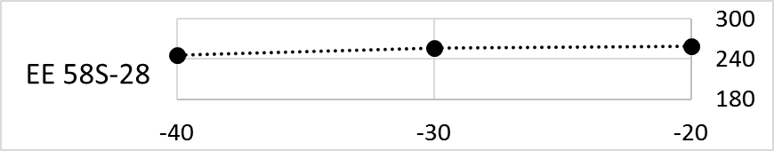
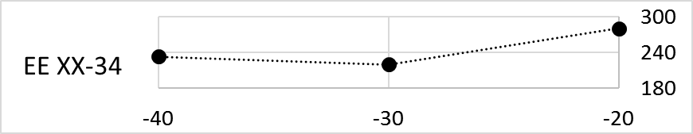
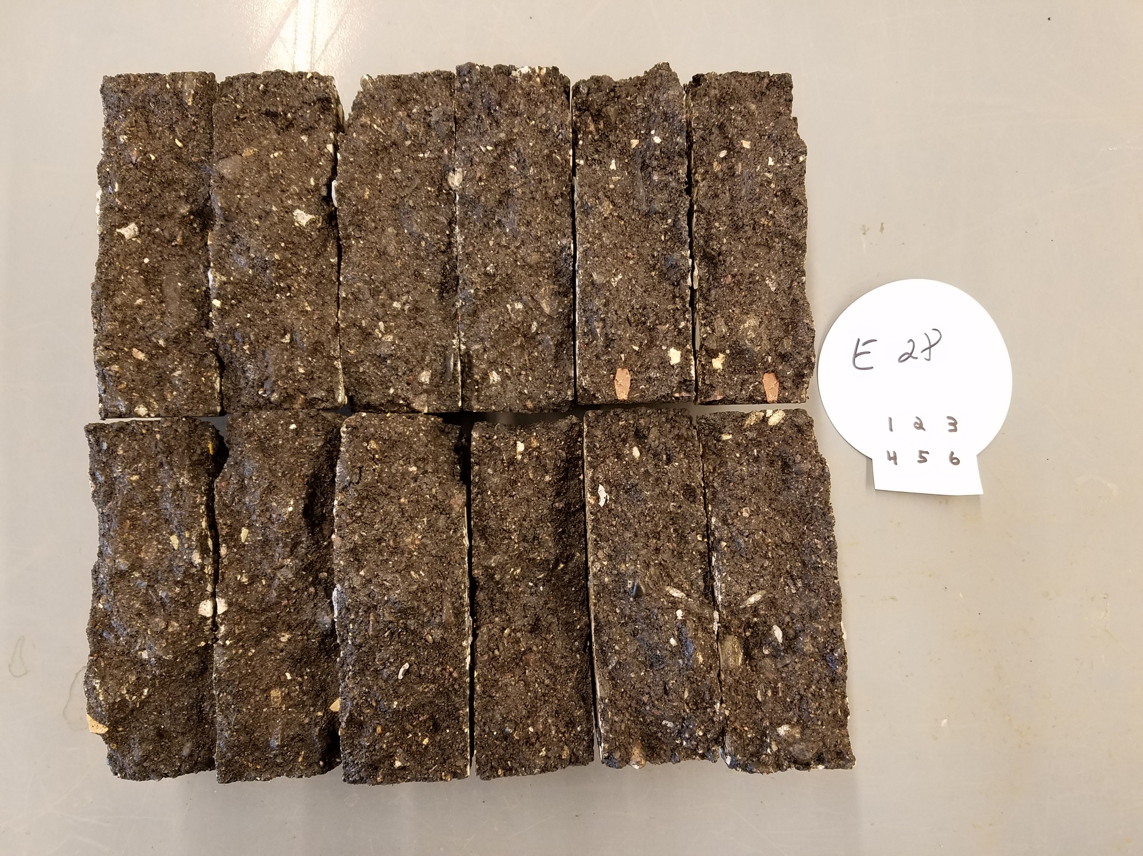
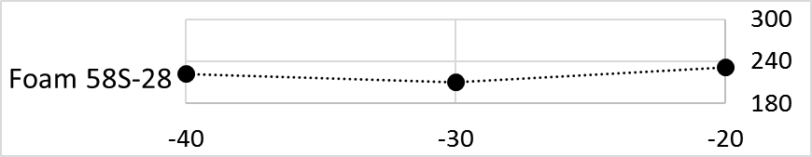
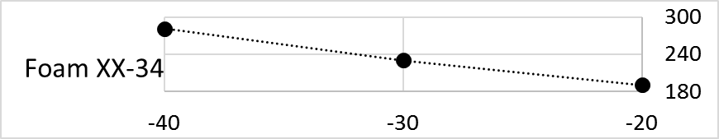
Indirect tension (T 322)
5/22/2019 | NRRA Workshop | 10

Slide 11
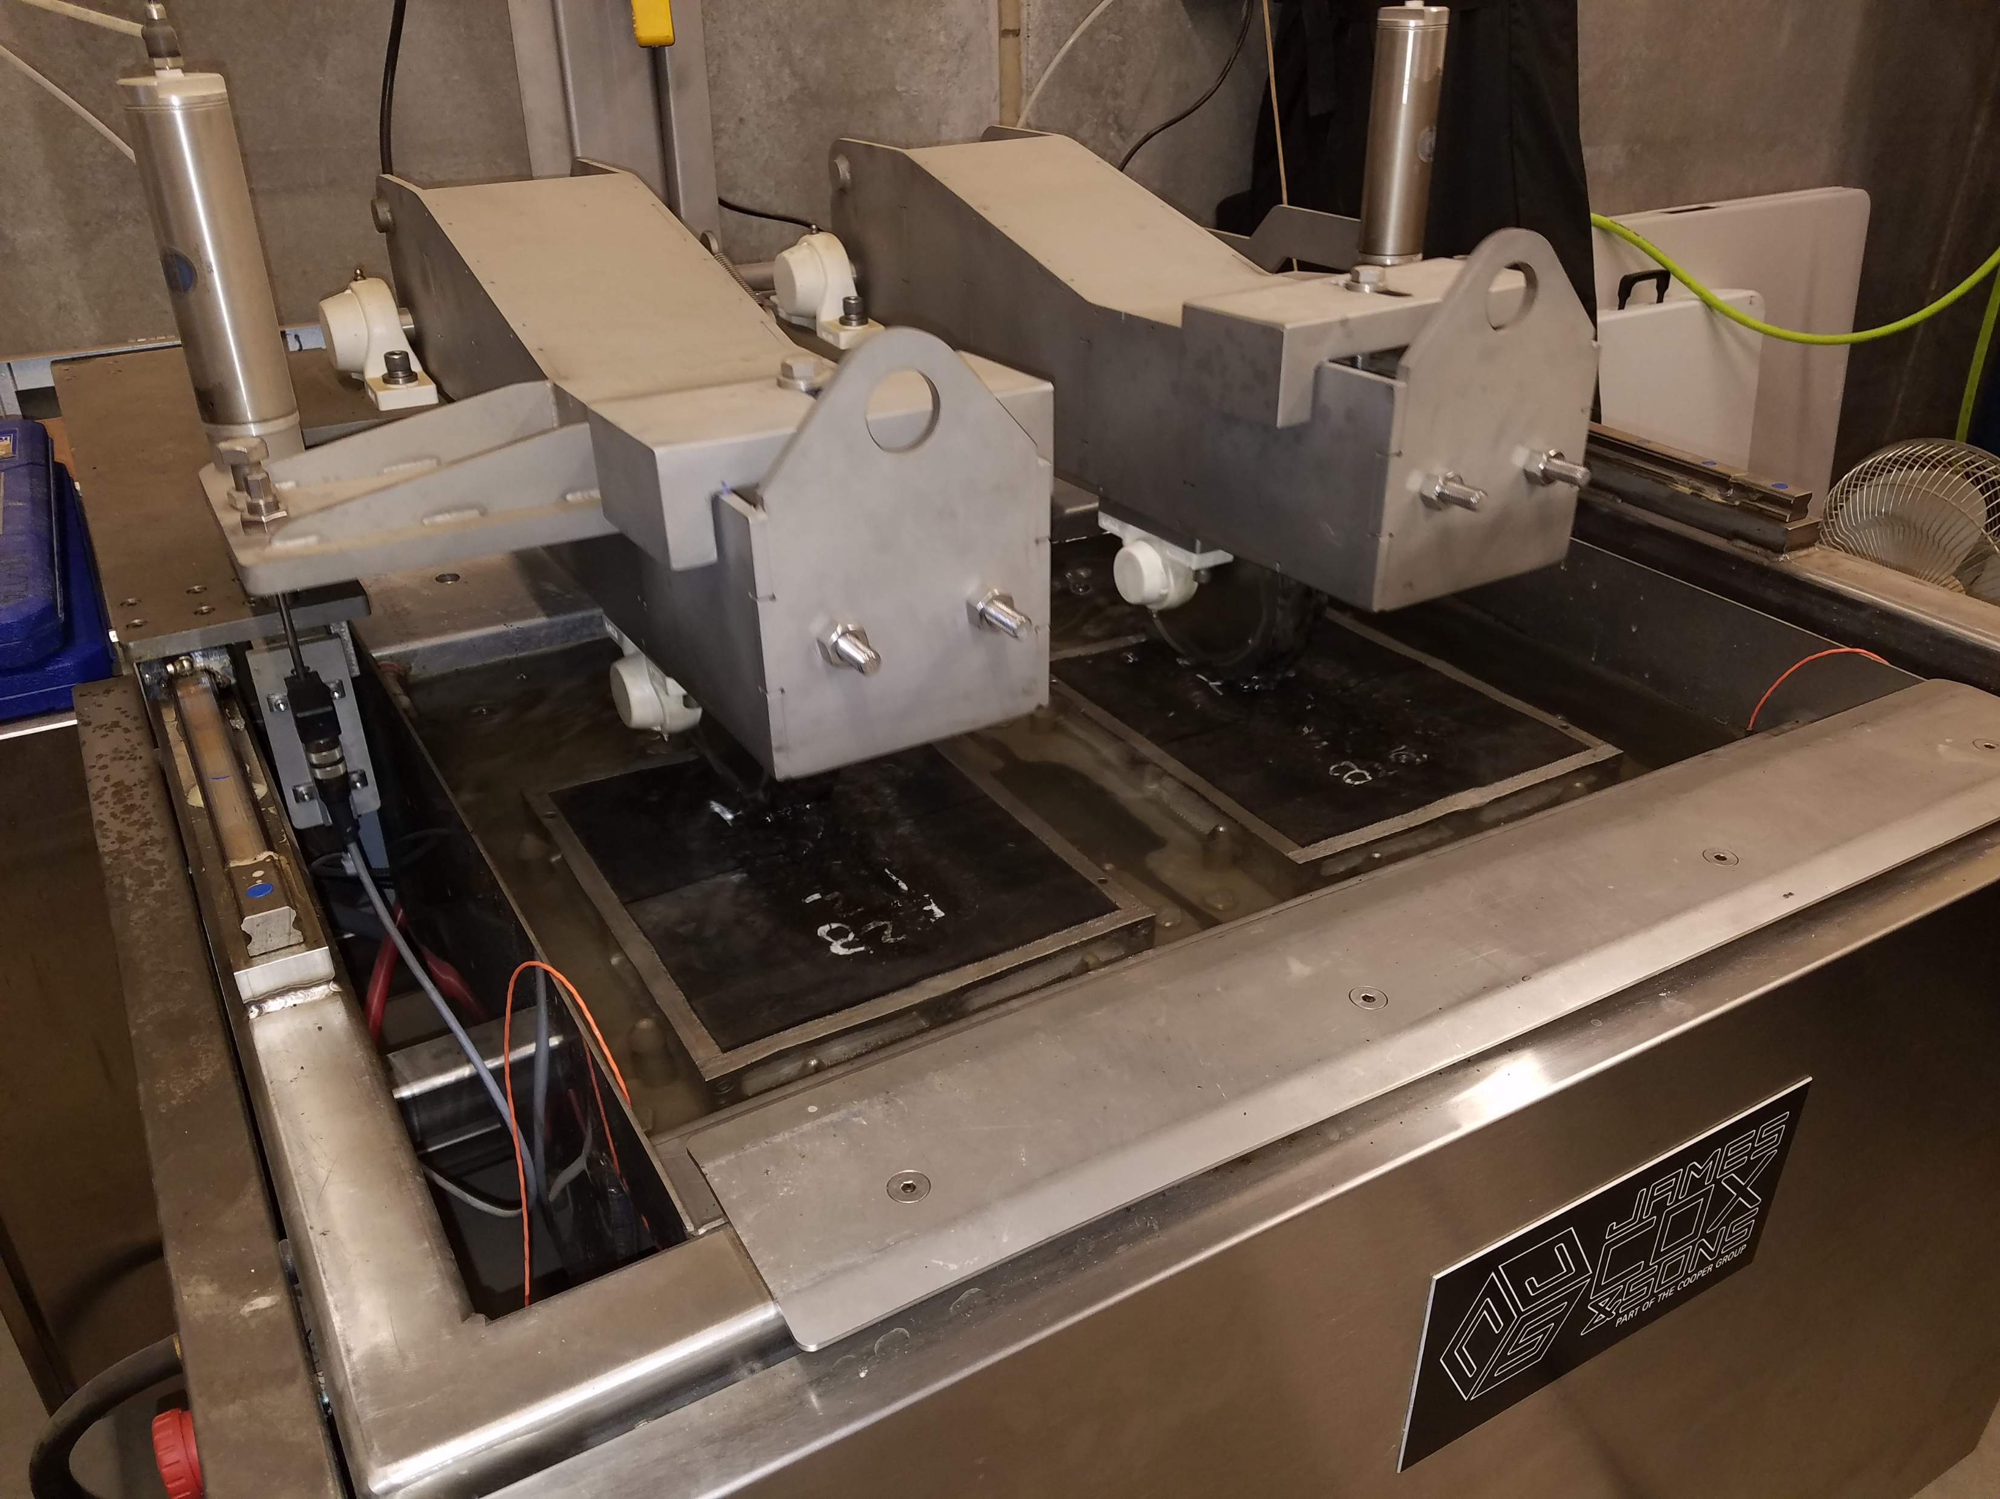
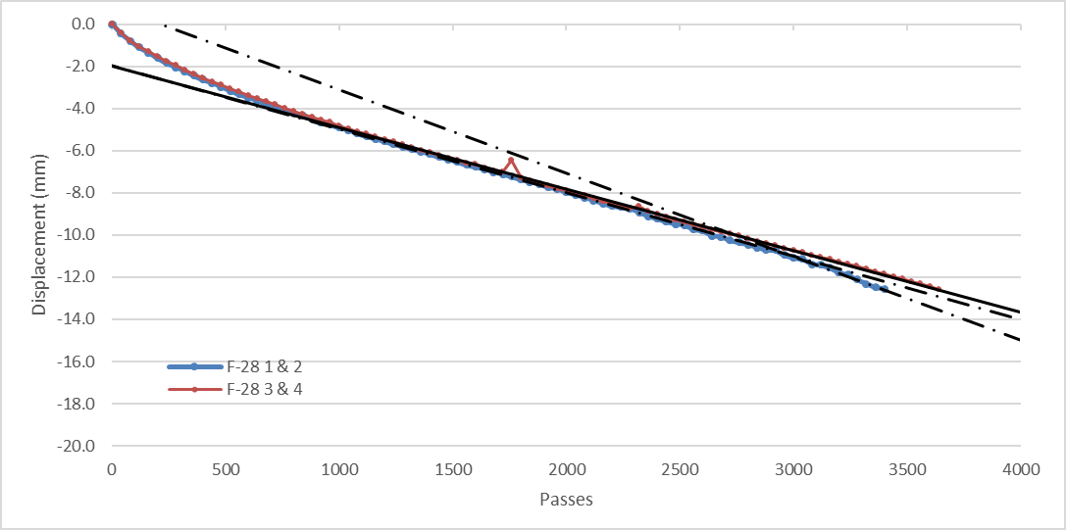
Hamburg Wheel Tracking
 | Passes to Failure (12.5 mm) | Creep Slope (um/pass) | Stripping Inflection Point (SIP)
Foam 58S-28 | 3520 | -2.97E-03 | 2935*
Foam XX-34 | 2880 | -3.83E-03 | --
EE 58-28 | 7120 | -1.28E-03 | --
EE XX-34 | 5400 | -1.66E-03 | --
5/22/2019 | NRRA Workshop | 11

Slide 12
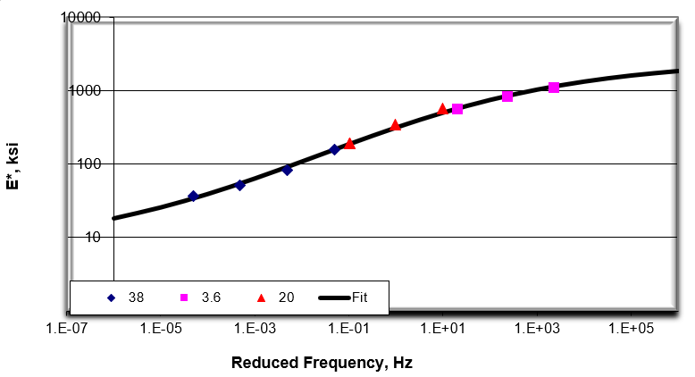
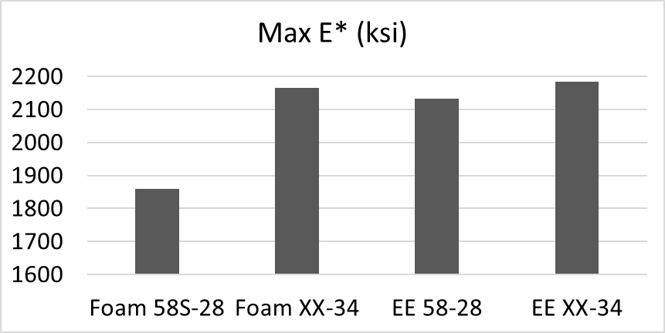
Dynamic modulus
F28
5/22/2019 | NRRA Workshop | 12

Slide 13
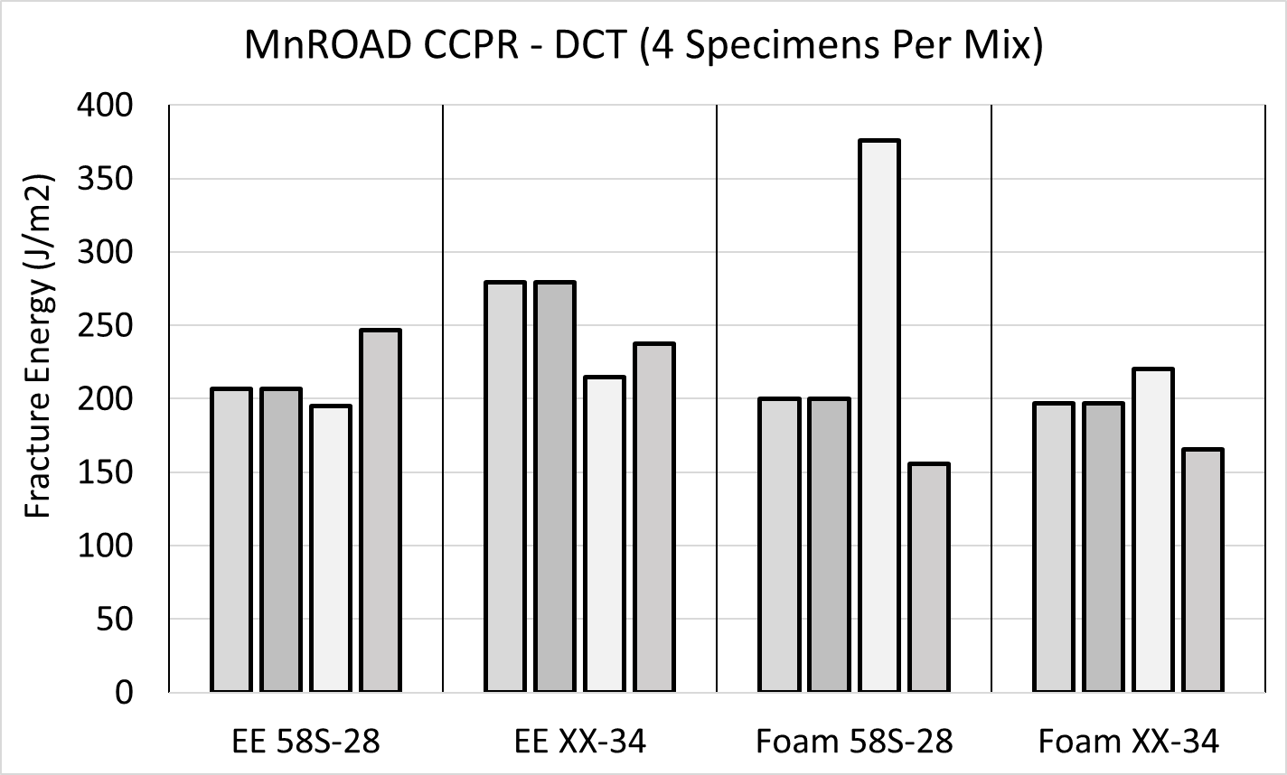
Disk-Shaped Compact Tension
DCT specimens remained intact through early loading
Batched specimens from field mix outperformed specimens used for mix design development
5/22/2019 | NRRA Workshop | 13

Slide 14
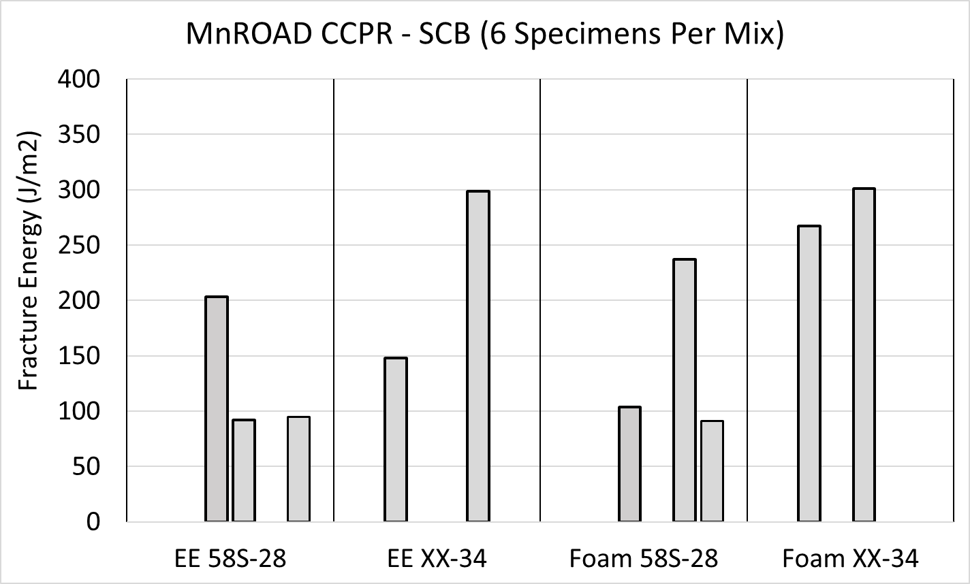
Semi-Circular Bending
@ -18°C
Low temp SCB procedure by Dr. Eyoab Zegeye Teshale of MnDOT Office of Materials and AET¹
Alternative/companion to DCT to estimate fracture energies for reclaimed specimens
5/22/2019 | NRRA Workshop | 14

Slide 15
Research products & timeline
Surveys
Summaries of
  State of practice
  Performance testing and analysis
  Spec recommendations
Final report
5/22/2019 | NRRA Workshop | 15

Slide 16



















































Principal Investigator | Technical Liaison
David Rettner, AET | Dave Van Deusen, MnDOT

Slide 17
Mix Designs
BINDER TYPE | Emulsion
MnROAD CELL | 133 | 135
SURFACING | DCS | 1.5" SP
PG | 58S-28 | XX-34
BINDER ADDED, % | 2.0
Voids @ Opt, % | 11.5 | 11.7
Max Dens @ Opt, pcf | 133.1 | 132.8
Marshall @ Opt, lbs | 1272 | 1365
Ret. Stability @ Opt, % | 72.1 | 71.0
Raveling, % | 1.60 | 1.70
Est Crit Crack Temp, °C | -35 | -36
IDT @ CC Temp, psi | 155 | 158
Developed at AET in Summer 2017
Exceeded low temp req of -21.4°C
Exceeded dry stability of 1250 lb
While no MnDOT requirement for raveling, foamed mixes did not meet target of 2.0%
5/22/2019 | NRRA Workshop | 17

Slide 18
Mix Designs
BINDER TYPE | Foamed
MnROAD CELL | 233 | 235
SURFACING | DCS | 1.5" SP
PG | 58S-28 | XX-34
BINDER ADDED, % | 1.5
Voids @ Opt, % | 12.2 | 10.8
Max Dens @ Opt, pcf | 133.7 | 131.8
Marshall @ Opt, lbs | 1311 | 1272
Ret. Stability @ Opt, % | 70.4 | 73.2
Raveling, % | 3.30 | 2.50
Est Crit Crack Temp, °C | -34 | -34
IDT @ CC Temp, psi | 128 | 132
Developed at AET in Summer 2017
Exceeded low temp req of -21.4°C
Exceeded dry stability of 1250 lb
While no MnDOT requirement for raveling, foamed mixes did not meet target of 2.0%
5/22/2019 | NRRA Workshop | 18

