Slide 1

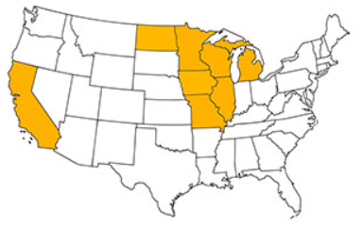
Rigid Team Update
2019 Pavement Workshop
May 21-23, 2019
Brett Trautman, P.E.
Physical Laboratory Director
Construction & Materials Div.
Missouri DOT
Office No.: 573-751-1036
Email: Brett.Trautman@modot.mo.gov
+ 46 Associate Members

Slide 2

Outline
Review Short Term Research -2017
Review Long Term Research – 2017
Phase II Research - 2019
Compacted Concrete Pavement - 2018

Slide 3

Review Short Term Research - 2017
Design and Performance of Concrete Unbonded Overlays
Repair of Joint Associated Distress Pavements

Slide 4
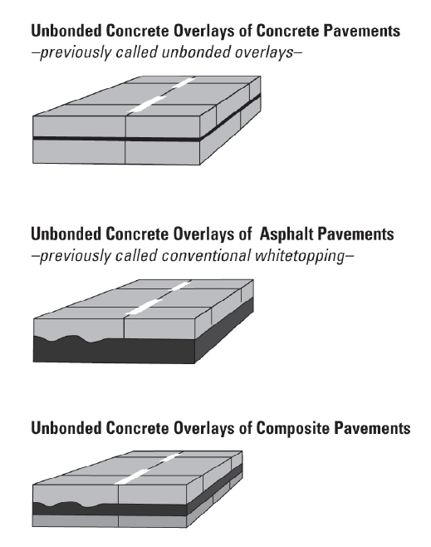
Design and Performance of Concrete Unbonded Overlays
Synthesis of member states
Survey
Questions on design features and field performance (good & bad)
Contractor is SRF Consulting
First draft completed

Slide 5
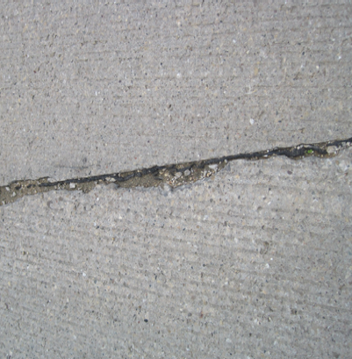
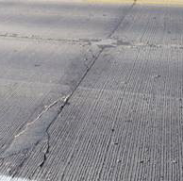
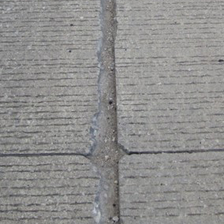
Repair of Joint Associated Distress Pavements
Develop technical brief based on current knowledge & expertise
Develop one hour webinar
Contractor is SRF Consulting
Dr. Peter Taylor with Iowa State University assisting

Slide 6

Review Long Term Research - 2017
FRC Research
Early Opening Strength
Reduced Cementitious Material

Slide 7
FRC Research
Contractor
University of Minnesota – Duluth (Dr. Manik Barman)
Objectives
  Determine contribution of fibers in reducing panel fatigue cracking
  Determine contribution of fibers in mitigating joint faulting
  Determine optimal panel size for thin unbonded concrete overlays
  Determine minimum thickness of FRC for low-volume streets

Slide 8
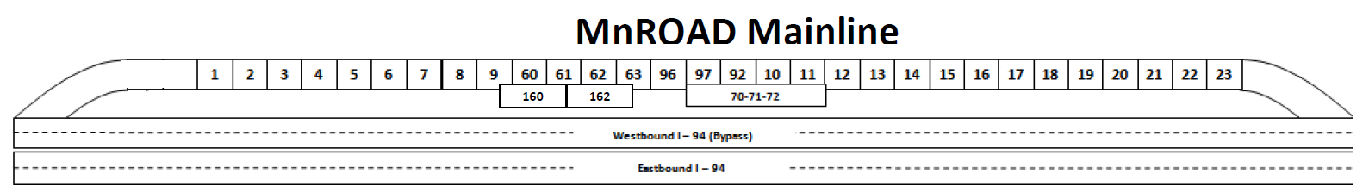
FRC Research
Mainline Cell #6 (506, 606, 706, & 806)
Evaluating the impact fiber dosage has on fatigue cracking & joint faulting
Cell No. | 506 | 606 | 706 | 806
Length | 144 ft. | 138 ft. | 138 ft. | 138 ft.

Slide 9
FRC Research
Pavement Details (Cell #6)
  Full depth pavement on grade
  All cells: 6’ x 6’ panels
  Fiber content:
  Cell 506: No fibers (control)
  Cell 606: 20% RSR
  Cell 706: 30% RSR
  Cell 806: 0.75% fibers by volume

Slide 10
FRC Research
Mainline Cell #5 (705 & 805)
Evaluating the impact fibers have on fatigue cracking, joint faulting, & panel size
Cell No. | 705 | 805
Length | 144 ft. | 124 ft.

Slide 11
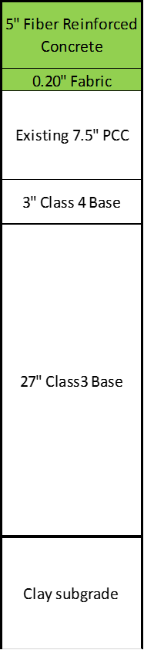
FRC Research
Pavement Details (Cell #5)
  Unbonded Overlay
  - Non-woven geotextile fabric interlayer
  Cell 705
  - 14’W x 12’L & 12’x12’ panels
  Cell 805
  - 6’ Wx12’L & 8’Wx12’L panels
  Fiber content: 20% RSR

Slide 12
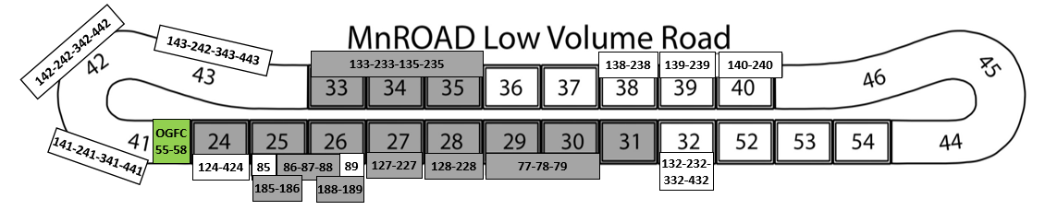
FRC Research
Low Volume Road Cell #39 (139 & 239)
Evaluate using fiber-reinforced concrete pavement for city streets
Cell No. | 139 | 239
Length | 270 ft. | 273 ft.

Slide 13
FRC Research
Pavement Details (Cell #39)
All cells: 6’ x 6’ panels
Full depth concrete on grade
Fiber content: 30% RSR

Slide 14
Early Opening to Traffic
Contractor
University of Pittsburg (Dr. Lev Khazanovich)
Objectives
  Evaluate visible and non-visible immediate damage caused by early age loading
  Quantify the effect of early loading damage on long-term performance
  Determine minimum strength at opening or other measurable variables associated with this parameter

Slide 15
Early Opening to Traffic
Low Volume Road Cell #24 (124, 224, 324, 424, 524 & 624)
Early sequential traffic loadings
Cell No. | 124 | 224 | 324 | 424 | 524 | 624
Length | 120 ft. | 120 ft. | 120 ft. | 115 ft. | 60 ft. | 20 ft.

Slide 16
Early Opening to Traffic
Pavement Details (Cell No. 24)
  Standard panel size 12’W x 15’L
  Full depth concrete on grade
  Standard concrete mix
  Doweled joints

Slide 17
Reduced Cementitious Content
Contractor
Iowa State University (Dr. Peter Taylor)
Objectives
  Investigate the early-age characteristics of concrete paving mixes containing low cementitious content
  Assess the potential for durability issues
  Identify effect of reduced cementitious content on long term serviceability and economics
  Develop recommended specifications for mixing and placement practices

Slide 18
Reduced Cementitious Content
Low Volume Road Cell #38 (138 & 238)
Cells will be exposed to deicing agents
Cell No. | 138 | 238
Length | 258 ft. | 260 ft.

Slide 19
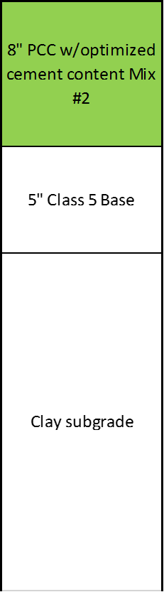
Reduced Cementitious Content
Pavement Details (Cell No. 38)
Standard panel size 12’W x 15’L
Full depth concrete on grade
Doweled Joints
Cell 138
- Cementitious content = 500 lb./cy
Cell 238
Cementitious content = 470 lb./cy

Slide 20
Phase II Research - 2019
Construction Report for Jointless Roundabout
Iowa State University ($50,000)
Incorporate Faulting Model To BCOA-ME
University of Pittsburg ($25,000)
Determination of Causes for Cracking Over Dowel and Tie Bars
Posting RFP ($100,000)

Slide 21
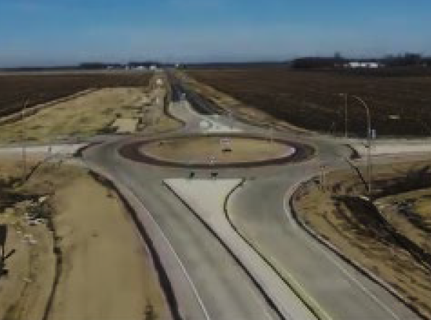
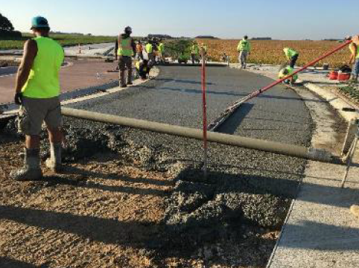
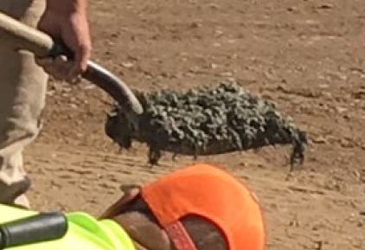
Construction Report for Jointless Roundabout
Roundabout constructed in Minnesota in 2018
Document project activities
Mix design, placement, test results & field issues
Document Initial Distresses
12 cracks noted to date
Field Monitoring
Three years

Slide 22

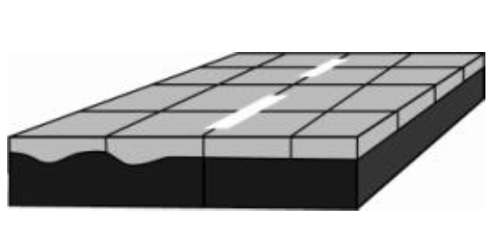
Incorporate Faulting Model To BCOA-ME
Adding faulting model to the existing BCOA program in Pavement-ME
PennDOT currently funding research to add faulting model to program
Only for Pennsylvania
NRRA funding to have program incorporate national inputs

Slide 23
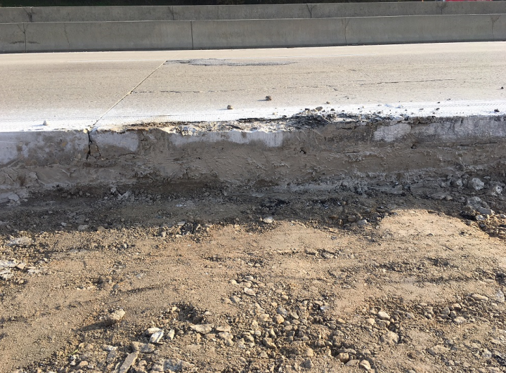
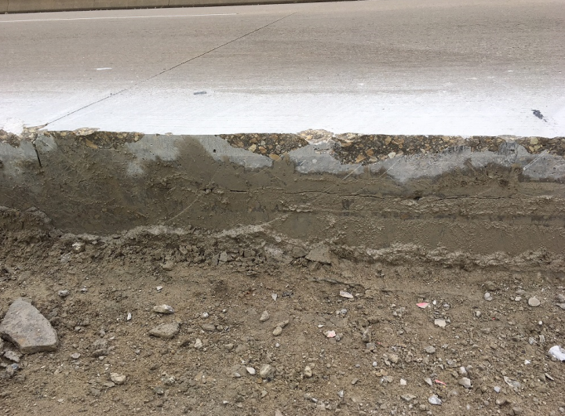

Determination of Causes for Cracking Over Dowel and Tie Bars
Two SPS-2 projects noted this issue
Other states have observed
Research being divided into two phases
Phase 1: Conduct literature review, examine pavements, obtain samples from pavements and design laboratory experiments

Slide 24
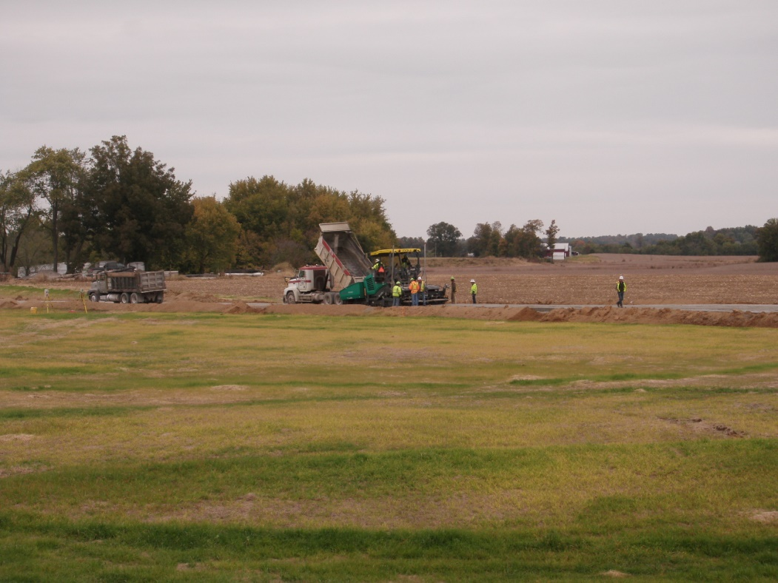
Compacted Concrete Pavement

Slide 25







Big Thanks!!
Emery Sapp & Sons
Andale
Euclid
National Road Research Alliance (NRRA)
Minnesota DOT
Missouri University Science & Technology
Southeast District - MoDOT

Slide 26
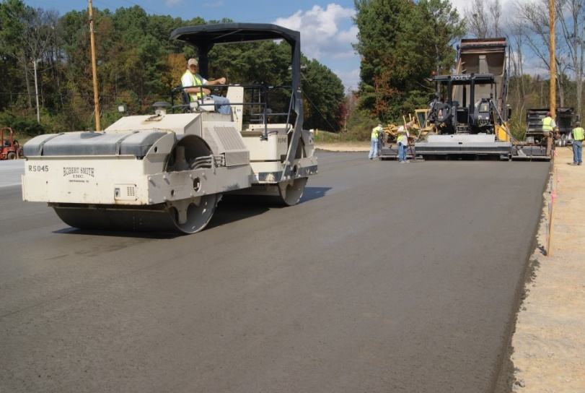
What is Compacted Concrete Pavement (CCP)?
Similar to RCC
Zero slump
Consolidate by compacting
No air entrainment
Significant Differences
Utilize a high density paver
Utilize special admixture
Apply special finishing aid
Broom Texture

Slide 27

NRRA Involvement
Rigid Team selected CCP
Cost more than anticipated
SE District added CCP to a project
Contract awarded
MoDOT asked if NRRA funds could be used for research
First NRRA satellite project

Slide 28
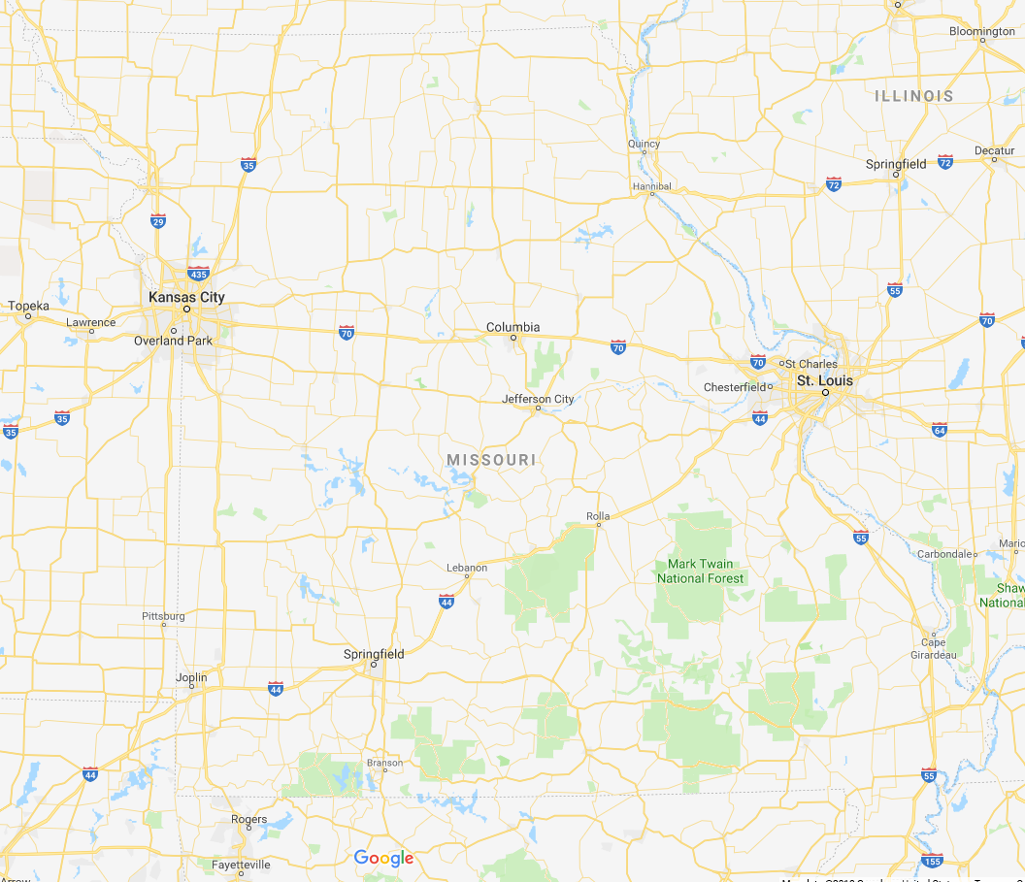

Where

Slide 29
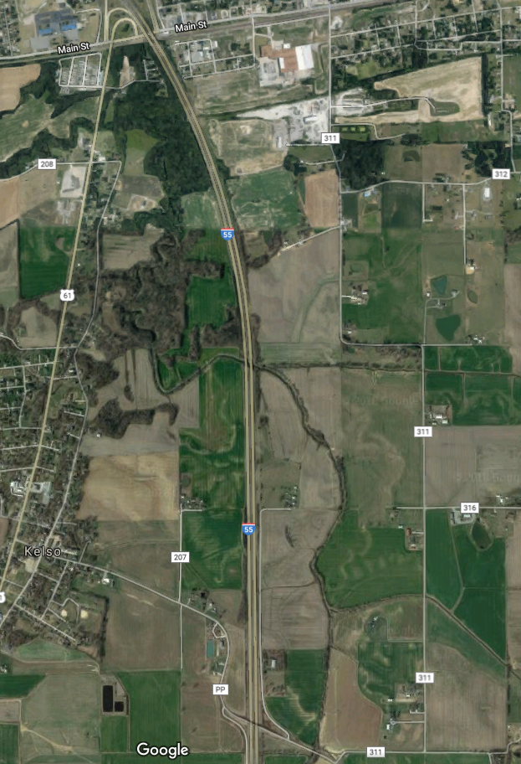

Project Location
Outer Road – East side of I-55
Scott County
Approx. 2 miles
Test Strip on Oct. 24
Full Production started on Oct. 25
- SBL placed first

Slide 30

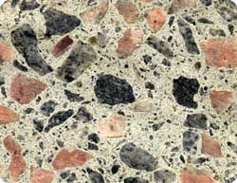
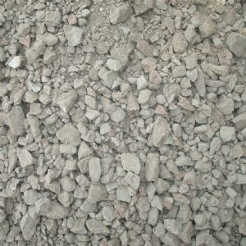
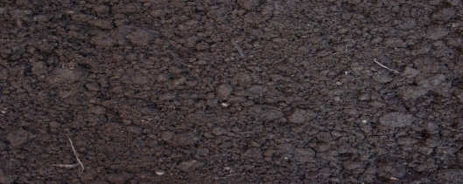
Pavement Structure
Plans
Proposed
6” CCP
8” CCP
4” Type V Base
6” Type V Base
12” Soil Stabilization

Slide 31
Mix Design Criteria
Cementitious Content: 550 lbs./C.Y.
Fly Ash Amount: 18%
w/cm Ratio: 0.38
Amount of Fine Aggregate: 35% (by agg. vol.)
Max. Aggregate Size: 1-inch
Special Admixture: ACEit
Fibers: 5 lbs./C.Y. of 2-inch macro fibers

Slide 32
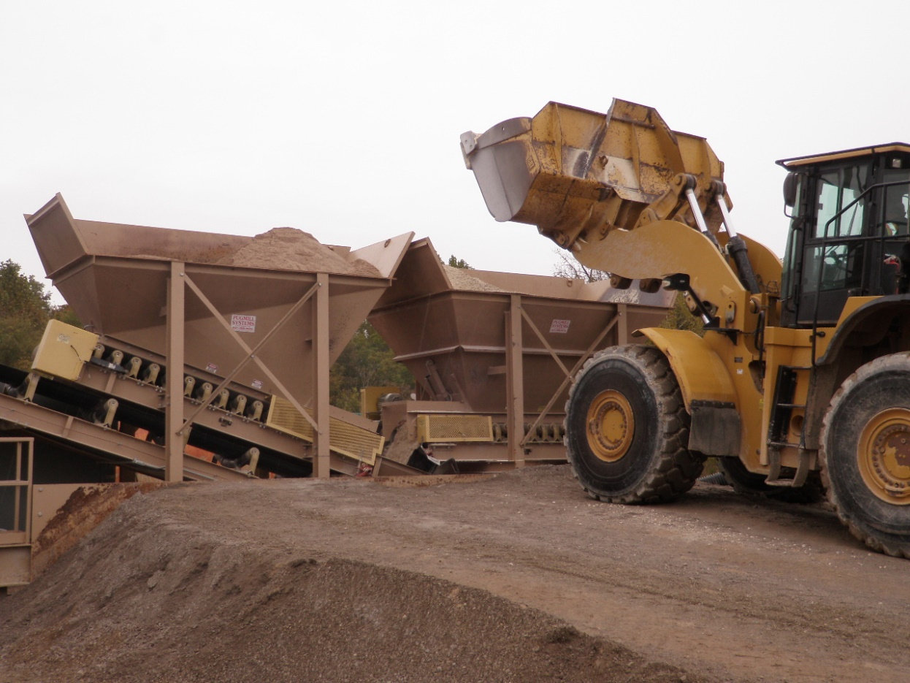
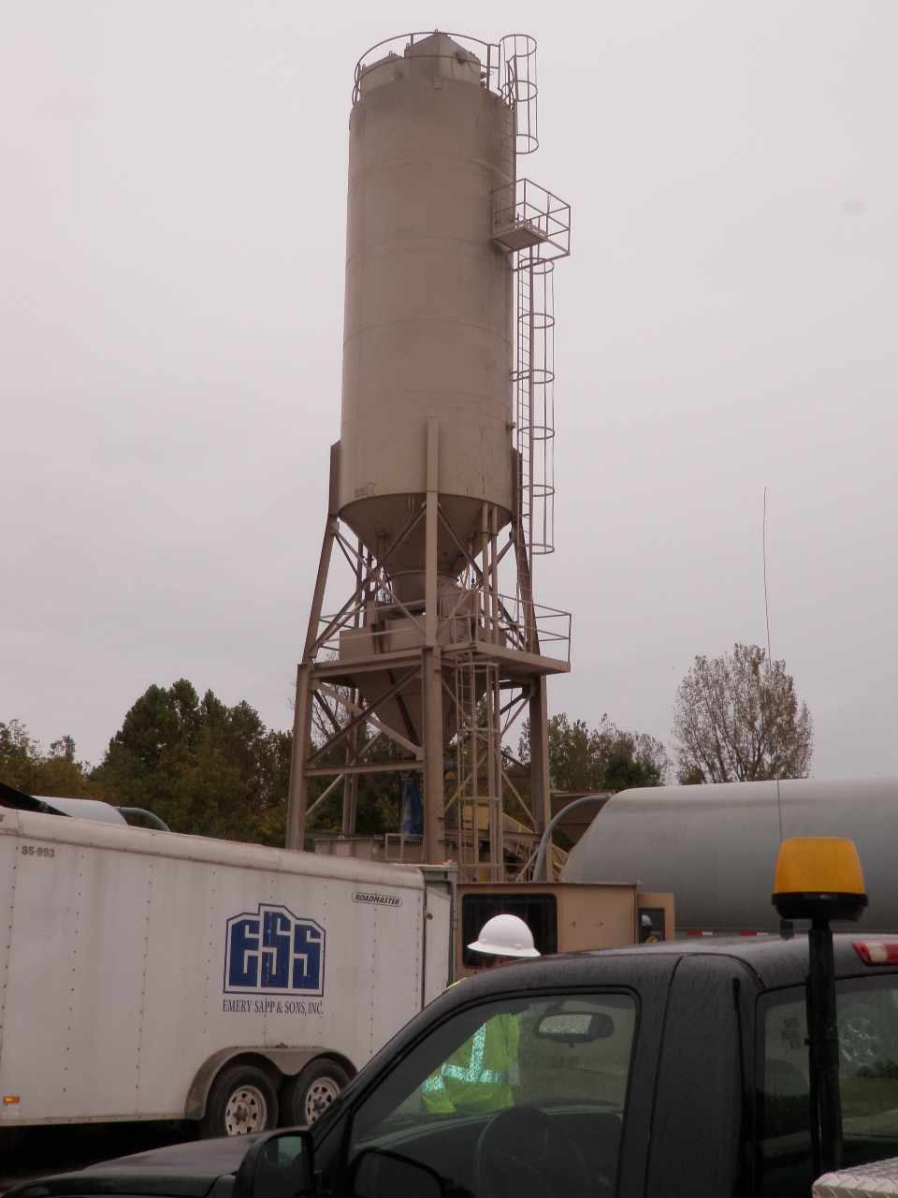
Concrete Plant

Slide 33
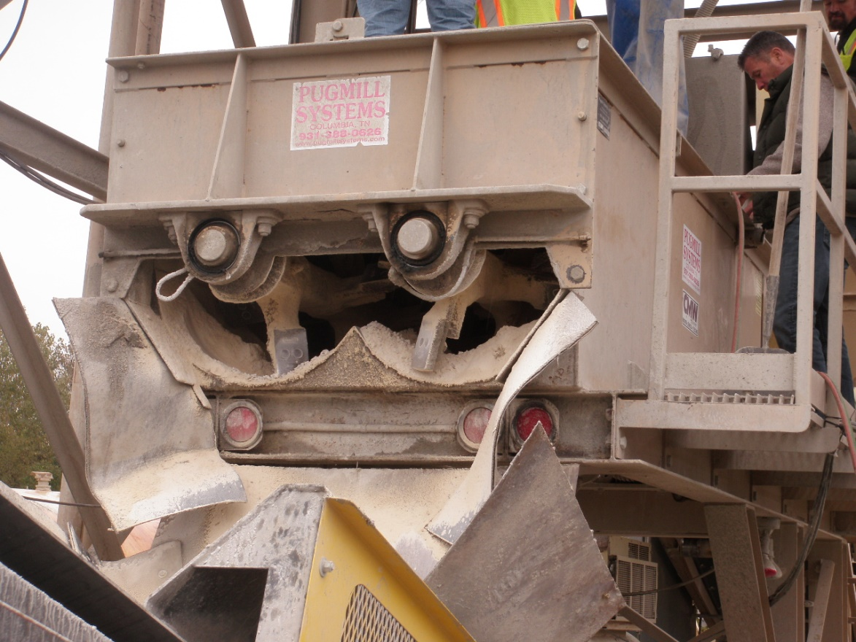
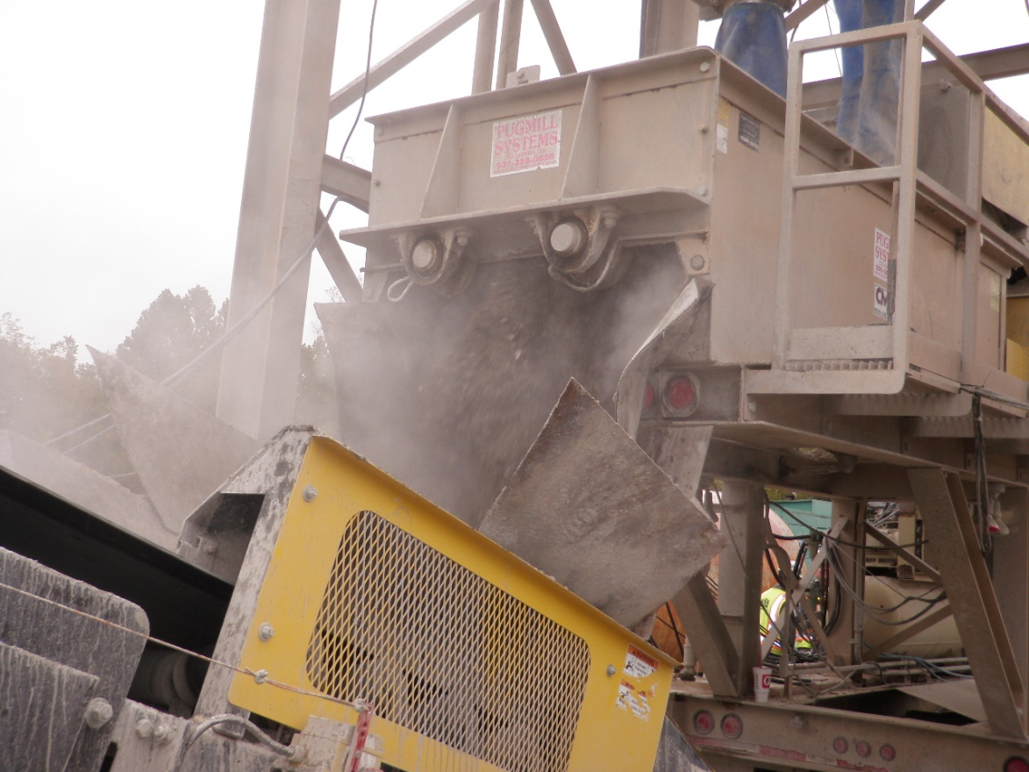
Concrete Plant

Slide 34
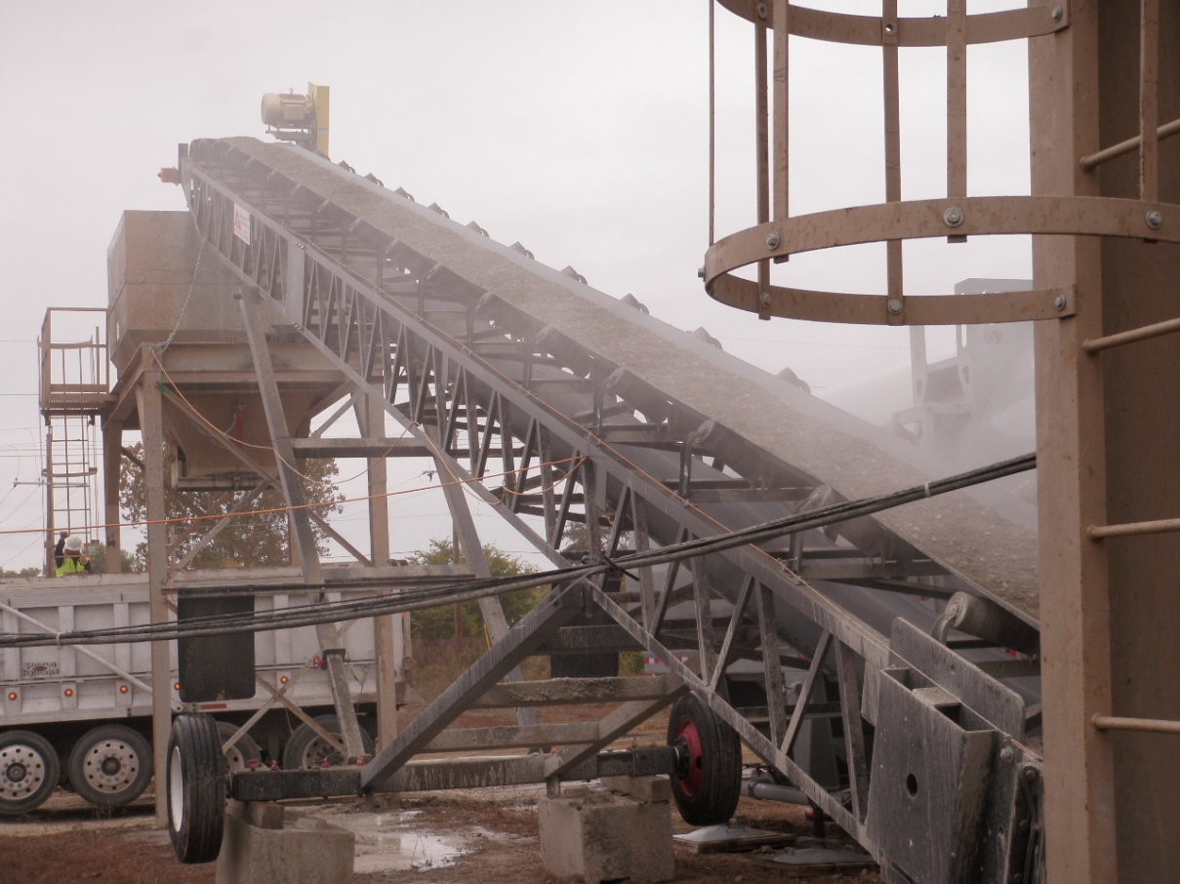
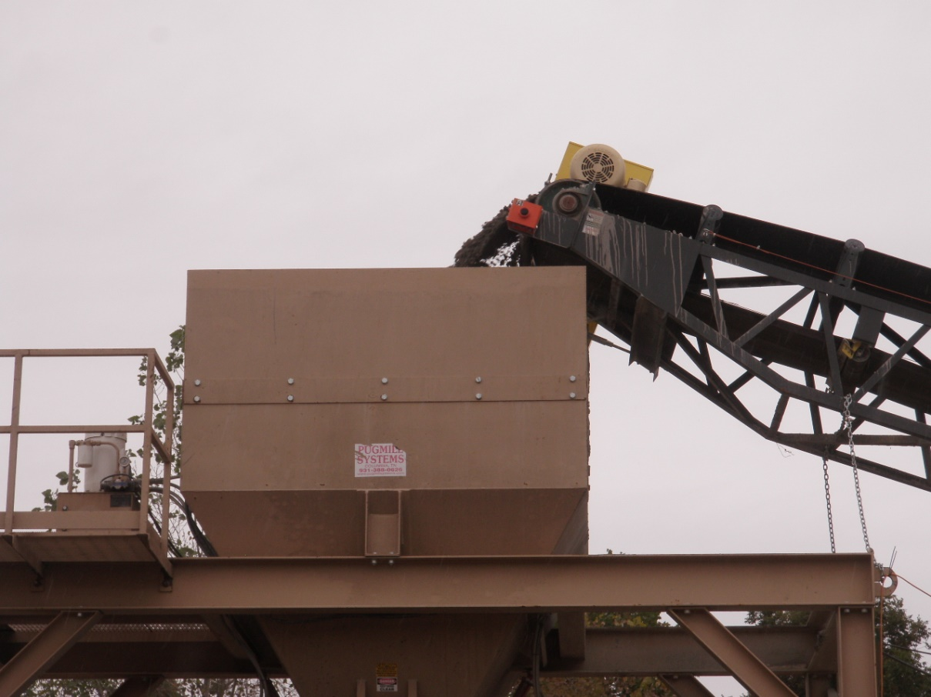
Concrete Plant

Slide 35
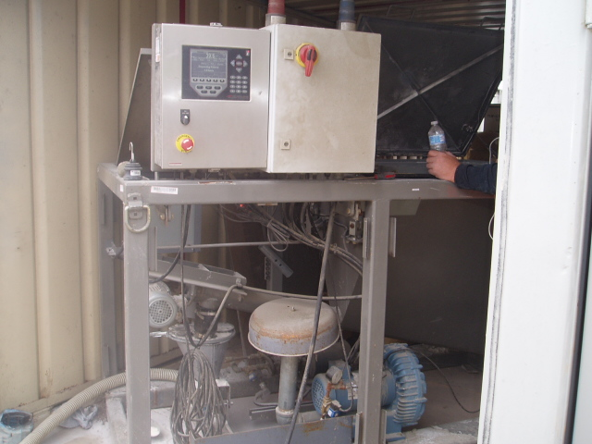
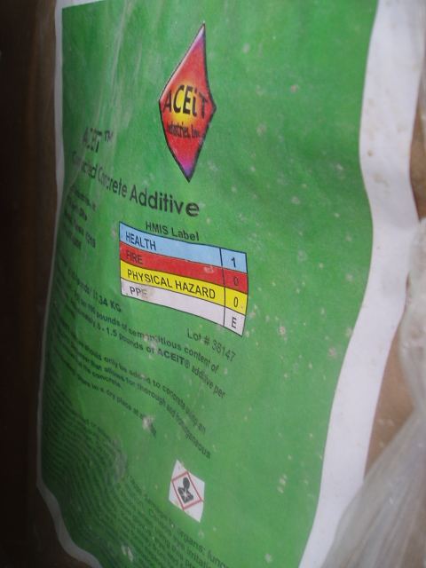
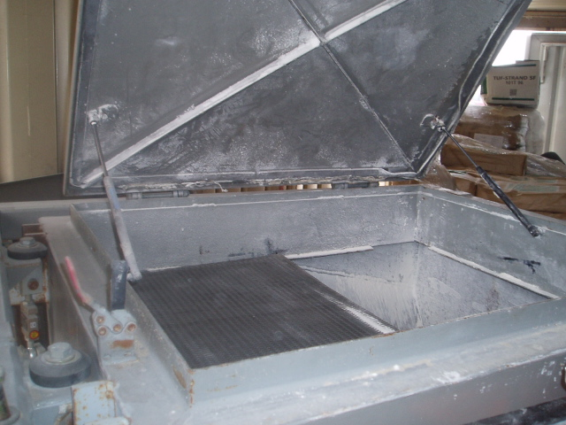
Adding ACEit Admixture

Slide 36
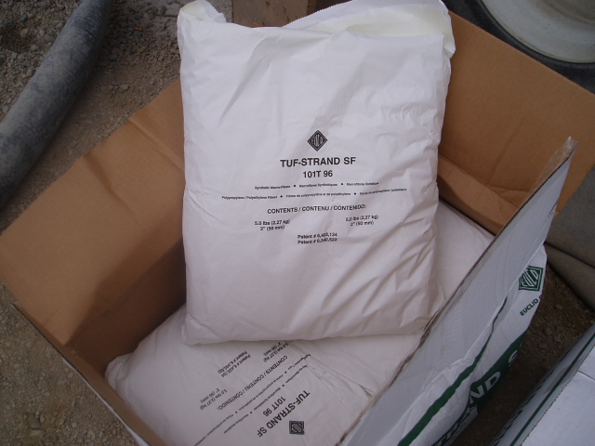
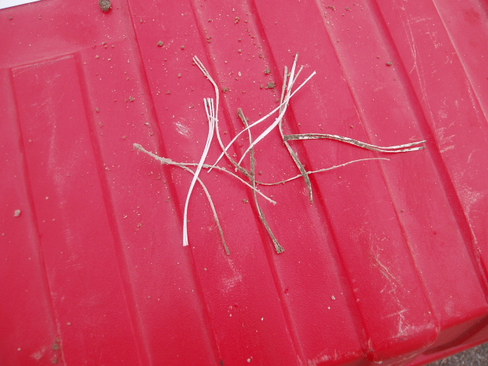
Macro Fibers
5 lbs./cu. yds.
2 in. length

Slide 37
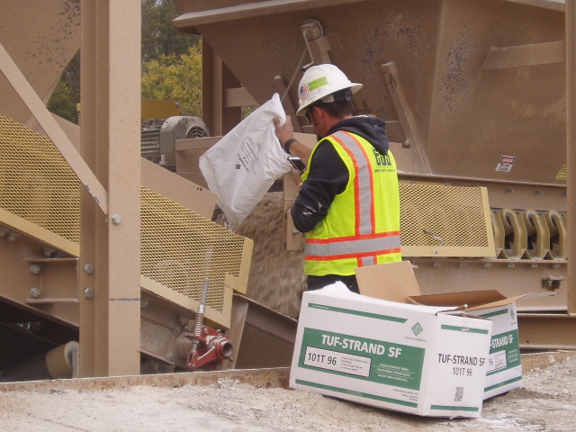
Adding Fibers

Slide 38
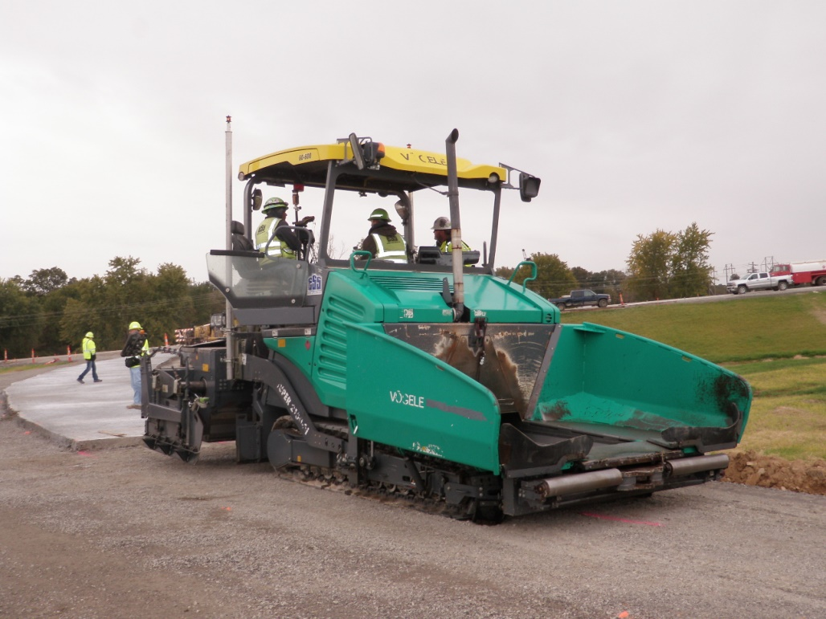
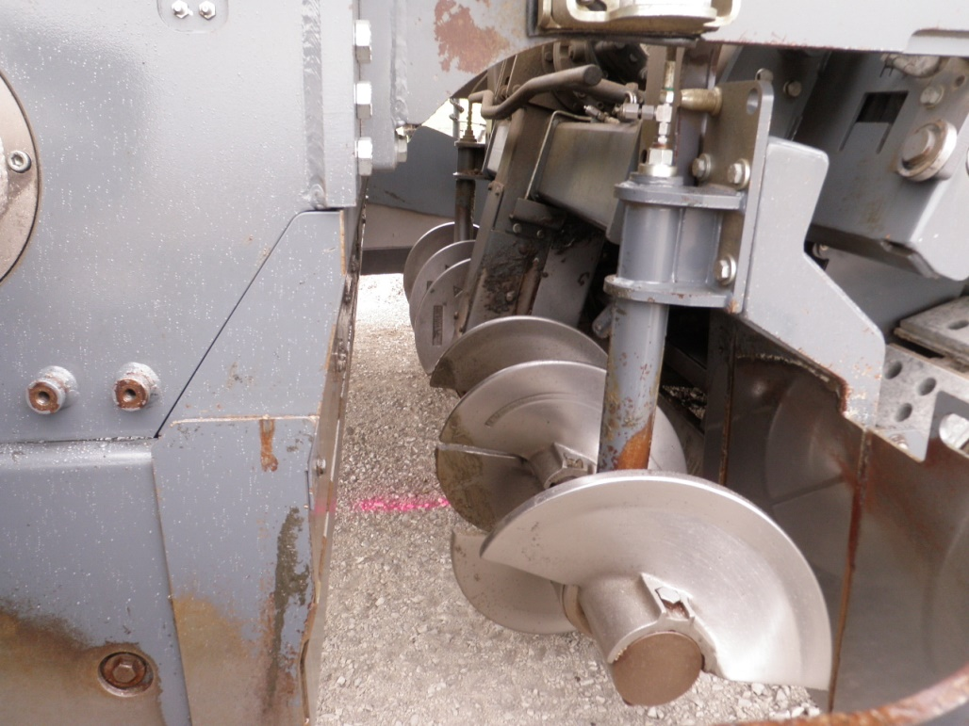
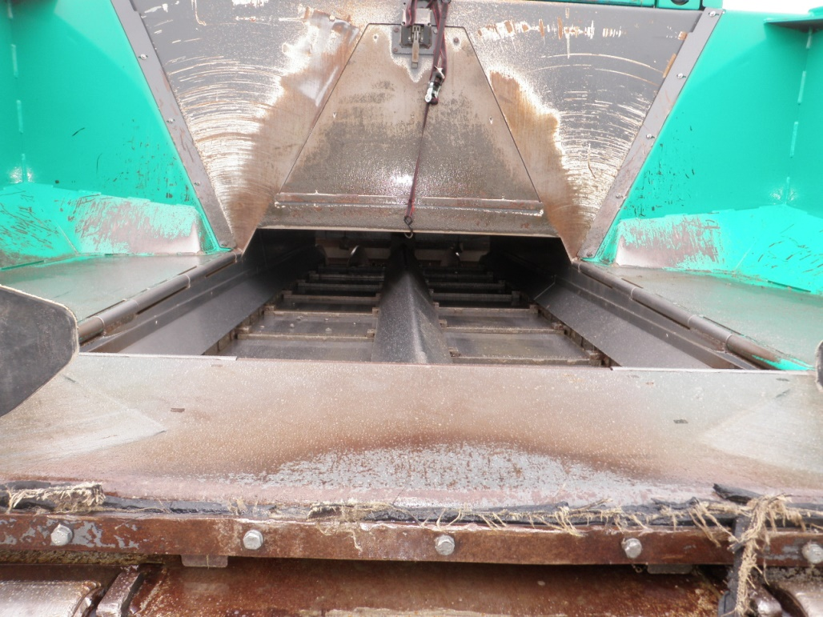
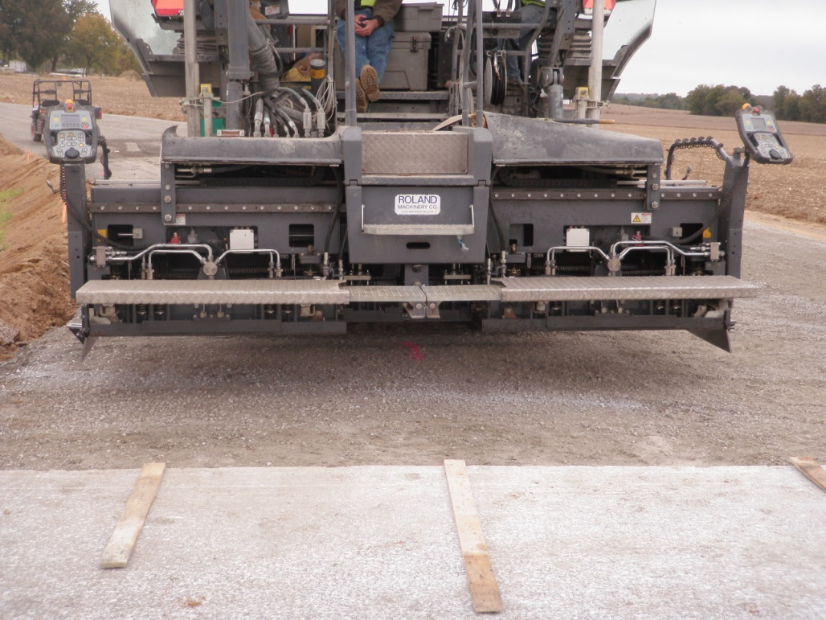
High Density Paver

Slide 39
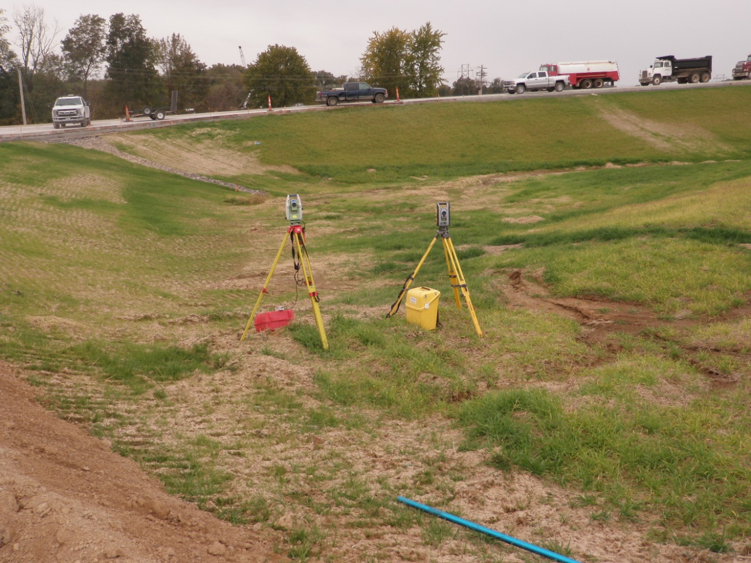
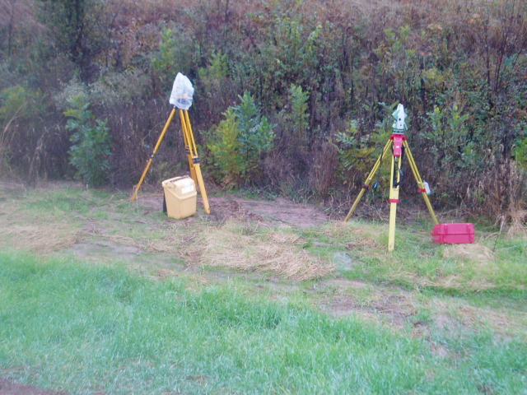
Stringless Paving

Slide 40
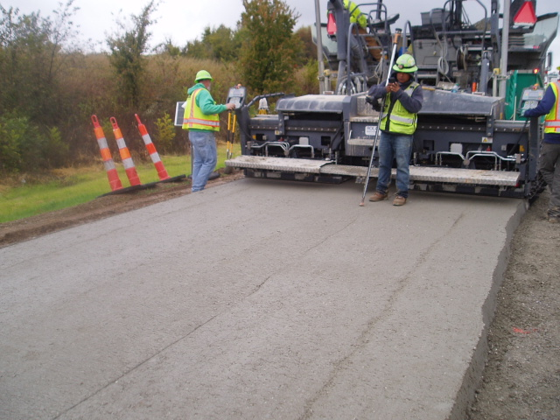
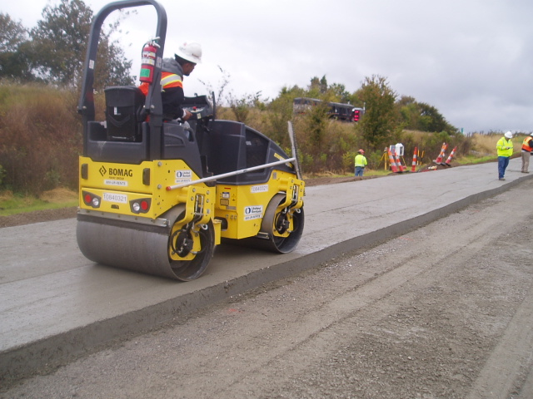

CCP Placement

Slide 41
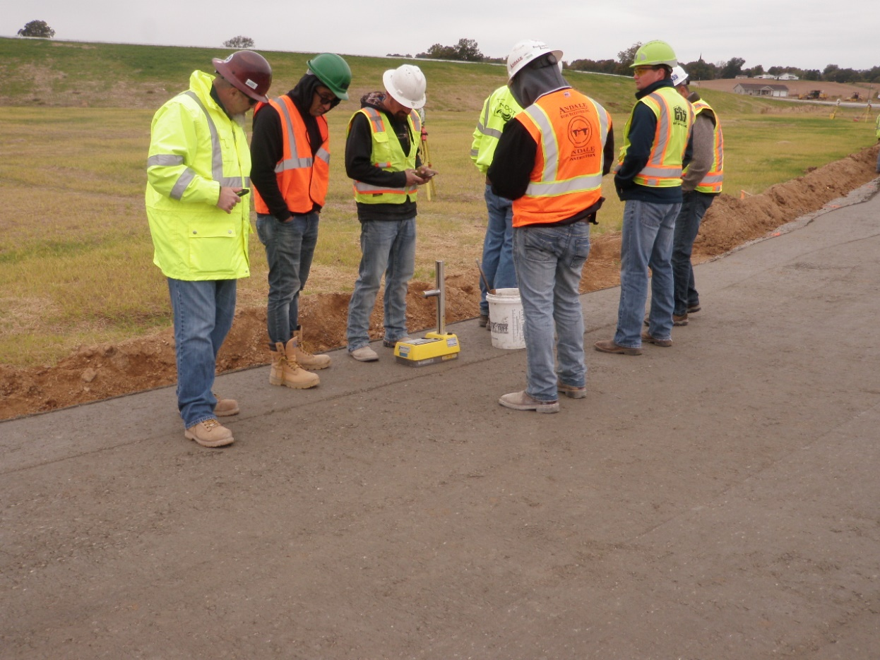
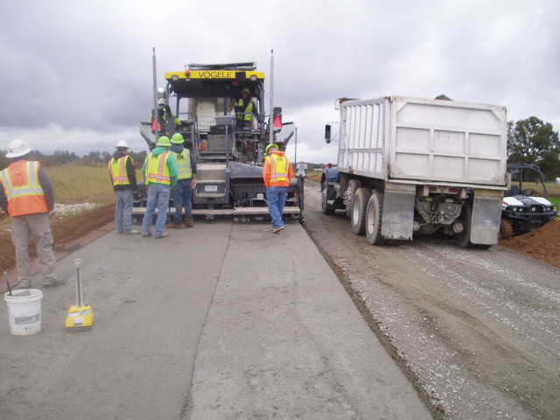
Density Testing
Typically 98% behind the paver

Slide 42
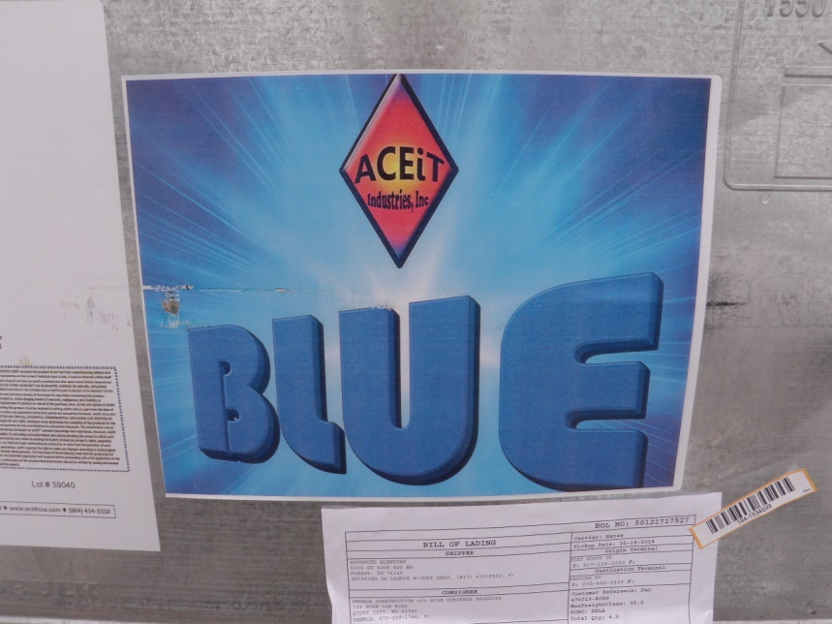
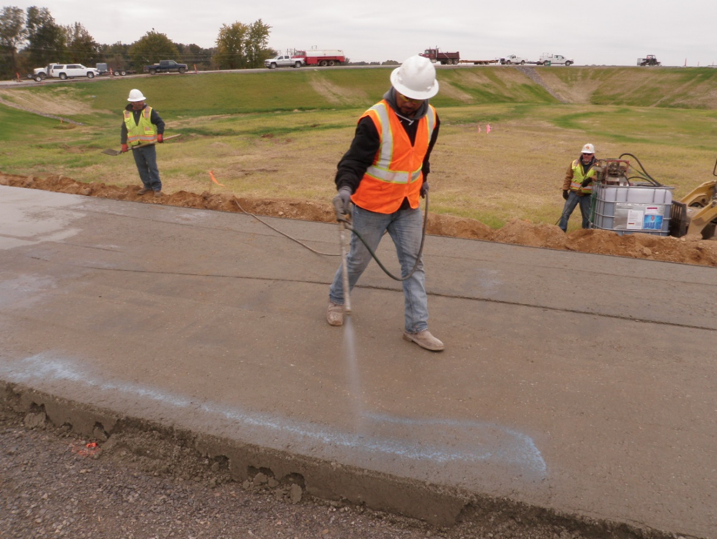
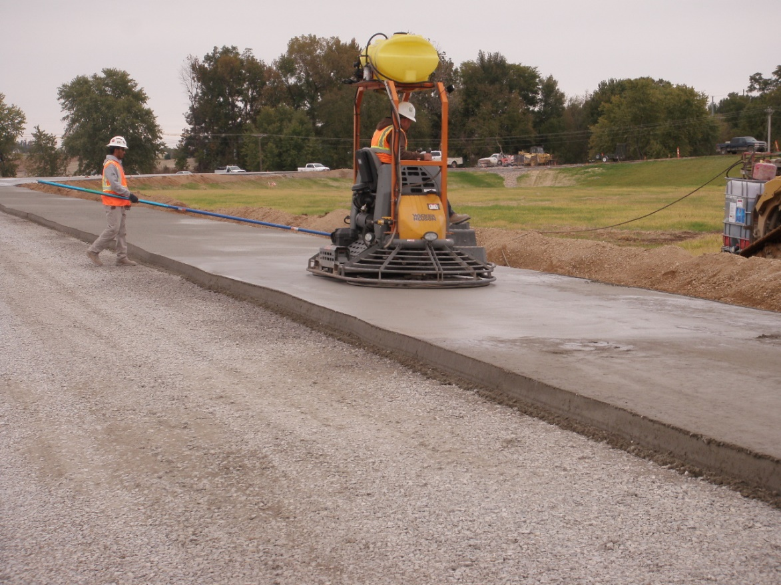
Finishing CCP

Slide 43
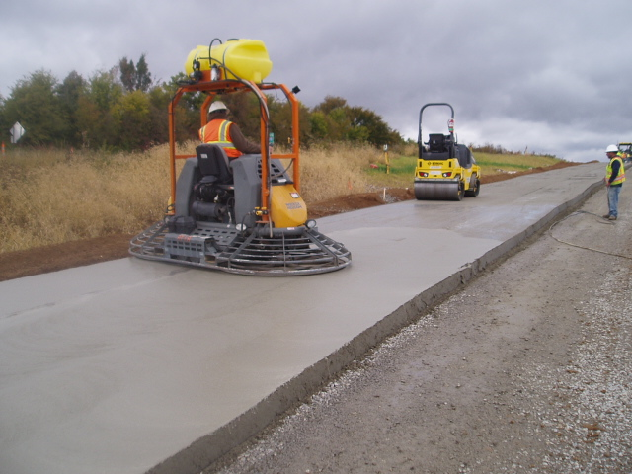
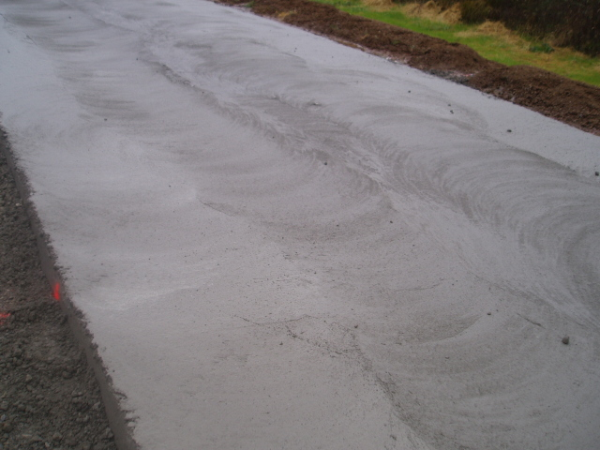
Finishing CCP

Slide 44
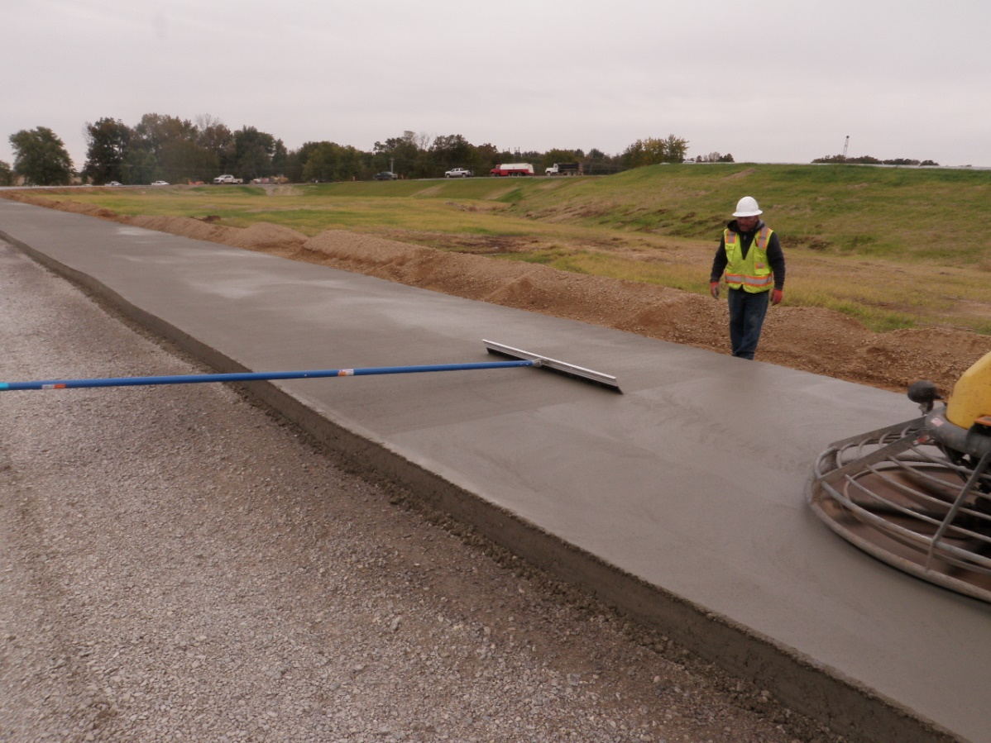

Texturing CCP

Slide 45


Curing

Slide 46


Sawing

Slide 47
Test Sections
Constructed three test sections (SBL’s)
Test Section No. 1 (495 ft.)
15 ft. joint spacing
No fibers
Test Section No. 2 (504 ft.)
12 ft. joint spacing
No fibers
Test Section No. 3 (255 ft.)
15 ft. joint spacing
5 lbs./C.Y. macro fibers utilized

Slide 48






Sensor Layout
Dynamic Strain Gauges
Dynamic Strain Gauges
Vibrating Wire Strain Gauges
Joint Opening
Block Out
Thermocouple Tree

Slide 49




Installing Sensors

Slide 50




Test Section No. 1
Looking North

Slide 51




Test Section No. 2
Looking South
Looking North

Slide 52




Test Section No. 3
Looking South
Looking North

Slide 53




Test Section No. 3

Slide 54


CCP with Fibers

Slide 55


Samples
Molded
Missouri University of Science & Technology
Missouri DOT

Slide 56




Extracting Samples

Slide 57




Extracting Samples

Slide 58




Falling Weight Deflectometer

Slide 59

Lessons Learned
Moisture content critical
Load truck in two dumps
Utilize surge hopper (prevent dumping wings)
Tunnel extensions fully charge
Monitor mixture consistence (each load)
Adjust amplitude & frequency of tamper screed
Wet Load Decrease Energy
Dry Load Increase Energy

Slide 60

































































Questions or Comments?

