Slide 1
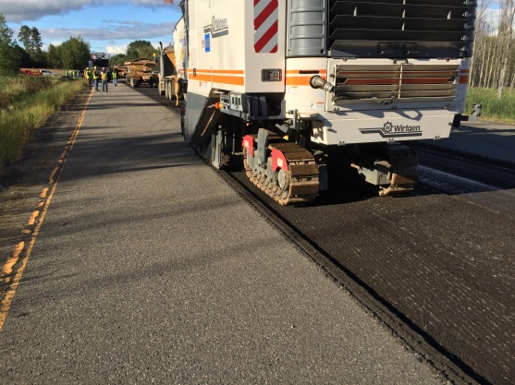
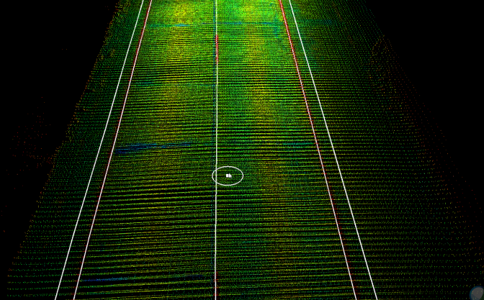
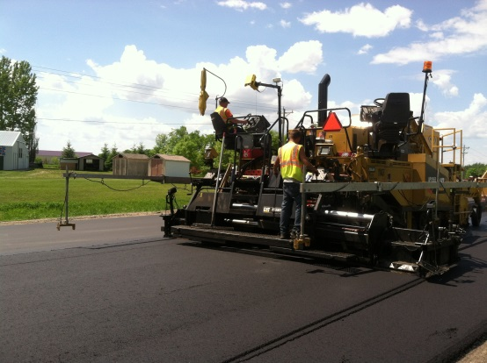
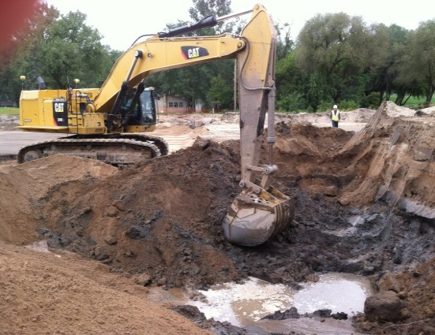
Keys to Successful Deployment of Intelligent Compaction and Paver Mounted Thermal Profiling Technologies
NRRA Pavement Conference, May 23, 2019
University of Minnesota Continuing Education and Conference Center

Slide 2
Words from the Wise
The Six Phases of Successful Deployment
Enthusiasm
Disillusionment
Panic
Search for the Guilty
Punishment of the Innocent
Praise and Glory for the Non-Participants

Slide 3
Keys to Success
NO ONE SHOULD BE ASKED TO BID ON SOMETHING
THEY DO NOT UNDERSTAND!
Ensure Agency-Contractor-Vendor Collaboration
Agency flexibility is needed during early implementation stages

Slide 4

Knowledge Sharing – Contractor Collaboration
Hold discussions with contractors:
‘Buy-In’
Increase Knowledge
Realities of Field
decrease risk

Slide 5
Contractor Collaboration
In-Depth Discussions at Meetings
  Asphalt Pavement Quality and Technology Committee
    3-4 times / year
  Specification Committee
    1-2 times / year
  Association of General Contractors
    2 times / year
  Ad-Hoc Committees
    as needed
  Minnesota Asphalt Paving Association
    all meeting platforms
Discussion Topics
  Specification development
  Implementation Schedules
  Debriefings
  New technologies, practices & opportunities
  Solutions to existing problems
  Needs / Resources
Workshops

Slide 6
Keep it Simple
We have to learn to walk before we run
Start Simple
Staged Goals
Expect Failures

Slide 7
Thank You!

