Slide 1
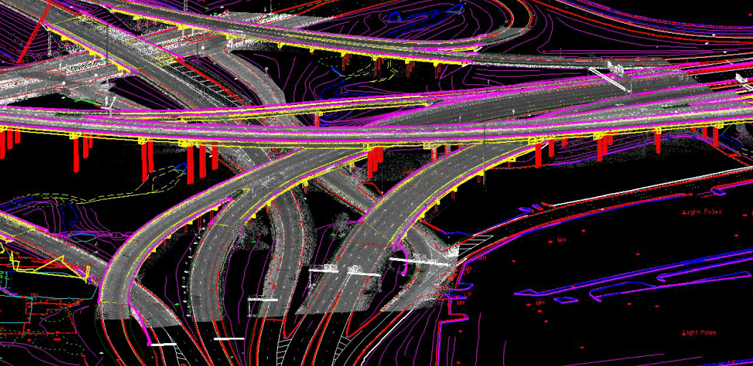
Building Information Modeling (BIM) for Infrastructure State of the Nation
National Road Research Alliance
BIM Workshop – May 2019
David Unkefer, FHWA david.unkefer@dot.gov
Image credit: Woolpert

Slide 2
Today’s Presentation
The Big Picture –BIM (for Infrastructure) and the Federal/FHWA Role
Business Drivers/Technology/Research
National and State Implementation
Resources
Notes:
NRRA National Road Research Alliance with heavy emphasis on paving e.g. MnROADs - 35 minutes
Overview of Building Information Modeling,
Overall Aspects of Program,
State Implementation Plans (technical components, use cases- pavements/IC, research)
Resources/contacts

Slide 3

BIM is a transformative approach to digital program and project delivery –
e-Everything
Source: https://www.channelpartnersonline.com/2019/04/11/todays-channel-the-big-picture/
BIM for Infrastructure is a collaborative work method for structuring, managing, and using digital data and information about transportation assets throughout their lifecycle.
Notes:
I’d like to point to where we’re headed with 3D models and digital data in general. I don’t think will come as a surprise that collecting georeferenced digital data provides great opportunities for automation of tasks and for lifecycle asset management. That concept has been described by FHWA and others as Civil Integrated Management or CIM.

Slide 4
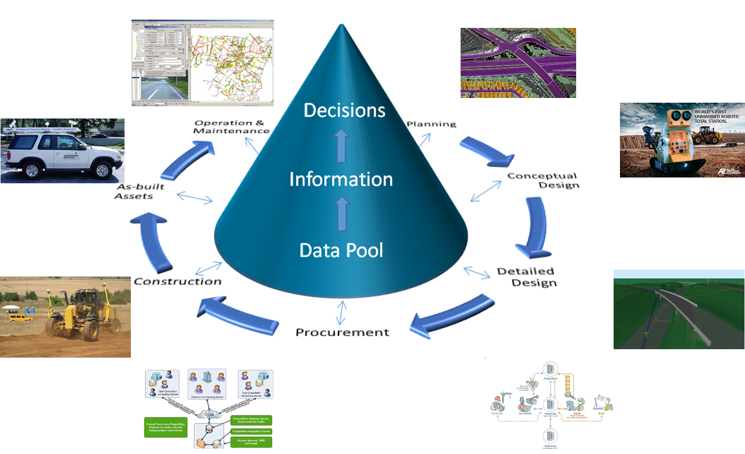
BIM for Infrastructure
(old term Civil Integrated Management or CIM)
Source: Dr. David Jeong, Iowa State University, Presentation August 17, 2016
Notes:
Overview of Building Information Modeling, (definition to date - what is it – Better information management, benefits, components, connections to CAV, performance/asset management)
Profound Changes in Program and Project Delivery

Slide 5
Profound Changes for
Program and Project Delivery
Source: FHWA

Slide 6
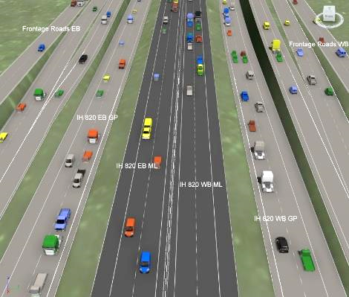
‘Implementation Guide for CIM in DOTs’
NCHRP 10-96/Report 831
Objective: Investigate the wide spectrum of CIM technologies and practices being deployed by DOTs on their projects and develop an implementation guide
Source: NCHRP

Slide 7
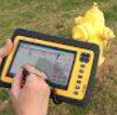
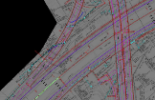
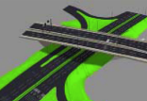
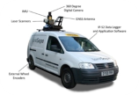
BIM/CIM Technology Clusters
2D
2D Plan sets in the field during construction
3D / nD
3D Visualization during construction (e.g. isometric drawings, physical models, etc.)
Sensing
3D Imaging (e.g. LiDAR, photogrammetry)
Data Management
3D CADD 4D Modeling Analysis (3D + schedule)
5D/nD Modeling Analysis (model-based quantity takeoff/model-based cost estimating)
Work Packaging Software / Advanced scheduling
Geographical Information Systems (GIS)
Global Positioning Systems (GPS)
Intelligent Transportation Systems (ITS)
Field Sensors (e.g. RFID, ground penetrating radar, ultrasonics)
Intelligent Compaction
Automated Machine Guidance and Control (AMG)
Utility Engineering / Clash Detection / Coordination
Electronic archival and updating of plans
Digital Asset Management
Mobile Digital Devices for onsite applications (tablets, smart phones, etc.)
Data Connectivity Other than Cellular Towers
Digital Signatures
Materials Management System (e.g. Spreadsheets and RFIDs)
Source: NCHRP

Slide 8
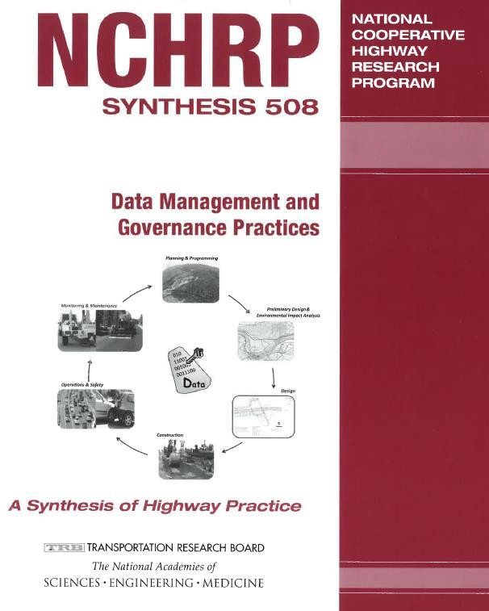
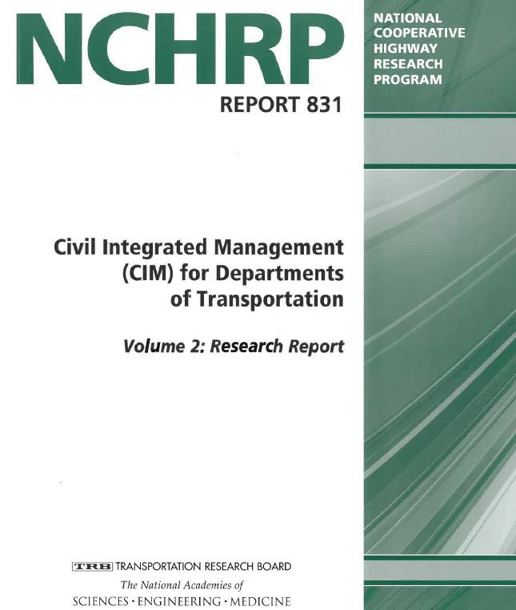
Want detail to concepts?

Slide 9
Federal/FHWA Role

Slide 10

The National Spatial Data Infrastructure
Executive Order 12906 of April 11, 1994
Notes:
The National Spatial Data Infrastructure (NSDI) is described by Executive Order 12906 (“Coordinating Geographic Data Acquisition and Access”) as “the technology, policies, standards, and human resources necessary to acquire, process, store, distribute, and improve utilization of geospatial data.” The NSDI has become a critical vehicle for facilitating seamless data development, information sharing, and collaborative decision making across multiple sectors of the economy.

Slide 11
Geospatial Data Act (October 2018)
This bill establishes: (1) in the Office of Management and Budget the Federal Geographic Data Committee (the committee), which shall be the lead entity in the executive branch for the development, implementation, and review of policies, practices, and standards relating to geospatial data; and (2) in the executive branch the National Geospatial Advisory Committee to provide advice and recommendations to the committee. The National Spatial Data Infrastructure (as defined in this bill) shall ensure that geospatial data from multiple sources is available and easily integrated to enhance the understanding of the physical and cultural world. The committee shall prepare a strategic plan for the implementation of the infrastructure consistent with national security, national defense, and emergency preparedness program policies regarding data accessibility.
Notes:
This bill establishes: (1) in the Office of Management and Budget the Federal Geographic Data Committee (the committee), which shall be the lead entity in the executive branch for the development, implementation, and review of policies, practices, and standards relating to geospatial data; and (2) in the executive branch the National Geospatial Advisory Committee to provide advice and recommendations to the committee. The National Spatial Data Infrastructure (as defined in this bill) shall ensure that geospatial data from multiple sources is available and easily integrated to enhance the understanding of the physical and cultural world. The committee shall prepare a strategic plan for the implementation of the infrastructure consistent with national security, national defense, and emergency preparedness program policies regarding data accessibility.
The committee shall operate GeoPlatform, an electronic service that provides access to geospatial data and metadata for geospatial data.
Agencies whose functions involve geospatial data shall implement a strategy for advancing geographic information and related geospatial data activities appropriate to that agency's mission in support of the strategic plan for the infrastructure. Such agencies shall disclose each contract, cooperative agreement, grant, or other transaction that deals with geospatial data.
Four years after enactment of this bill, federal funding shall not be made available for the collection, production, acquisition, maintenance, or dissemination of geospatial data that does not comply with applicable standards established by the committee.
The committee and agencies using geospatial data shall rely upon and use private individuals and entities for the acquisition of commercially available surveying and mapping and the provision of geospatial data and services, to the maximum extent practical.
The bill requires the Federal Acquisition Regulation to be revised to specify that the definition for "architectural and engineering services" includes surveying and mapping services and the acquisition of geospatial data.

Slide 12
MAP-21 – 23 USC 106 (j)
Use of Advanced Modeling Technologies
… the Secretary shall encourage the use of advanced modeling technologies during environmental, planning, financial management, design, simulation, and construction processes of the projects.
… compile information/best practices … disseminate … and promote use
… develop and publish on the public website … a detailed and comprehensive plan for the implementation …
Notes:
(j) Use of Advanced Modeling Technologies.— (1) Definition of advanced modeling technology.— In this subsection, the term “advanced modeling technology” means an available or developing technology, including 3-dimensional digital modeling, that can— (A) accelerate and improve the environmental review process;
(B) increase effective public participation;
(C) enhance the detail and accuracy of project designs;
(D) increase safety;
(E) accelerate construction, and reduce construction costs; or
(F) otherwise expedite project delivery with respect to transportation projects that receive Federal funding.
(2) Program.— With respect to transportation projects that receive Federal funding, the Secretary shall encourage the use of advanced modeling technologies during environmental, planning, financial management, design, simulation, and construction processes of the projects.
(3) Activities.— In carrying out paragraph (2), the Secretary shall— (A) compile information relating to advanced modeling technologies, including industry best practices with respect to the use of the technologies;
(B) disseminate to States information relating to advanced modeling technologies, including industry best practices with respect to the use of the technologies; and
(C) promote the use of advanced modeling technologies.
(4) Comprehensive plan.— The Secretary shall develop and publish on the public website of the Department of Transportation a detailed and comprehensive plan for the implementation of paragraph (2).

Slide 13
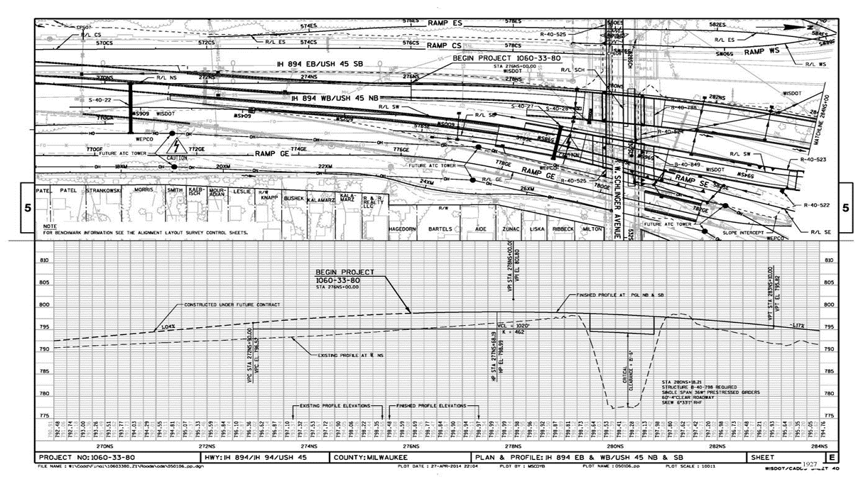
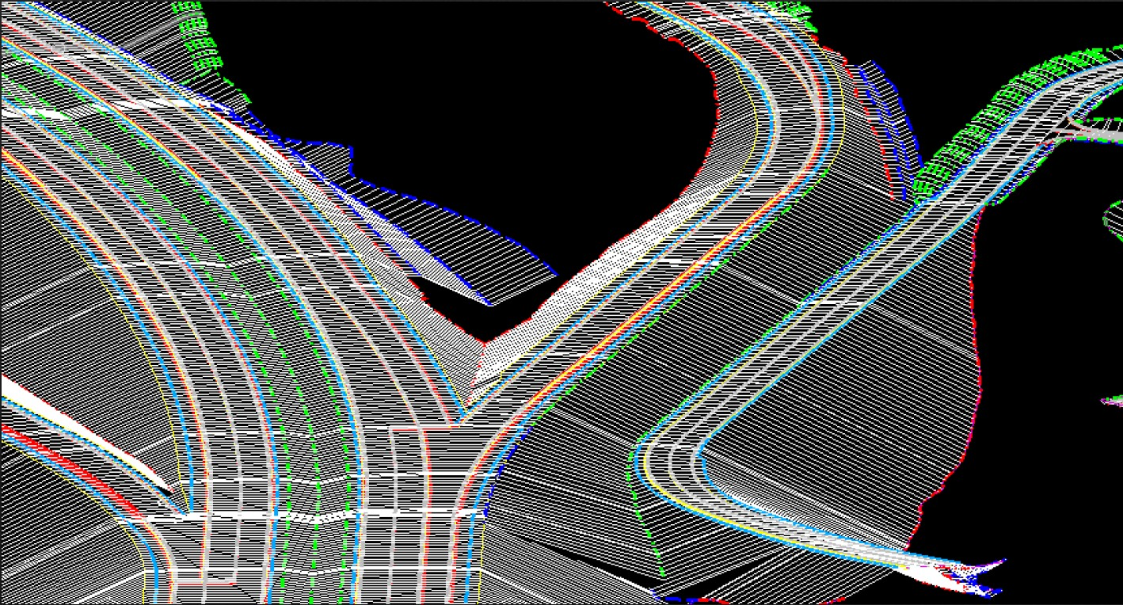
EDC 2 - 3D Engineered Models for Construction
Moving from Analog to Digital 3D Models
Images: Wisconsin DOT

Slide 14
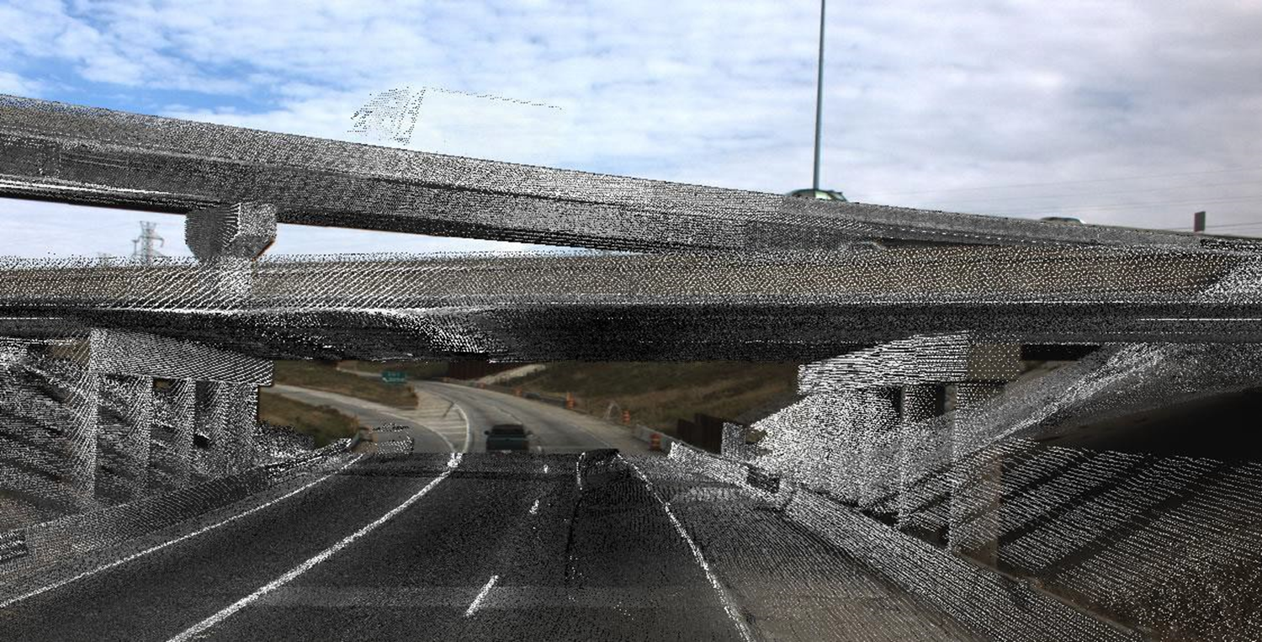
EDC 3 – 3/4/5D Engineered Models & Post-Construction
As-found Survey Data (e.g., Lidar for Asset Management)
Schedule (4D) and Cost (5D) Modeling
Post-construction Survey Data (as built including utilities)
Image: Wisconsin DOT

Slide 15
EDC 3 & 4 - e-Construction
Electronically capturing construction data
Electronic submission of all construction documentation
Increased use of mobile devices
Increased automation of document review & approval
Use of electronic signatures by all parties throughout process
Secure document and workflow management accessible to all stakeholders on any device

Slide 16
FHWA BIM Activities/Investment

Slide 17
Business Drivers

Slide 18
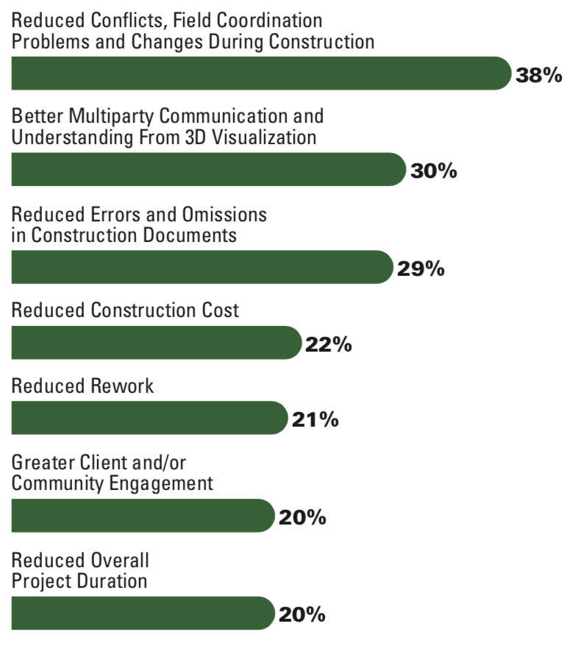
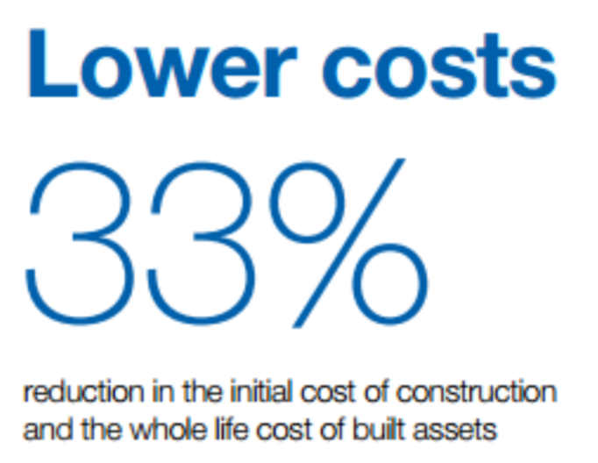
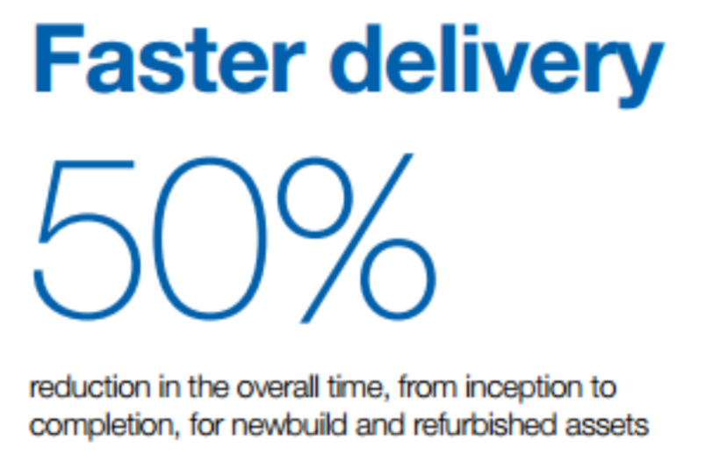
BIM for Infrastructure – Why?
Percentage of BIM Users (owners, engineers and subcontractors)
Credit to Dodge: Section: “Executive Summary” (Page 1)
Notes:
Motivation is Lower Costs and Faster Project Delivery. Some studies show as high as 33% Lower Costs and 50% faster project delivery.
With aging infrastructure and limited funding, both cost and time savings are absolutely critical to meeting the needs of the infrastructure.
Keeping pace and being able to deliver infrastructure; Setting up for management and maintenance of infrastructure

Slide 19
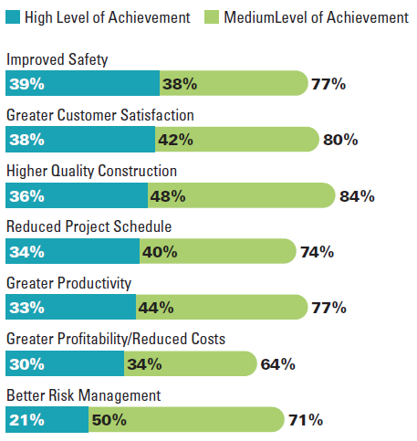

The Digital Transformation of the Construction Industry
Lean Design and Construction: Generating meaningful benefits
Data source & Image credits: Dodge Data and Analytics

Slide 20


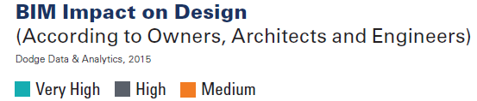

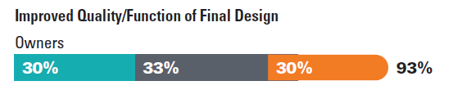
The Digital Transformation of the Construction Industry
Design Teams: Delivering better projects to Owners
Data source & Image credits: Dodge Data and Analytics

Slide 21
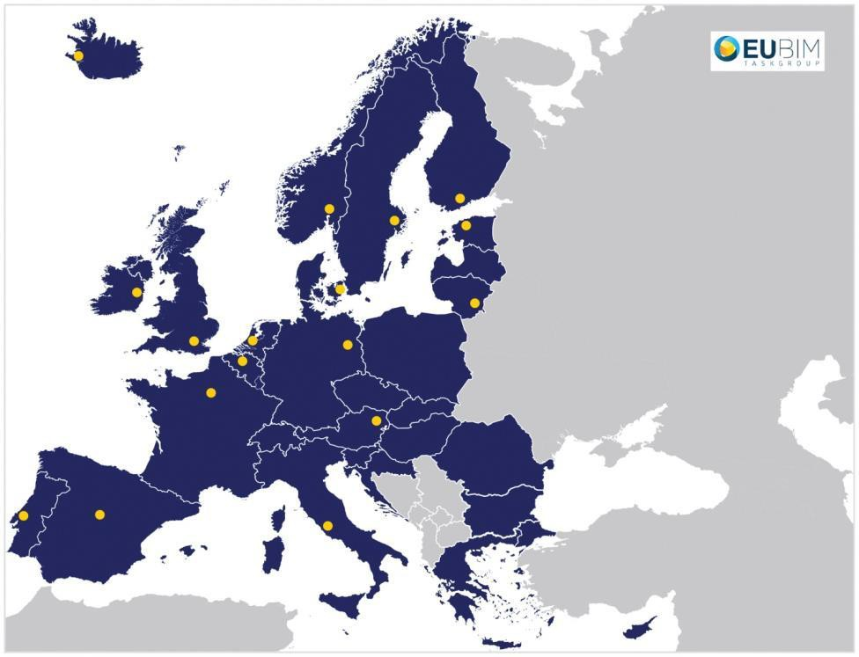

EU BIM Task Group
Deliver greater value for public money
Increased openness, fairness, competitiveness and productivity
Stimulating innovation and growth in the construction and digital economies
Image credits: EU BIM Task Group

Slide 22

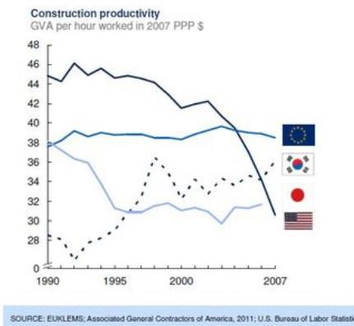
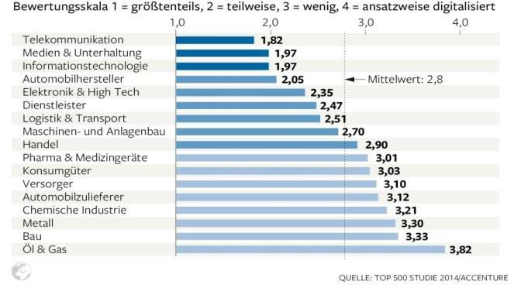
Construction: declining productivity and low digitalisation
Productivity
Other non-farm industries
Digitalisation
Construction Sector
Image credits: EU BIM Task Group

Slide 23

Connected & Autonomous Vehicles
FOR MORE INFORMATION and to REGISTER
FHWA National Dialogue On Highway Automation Website: ops.fhwa.dot.gov/automationdialogue/
Email Address: HighwayAutomation@dot.gov
FOCUS AREAS
Digital Infrastructure and Data: Explores the data opportunities and challenges regarding highway automation. Will identify new partnerships and collaboration between public agencies and industry to enable data exchange.
August 1-2, 2018 National Workshop, Seattle, WA
Infrastructure Design and Safety: Discusses infrastructure design and standardization needs to facilitate automation. Will highlight areas where automation technology developers and public agencies need discussion and collaboration to address where the roadway infrastructure, design, condition, and environment could lead to potential safety challenges.
Week of November 12, 2018 National Workshop, Austin, TX
Notes:
FOCUS AREAS
The FHWA National Dialogue on Highway Automation workshops will address the following focus areas as
they represent key categories of interest to the highway community.
Planning and Policy: Considers issues relevant for the planning and policy community, such as how
automation impacts travel demand, land use, infrastructure investment, right of way use, policy barriers, and
other topics.
Digital Infrastructure and Data: Explores the data opportunities and challenges regarding highway
automation. Will identify new partnerships and collaboration between public agencies and industry to enable
data exchange.
Freight: Explores truck platooning applications and truck automation, as well as implications for traffic
operations and infrastructure.
Operations: Addresses the range of operations questions with respect to automation, such as traffic incident
management and system efficiency. Will initiate a discussion on further research needed to understand these
types of challenges.
Infrastructure Design and Safety: Discusses infrastructure design and standardization needs to facilitate
automation. Will highlight areas where automation technology developers and public agencies need
discussion and collaboration to address where the roadway infrastructure, design, condition, and environment
could lead to potential safety challenges.

Slide 24
Technology Uses

Slide 25
Geospatial Tools Used for Highway Construction and Asset Management
Application | GNSS | Terrestrial Lidar | Mobile Lidar | Aerial Lidar | Terrestrial Photogrammetry | Aerial Photogrammetry | SfM | sUAVs/sUASs | Ground -based Radar | AMG | Robotic Total Stations | Sonar
Topographic surveying | ✓ | ✓ | ✓ | ✓ | ✓ | ✓ | ✓ | ✓ | - | - | ✓ | ✓
Earthwork | ✓ | ✓ | - | ✓ | ✓ | ✓ | ✓ | ✓ | - | ✓ | ✓ | -
Paving | ✓ | ✓ | ✓ | - | - | - | - | - | - | ✓ | ✓ | -
Roadway design | ✓ | ✓ | ✓ | ✓ | - | ✓ | - | - | ✓ | - | ✓ | -
Automated machine guidance and control | ✓ | ✓ | ✓ | - | - | - | - | - | - | ✓ | ✓ | -
Verification | ✓ | ✓ | ✓ | - | - | ✓ | - | - | - | - | ✓ | -
As-built surveys | ✓ | ✓ | ✓ | - | - | ✓ | - | - | - | - | ✓ | -
Site/progress monitoring | ✓ | ✓ | - | ✓ | - | ✓ | - | - | - | - | ✓ | -
Inspection | ✓ | ✓ | ✓ | - | - | ✓ | - | - | - | - | ✓ | -
Quality assurance/quality control | ✓ | ✓ | ✓ | - | ✓ | ✓ | ✓ | ✓ | - | ✓ | ✓ | -
Asset management | ✓ | ✓ | ✓ | ✓ | - | ✓ | - | - | ✓ | - | ✓ | ✓

Slide 26
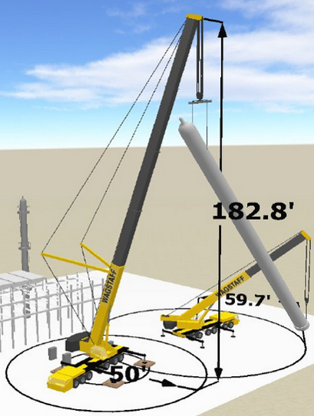
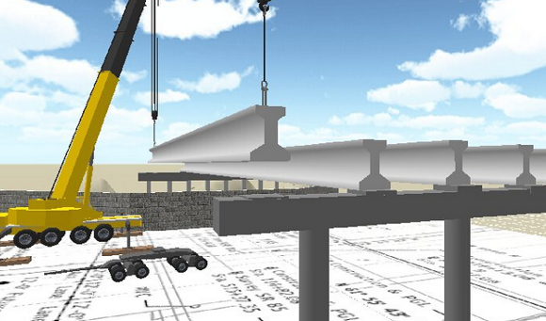
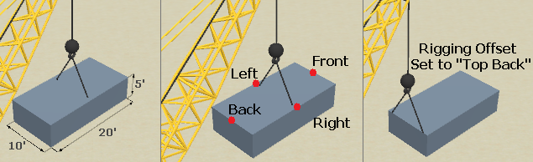
Planning Complex Activities
Source: FHWA
Notes:
Contractors plan complex and risky activities pre-bid or pre-construction to understand and manage the risks.
Many contractors use 3D modeling to plan risky or complex construction activities. Tools like 3D Lift Plan use geometrically-accurate equipment models to plan out lifts. The tool lets them plan the load bracing as well as equipment movements. Having 3D models of structures available pre-bid would allow contractors to do this planning during the estimating process and have an estimate that more closely reflects how construction will be performed.

Slide 27
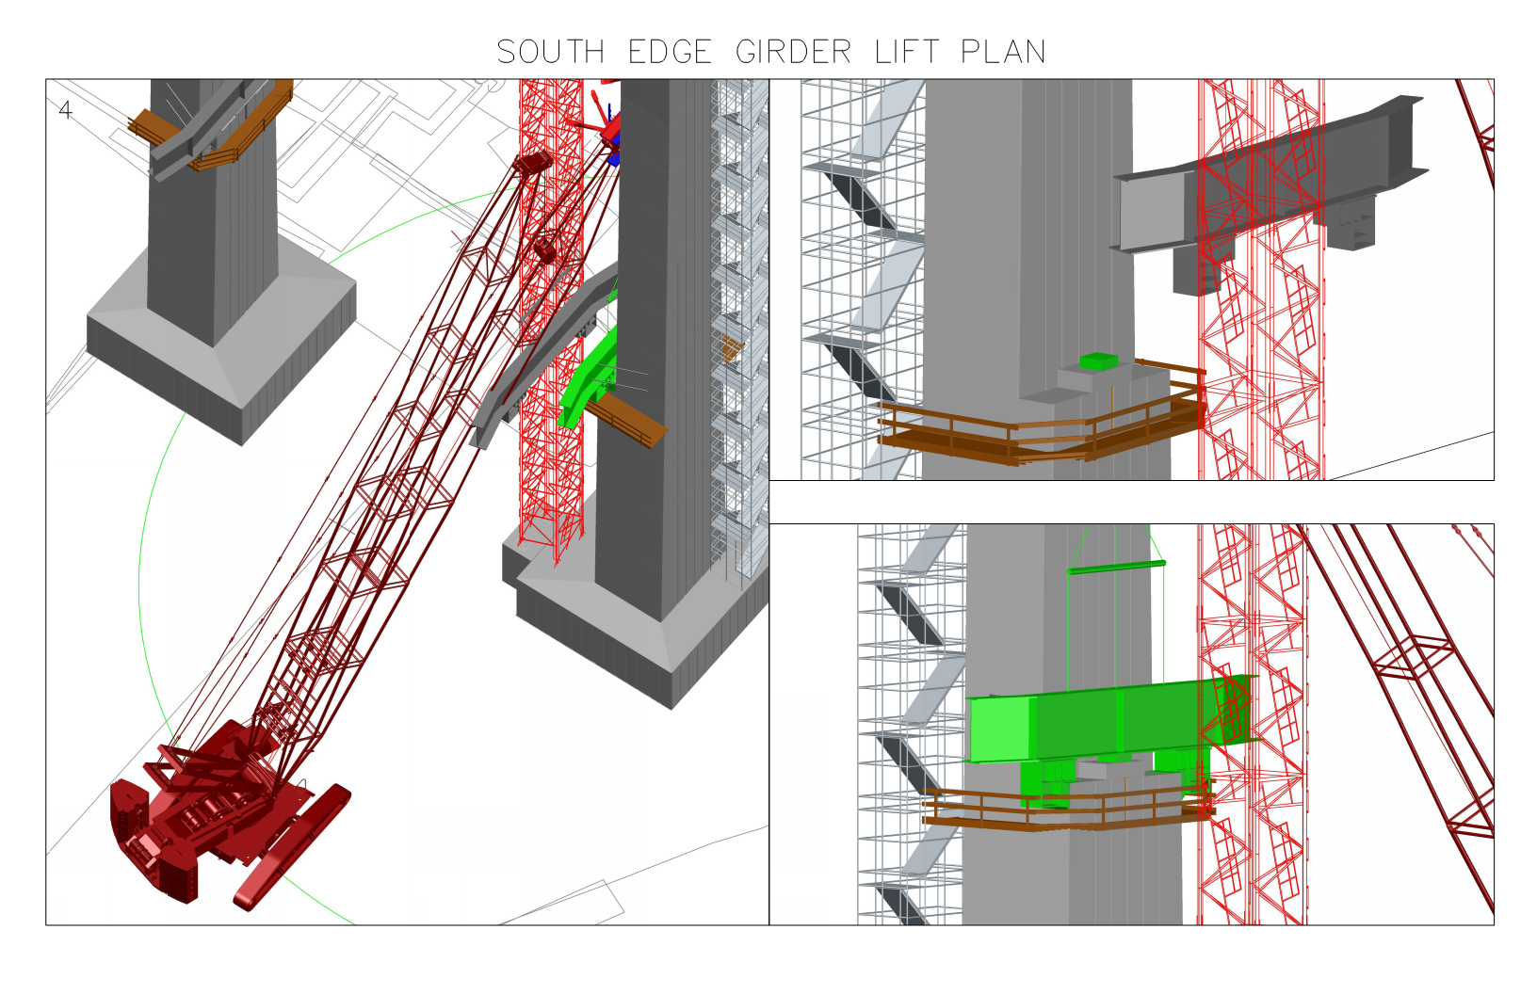
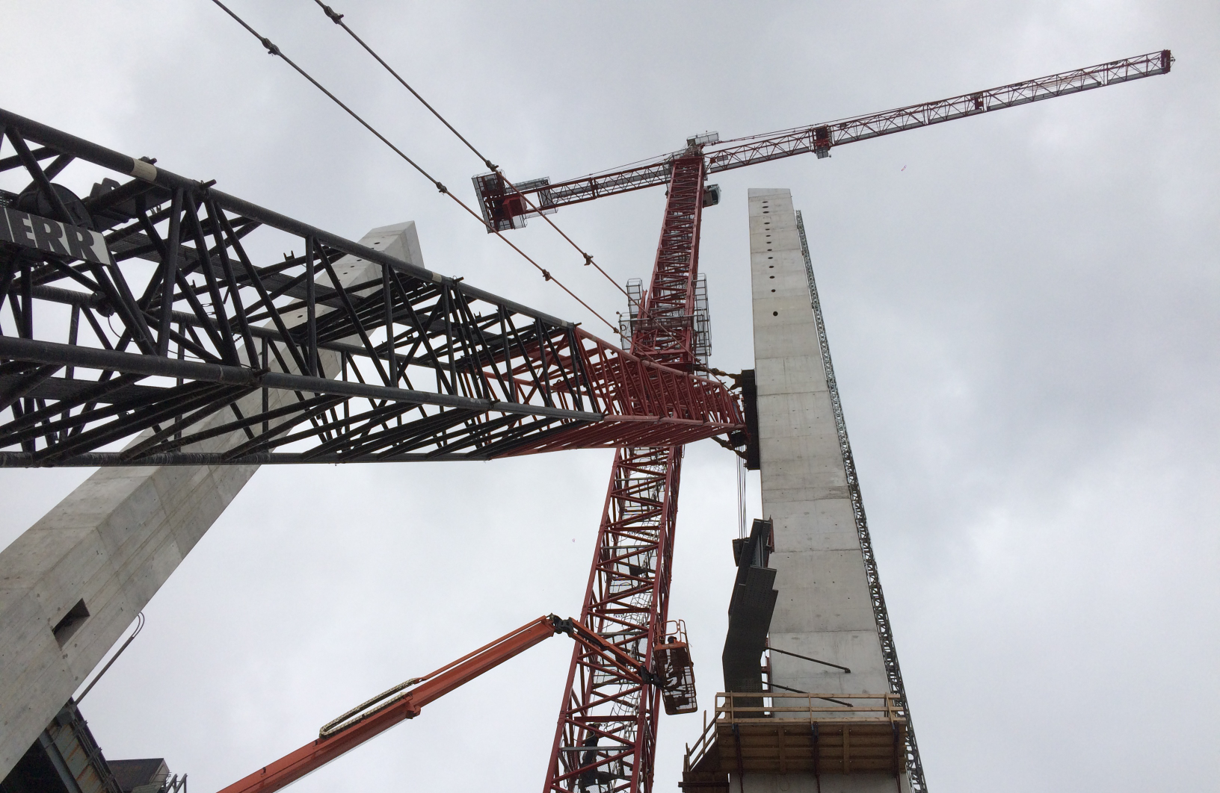
3D/4D Data Models for Construction
Kosciuszko Bridge Replacement
Modeling and Performing the Steel Erection
3D modeling was used throughout construction. The slide on the right shows the contractor modeled the crane movements to assess the constructability could be performed within a confined area demonstrating the value of the 3D model
Actual crane movements performing the work as planned and modeled
27

Slide 28
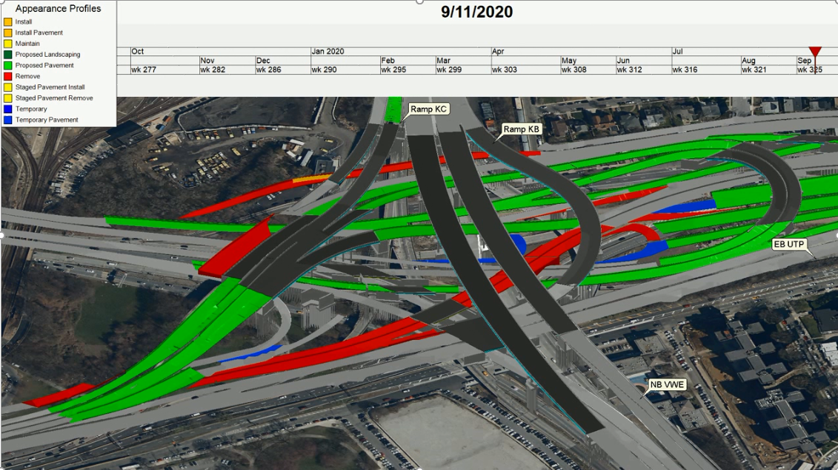
Leveraging 3D and 4D Data: Assessing Deliverability & Risk
28
Notes:
For projects / contracts where CIM is used, NYSDOT provides this guidance

Slide 29
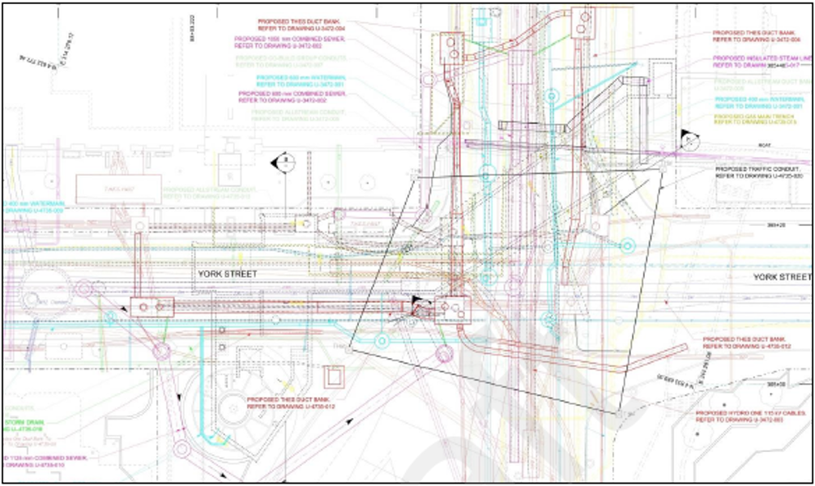
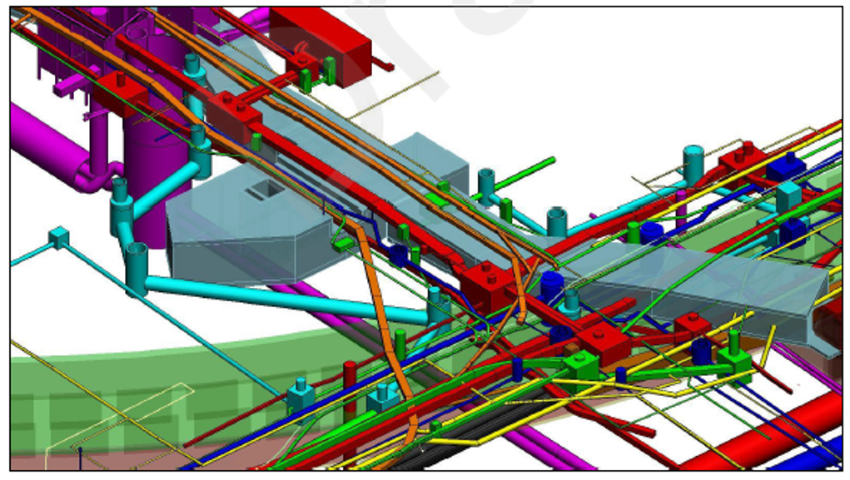
Clash Detection
Typical 2D plan sheet of utility layout
The same utility layout modeled in 3D. Which is more informative?
29

Slide 30
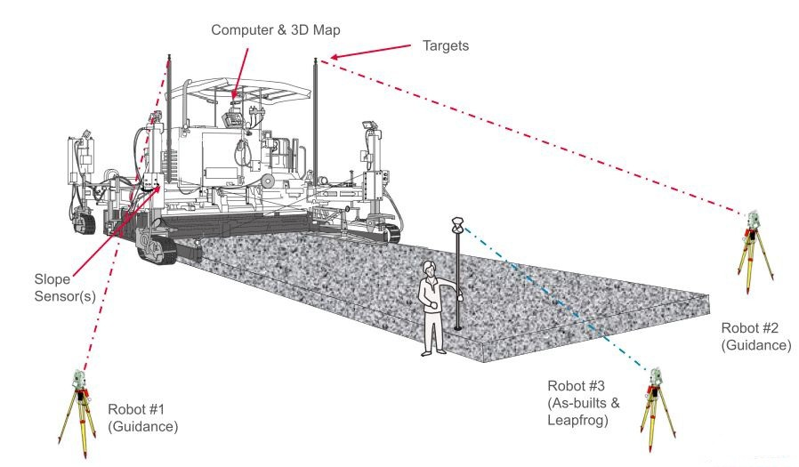
AMG Paving

Slide 31
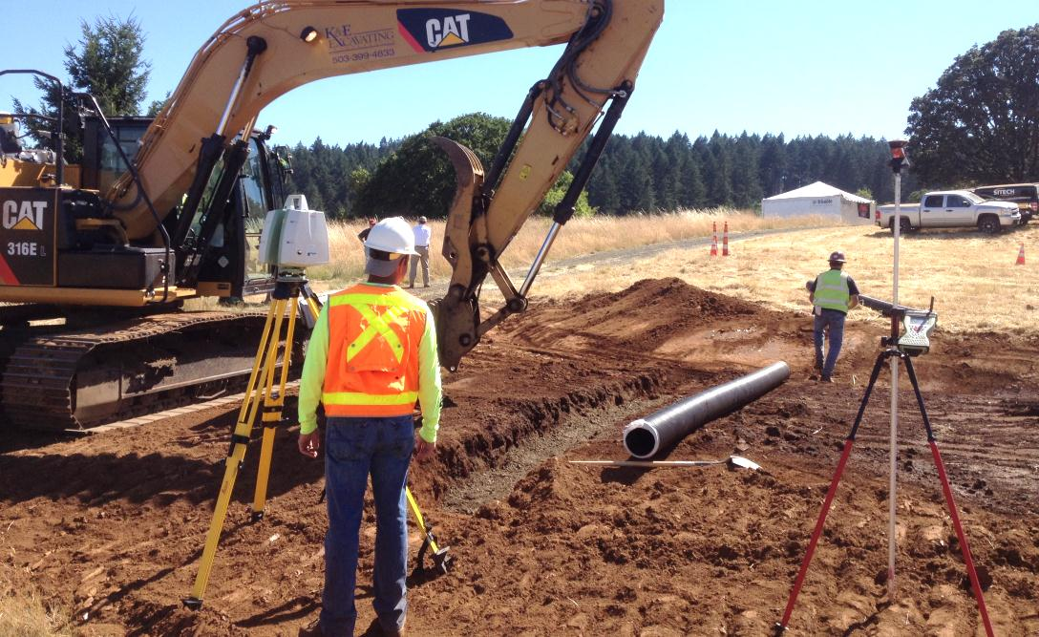
Creating Digital As-Built Records
Construction is the most cost-effective time to capture position information
Image Source: FHWA

Slide 32
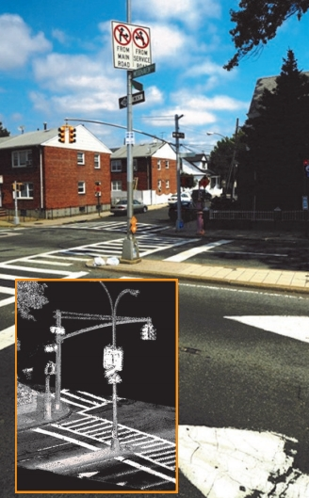
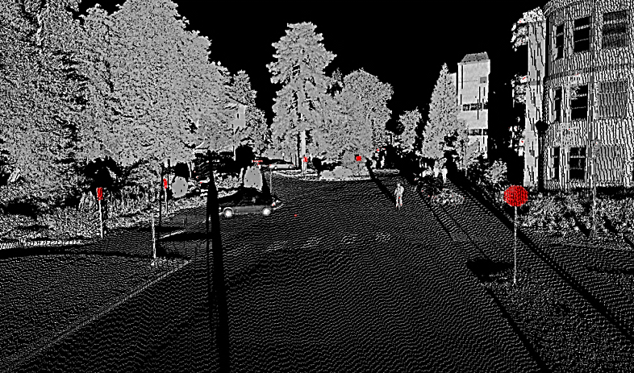
As-found Survey Data for…
  Street Sign Inventories
Locate assets
Evaluate asset condition
Determine most economic replacement strategy
Monitor sign readability for safety
Image Sources: NCHRP, ACA

Slide 33
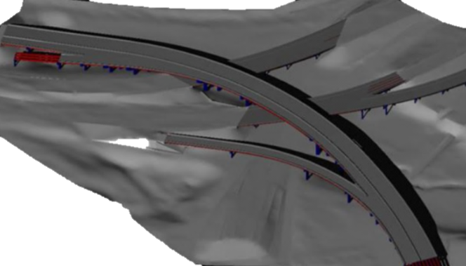
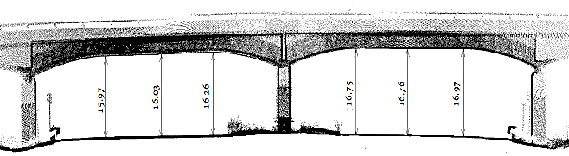
As-found Survey Data
Bridge Inventories
Design
Clearances
Condition assessments
Eastbound Westbound
Route: KY-222 Milepoint: 129
Structure ID: 047XXXXX Year Built: 1962
Design Construction: Tie-beam Material Design: Concrete Continuous
Length: 62.8 m Scan date: 6/19/2013
Image Sources: Woolpert, Kentucky Transportation Cabinet

Slide 34
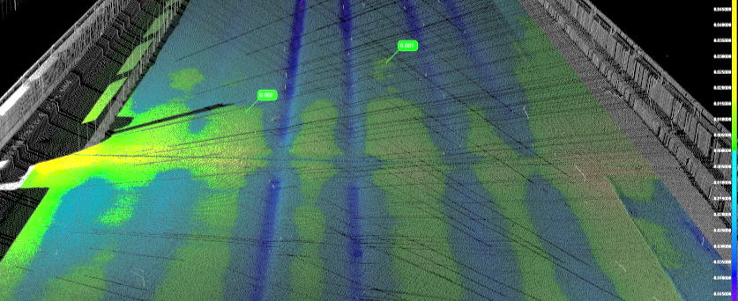
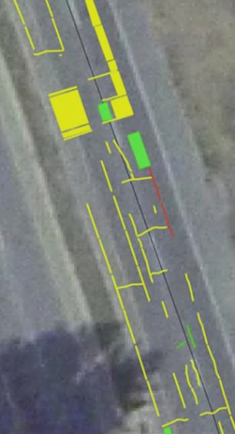
As-found Survey Data
Pavement Condition
Cracking
Rutting
Distress
Potholes
Low Severity
Area/Linear distress
Medium Severity
Area/Linear distress
High Severity
Area/Linear distress
Image Sources: Washington DOT, Jason Amadori

Slide 35
FHWA Unmanned Aerial System Summary
July 10, 2018
James S. Gray, PE, UAS & Construction Technology Engineer
Office of Infrastructure, FHWA
(703) 509-3464, James.Gray@dot.gov

Slide 36
FHWA’s BIM-Enabling Research
Contact Katherine Petros (FHWA) Katherine.Petros@dot.gov

Slide 37
Recently Completed BIM-Enabling Research
Utilizing 3D Digital Design Data in Highway Construction – Case Studies
Automation in Highway Construction
Return on Investment for Paperless Project Delivery (e-Construction)
Effective Use of Geospatial Tools in Highway Construction
Determination of Improved Pavement Ride Quality when Utilizing 3D Modeling and Automatic Machine Guidance

Slide 38
Ongoing FHWA BIM Research
Integrating 3D Digital Models and other Building Information Management Data into Asset Management
Construction Inspection for Digital Project Delivery
Leveraging Augmented Reality (AR) for Highway Construction
Identifying Data Frameworks and Governance for Establishing Future BIM for Infrastructure Standards
Unmanned Aerial Systems (UAS): Bridge Inspection - Data Quality and Handling

Slide 39
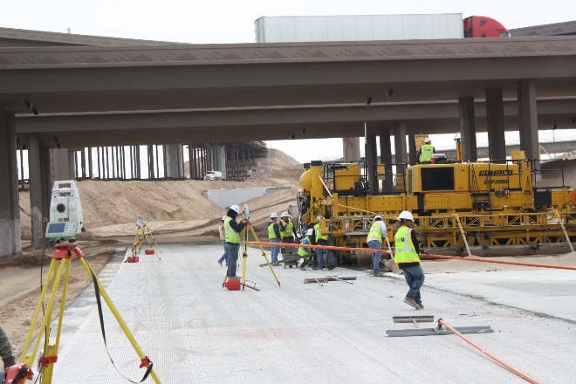
Determination of Improved Pavement Ride Quality (Smoothness) when Utilizing 3D Modeling and
Automatic Machine Guidance (AMG)
Brief Scope: To assess the smoothness benefits from the use of 3D engineered models and AMG
Project Status: Project completed
Key Engagement Opportunities: Webinar held in December 2017
Key Deliverables : Final Report (in publication), Technical Brief, and Webinar
Source: FHWA
December 2017 webinar link: https://connectdot.connectsolutions.com/p81n6pqvvrh/
Notes:
December 2017 webinar link: https://connectdot.connectsolutions.com/p81n6pqvvrh/

Slide 40
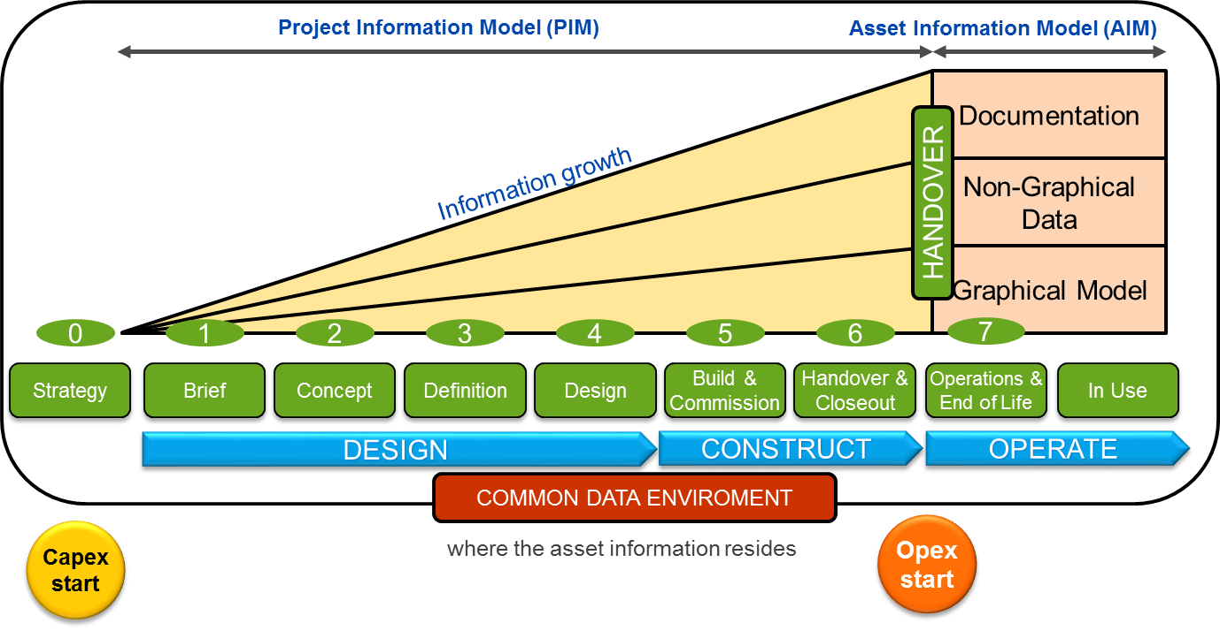
Ongoing: Integrating 3D Digital Models and other Building Information Management Data into Asset Management
Brief Scope: Develop best practice guidance to enable the integration of BIM data into highway agency practices, standards and specifications for better asset management outcomes
Project Final Deliverable Schedule: May 2018
Project Status: Finalizing project report. Completed technical review of national and international efforts with regard to standards, data exchange and use
Key Engagement Opportunities: Webinar in June 2018.
Key Deliverables To Date: Interim Report of Findings
Source: FHWA

Slide 41
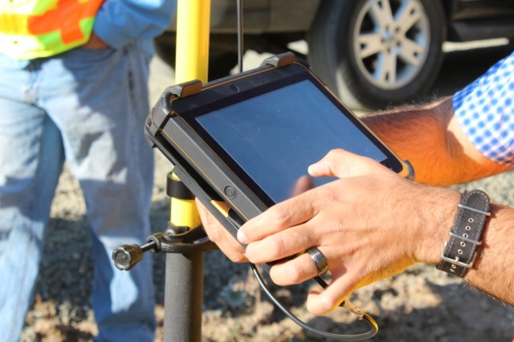
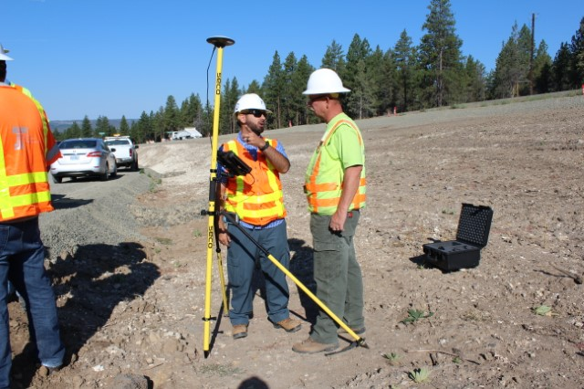
Ongoing: Construction Inspection for Digital Project Delivery
Brief Scope : To document effective practices and management of digital data used during construction inspection, and to develop guidance for managing, disseminating and integrating inspector’s digital data
Project Schedule: Oct 2018 completion
Project Status: Final Report in progress
Key Deliverables To Date: Interim Report
Source: FHWA

Slide 42
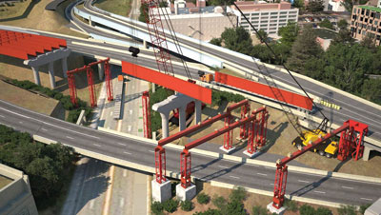
Ongoing: Identifying Data Frameworks and Governance for Establishing Future BIM for Infrastructure Standards
Brief Scope: To investigate the best approach for establishing policies and standards related to digital data, and to create a road map for future efforts towards implementing BIM
Project Schedule: Dec 2018 completion
Project Status: Lit review/Desk Scan in progress
Key Engagement Opportunities: Agency participation in upcoming interviews
Key Deliverables To Date: None
Source: Connecticut DOT and WSP
Notes:
Will develop a Conceptual Data Standard, A Data Governance Approach, and an Implementation Plan

Slide 43
FHWA Structures Office
Establishing common exchange language/schema
Considering BuildingSmart Industry Foundation Classes (IFC)
Ongoing work to ‘translate’ NBI data to 3D models
Contact Brian Kozy (FHWA) brian.kozy@dot.gov

Slide 44

Ongoing: Unmanned Aerial Systems (UAS):
Bridge Inspection - Data Quality and Handling
Brief Scope: Document effective use of UAS in bridge inspection and best practices for how the collected data should be assessed, presented, and stored to provide reliable and actionable information to owners.
Project Schedule: Awarded February 2018
Project Status: 20 month project.
Key Engagement Opportunities: Agency participation in upcoming interviews
Key Deliverables To Date: None
Source: FHWA TFHRC
Notes:
Unmanned Aerial Systems(UAS): Data Quality and Handling for Highway Applications
Objective: Assess the data quality that can be obtained from current generation UAS and compare it to the quality needed for effective highway applications such as bridge inspections. Identify how UAS data is being managed and stored and made accessible. Identify gaps in data quality and storage and provide guidance and best practices.

Slide 45
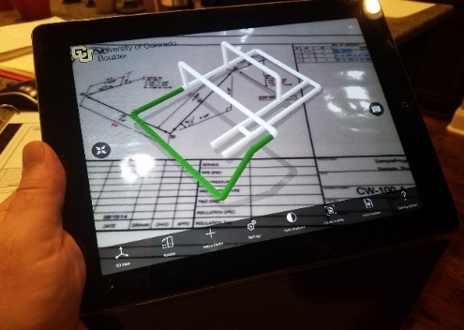
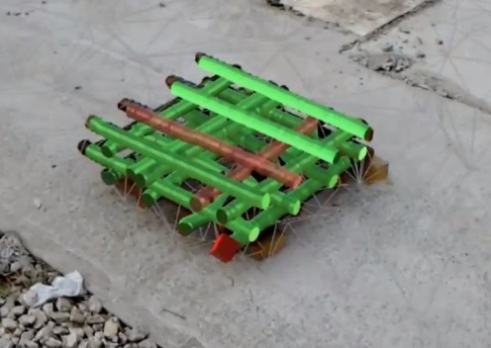
Ongoing: Leveraging Augmented Reality (AR) for Highway Construction
Brief Scope : Investigate the availability, accessibility, and reliability of using AR for construction inspection and review, QA, training, and improved project management. Document potential advantages, limitations and cost of using AR.
Project Schedule: November 2018 completion
Project Status: On-going. Completed Market Review.
Key Engagement Opportunities: Augmented Reality in Highway Construction Workshop (held May 9, 2018) & Webinar in November 2018
Key Deliverables To Date: None
Source: FHWA TFHRC
Notes:
Display what is not yet constructed
Typically overlay VR view on real-world view
Show proposed design information over real-world view
‘Clipping’ objects to be removed a challenge
Display what is hidden from view
Overlay of buried elements or those not visible
Overlay or ‘tag’ abstract information
Design data (alignments, stationing, dimensions, property/ROW boundaries)
Tag meta-data to real-world objects
Remote communication
Video feed of remote user
Documentation, instruction, user guides
Safety
Display/monitor un-safe situations, risks
Guide user through environment
Augmented Reality: FHWA workshop May 9, 2018, Top 5 Augmented Reality Applications for Transportation Construction with the
Highest Impact Ratings
Inspector’s Toolkit: use of augmented reality to verify that work is being installed properly by providing the right information and right format for the inspector in the field (7.42)
NextGen Training and Certification: use of augmented reality supported training and certification for construction inspection (7.09)
Automated Inspection: use of augmented reality to support automated code/standard compliance checking of installed items through machine learning (7.08)
Augmented Reality support of Right-of-Way Acquisition: provide project visualization to property owners to better understand a project’s impact and to show design options to the property owner as well (6.96)
Visual Variances: visually tag variances in the field with regards to schedule and quality issues to ensure all parties are viewing the same issue (6.96)

Slide 46
National & State Implementation
Notes:
National & State Implementation Plans (Roadmap/global scan, FL-ROADS, CT-TED, NY-BIM, IA, UT-MBDC, MT, P3s, Global (UK-Crossrail pilot, Netherlands, EU BIM task group-guide standard, Korea, gaps)

Slide 47
FHWA national ‘BIM roadmap’ under construction
Contract to produce BIM implementation roadmap and refine ‘What BIM is for Transportation’
Build on EDC and industry efforts
International efforts
FedBIM
IHEEP focus group in September
Contact: Connie Yew FHWA HQ, Connie.Yew@dot.gov

Slide 48
Vision, Goal & Objective (DRAFT)
VISION
Transform the way we deliver infrastructure projects – Digitalize the nation’s infrastructure project throughout the asset lifecycle (from design to construction to operations to asset management and maintenance)
GOAL
The States adopt BIM for Infrastructure as standard practice
OBJECTIVE
The States implement a set of roadmap activities to achieve a progressively higher degree of BIM maturity over time.
…directly supports FHWA FY 2019-2022 Strategic Plan Infrastructure & Innovation Goals
Section: “Vision, Goal & Objective” (Page 6)

Slide 49
BIM for Infrastructure Components (DRAFT)
Tools & Technology. – Used to digitize
People & Skills – Who would develop digital models
Data & Standards – For Data Modeling
Policies & Processes – To Create & Maintain Data
BIM for Infrastructure Components
Policies & Processes
Tools & Technology
People & Skills
Data & Standards
Section: “What is BIM for Infrastructure” (Page 7)
Notes:
To digitize physical and functional characteristics of Infrastructure there are four key components involved…

Slide 50
Target Milestones (DRAFT)
Establish Understanding of BIM for Infrastructure - Components, Scope, Value, Growth Levels
Achieve BIM for Infrastructure Growth Level 1
Achieve BIM for Infrastructure Growth Level 2
Section: “Executive Summary” (Page 2)
Notes:
The objective in the near term is to establish an understanding of BIM - Building Information Modeling, how it compares with Building Information Model, Civil Integrated Management, Building Information management; what are the components of BIM, what’s the scope, why do BIM and how to grow your BIM practice.
The next step would then be to achieve BIM growth levels 1 and 2.

Slide 51
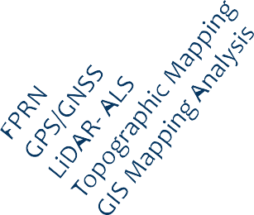
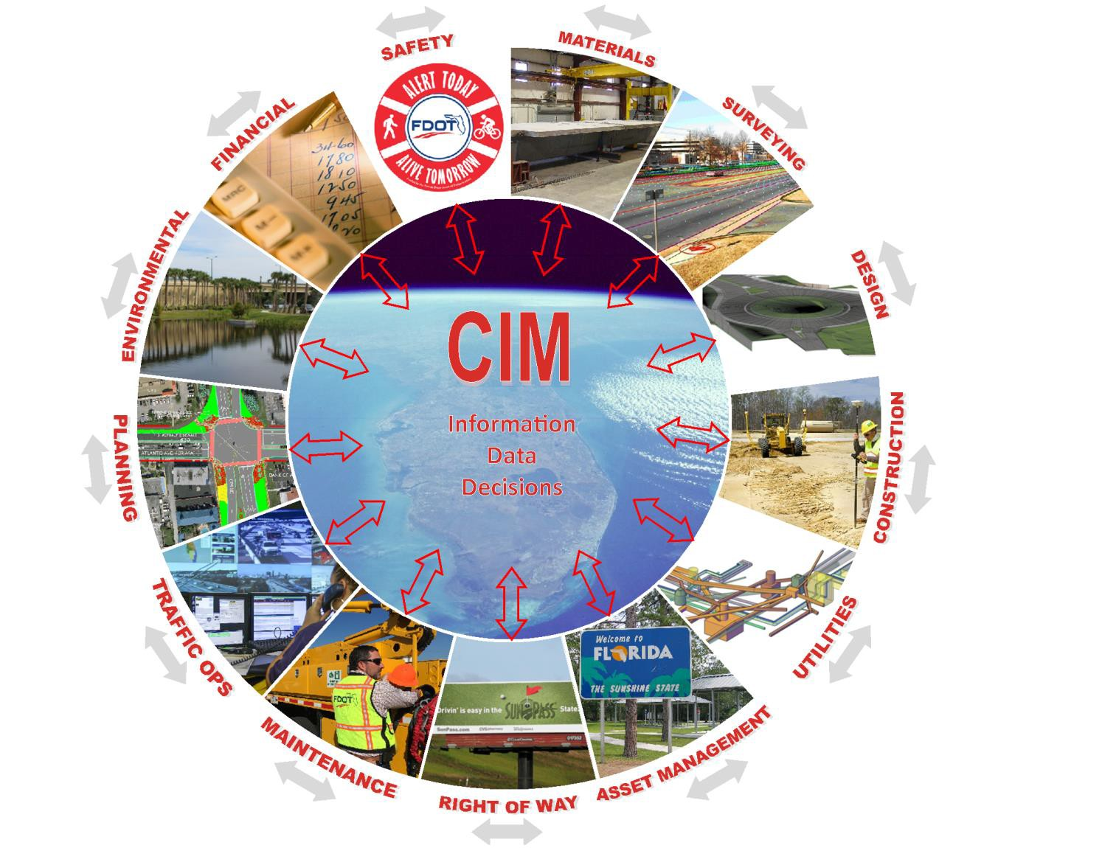

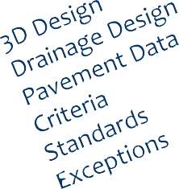
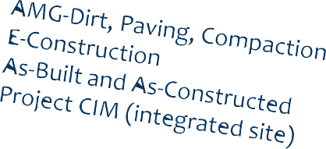
CIM -Maximizing the value for Stakeholder Teams!
Core building blocks are 3D models and Data (geospatial) that brings organizational value when integrated.
What data do you manage that potentially adds value?

Slide 52















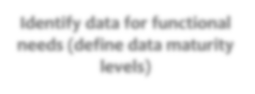









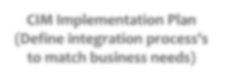








Example of CIM Implementation Framework
Three-stage process
Planning from current capabilities
Organizational Needs
Assessment of future capabilities
Implementation Decisions
Implementation considerations
Identify data for functional needs (define data maturity levels)
Identification of investments
(people, tools & functions)
Project/Data Delivery Strategies
Standards & Policy
Identification of benefits (business outcomes)
Training & Cultural Shift
CIM Implementation Plan (Define integration process's to match business needs)
Governance
Synthesizing results (implementation documents)
Data Maturity and Analytics
Communicating lessons learned, best practices & updating CIM objectives

Slide 53












































































Impact of CIM on Project Workflow
DOT Digital Data Archive
Surveying
Preliminary Design
Detailed Design
Construction
As-Built Models/Data
Facility Management
Scoping & Surveying
Preliminary Design
Detailed Design
Construction Planning & Procurement
4D Scheduling
Construction
Operations & Maintenance
Inventory Mapping
Site Mapping
Digital Design
Digital Design
Automatic Machine Guidance (AMG)
ROW Map Development
Utility Mapping
Design coordination & asset data integration
5D Estimating
Intelligent Compaction
Asset Management
ROW Map Development
Traffic Management Planning
Safety
Environmental Process
Utility Conflict Analysis
Remote Equip. Monitoring
Materials
Environmental Process
Materials Management
Visualization
Visualization
CoEn-CstornuscttrioucntiQouna&lity ACos-nbturioltl
Pavement Condition
Visualization
Visualization
Construction Quality Control
Inventory Repairs & Changes
Project Information Management Asset Information Management
* DDMI= Document-, Data- and Model-based Information

Slide 54
TED - A Change in Mindset Regarding Data
“The most important thing we are doing here is collapsing the silos,"
-Eash Sundaram, EVP of innovation and CIO of JetBlue
“Organizations that do not understand the overwhelming importance of managing data and information as tangible assets in the new economy will not survive” - Tom Peters, Author, In Search of Excellence
Engineering & Construction Data
Capital Projects, Signs, Guiderail, Bridges
Planning Data
MIRE, HPMS, AADT
Safety Data
Crashes
Public Trans Data
CTFastrak
Finance & Administration Data
CPD
Transportation Enterprise Data Warehouse
CTDOT
Highway Operations Data
Illumination, GridSmart
Field Maintenance Data
Paving, Service Memos

Slide 55
Current Development Strategy
Empowering Collaboration Across Bureaus
Key Elements To Our Successful TED Collaboration Strategy
TED Development Formalized April 2017
  Mission and Function Statements
  Weekly Meeting Schedule
  Agency-wide Representation
  Consensus Driven
  Enterprise Focused
Leadership/Personnel
  Upper level Management oversight
  Facilitated by RDIP Data Champion and Business Systems Integration Specialist
  Dedicated IT Consultant for Management of Enterprise Data System
  Knowledgeable High-Level Staff Participation
Work Group Structure
  Data Collection
  Data Maintenance/Migration
  Data Integration/Linkage
  Geospatial Management /Use
  Safety Analysis Development
  Data Visualization /Reporting
Focused Work Plans
  Tasks
  Milestones
  Timeframes
  Developed/Updated Weekly
  Clearly Stated Performance Outcomes
    Short Term
    Mid Term
Notes:
Walk through the slide
Key Values provided today
Make up of the TED team and work Group structure and work plans
TED now hosts 30 maintained data sets available for geospatial viewing and analysis
DOT staff members come together weekly to report progress on work plans, share ideas, and upgrade data management strategies
The success of TED is hinged on the ability to collaborate within bureaus and provide value to all

Slide 56



Asset Inventory and Condition Assessment
… and Simplified Design
Image credits: Utah Department of Transportation

Slide 57
Resources

Slide 58

Available FHWA Innovation Deployment Funding
Accelerated Innovation Deployment (AID) Funding
  Up to $1M per award
  Project initiates within 6 mo
  http://www.fhwa.dot.gov/accelerating/grants/index.cfm
State Transportation Innovation Council (STIC) Incentive Funds
  Up to $100,000 per year
  contact your FHWA state office
  https://www.fhwa.dot.gov/innovation/stic/guidance.cfm
MAP-21 Section 1304 Innovative Project Delivery Funding
  Up to 5% increased federal share
  http://www.fhwa.dot.gov/map21/qandas/qaipd.cfm
Notes:
Key Message: There are three funding options to support innovation deployment
Background info: FHWA is promoting three different funding vehicles to support innovation deployment. There are different eligibility criteria:
AID Demonstration Funding
Approximately $30,000,000 program
Apply when project ready to initiate within 6 months
Full cost of innovation, up to $1 million per award
Award goals per fiscal year: $14 million for States - Up to 2 awards per State, Up to one for State DOT, Up to one for sub-recipient (MPO or local government)
State Transportation Innovation Council (STIC) incentive funds
Up to $100,000 available to each STIC per year
Fund activities to make an innovation standard practice statewide
Examples: developing standards and specifications, preparing SOPs or technical guidance, developing/delivering training, etc.
MAP-21 Section 1304 Innovative Project Delivery
Incentive is an increase of federal share on a project by up to 5%
Restricted to NHPP, STP and PL funding categories
Technologies and practices should be truly innovative to the State
Interactivity: Poll audience to ask if they were aware of any of these funding vehicles
Ask if the host state has used any of these funding vehicles to deploy any EDC or EDC2 innovations
Ask if the host state has a STIC and if so, if they have received any incentive funds – how were the funds used?
Provide examples of projects that have received awards for each of these categories
Notes: A total of 2 minute(s).

Slide 59


3D Engineered Models/e-Construction
National Website
Support & Available Tools
Web pages www.fhwa.dot.gov/3d, https://www.fhwa.dot.gov/construction/econstruction/

Slide 60
EDC3 ‘How to’ Guidance Briefs
Lidar data collection and management
Standards based data collection and exchange based on business requirements
Updating or maintaining 4D models as schedules evolve
Project selection guidance for 4D modeling by usage case
Guide specifications for capturing digital as-builts for subsurface utilities.
Dealing with legacy survey data in the design, construction, and asset management phases
Framework for digital asset management
Estimating return-on-investment for technology implementation at the project and program level

Slide 61
Thank you!
“The U.S. Government does not endorse products or manufacturers. Trademarks or manufacturers’ names appear in this presentation only because they are considered essential to the objective of the presentation. They are included for informational purposes only and are not intended to reflect a preference, approval, or endorsement of any one product or entity.”

