Slide 1
NRRA
Recycling Economic & Environmental Benefits
Dan Wegman
Braun Intertec
May 22nd, 2019

Slide 2

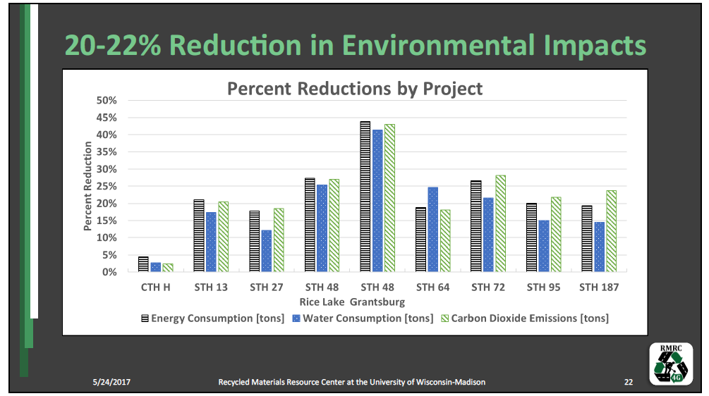

Slide 3
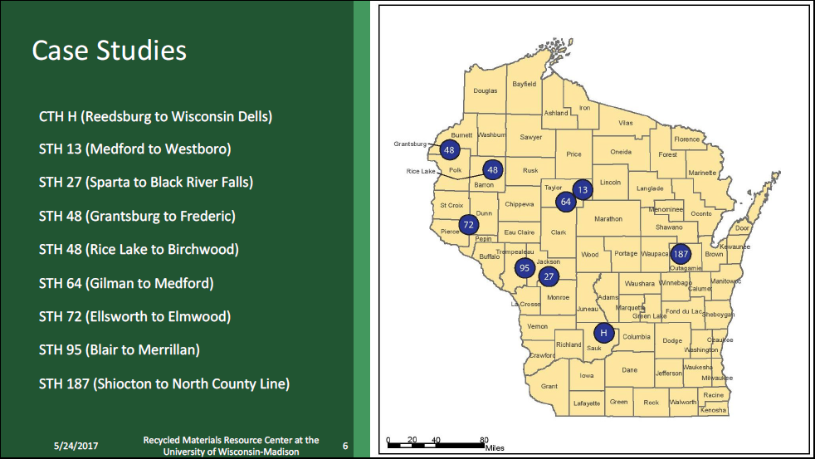

Slide 5
WisDOT Cold In-Place Recycling Pavement Rehabilitation
Barry Paye, PE
Chief Materials & Pavement Engineer
Wisconsin DOT

Slide 6
Benefit of CIR
Cost Savings
  Potential cost savings compared to equivalent
  mill/overlay rehabilitation methods.
Engineering
  Addresses actual distress rather than symptoms.
  Cracks eliminated/reduced – CIR act as crack relief layer.

Slide 7
Benefit of CIR
Construction Time
  CIR layer can be opened to traffic within a couple of
  hours.
  Minimal Traffic disruption and user delay.
Environmental Benefit
  Using in-place materials minimizes hauling cost & use
  of virgin material.
Notes:
.

Slide 8
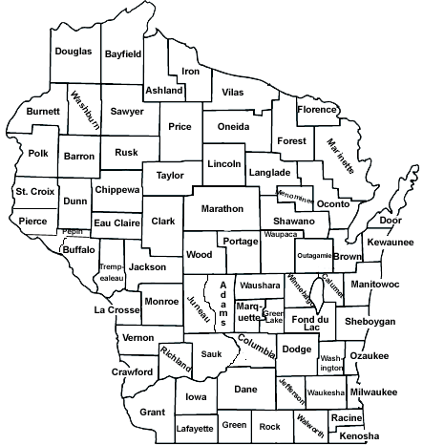
CIR Projects Map (Since 2012)
Construction Year | Project Length (Lane-Mile)
2012 | 26
2014 | 24
2015 | 50
2016 | 58
Total | 158

Slide 9
STH 48 (Grantsburg – Frederic) Performance Data
Four years in service
Transverse Cracking
Longitudinal Cracking
Non-CIR
CIR
CIR
Non-CIR
CIR
CIR
Roughness
Non-CIR
CIR
CIR
Non-CIR
CIR
CIR

Slide 10
WisDOT Experience
17% Let savings vs 4” mill & overlay
10x reduction in cracking compared to mill & overlay
Minimal disturbance to traveling public

Slide 11
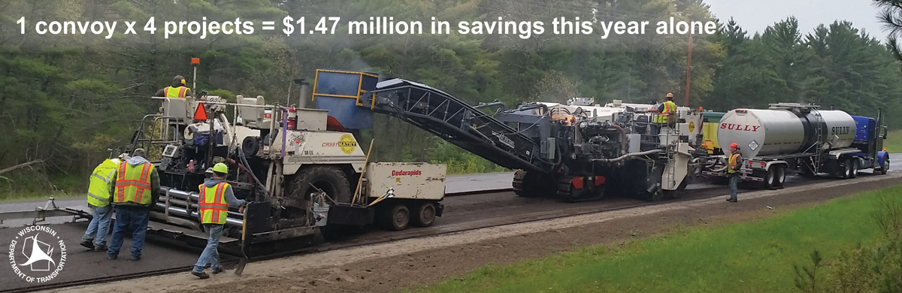
Public Benefits

Slide 12
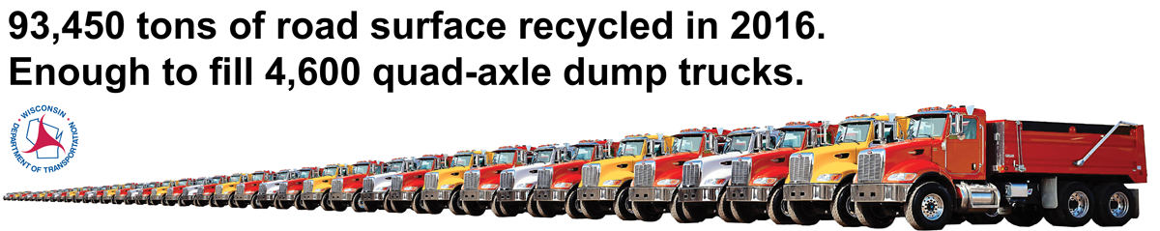
Public Benefits

Slide 13
Cost per Remaining Service Life Year Added Bituminous Treatments
Terry Beaudry MEO 2017
Treatment | HPMA Cost/Lane Mile | RSL Years | $/RSL/Year Added
CIR | $154,251 | 17 | $9,074
Reclaim | $237,212 | 24 | $9,884
Medium Mill/OL | $160,660 | 15 | $10,711
Thick Mill/OL | $211,550 | 17 | $12,444

Slide 14
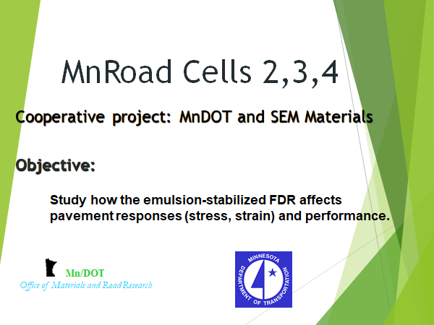

Slide 15
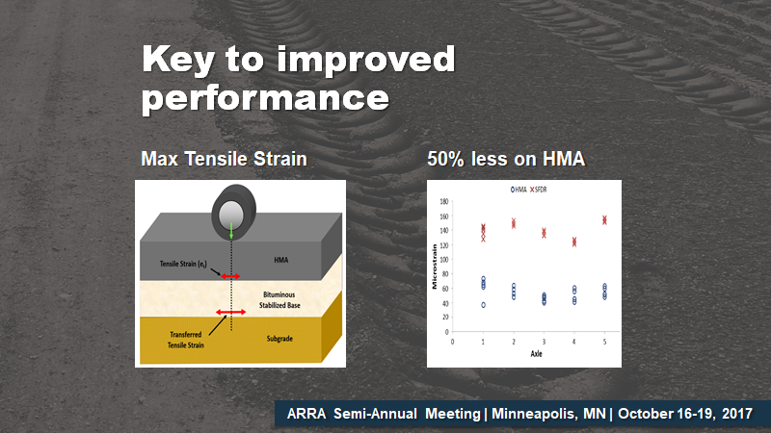

Slide 16
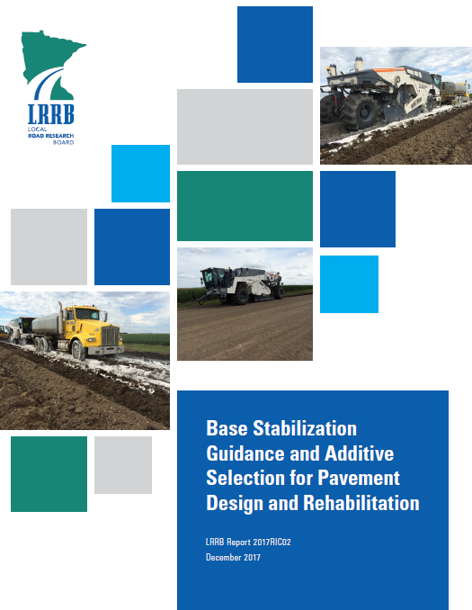

Slide 17
RoadResource.org
A COMPREHENSIVE RESOURCE FOR OPTIMIZING NETWORK MANAGEMENT
Dan Wegman - Braun Intertec

Slide 18

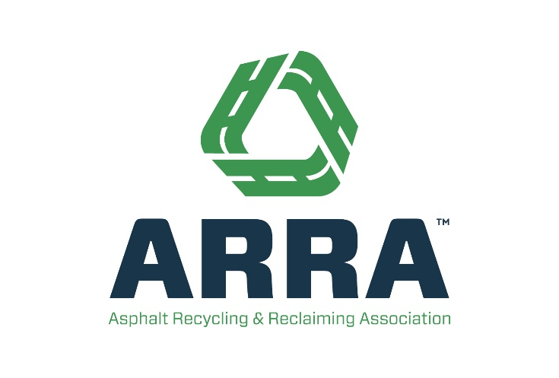


Three Associations Join Together to Support the Industry at Large
FORMING THE PAVEMENT PRESERVATION & RECYCLING ALLIANCE
RoadResource.org
18
Notes:
The three organizations representing each branch of progressive pavement management join together to support the industry at large.
To create a voice that is more powerful, comprehensive, competitive and credible than any single association could be alone
Pavement Preservation and Recycling Alliance – for better roads today and stronger networks tomorrow.

Slide 19

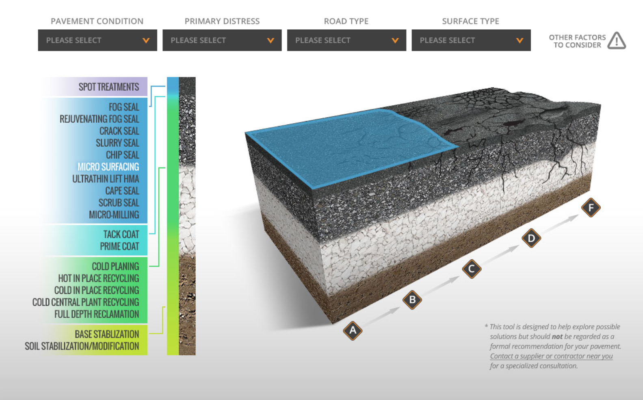
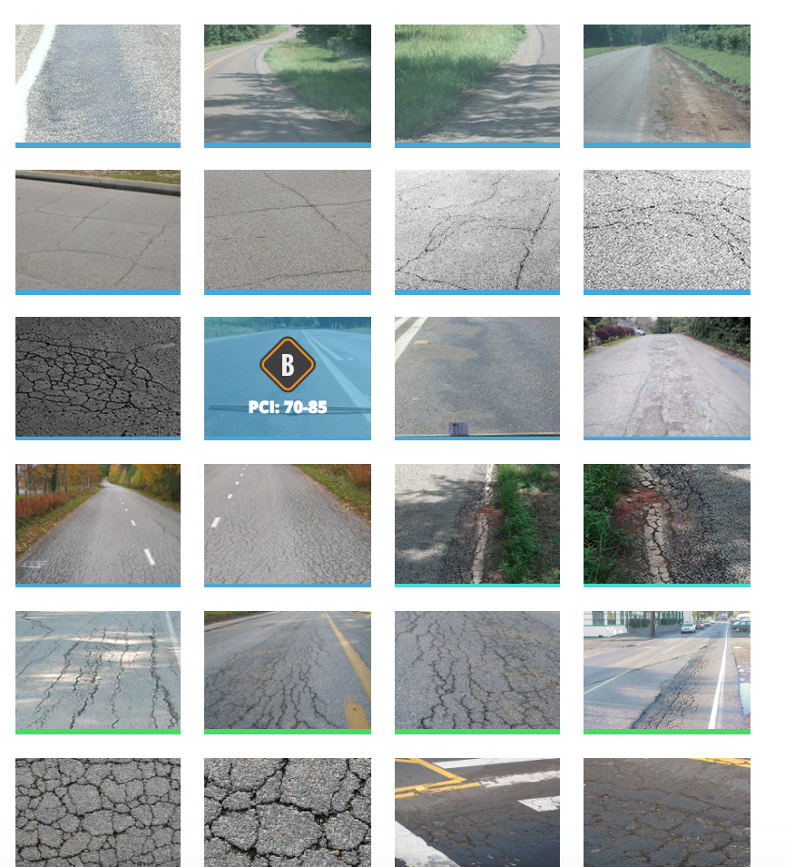
Which treatment is best for my road?
Input pavement criteria or select photos for treatment options
19
RoadResource.org
Notes:
Most road managers just want to know one thing: Which treatment should I use on my pavement?
This tool takes in information about your pavement and identifies possible solutions, using pavement condition, primary distress, road type and surface type, or comparing photos of other similar roads.
Note: This tool is NOT meant to be a diagnosis for your pavement, but to educate and demonstrate capabilities by treatment. Users are directed to “ask an expert” with these pages.

Slide 20
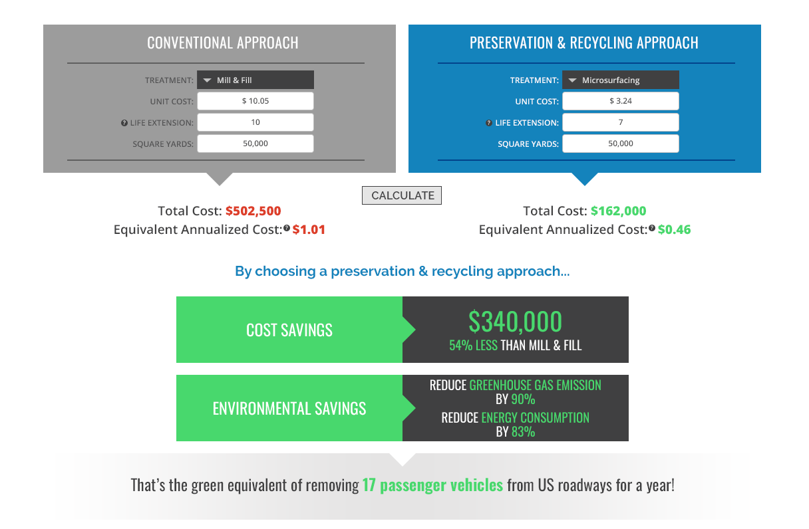
Compare Treatments
Project Cost & Environmental Benefits
NOTE ON COST:
Every calculator gives users the ability to use average life extension numbers and cost data from an internationally aggregated cost survey (US & CA) or input their own costs and life extension relevant to their region.
20
RoadResource.org
Notes:
Cost & Green Calculator
A treatment-level calculator that allows users to compare economic and environmental impact of one treatment over another.
Note: Across the site, data is auto-populated with figures and data from international cost survey and average life extension– We’ve also given users the ability to enter their own figures– making the information more relevant to your region/experience.

Slide 21
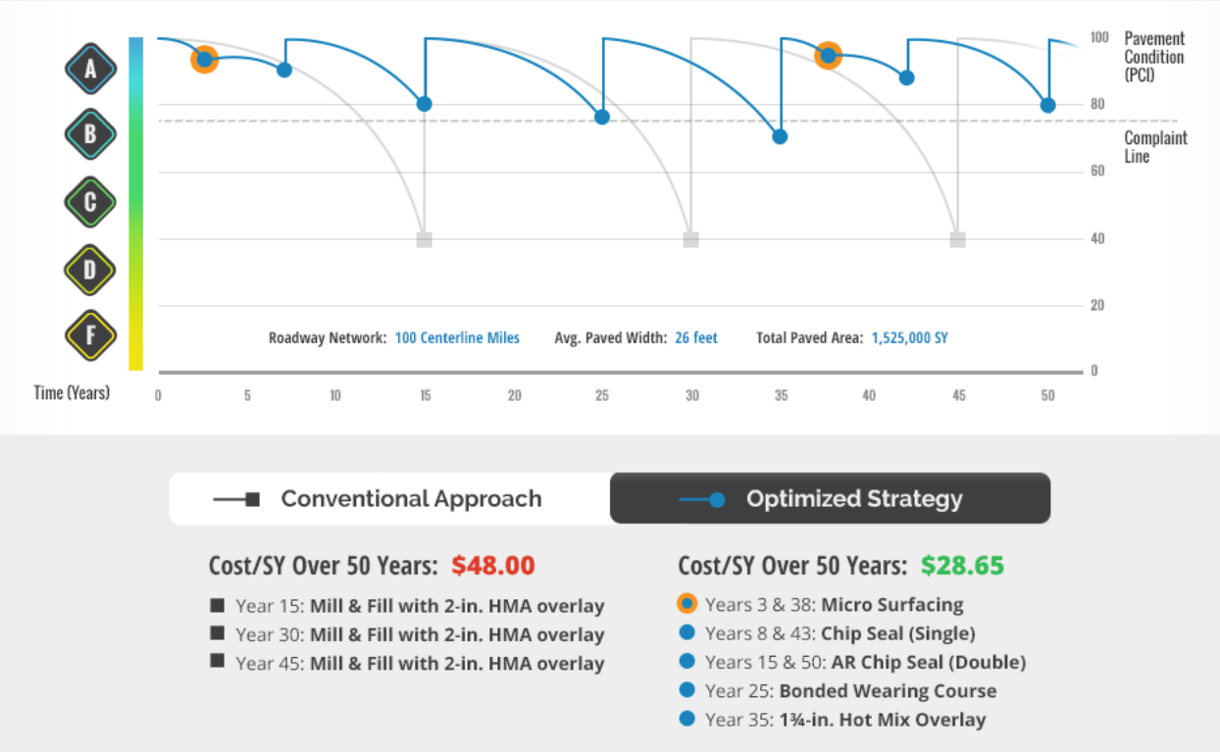
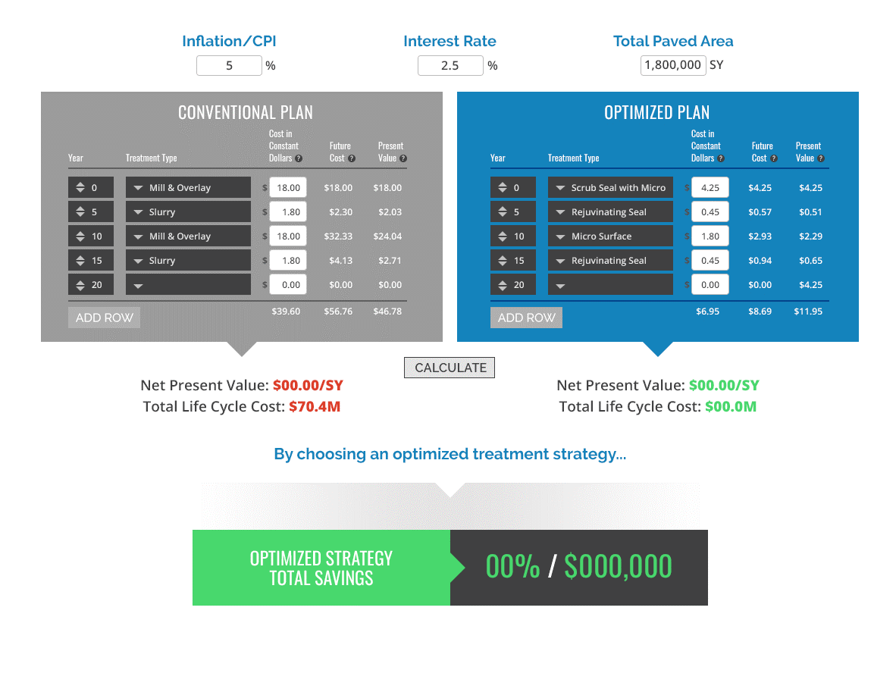

Life Cycle Cost Calculator
Save big over the life of your pavement with progressive maintenance
21
RoadResource.org
Notes:
Life Cycle Cost Calculator
Teaching concept– Not designed to replace a PMS, but to support network thinking. The lifecycle calculator lets you design a road treatment plan, demonstrating the ability to revive and preserve a road for 50 years or more.
In Understanding the time-value of money, users can see that a dollar today is worth much more 15 years down the line. It pays to invest in your roads upfront.

Slide 22
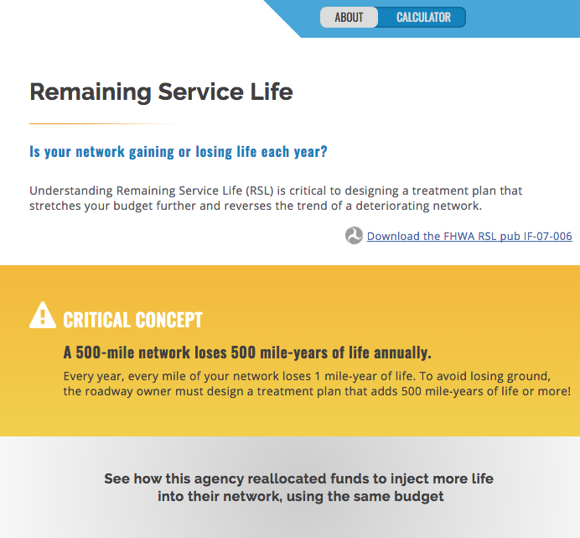
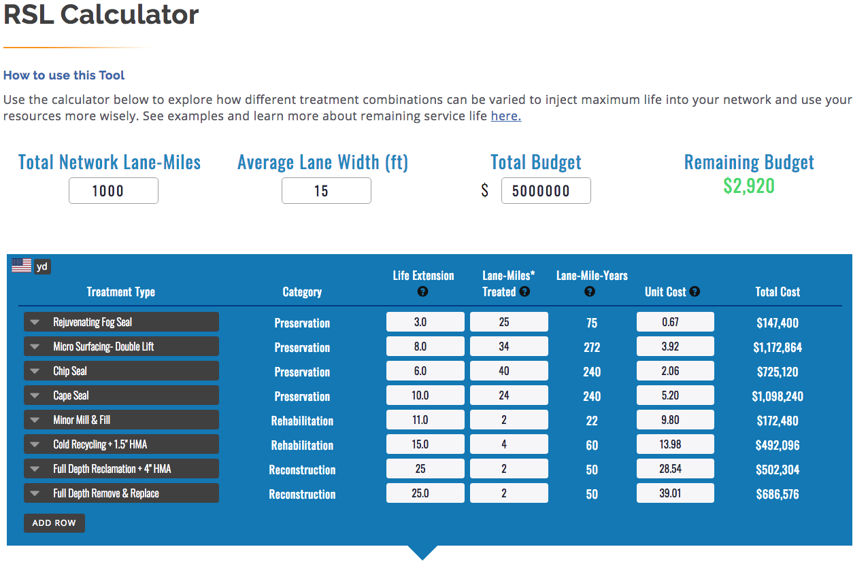
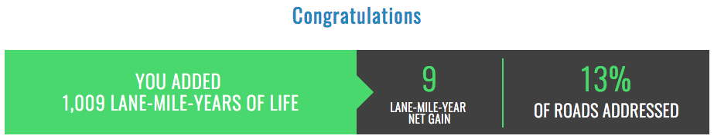
Remaining Service Life
How much life is your network gaining or losing each year?
22
RoadResource.org
Notes:
Remaining Service Life
looks at the health of your network through your yearly treatment plan.
A critical concept for network management: each mile of road has a life expectancy. Every year, each mile of road within your network uses one mile-year of life. That means that your network has a limited number of mile-years to live. RSL helps you understand the effectiveness of your annual treatment plan, to determine if that plan will add or subtract life from your network, and identify tweaks you can make to make overall, incremental “network-level” gains.

Slide 23
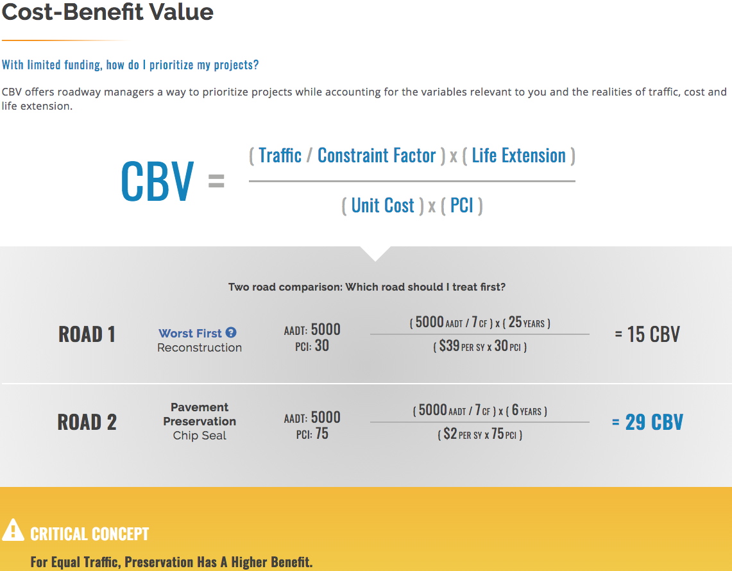
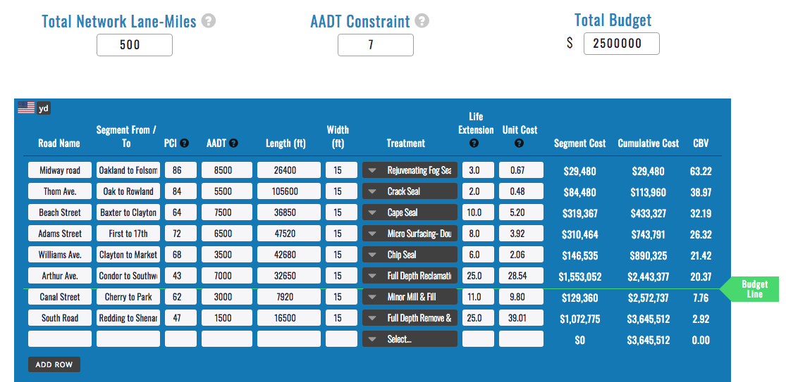
Cost-Benefit Value
Which projects will give the “biggest bang for the buck?”
23
RoadResource.org
Notes:
Cost-Benefit-Value
This formula prioritizes road projects. “Great, I know I should be treating all of my roads, every year, but that’s not realistic in any way.– Which projects will give me the biggest bang for the buck?? How do I prioritize limited resources?”
CBV takes into account project size, overall cost, Average Annual Daily Traffic, and your annual budget --- each project is evaluated using a CBV figure to give you quantifiable comparison factors between projects.
Allows users to see “No, this project isn’t very important for this year. I’ll address several others instead, and take a different approach next year”

Slide 24


Visit the new RoadResource.org

