Slide 1
The IDEAL Cracking Test
Randy West, Director & Research Professor

Slide 2
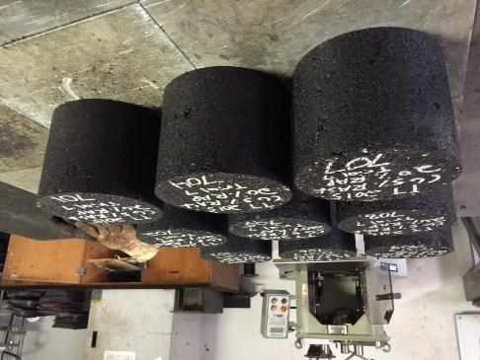
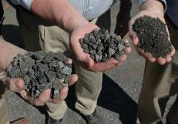
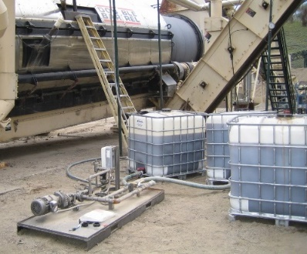
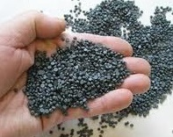
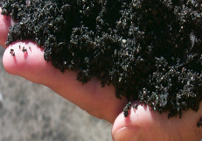
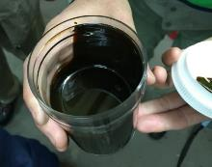
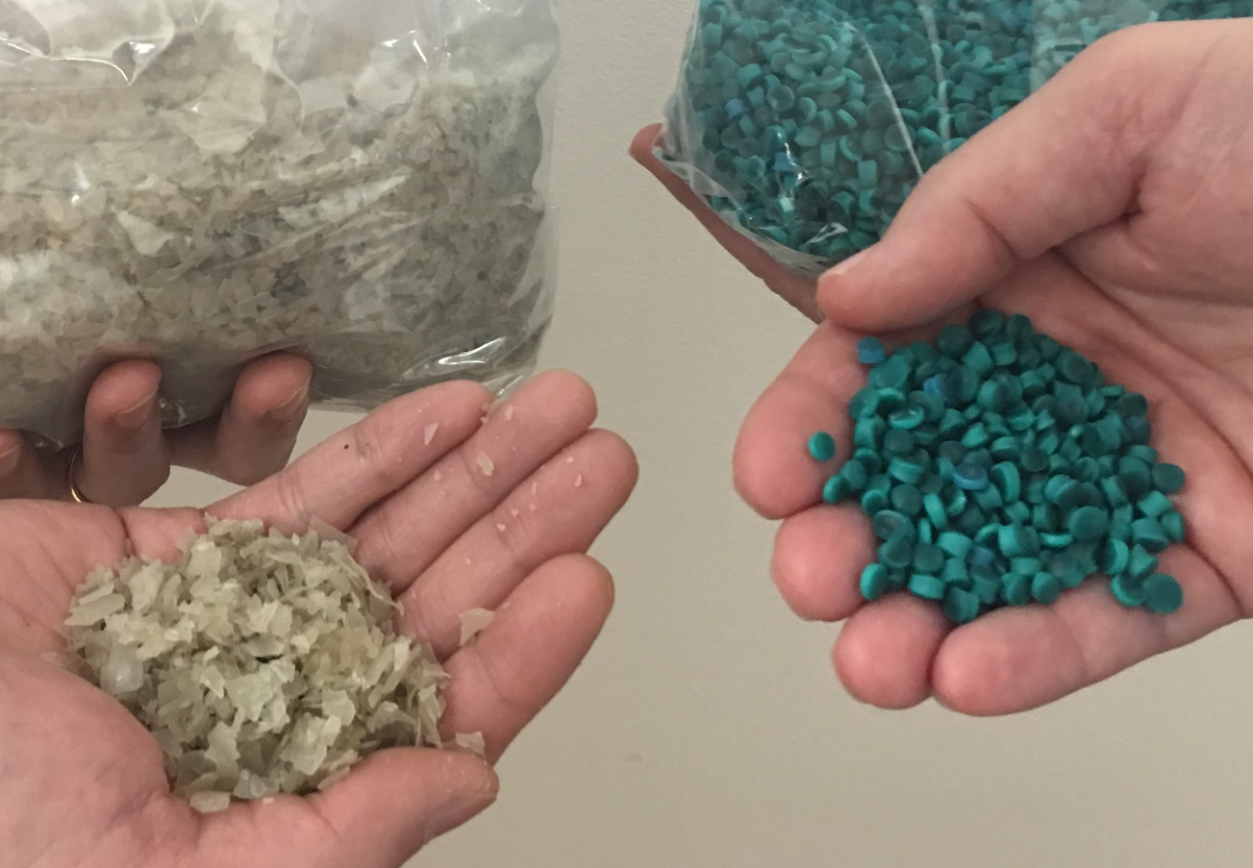
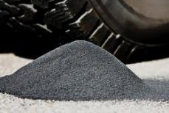
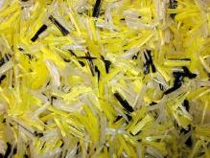
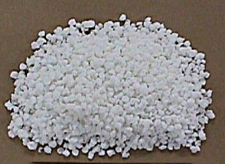
With volumetric mix design systems…
WMA additives
Sulfur pellets
Fractionated RAP
Recycled Shingles
we have no way of knowing if these materials help or hurt
Recycling agents
Recycled Plastics
Aramid & Polyolefin fibers
SBS polymer
Recycled Tire Rubber

Slide 3
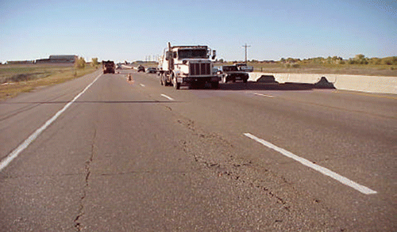
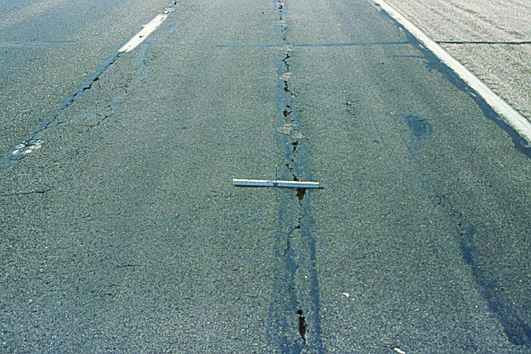
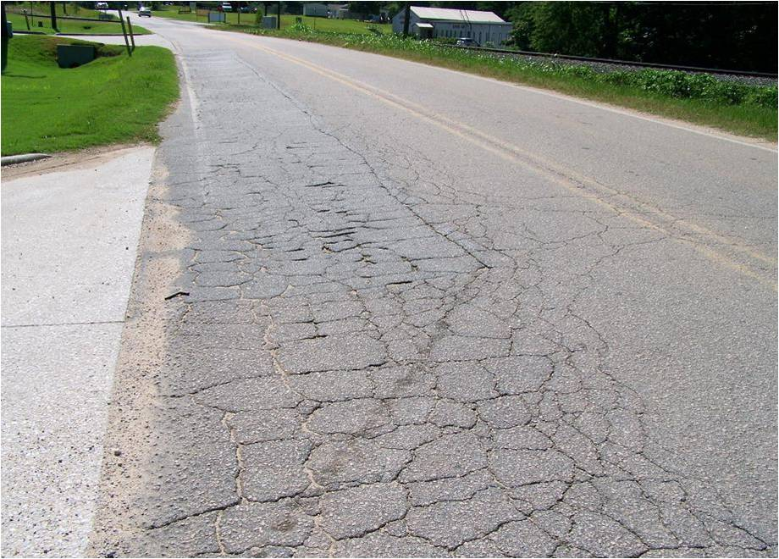
The need for mixture cracking tests rises
A decade after Superpave implementation, we realized we needed to evaluate cracking susceptibility.
RAP ETG – cracking test is the top research need
Distracted by WMA, other recycled materials, tweaking volumetric criteria
Fragmented research, no national projects

Slide 4
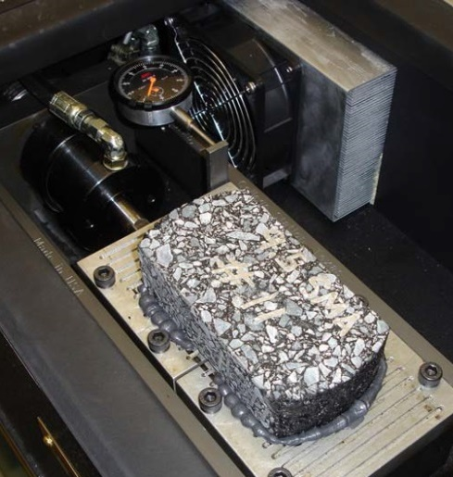
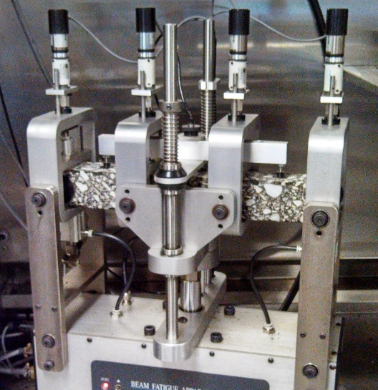
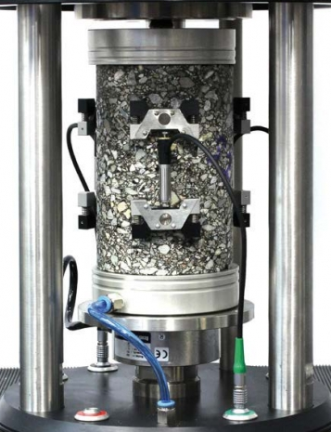
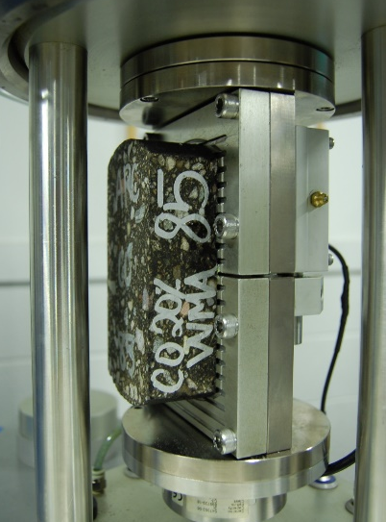
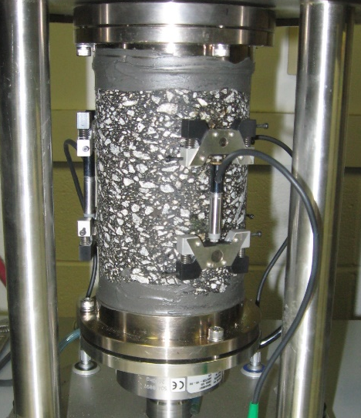
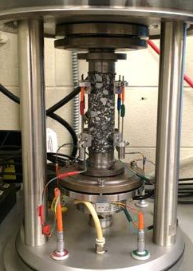
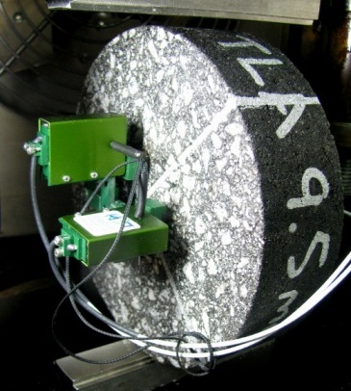
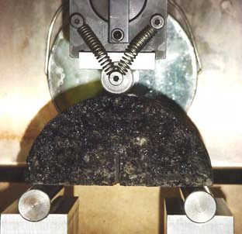
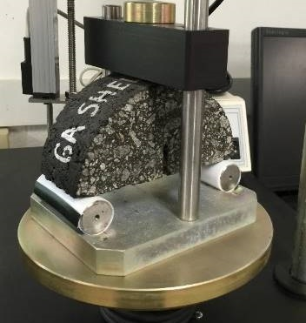
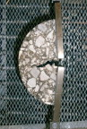
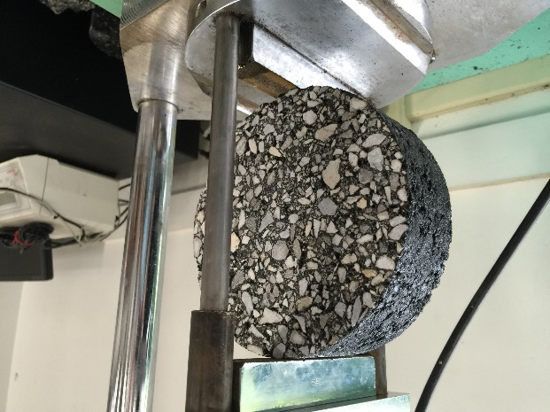
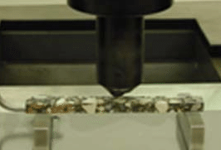
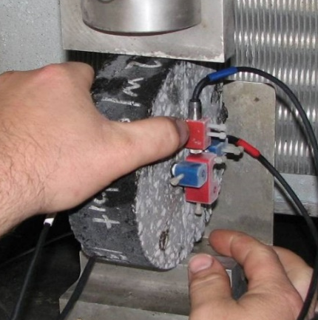
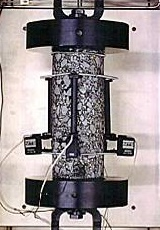
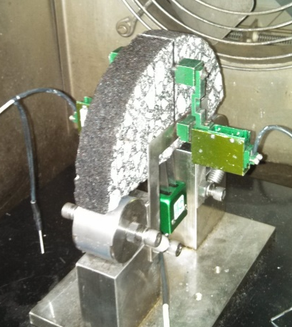
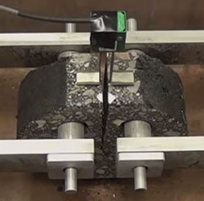
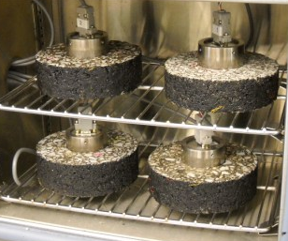
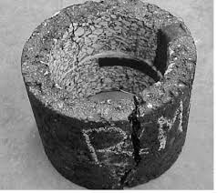

Slide 5
IDEAL Cracking Test
Developed by Fujie Zhou, et al at Texas A & M Transportation Institute
Criteria for IDEAL-CT
  Simplicity: no instrumentation, cutting, gluing, drilling, and notching;
  Practicality: minimum training needed for routine operation;
  Efficiency: test completion within 1 min.;
  Test equipment: cost less than $10,000;
  Repeatability: coefficient of variance (COV) less than 25 %;
  Sensitivity: sensitive to asphalt composition (binder, others);
  Correlation to field: a good correlation with field cracking.

Slide 6
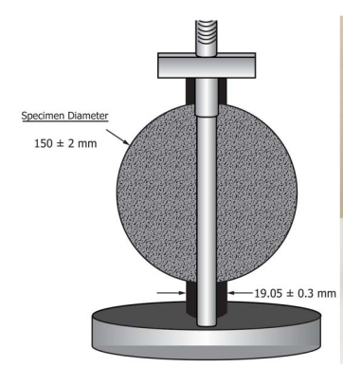
The IDEAL Cracking Test
ASTM D8225-19
Indirect Tensile Strength
  150 mm dia. × 62 mm height
  Target air voids 7.0 ± 0.5% most common
  No specimen cutting or notching
50 ± 2.0 mm/min load rate
25°C most common
Measure Load and Displacement
Analysis similar to I-FIT
Result is the CT_{Index}

Slide 7
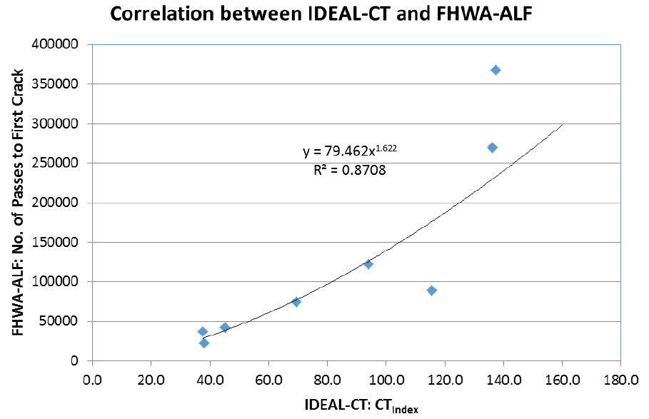
Correlation to Performance
FHWA Accelerated Loading Facility (ALF)

Slide 8
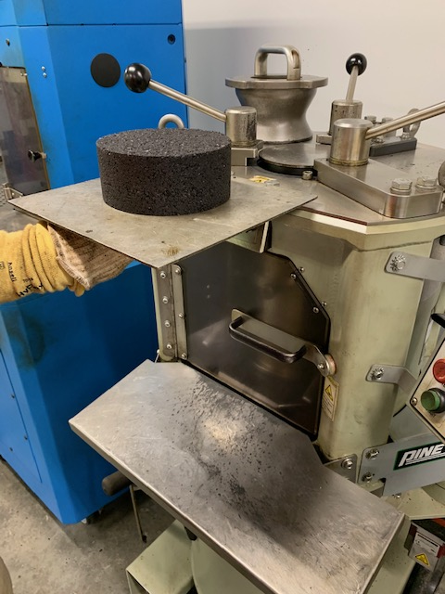
Compacting IDEAL-CT Specimens
62 ± 1 mm height × 150 ± 2 mm diameter
  same as Hamburg
Air voids = target ± 0.5%
  target typically 7.0%
3 replicates, minimum

Slide 9
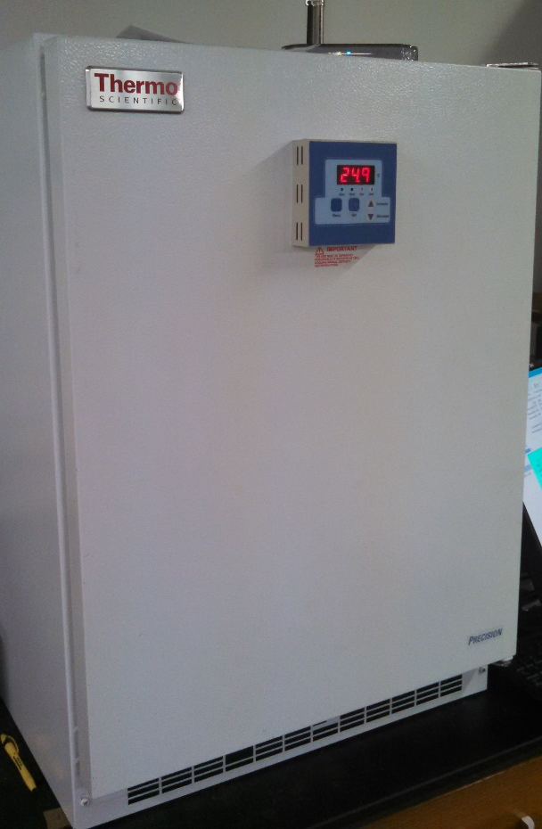
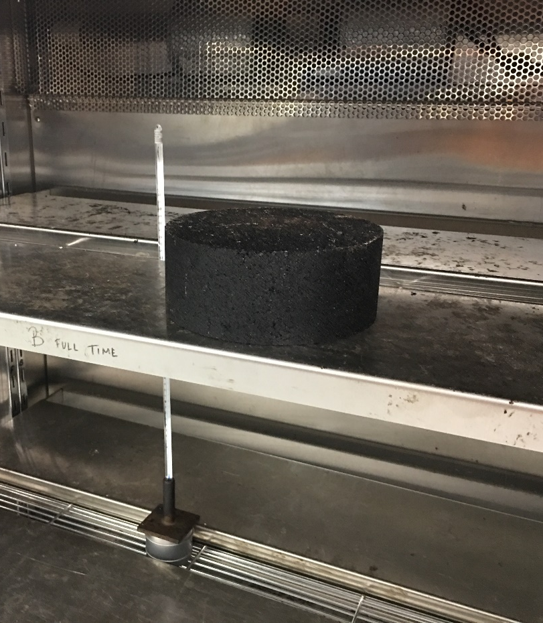
Specimen Conditioning
2 hours ± 10 minutes in an environmental chamber
Testing should be completed in 4 minutes or less after removal from conditioning

Slide 10
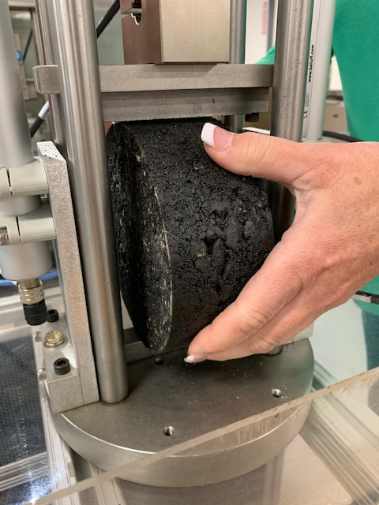
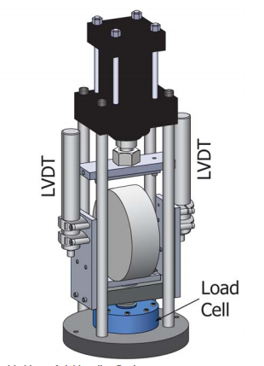
Conducting the IDEAL CT Test
Test Setup
  Specimen centered in the fixture and making uniform contact on the support
Contact Load
  100 ± 10 N in Load Line Displacement (LLD) Control
Load Rate
  50 ± 2.0 mm/min in LLD Control
Test Duration
  Typically less than 10 seconds
  Test stops when load drops below 100 N

Slide 11
Test Temperature
  Intermediate performance grade temperature (PG IT) ± 0.5°C
  PG IT = (PG HT + PG LT)/2 + 4
  If PG IT > 25°C, use 25°C
  Examples
    For a project requiring performance grade (climatic temperature) of 64-28, PG IT = 22, use 22°C
    For a project requiring performance grade (climatic temperature) of 70-22, PG IT = 28, but use 25°C

Slide 12
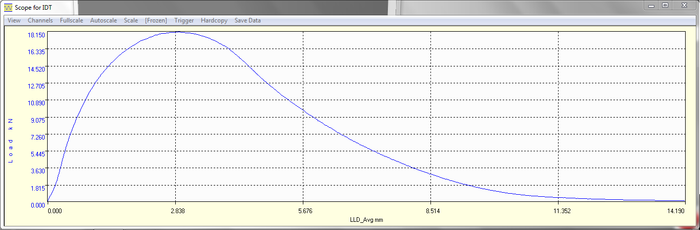
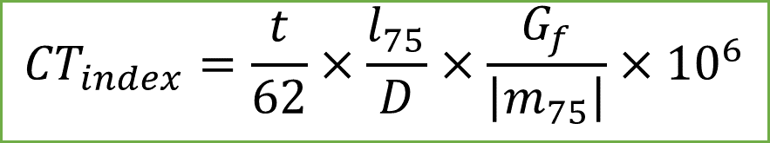
IDEAL-CT Output
P_{max}
0.75 × P_{max}
$${CT}_{index}=\frac{t}{62}×\frac{l_{75}}{D}×\frac{G_{f}}{\left|m_{75}\right|}×{10}^{6}$$
m₇₅
Failure Energy G_{f}
(Joules/m²)
l₇₅

Slide 13
IDEAL-CT Results
Range of CT_{Index} results for 77 mixtures tested at NCAT from 11 states.
  Subset does not include mixes that were long-term aged.
  31% with CT_{Index} < 50

Slide 14
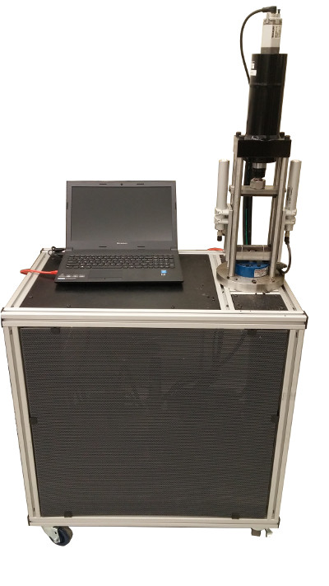
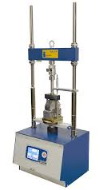
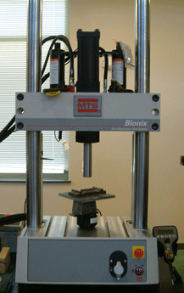
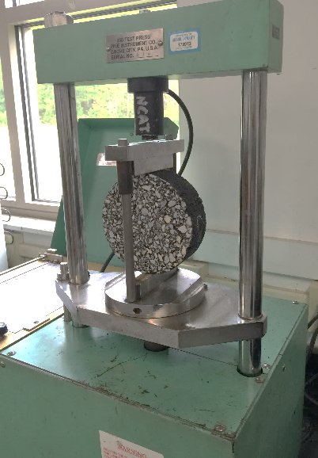
IDEAL-CT Equipment
Instrotek
Marshall press
MTS
TestQuip
others

Slide 15
CT_{Index} versus I-FIT Flexibility Index
IDEAL-CT has several similarities to I-FIT.
Do their results correlate?

Slide 16
Effect of air voids on CT_{Index}
Experiment on NCAT Test Track; four sections of the same mix compacted to 88% to 95% of Gmm
As air voids increase, CT_{Index} decreases.
This is counterintuitive.

Slide 17
CT_{Index} Variability
Two important measures of variability
  Within-lab (repeatability)
    TTI: COV 2 to 24%
    NCAT: COV 10 to 20%
    ASTM: COV ~12%
  Between-lab (reproducibility)
    13 labs in NCAT round robin
    Avg. CT_{Index} ranged from 37 to 188
    Std. Dev. of CT_{Index} ranged from 13 to 30
    COV of CT_{Index} ranged from 13 to 37%

Slide 18
IDEAL-CT round robin preliminary results

Slide 19

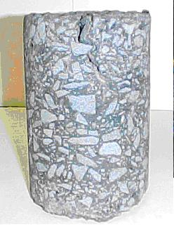
Pavement Aging
Aging of asphalt pavements occur over time
There is a steep gradient of aging from the surface down

Slide 20
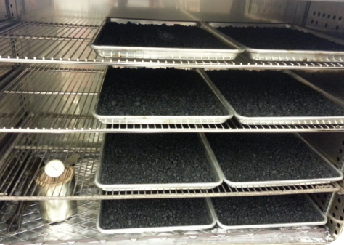
Aging Protocol
ASTM procedure does not provide guidance on long-term aging
NCAT recommends aging loose mix at 135°F for 8 hours

Slide 21
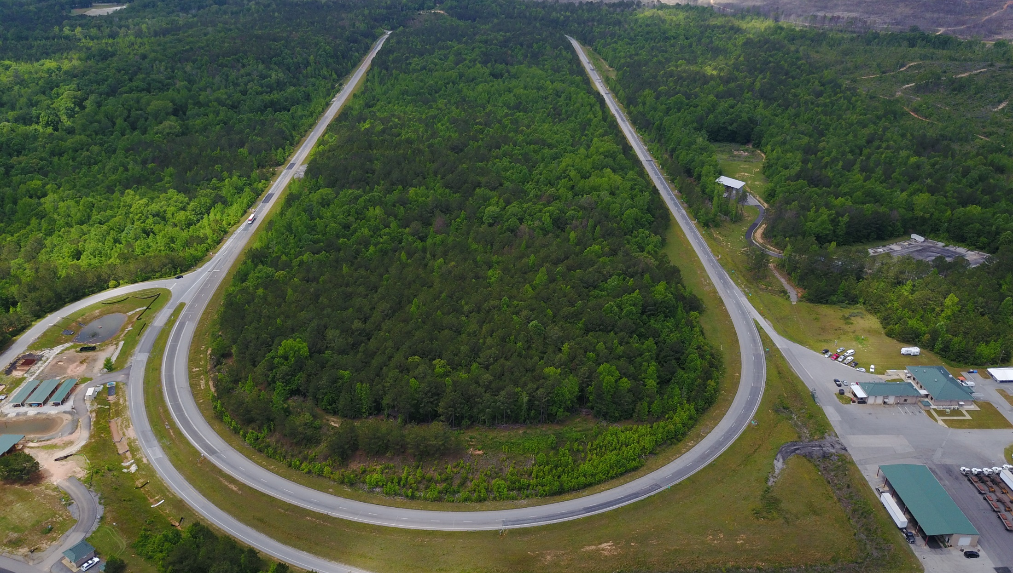


MnROAD-NCAT
Pavement Research Partnership
Cracking Group Experiment

Slide 22
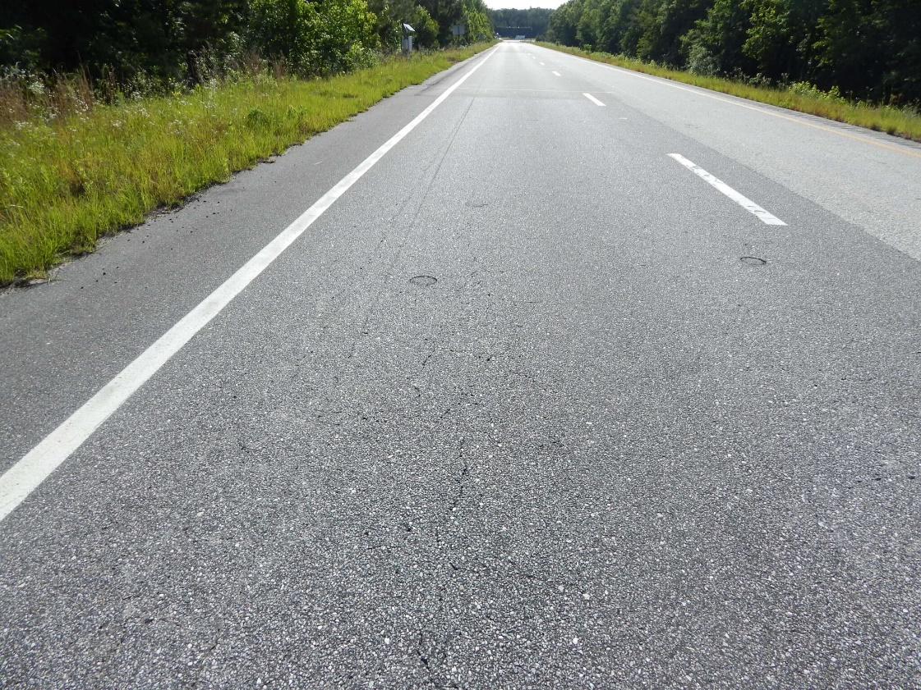
NCAT CG Field Performance
Cracking (% of lane area)
Section | Description | Start of this Cycle | Current 3/18/19
N1 | 20% RAP (Control) | 10.3 | 10.3
N2 | Control w/ High Density | 6.9 | 6.9
N5 | Low AC, Low Density | 3.5 | 5.7
N8 | 20% RAP 5% RAS | 16.6 | 31.2
S5 | 35% RAP PG 58-28 | 0 | 0
S6 | Control w HiMA | 0 | 0
S13 | AZ Rubber Mix | 0 | 0
Section N8
May 20, 2019

Slide 23
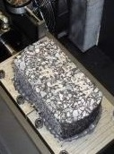
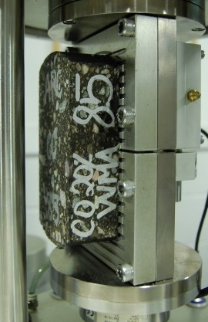




Selected Top Down Cracking Tests
Energy Ratio
SCB-LA
IFIT
OT-TX
OT-NCAT
IDEAL-CT
All tests were conducted on both lab mix and plant mix samples that were short-term and critically aged.

Slide 24

IDEAL-CT Results for NCAT Cracking Group
Lowest result
Highest results

Slide 25
Summary of IDEAL CT
One of the most promising simple mix cracking tests
Effect of air voids is counterintuitive
Effect of some polymer modification is counterintuitive
Ongoing research and training
  ruggedness experiment at TTI
  establish criteria for specifications
  lab aging protocol
  BMD workshops

Slide 26



Balanced Mix Design Workshops
Framework for Balanced Mix Designs
NCHRP 20-07, Task 406
Six Regional 1-Day Workshops
Forest Park, GA, June 26
King of Prussia, PA, July 16-17
Springfield, MO, August 21
Salt Lake City, Sept. 26
Sacramento, CA, Oct. 1
Pewaukee, WI, Dec. 4-5
Instructors: Randy West and Fan Yin
Cracking
Resistance
Rutting
Resistance
FHWA will provide invitational travel for limited DOT participation

Slide 27
randy.west@auburn.edu

