Slide 1
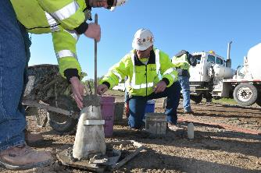

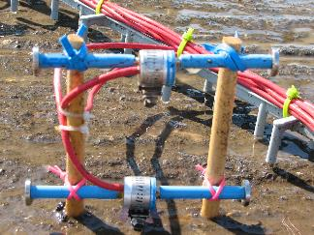
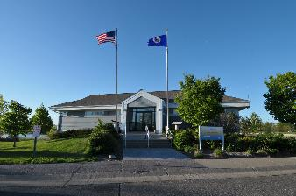
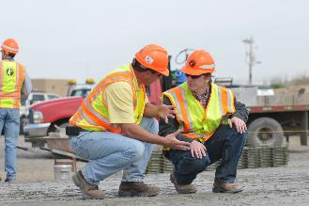

Quarter Century of MnROAD Advancements
2019 NRRA Pavement Workshop
Benjamin Worel, P.E. (MnROAD Operations Engineer)
Minnesota Department of Transportation
May 23, 2019

Slide 2

Gerald Rohrbach Distinguished Speaker
MnDOT for 35 + years
  Director of Office of Materials and Road Research
  MnDOT
  NCHRP committees
  AASHTO Subcommittee of Materials
Gerry created a productive culture…..
Liked and respected by all
Everybody had an important role to contribute
Working together you can be a part of something bigger than yourself

Slide 3
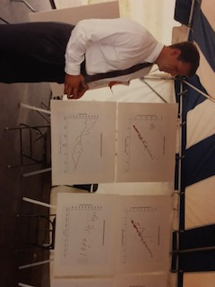
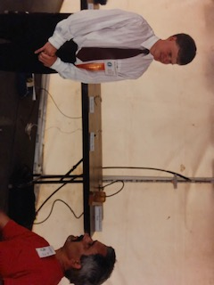
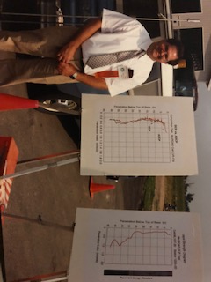

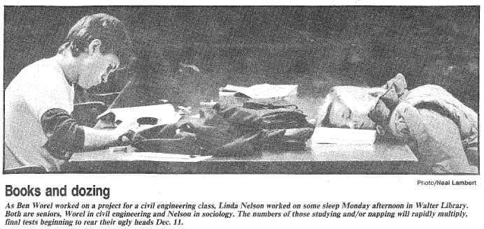
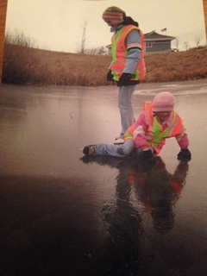
Presentation Outline
History
(MnROAD 101)
MnROAD
Key
Advancements
(We have come along way)
Future

Slide 4
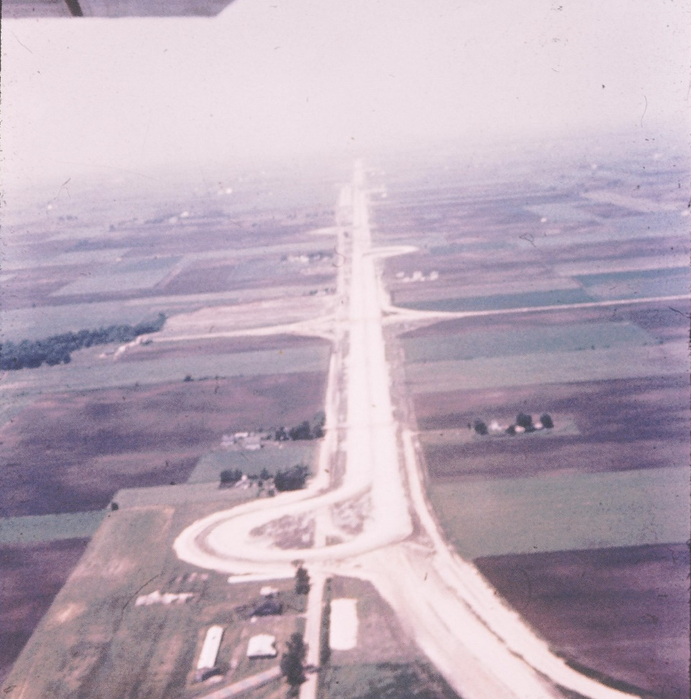

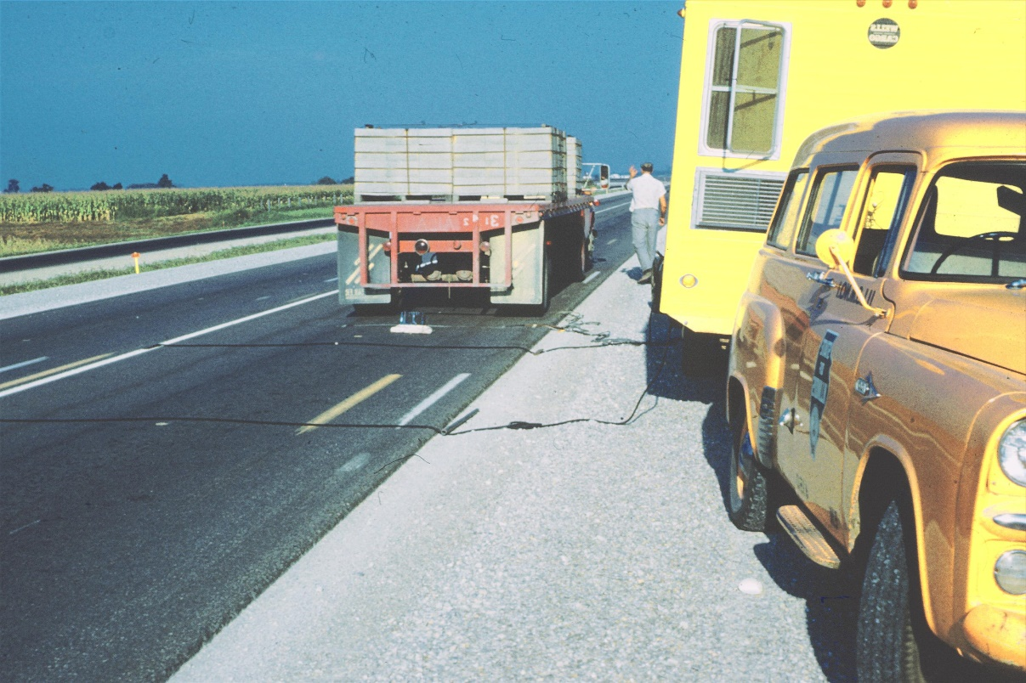
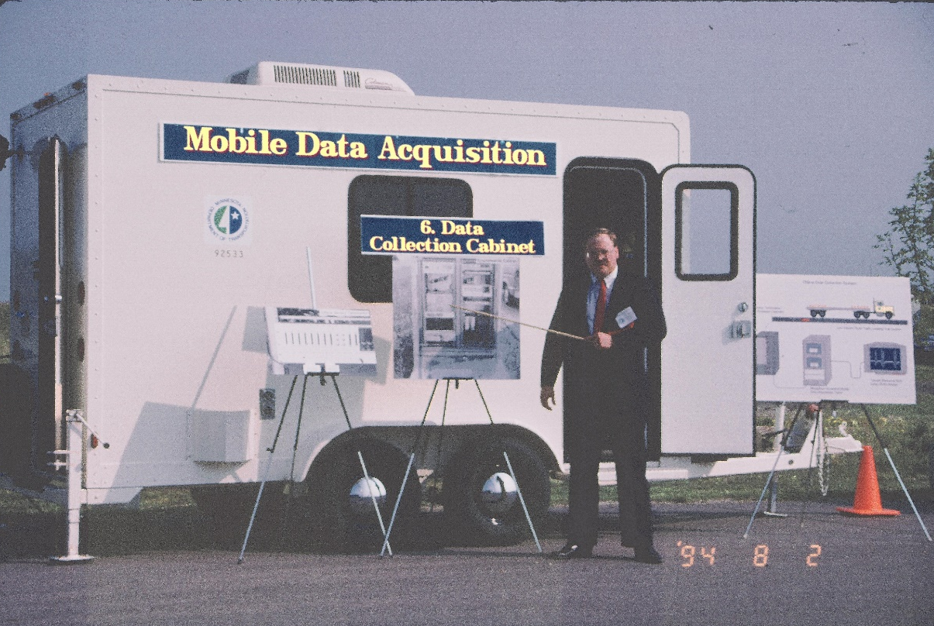
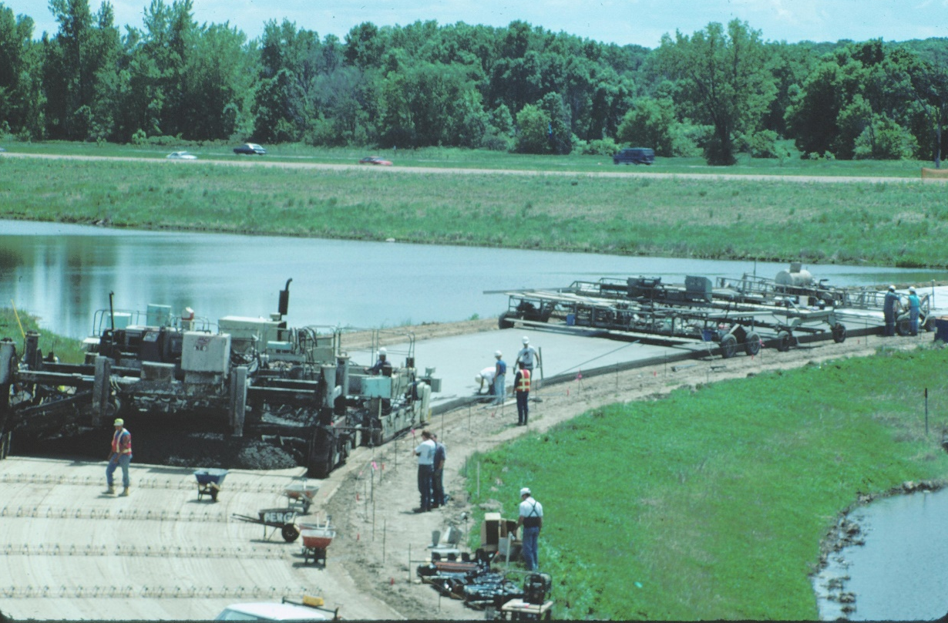


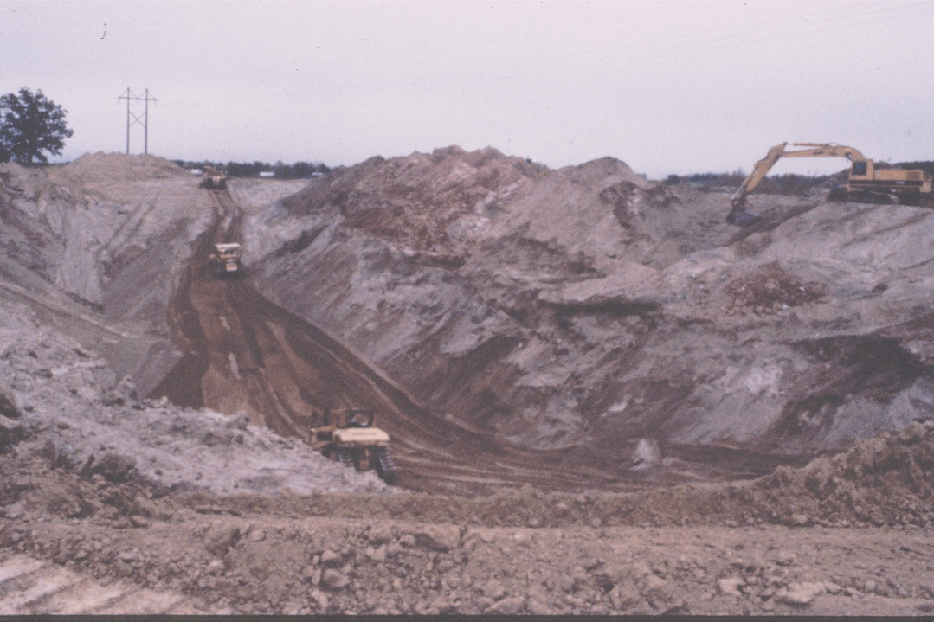
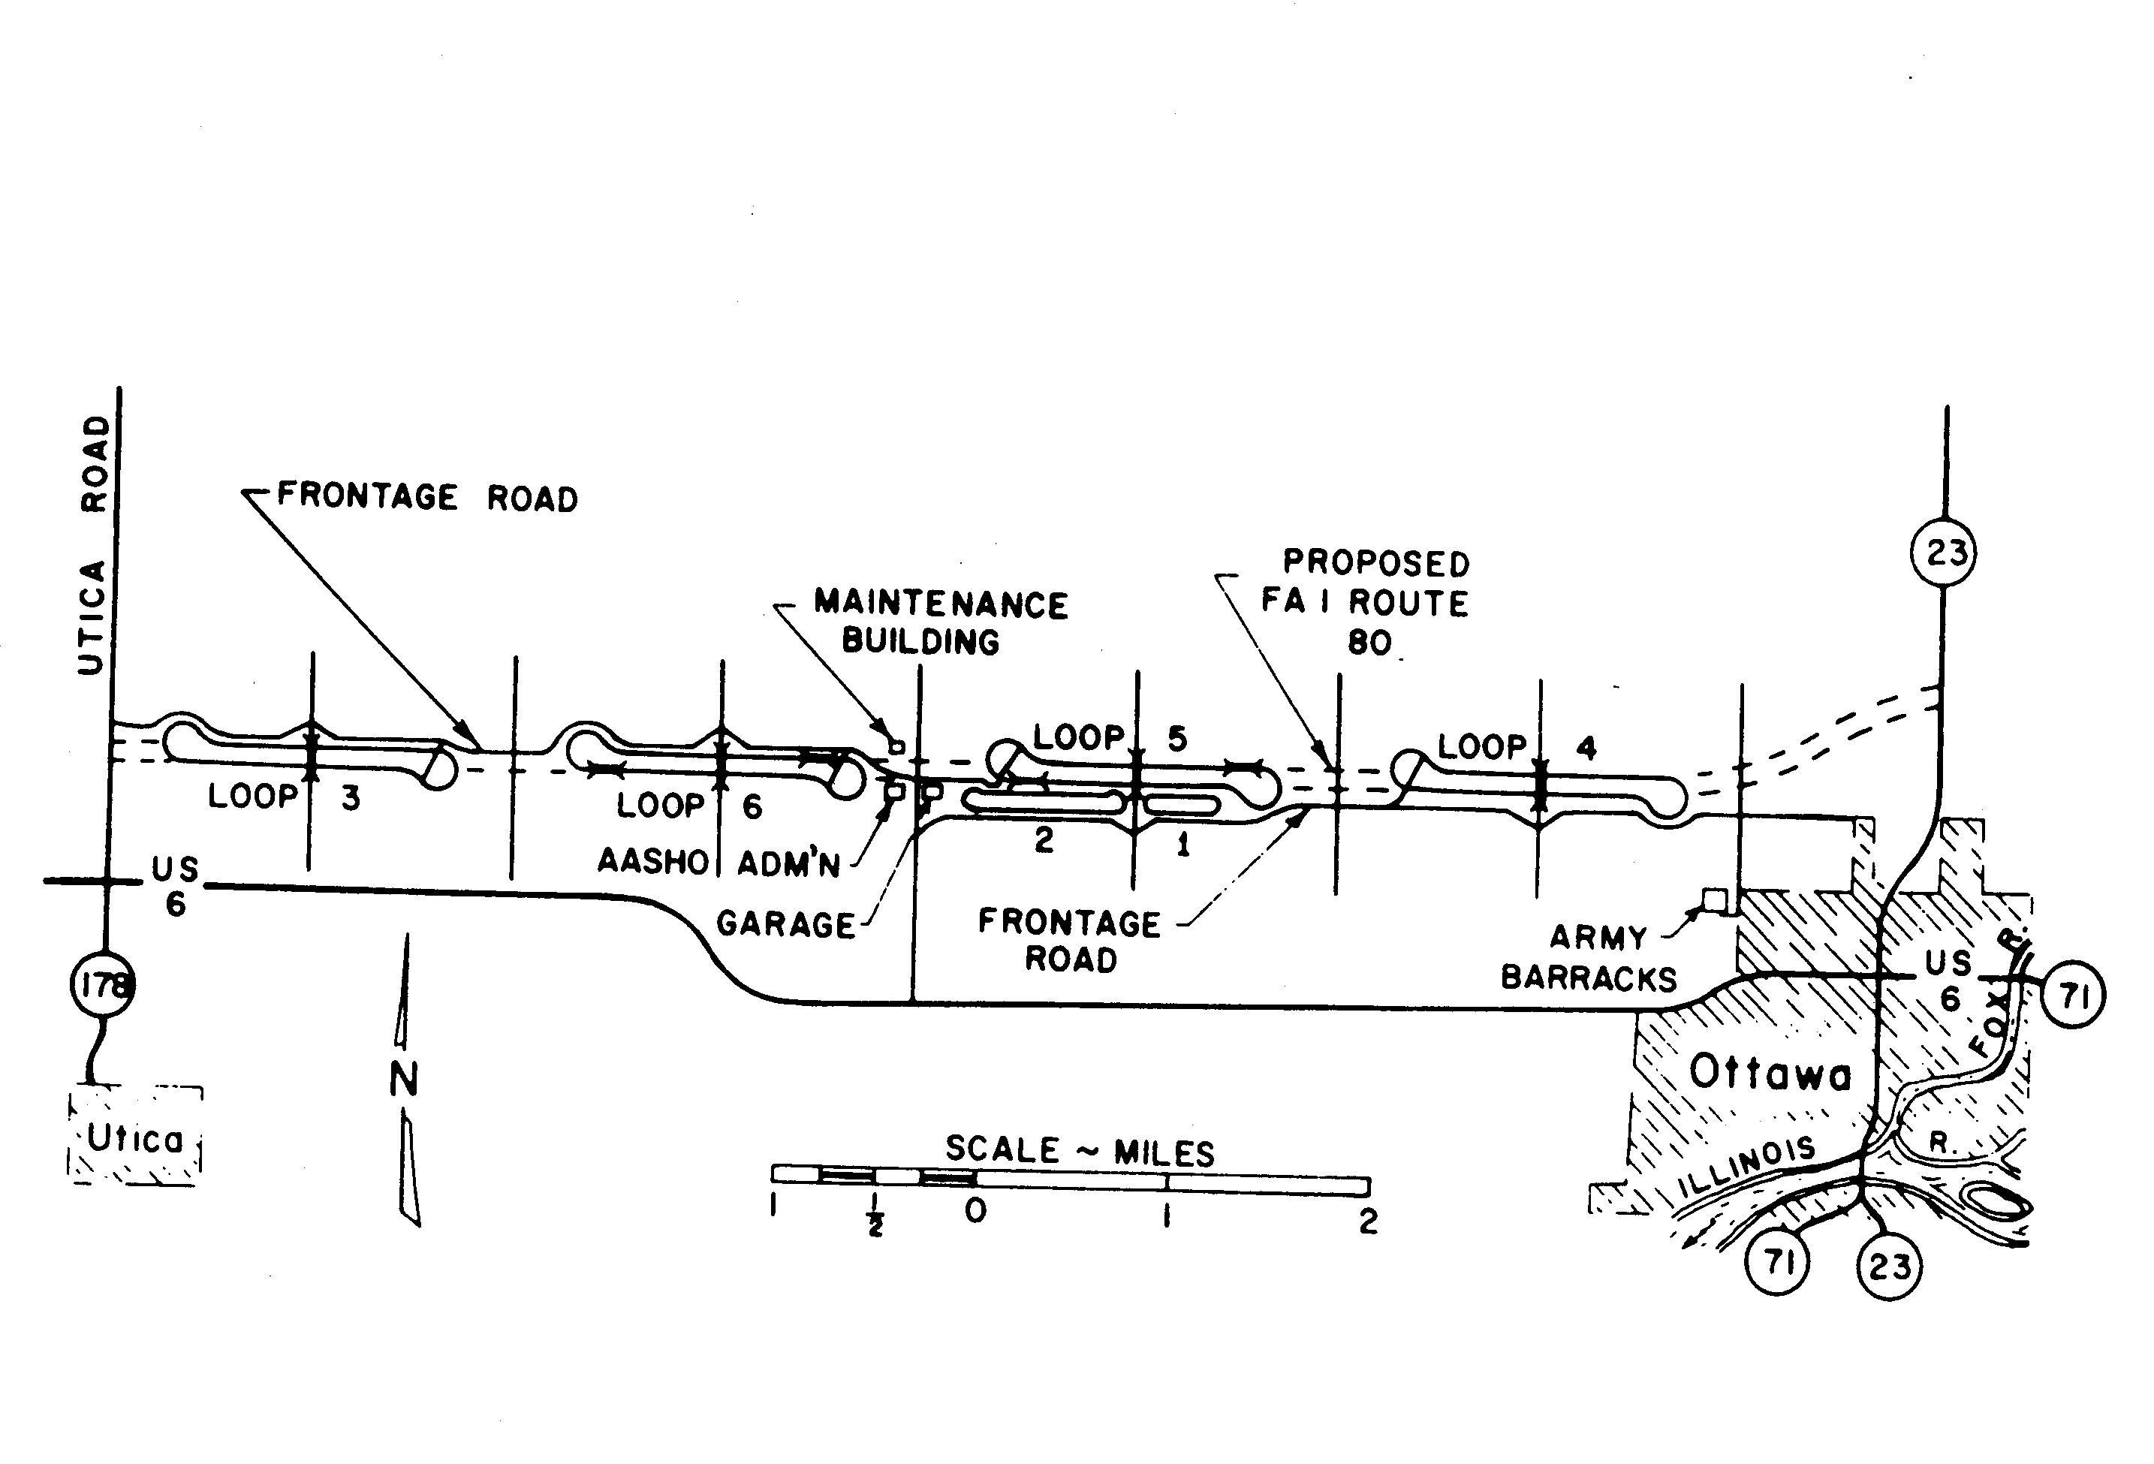
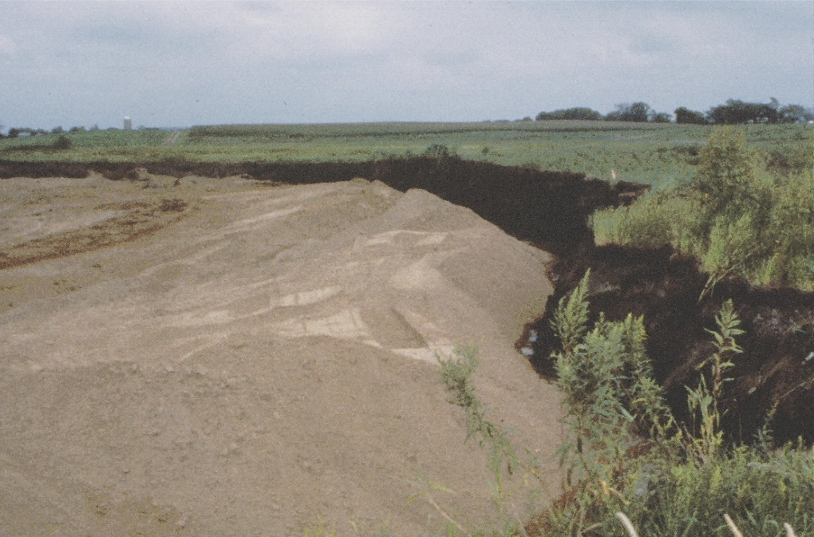
MnROAD Early History
AASHO Road Test (1956-58 built – traffic loadings from 1958-60)
Need for Local Calibrations
  MnDOT started Investigation 183 / Flexible Designs (Started 1960’s)
  SHRP/LTPP started for national efforts (8/8/1988)
  Idea of a cold regions testing facility (1980’s)
MnROAD Development
  Development of Support
    Getting 25 million in 1990
  Soil Foundation
  Instrumentation
  1992 and 1993 Construction
  August 2, 1994 Traffic

Slide 5
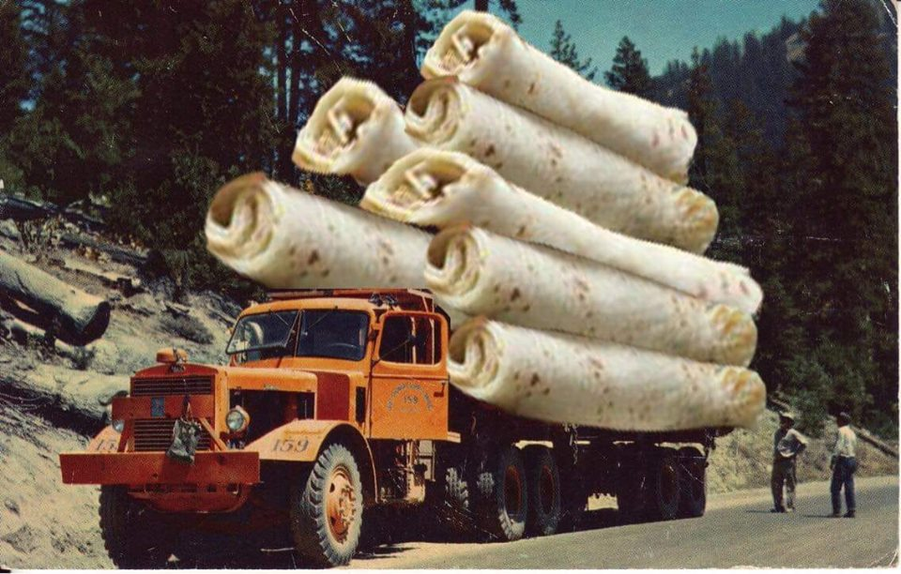
MnROAD – why is was really built?

Slide 6
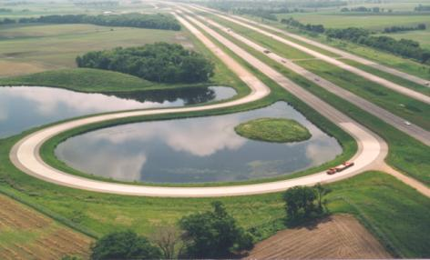
MnROAD Background
MnROAD Owned and Operated by Minnesota DOT
~25-Years of Long Term Customer Service
HMA and PCC Pavements
New and Rehabilitation
Major Experiments
  Phase I (1994-2006)
  Phase II (2007-2016)
  Phase III (2017-Future)

Slide 7
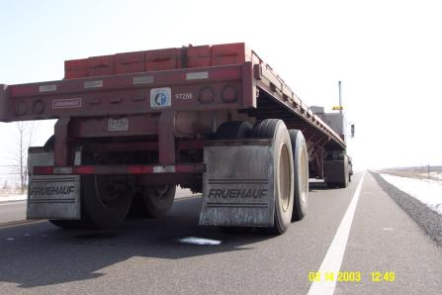
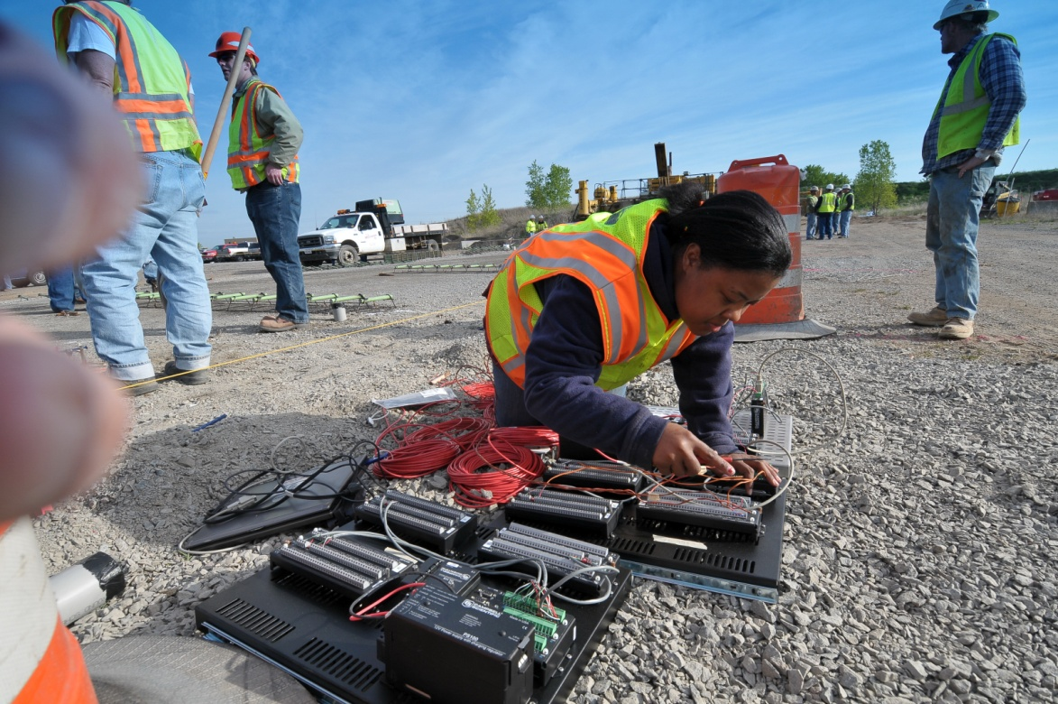
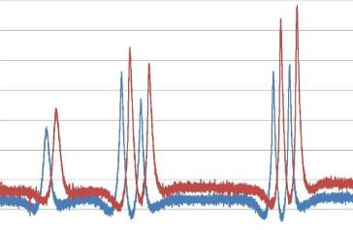

MnROAD Operations
Research Development / Partnerships
Coordination of Construction
Traffic Loadings
Performance Monitoring
  Cracking / Rutting / Ride / FWD, …..
Sensors
  Static (Environmental)
  Dynamic (Traffic Loading)
MnROAD Database
Technology Transfer

Slide 8




Phase-I Key Stakeholders
Construction / Research Funding
  MnDOT
  Local Road Research Board
Research Funding and Major Projects
  FHWA project support
  University of Minnesota
  Cold Regions Research and Engineering Laboratory
MnDOT and LRRB Relationship since 1959

Slide 9
Phase-II Key Stakeholders
Construction / Research Funding
  MnDOT
  Local Road Research Board
  FHWA / SHRP 2
Research Funding and Major Projects
  Multiple Pooled Fund Efforts
    1:1 - One pooled fund : One project
  University of Minnesota + Other Universities
  Development of TERRA
MnDOT and LRRB Relationship since 1959
PooledFund.org

Slide 10


Phase-III Stakeholders
Construction / Research Funding
  MnDOT
  Local Road Research Board
  Industry Partnerships
Research Funding and Major Projects
  Development NRRA
  Bigger Pooled Fund Efforts
    Pooled Fund : Many Projects
    Many Universities / Consultants
  NCAT Partnership
  MnDOT Lead Pooled Funds
MnDOT and LRRB Relationship since 1959

Slide 11
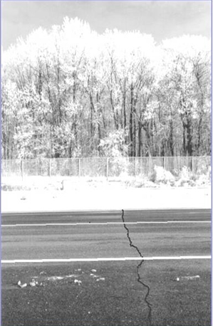
Thermal Cracking ~ 1990
Marshall Mix Designs
  Did not take the environment into account
MnROAD HMA Test Sections
  AC-20 and 120/150 Binders
  5 and 10 year test cells (thin / thick)
  Varying Base Types
Northern Climates Accepted Cracking

Slide 12
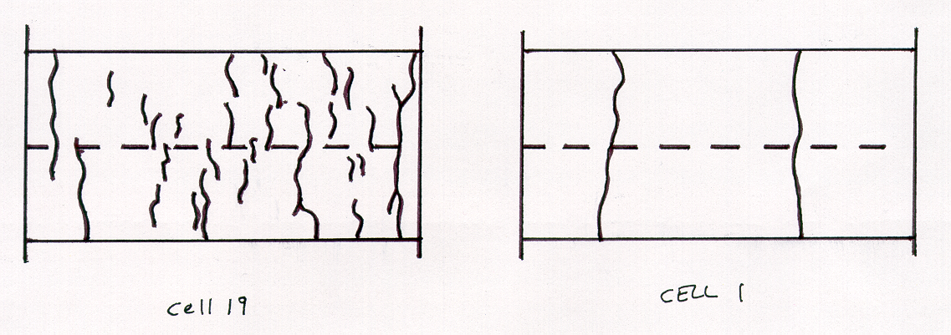
Low Temperature Cracking
Major Findings
  1994 MnROAD Test Sections (PG 64-22, PG 58-28)
  1999 LVR (PG 58-28, 58-34, 58-40)
AC 120-150 (PG 58-28)
Cell 1
AC 20 (PG 64-22)
Cell 19

Slide 13
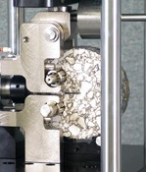
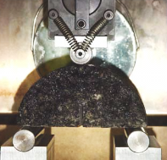
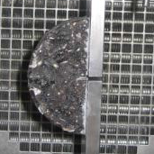
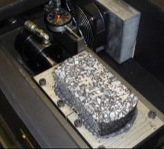
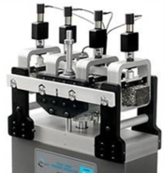
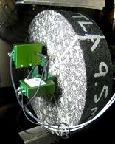
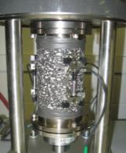
National HMA Cracking Performance Test
PG Grading System
2 MnDOT Led Pooled Funds – 4 Universities
NCAT Partnerships
  Utilize both MnROAD / NCAT Test Tracks
    Top Down / Reflection / LTC cracking Efforts
Balanced Mix Design

Slide 14
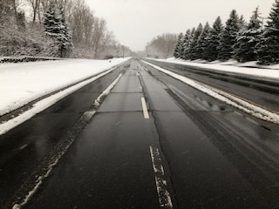
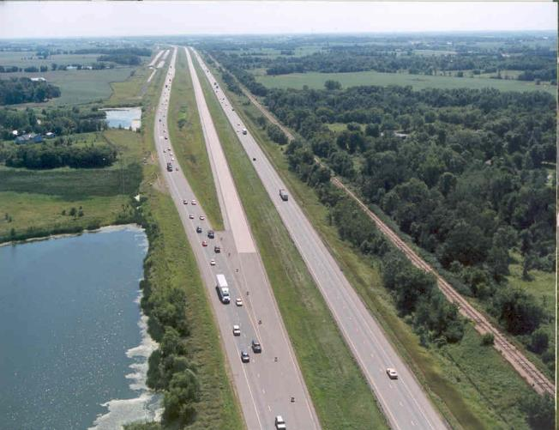
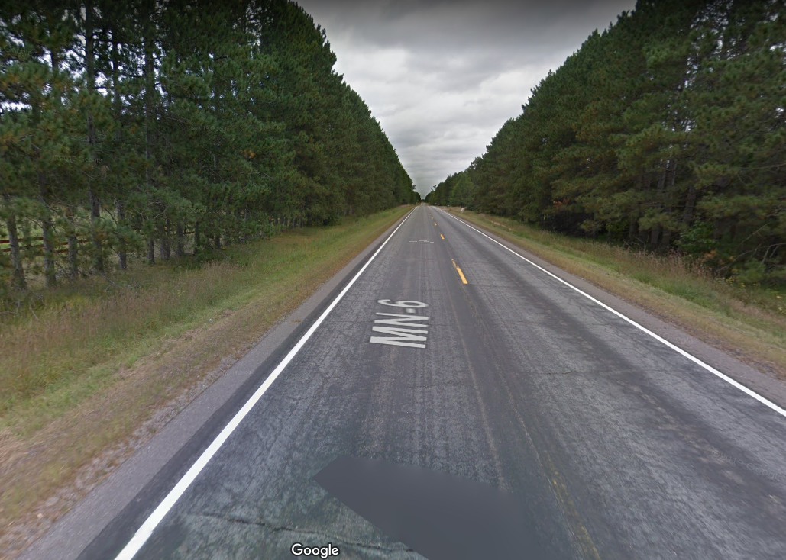
MnROAD Partnerships Rejuvenators
October 2018 - Cargill and Hardrives
Collaborative Aggregates – 2017 Hennepin Mix
  NB Control - 30% RAP
  SB - 30% RAP / Delta-S
Cargill 2018 MnROAD Transitions
Cargill – 2018 MnROAD Transitions
  Control - 25% RAP Superpave (SPWEB540 / PG 58S-28)
  High RAP - 45% RAP Superpave (SPWEB540 / PG 58S-28 / Anova)
  Lab Testing / Long Term Monitoring
2019 NRRA Rejuvenator Test Sections
  TH-6 (Emily to Outing, Minnesota)
  7-10 Rejuvenators / Industry pays for extra costs / NRRA monitors
    Control – 30% RAP (Project)
    Control – 40% RAP
    Treatments – 40% RAP with Rejuvenators

Slide 15
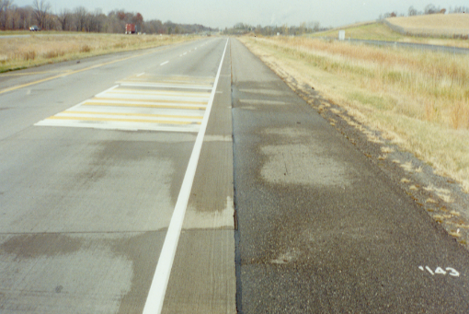
Importance of Sealing
PCC Lane / HMA Shoulder Sealing
  Cell 7 Control
  Cell 8 Sealed
  Results
    * 89% reduction between cells
    86% reduction within Cell-8
Cell 7
Cell 8
MnDOT: Ruth Roberson
Roger Olson
Chad Millner
Similar results for HMA Pavements

Slide 16
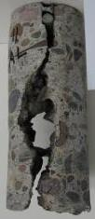
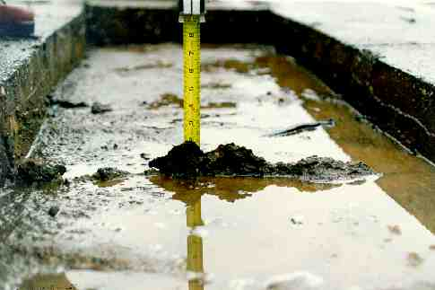

Drainage - Effects of Trapped Water
Asphalt
  Deterioration asphalt
  Increased roughness (ride)
Concrete
  ML Observations (high traffic)
    None - PASB used
    Some - Class-5 / well sealed joints / edge drain
    High amount - Class-5 / no edge drains
  LVR Observations (low traffic)
    If sealed class-5 is not as destructive
    If not-sealed class-5 can develop joint damage
Benefits
  Importance of drainable bases / sealing
  Effect on ride

Slide 17
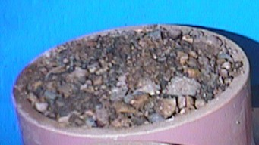
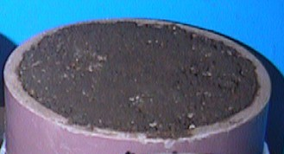
Class-5 (Minnesota Common Base Material)
Both Class-5 Material
Same Performance?
3%
7%

Slide 18
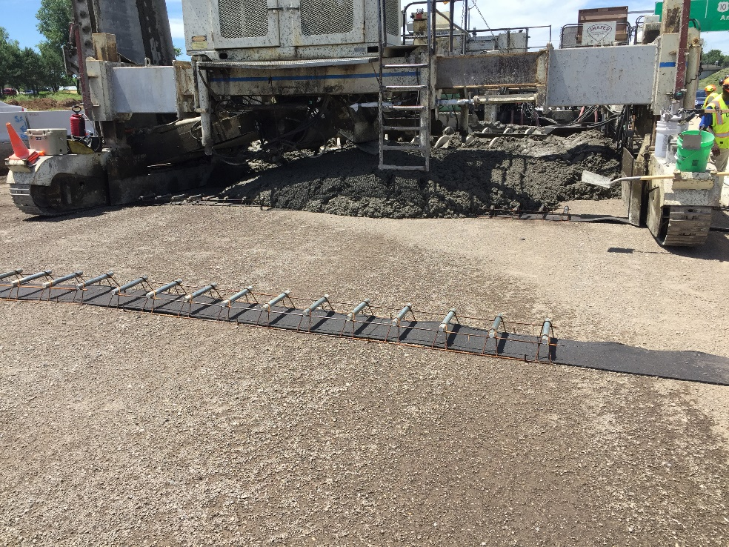
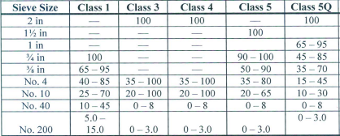
Pavement Drainage / Base Improvement s
Subsurface Drainage Innovations
HMA and PCC Underlying Base Layers
  Updated specifications Class 5Q in lieu of Class 5
    Tighter Gradations “More drainable and Stable”
  Large Stone Base Materials
    Good performance / ~40% less Frost Depth
    Concrete
      Geocomposite Joint Drain
      Non-Woven Geotextile interlayer
      (PCC overlays of PCC)

Slide 19
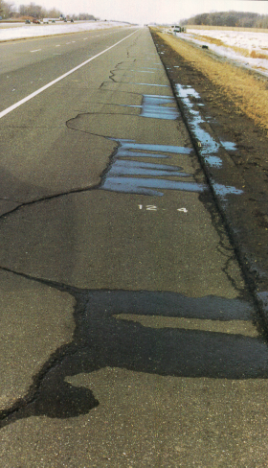
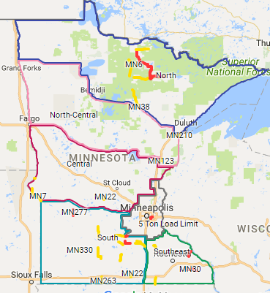
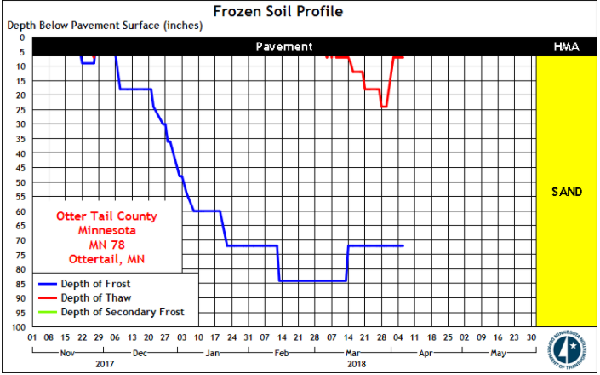
Seasonal Load Limits
Spring Restrictions / Winter Overloads
MnROAD Models
Thawing Index
MnDOT Website
Monitoring Sites Installed around the State
Spring Thaw

Slide 20

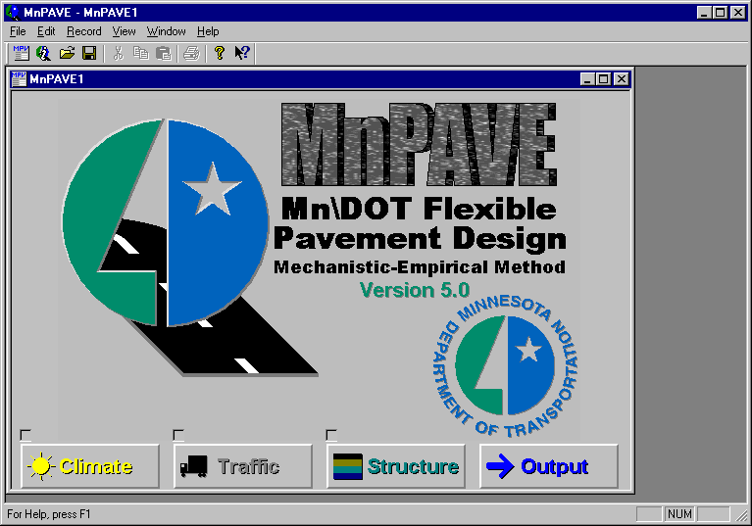


MnROAD ME Designs Impacts
Flexible – MnPAVE Flexible
Major Inputs into PavementME (HMA and PCC))
Rigid – MnPAVE Rigid
Concrete Overlay of Asphalt

Slide 21
Concrete Innovations
PCC Designs
  Very a lot
  Somewhat Conservative
  True for LVR and Mainline Test Sections (Tom Burnham)
Test Cell | MnDOT Method | 1993 AASHTO 95% Rel. | 1993 AASHTO 50% Rel. | 1984 PCA Method
5 | 5.8 | 1.2 | 5.1 | 2.9
6 | 2.6 | 0.8 | 3.3 | 0.7
7 | 4.4 | 2.3 | 9.3 | 2.2
8 | 2.4 | 0.8 | 3.2 | 0.6
9 | 3.9 | 1.8 | 7.2 | 1.6
10 | 12.0 | 5.3 | 19.2 | 76.4
11 | 13.1 | 3.0 | 12.0 | 60.2
12 | 12.0 | 4.3 | 16.1 | 75.9
13 | 12.1 | 4.2 | 16.1 | 69.4

Slide 22
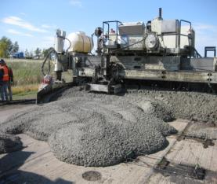
Whitetopping Design
TPF-5(165) Pooled Fund
  10 state participation
  National design procedure
  19 Test Cells (built: 1997, 2004, 2008)
Observations
  Learned the important factors – accelerated loading
    Thickness
    Panel size
    HMA condition and seasonal behavior
    Importance of bond
    Importance of sealing
Benefits
  Rational (optimized) design procedure
  Provides options for distressed asphalt pavements

Slide 23
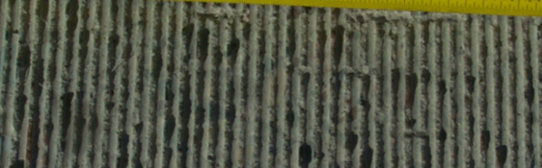
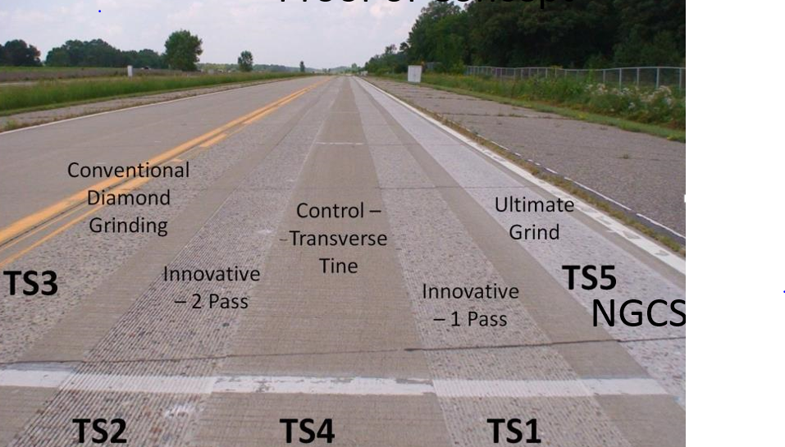
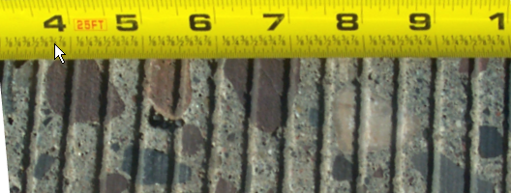
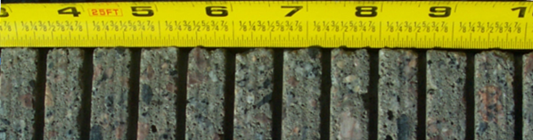


Diamond Grinding Innovations
Evolution from Lab to Specification
  Purdue Study
  Built with industry involvement
    IGGA
    Diamond Surface Inc.
  Tested at MnROAD
    Cell 37 LVR
    Mainline following years
  Developed a specification
  Used in Minnesota and around the country
2007 TRADITIONAL GRIND
2007 INNOVATIVE GRIND
2008 INNOVATIVE GRIND
2010 INNOVATIVE GRIND
NGCS

Slide 24

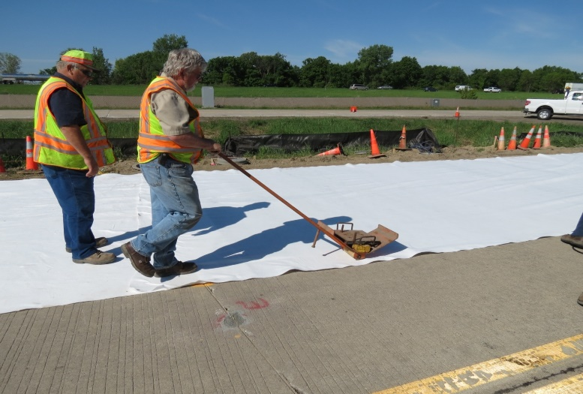
Sustainable Technologies
Reduce
Warm Mix Asphalt
Recycled Pavements
  Asphalt, Shingles, Concrete
  New Pavements, Recycled Base Materials
Surface Treatments
  Chip Seal, Microsurfacing, Fog Seal
Thin Pavements
  - Unbonded Overlays, Novachip
In Place Recycling
  FDR, Stabilized FDR
Lower Construction Costs, Shorter Construction Time, Improved Pavement Performance
Reuse
Recycle

Slide 25


InPlace Recycling
Road Science Partnership
  3 Cells (mainline) / 1 Cell (LVR)
Observations
  2.75” Interstate surface on engineered FDR
  Engineered emulsion → balance stiffness/flexibility
Benefits
  Design for distressed pavements/Full depth repairs

Slide 26

SPR-5(375) Phase-II
PG2 - Pavement Preservation Pooled Fund
  MnDOT Lead State
  Partnership with NCAT
  3 year Study (2019-2021, add 2022-2023)
  24 Partners
  Red States – 5 year commitment
    3 States
    Foundation of Pavement Preservation
  Green States – 3 year commitment
    16 States
    FHWA
  Blue States – Verbal commitment
    3 States
Notes:
Through Dec 30, 2023
Auburn Univ (NCAT is a non profit arm of Auburn) is a subcontractor to MnDOT

Slide 27
Roadway Details
NCAT Offsite Test Sections
Lee Road 159 (2012)
US-280 (2015)
MnROAD Offsite Test Sections
  Mille Lacs County CSAH-8 (2016)
  US-169 (2016)
  70th and 80th Street Recycling
Roadway | LR-159 | US-280 | CSAH-8 | US-169
Traffic volume | Low | High | Low | High
Thickness (inch) | 5.5 | 9.9 | 7.0 | 6.5
Section length (feet) | 100 | 528 | 528 | 528
# Test Sections | 23 | 34 | 22 | 21
Age (Years) @placement | 14 | 9 | 6 | 6

Slide 28
Northern Layout of US-169/CSAH-8
Northern
High Traffic
Preservation
on US-169
Northern
Low Traffic
Preservation
CSAH-8

Slide 29
Pavement Preservation Study
70th and 80th Construction Timeline
Project Initial Review (2018)
Mix Designs – (May/June 2019)
Construction
  Partnering with Industry
  June 2019
    Hot Mix Recycling
  August 2019
    Cold In-Place Recycling (foam/emulsion)
    Cold Central Plant Mix Recycling (foam/emulsion)
    Stabilized Full Depth Recycling (foam/emulsion)
    Mill and Fill (Control)
    1” Thinlay Overlay
Notes:
Through Dec 30, 2023
Auburn Univ (NCAT is a non profit arm of Auburn) is a subcontractor to MnDOT

Slide 30

Early Intelligent Construction Tools
Ground Penetrating Radar
Early MnROAD Cell-28 HMA thickness vs cracking and fatigue

Slide 31




Intelligent Construction Tools
Veta Software TPF-5(334)
HMA Rolling Patterns
Paver Operations / IR Temperature Bar
3D GPR / Rolling Density Meter (pooled fund)

Slide 32

Current NRRA Initiatives
Construction
  2017 MnROAD
  2018 Missouri CCP
Long Term Projects
  2017 - 8 Projects
  2019 – 12 Projects
Short Term / Technology Transfer Projects
  2017 - 8 Projects
  2019 – 4 Projects
Already Covered already in the workshop
Thanks for everyone's efforts
(Shows the power of what can be done together)

Slide 33




Other Current Non-Pavement Partnerships
Autonomous Vehicle Testing
  Effects on pavement design
Roadside Vegetation
  University of Minnesota Studies
  Erosion Control Classes 2019
Traffic/WIM Technology
  Kistler, Intercomp, IRD
3M
  Machine Vision
  Pavement Marking

Slide 34



MnROAD Test Section Benefit Types
Direct
  Savings of materials
Indirect
  Time savings and quality
Avoidance
  Don’t do that on the system
Demonstration
  Confidence to try something new

Slide 35

MnROAD Benefits (only for Minnesota)
Phase-1
  9:1 B/C Ratio
  Seasonal Load Restrictions; Low Temp Cracking
Phase-2
  5:1 B/C Ratio
  Surface Characteristics (HMA/PCC), Pervious Pavements, Implements Husbandry, Stabilized Full Depth Reclaimation, Lightly Surface Roadways, Chip Seal Video, Whitetopping, Thin PCC, Optimal Timing of Preventive Maintenance, Low Temperature Cracking II, Quiet Rumble Strips, Drainable/Stabile Bases
  Phase-3 with NRRA???????

Slide 36

MnROAD and LTPP InfoPave
FHWA and i-Engineering
MnROAD Access
Data
Pictures
Reports/Software
Ties to
LTPP Data
Westrack
C-SHRP
Initial Development
TRB 2019
Working on this summer

Slide 37

New Technology of Interest
Google Earth
Opens up the idea of walking a road from your computer
Panorama Camera
Create your own images like a house tour
https://makevt.com/media/tourmaker/iqrcgsaydj/
Google Earth
2008-2019

Slide 38


Technology Transfer Efforts
Research Pays Off Seminar Series
  Every 3rd Tuesday
  10-11 am
NRRA
  May Workshops
  Technical Visits
  Want your ideas
Newsletters
  Highlight Members
  Highlight NRRA Projects
  Highlight Emerging Technology
Pavement Workshop
May 23-24, 2018
MnROAD NCAT Sponsor Meetings
  Early Spring / Late Summer

Slide 39


NRRA National Request for Ideas / Innovation
Need New Ideas
  Available Real Estate now
    New Construction
    Rehabilitation
    Maintenance
Processes
  Informal – MnROAD Website
  Formal - Call for Innovation
    Due: August 2, 2019
  Balance Portfolio
    Traditional Research
    Non-Traditional Research
MnROAD Website http://www.dot.state.mn.us/mnroad/newideas.html

Slide 40


Thank You
Questions?
Benjamin Worel
ben.worel@state.mn.us
NRRA shares Gerald Rohrbach’s vison: Working together you can be a part of something bigger than yourself

Slide 41





National Test Tracks Past/Present/Future
Illinois
1960’s
Wyoming
~Future HMA Mainline
WesTrack
1990’s
Florida
~2020 Concrete Mainline

