Slide 1
University Prospective: MnROAD Testimonials
Zhanping You, Ph.D., P.E.
Distinguished Professor, Michigan Tech
zyou@mtu.edu
May 22, 2019

Slide 2
Michigan Tech Involvement:
2017 NRRA Grand Opening and Test Sections Tour

Slide 3
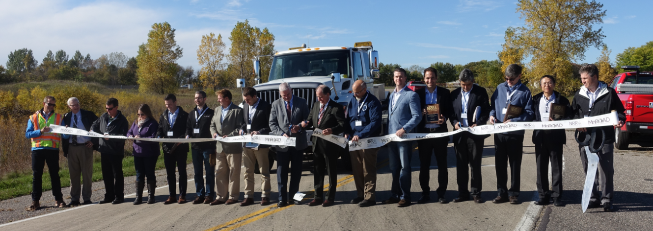
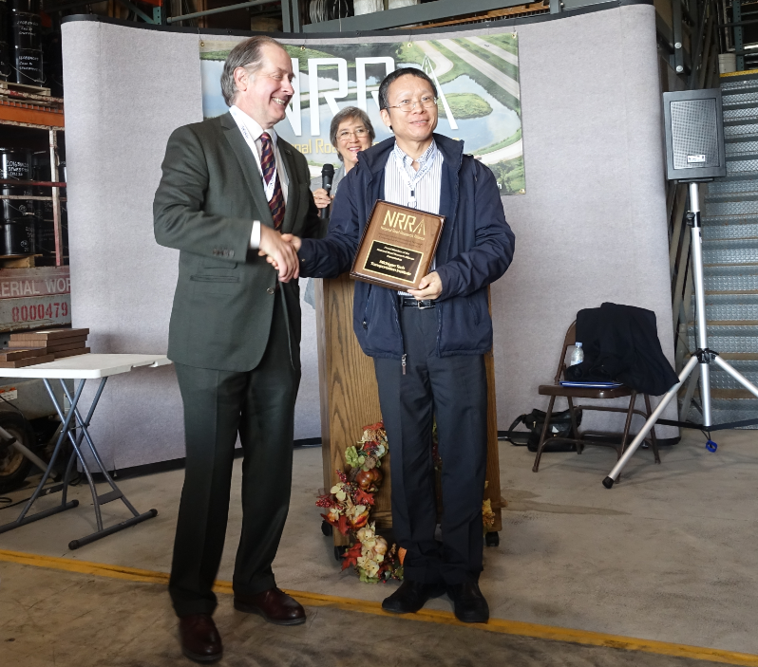
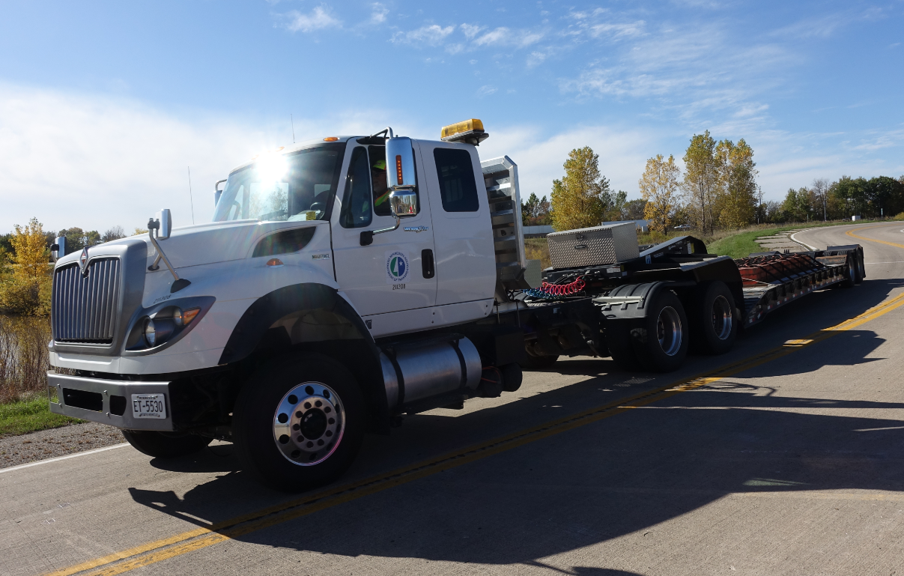
2017 NRRA Grand Opening

Slide 4
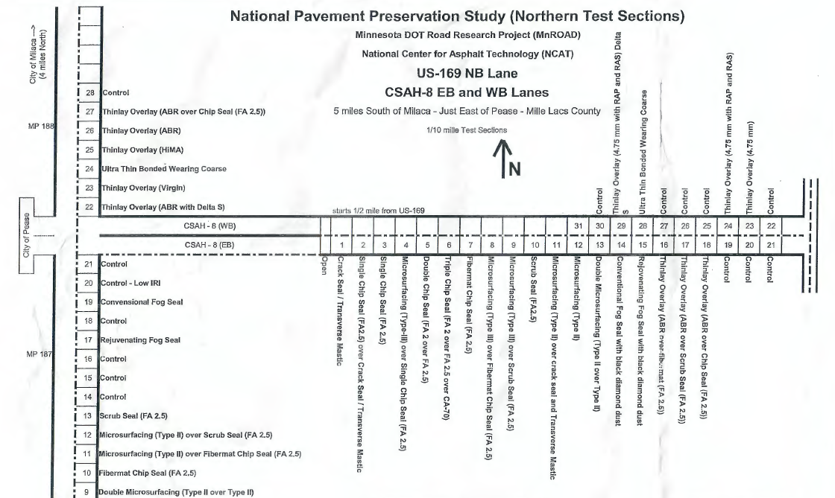
2017/2018 MnROAD Tours and Test Sections Tours
National pavement preservation study (Northern test sections)
US-169 Lane, Pease, MN
CSAH-8 Lanes, Pease, MN

Slide 5
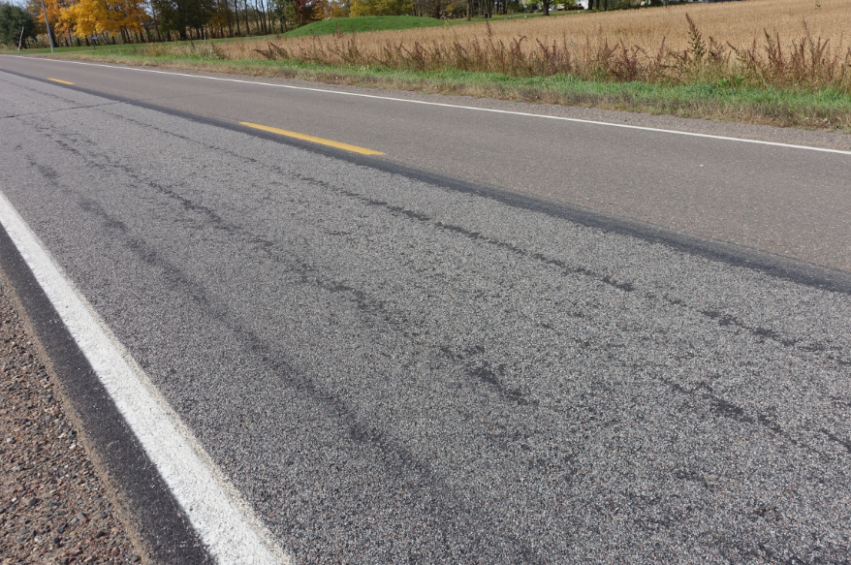
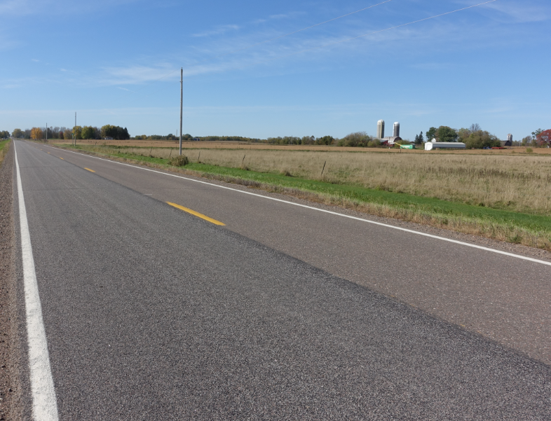

2017 Test Sections Tour
CSAH-8 Lanes, Pease, MN
Single Chip Seal (Section #3)
Microsurfacing (Section #4)
Double Chip Seal (Section #5)
Triple Chip Seal (Section #6)
#3
#5
#6
#4

Slide 6
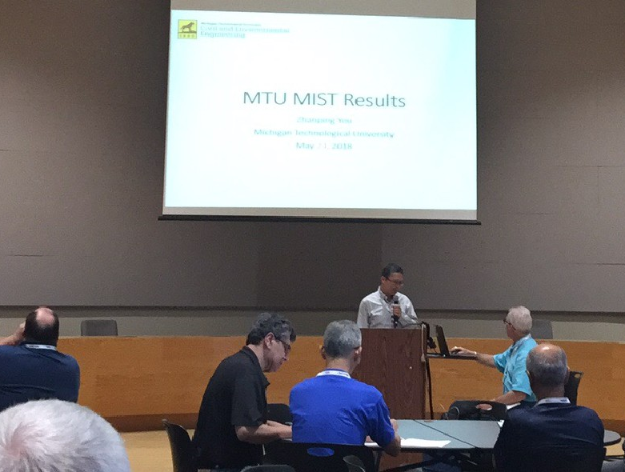
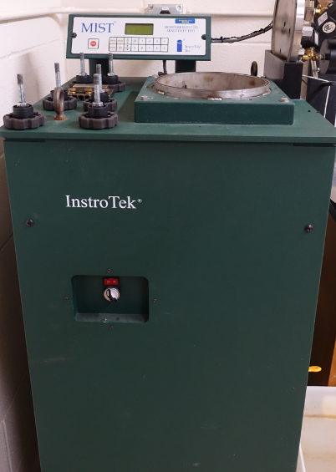
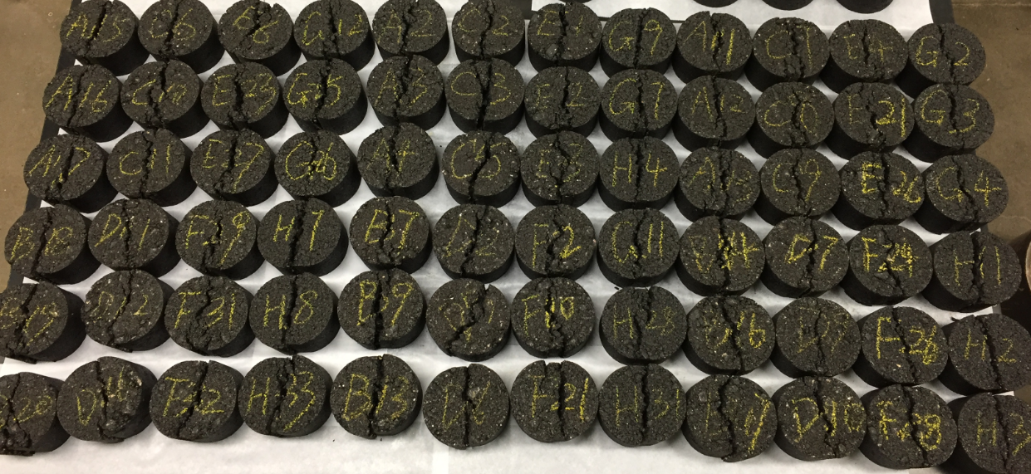
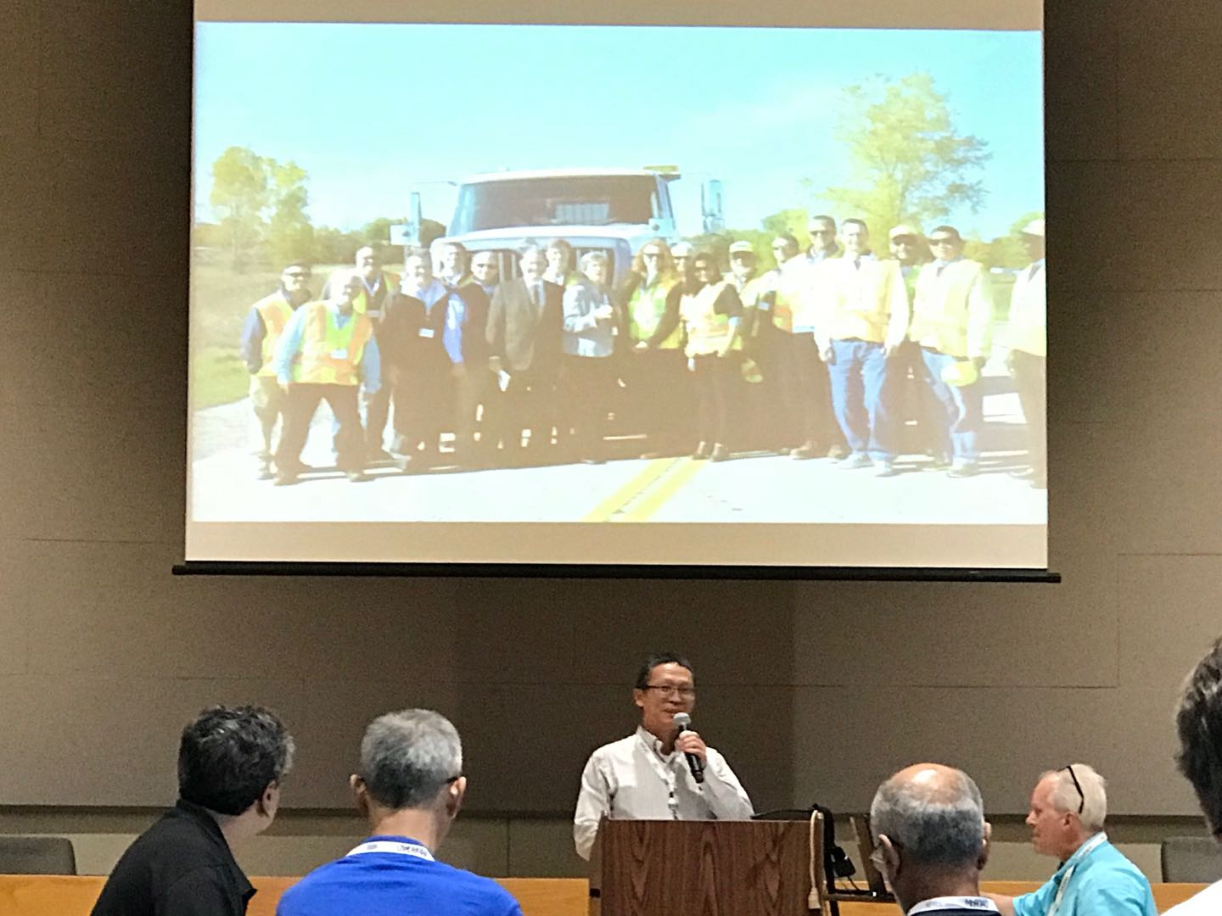
2018 MnROAD Materials Test in Michigan Tech
MIST test by MTU

Slide 7
Asphalt Materials Labs at Michigan Tech

Slide 8
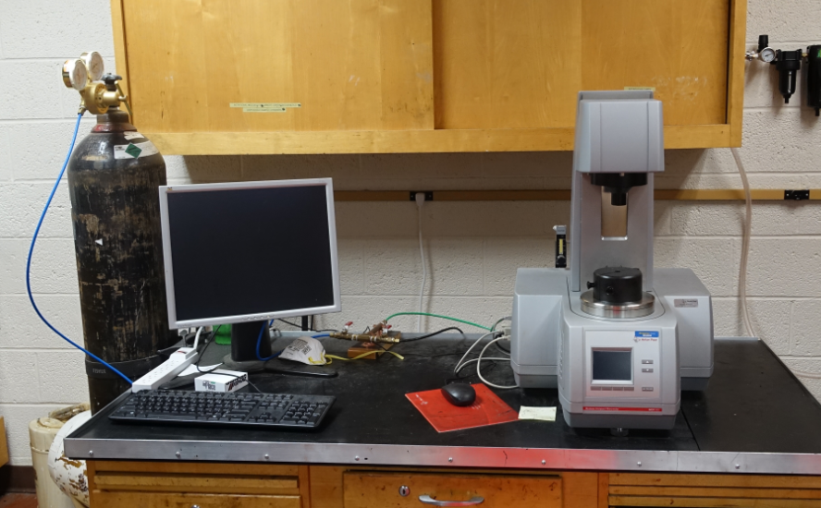
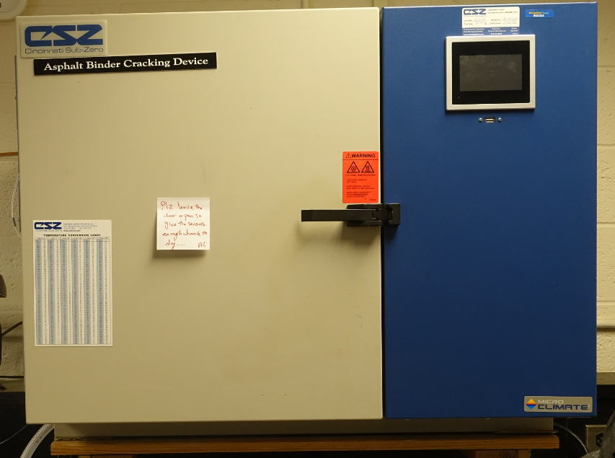
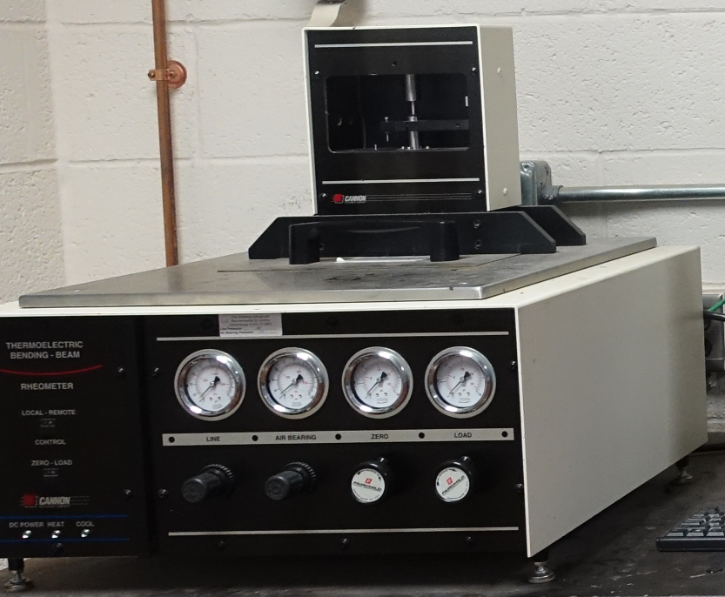
Asphalt Materials Labs at Michigan Tech
Asphalt Binder Cracking Device
Bending Beam Rheometere
Anton Paar Rheometer

Slide 9
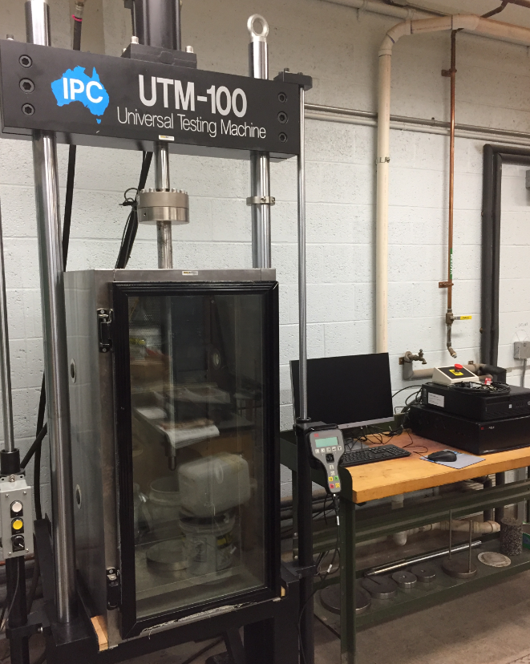
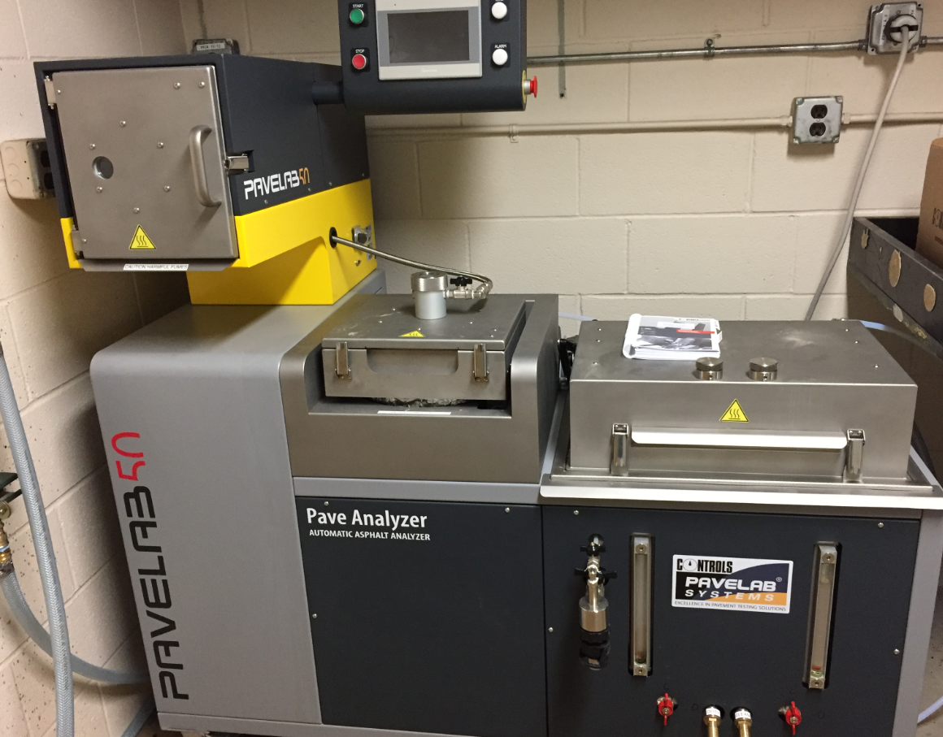
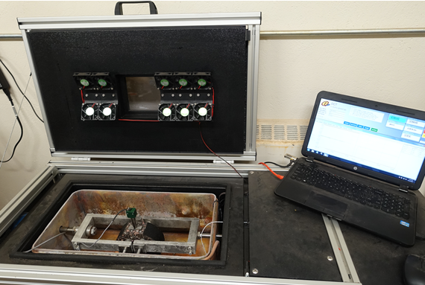
Asphalt Materials Labs at Michigan Tech
Disk-Shaped Compact Tension Test
UTM-100
Automatic binder extractor

Slide 10
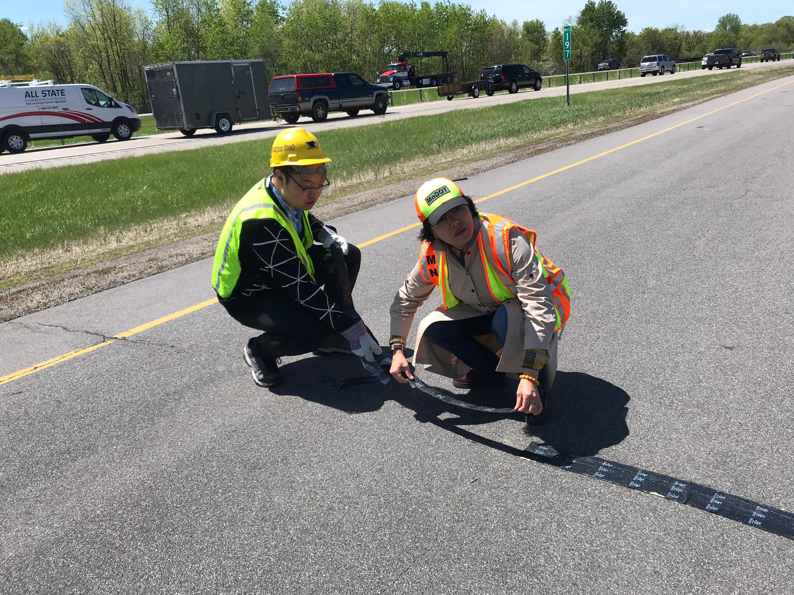
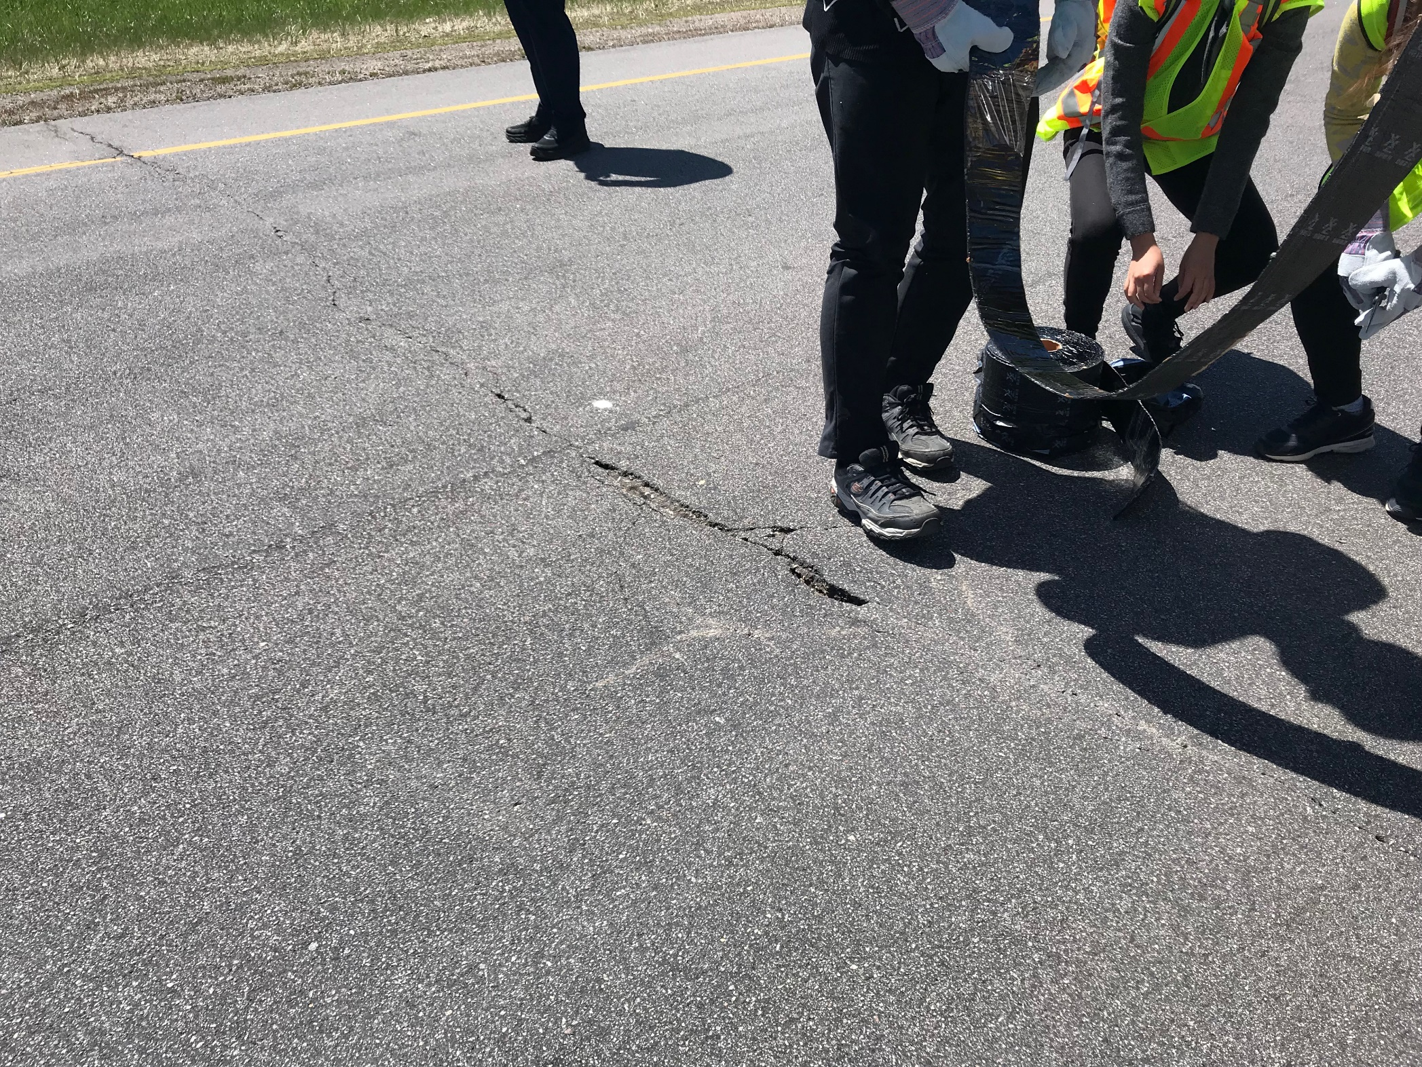

Slide 11
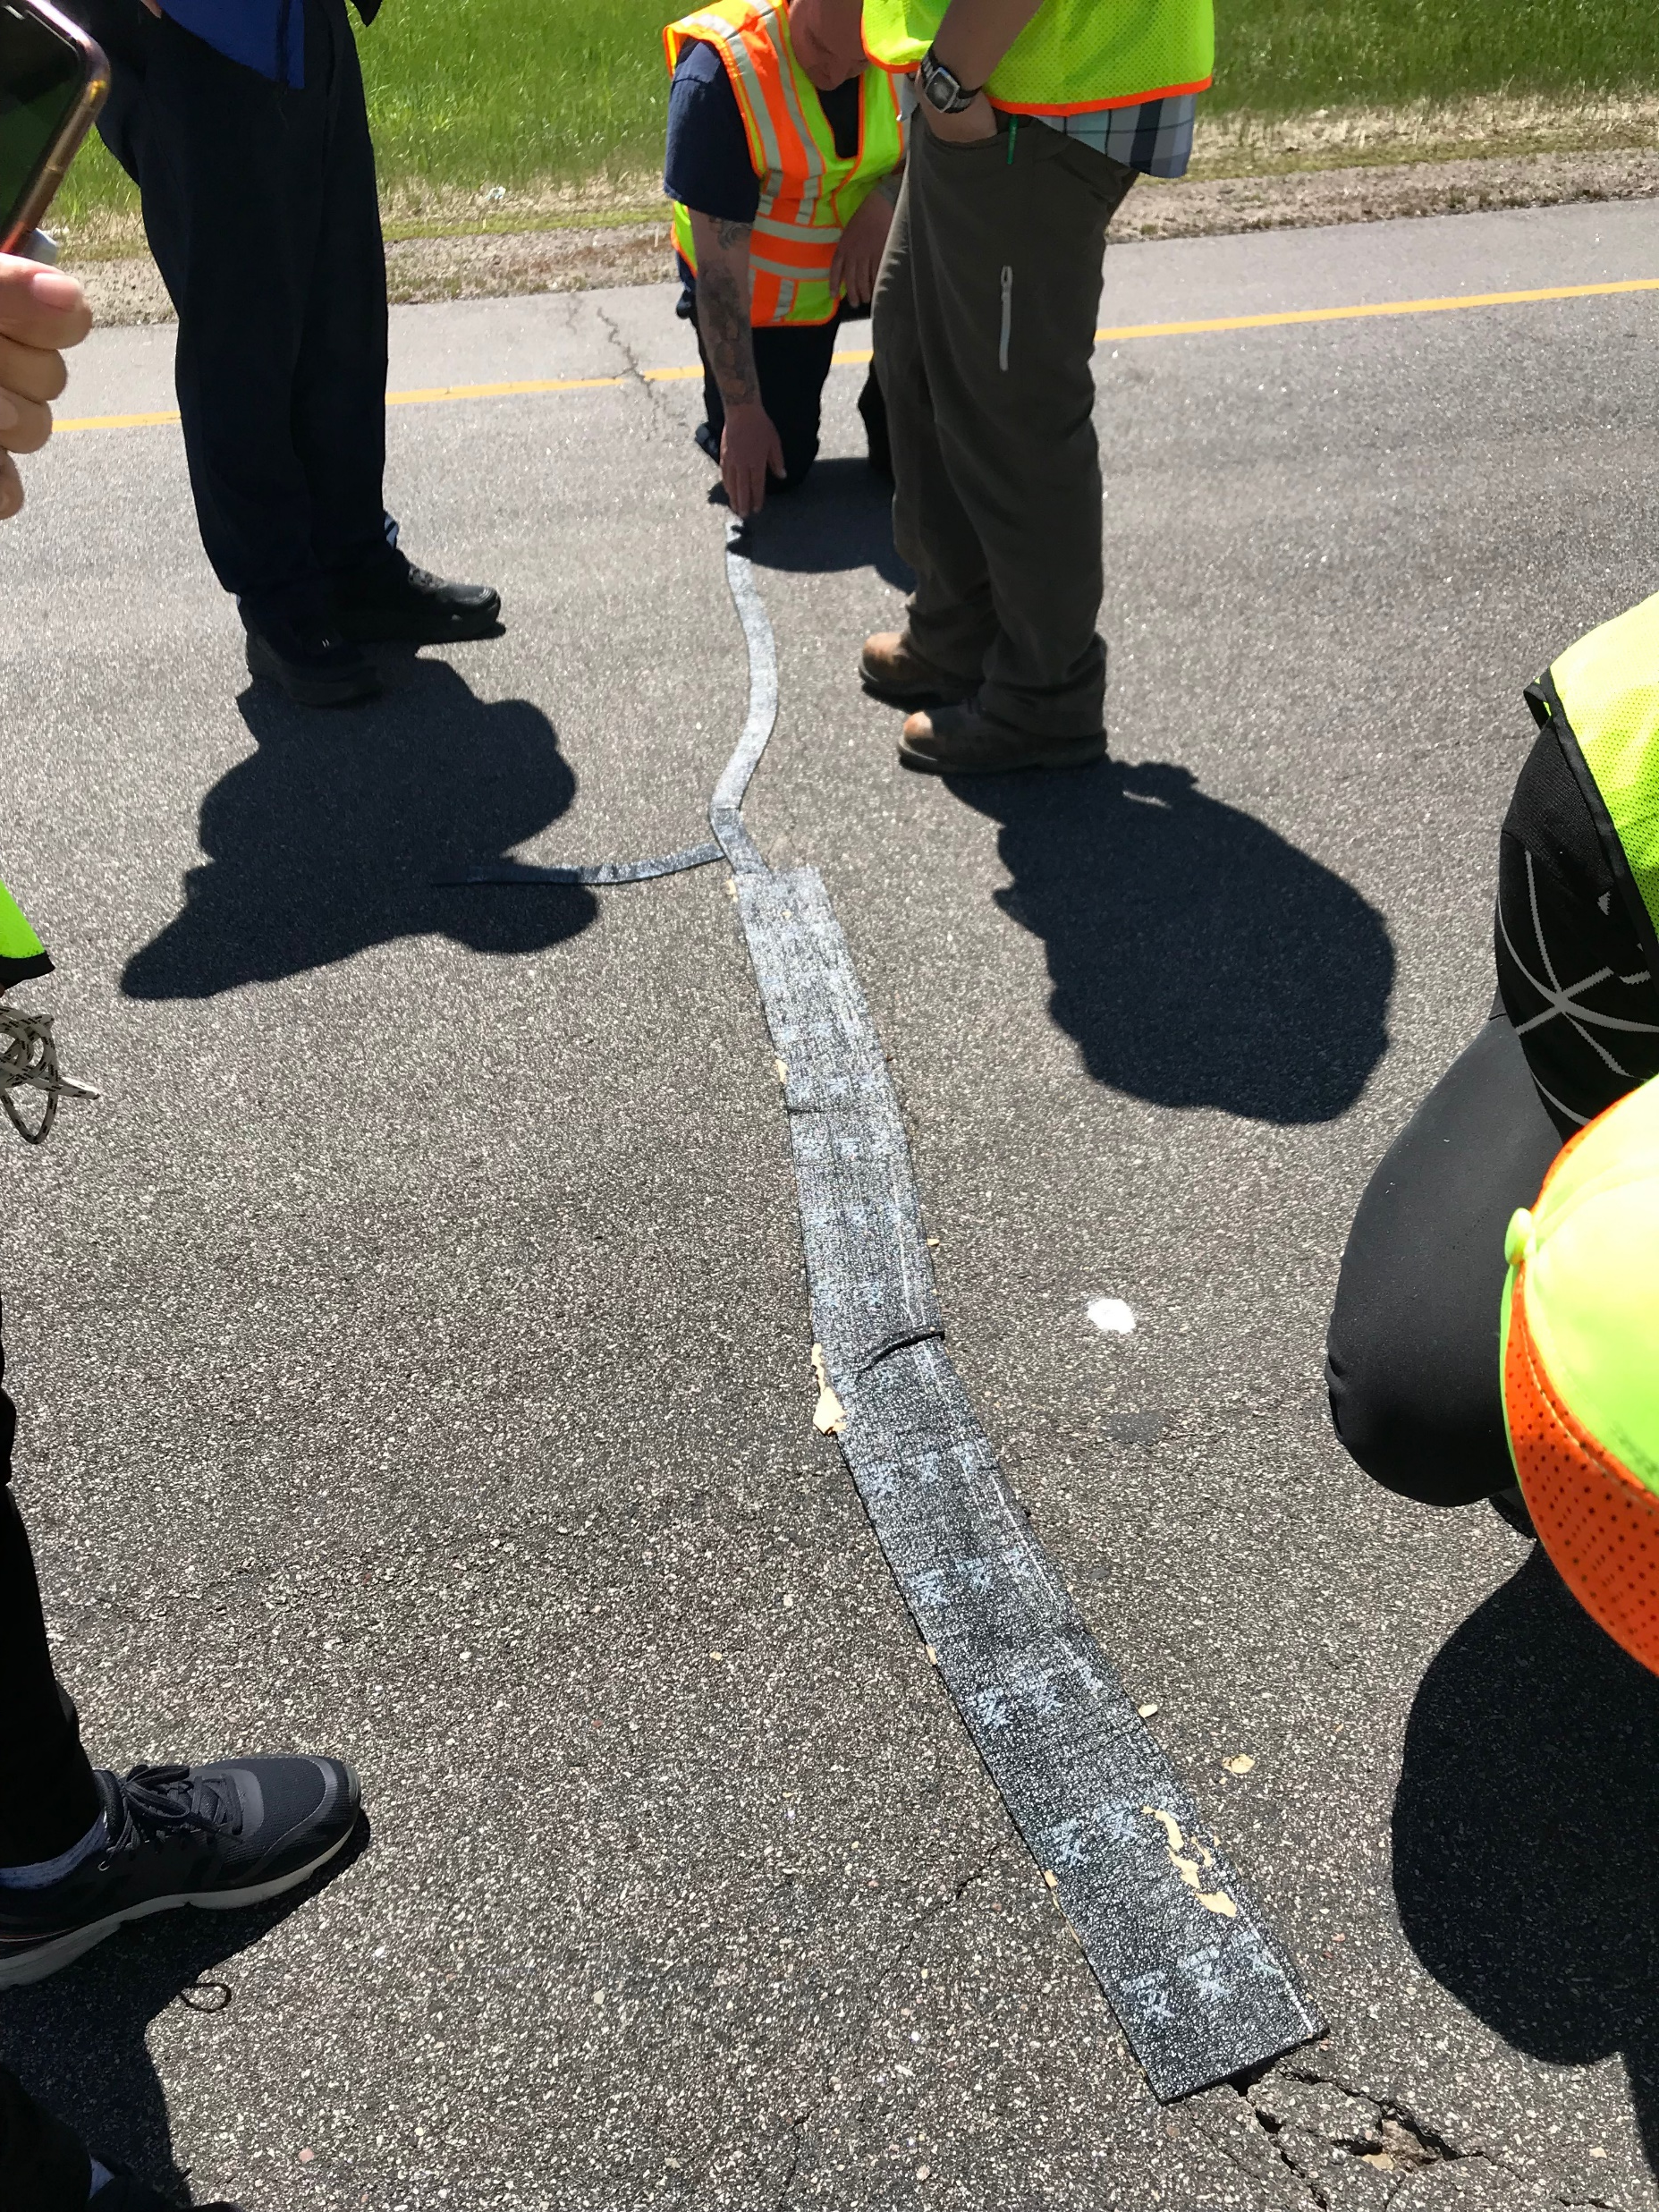

Slide 12
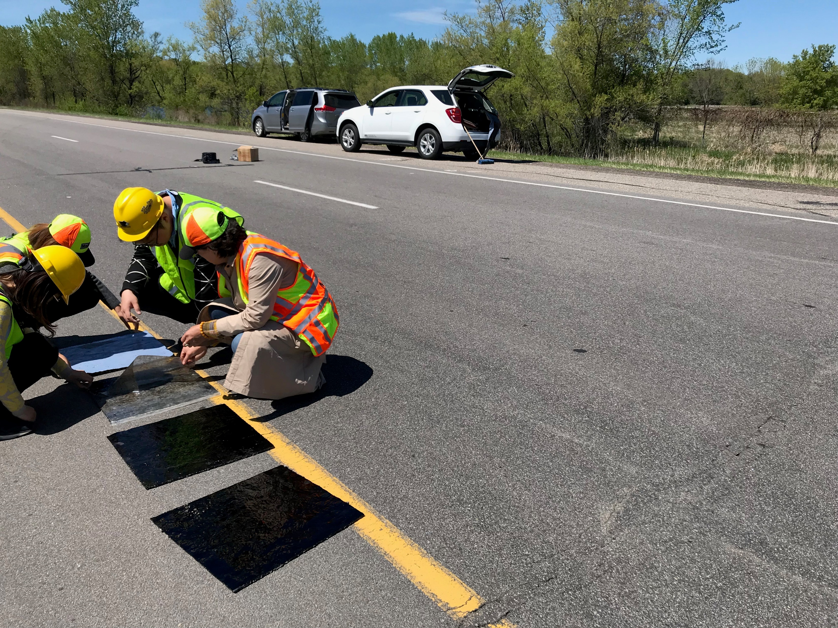
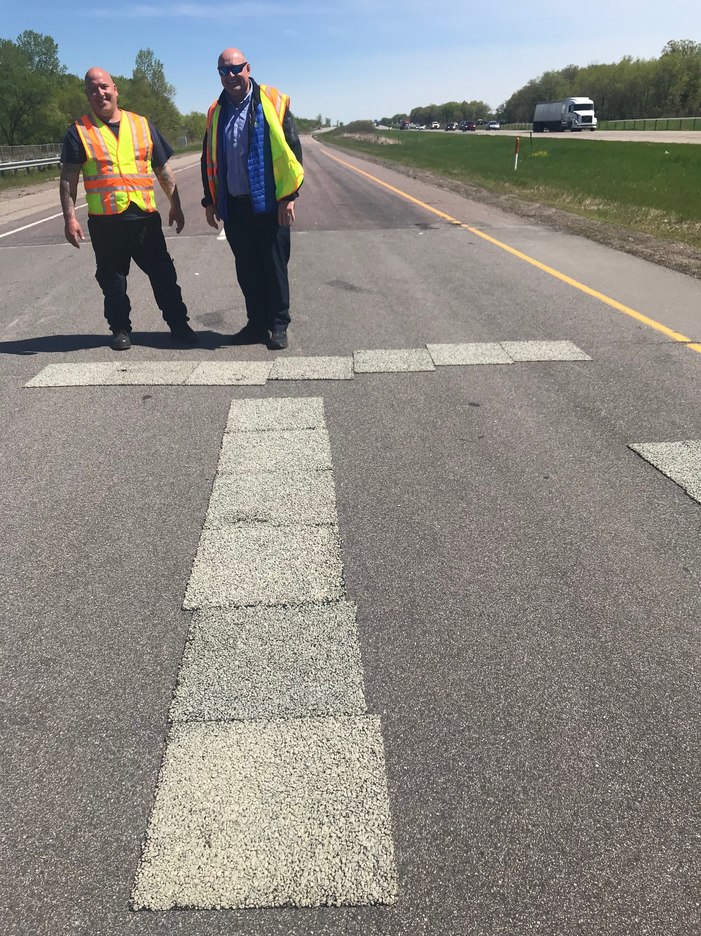

Slide 13
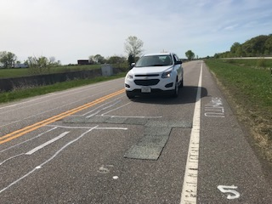

Slide 14
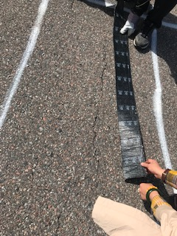

Slide 15
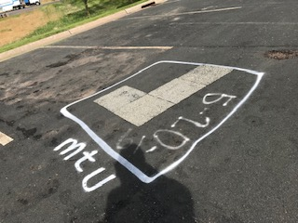

Slide 16
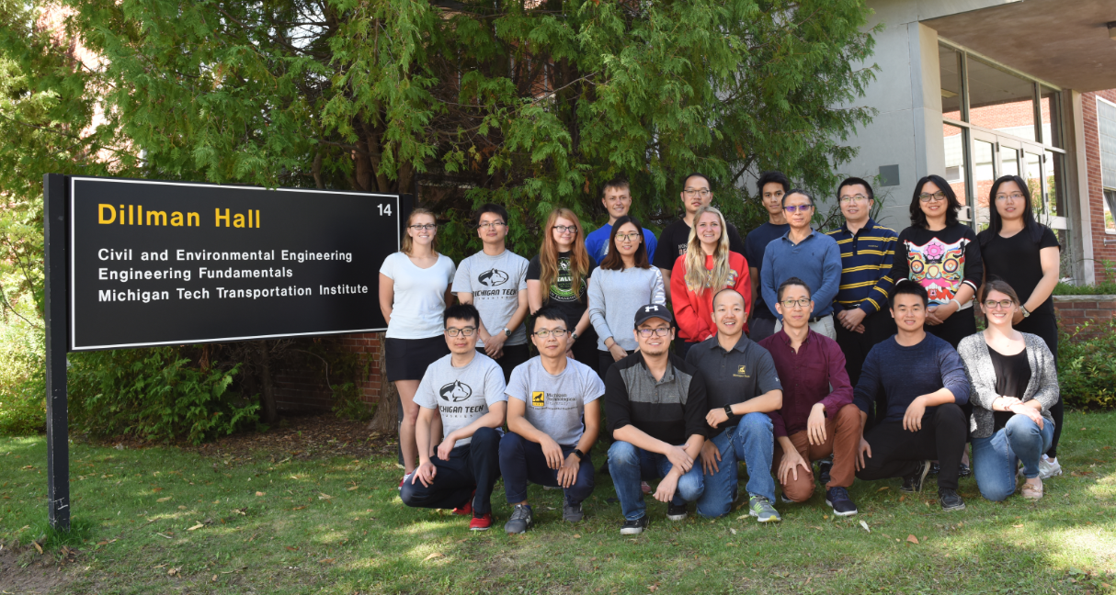
Thanks !

