Slide 1

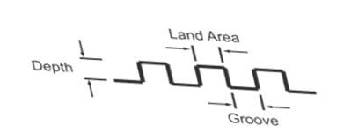
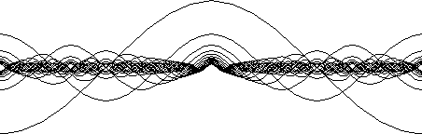
Environmental and Pavement Factors affecting Non-Pervious Concrete Pavement Acoustics
Bernard Igbafen Izevbekhai, P.E.
Bernard.izevbekhai@state.mn.us
90th Annual Transportation Research Board Conference Jan 26 2011

Slide 2
Acknowledgements
Dr. Lev Khazanovich, Civil Eng UMN
Prof. Vaughan Voller, Civil Eng UMN
(TLI UMN & CE UMN), Dr. Randall Barnes, Prof. Tom Maze (deceased), Prof. Carl Smith, Dr. Eugene Skok, Dr. Mihai Marasteanu
Prof Rajesh Rajamani. Dept of Mech Eng UMN
Mn/DOT Maureen Jensen, Keith Shannon, Karen Ehrismann.
Mn/DOT Erland Lukanen, Tim Nelson, Bruce Tanquist.
Others including
      Dr. Paul Donavan (Illingworth & Rodkin)
      Dr. Rob Rasmussen (Transtec)
      Prof. U. Sandberg (VTI Sweden).
      Prof Andy Seybert. (University of Kentucky)
      Dr. Steve Karamihas (UMTRI)

Slide 3

INTRODUCTION

Slide 4
MOTIVATION
Moratorium on Concrete pavements in 1999 Due to Noisy Transverse Tined Pavement.
Exorbitant Cost of Noise Walls $5-12 million/ mile 12ft high.
(http://www.fhwa.dot.gov/environment/noise/barrier/summary.htm )
International & Nationwide Quiet Pavement Initiatives, 2006 Quiet Pavement Forum. FHWA TPF 5-134. FHWA; TPF 5-135
Observed Major Research Needs (Developed many problem statements) on Pavement Surface Characteristics.
Opportunity for Research and Analysis:
    ISE TLI UMN
    CE UMN
    Mn/DOT MnROAD Facility
Pavement Sustainability: Most Concrete pavement rehabs are carried out for functional (not structural) reasons such as noise.

Slide 5
Justification For TPIN (Near Field) Measurements
Noise Sources are Aerodynamic Noise, Stack (Power Train) and
Tire Pavement Sources (Sandberg 2002, Hanson 2004)
Beyond the crossover speed, Tire Pavement noise becomes more important than the other sources (Rassmussen et al Little Book)
TPIN IS THE MOST IMPORTANT ROAD NOISE SOURCE
Rassmussen et al (Little Book)
Cross over Speeds (Hanson et al Minnesota Noise Study 2004)
Notes:
5

Slide 6
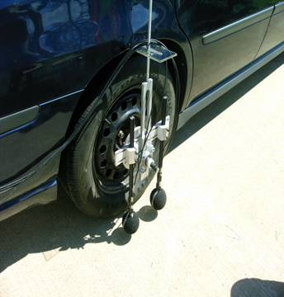
OBSI(?) used as Near Field Noise Metric
Communication Cables to Frequency Analyzer
Standard Reference Test Tire
Rig System
Leading microphones
Communication Cables to Frequency Analyzer
Interim Protocol adopted by AASHTO Sedan Outfitted with Dual Probe (TP 76-08) 2008.
On Board Sound Intensity
OBSI = 10 * log [10 ^{{SI} ₁ ^{/10}} + 10 {10 ^{{SI} ₂ ^{/10}} + +10 ^{{SI} ₁₂ ^{/10}} ]
Where SI_{i} (i=1, 2 , 3, …, 12) are sound intensities in dB at each the 3rd octave frequencies.
SI level= 10 * log₁₀ ∑ 10 ^{{SI} ₁ ^{/SI}_{o}} ) where L_{i =} SI in Watts/m² and L_{0 is} SI₀ at threshhold of human hearing = 10⁻¹² Watts/m²

Slide 7
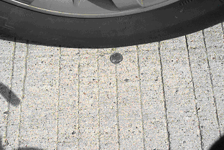
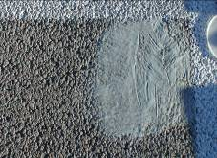
INTRODUCTIONS: TEXTURE CATEGORIZATION
1) ORIENTATION
A) Negative (Sharp Crevassed)
B)Positive / Spiky
2) DIRECTION
A) Longitudinal
B)Transverse
3) POROSITY
4) (AN)ISOTROPY
A) Porous; Isotropic
B) Non-Porous; Anisotropic
Texture Variables Interact With Tire: Determine which variables Influence OBSI
Notes:
THE FUNDAMENTAL PUZZLE Textrur

Slide 8
PHYSICAL CONCEPTS: LOGICAL IDENTIFICATION OF CAUSATIVE ASSOCIATIVE OR NEGATING VARIABLES AND THEIR SIGNIFICANCE
SOLUTION TO PROBLEM OF AN ELEMENTARY ACOUSTIC MEDIUM SUBJECTED TO A PULSATING SOURCE

Slide 9
PHYSICAL CONCEPTS: THE SOUND SOURCE
Undisturbed x-section area = S, length Δx volume SΔx)
Right end displacement
y₂= y(x +Δx,t)
Left end displacement = y(x,t)
ΔX
O
X
Change in volume of disturbed cylinder = S(y₂-y₁)

Slide 10
PHYSICAL CONCEPTS: ACOUSTIC SOURCE
A
Particle displacement versus position x at t=0
-A
Particles in Left Displacement
P max
Max Compression
Pressure fluctuation p versus position x at t=0
-Pmax
Max Rarefaction

Slide 11
PHYSICAL CONCEPT : RESPONSE OF AN ACOUSTIC MEDIUM
For adiabatic conditions, the motion of a pulsating air mass subjected to a reciprocating source under free field propagation is expressed as [Linsley et al (2001]:
Y(x, t) = A cos (kx- wt)
U(x, t) = -w sin (kx- wt)
And β = ρc²
where β is bulk modulus. For gases the bulk modulus is related to the density and the speed of sound as follows:
The pressure in the cylinder has the following form
P (x, t) = P (x, t) = -β

Slide 12

PHYSICAL CONCEPTS :Intrisic Factors
Sound Intensity is defined as follows:
SI = =
Where is one period of oscillation = 2π /w
SI = 0.5 kA² w = SI = 0.5ρc A² w²
This equation shows that SI comprises two major components:
  The Environmental (ρc) SI* = ρc
  Pavement Surface and Measurement Input (A² w²)
.
The Environmental (ρc) | Pavement Surface and Measurement Input (A² w²)
Air density | Texture Asperity Spacing,
Temperature | Texture direction
Atmospheric pressure | Measurement Speed
Relative Humidity | Texture orientation, Pavement smoothness
 | Resonant Phenomena

Slide 13
ENVIRONMENTAL COMPONENT : Temperature)
OBSI – TEMPERATURE PATTERN
(OBSERVE NEGATIVE CORRELATION)
Notes:
(

Slide 14
ENVIRONMENTAL COMPONENT : Temperature)
NEGATIVE CORRELATION: MIRRORED FUNCTION

Slide 15
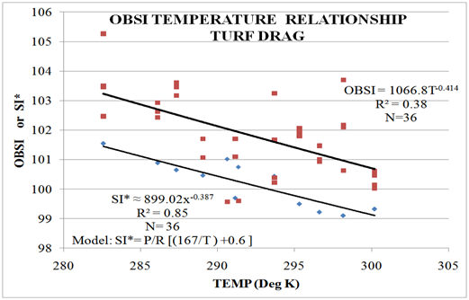
ENVIRONMENTAL COMPONENT: SI* Validation

Slide 16
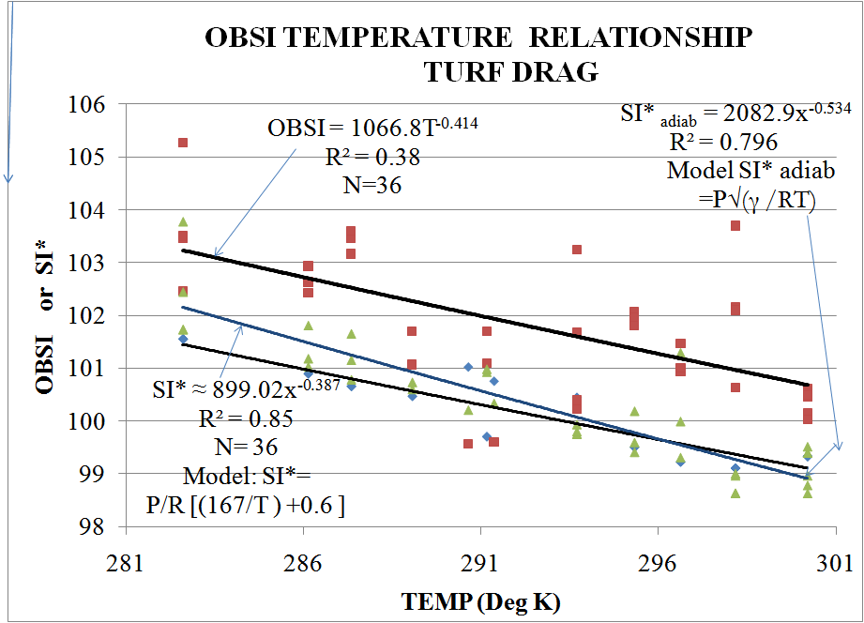
ENVIRONMENTAL : Is(o)entropicity /Adiabacy
Under Adiabatic conditions
Speed of sound c =
Where R = the universal gas constant= 287.058 (J/kg-K), T = the absolute temperature.
For air, the adiabatic constant γ = 1.4, c =
SI* _{adiabatic} or ρc ≈ P √ (γ/RT)
ADIABACY WAS VALIDATED IN THE SURFACE TYPES STUDIED

Slide 17
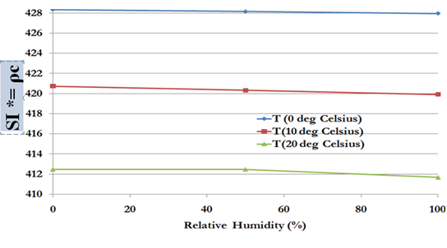
ENVIRONMENTAL : R.H. & ATM Pressure
Temperature and RH have some effect but RH effect is
relatively insignificant compared to temperature (Bohn 1988)
Atmospheric Pressure does not Vary Significantly enough to influence OBSI at a test site

Slide 18




SURFACE CHARACTERISTICS: Texture Orientation
(ISO 4287-1997)
Where r = ordinates of the asperity wrt reference surface
N = Number of measurements
Yi = Ordinate of asperity (or groove) Y= Expected Value of Y
s = Standard deviation N= number of measurements in the asperity
R is expected value in the ISO equation
Positive Texture Negative Texture
Rku>3 Kurtosis >0 Rku, Kurtosis < +ve Texture Value <0
Spiky asperities (Relatively Spiky Grooves)
Skewness>0 Skewness<0
Skewness /Kurtosis characterize the Probability function of the Amplitude or the ADF NOT THE TEXTURE CONFIGURATION!!!!!!!!

Slide 19
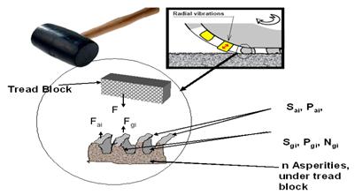
Surface Characteristics: Texture Orientation
Rasmussen et al 2007
ADF | IDG | Conventional | Turf/ Broom | TRAN. T
Kurtosis | -1.784 | -3.1265 | -1.596 | -0.5885
Skewness | -0.5829 | 0.1410 | 0.505 | -1.1713
Texture Orientation= (SGN Skewness) | Negative | Positive | Positive | Negative
Positive Texture~Higher Block Noise

Slide 20
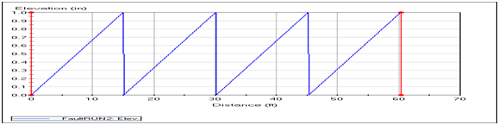

SURFACE CHARACTERISTICS: Pavement Smoothness
Y= FRAC X(L)/L
Where L is the panel length,
X is the distance from the joint to a point on the leave slab
Where Y is the Elevation of faulted panel at X- distance from the joint L is the panel length.
It can be shown that IRI of a series of 1 inch faulted panel was 629 inches/ mile and RN was 0.07. Consequently, for fraction n/N of the number of faulted slabs of a certain degree of faulting F,
IRI (Faulting Induced) =
Concatenations at joints are individual noise sources Logarithmically and not arithmetically summed

Slide 21

SURFACE CHARACTERISTICS:Pavement Roughness
ISO 4287- 87
Stoikomenov et al (2007)
Takahashi et al (1973)
It is evident that a change in IRI from 1 inch per mile to 2 inches per mile will result in a change of 4 dBA if m = 0.8 all things equal

Slide 22
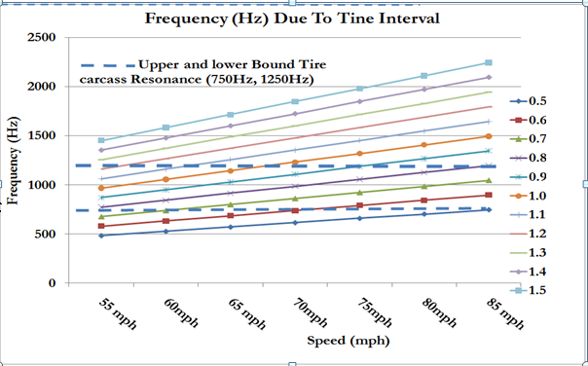
SURFACE CHARACTERISTICS:Texture Direction
Tread Block Impact is more in Transverse Textures (Lower frequency impact

Slide 23
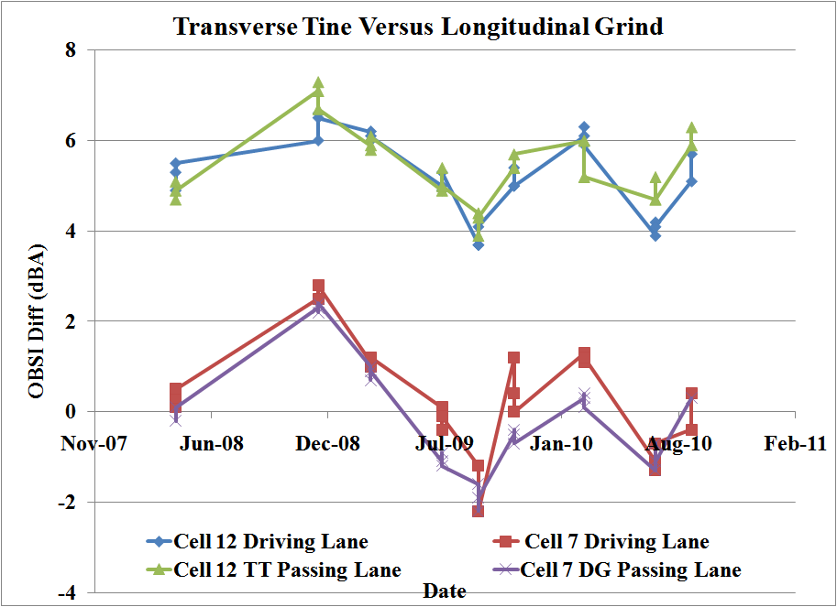
SURFACE CHARACTERISTICS: Texture Direction
The probability of the transverse tine being quieter than longitudinal of the same
geometric dimensions is computed to be 10E-47

Slide 24
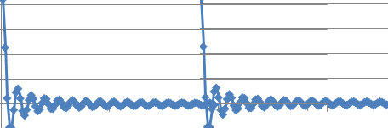
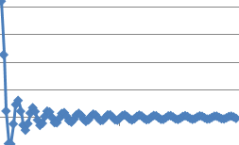
SURFACE CHARACTERISTICS: Texture Direction
Transverse Tine In Spatial and Time Domain
Sound Intensity
L
L
Transvere Tine (Spatial Domain) Time Domain
T= 2π/w = L/v
FOURIER TRANSFORM →→ SINC FUNCTION
The time domain transform of the box car configuration is the symmetric sync function. In principle the rectangular distribution in the spatial domain results in a pattern of frequencies in time domain where it rises from 0 to an infinite value in a discrete pattern of increasing frequency and subsequently from infinity to zero.
  Perceived as whine
  Amplified by resonance.
Notes:
Sound Intensity

Slide 25
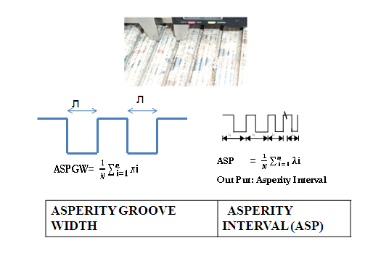
SURFACE CHARACTERISTICS:
Asperity Interval and Asperity Groove Width
Source strength ~ v_{(groove)}
Frequency ~ dv/v_{(groove)}
Notes:
Source strength ̃̃ V Resonant frequency ̃

Slide 26
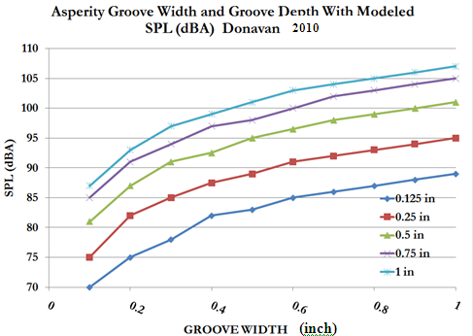
SURFACE CHARACTERISTICS: Asperity Interval

Slide 27


RESONANCE Phenom:
HelmHoltz Resonance
L
V
When a fliud enters the cavity through the neck, the fluid in the neck has a total effective mass (m), it can be shown that
S is Surface area, L is length of joint (bottle neck) V is volume of bottle (Joint deterioration / erosion , bevelling volume)

Slide 28
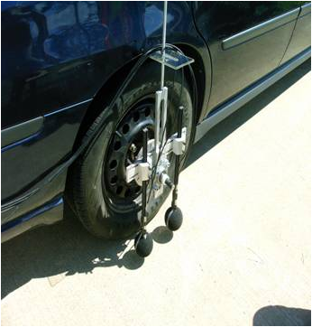
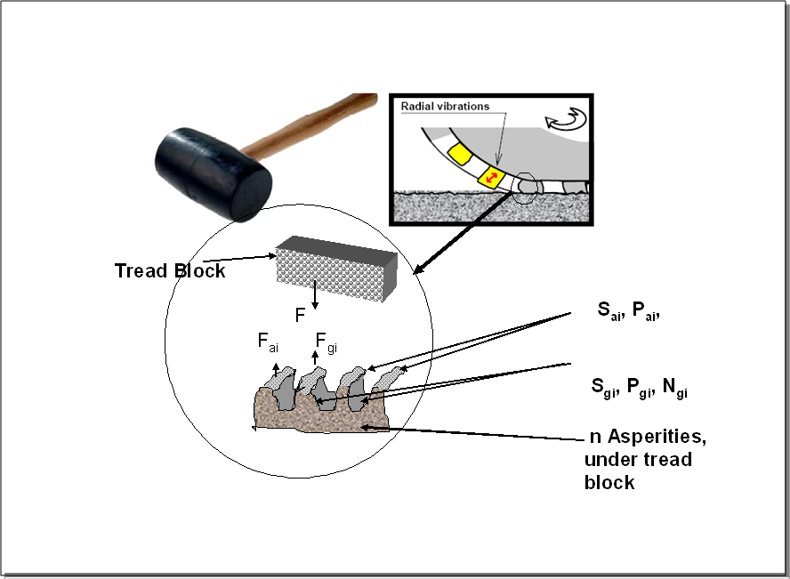
RESONANCE PHENOM: Helmholtz Resonance
HelmHoltz Phenom
Source Phenom: Monopole, Dipole Multipole
Treadblock Phenom
Helmholtz Resonance, Pipe Resonance Tire Carcass Resonance, Quartercar Gain Algorithm.

Slide 29
RESONANCE PHENOM: Helmholtz Resonance
Progression of Joint Deterioration Showing Dimensions of Acoustic Relevance
Consider an orifice of area s with a neck length L, fluid density is ρ and displacement of fluid in cavity is ξ. It can be shown that with spalling of the neck, effective neck length of tube is altered. As the joint deteriorates (assume wedge to be isosceles triangle of normal sides “a”, and volume V of cavity increases, the acoustic energy generated by a tire riding over the joint will increase.

Slide 30




RESONANCE PHENOM: Helmholtz Resonance
For very small areas neck radii or characteristic dimension (λ >> a) the radiation resistance in the cavity (Pierce 1994] [kinsler et al 2002] is given by
The acoustic radiation resistance of an unspalled joint will reduce with subsequent spalling.
The higher the volume of cavity of deterioration of an unspalled joint, the lower the natural frequency.
The more the joint spalling (L’ increases) the lower the natural frequency.
Notes:
For very small λ >> a the radiation resistance in the cavity [1] [3] is given by
The higher the volume of cavity of deterioration of an unspalled joint, the lower the natural frequency

Slide 31
PREDICTIVE MODEL: EXPLANATORY VARIABLES
IRI: International Roughness Index, m/km measured with a laser equipped
device and not filtered.
ASP: Asperity Interval is the mean interval between major asperities
on the pavement surface. In a ground texture, it is the sum of
the land width and the groove width. In a tined texture, the asperity
interval is the cell mean of the sum of a tine width and the
tine spacing.
RATIO : Ratio of groove width to asperity interval.
DIR: Direction of texture. Categorical variable in which 0 is assigned
to Longitudinal texture and 1 is assigned to transverse Texture
Longitudinal International Roughness Index, m/km measured with a
laser equipped and not filtered
MPD: Mean Profile Depth. (mm) In a ground texture, obtained from the
use of a circular track meter ASTM E-2157

Slide 32
PREDICTIVE MODEL: EXPLANATORY VARIABLES
OR: Texture Orientation. The texture is of positive orientation if the
riding surface is below the asperities. It is negative when the
riding surface is above the prominent features. This was subdivided into
OR1 and OR2 to account for neutral orientations. For positive, neutral and
negative orientations respectively OR1 was assigned {1, 0 and 1}
respectively and OR2 was assigned {1, 1 and 0}respectively.
SR Surface Rating. A measurement ranging from 0 to 4 to indicate the
degree of surface distress, 4 being the best performing pavement and 0
being the worst condition. Terminal or trigger SR is typically 2.
TEMP Air temperature at the time of OBSI testing (⁰ C) . This scale was
chosen lieu of the absolute scale for ease of comparison of OBSI temp
gradient to research results where these were used.

Slide 33
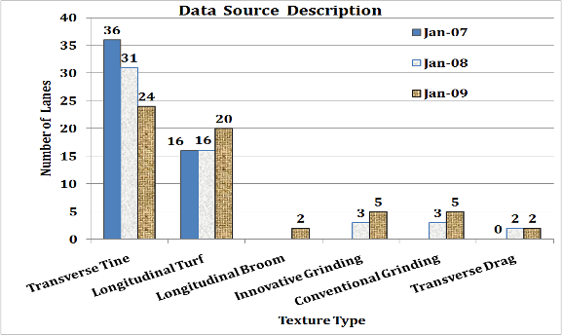
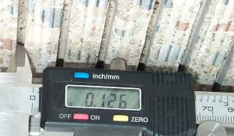
PREDICTIVE MODEL FOR NON POROUS PAVEMENT ACOUSTICS
EXPLANATORY VARIABLES
OBSI
ASP : ASP = 1/N ∑ λi
i=1
OR1: Categorical (Orientation)
OR2: Categorical (Orientation)
ASPGW : Asperity Groove Width
Dir: Categorical Texture Dir (Long=0),
IRI: ASTM E-950
Ratio: Mean ASPGW/ASP
MPD: ASTM E-2157
Temp (deg K): Air Temperature
TESTING
ASTM E-2157
ASTM E-950
AASHTO TP 76-09
ASPERITY (ASP)mm

Slide 34
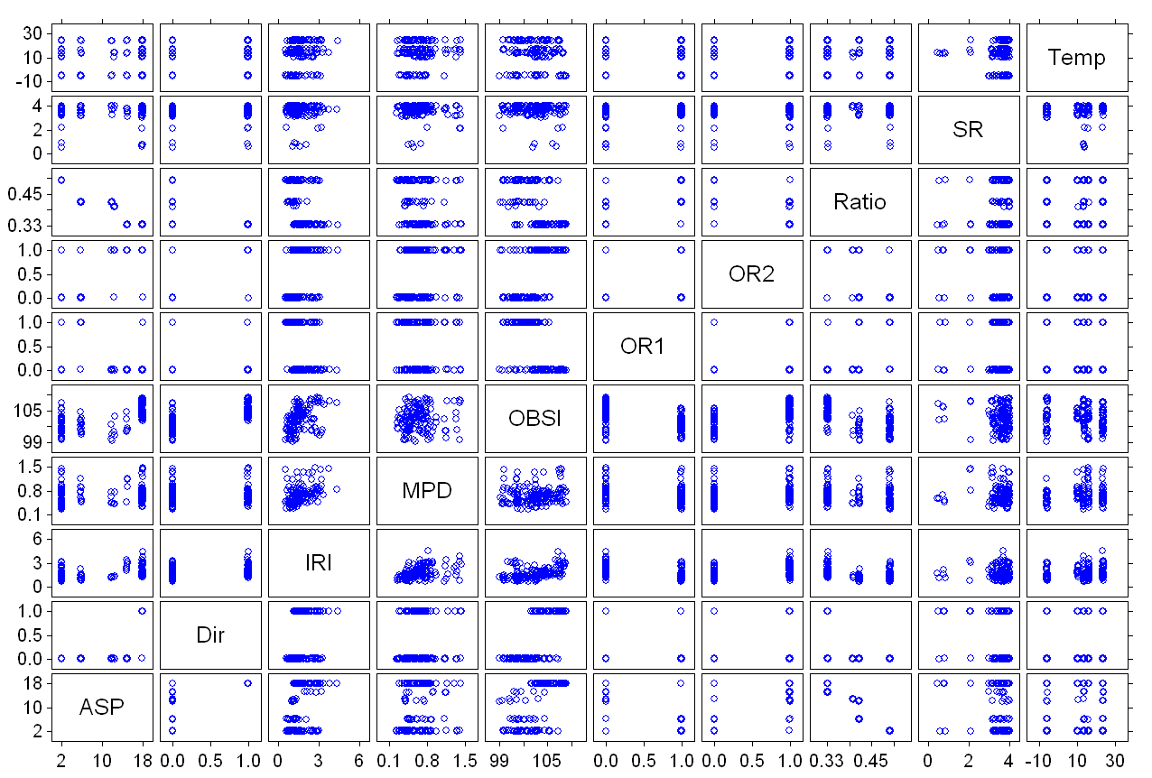
PREDICTIVE MODEL :SCATTERPLOT

Slide 35
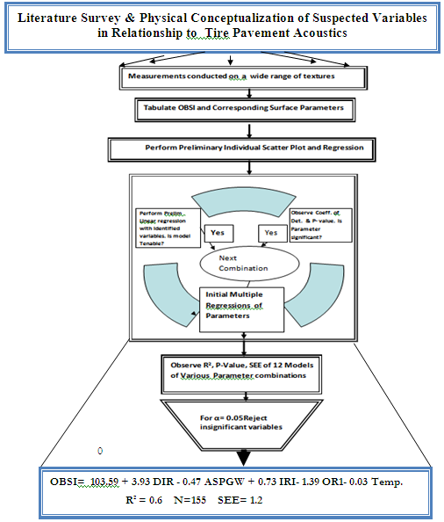
Model Development Process

Slide 36
Model Correlations and Power
n = f (α ,β). 2σ² / δ²).
Needed to detect= 0.5dBA
If α=0.05 and 80% degree of certainty correlation
(α = 0.2 ,β= 0.05), f (α ,β)= 13. Combinations needed of OBSI Versus IRI, TEMP, ASP/ ASPGW, OR1, 140.
Else Power (N=155)=83%

Slide 37
Model
OBSI = 103.59 + 3.93 DIR - 0.47 ASPGW + 0.73 IRI- 1.39 OR1- 0.03 Temp.
R² = 0.6 N=155 SEE= 1.2
P-value << 0.05 in each significant variable.
TEMPERATURE NORMALIZATION
OBSI ₍₂₉₃₎ = OBSI _{(T)} (T/293)^{M}
  M= 0.387 for turf drag
  M= 0.306 for Innovative diamond grind
  M = 0.300 for conventional grind
  M= 0.54 for transverse tine

Slide 38
CONCLUSION
This research identified associative initial variables from physical concepts of the response of a element in the acoustic medium.
Prior to this research Mean Texture Depth (and by implication, Mean Profile Depth was thought to be an important variable in the prediction of OBSI TPIN). This research has proven, (contrary to conventional wisdom and widely held opinions) that MPD has no significant correlation to OBSI.
Texture Direction was found to be the most influential parameter. It was analyzed as a categorical variable in the model developed. In the model developed, a sensitivity analysis indicated that the transverse tined concrete pavements were averagely noisier than non-transverse concrete pavements by 4-dBA.
Prior to this research work, there was neither a definition of asperity interval nor an understanding of its importance in tire pavement interaction noise. In the context of tire pavement interaction texture asperity interval was found to be influential to OBSI.

Slide 39
CONCLUSION
Prior to this research, there was no OBSI predictive model that included IRI although there was conventional wisdom among practitioners that the roughness effects cannot be ignored. These have been demonstrated
Prior to this research work there was no omni-bus sound intensity surface characteristic models composed of explanatory variables that belong to the pavement surface parameters, pavement ride comfort and climatic factors. This research work has provided this omnibus model with influential variables (of p-value<< 0.05) with a coefficient of determination of 0.6
A temperature correction algorithm was proposed and validated
Continuing studies will improve the coefficient of determination possibly by frequency fragmentation

Slide 40
I THANK THEE

