Slide 1
Early Performance of Concrete Pavement Overlays in Minnesota
15th Annual TERRA Pavement Conference
February 10, 2011
Tom Burnham, P.E.
Minnesota Department of Transportation
Office of Materials and Road Research

Slide 2
PCC OVERLAYS
  Becoming more popular in Minnesota
    Why????
      More competitive on first cost basis
      Federal stimulus money
      Mn/DOT Innovation funding
    Good performance
    Standard (thick) unbonded concrete overlays have performed very well
    What’s new
      How thin can we go?

Slide 3
PCC OVERLAYS
Unbonded
  Used over distressed PCC pavements requiring additional structural capacity
  Thickness
    “Standard” or most common > 7.5”
    “Thin” < 7”
  Interlayer
    To prevent reflective cracking and provide “cushioning” between rigid layers
      PASSRC (Permeable Asphalt Stabilized Stress Relief Course)
      Dense graded HMA (new)
      Milled HMA (existing composite pavement)
      Fabric (new to Minnesota)

Slide 4
PCC OVERLAYS
Bonded
  Used over distressed HMA pavements (aka whitetopping)
  Thickness
    “Standard” = 6” or more (bond not critical)
    “Thin” = 4” to 6” (temporary bond beneficial)
    “Ultra-thin” = 4” or less (bond is critical)
  HMA prep
    Milling (inlays)
    Pre-overlay repairs for true “overlays”

Slide 5
Early PCC Overlay Performance in Minnesota
Unbonded Overlays
  MnROAD Cells 105-405
  TH53 Twig
  TH 212 Renville to Danube

Slide 6
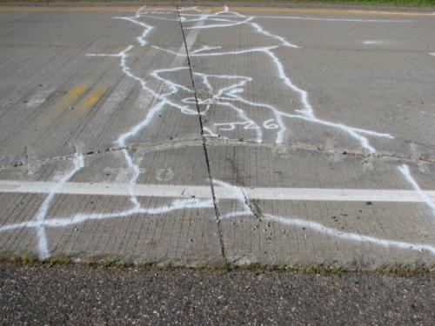
MnROAD Cells 105-405, Thin UBOL
Design Details:
  Thickness = 4” and 5”
  Panel size = 15’L x 14’/13’ (driving/passing)
  PASSRC interlayer
  Unsealed joints
  I-94 traffic
  14 year joints vs broken joints

Slide 7
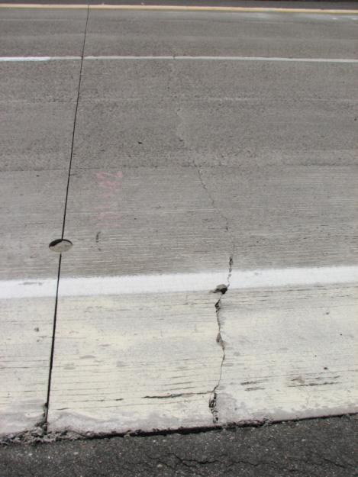
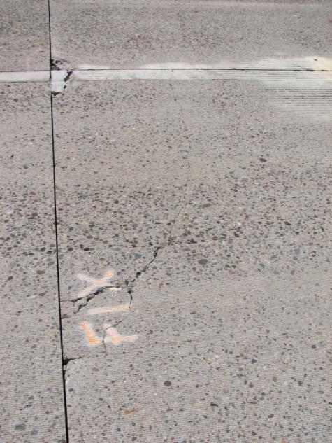
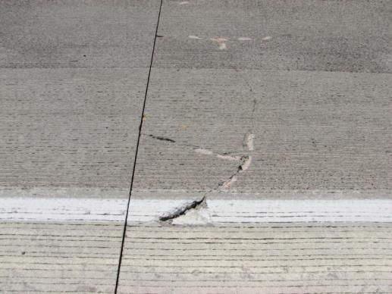
MnROAD Cells 105-205, Thin UBOL
Early Performance = poor
  More than 80% of 4” thick panels cracked within 2 years
  Cause: Excessive curling of thin slabs
  Distress from impact loads
  To be replaced in 2011 with 5”, 6’L x 6’/7.5’W panels over fabric interlayer

Slide 8
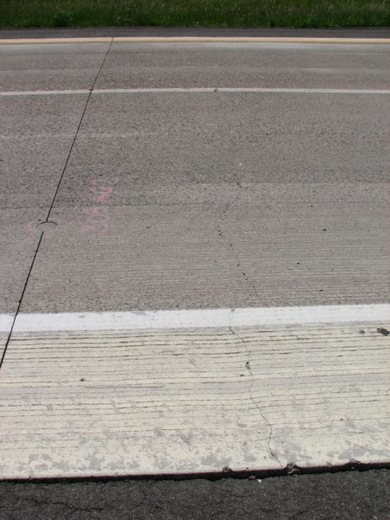
MnROAD Cells 305-405, Thin UBOL
Early Performance = fair
  40% of 5” thick panels cracked within 2 years
  Less cracked panels over non-broken joints

Slide 9
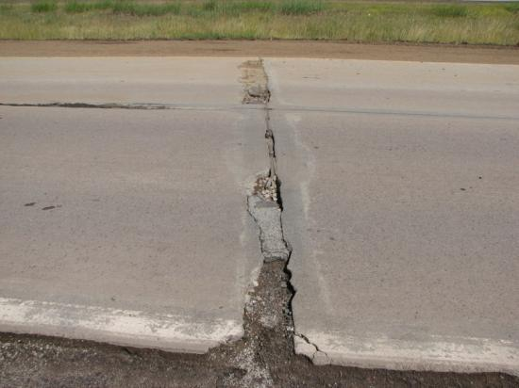
TH 53 Twig, Thin UBOL
Design Details:
  Southbound lanes constructed 2008, N.B. 2009
  Thickness = 5”
  Panel size = 12’L x 12W’ (also section with 6’x6’)
  Dense graded HMA interlayer
  Unsealed joints
  Some panels reinforced
  Heavy truck traffic
  36 year existing “joints”

Slide 10
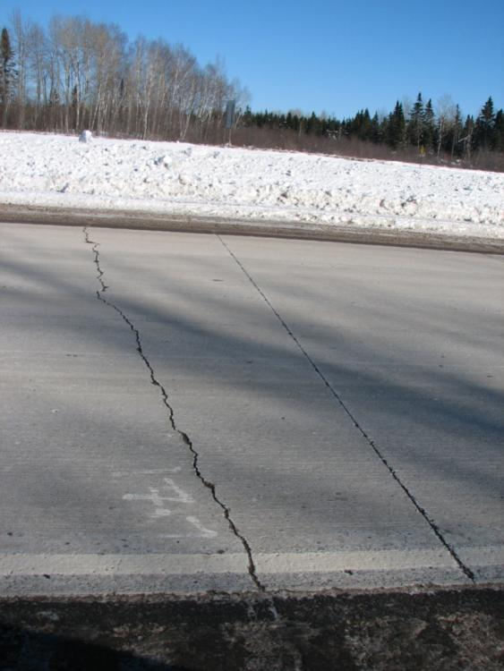
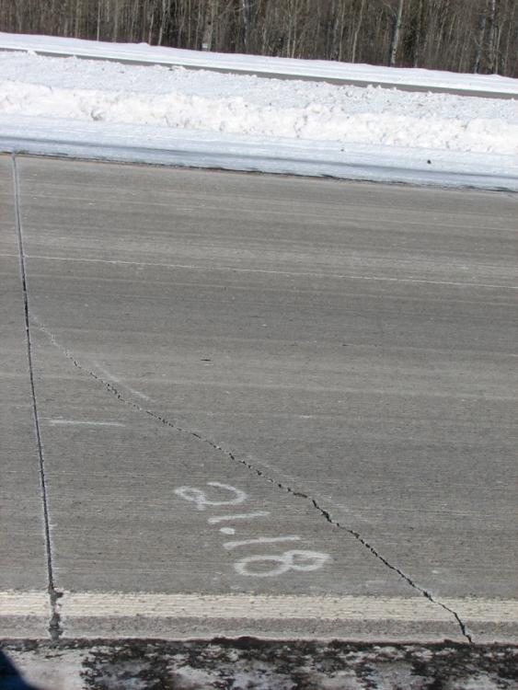
TH 53 Twig Southbound, Thin UBOL
Early Performance = fair
  Numerous transverse cracks within 6 months
  Corner and longitudinal cracks now progressing

Slide 11
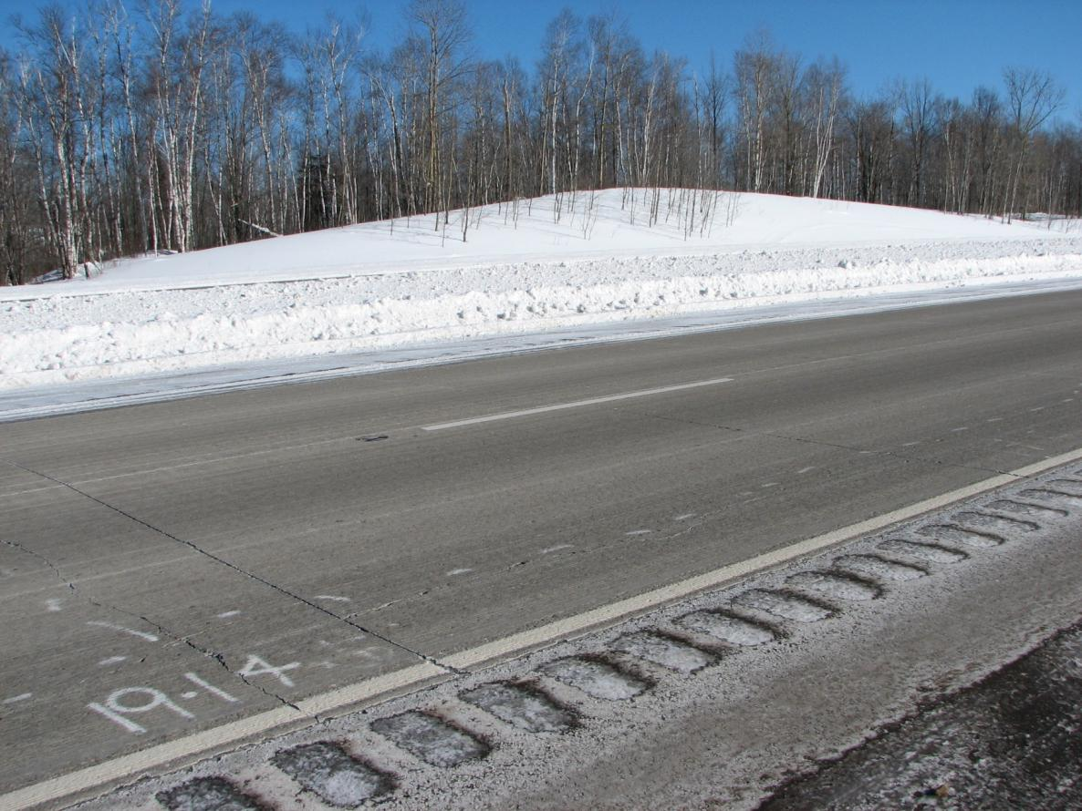
TH 53 Twig Southbound, Thin UBOL

Slide 12
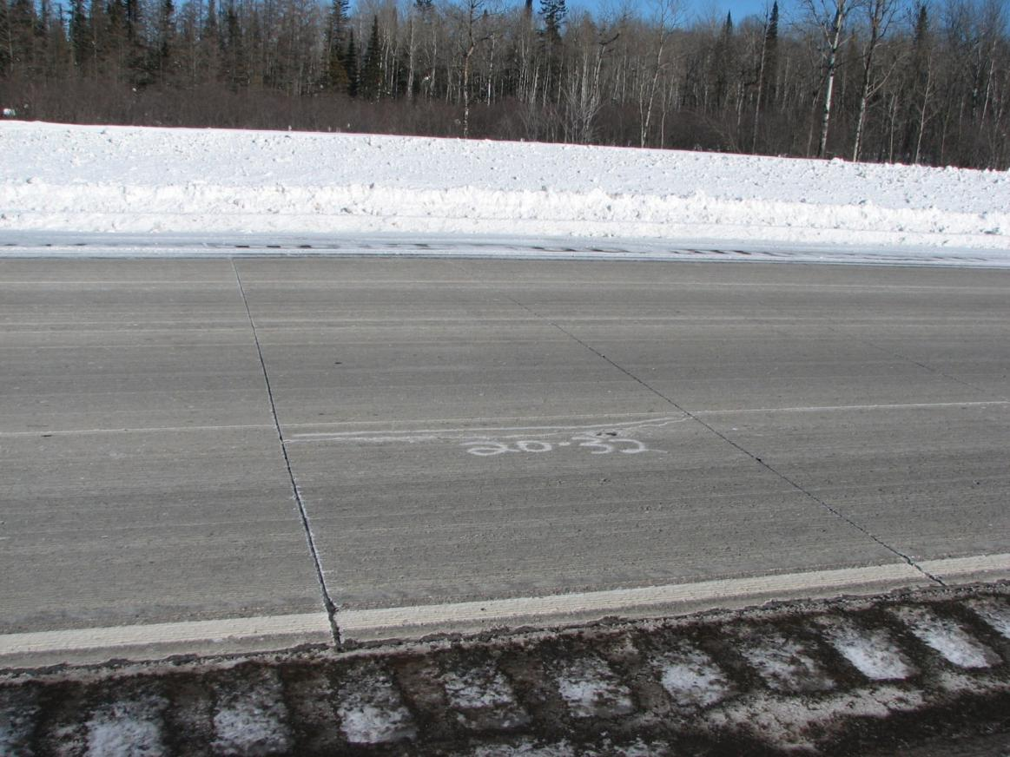
TH 53 Twig Southbound, Thin UBOL
Crack in 6’ x 6’ panel

Slide 13
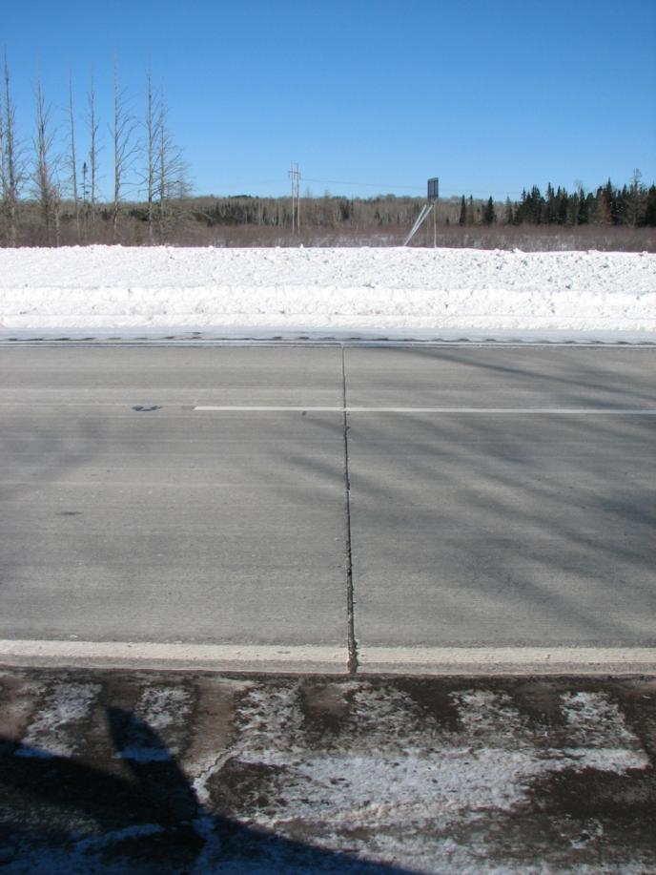
TH 53 Twig Southbound, Thin UBOL
Wide joints – Would hot-pour sealant be effective?

Slide 14
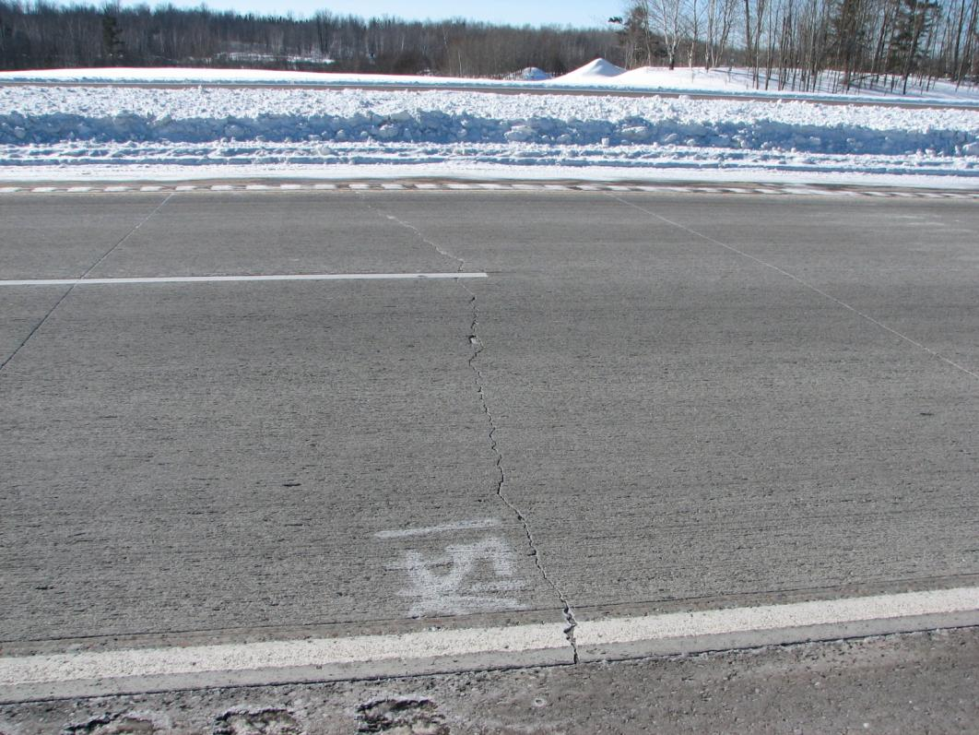
TH 53 Twig Northbound, Thin UBOL
Early Performance = good
  Some transverse cracks

Slide 15
TH 212 Renville to Danube, UBOL
Design Details:
  Constructed 2009
  Thickness = 8” (Standard)
  Panel size = 15’L
  Milled existing HMA interlayer
  11 dowels/joint
Early Performance = Very good

Slide 16
Early PCC Overlay Performance in Minnesota
Bonded Overlays (whitetopping)
  MnROAD Cells 114-914
  I-35 North Branch
  CSAH 9 Harris
  CSAH 7 Hutchinson
  TH 23 Marshall
  CSAH 46 Albert Lea
  TH56 West Concord

Slide 17
MnROAD Cells 114-514, Thin Whitetopping
Design Details:
  Thickness = 6”
  6’L x 6’W panels
  Remaining HMA (5-6.5”)
  Doweled (2’ c. to c. spacing) vs undoweled
  Unsealed joints
  I-94 traffic
Study Objective:
Effect of remaining HMA thickness

Slide 18
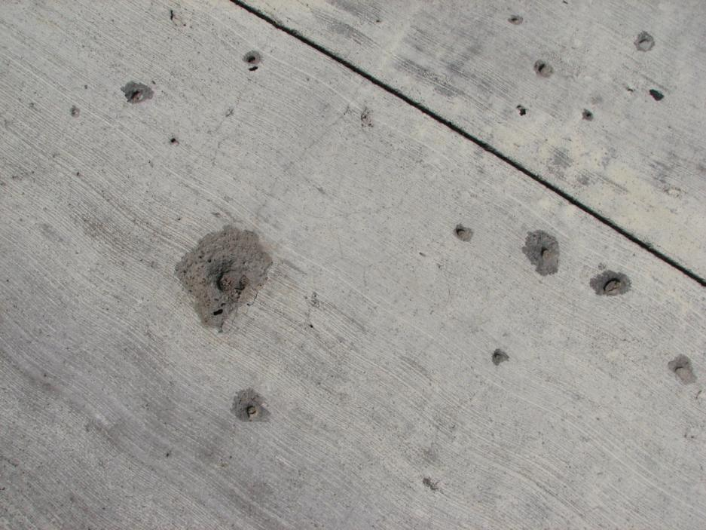
MnROAD Cells 114-514, Thin Whitetopping
Early Performance = Good
  A few panels cracked, Cells 114 and 314
  Insufficient remaining HMA thickness (5”) or bad material?

Slide 19
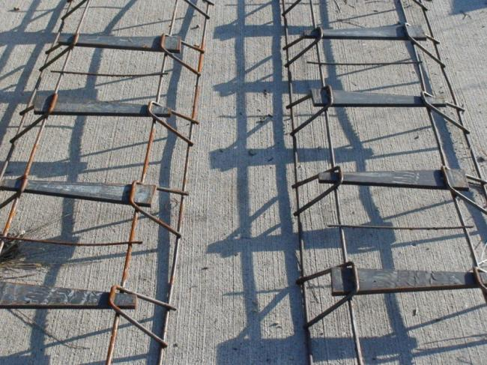
MnROAD Cell 614, Thin Whitetopping
Design Details:
  Thickness = 6”
  12’L x 6’W panels
  Remaining HMA thickness = 7”
  Flat dowels (1’ c. to c. spacing)
  Unsealed joints
  I-94 traffic

Slide 20
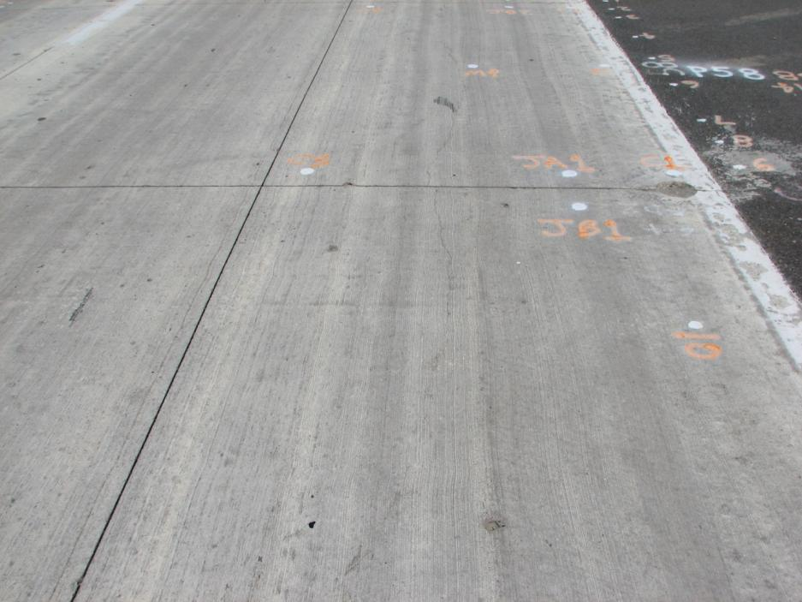
MnROAD Cell 614, Thin Whitetopping
Early Performance = Good
  One longitudinal crack
  Cause: Refill of core hole?

Slide 21
MnROAD Cells 714-914, Thin Whitetopping
Design Details:
  Thickness = 6”
  6’L x 6’W panels
  Remaining HMA thickness = 8”
  Doweled (2’ c. to c. spacing) vs undoweled
  Unsealed joints
  I-94 traffic
Study Objective:
Effect of remaining HMA thickness

Slide 22
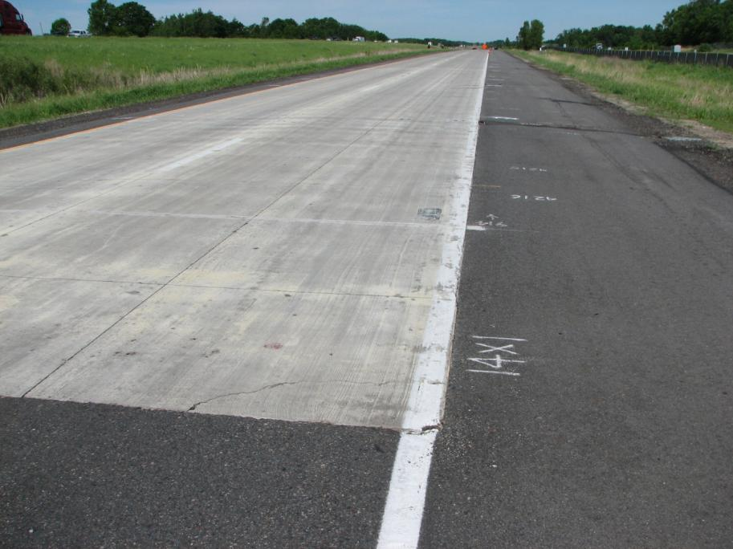
MnROAD Cells 714-914, Thin Whitetopping
Early Performance = Very Good
  No distresses (other than popouts)
  Sufficient remaining HMA thickness = 8”?

Slide 23
I-35 North Branch, Thin Whitetopping
Design Details:
  Constructed 2009
  7.1 miles
  Thickness = 6”
  Milled HMA (4” inlay)
  Remaining HMA = 8”
  6’L x 6’W panels
  Undoweled
  Ties between panels and lanes
  Sealed joints
  I-35 traffic

Slide 24
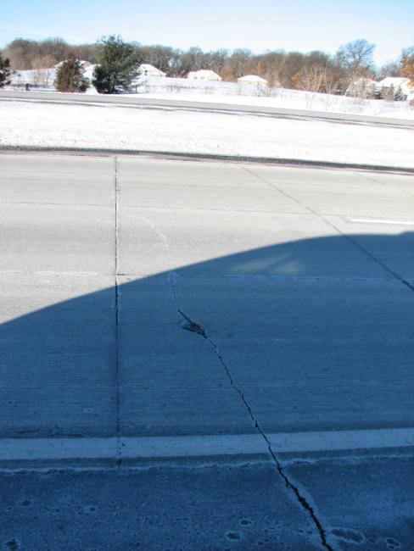
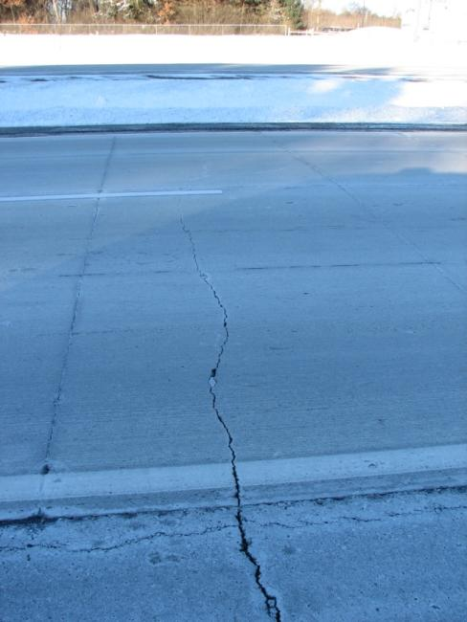
I-35 North Branch, Thin Whitetopping
Early Performance: Good
  Multiple transverse cracks with first 6 months
  Cause: Reflective cracking from underlying bonded HMA
  Feb 2011: Little change in distresses

Slide 25
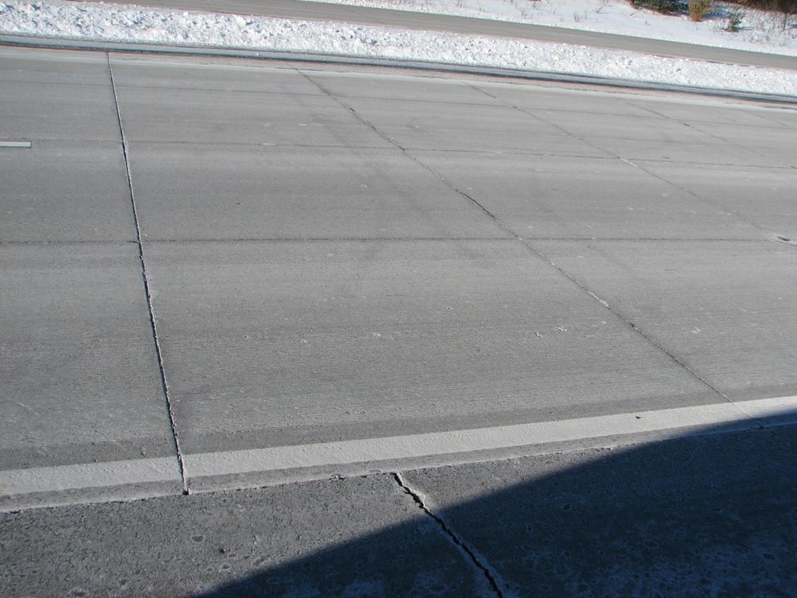
I-35 North Branch, Thin Whitetopping
Cracks in shoulder do not always reflect

Slide 26
CSAH 9 Harris, Whitetopping
Design Details:
  Constructed 2010
  1.1 mile
  Thickness = 7”
  Milled HMA (7” inlay)
  15’L x 12/14’W panels
  3 dowels in OWP only
  Sealed joints
  Heavy local truck traffic

Slide 27
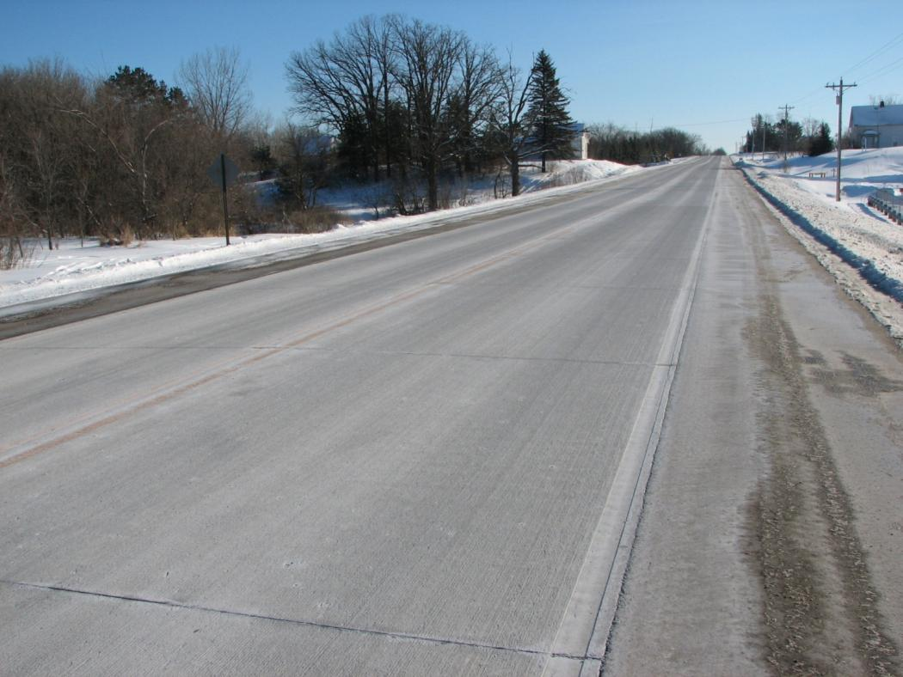
CSAH 9 Harris, Whitetopping
Early Performance = Very good
  - No visible cracks

Slide 28
CSAH 7 Hutchinson, Thin Whitetopping
Design Details:
  Constructed 2009
  2.5 miles
  Thickness = 5”
  Average milling depth = 3.6”
  Remaining HMA = 8” (var.)
  6’L x 6’W panels
  Undoweled
  Unsealed joints
  Local traffic (ADT=2200)

Slide 29
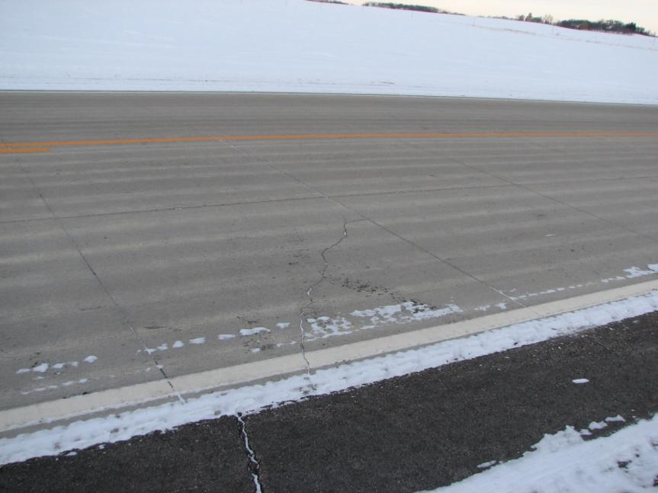
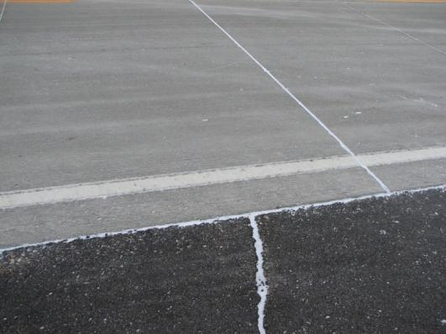
CSAH 7 Hutchinson, Thin Whitetopping
Early Performance: Good
  One reflective crack near driveway
No reflective cracking into inlay
Reflective cracking into PCC from HMA driveway entrance?

Slide 30
TH23 Marshall, Whitetopping
Design Details:
  Constructed 2009/2010
  8.3 miles
  Thickness = 7.5”/8.5”
  Average milling depth = 3”
  15’L x 13/14’W panels
  11 dowels across joints
  Sealed joints
  Heavy truck traffic
Early Performance = Very good?
(Could not safely evaluate due to weather conditions)

Slide 31
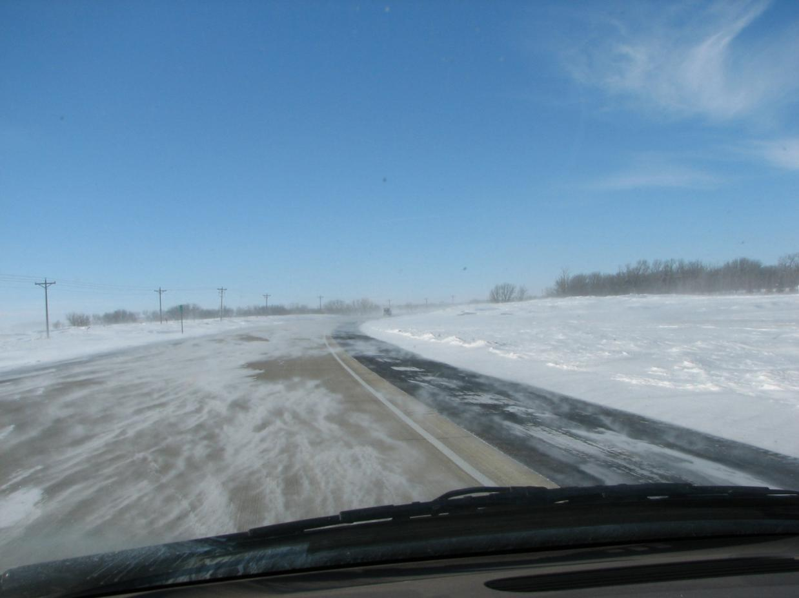
TH23 Marshall, Whitetopping

Slide 32
CSAH 46 Alden to Albert Lea, Thin Whitetopping
Design Details:
  Constructed 2009
  Thickness = 6”
  Milled HMA (2”)
  15’L x 13.5’W panels
  3 dowels in OWP only
  Unsealed joints(?)
  Traffic?

Slide 33
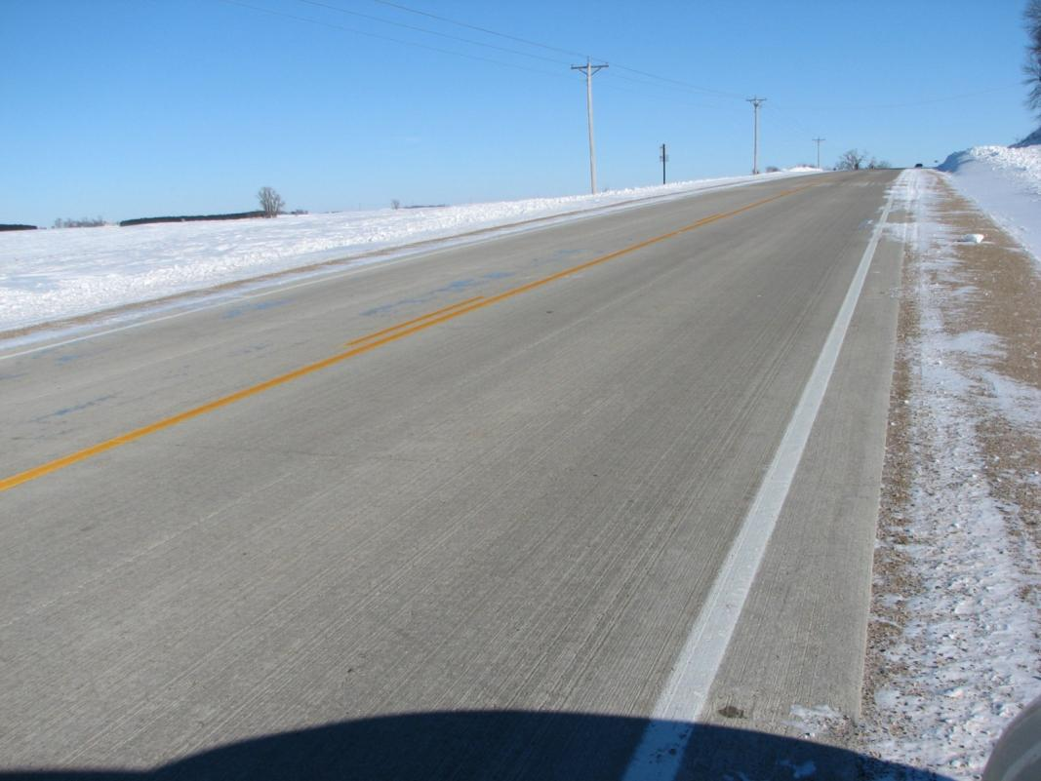
CSAH 46 Albert Lea, Thin Whitetopping
Early Performance: Very Good
  No visible distresses

Slide 34
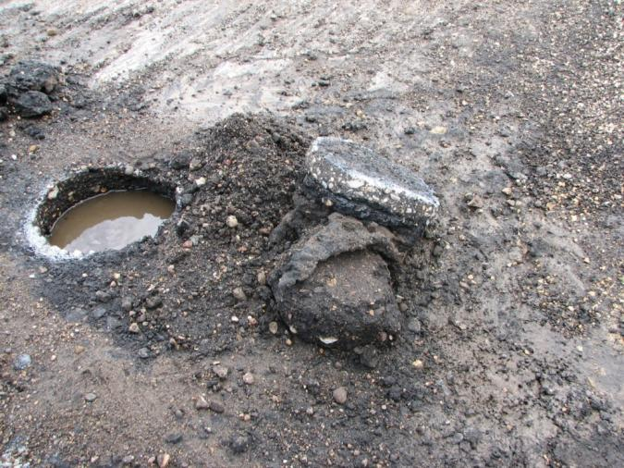
TH 56 West Concord, Thin Whitetopping
Design Details:
  Constructed 2010
  6.2 miles
  Thickness = 6”
  Milled HMA (2”)
  Remaining HMA = 8.5” (very poor condition)
  15’L x 13.5’W panels
  11 Dowels
  Sealed joints
  Heavy truck traffic

Slide 35
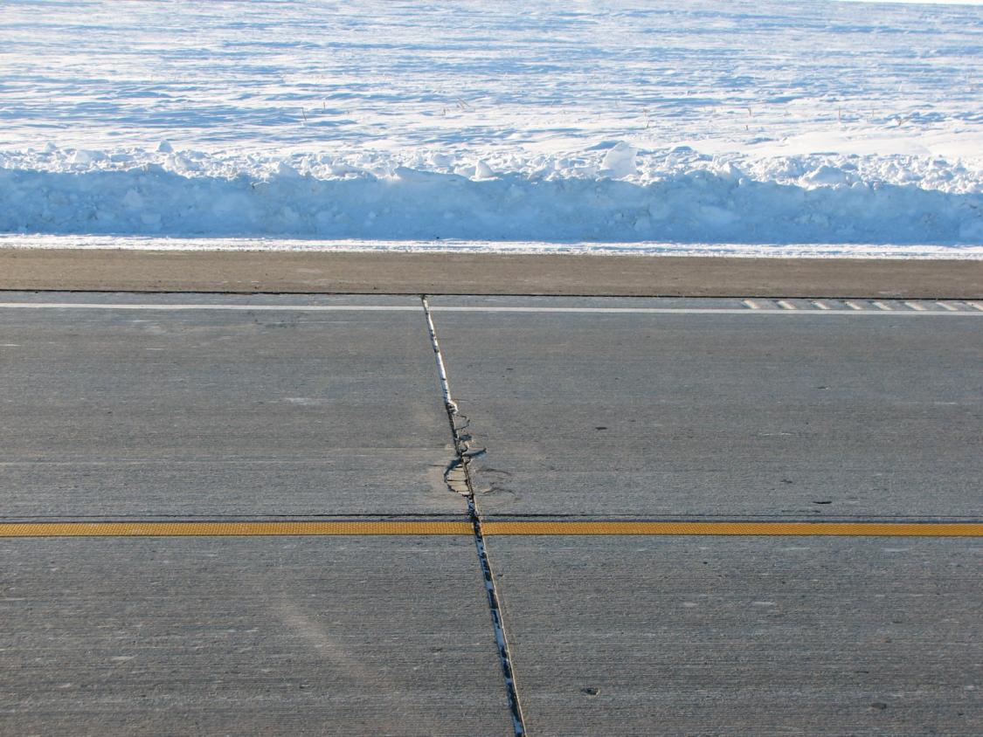
TH 56 West Concord, Thin Whitetopping
Early Performance: Very Good
  Some construction issues at joints

Slide 36
Summary
UBOLs
  Good performance on standard “thick” UBOLs
  More frequent occurrence of distresses in thin UBOLs
  Definite limits on acceptable panel size
Whitetoppings
  Mixed application of large and small panel sizes
  Overall good performance for thin sections
  Demonstrating susceptibility to reflective cracking
  Evidence of lower limit on remaining HMA thickness after milling

Slide 37
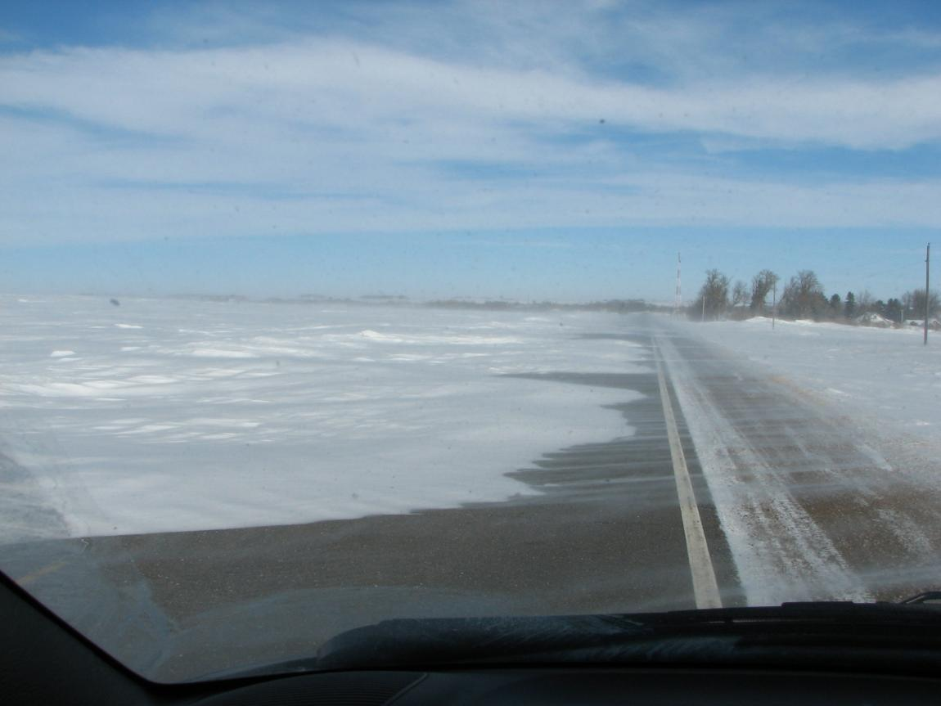
Questions?

