Slide 1

Performance of Thin Jointed Concrete Pavements Subjected to Accelerated Traffic Loading
4th INTERNATIONAL CONFERENCE ON ACCELERATED PAVEMENT TESTING
Davis, CA, USA
September 19-21, 2012
Tom Burnham, P.E.
Bernard Izevbekhai, PhD, P.E.
Minnesota Department of Transportation
Office of Materials and Road Research

Slide 2
Why Thin PCC?
    Economics
      Less money in budgets
      Thicker PCC pavements far exceeded design lives
      Quicker to construct
    Sustainability
      Optimize material usage
      Less energy use during construction

Slide 3
“How Thin Can You Go?”
      Structural Capacity
        Flexural strength
        Joint load transfer
        Fatigue loading
        Ultimate loading
      Environmental response
        Warp and curl
        Uniform slab support

Slide 4
MnROAD
  Cells 113-513
513a
513b
113a
113b
213
313
413
127
127
127
127
140
152
165
(5”)
(5”)
(5”)
(5”)
(5.5”)
(6”)
(6.5”)
127
127
127
127
127
PCC
127
127
CL1
127
127
127
127
114
102
89
CL5
Clay
SG
Panels LxW (m):
4.6x3.6
3.6x3.6
3.6x3.6
4.6x3.6
4.6x3.6
4.6x3.6
4.6x3.6
Dowel Type:
Plate
Plate
Round
Round
Round
Round
Round

Slide 5
MnROAD
  Cells 113-513
Cell | Average slab thickness in driving lane outer wheelpath, mm | Average slab thickness at centerline, mm | Average slab thickness in passing lane outer wheelpath, mm | Overall average slab thickness, mm | Design slab thickness, mm | Difference between as-built and design thickness, mm
513 | 156 | 144 | 150 | 149 | 127 | +22
113 | 145 | 132 | 151 | 143 | 127 | +16
213 | 156 | 143 | 158 | 151 | 140 | +11
313 | 158 | 157 | 159 | 158 | 152 | +6
413 | 164 | 159 | 165 | 163 | 165 | -2

Slide 6
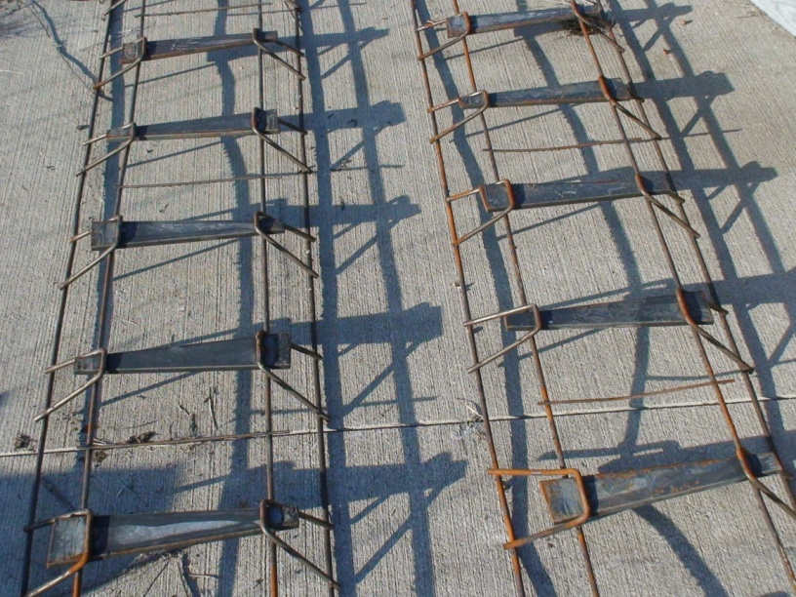
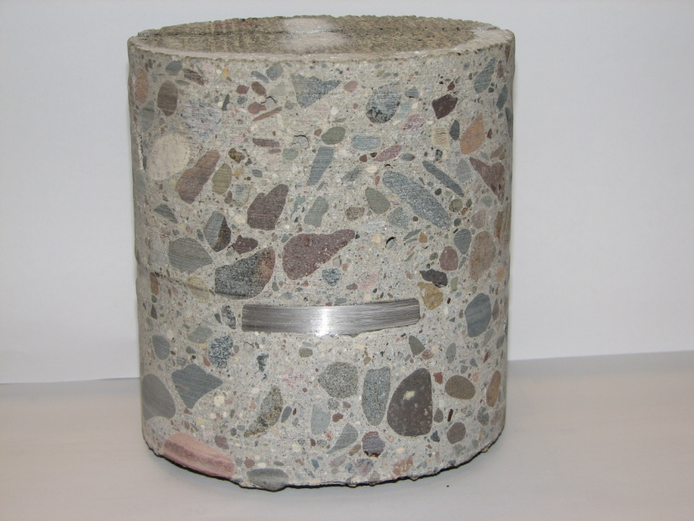
Joint Load Transfer Devices
  Standard 25 mm (1”) dia. x 381 mm (15”) long epoxy coated steel dowels for Cells 113-413
    ACI 302.1R-04 recommends against 25mm dowels in slabs < 178 mm (7”) thick
    This experiment > recommendations in all test cells
  Plate dowels for Cell 513
    9.5 mm (3/8”) x 305 mm (12”) long tapered width

Slide 7
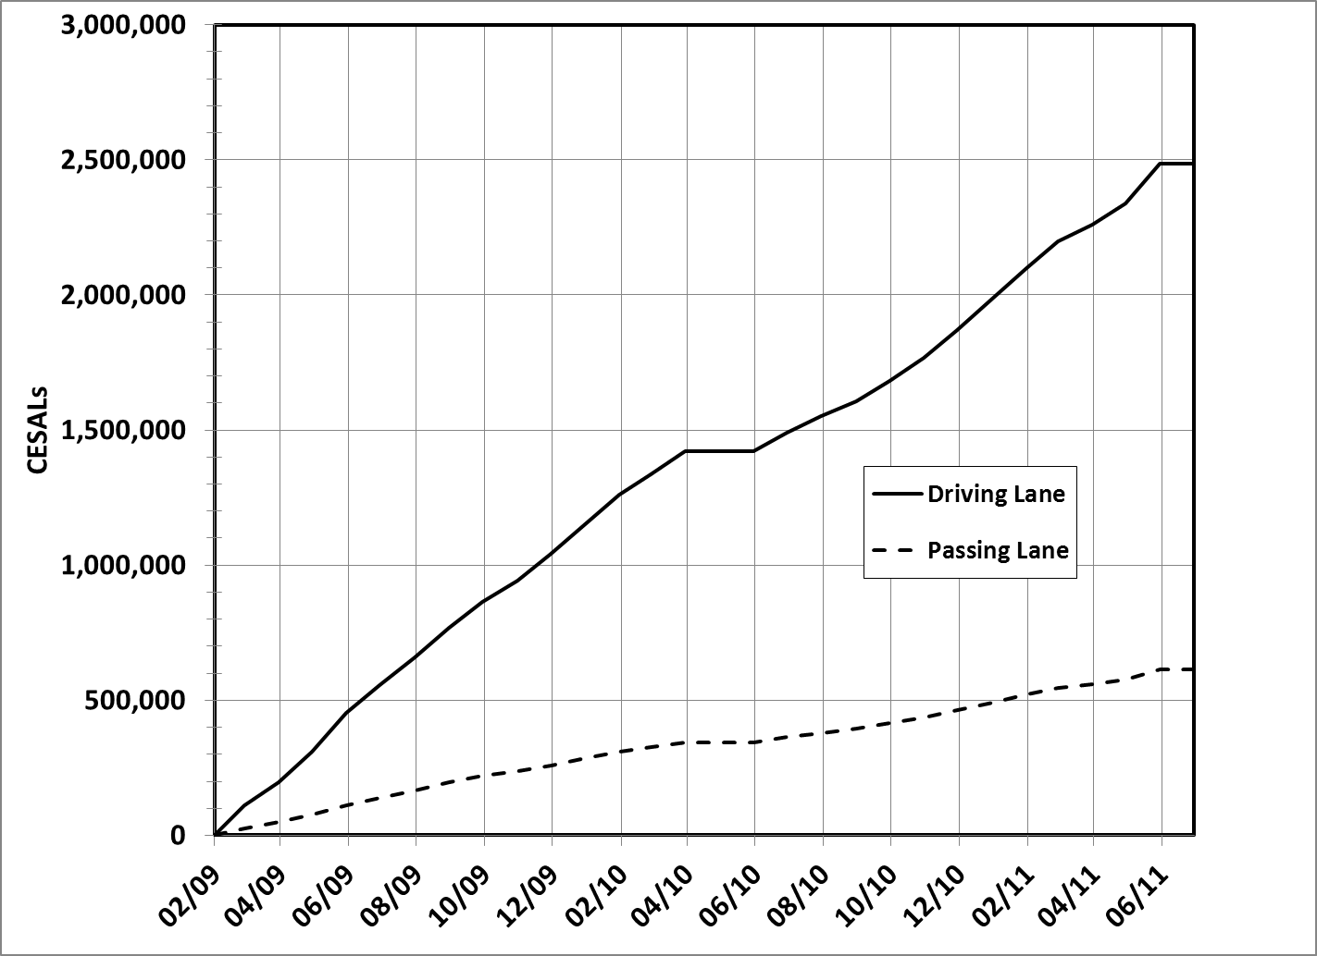
  MnROAD Traffic Load History
  Live interstate traffic = “Accelerated” for thin PCC designs

Slide 8
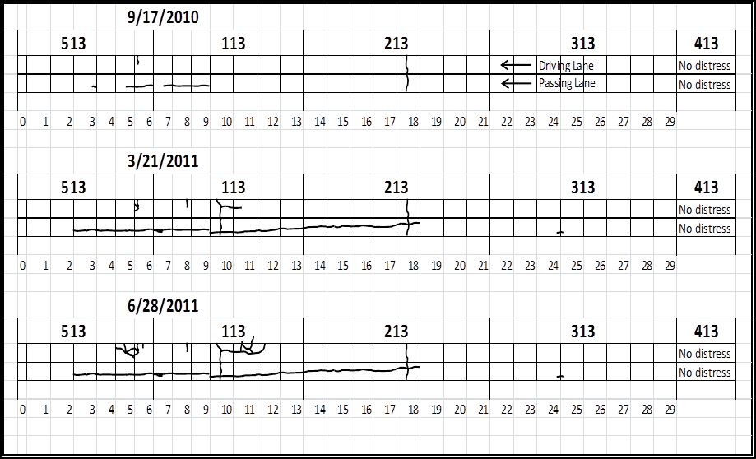
  Test Cell Performance
  > 1 million CESALS to first visible cracks

Slide 9
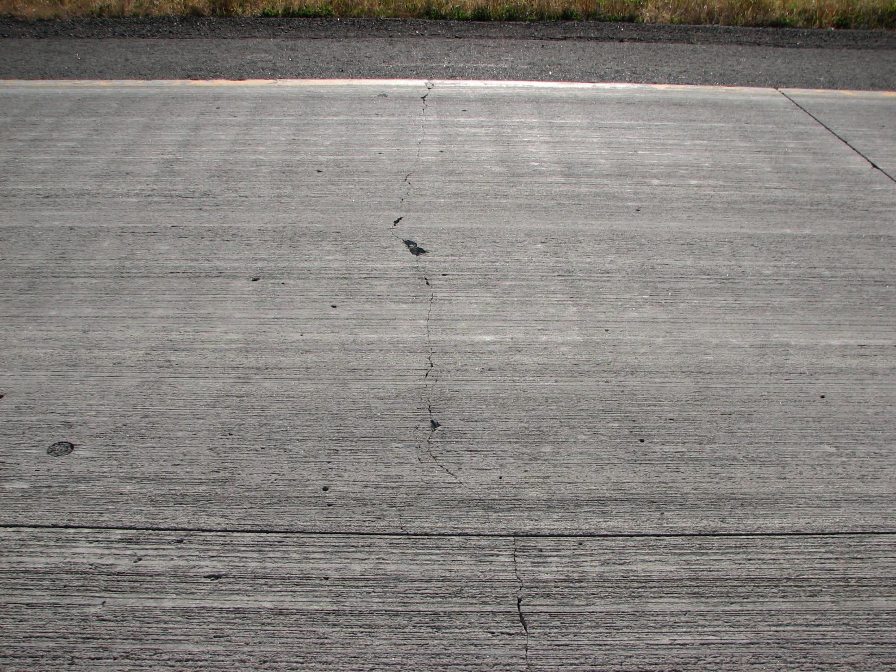
  Test Cell Performance
Cell 213 transverse crack, Oct 2010

Slide 10
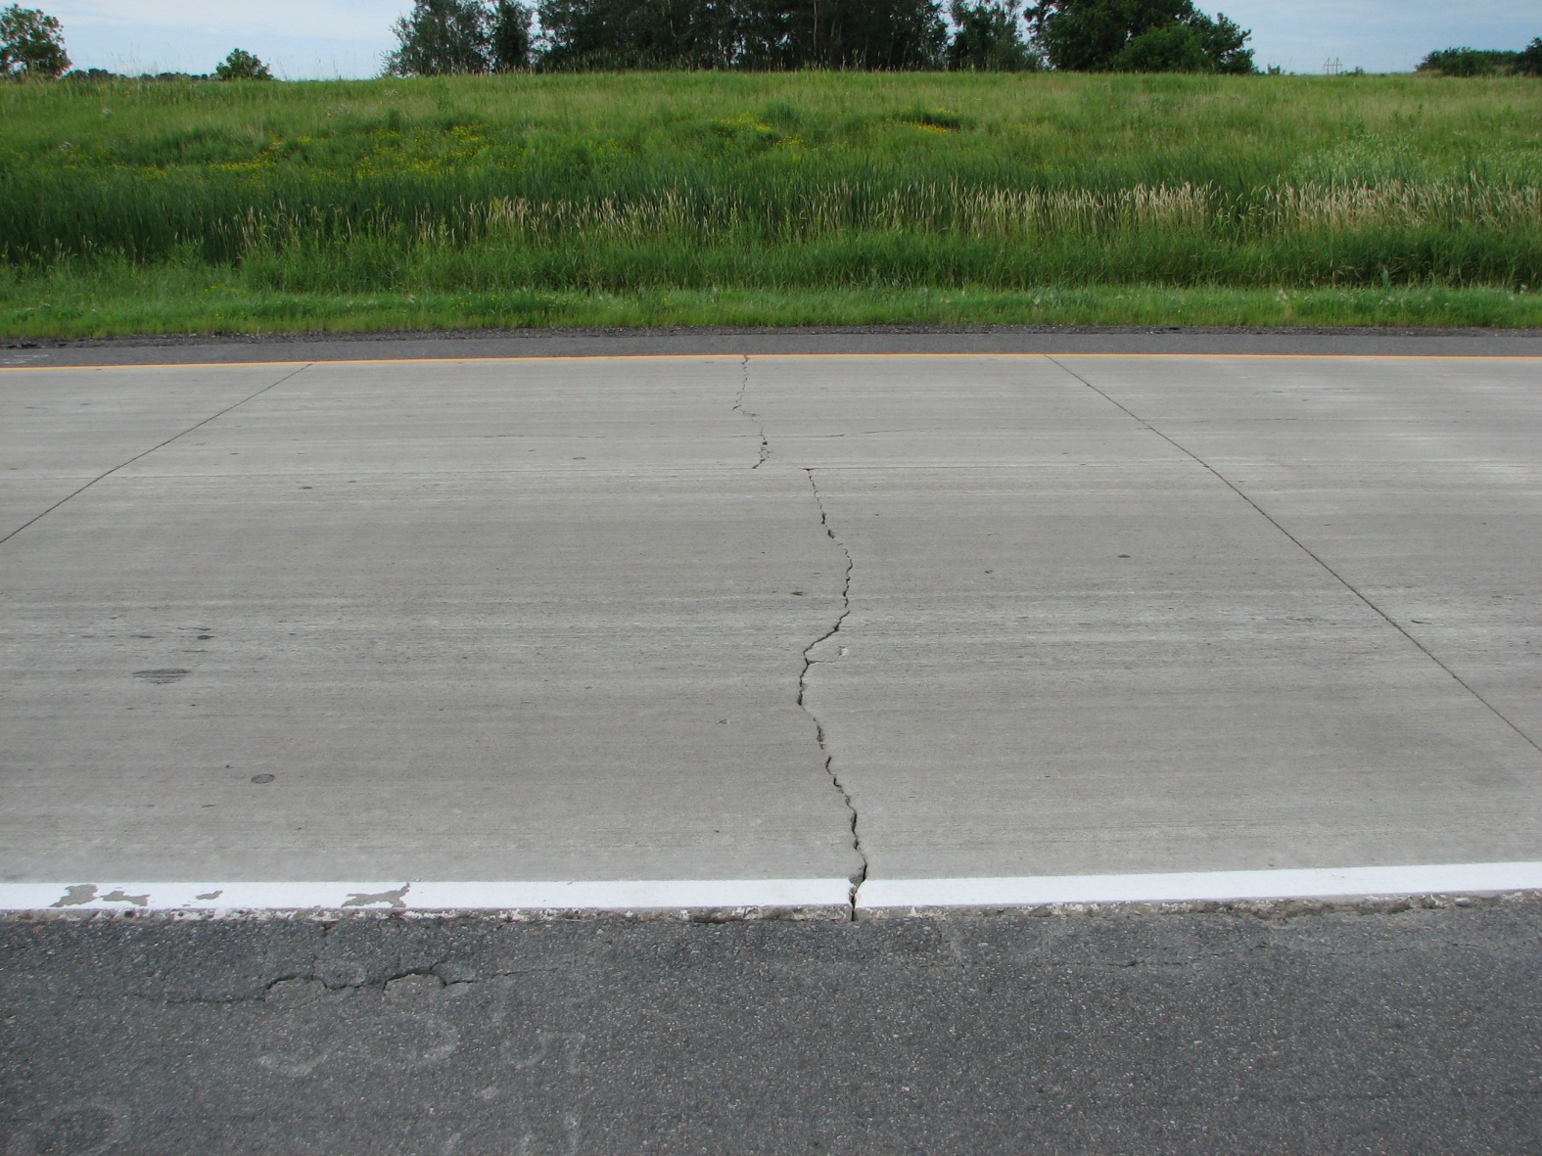
  Test Cell Performance
Cell 213 transverse crack, Oct 2011

Slide 11
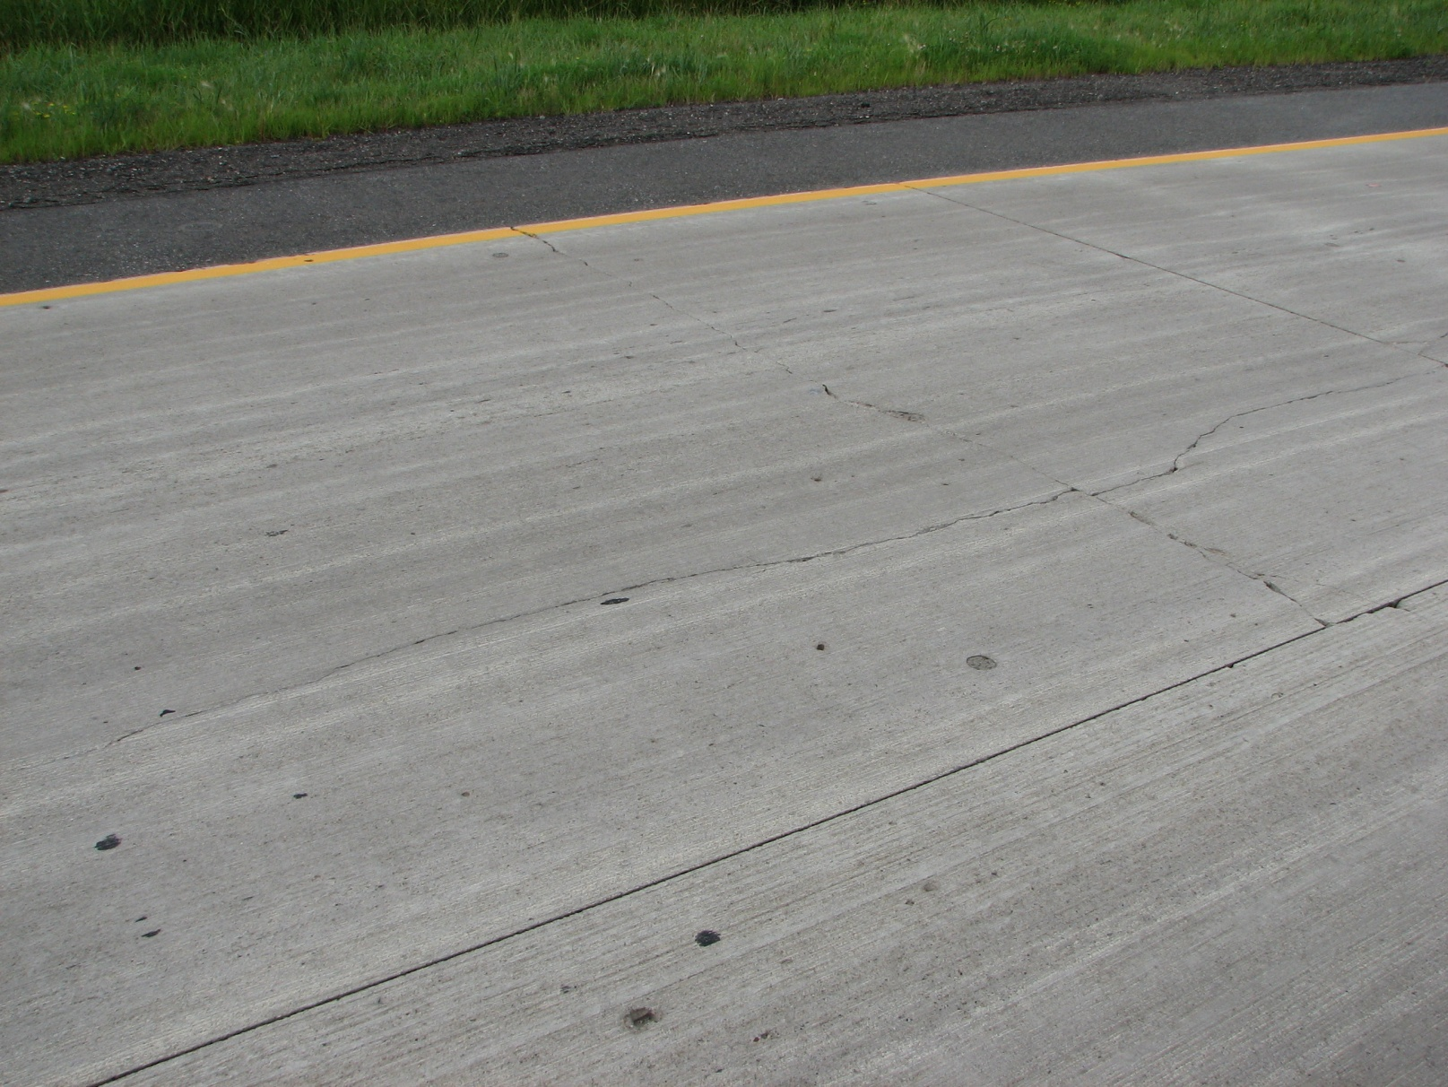
  Test Cell Performance
Cell 213 passing lane cracks, July 2011

Slide 12
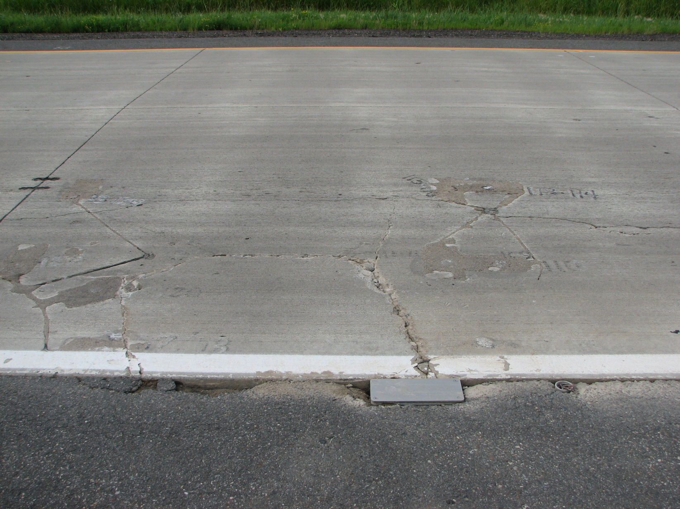
  Test Cell Performance
Cell 113 cracks in sensor area, July 2011

Slide 13
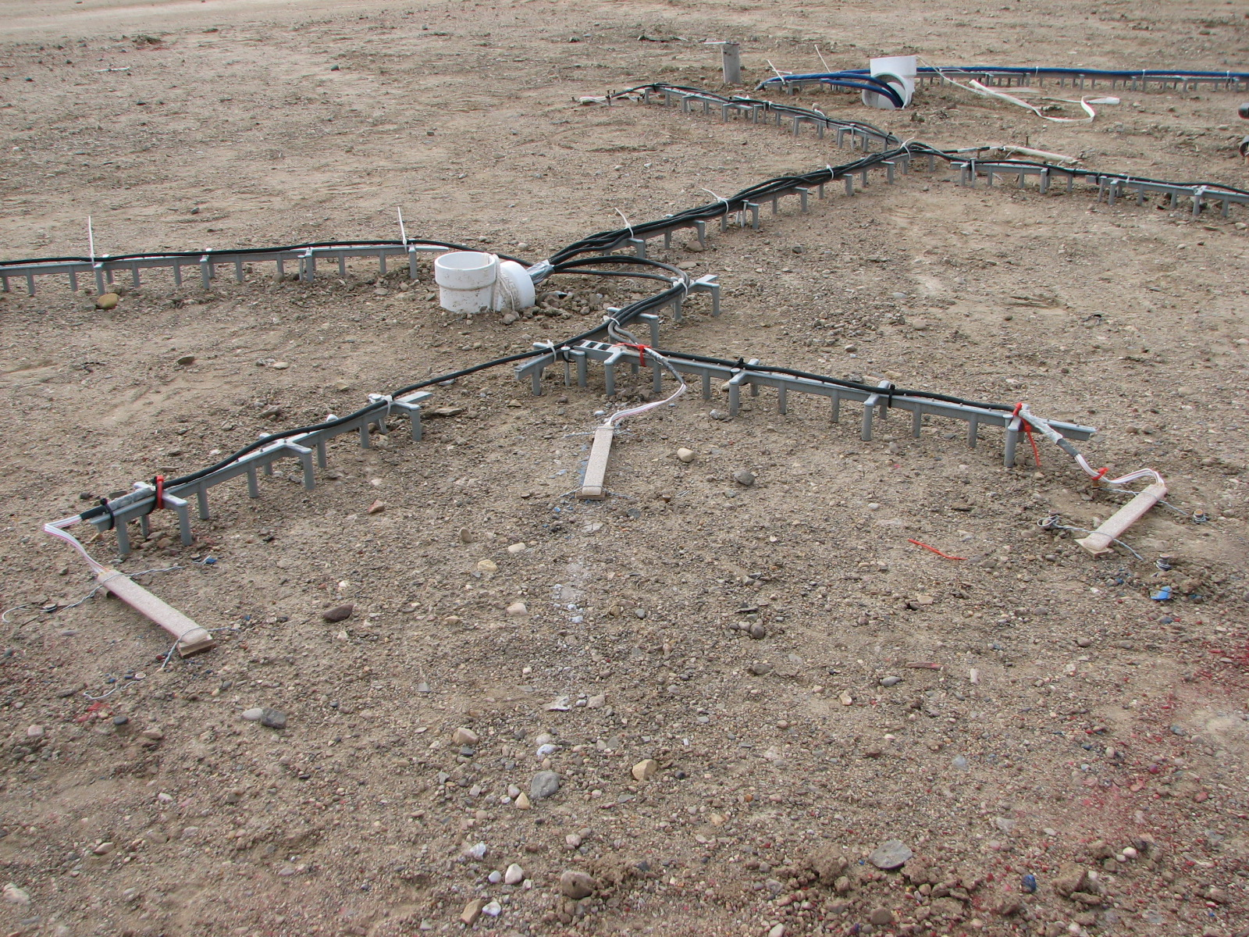
  Routing Sensor Leads

Slide 14
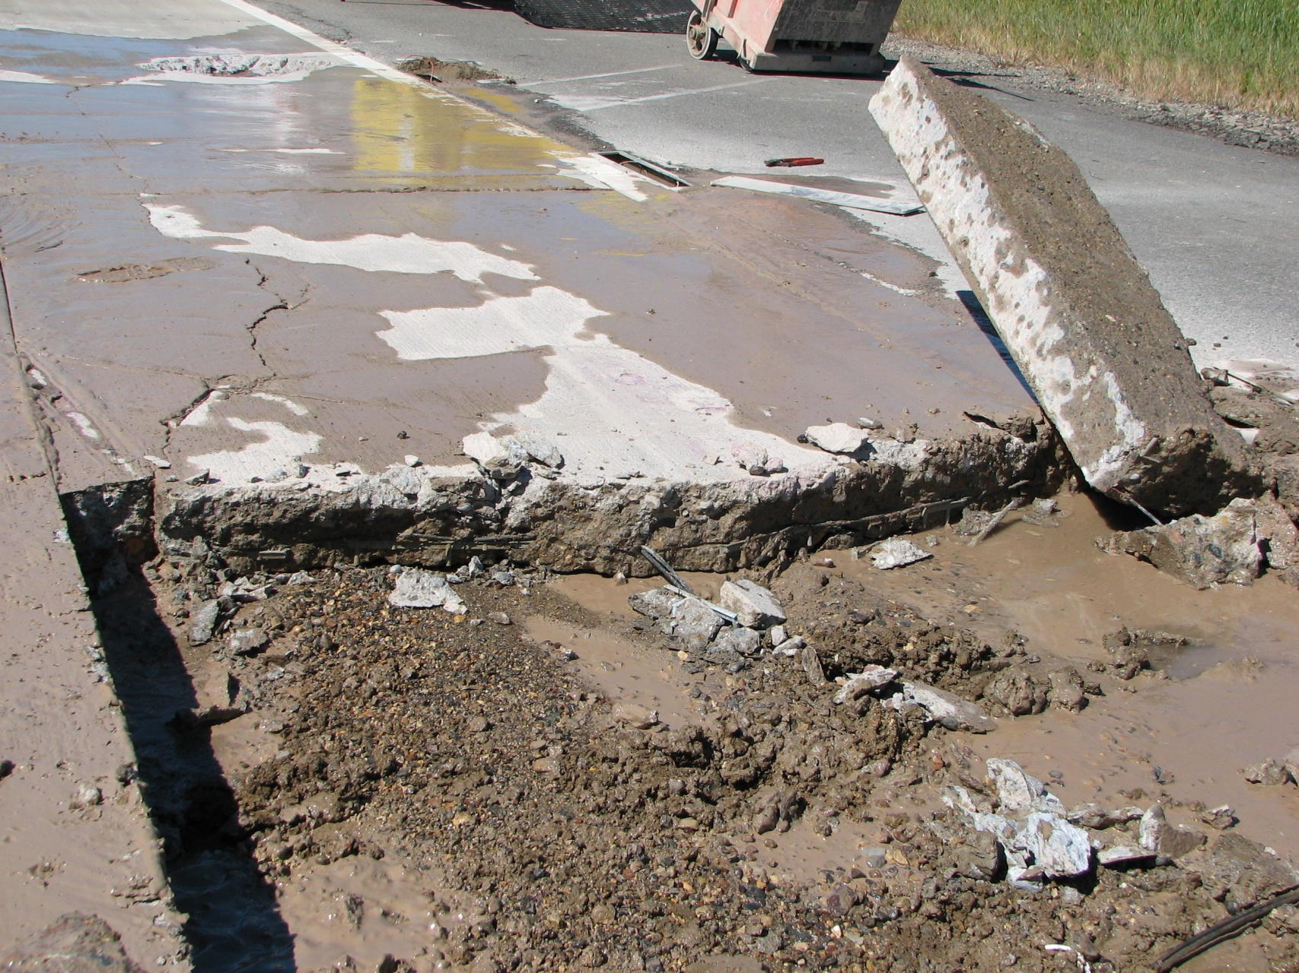
  Test Cell Performance
Distress from sensor leads?

Slide 15
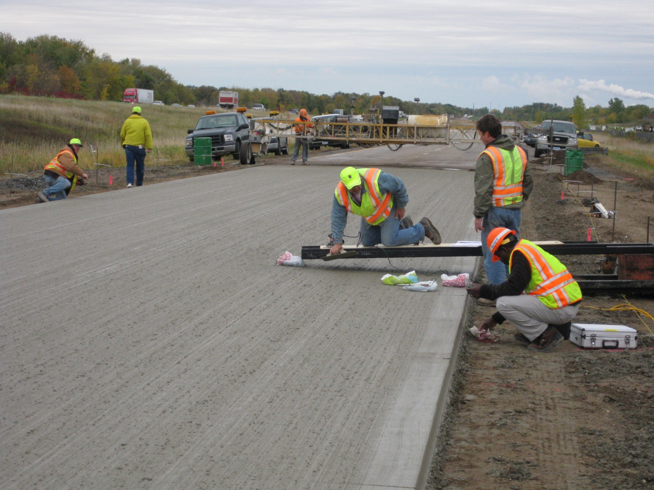
  New Sensor Installation Technique

Slide 16
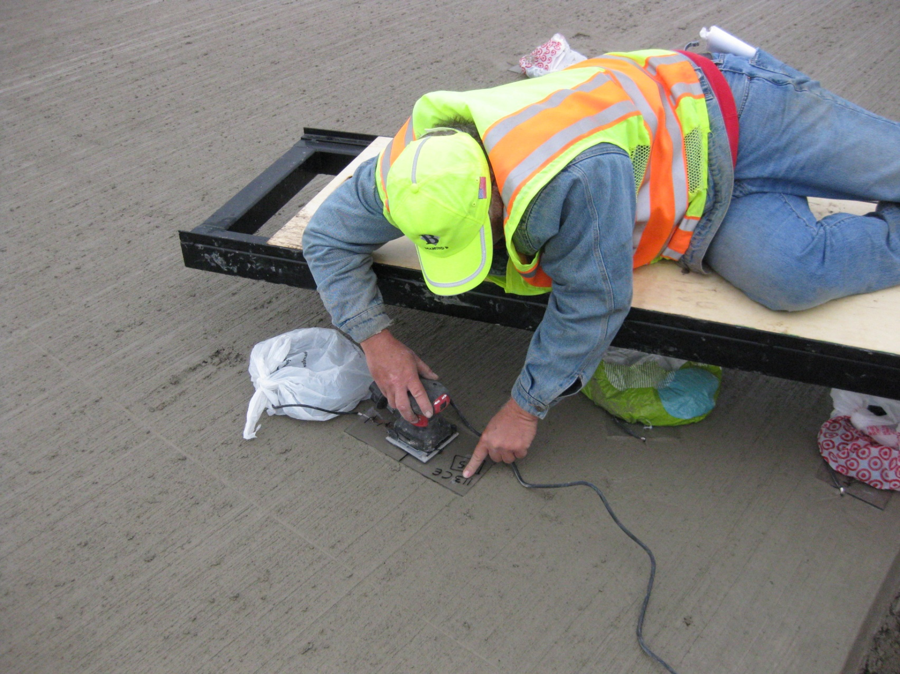
  New Sensor Installation Technique

Slide 17
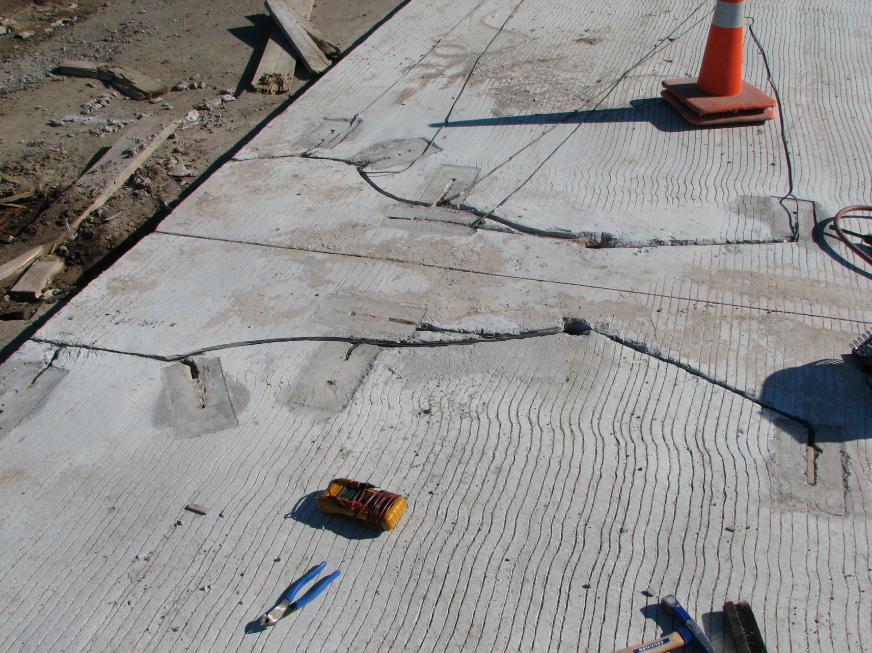
  New Sensor Installation Technique

Slide 18
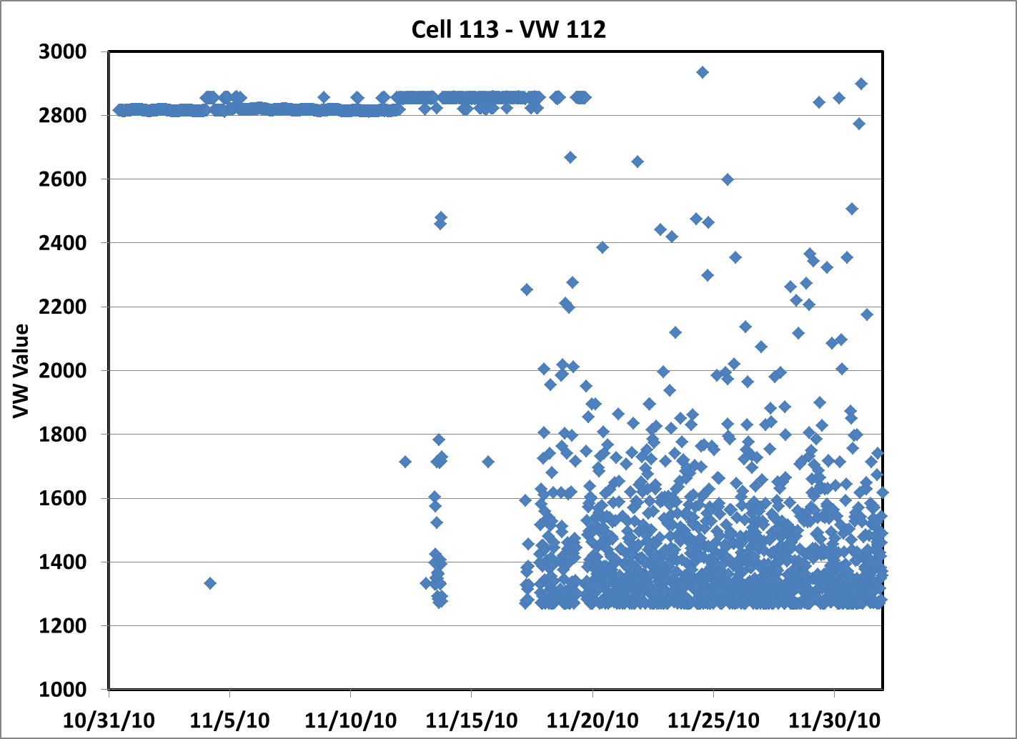
Sensor indicates when cracking occurred

Slide 19
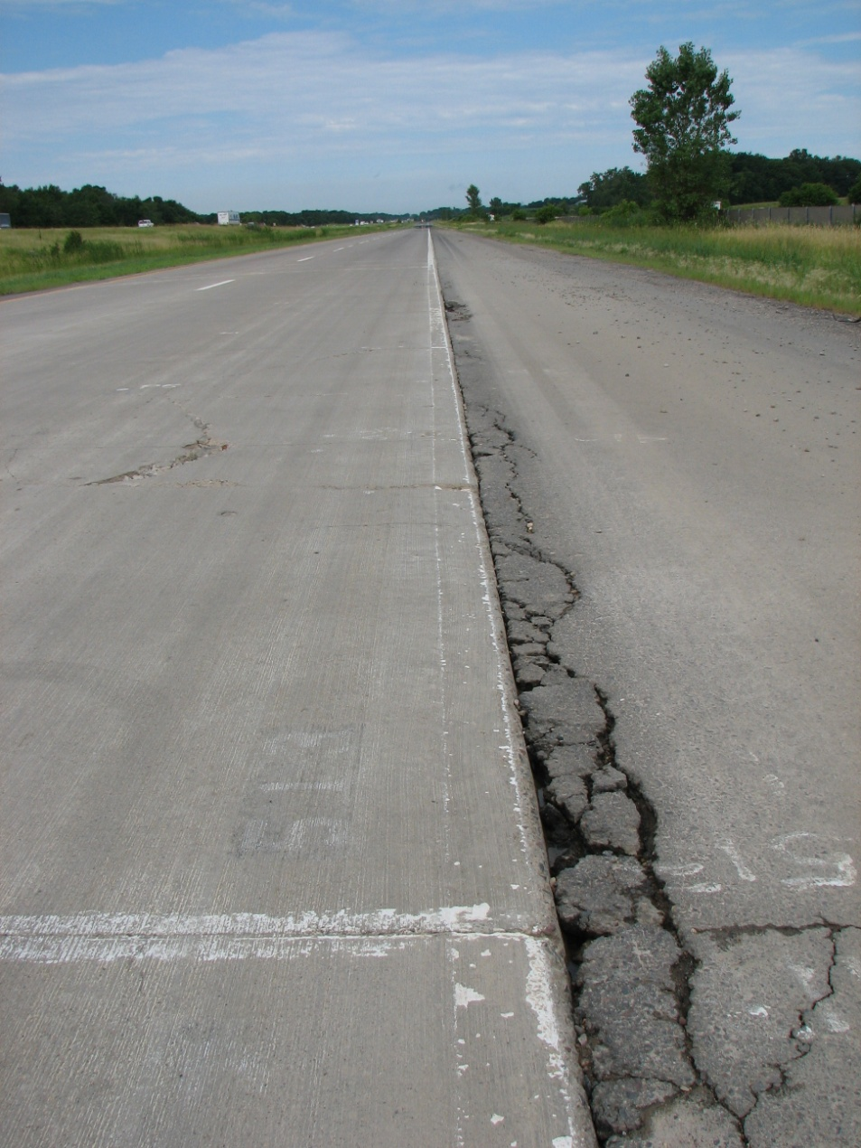
  Test Cell Performance
Pumping from shoulder joint, July 2011

Slide 20
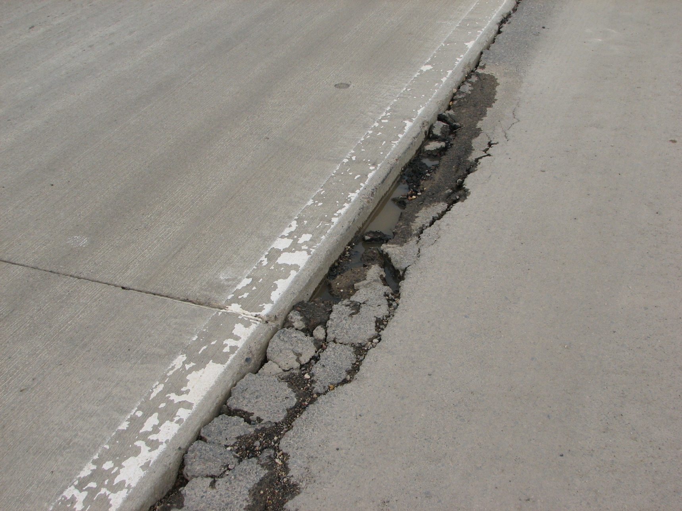
  Test Cell Performance
Slow draining base

Slide 21
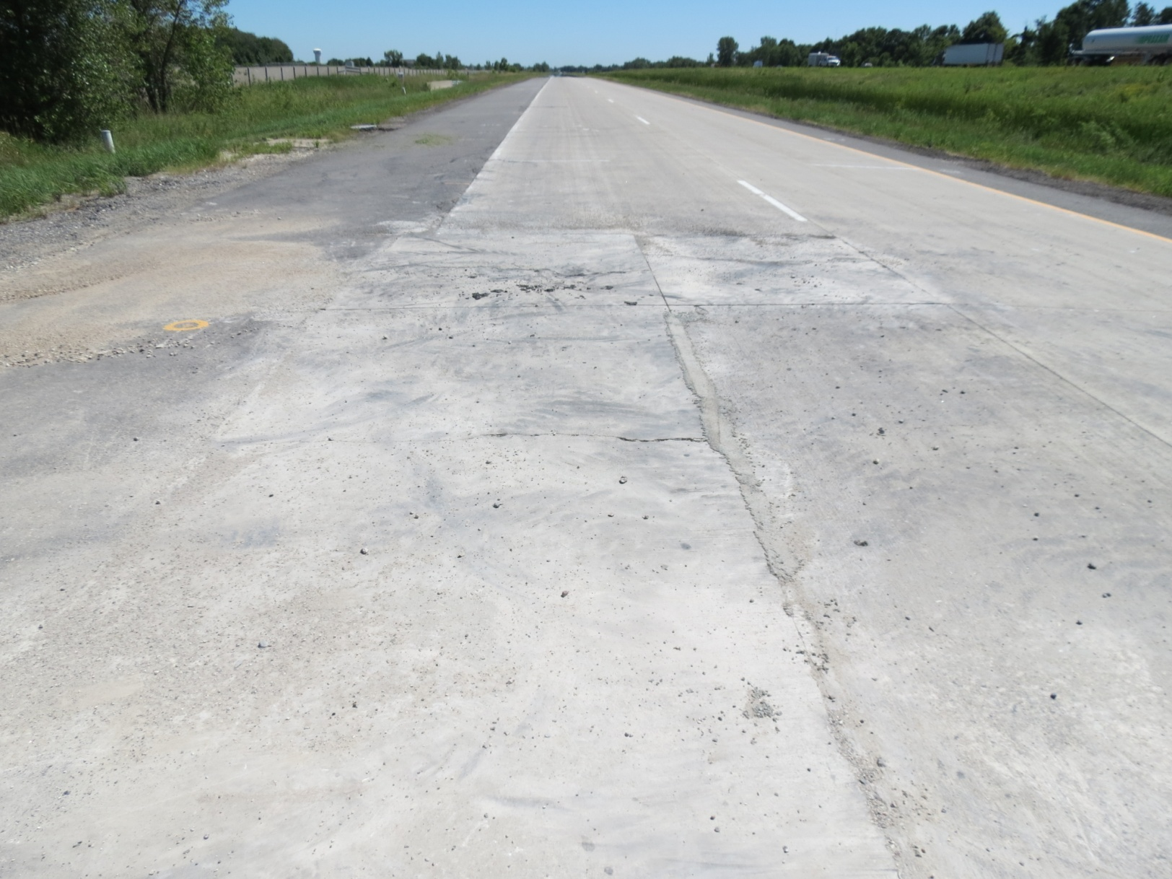
  Repairs
Difficult to repair such thin slabs!

Slide 22
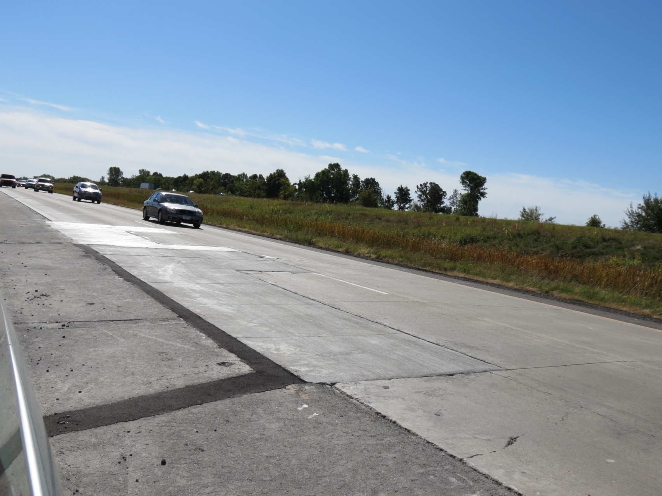
  Repairs
Drainage and smaller slabs work better

Slide 23
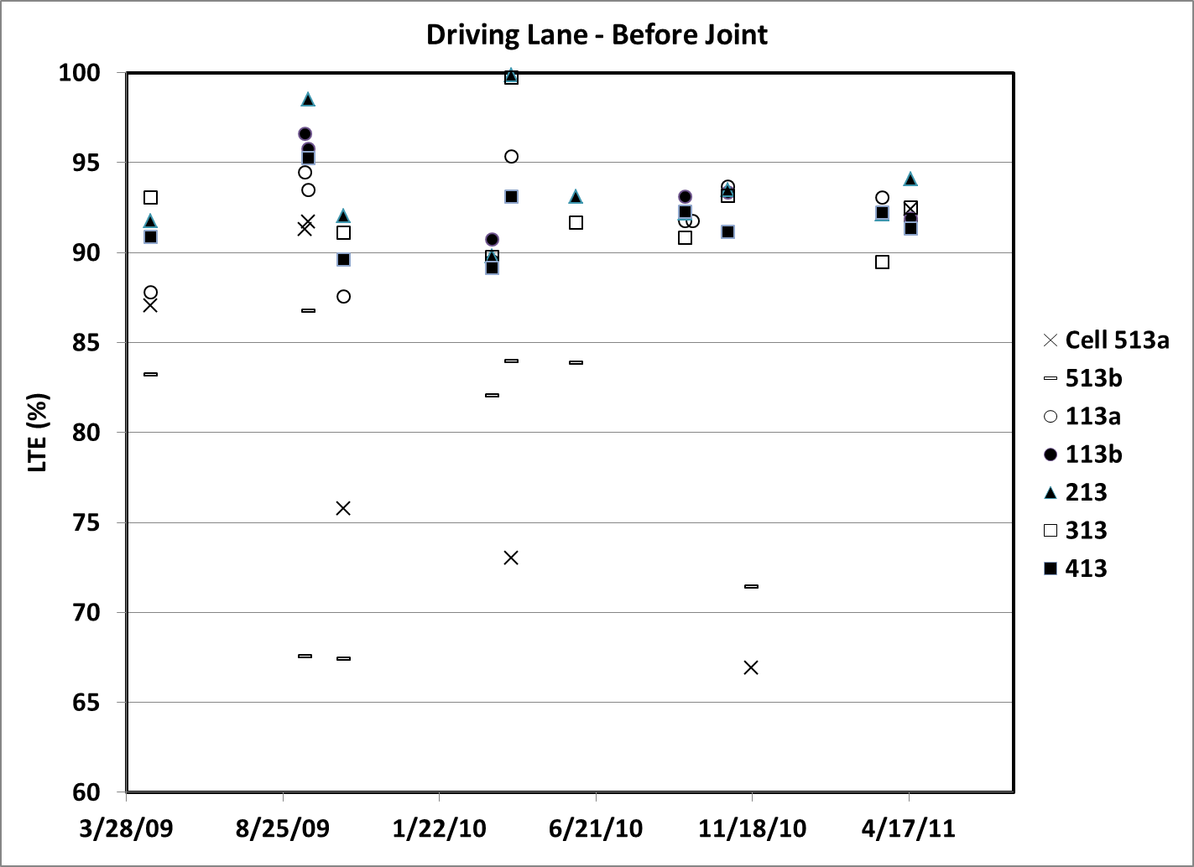
  Joint Load Transfer Efficiency

Slide 24
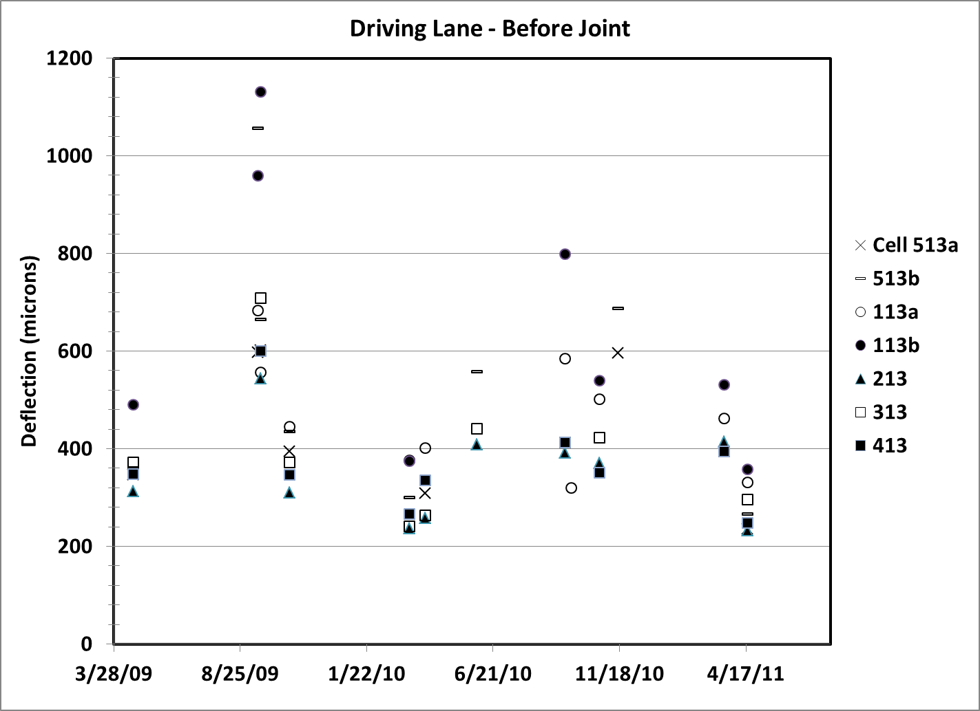
  Joint Deflection

Slide 25
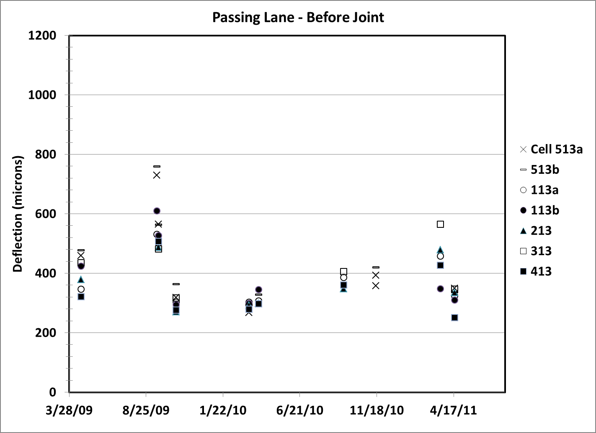
  Joint Deflection

Slide 26
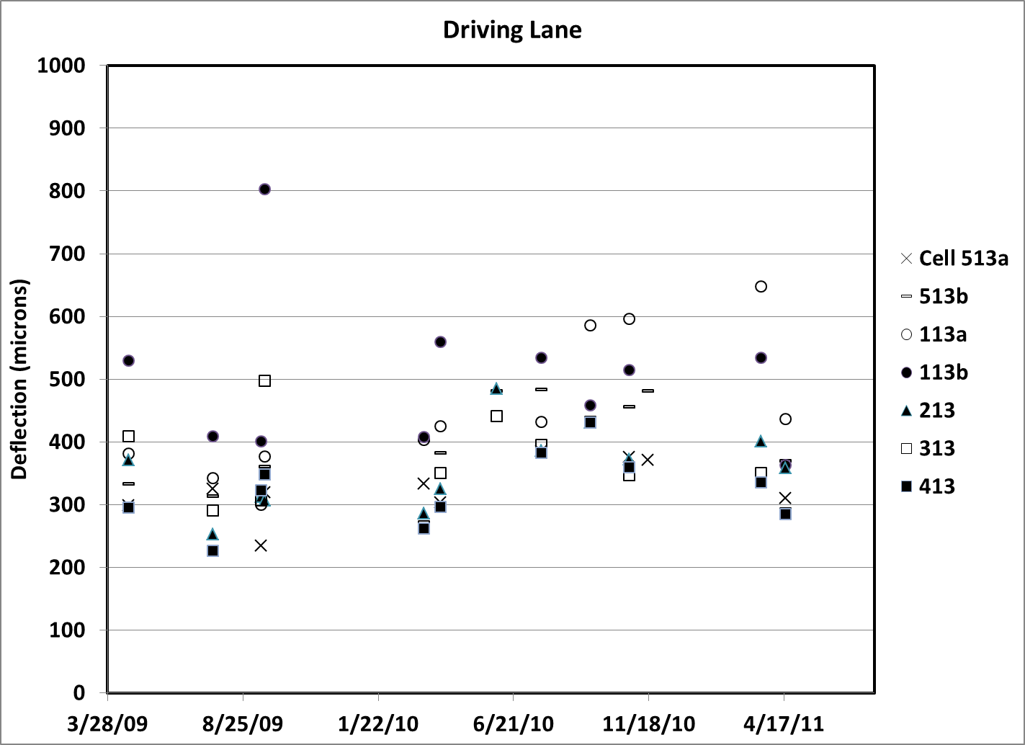
  Mid-Panel Edge Deflection

Slide 27
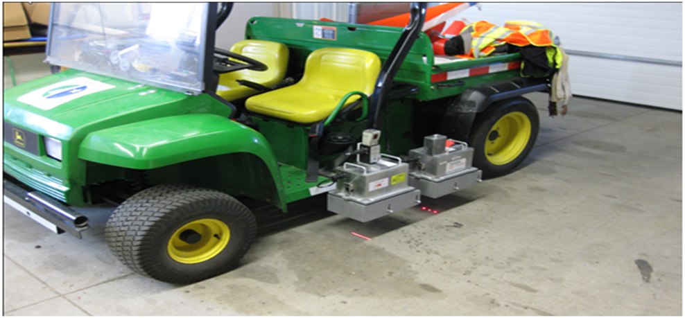
  Ride Quality History
IRI and RN measuring device (Lightweight Profiler)

Slide 28
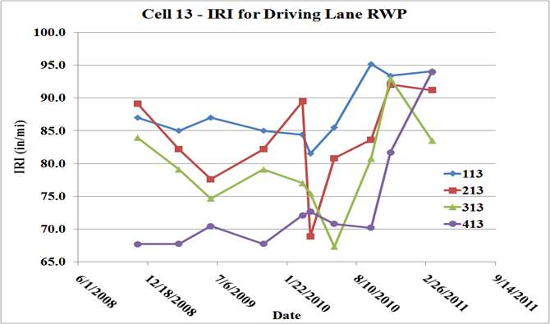
  Ride Quality History - IRI
Ride measurements can be affected by repairs
63.5 in/mi = 1 m/km

Slide 29
  Ride Quality History - IRI
63.5 in/mi = 1 m/km

Slide 30
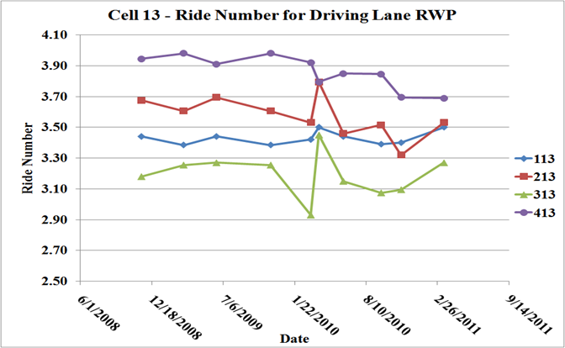
  Ride Quality History - RN

Slide 31
Ride Quality History
  Overall, it cannot be deduced that IRI (or RN) and pavement thickness were correlated simply by observing the plots
  Statistical method used to ascertain the extent to which the IRI and RN may be attributed to pavement cell thickness
      Ride Number appears to be significantly correlated to the thickness and traffic ESALs
      IRI not significantly correlated to pavement thickness, but ESAL was a significant variable

Slide 32
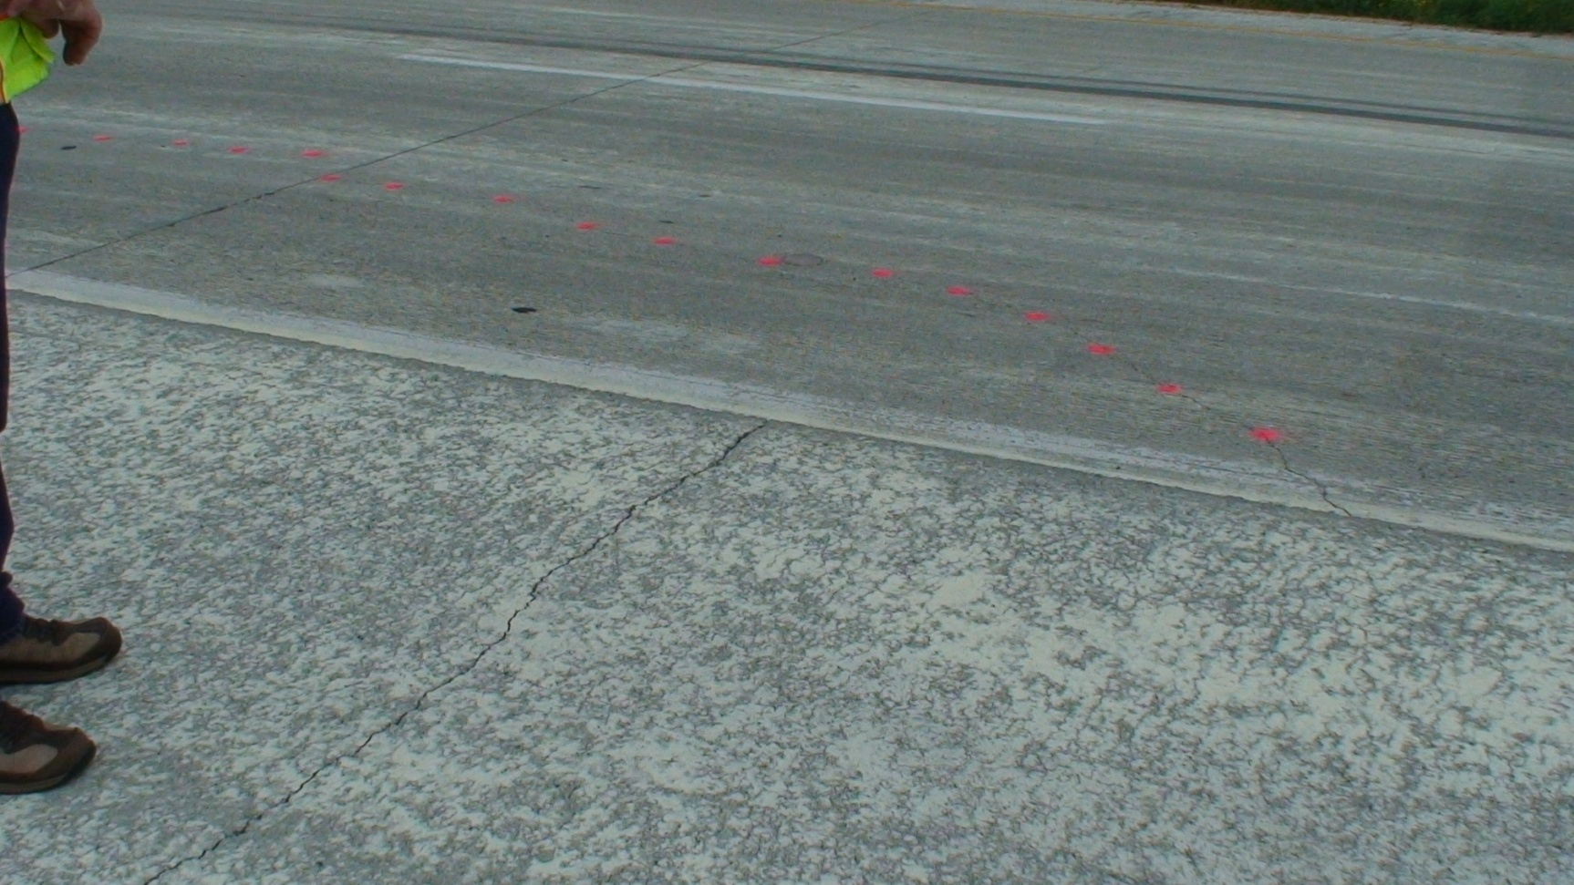
  Cells 306-406 Performance
6” PCC constructed in 2011
Design based on “good” performance of Cell 313
Cracking within 6 months (base related?)

Slide 33
  Summary
MnROAD Cells 113-513 have provided valuable data toward determining “how thin can you go?”
Thinnest cells able to carry interstate traffic in Minnesota climate for over 1 million ESALs before cracking.
Cells failed by pumping of base materials in driving lane, settlement of base or slab curling in passing lane.
Cracking occurred in all sections with a design thickness < 152 mm (6”).
Difficult to repair thin slabs.
Now have data available for development and calibration of M-E pavement design procedures for thinner PCC pavements.
Traffic loading was accelerated. Must be careful when translating to more typical design scenarios.
Notes:
Intentionally unbonded

Slide 34
  Recommendations/Questions
Determine the effect of slab size on performance.
Determine whether cracking related to pumping, or just a few overloaded axles.
Determine cause of difference in cracking type between driving and passing lane.
Understand how interstate traffic loads would translate to typical lower volume loadings.
Are thinner slabs much more vulnerable to base settlement?
Notes:
Intentionally unbonded

Slide 35
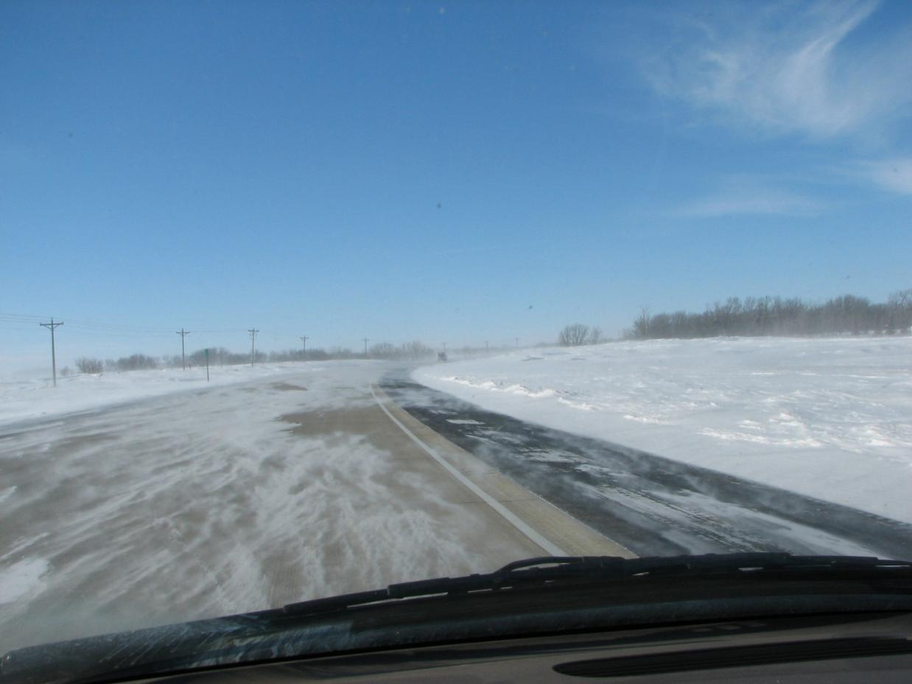
Questions?

