Slide 1

Indian Country
Lunch and Learn
Levi Brown | Tribal Liaison Manager
Government Affairs

Slide 2
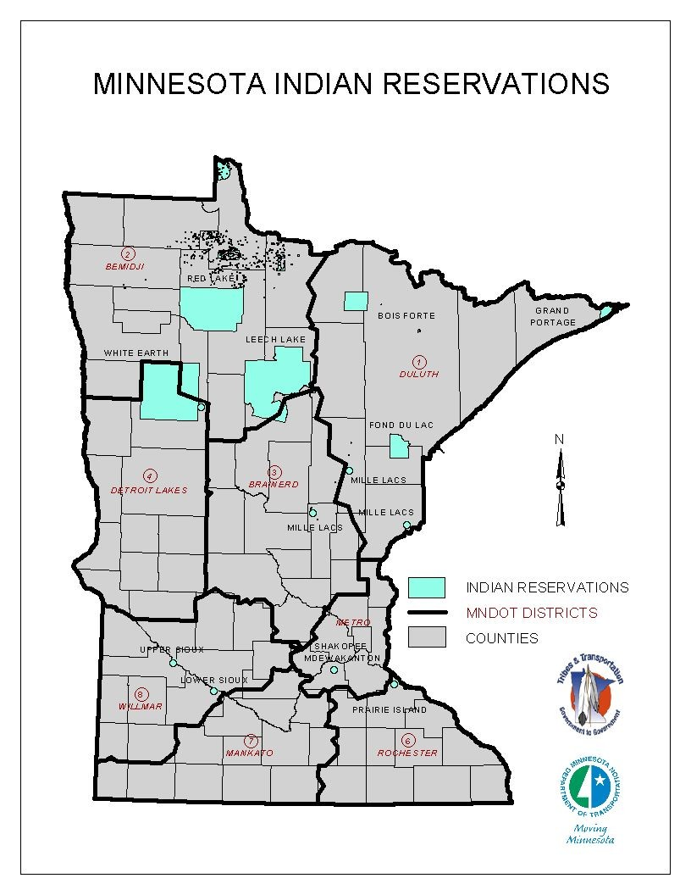
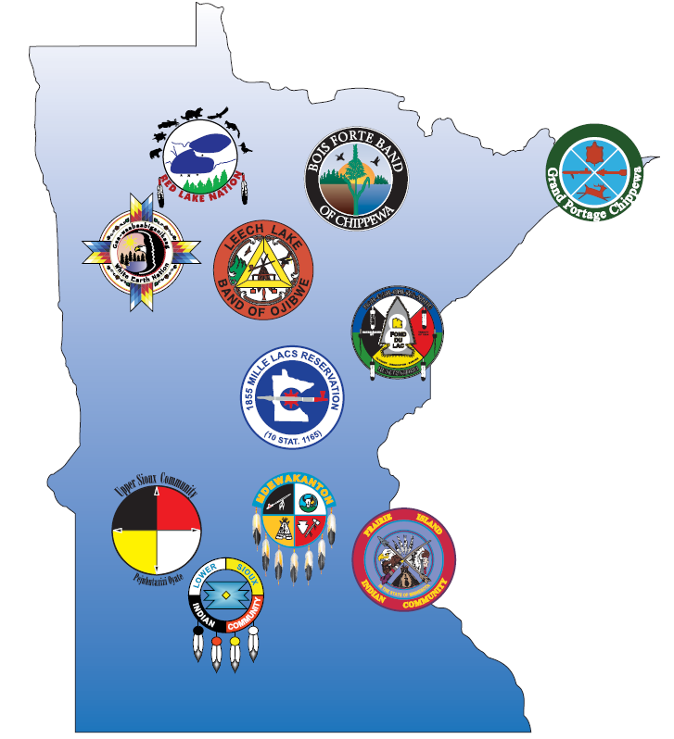

Tribal Government in Minnesota
Bois Forte
Fond du Lac
Grand Portage
Leech Lake
Mille Lacs
White Earth
Red Lake
Lower Sioux
Prairie Island
Shakopee Mdewakanton
Upper Sioux
Ho-Chunk (WI)
Notes:
7 Ojibwe Tribes: Red Lake, Bois Forte, Grand Portage, White Earth, Leech Lake, Fond du Lac and Mille lacs
4 Dakota Tribes: Upper Sioux, Shakopee Mdewakanton, Prairie Island, and Lower Sioux

Slide 3
Indian Country terms
Usufructuary Rights
Fee Land
Ceded Territory
Indian Country
Tribal Land
Exterior Boundary
Reservation
Trust Land
Public Law 280
What is all this stuff? Don’t Tribes just own their land?
Notes:
Al

Slide 4
Things to Remember
Sovereignty, Federal Indian Law and Treaties
Tribes are established governments with significant authority and a responsibility to their constituents.
Tribes have retained sovereignty, they were not granted anything.
See the Marshall Trilogy, Johnson v. McIntosh (1823), Cherokee Nation v. Georgia (1831) and Worcester v. Georgia (1832). These Supreme Court cases established the bases for Federal Indian Law.
If a treaty pre-dates statehood State ownership of lake beds and mineral rights is limited (the Federal Government could not grant what it did not have).
Every treaty is different.
Not all Tribes have treaty created Tribal Lands.

Slide 5
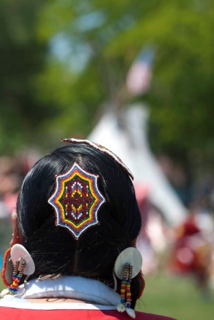
Basic Terms
Tribe
Tribe – Today I am using Tribe as defined in 25 CFR 151.2: Tribe means any Indian tribe, band, nation, pueblo, community, rancheria, colony, or other group of Indians, including the Metlakatla Indian Community of the Annette Island Reserve, which is recognized by the Secretary as eligible for the special programs and services from the Bureau of Indian Affairs.

Slide 6

Basic Term
Indian Country
Indian Country - 18 USC §1151 Indian country defined states: Except as otherwise provided in sections 1154 and 1156 of this title, the term “Indian country”, as used in this chapter, means (a) all land within the limits of any Indian reservation under the jurisdiction of the United States Government, notwithstanding the issuance of any patent, and, including rights-of-way running through the reservation, (b) all dependent Indian communities within the borders of the United States whether within the original or subsequently acquired territory thereof, and whether within or without the limits of a state, and (c) all Indian allotments, the Indian titles to which have not been extinguished, including rights-of-way running through the same.

Slide 7
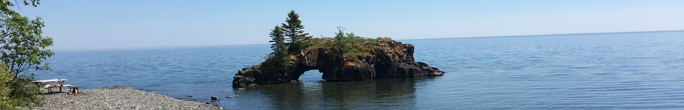
Reservations
Reservation –
  Land reserved in a treaty by a Tribe or group of Tribes for their own use
  Reservations created by Congress
  Land proclaimed Reservation under the Indian Reorganization Act of 1934 codified at 25 U.S.C. § 467 and
  Most Federal Agencies interpret Trust Land as Reservation for jurisdictional purposes
Exterior Boundary – The outer perimeter of a Reservation, typically created by Treaty.
  Checkerboarded – A pattern of Indian and non-Indian ownership within the exterior boundary of a Reservation

Slide 8

Fee Land
Land owned in fee simple by a Tribal Government typically land purchased by the Tribe at market value.
Fee Simple or Fee Simple Absolute - The broadest property interest allowed in land. It is of potentially perpetual endurance. Parts of the interest may be granted out without extinguishing the underlying fee ownership.
The Tribal Government is both the legal and beneficial owner.
It does matter if the Fee Land is within the exterior boundary of a Reservation.
Tribally owned Fee Land is effectively exempt from eminent domain actions whether in or out of the Reservation.

Slide 9
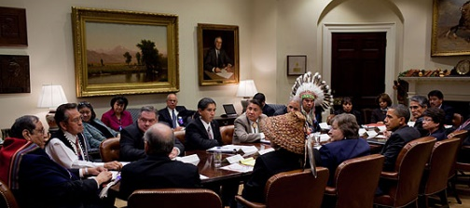
Trust Land
Land held by the United States Government in Trust for a Tribe.
This creates an actual fiduciary trust responsibility.
The Unites States is the legal owner, the Tribal Government is beneficial owner. (Example MCT Lands)
The land is a Federal/Tribal jurisdiction rather than a Federal/State/Tribal Jurisdiction
It does not matter if the Fee Land is within the exterior boundary of a Reservation, rights are the same.
Trust land is Indian Country and treated as Reservation for most, if not all, purposes.
It is effectively not part of the State surrounding it. State law does not apply subject to Public Law 280.
States may not exercise eminent domain actions against trust land.

Slide 10
Individual Title Status Report - ITSR

Slide 11
Fee to Trust to Reservation
Land purchased by Tribes and held in fee can be transferred to trust status.
This is a Federal regulatory process governed by 25 CFR §§ 151.1 – 151.15 for non-gaming acquisitions. Gaming acquisitions must also comply with 25 CFR § 292, which implements the Indian Gaming Regulatory Act.
The Unites States Department of the Interior, Bureau of Indian Affairs manages the process.
The Assistant Secretary for Indian Affairs is generally delegated the authority to approve such transfers. That authority is, with exceptions, delegated further to BIA Regional Directors.
There are notice provisions for taxing authorities (States and their political subdivisions and other bodies with delegates state taxing authority) and rights to appeal.
Once in trust land may be proclaimed Reservation.

Slide 12
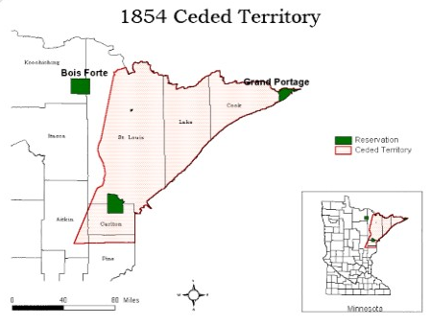
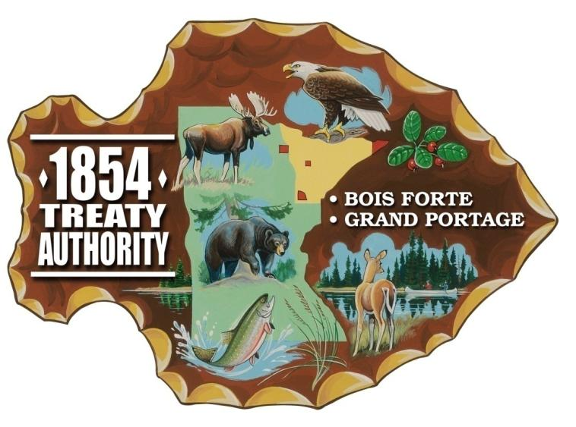
Ceded Territory
This is a treaty created situation.
When Indian Nations granted land to the United States in treaties, they reserved land for themselves and also reserved Usufructuary Rights (the rights to hunt, fish, gather, pass through and use for certain purposes).
These rights continue to exist and are exercised by the various Bands in Minnesota and Wisconsin.
Since these were created by Treaty they are fundamental Federal law.
This creates a complex jurisdictional situation regarding those rights.
The four (4) Dakota Communities in Minnesota have not pursued ceded territory Usufructuary rights. Their treaty situation is complicated.

Slide 13
Thank you again!
Levi Brown
Levi.Brown@state.mn.us
651-236-7048

