Slide 1
Chapter 5
Select Figures from
MN MUTCD
Sign Plan Design for At-Grade Intersections
June 2017

Slide 2
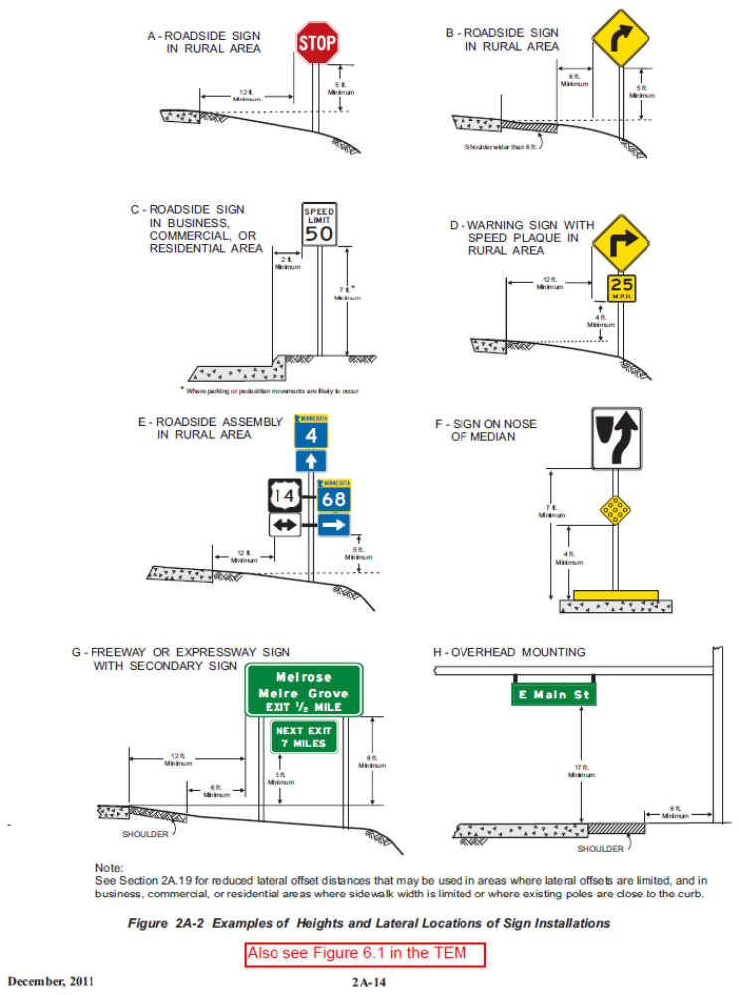
MN MUTCD Figures
Page 5-8

Slide 3
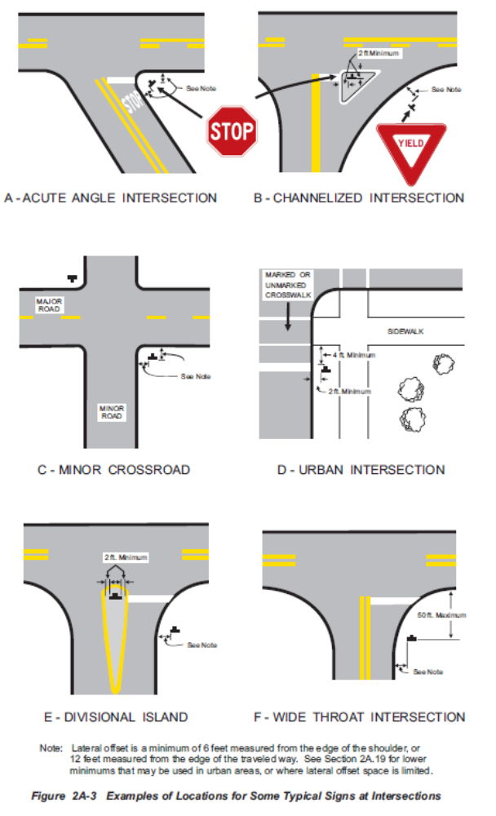
MN MUTCD Figures

Slide 4
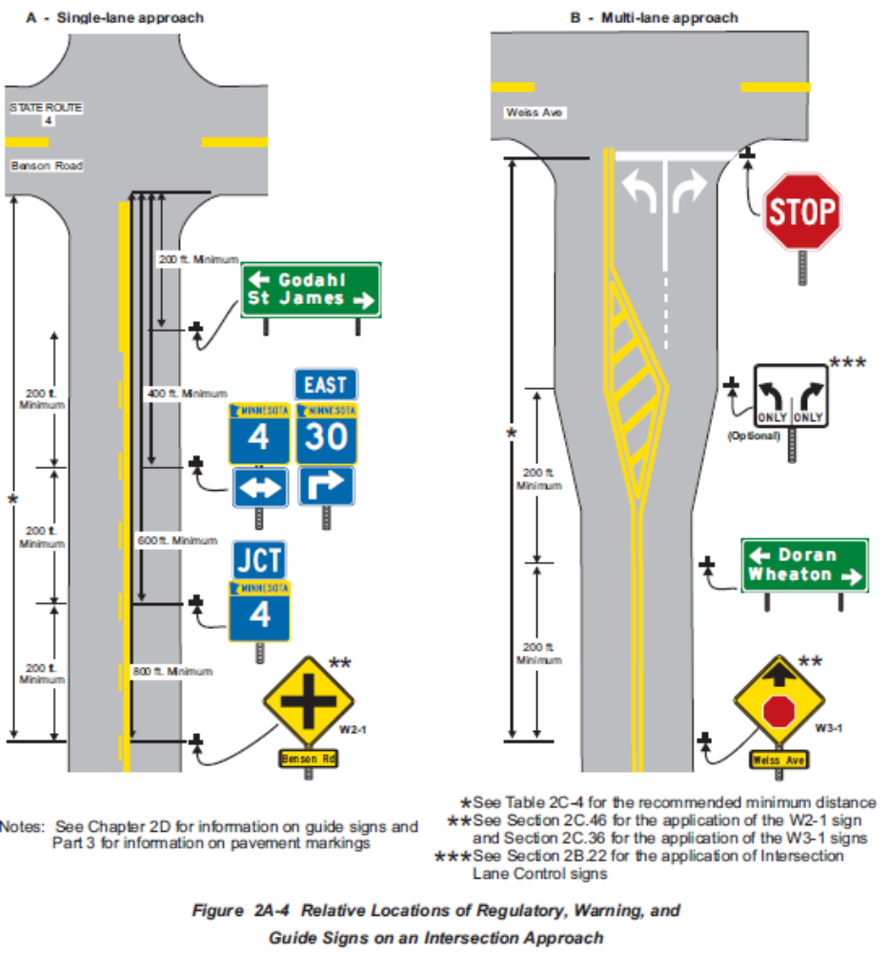
MN MUTCD Figures

Slide 5
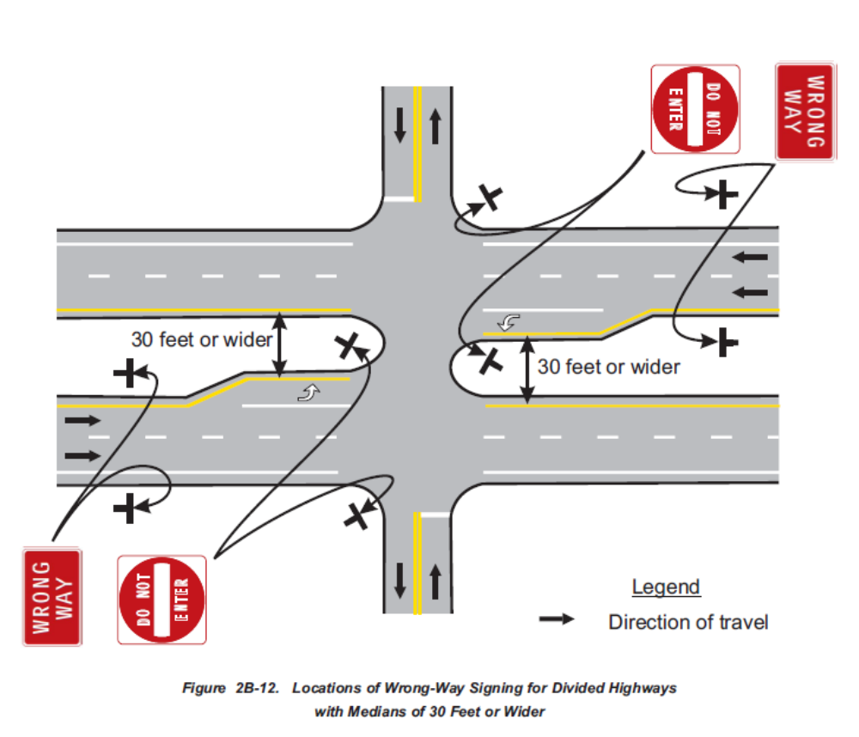
MN MUTCD Figures
Page 5-29

Slide 6
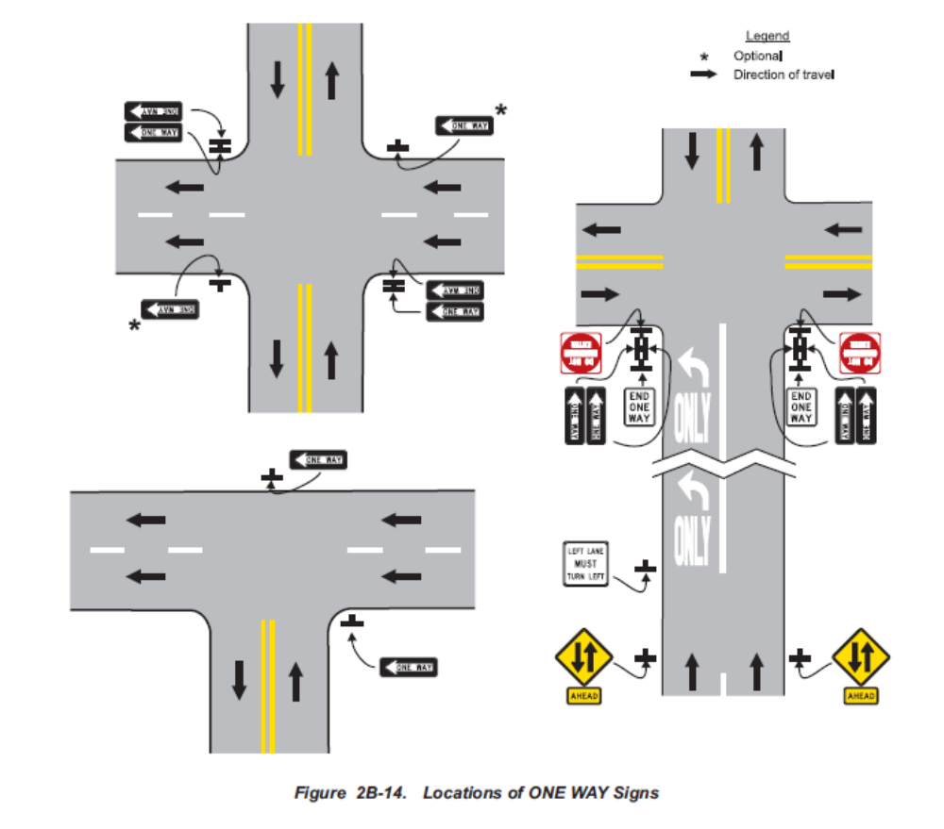
MN MUTCD Figures

Slide 7
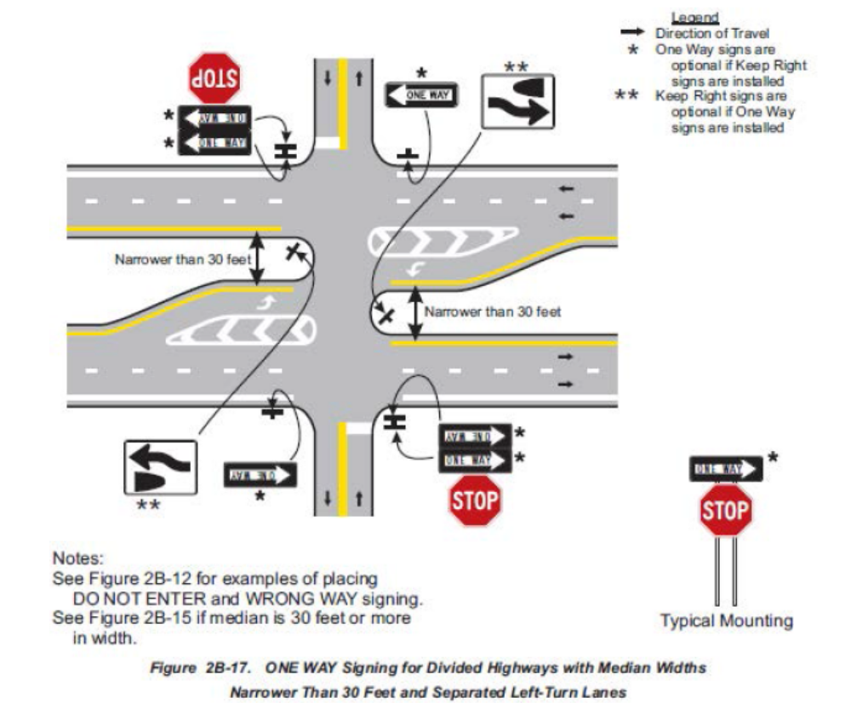
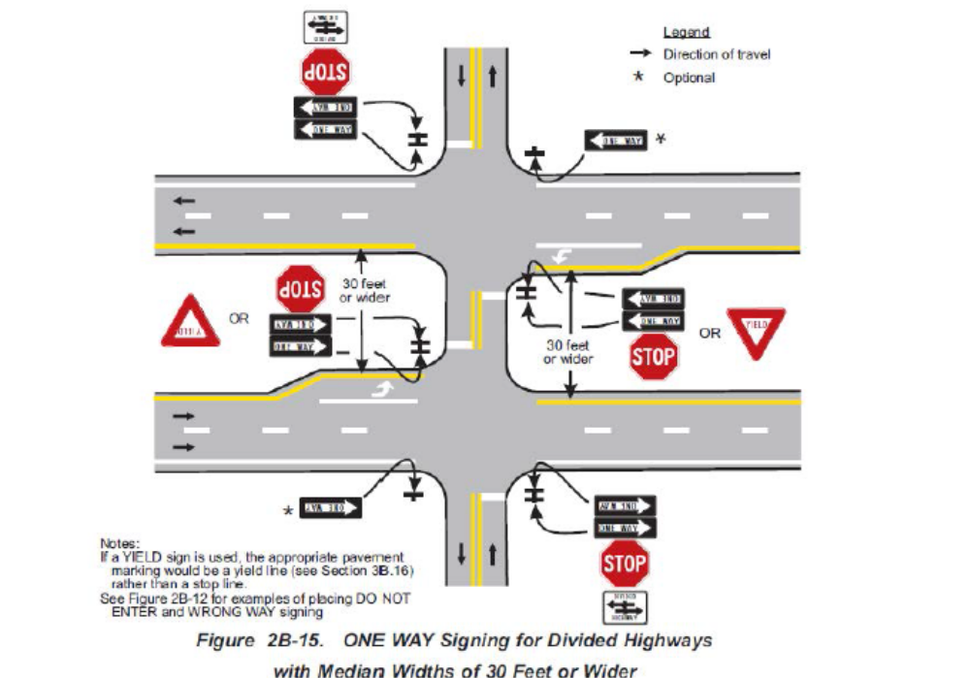
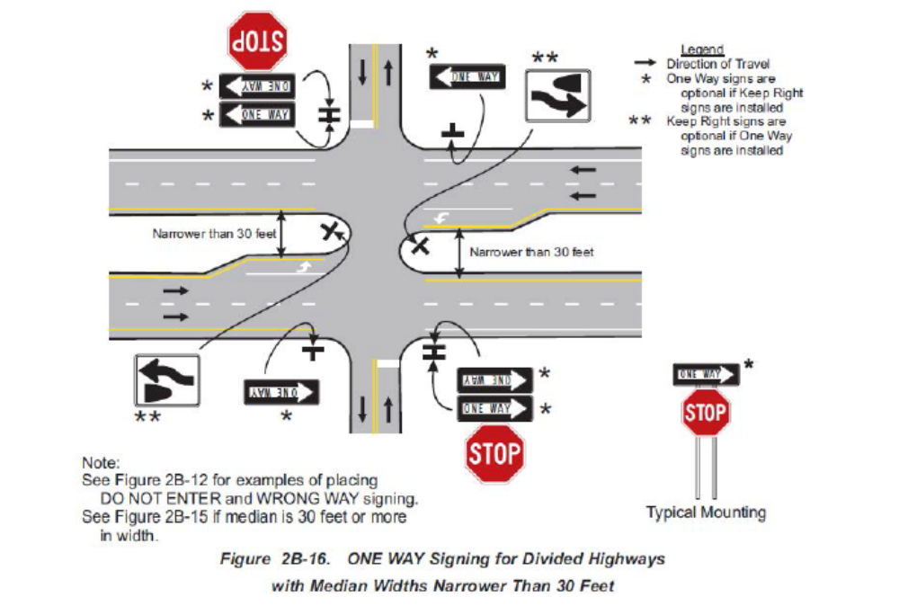
MN MUTCD Figures

Slide 8
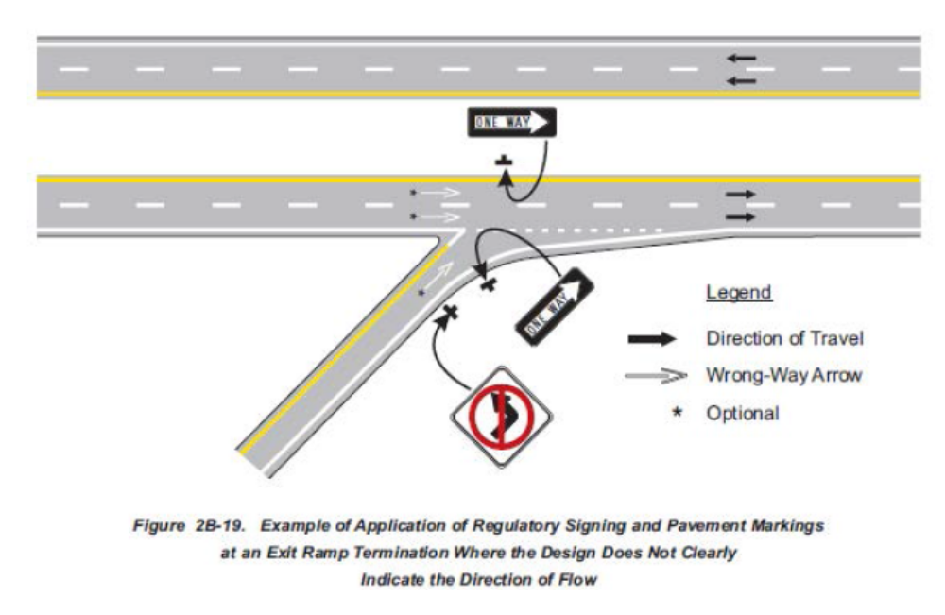
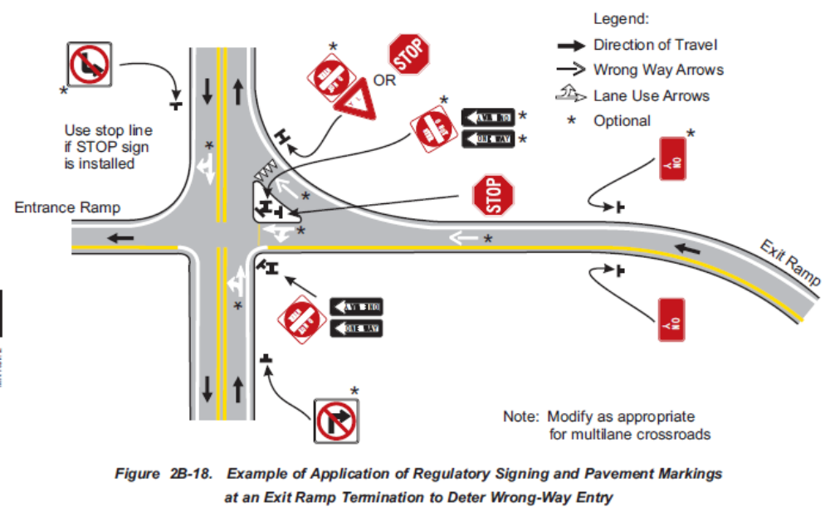
MN MUTCD Figures

Slide 9
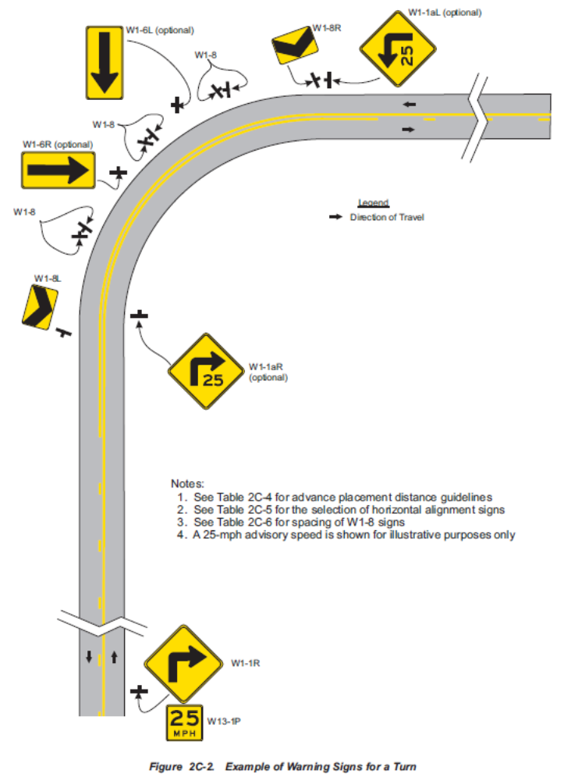
MN MUTCD Figures
Page 5-42

Slide 10
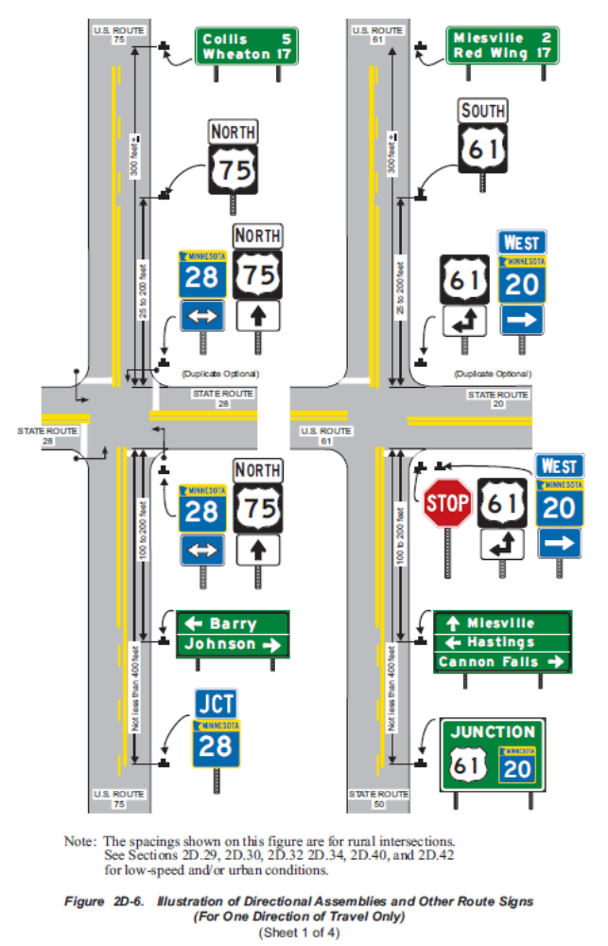
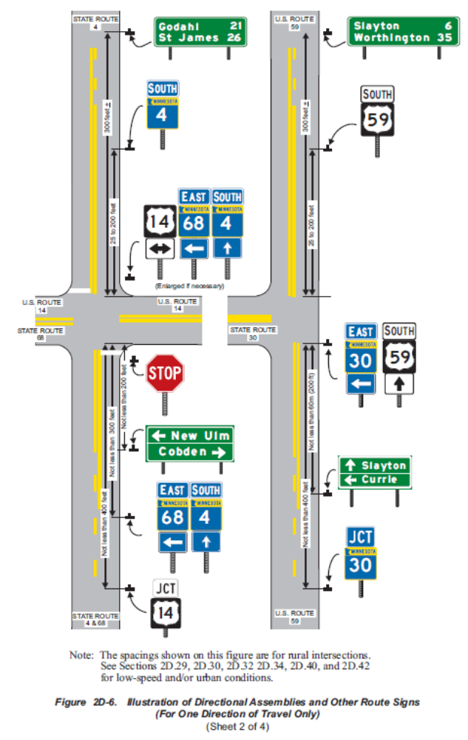
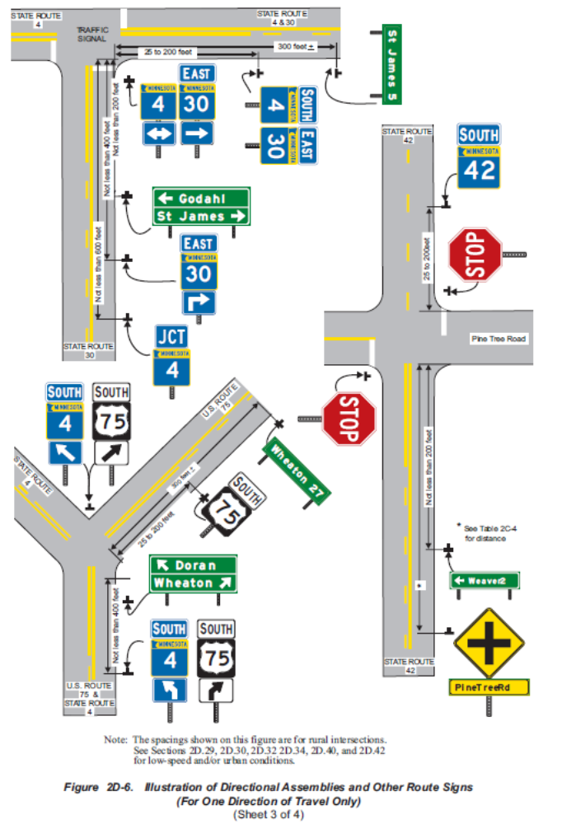
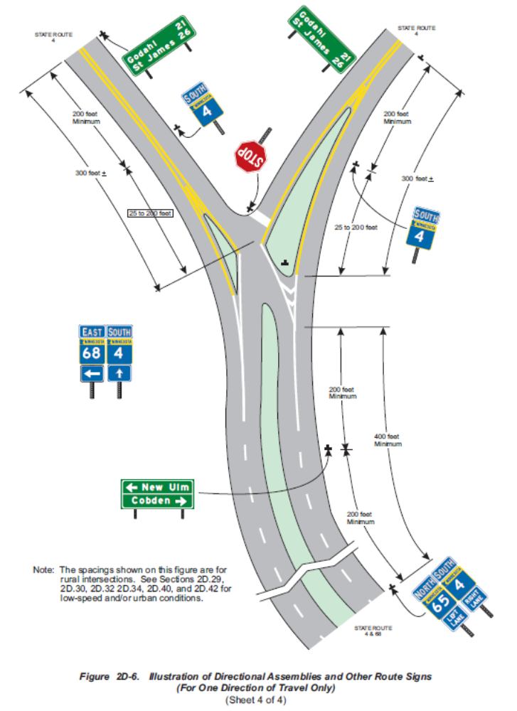
MN MUTCD Figures
Page 5-50

Slide 11
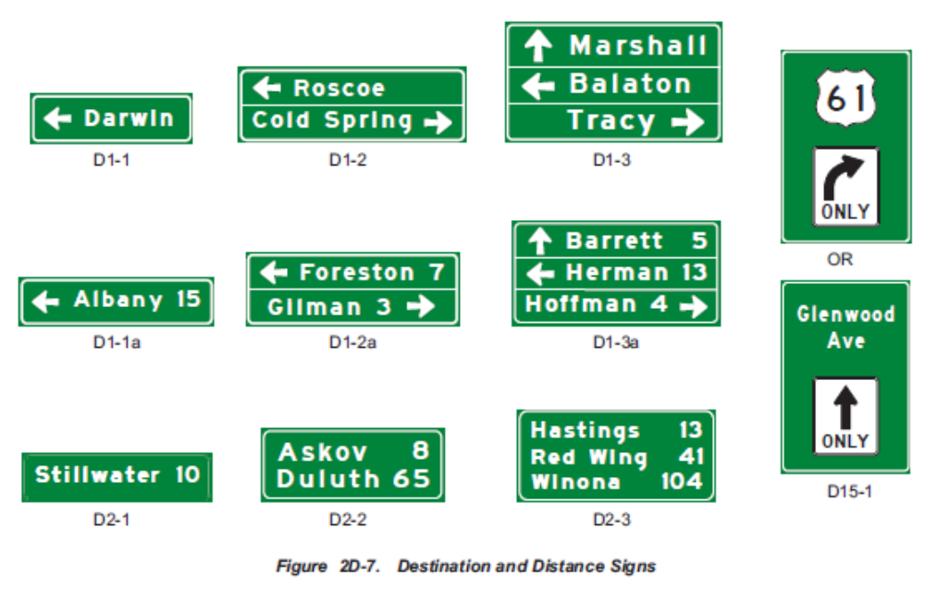
MN MUTCD Figures
Page 5-56

Slide 12
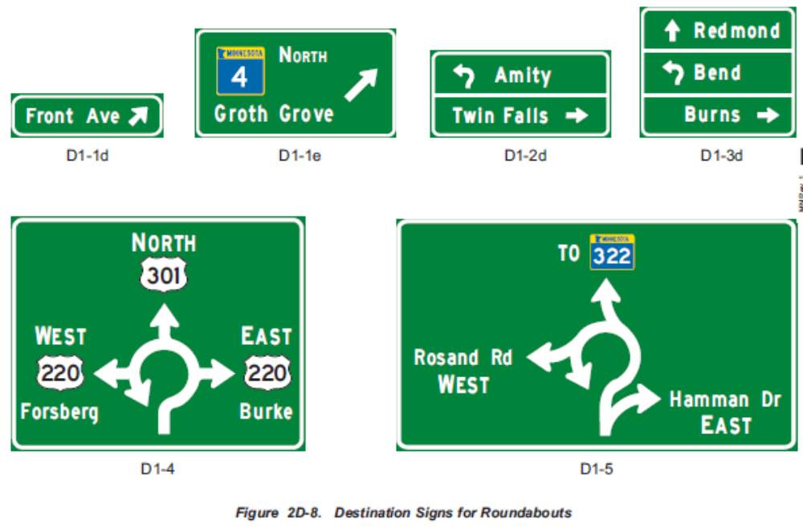
MN MUTCD Figures

Slide 13
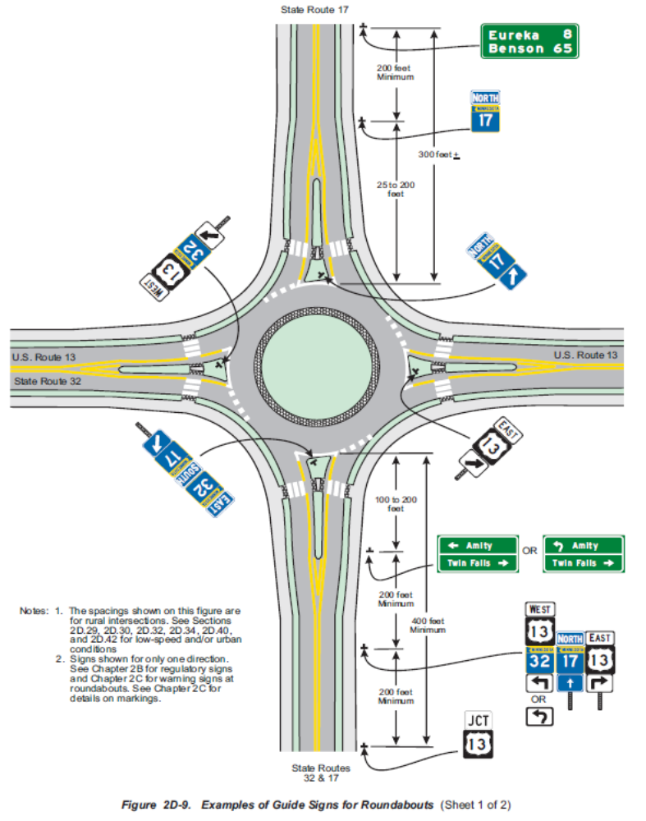
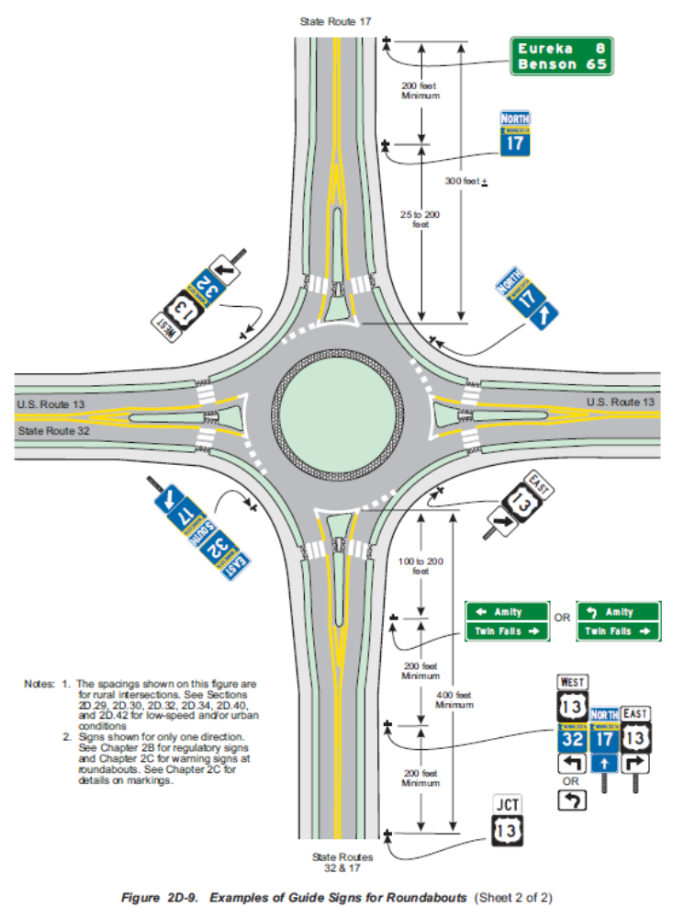
MN MUTCD Figures

Slide 14
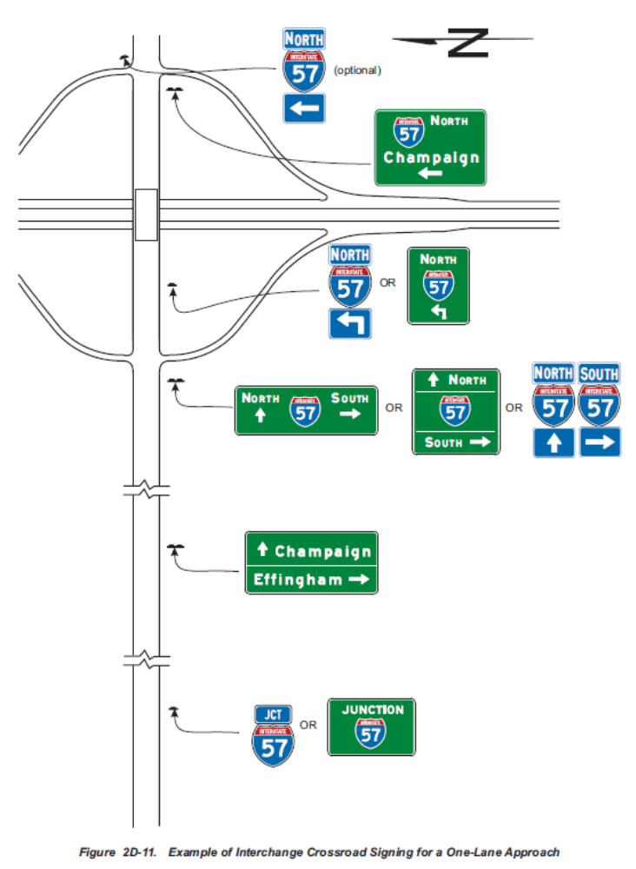
MN MUTCD Figures
Page 5-66

Slide 15
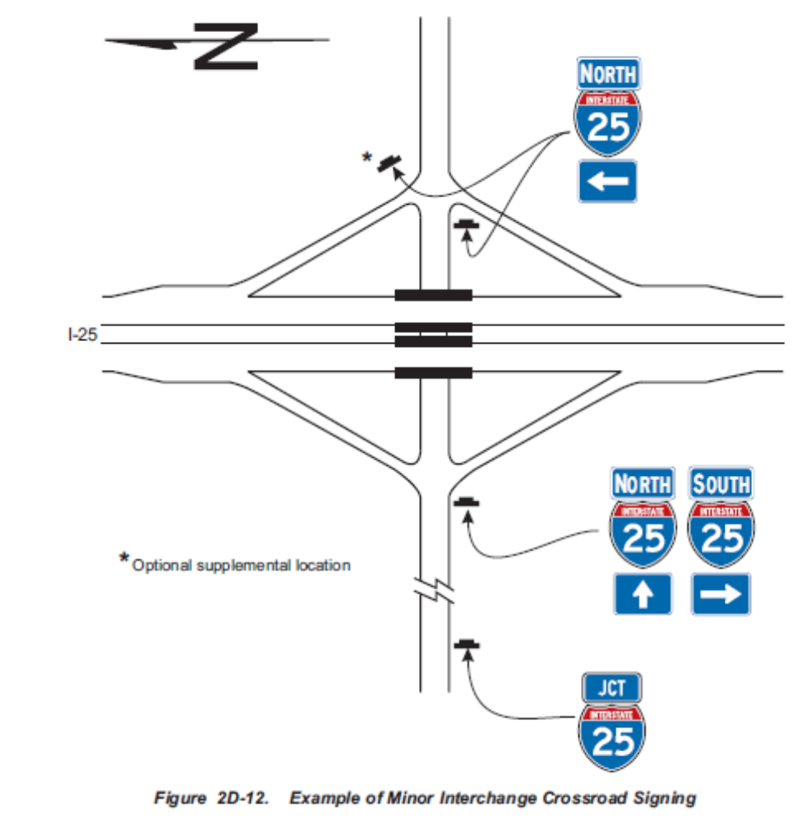
MN MUTCD Figures

Slide 16
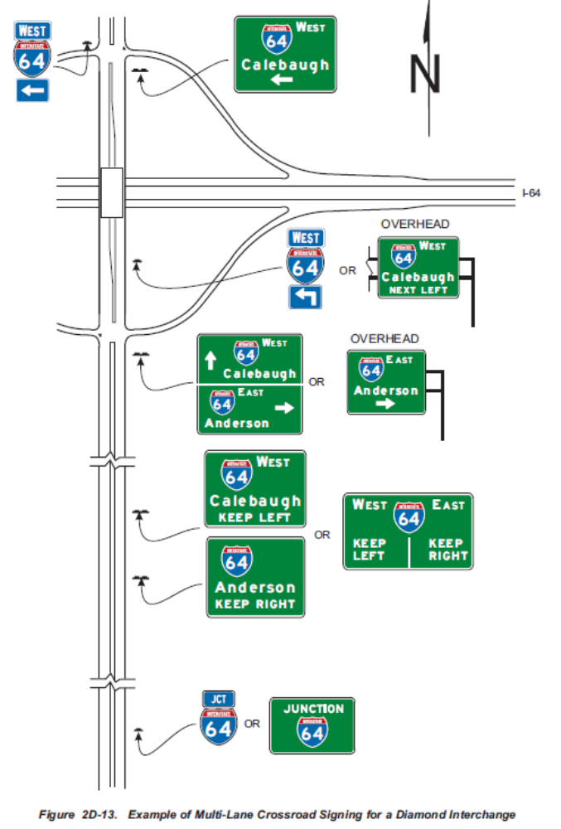
MN MUTCD Figures

Slide 17
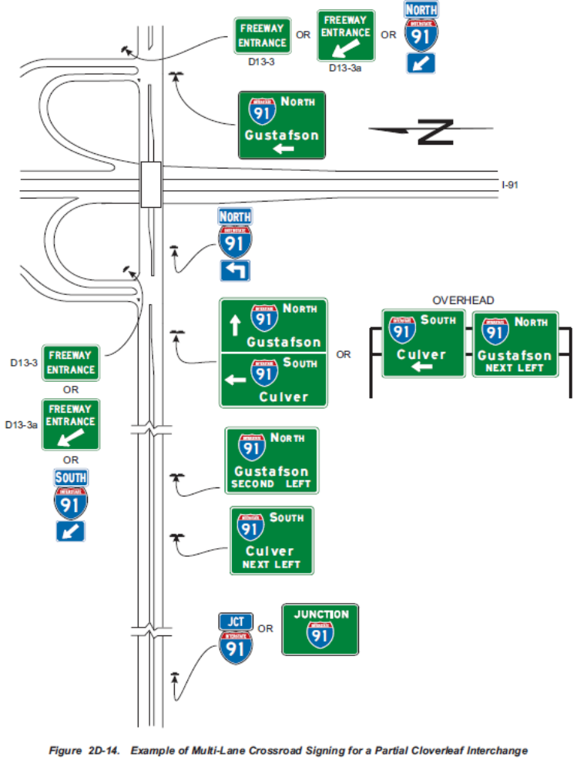
MN MUTCD Figures

Slide 18
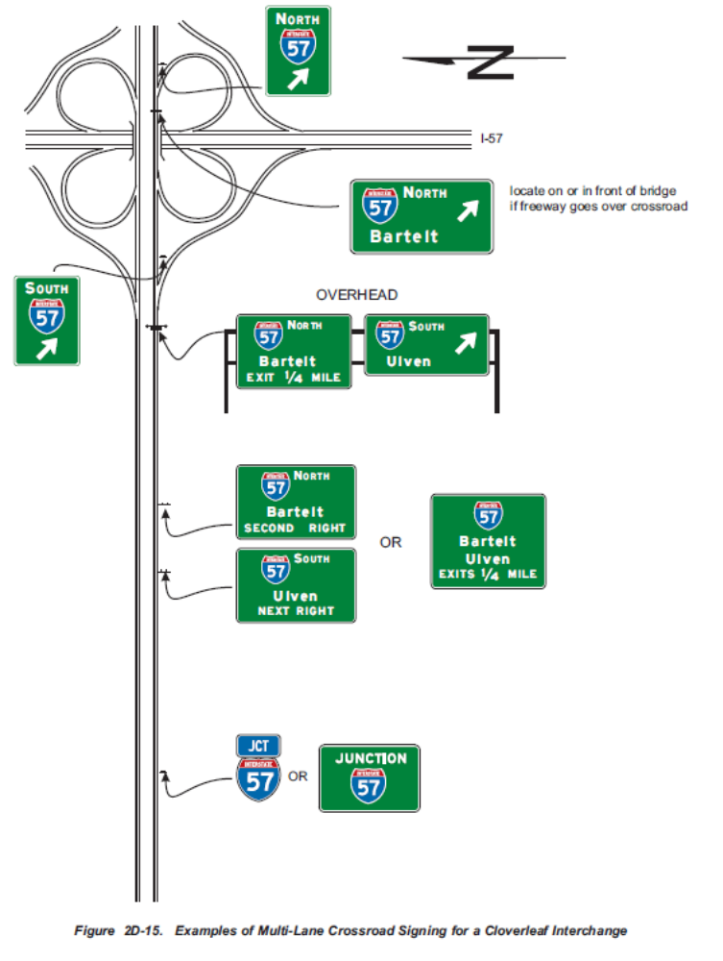
MN MUTCD Figures

Slide 19
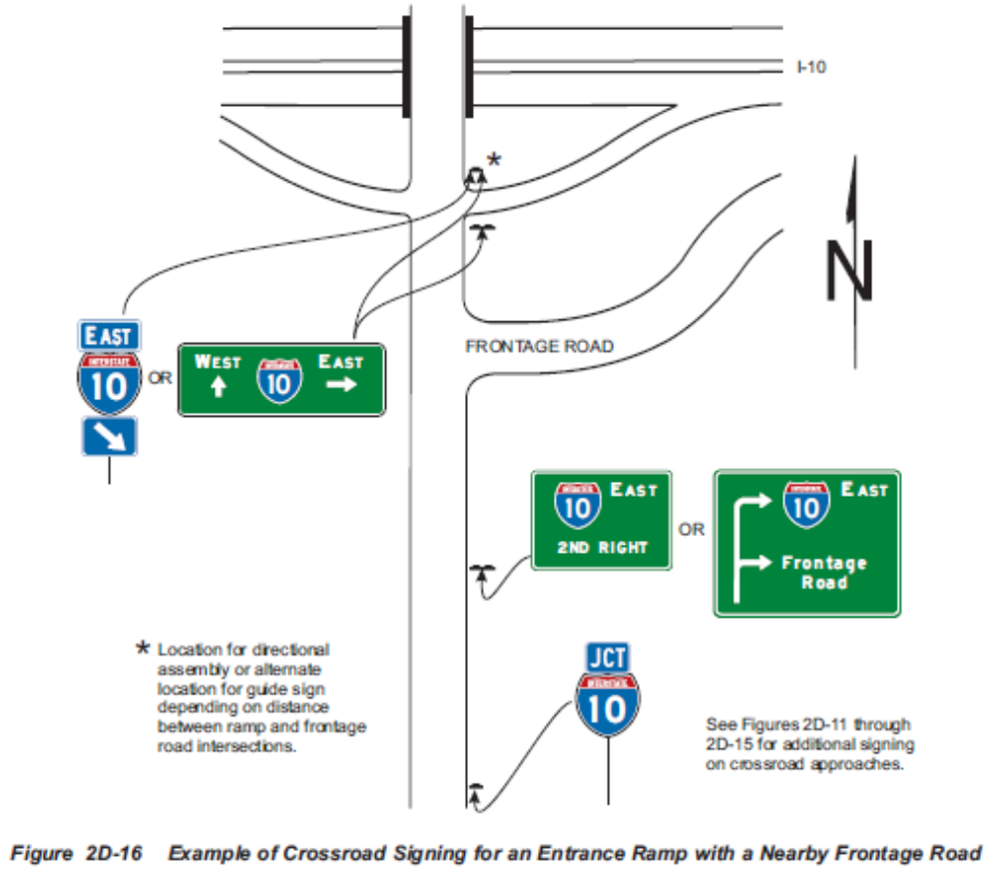
MN MUTCD Figures

