Slide 1
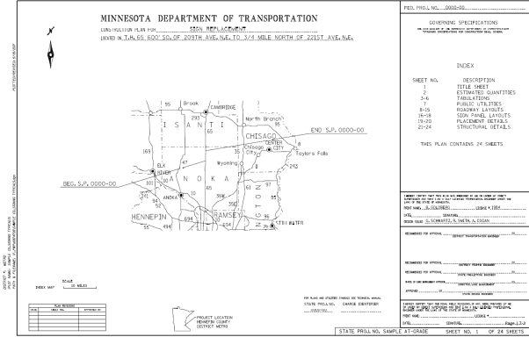
Chapter 6
Signing Plan Design & Plan Sets
Sign Plan Design for
At-Grade Intersections
June 2017

Slide 2
Signing Plan Assembly Steps
Download latest plan set assembly steps from OTST website
Sample plans organized to follow an established format
When proceeding through steps, refer to sample plans

Slide 3
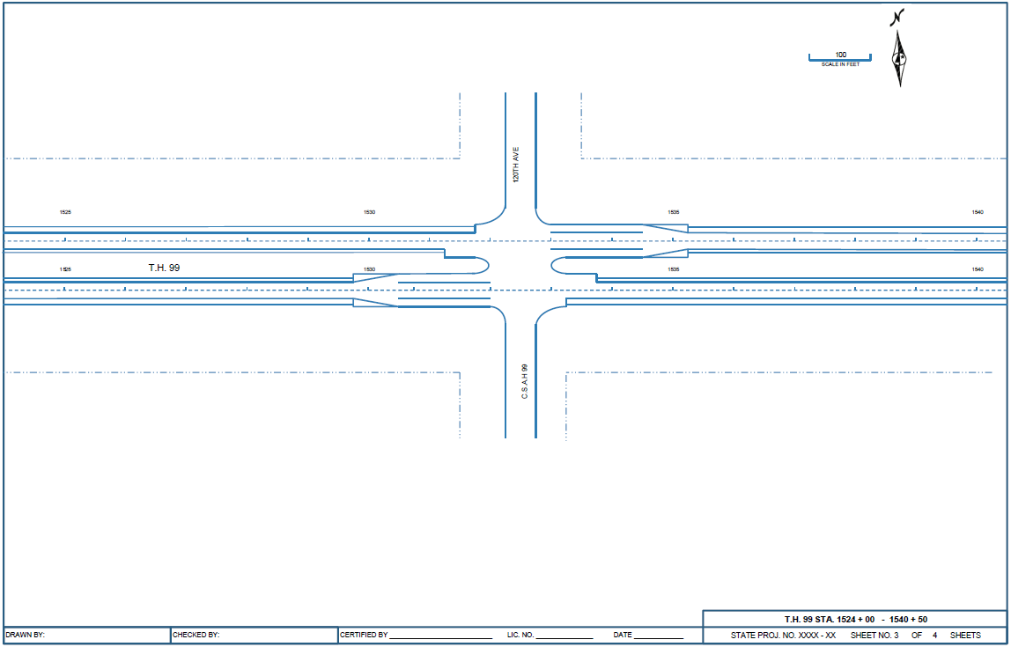
Signing Plan Assembly Steps
Begin with a Microstation seed file
Attach coordinate correct reference files (roadway mapping and alignments)

Slide 4
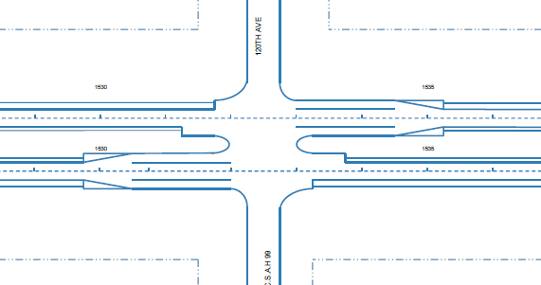
Signing Plan Assembly Steps
Place all signs on roadway plan sheet for each direction of travel (Use figures in TEM and MN MUTCD)

Slide 5

Signing Plan Assembly Steps
Place all signs on roadway plan sheet for each direction of travel (Use figures in TEM and MN MUTCD)
  See MN MUTCD and TEM for placement and spacing
  Design all necessary guide signs in SignCAD
    Refer to MnDOT Traffic Guide Sign Design Manual for standards and procedures

Slide 6
Signing Plan Assembly Steps
Label signs in an orderly fashion beginning at the left edge of the first sheet and progressing through the last roadway sheet
  NOTE: refer to the TEM Chapter 6 section 6-4 for information on how MnDOT classifies signs by design type (A, C, D, EA, EO and OH)
  New signs get labeled with their sign type and a unique A type number similar to an OH sign number.
    EXAMPLE: A I94-001, A I94-002, A MN280-001 etc. for new A signs. C-1, C-2, C-3 etc. for new C signs. D-1, D-2, for new D signs

Slide 7
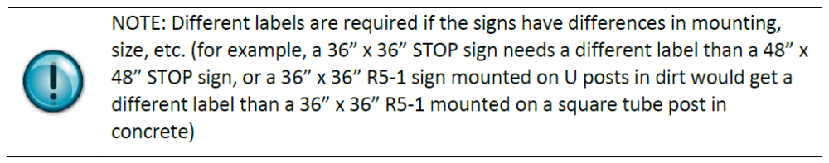
Signing Plan Assembly Steps
  Existing signs being removed are labeled with their sign type and a sequential number beginning with 101
  Except Type C signs and Delineators and Markers
    EXAMPLE: A I94-101, A I04-102, A MN280-101 etc. for Type A signs being removed. D-101, D-102, for Type D signs being removed. * C signs being removed DO NOT NEED TO BE LABELLED THIS WAY. C signs are shown on the roadway and totaled in the Statement of Estimated quantities, but do not need to be labelled C-101, C102) *See sample Signing plans.
  Existing signs being Salvaged are labelled with their sign type and a sequential number beginning with 201
    EXAMPLE: A I94-201, A I94-202. C-201, C-202 etc.
  All completely identical Type C, D, EA, and EO signs receive the same label throughout the plan.

Slide 8
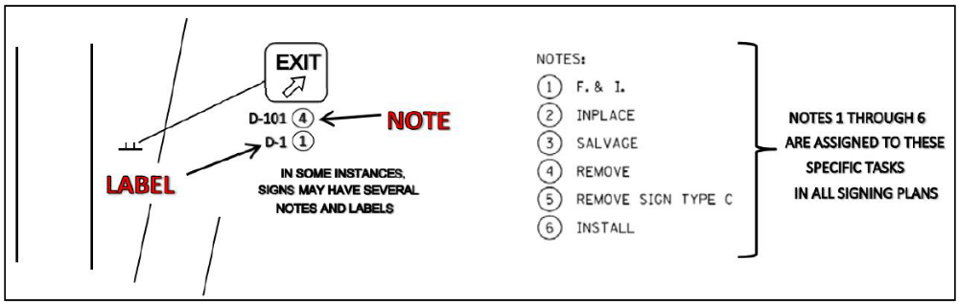
Signing Plan Assembly Steps
  Circled numbers (notes) describing the work to be done to the sign follow the label
  Notes 1 through 6 describe common signing situations or tasks and are consistent in all signing plans

Slide 9
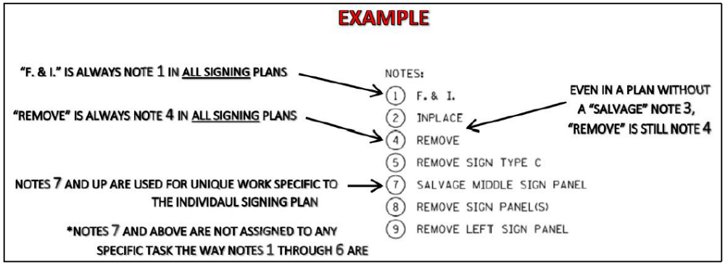
Signing Plan Assembly Steps
  Notes 7 and beyond will vary by plan depending on the work required in the individual signing plan
  Type OH signs have a unique numbers assigned to them. Contact the OTST Signing Unit to obtain new OH sign numbers (Brian Barrett 651-234-7374)

Slide 10
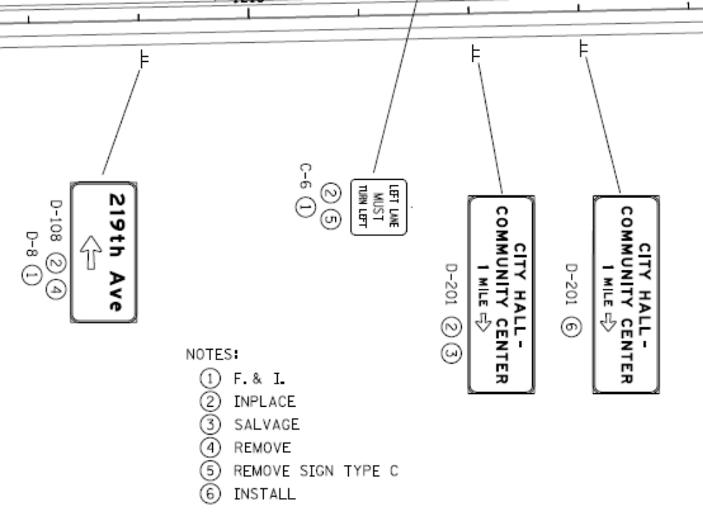
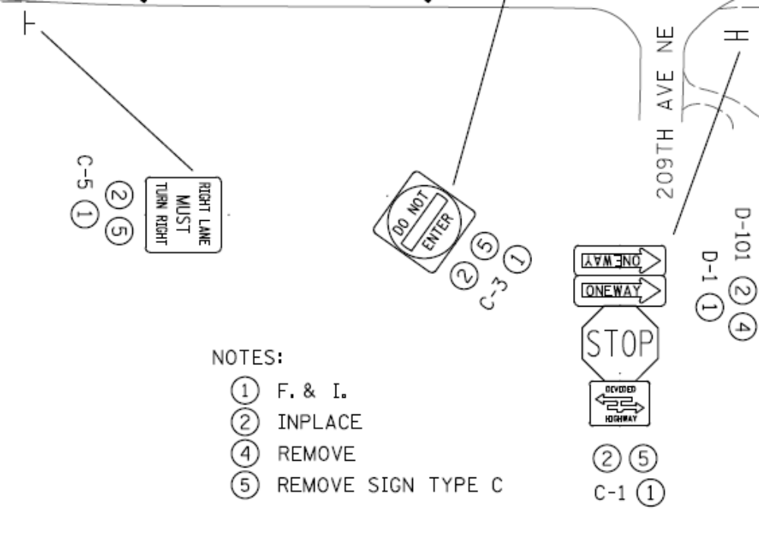
Signing Plan Assembly Steps

Slide 11
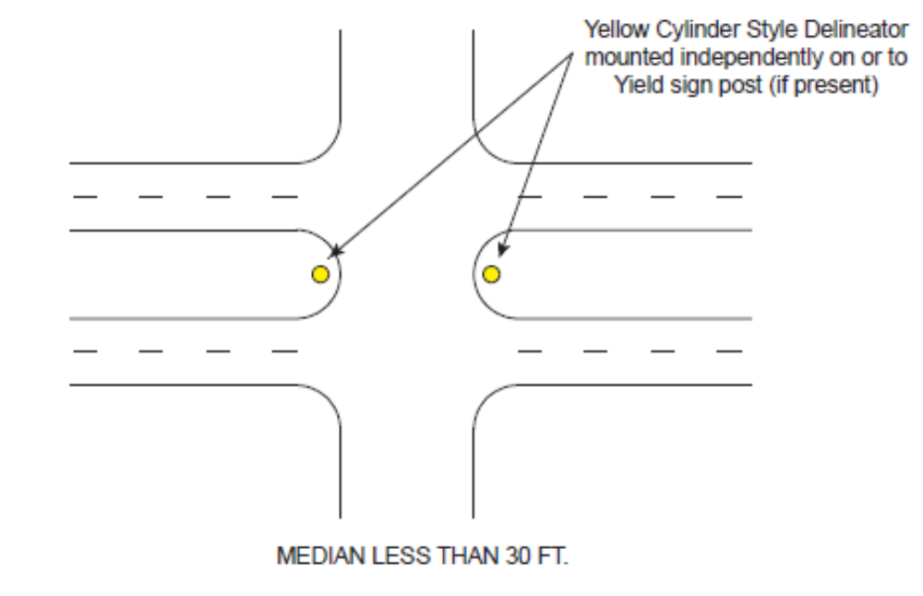
Signing Plan Assembly Steps
Show appropriate delineation and markers
  See TEM Chapter 6 for details
  A note may be used to indicate standard delineation at standard exit ramp/loops
  See sample Signing plans.

Slide 12
Signing Plan Assembly Steps
Organize roadway into plan sheets
  Begin with mainline roadway from start to finish of the project.
  Stationing generally increasing from left to right
  Interchange/intersections follow mainline roadway
  Label all roadways, cross streets and bridges
  Place “north” arrow and scale on all sheets
  Eliminate all unnecessary elements in the file
  When all the sign panels, delineators and markers are placed on the roadway layouts, with labels and notes, and the roadway layouts are organized into plan sheets, the plan is considered 60% complete. It is ready for initial review. Print outs of these roadway layouts, and Type A, D, EA, EO and OH panel designs should be submitted to MnDOT for review.

Slide 13
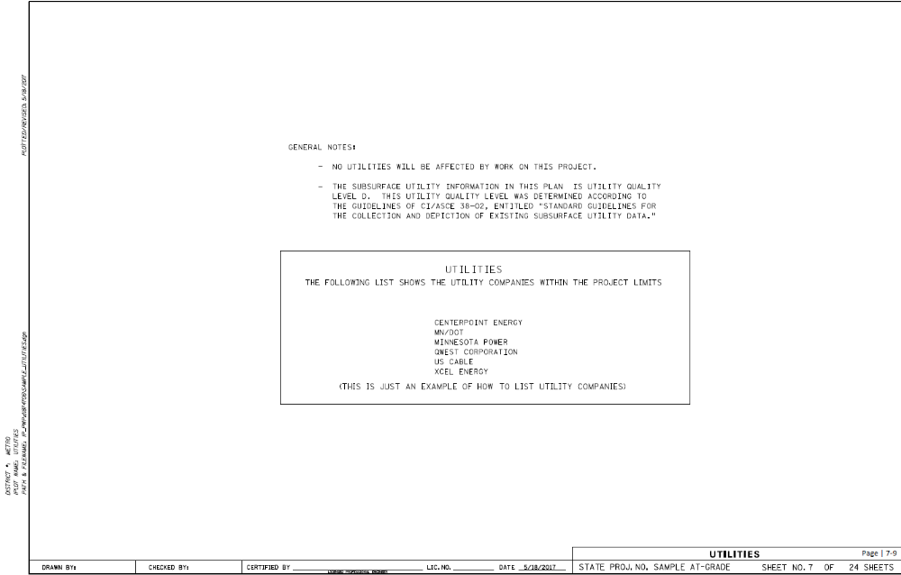
Signing Plan Assembly Steps
Utilities: Compile a list of the utility companies within the project limits for inclusion in the plan
NOTE: Follow Utility Manual processes

Slide 14
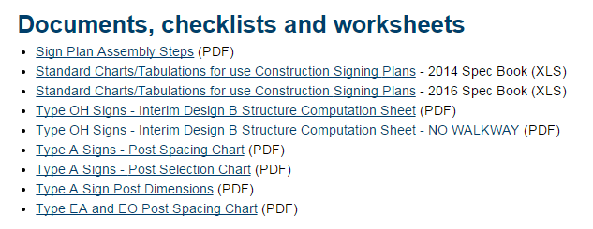
Signing Plan Assembly Steps
Design Type A and OH sign structures following the cross section format in the sample plan (Freeways Class)
Create estimated quantities tabulation and appropriate data boxes for each sign type and the work being done to the sign
  Master Tabs and Sample Plan

Slide 15
Signing Plan Assembly Steps
Assemble all necessary structural and detail sheets
Complete the title sheet (if signing plan is not part of a larger construction project)
Assemble all plan sheets in their proper order (see sample plan)
Number all plan sheets
Verify all cross sheet referencing in the plan

Slide 16

Title Sheet
Plan Description & Location

Slide 17
Title Sheet
Governing Specs &
Index of Sheets

Slide 18
Title Sheet
Project Numbers

Slide 19
Title Sheet
Plan Approvals/Certification

Slide 20
Title Sheet
Index Map
Index Map

Slide 21
Title Sheet
Begin/End Stations

Slide 22
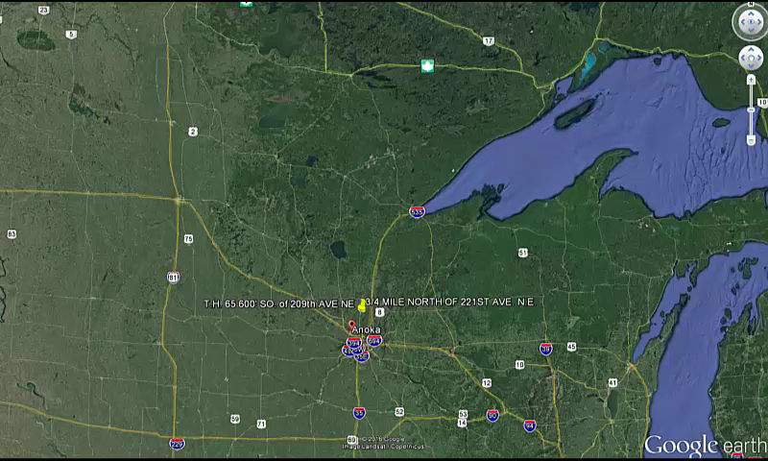
Sample Plan

Slide 23
Title Sheet
Project Location
Plan & Map Scales

Slide 24
Title Sheet
Plan Revisions Table

Slide 25
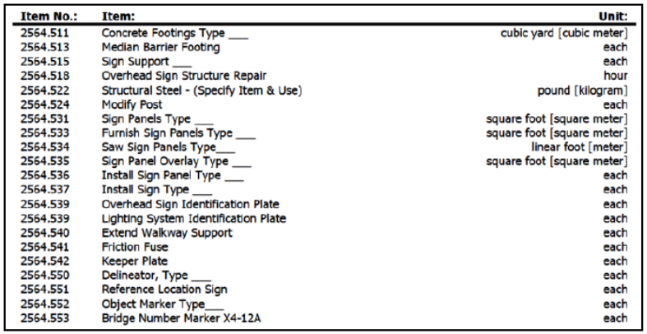
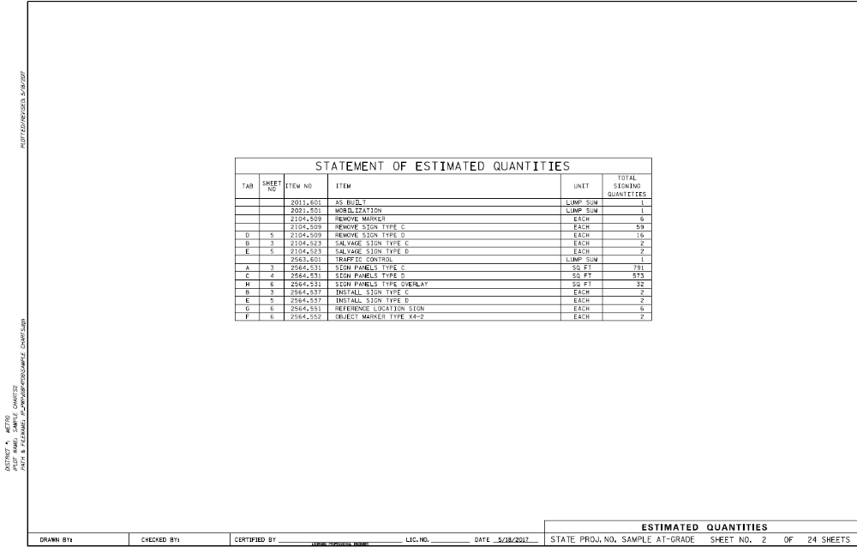
Estimated Quantities
List of Pay Items
For list of items, see Spec Book

Slide 26
Estimated Quantities

Slide 27
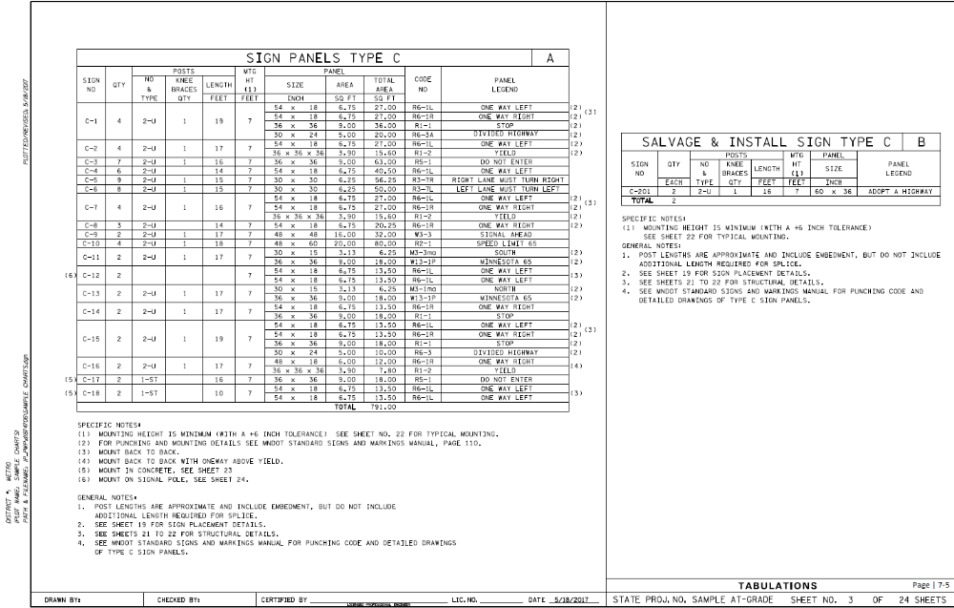
Type C Sign Data Sheet
Chart A and Chart B
Chart A for signs to be furnished and installed
Chart B for signs to be salvaged and installed

Slide 28
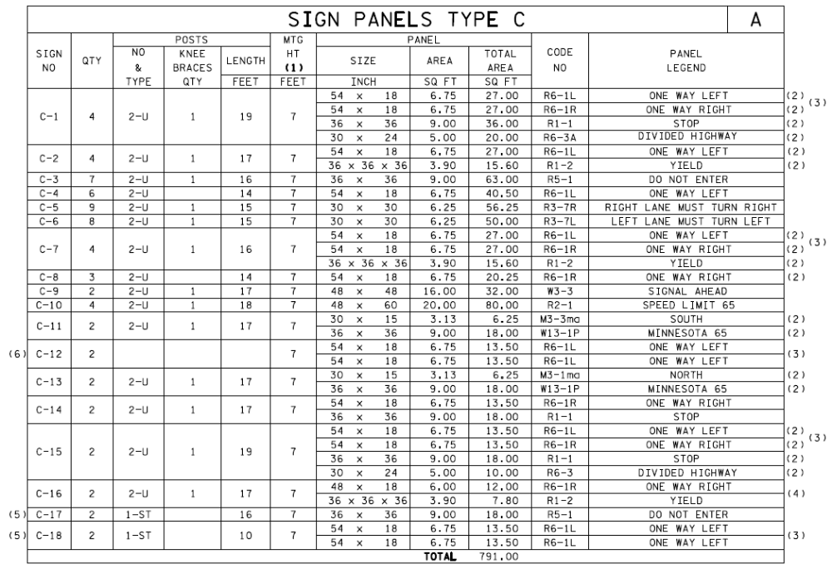
Type C Sign Data Sheet
Chart A
Sign Number
Order in accordance with the Standard Signs Summary
Regulatory
Warning
Route Markers & Auxiliaries

Slide 29
Type C Sign Data Sheet
Chart A
Quantity
Order

Slide 30
Type C Sign Data Sheet
Chart A
Posts
Number of Posts, Type, and Knee Brace Quantity
TEM Charts 6.2
Length
Post Length Determination Sheet

Slide 31
Type C Sign Data Sheet
Chart A
Mounting Height

Slide 32
Type C Sign Data Sheet
Chart A
Panel Summary
Size specified in the Standard Signs Summary
STOP signs specified in TEM 6-5.12

Slide 33
Type C Sign Data Sheet
Chart A
Code Number, Panel Legend
Code specified in the Standard Signs Summary

Slide 34
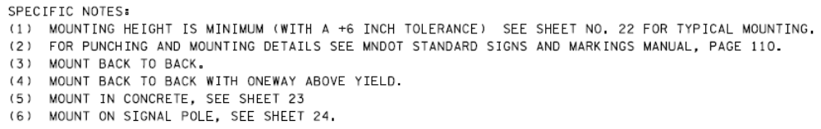
Type C Sign Data Sheet
Chart A
Specific Notes

Slide 35
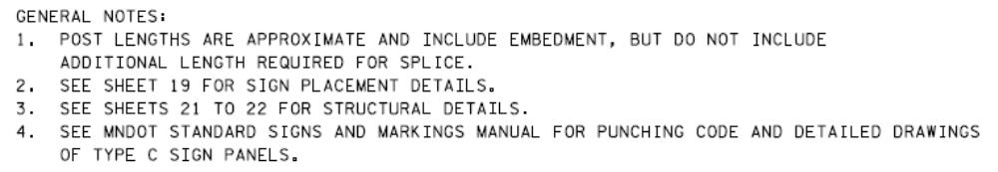
Type C Sign Data Sheet
Chart A
General Notes

Slide 36
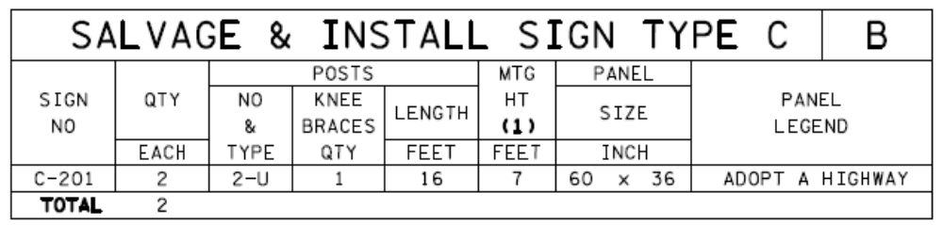
Type C Sign Data Sheet
Chart B
Same information as Chart A, however,
Chart B is for Signs to be salvaged and installed

Slide 37
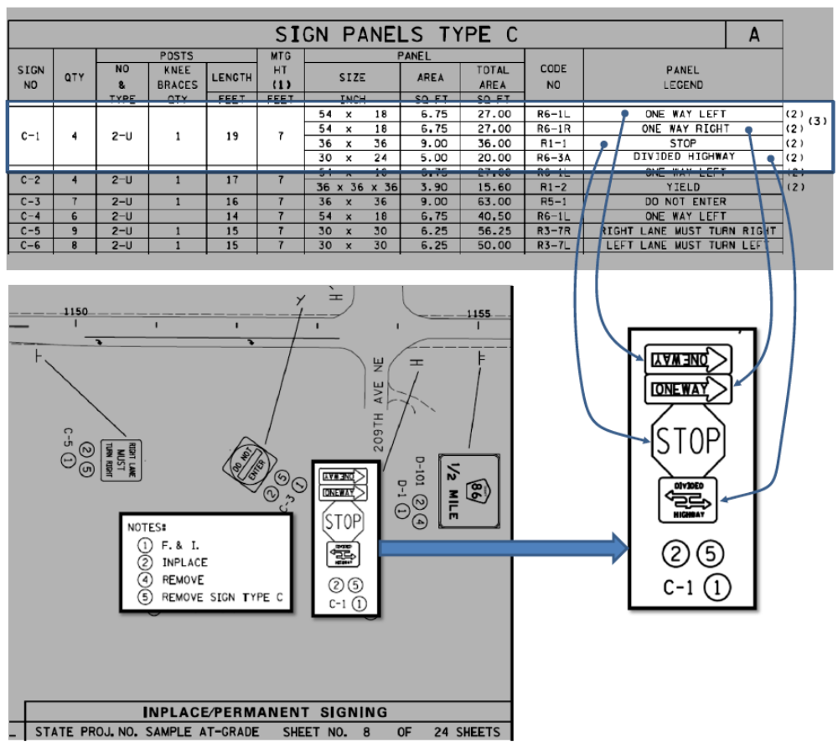

Slide 38
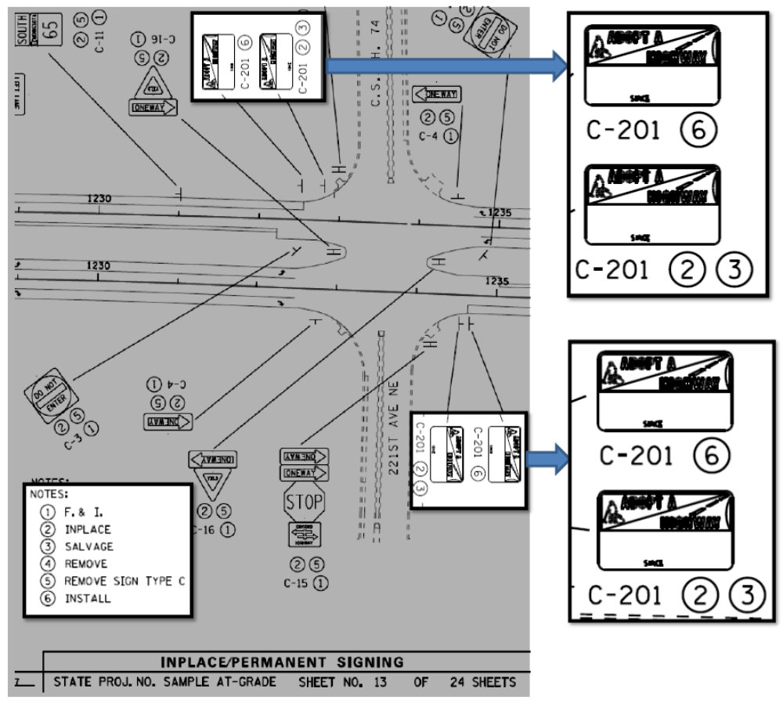

Slide 39
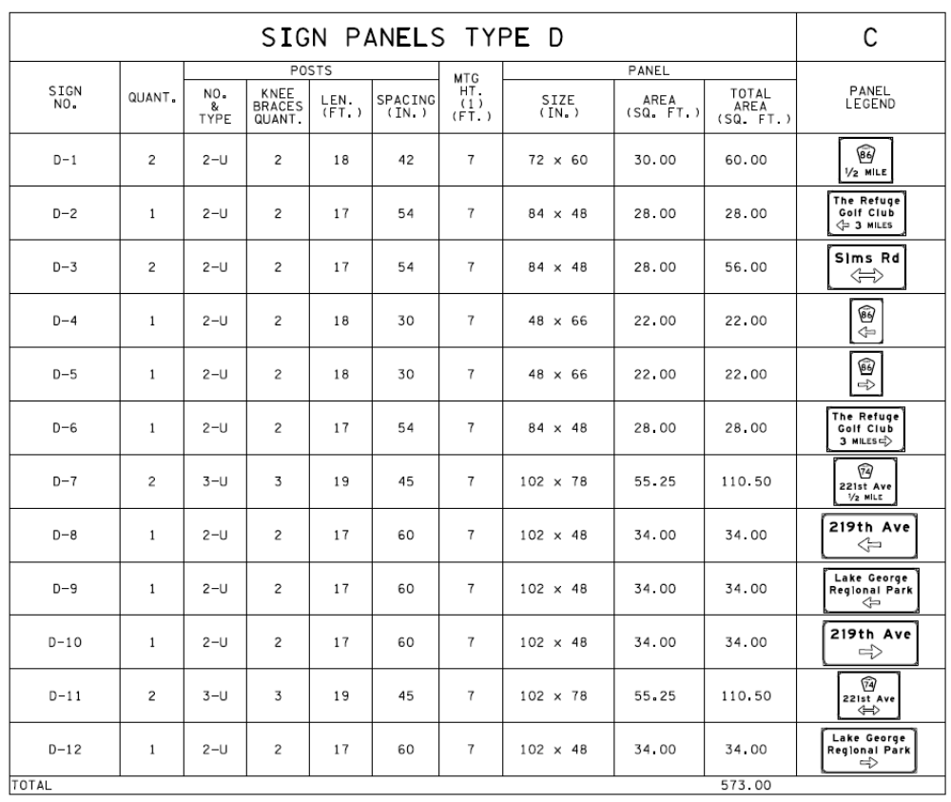
Type C Sign Data Sheet
Charts C
Post Spacing
  Punch Codes in Standard Signs Manual or
  TEM Chart 6.4
Panel Legend (graphic)
  Details on later sheet

Slide 40
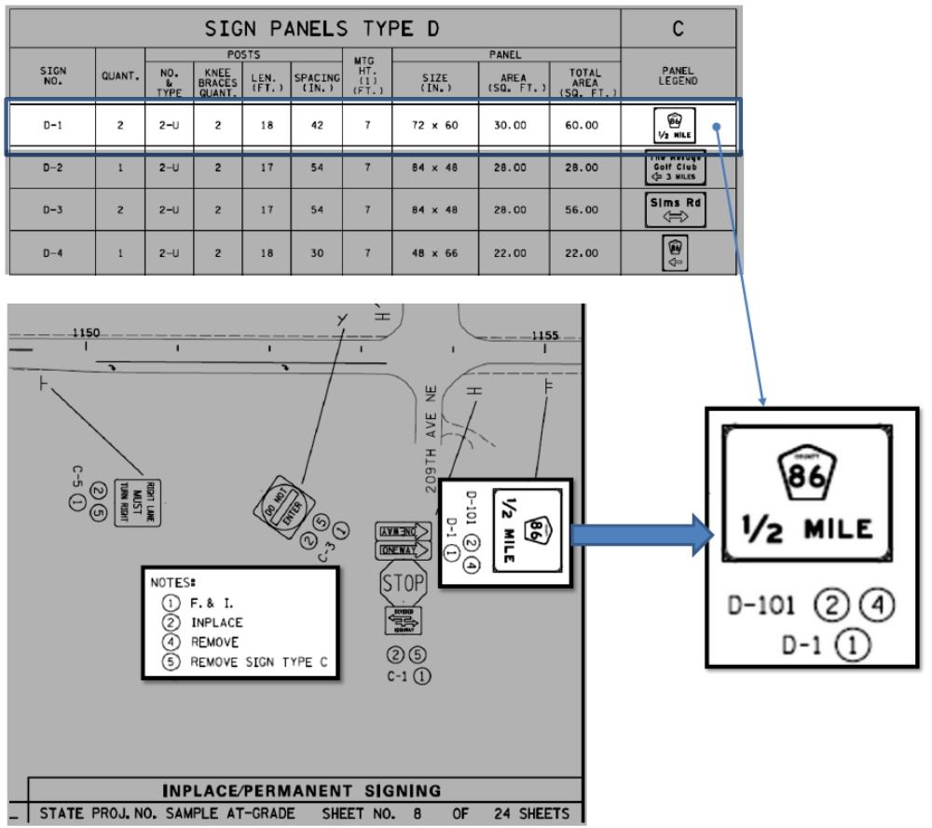

Slide 41
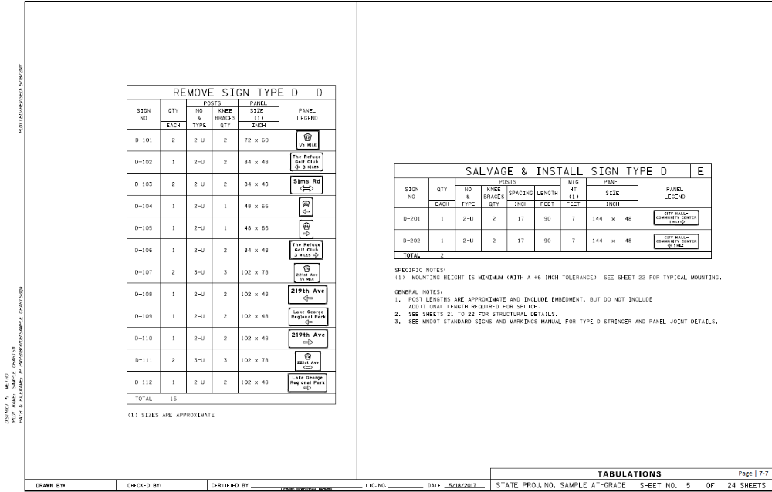
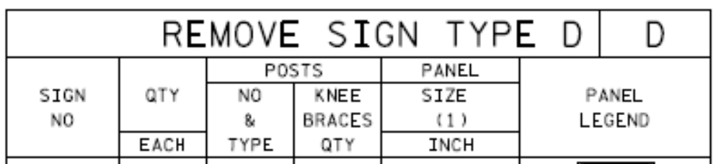
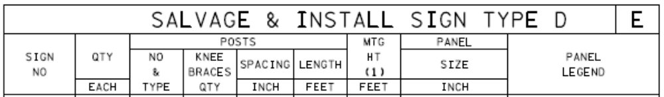
Type D Sign Data Sheet
Chart D and E

Slide 42
Chart E

Slide 43
Chart F, G and H

Slide 44
Chart F

Slide 45
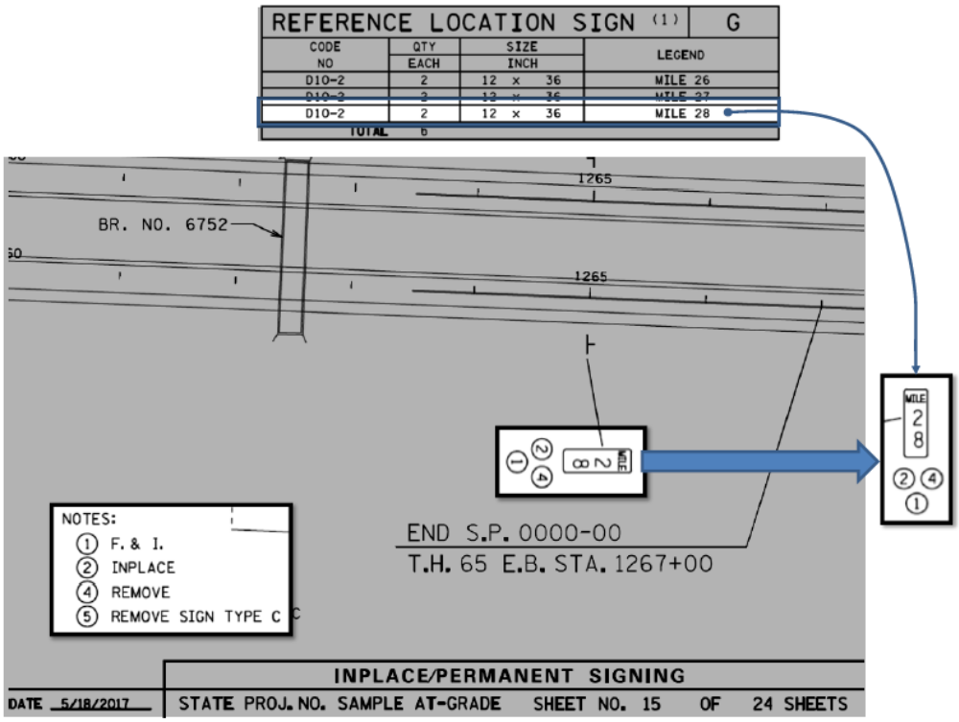
Type D Sign Data Sheet
Chart G - Markers

Slide 46
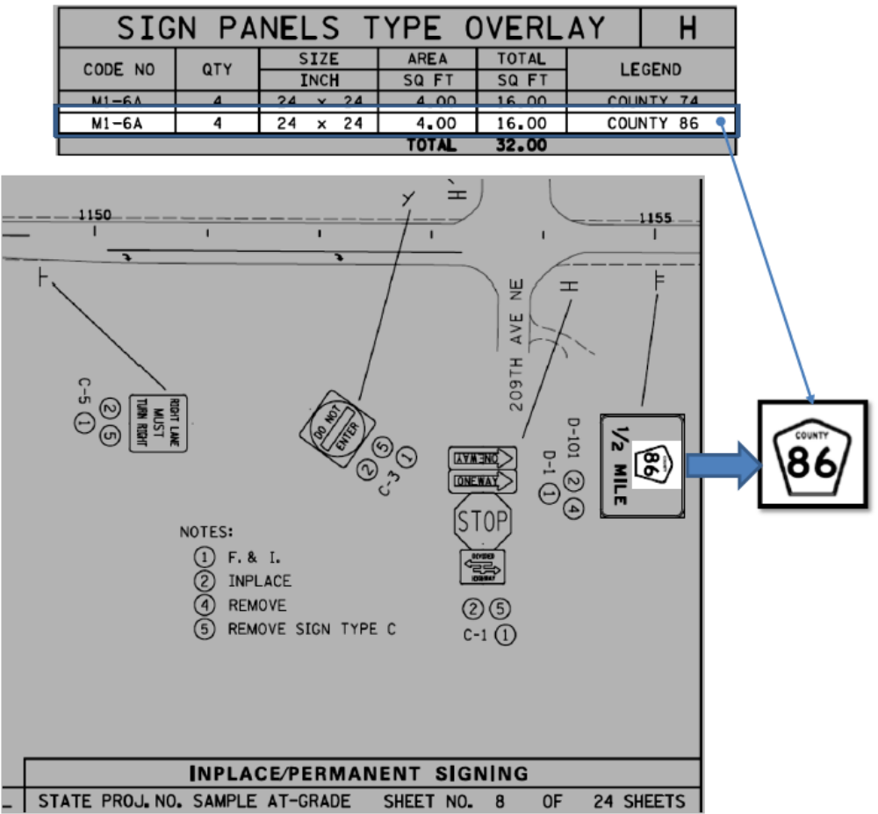

Slide 47
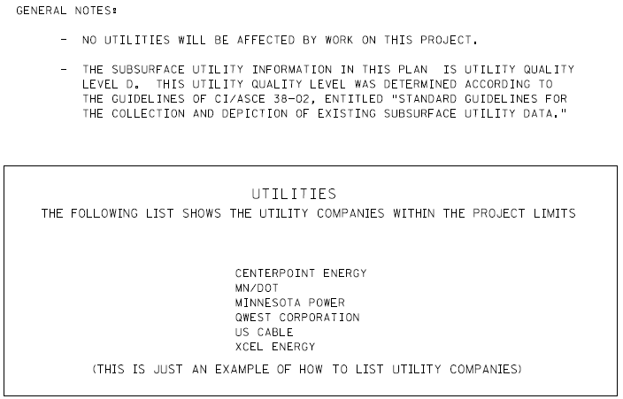
Utilities
Follow the Utility Manual Processes

Slide 48
Utilities
Affect on Utilities

Slide 49
Utilities
Subsurface Utility Info

Slide 50
Utilities
List of Utilities

Slide 51
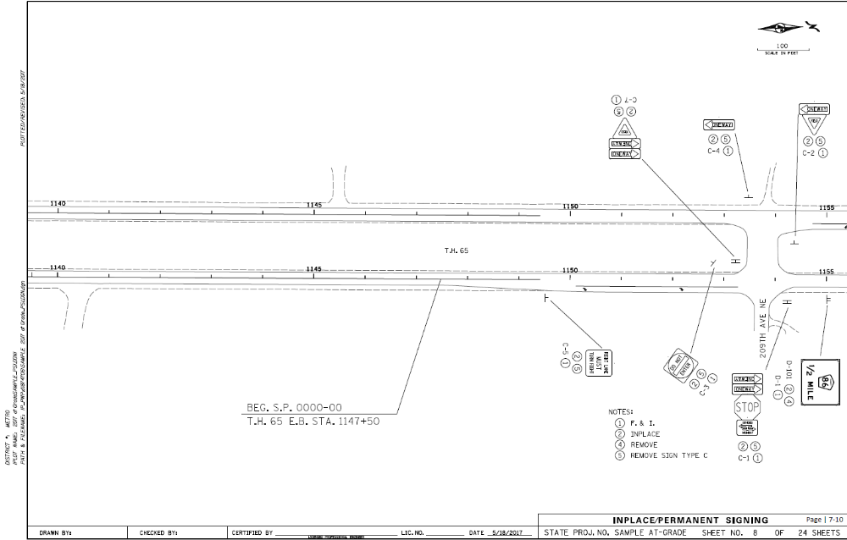
Roadway Layout
Stationing

Slide 52
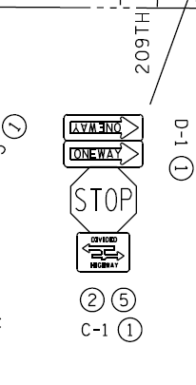
Roadway Layout
Sign Numbers

Slide 53
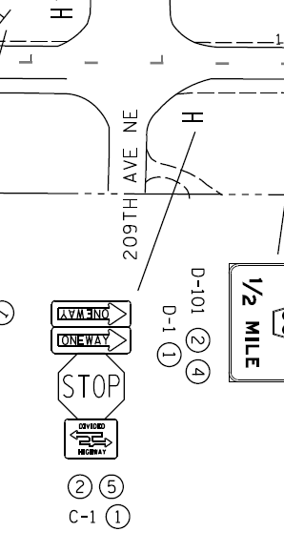
Roadway Layout
Sign Locations

Slide 54
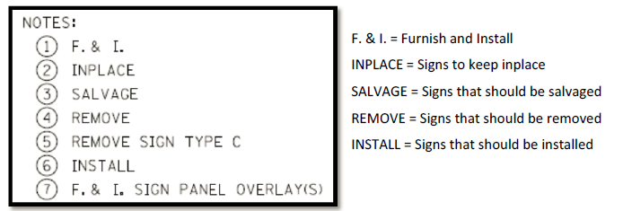
Roadway Layout
Notes

Slide 55
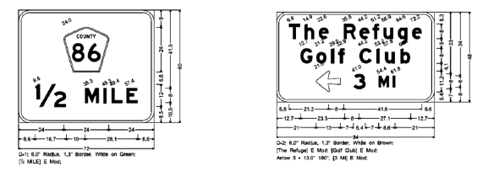
Type D Sign Panels
  SignCAD software used to design panels
  Sign panel dimensioning
  See Standard Signs and Pavement Markings Manual for arrow, fraction and overlay details.
  Guide Sign Design Course offered in July

Slide 56
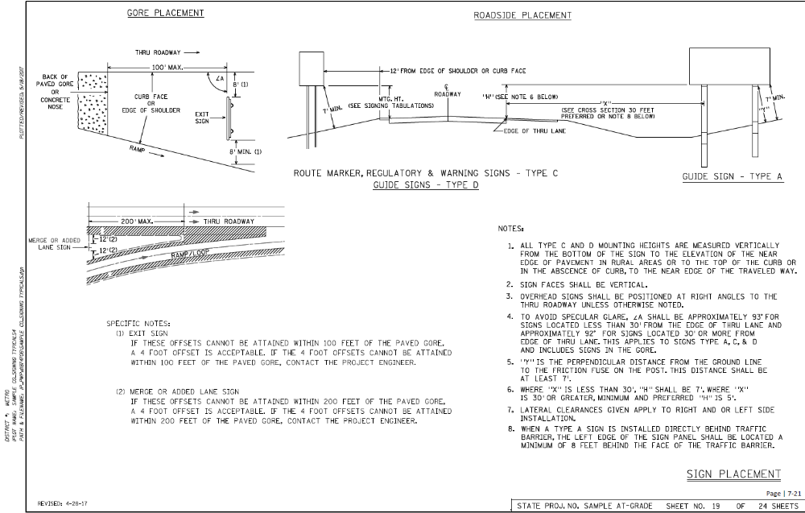
Sign Placement
TEM Figure 6.1

Slide 57
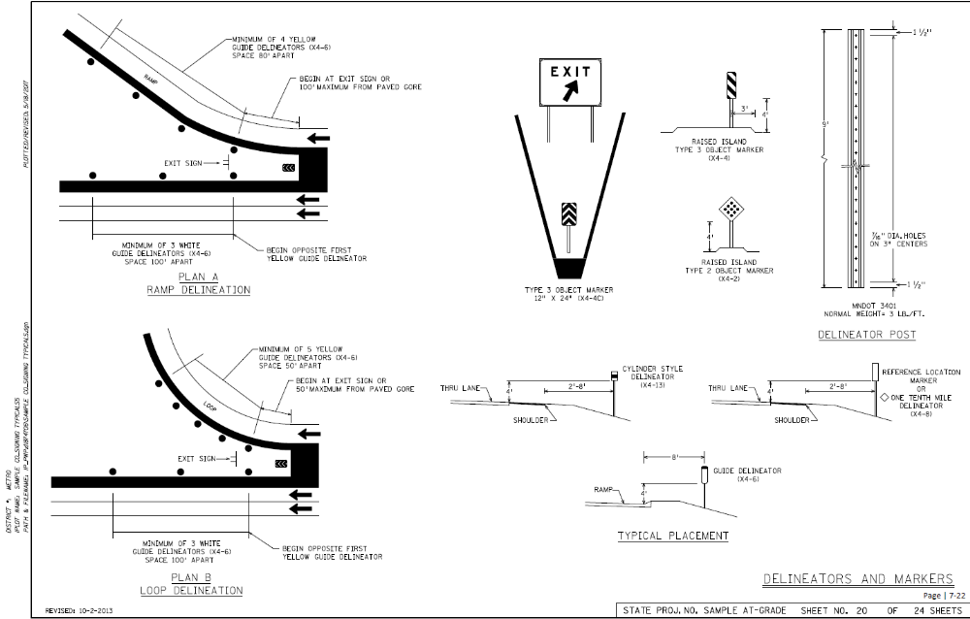
Delineators & Markers

Slide 58
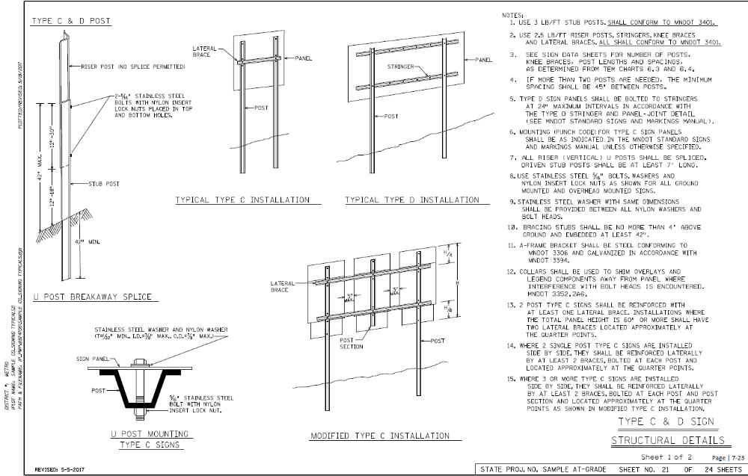
Type C & D Signs
Structural Details
TEM Charts 6.3 and 6.4

Slide 59
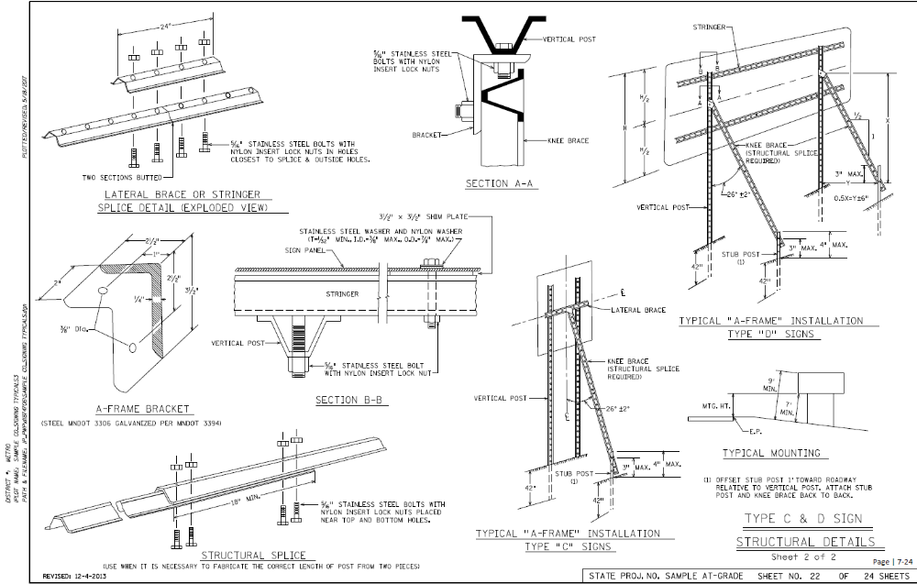
Type C & D Signs
Structural Details

Slide 60
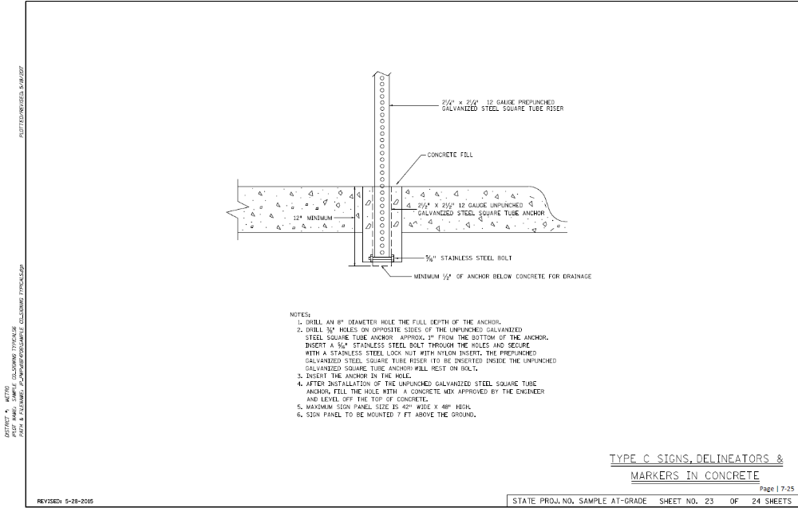
Type C Signs, Delineators & Markers in Concrete

Slide 61
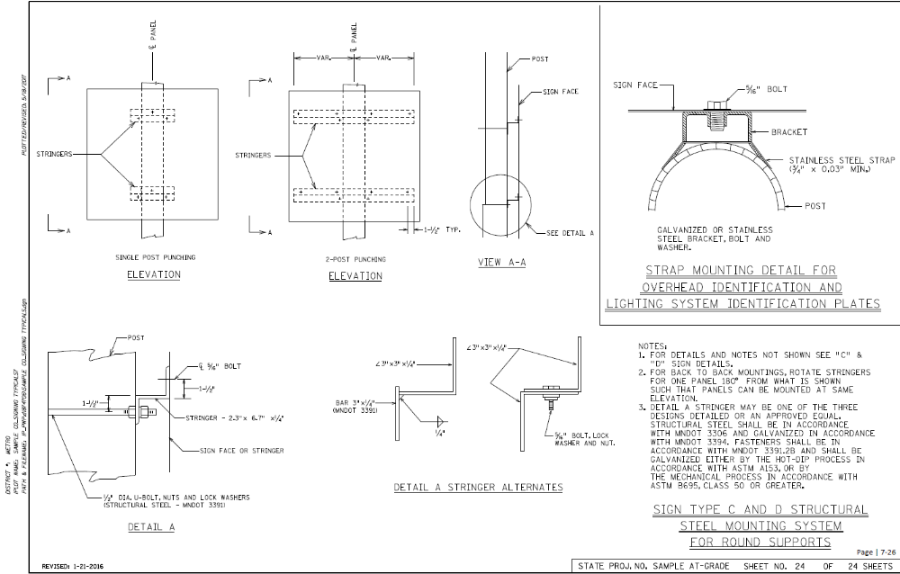
Type C and D Structural Steel Mounting System for Round Supports

Slide 62
Common Plan Set Issues
The following is a list of some of the common issues with plan sets from MnDOT reviewers
These are not in any order of importance

Slide 63
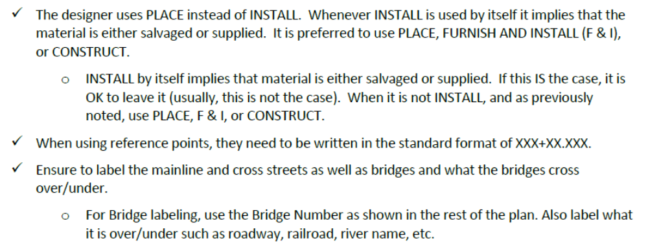
Common TTC Plan Set Issues

Slide 64
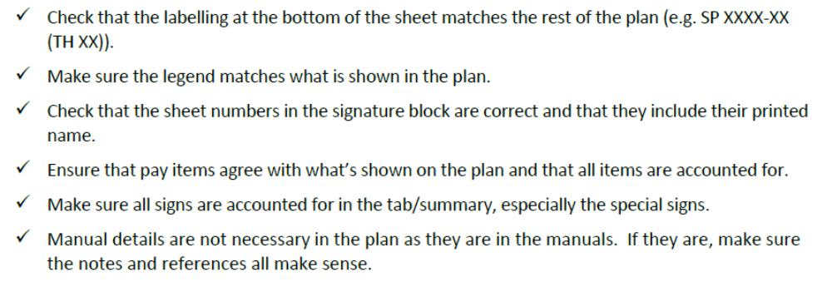
Common TTC Plan Set Issues

Slide 65
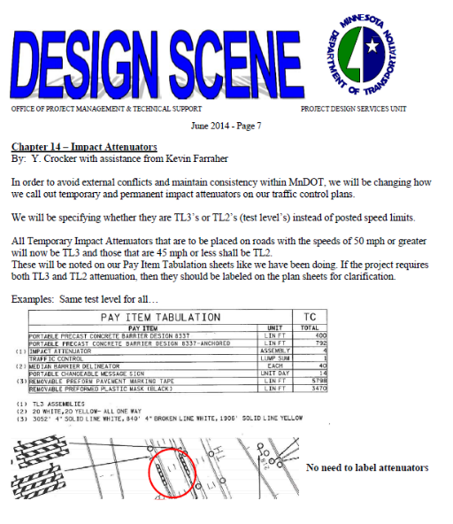
Design Scene
A guidance document for designers, technicians and engineers to help improve the quality and reduce cost and time of plan preparation

