Slide 1
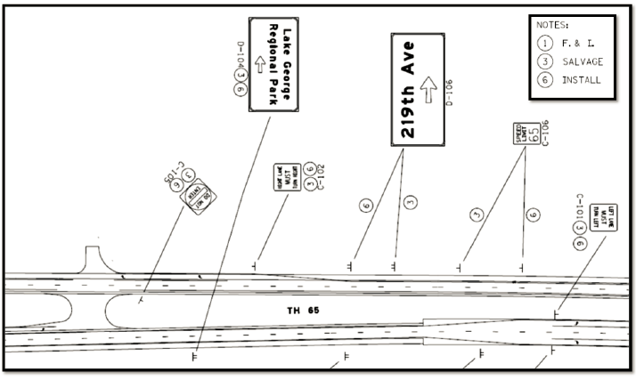
Chapter 7
Signing Plan Sets
Traffic Signs 101
June 2020

Slide 2
Traffic Signs 101
Design
  1. Title sheet
  2. Statement of Estimated Quantities
  3. Sign tabulation
  4. Standard Plans
  5. Utility Sheet

Slide 3
Traffic Signs 101
Design
  6. Traffic barrier data sheets
  7. Roadway plan sheets for signing
  8. Sign panel drawings for all non-standard signs
  9. Standard details
  10. Structure Elevations for Type A and Type OH signs

Slide 4
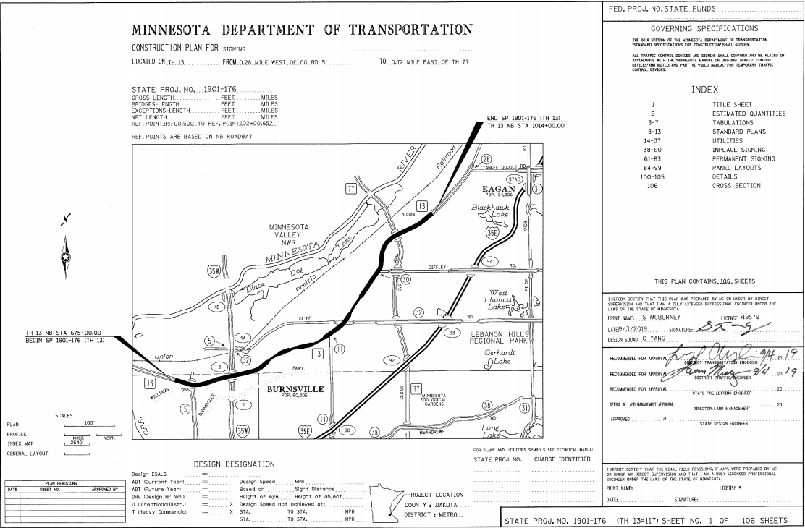
Traffic Signs 101
Title Sheet
Notes:
MnDOT is in the process of adding more information on the title sheet and SEQ. We are adding a signing symbols and a list of standard plan sheets. See attached for a working copy, but you can use these two elements on the first sheet

Slide 5

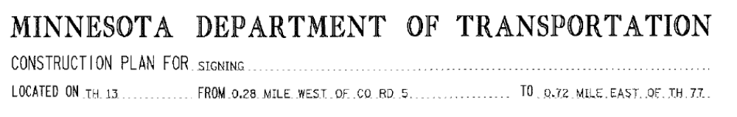
Traffic Signs 101
Plan Description and Location

Slide 6
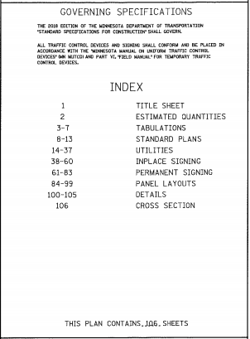
Traffic Signs 101
Governing Specifications and Index of Sheets

Slide 7
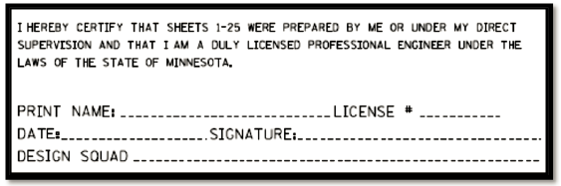
Traffic Signs 101
Plan Preparation Certification Note

Slide 8
Traffic Signs 101
Project Numbers and Sheet Numbers

Slide 9
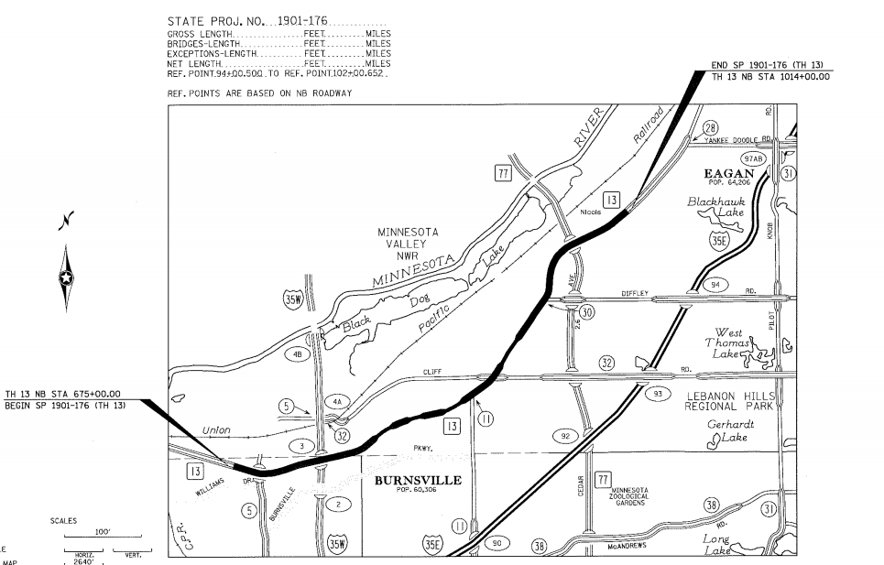
Traffic Signs 101
Index Map

Slide 10

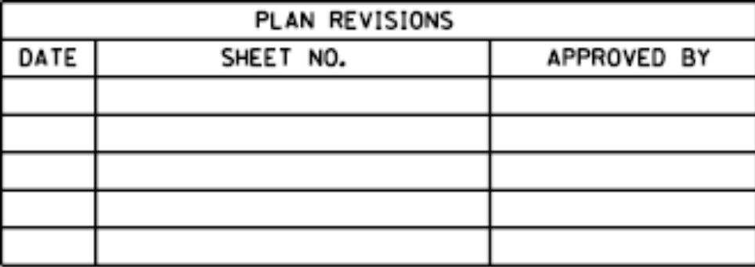
Traffic Signs 101
Project Location
Plan Revisions Block

Slide 11
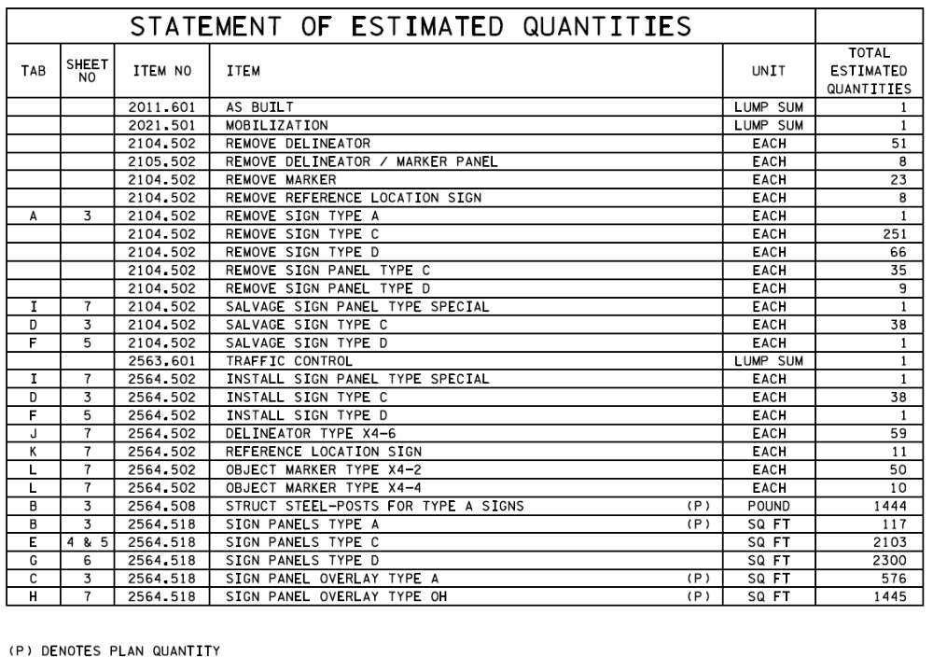
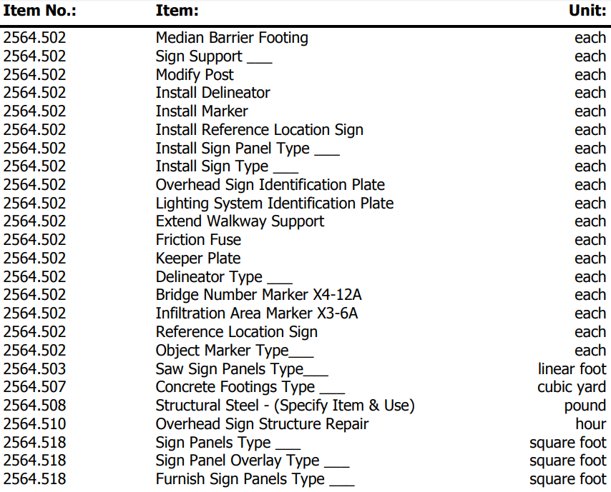
Traffic Signs 101
Estimated Quantities

Slide 12
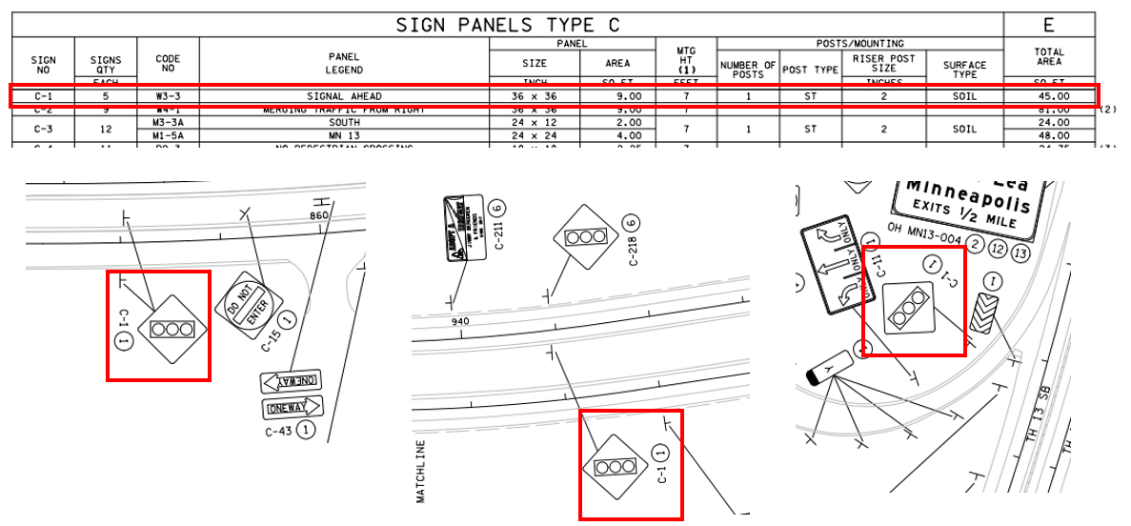
Traffic Signs 101
Sign Data Sheets

Slide 13
Traffic Signs 101
General Layout Sheets

Slide 14
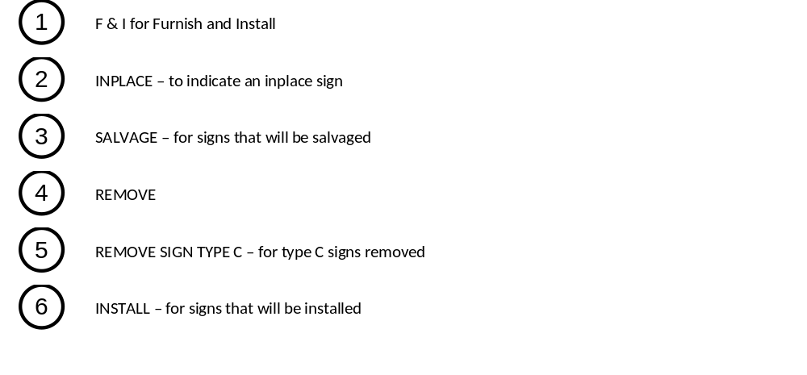
Traffic Signs 101

Slide 15
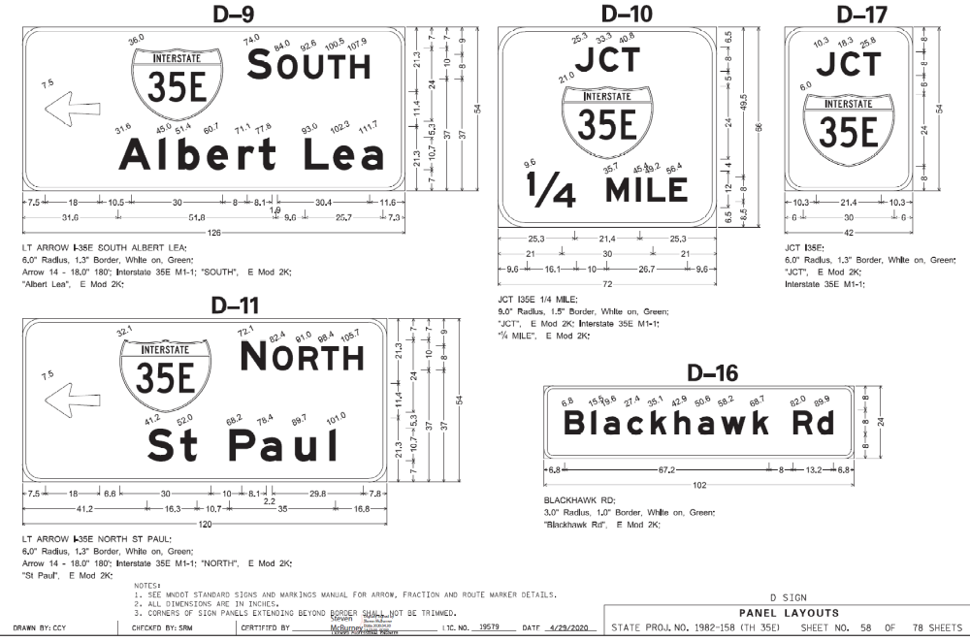
Traffic Signs 101
Sign Panel Layout Sheet

Slide 16
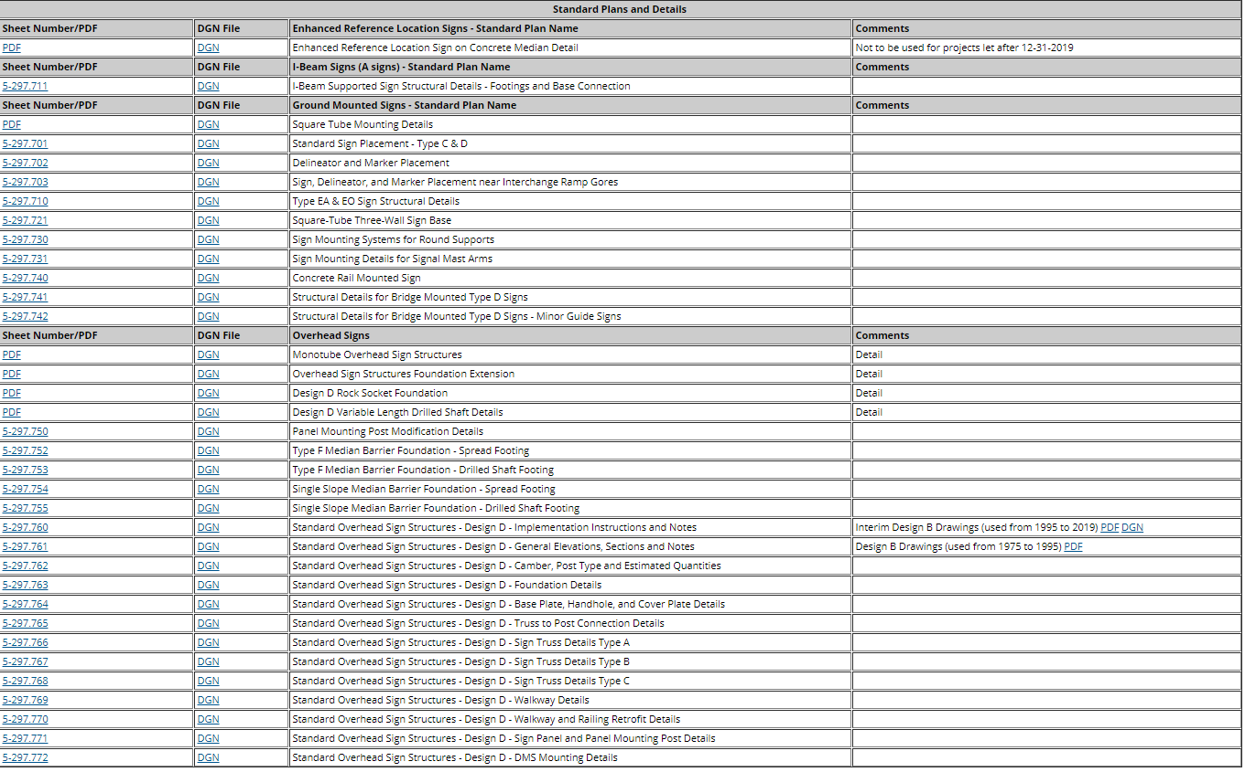
Traffic Signs 101
Structural Details

Slide 17
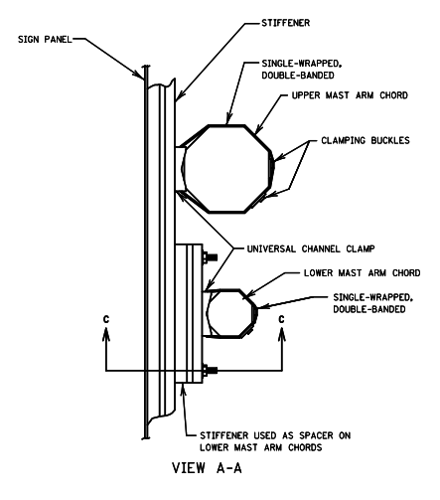
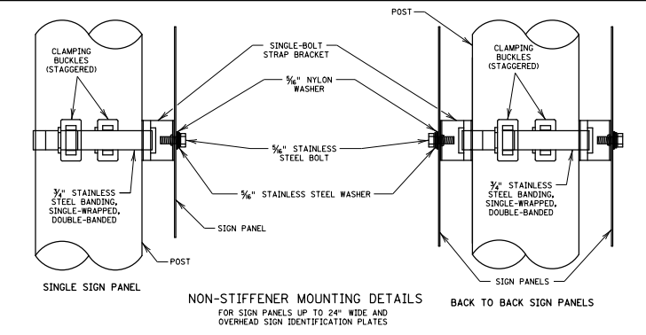
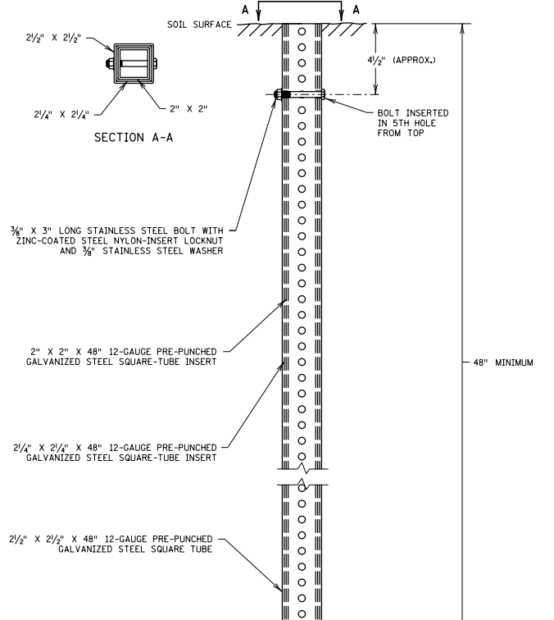
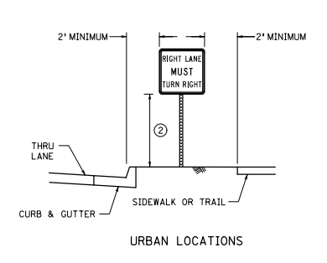
Traffic Signs 101
Structural Details

Slide 18
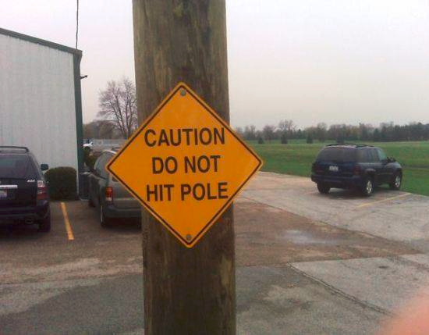
Traffic Signs 101
Comments/Questions?

